Slide 1
QC, Risk, and Safety Overview
Maurice Ball/Jerzy (Yurick) Czajkowski
PIP-II LINAC Complex Mechanical Fluid Systems PDR
April 21, 2021

Slide 2
Table of Contents
Quality Control
Installation Plan
Risk
Safety

Slide 3
Quality Control (QC) Plan
PIP-II Linac Installation Commissioning QA Plan (Document number: pip2-docdb-2611)
PIP-II Building Infrastructure Materials Quality Control Plan (Document number: PIP-II-Doc-ED0013639)
QA/QC by project phase:
Before Installation
Plans and Specifications, Sequence of Operations, Commissioning Procedures
Preliminary and Final Design Reviews to verify system designs
Coordination and sign offs from other L3s for rack locations
During Installation
Vendor visits
Receiving Inspections
Construction oversight and change order processes
After Installation
Acceptance Inspections/Testing
Commissioning
Training
Procurement Quality / Supplier Quality
Issues Management (Corrective Action/Preventive Actions)
Lessons Learned (in process)

Slide 4
Quality Control (QC) Plan (Continued)
Installation Plan – In Stages
LCW
F37 Service Building Pump Room
BTL Enclosure, Absorber, High Bay Building Warm Front End
Connection to accelerator components – coordinated with Accelerator Complex Upgrades/BTL Installation group under a separate scope
PCW
Utility Plant Pump Room, Utility Bridge
LINAC Gallery
High Bay Building/Warm Front End
Connection to LINAC Gallery components – coordinated with LINAC Installation group under a separate scope

Slide 5
Quality Control (QC) Plan (Continued)
Sequence of Installation
Equipment mounted; pipe supports installed; piping connected
Acceptance of physical installation
Pneumatic (snoop) pressure test
Hydrostatic pressure test (test and final acceptance may be delayed).
Coordination with Fermilab designated personnel (i.e. Task Manager)

Slide 6
Risk Assessment Summary for Mechanical Fluid Systems
Notes:
(Standard engineering requirement of the Fermilab Engineering Manual

Slide 7
Risk – Technical and Safety
We have a process for assessing technical and safety risk.
We have started drafting these and will complete them in the near future (i.e. within the next few weeks)
Safety Risk
Prevention through Design Table == Personnel Risk/Safety
Technical Risk
FMEA == Failure Mode and Effect Analysis

Slide 8
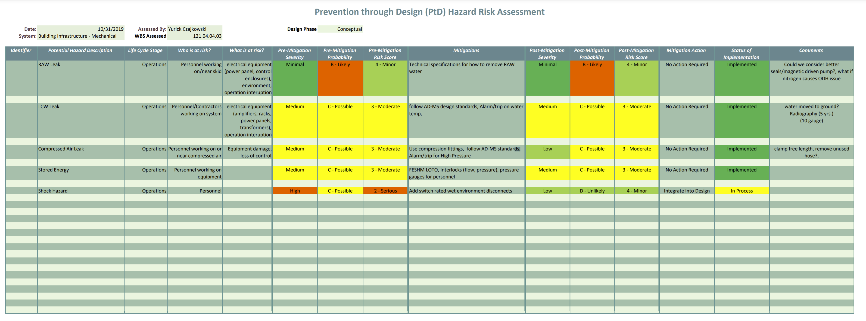
FMEA - Personnel Risk/Safety - Prevention through Design Table

Slide 9
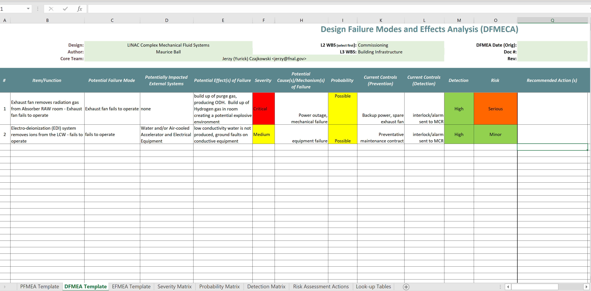
FMEA - Technical Risk

Slide 10
ES&H
Construction of Building Infrastructure will be in full compliance with the PIP-II Integrated Safety Management Plan (docdb #141) developed by the Project ES&H Coordinator
Work with ES&H Coordinator to define mitigations for the following hazards:
Electrical
Welding/cutting/brazing
Pressurized systems
Cooling water
Material handling and rigging

