Slide 1
PIP-II Coupler activity update at FNAL
Nikolay Solyak
17 June 2020

Slide 2
SSR2 coupler procurements status
Drawings were reviewed by IJCLab, thanks
Documentation for procurement
As of June 16, 2020, Fermilab is using the following set of documentation to procure SSR2 couplers (4 full couplers and 2 antenna sub-assemblies) for the PIP-II pre-production SSR2 CM
SSR2 coupler assembly, drawings: F10110745 rev B
SSR2 coupler Procurement Plan: ED0011771 rev A
SSR2 coupler Fabrication Specification: ED0011772 rev A
Acceptance Criteria for Coupler Ceramic Window F10133029 rev. None
Those documents are ready to be shared with DAE-BARC and IJCLab.
Ceramic disks (20) in production, should be ready soon.

Slide 3
650 MHz coupler procurement status
Same design for both LB650 and HB650 couplers
Final List of TC documentation, sent to FNAL procurement to start RFP
ED0005788-C---650MHZ COUPLER ASSEMBLY Procurement Plan
ED0005689-C--650 COUPLER Technical Specification
F10056895 Rev C - 650MHz Main Coupler Drawing Package
F10130914 Rev A - Antenna Assembly Drawing Package
DRAFT_Proposed Evaluation Criteria_650 couplers
DRAFT_Acquisition Plan-0026 (exported to word from RAPTR)
FPC Bidders List
This order will be a best value procurement with a technical evaluation of bids constituting a 70% weight.
RFP shall only go to companies that have produced RF couplers for accelerators (CPI, RITH, and Cannon/Toshiba).

Slide 4
Special meeting/discussion
CEA reviewed Engineering (Manufacturing) Specification for 650MHz coupler. Thanks.
Discussion Thursday meeting this week. Assumption: correction of document should not delay procurement process
Discussion of heater type (next slide)
Temperature of vacuum gauge IKR060 in SSR2 and 650 couplers
Sergey calculated rather special worst case: no RF, no heater, no air. For this case the gauge temperature is -4C. (temp specs for IKR60 [5-250]C, maybe it can work at lower temperature?)
If not, heater and air can be applied to heat CCG > 5C

Slide 5
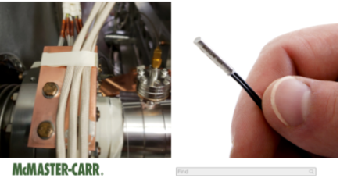
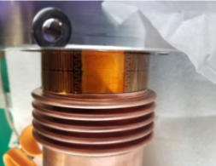
325/650 coupler heater discussion mtg. June 11th 2020
Discussion on heater and thermal strap (warm), possible options, thoughts, etc.
Heater (goal to eliminate heater in production couplers) thermal strap should help to keep ceramic warm
Option #1: cylindrical same as used in STC, but smaller
0.25”, 4x10W, Cu body plus heater plus Indium layer.
Attach on air side flange next to ceramic
Option #2: Strip heater (same with SSR1, LCLS-II), wrap around warm outer conductor tube
stycast, Kapton tape, G10 strip
need good contact reliability
SSR1 installation procedure
4 unit x10W=40W
Option #3: Cartridge heater with Cu brick at end of thermal strap
Conclusion: Design opt#1 and test both of Op#1 and #2 in next STC

