Slide 1
650 MHz coupler model discussion
17 June 2020 H. JENHANI / S. ARSENYEV
Fermilab answers added
PIP-II Coupler collaboration meeting

Slide 2
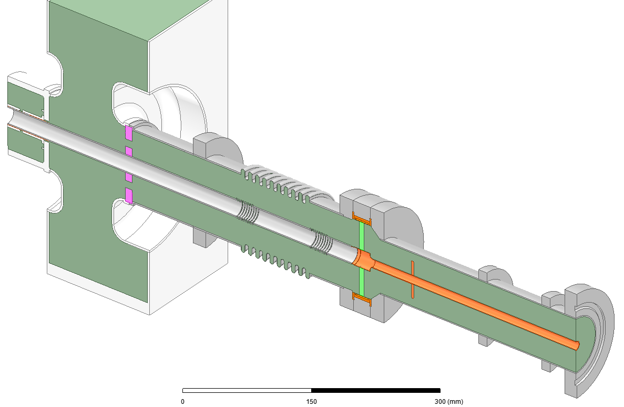
650 MHz Coupler Model Details
650 MHz Power Coupler Model at CEA

Slide 3
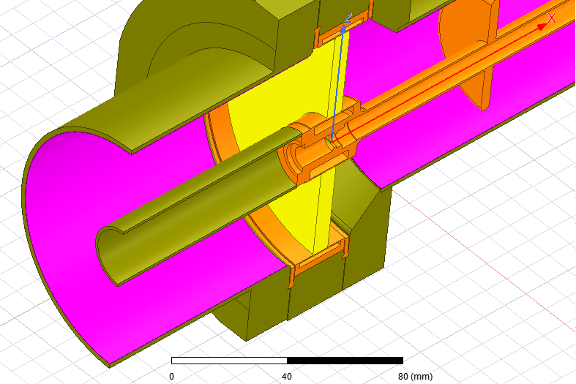
Most important details to fix
Wall thickness and copper coating characteristics:
The walls thicknesses we used in the CEA 3D thermal model correspond to the last version of the drawing we received. But, there is some differences with the last Fermilab thermal 3D model we received.
Fermilab Answers:
The dimensions and information in the drawings are the most updated.
In the Fermilab 3D model thickness of SS and Cu plated are sometimes different from reality for meshing considerations. The material characteristic are scaled in order to take in account this modifications in order to keep the global model representative of the real physics.
The warm inner conductor in the figure presented here was uncoated. The thermal impact of coating neglected.
Fermilab thermal model
Different SS and Cu thickness comparing to the drawings

Slide 4
Most important details to fix
The copper coating thicknesses we used, before, for simulation, are the values we discussed during the FDR. But now we are using the values given in the last drawings we received which are different. What are the final values to take in consideration?
Fermilab Answer:
The Copper plating thickness mentioned on the drawings and presented here are the final values.
The nominal Cu coating RRR used for the simulation is equal to 10. According to the TRS ED0005689, Rev. C, the acceptable RRR range is between 10 and 100.
Fermilab Answer:
RRR has low probability to reach 100, however it will be interesting to make calculations for this case.
 | FDR | Drawings
Inner warm conductor Cu thickness | 10µm | 20µm
Outer warm conductor Cu thickness | 20µm | 20µm
Outer cold conductor Cu thickness | 15µm | 10µm

Slide 5
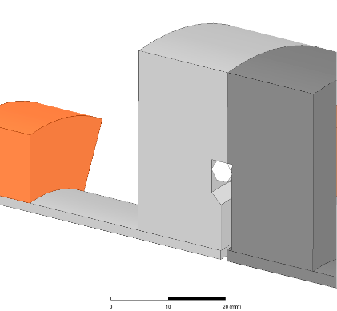
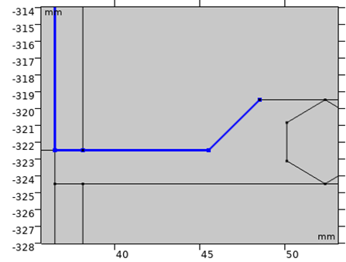
Most important details to fix
Interface between coupler and cavity:
Thermal boundary conditions:
CEA model replaces the cavity with a fixed temperature boundary condition (2K for the worst case)
Fermilab puts different boundary condition on the cavity coupler port tube ➔ this is more realistic but needs a good knowledge of:
the thermal conductance between coupler and cavity
and the material thermal conductivity.
CEA model
5K intercept
Fermilab model
Fixed temperature
Cavity
Cu coated surface
Cavity
5K intercept
Coupler to cavity interface
Fermilab Answers:
2K temperature is fixed on the cavity coupler port tube (left side of the fermilab model figure).
The heat flux between coupler and cavity flanges is conveyed only through the Al gasket (material AlMgSi0.5 F22 (3.3206.71)).
Niobium thermal characteristics are applied to both tube and flange of the cavity coupler port, however the real flange material is niobium titanium. The thermal conduction due the assembly hardware (bolts,…) were neglected.

Slide 6
Most important details to fix
Potentially uncoated coupler to cavity flange surface has an important impact on the RF losses for the worst phase. We didn’t find the specification for this detail.
Fermilab Answers :
The Fermilab model consider copper plating on the coupler flange as presented in this figure.
The conductivity of the intercepts materials has significant impact on the heat fluxes. CEA model uses copper with RRR=20 for intercepts. We don’t know the material used by Fermilab.
Fermilab Answers :
- The copper used for intercepts in the model has RRR=10. This is just simulation choice and not based on the real material characteristics.

Slide 7
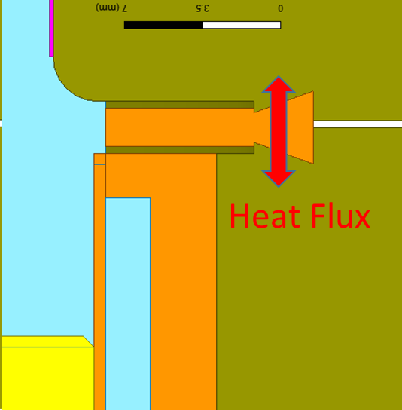
More details concerning Fermilab modelization
Details from Fermilab:
The convection coefficients used in Fermilab model were presented (the same than what was presented in the FDR). 4 g/s air flow is the nominal value for RF operation on cryomodule.
The temperature of the convective air is estimated as following. Antenna air circuit is divided to sub parts. Each sub part air temperature is estimated considering its input temperature and the temperature rise due to the joules removed by air in that sub part. The worst phase for coupler RF losses is considered for all the thermal calculations.
The RF calculation is not automatically coupled to the thermal calculation. RF losses are estimated by initial RF calculations, then, used as input for the thermal calculations.
The thermal calculations do not consider the entire structure of the coupler. They are made on two separate models: one representing the air part only and the other representing cold part connected to the coaxial warm part up to the inner bellows limits.
For the thermal model of the cold part, the air side of the inner and outer conductors are isolated.
For flanges assembly on both sides of the ceramic, the external conductor heat flux path to the window is represented in this figure.

Slide 8
More details concerning Fermilab modelization
During calculation convergence, the material thermal conductivity variation as a function of the temperature profile change is considered. However, the impact of the surface resistivity change as a function of the thermal profile variation is not considered. Only the initial estimation of the temperature profile is considered for the RF losses which are maintained fixed during the thermal calculation.
The reflection phase parametric sweep used for the RF calculation is performed with a Pi/4 steps from 0 to 2*Pi [rad]. Pi/8 step calculation may show higher thermal values results for Ceramic T° and heat fluxes (to be checked).
Anomalous copper RF losses are not calculated as they are considered insignificant.

