Slide 1
PIP-II Report
PIP-II Team
Project Management Group
17-June-2020

Slide 2
WBS 121.01 Project Management
Top priority is preparing documentation Early Conventional Facilities (ECF) subproject. See following slide.
“What if” Scenario planning in process
  Scenarios for reduced FY21/22 funding levels ($80M/$100M vs. planned $120M/$120M). Also looking at flat funding ($60M for FY21).
  COVID impacts. First results presented at 6/4 IPT. Preparing follow up presentation for 6/25 IPT.
Procurement activities and challenges:
  Staffing challenges
  Award package for Cryoplant Building. Target submittal to FSO early next week.
  pHB650 cavity procurement. Need to award ASAP.

Slide 3
EVMS
Small improvement in SPI 0.90->0.91, CPI unchanged.
Fran Leavell appointed as Change Control Coordinator to improve communication, ensure process compliance.

Slide 4
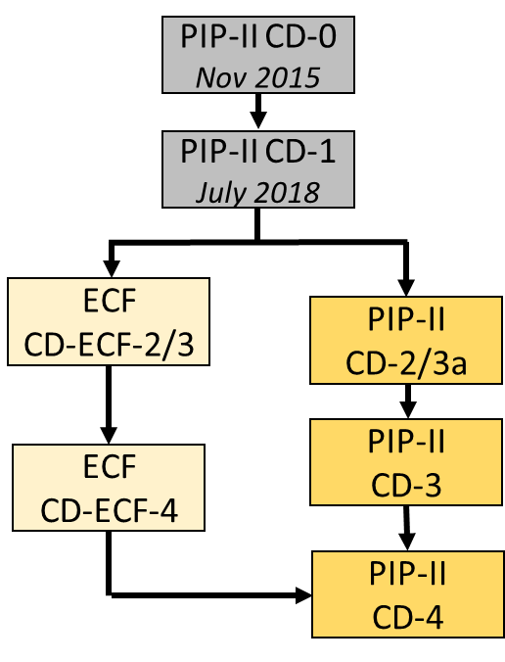
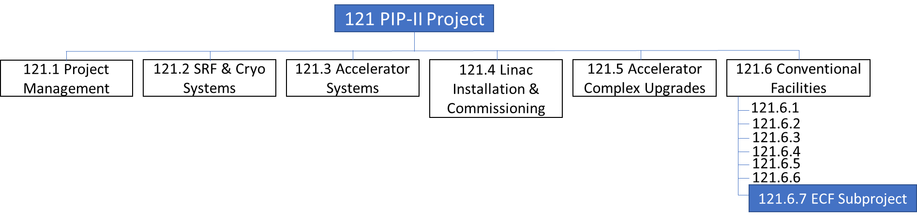
ECF Subproject
Proposed ECF Tailoring Strategy:
Cryoplant Bldg & Site Work removed from 3a and repackaged as a subproject called Early Conventional Facilities (ECF) with CD-ECF-2/3 approval by July 17th 2020
  July timing will support project schedule and construction proposal deadlines
Contingency is held at the PIP-II project level
  DOE and FRA distribute contingency to the ECF subproject up to authorized levels following change control established in the PIP-II PPEP and ECF PEP
Slide content from A. Bihary

Slide 5
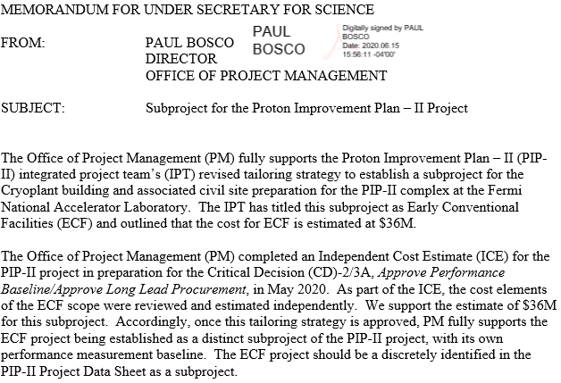
ECF Support
ECF Documents submitted to OPA for review.
  One round of comments incorporated so far. No known issues.
FPD briefing to SC-1 6/25.

Slide 6
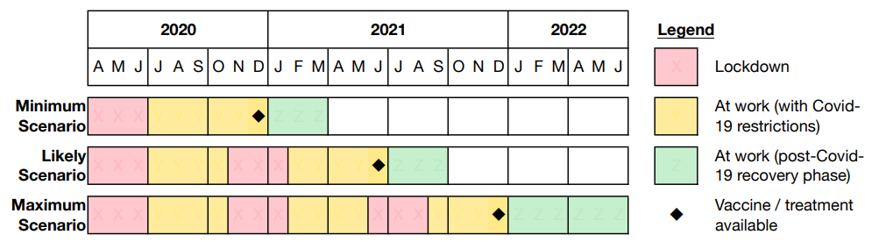
COVID-19 Scenarios considered w/notable activities
CD-3 ESAAB
CryoPlant Bldg Construction
SiteWork Construction
Linac Complex Design
Linac Complex Construction Start
PIP2IT Beam
PIP2IT Test Cave Conv.
pHB650 Fabrication and Assembly
pHB650 Test
SSR1 Nb Proc. (for DAE cavities)
pSSR2 Cavity Procurement
pSSR2 Cav. Test

Slide 7
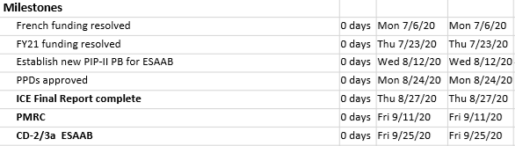
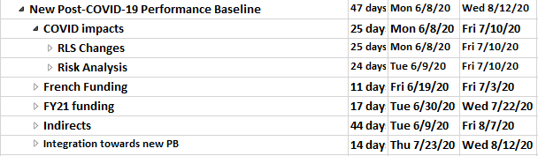
Timeline to CD-2/3a ESAAB
COVID impacts
  Incorporate known COVID impacts (Fermilab + Partners) in RLS
  Incorporate future COVID impacts (Fermilab + Partners) in Risk Register
    Add a new risk to RR: ‘Pandemic resurgence’
    Re-assess/update existing risks under COVID lens
Timeline assumes no repeat of IPR

Slide 8
ESH
COVID-19
  Started the PIP-II COVID-19 Recovery Plan on May 21
    Focuses on restarting cavity processing, testing and assembly
    Restart of PIP2IT installation and operations
    Currently ~85 employees on site supporting PIP-II activities
      Overall activities going well
Conducted the ORC for 2.1 MeV Beam Operations
PIP2IT Accelerator Readiness Review
  Planned for August 5-6
  Agenda and charge completed
  Committee members identified
  Working on support documents and presentations
  COVID-19 protocols will likely effect how the review is conducted
Reviewing Program Support Indirect Rates
Supporting procurement and design reviews
Reviewing D/S/P Min-Safe plans

Slide 9
International - General
9-JUN-2020 BARC/DPS has placed the PO for the PIP-II cryoplant with ALAT. The process to reach agreement on Terms & Conditions is underway.
All IKC laboratories have re-starting to work onsite in June with limitations.
Shipment of seven 325MHz amplifiers to Fermilab will be delayed. Current status is that three have been tested and 5 have been assembled. The first three will be ready to ship next week (22-JUN-2020), but it is not clear if transportation (flights) will be available.
Work in progress on VAT and Import Duties for Shipment between Fermilab, CEA and CNRS: several scenairios exanimated.
iCRADA in progress with Poland for LLRF, MPS topics.

Slide 10
International – Doc overview
PPDs Part 1: Significant progress with STFC/UKRI; plan in place with CEA; under review by DAE.
PPDs Part 2 :
Updates in-progress without COVID-19 effect yet: completed for all the EU Partners (CEA in last check step)
Significant progress with DAE to integrate PPD milestones and to logically connect in P6.
To assess the IKC COVID-19 impact, the first step is to send the T6 MSs - input to partner schedule – new date. Plan to send those MS at the end of June.
Draft Acceptance Plans for each IKC are in progress
Significant progress on UKRI, CEA after discussion with Partners.

Slide 11
WBS 121.2 SRF Updates – HWR Status
Resumed 2K.
Almost ready for RF power ramp.
  Cavity frequency tuned
  Final test preparation this morning
  Test plan completed
    Test traveler ready to go
    Acceptance plan released
PMG SRFCRYO Update

Slide 12
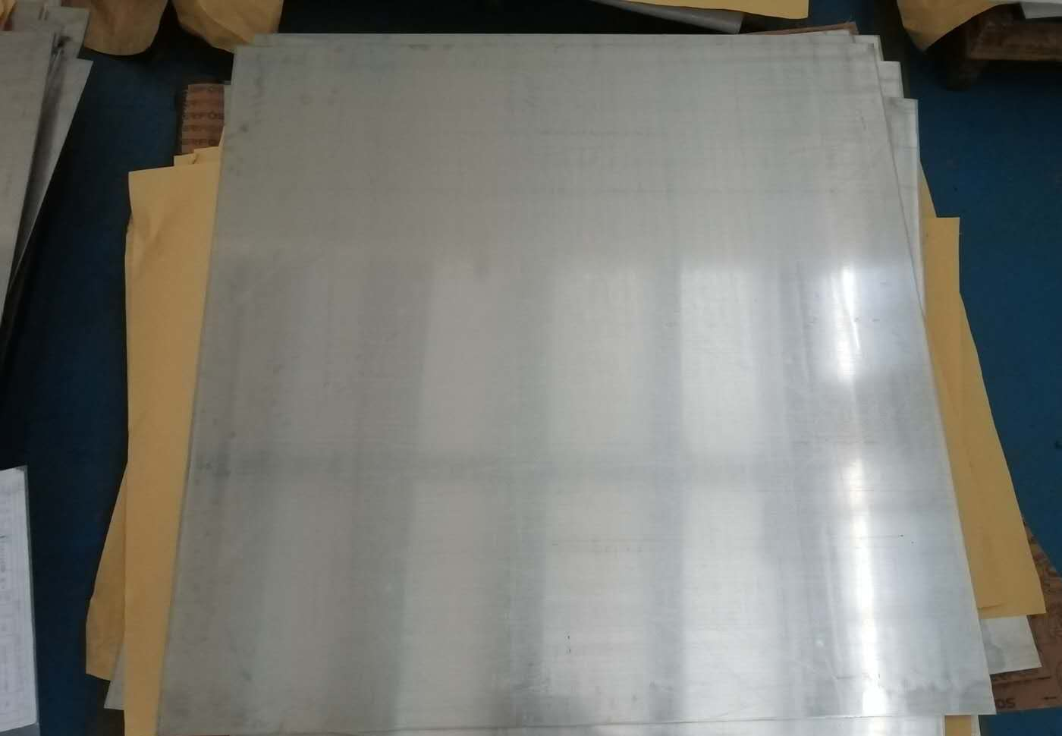
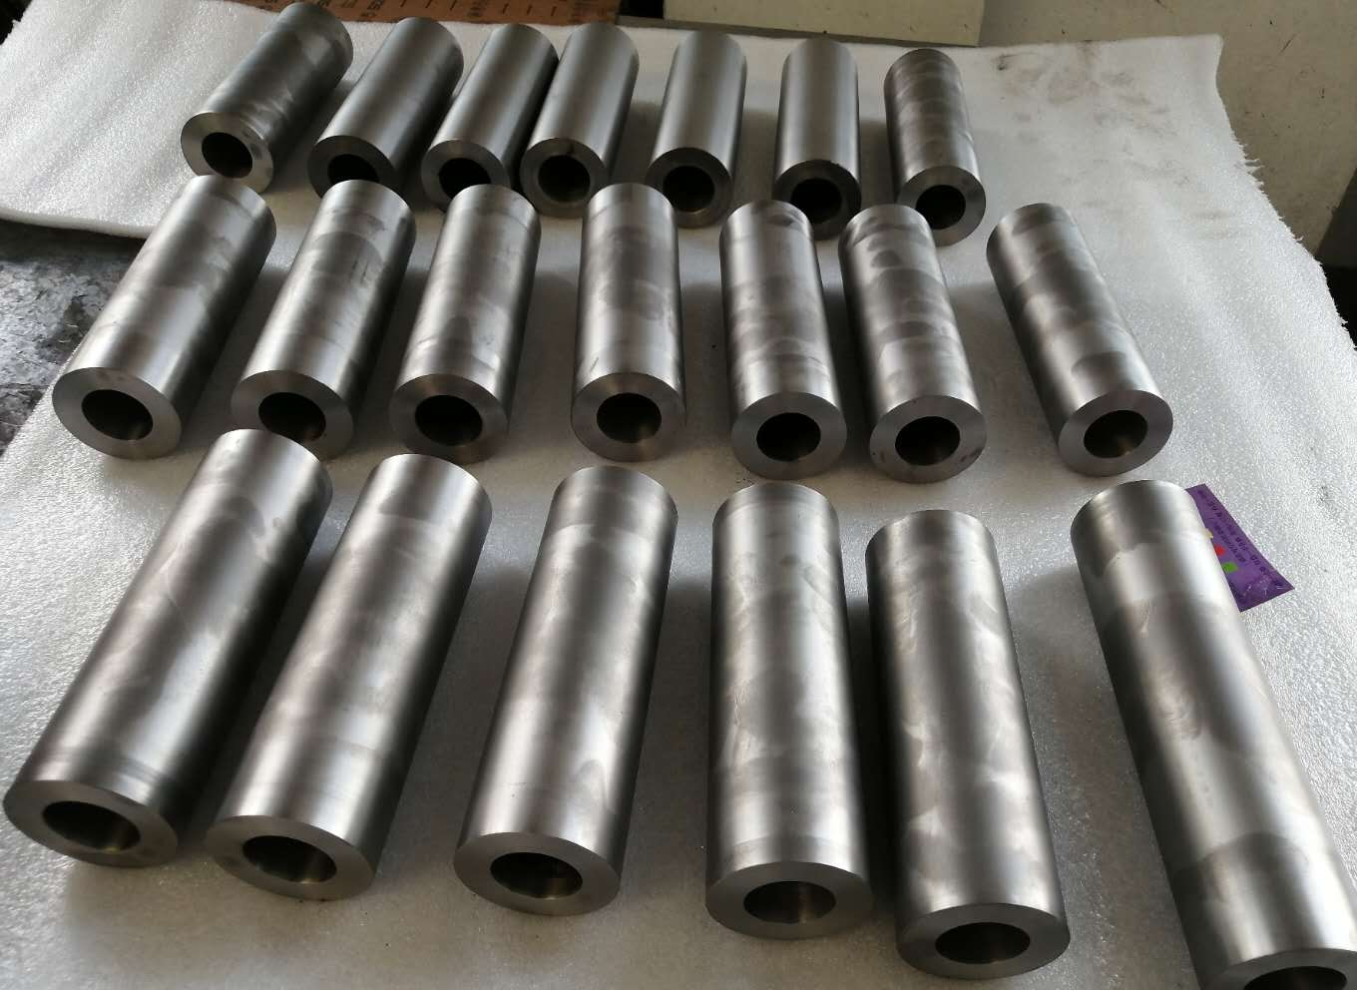
WBS 121.2 SRF Updates – SSR Cryomodules
SSR1: installation is in progress at PIP2IT test cave
  Cryo-connection completed.
  Ready for helium circuit pressure testing
SSR2: Niobium sheets production at vendor
  All 40 pcs Nb sheets: cutting completed, waiting for final polishing and inspection.
  QC hold point: Sample cutting and send to Fermilab for sample test before shipping.
  Composition met spec.
  RRR: met spec (362 – 480)
SSR2: Cavity procurement is in progress
  Bids evaluation completed, pending procurement action
SSR2: Conduction cooled solenoid FDR is scheduled in mid-July, 2020
SSR2: Power coupler procurement is in progress, pending procurement action
SSR2: cryomodule design in progress.
SSR2 Nb: Sheet cutting completed (all)
SSR2 Nb: Nb tubes
finished the machining process
PMG SRFCRYO Update

Slide 13
WBS 121.2 SRF Updates – 650 Cryomodules
Status and plans of four HB650 5-cell cavities
B9A-AES-007; Cavity jacketing resumed, pending hardware from AES-008
B9A-AES-008; First phase of jacketing was completed. The second phase of jacketing resumed. Instrumentation before jacketing is in progress.
B9A-AES-009: Met vertical testing acceptance. Additional cold EP 3um was completed. VTS preparation almost completed. ANL building AC has been down. Expected to recover today.
B9A-AES-010: Transportation to RRCAT is paused, pending RRCAT request.
B92A-RRCAT-502: Cavity paused; test cage delivery delayed due to covid-19.
LB650 Cavities:
INFN ESS MB704 received. Processing on hold.
MSU cavity S65-01 was tested at MSU. Cavity achieved 21 MV/m (2.1e10 @ 16 MV/m).
  Vertical re-test is scheduled on 7/2.
MSU cavity S65-02 re-processing completed. Vertical test is not schedule yet.
INFN prototype 5-cell: cavity RF QC is scheduled, pending ANL EP tooling.
INFN 1-cell LB650: Niobium material characterization. Processing is pending ANL EP tooling.
PMG SRFCRYO Update

Slide 14
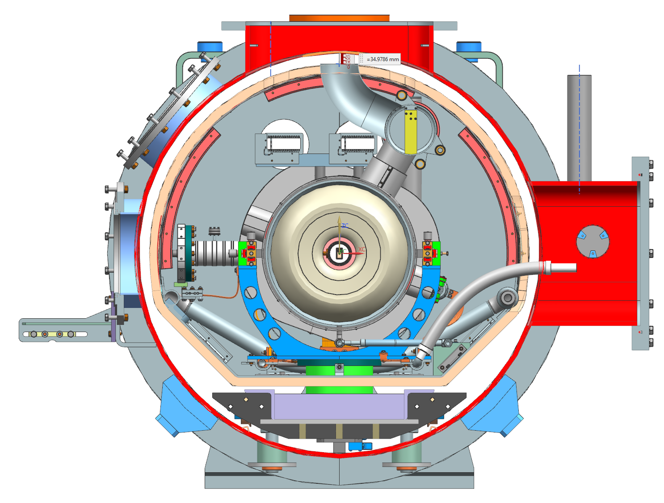
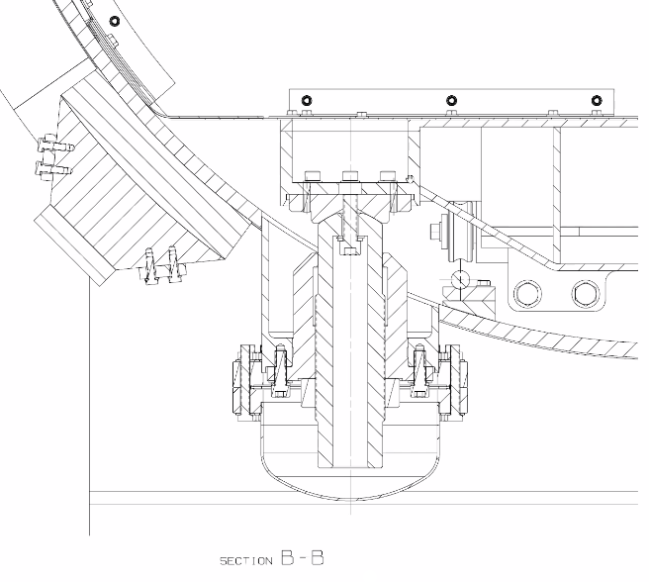
WBS 121.2 SRF Updates – 650 Cryomodules
Niobium specification:
Received NX niobium samples from INFN
  Conducting sample studies as soon as allowed
  Focusing on cavity processing and testing
Procurements:
B92 cavity procurement is in progress. Buy American Act review took longer time than expected and req needs update
650 MHz Coupler procurement is pending procurement action.
LB650 MHz niobium procurement is pending procurement action
Cryomodule Design:
HB650 final design is nearly completed
  Drawing package is being developed
  Transportation simulation is in progress
    Design iteration for a better strong-back vessel interface
  Strong back model (CEA) was completed.
    Design simulation is in progress
Tooling design is in progress
Magnetic shield design iterated
FDR scheduled from 7/29-31, dry run scheduled from 7/6-8
Improve design for transportation
PMG SRFCRYO Update

Slide 15
WBS 121.2 SRF Updates – Cryogenics
Cryoplant award is in progress.
  DAE approved requisition.
Cryoplant integration preliminary design is in progress
CDS final design is in progress. FDR is scheduled in July.
Cryogenic Integrated Review Workshop held in May
  Workshop report completed.
  Issues follow up is in progress such as MAWP, beamline burst disc design, etc.
PMG SRFCRYO Update

Slide 16
Accelerator Systems
Acc Sys overall
  QA plan written, reviewed, and approved
  L3 QC plans in development
  PIP2IT on-site activity ramping up
    Re-establish LEBT beam, oversee ORC processes
MPS
  System brought up for PIP2IT
  Upgrades and expansion in progress
    Hardware beam switch
    Increased # of inputs
  ARR Documentation

Slide 17
Accelerator Systems
HPRF/RF distribution
  650 MHz PIP2IT RF distribution PDR on 28 May
  650 MHz 40 kW amplifier requirements workshop follow-up
  PIP2IT
    RFQ faulted amplifier repaired and operational
    SSR1 7 kW amplifier operability restored (12-hour test)
      Ongoing dialogue with Indian partners on root cause of fault
  Deputy L3 manager role filled
LLRF
  PIP2IT RFPI and HWR resonance control on-site work
  Updated SOW with LBNL
  Polish collaboration: I-CRADA being drafted for LLRF partnership with WUT and LUT

Slide 18
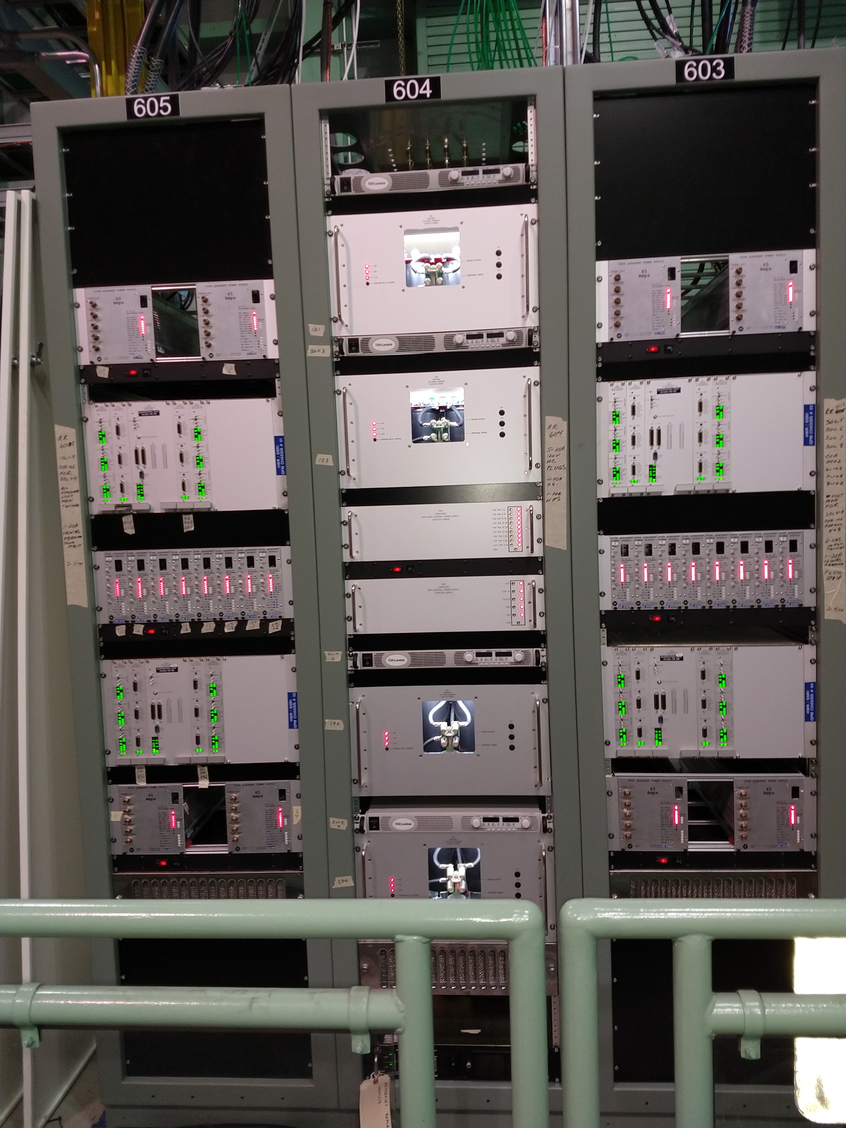
Accelerator Systems
Magnets/Power supplies
  PIP2IT on-site work
      Complete cabling and check-out
      QPM integration
Vacuum
  PIP2IT on-site work
    WFE vacuum restored
    Spool pieces leak checked
      Possible patent opportunity: bellows leak checker
    Analysis of cryomodule gas loads
    Dialogue with SRF/Cryo: beamline vacuum burst disks, gate valves, coupler vacuum instrumentation

Slide 19
Accelerator Systems
Controls
  PIP2IT
    on-site support
    HPRF interfaces
    Self-paced EPICS training development
Safety Systems
  Respond to review recommendations
  FESHM draft chapter on Non-ionizing radiation hazards
Beam Instrumentation
  PIP2IT on-site support
  Laser-based profile monitor development

Slide 20
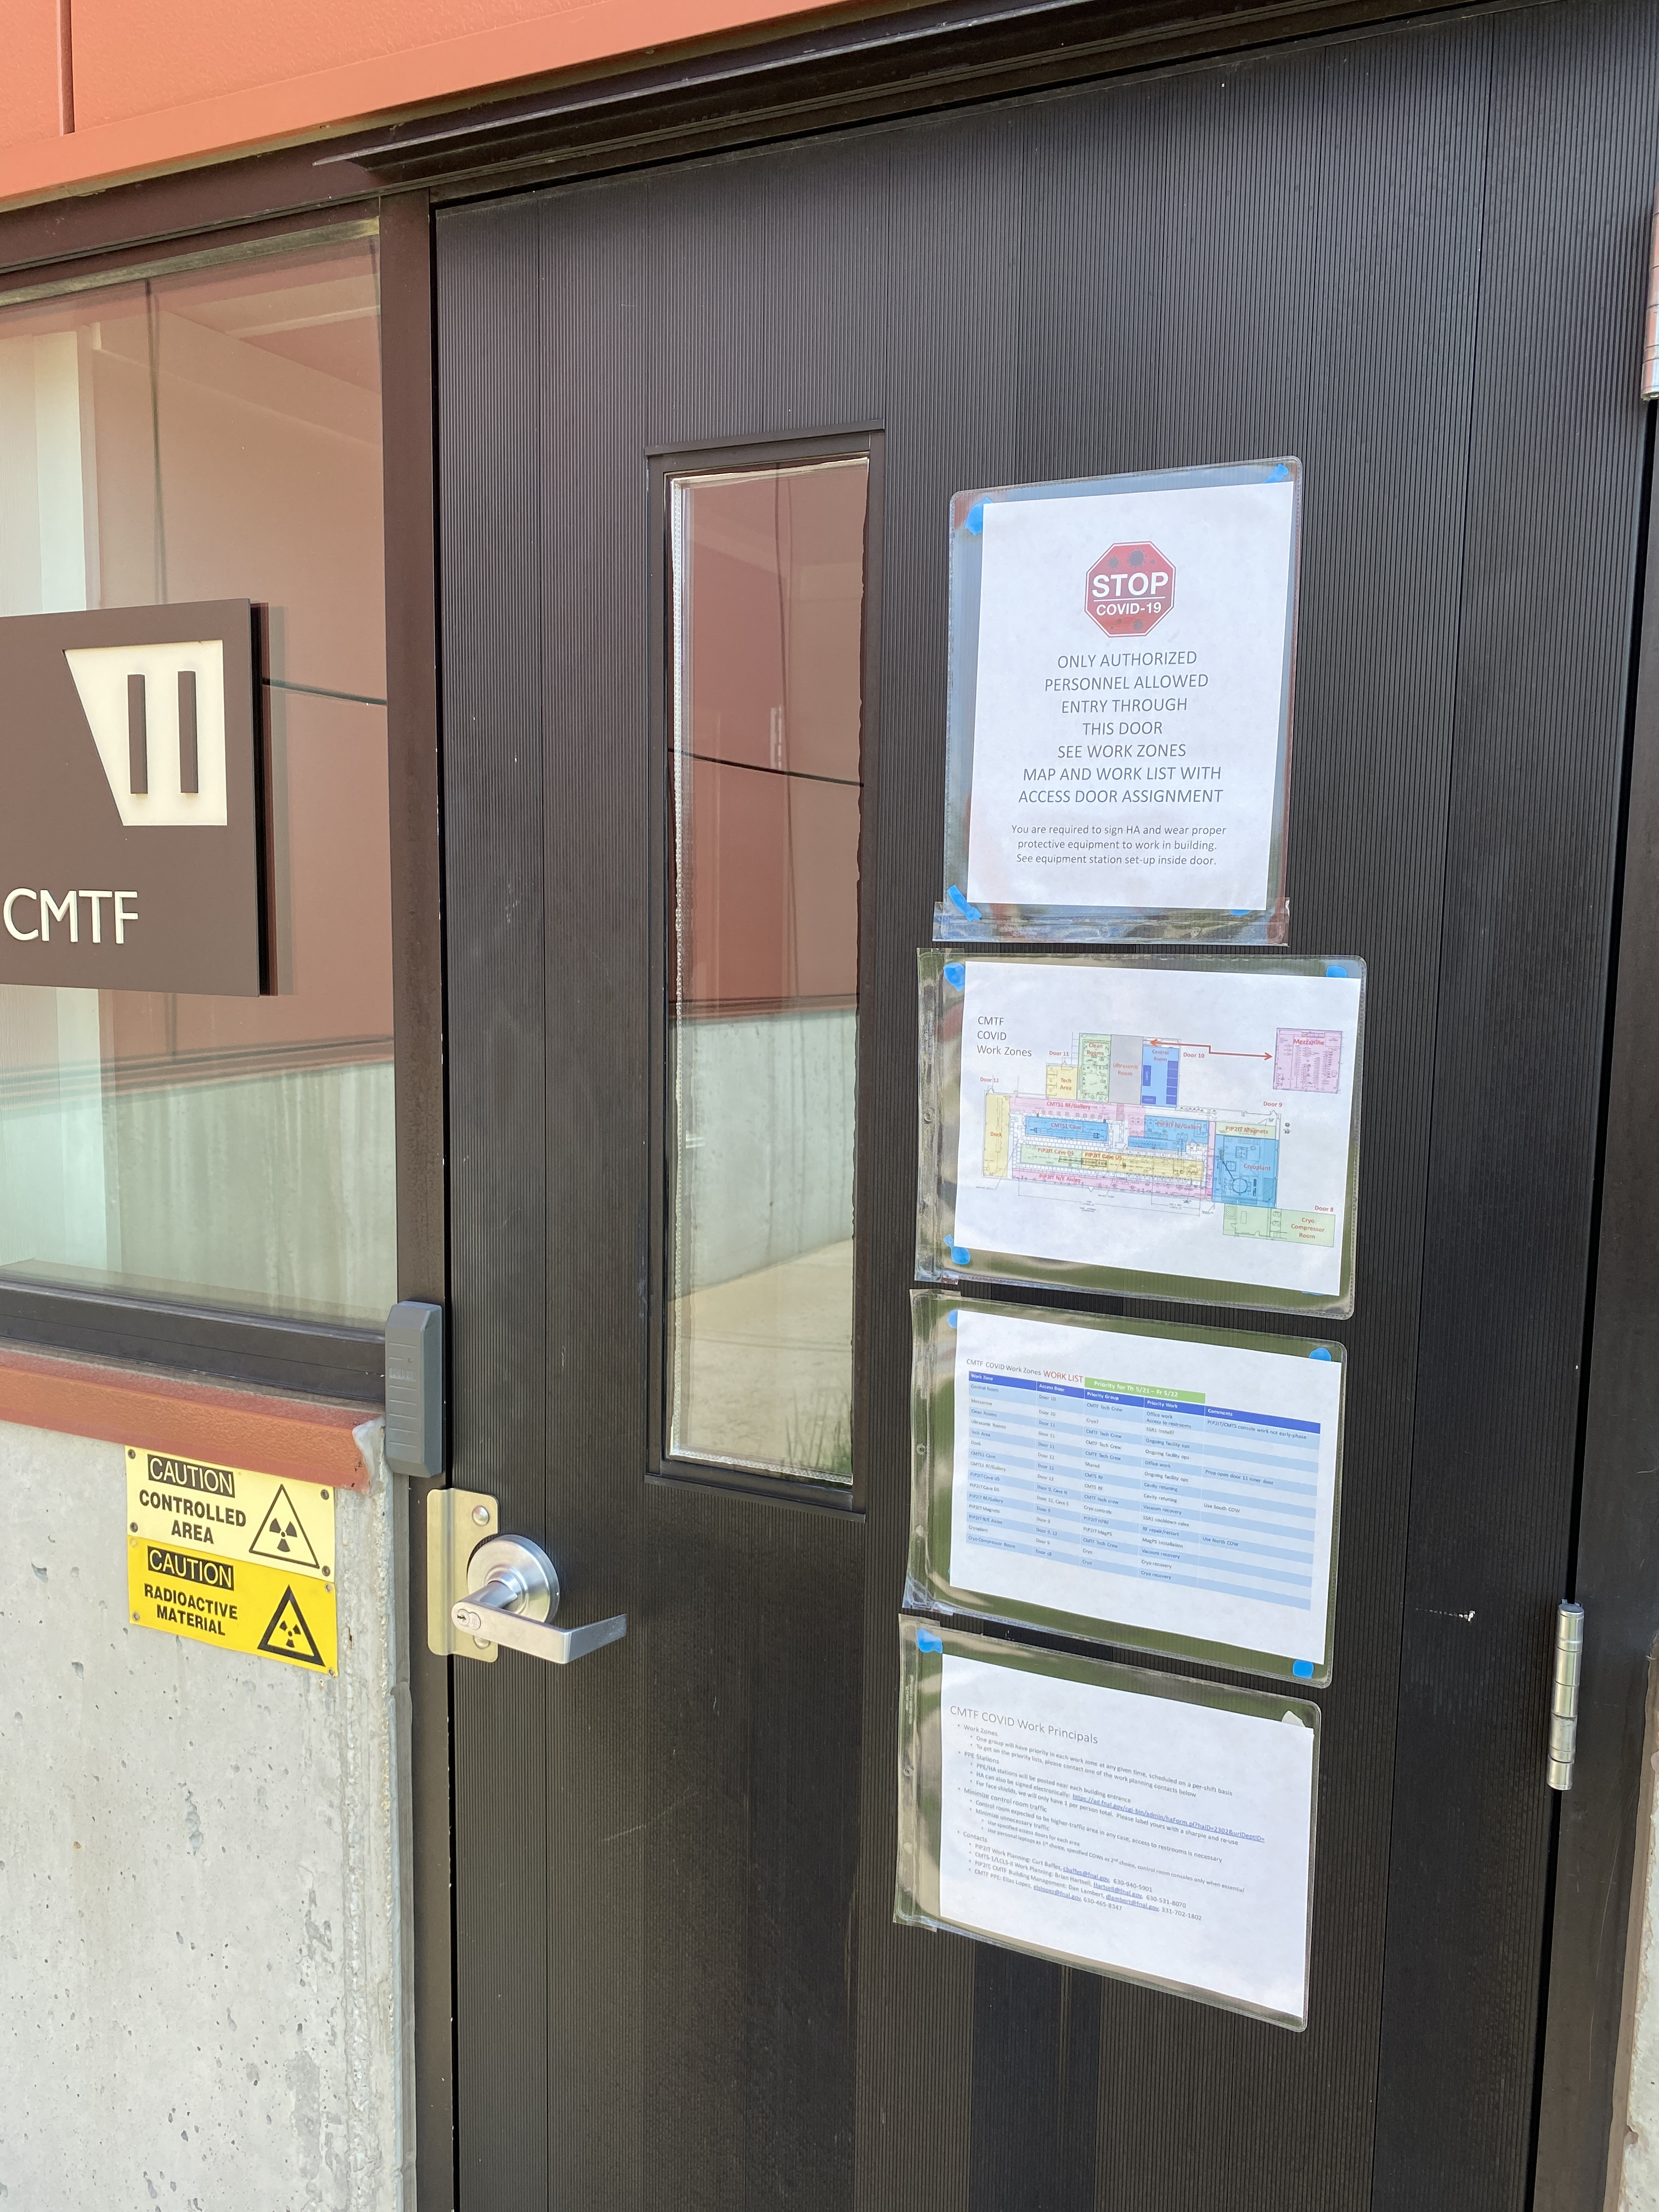
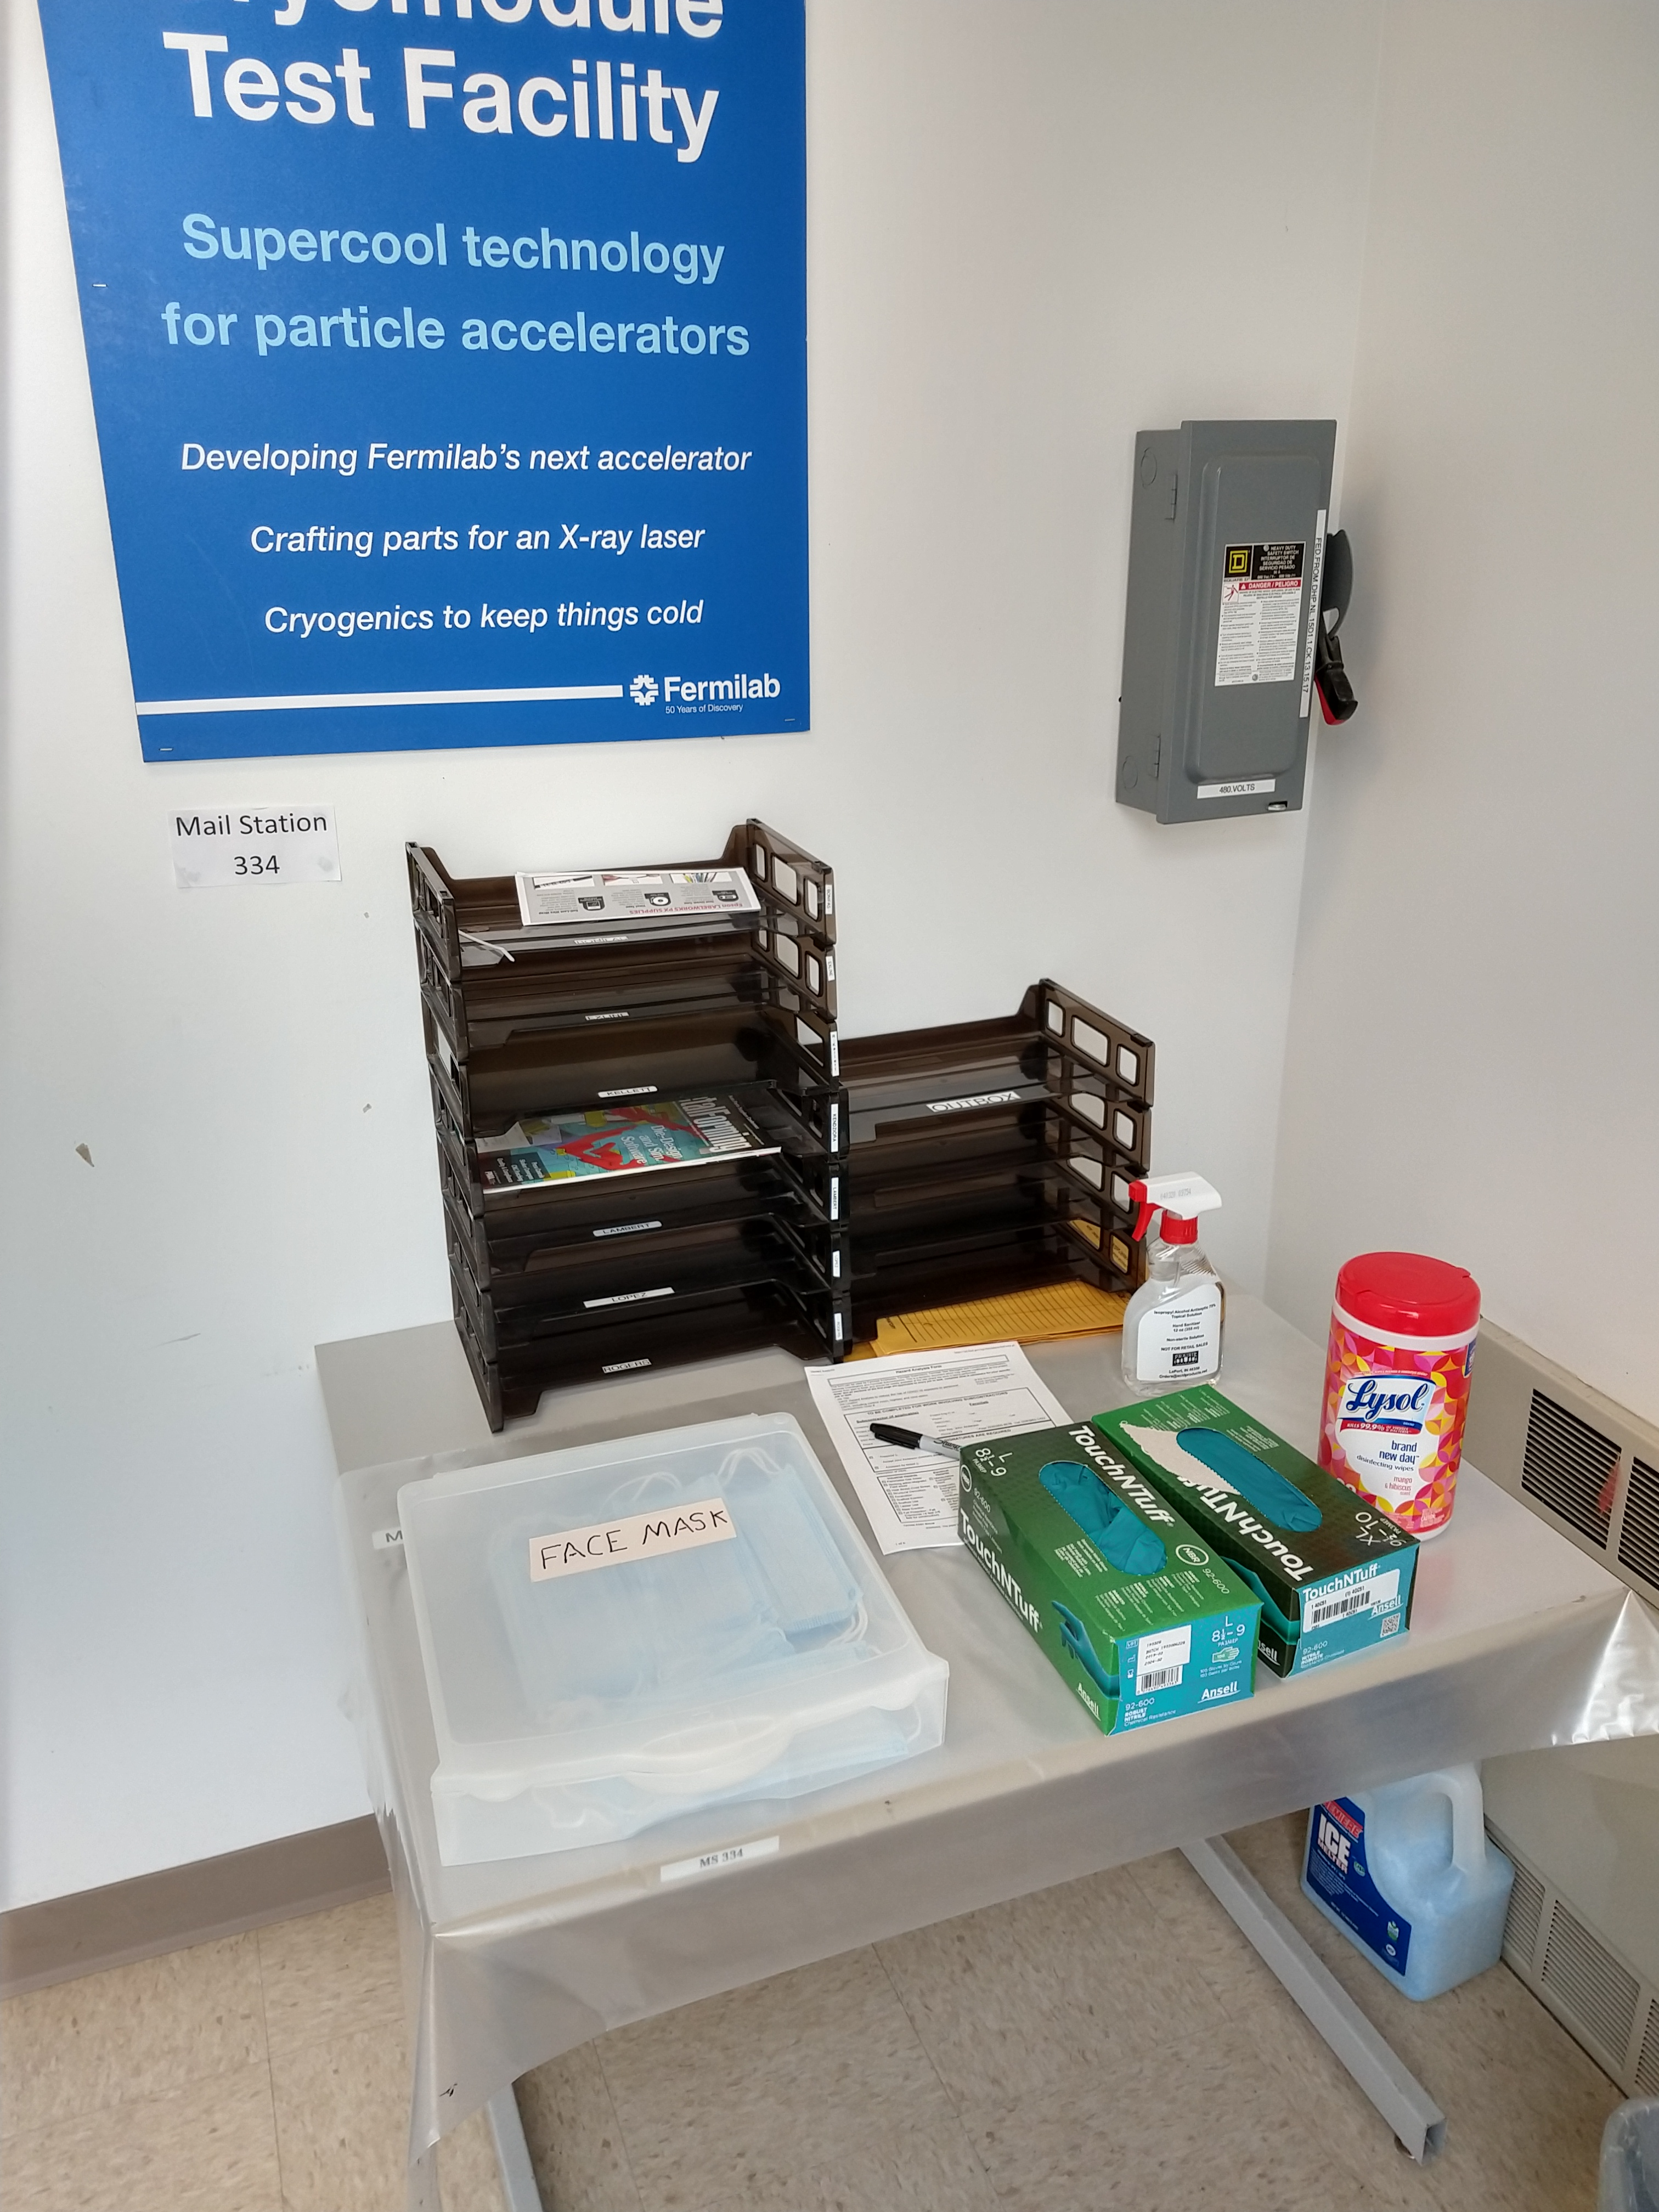
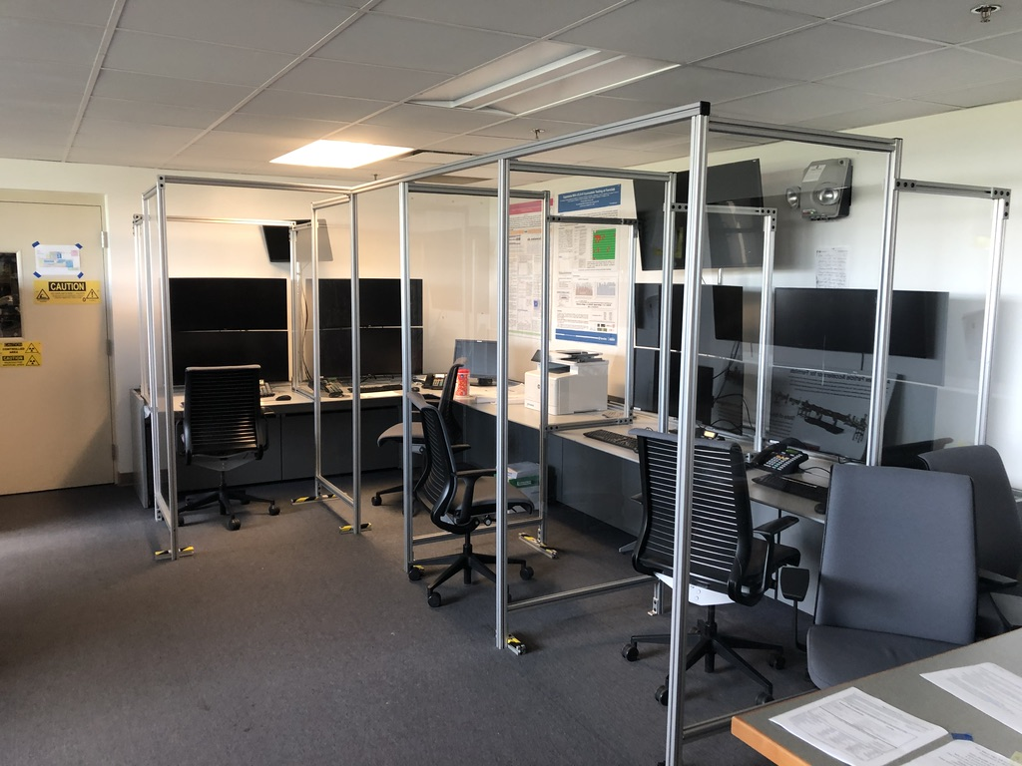
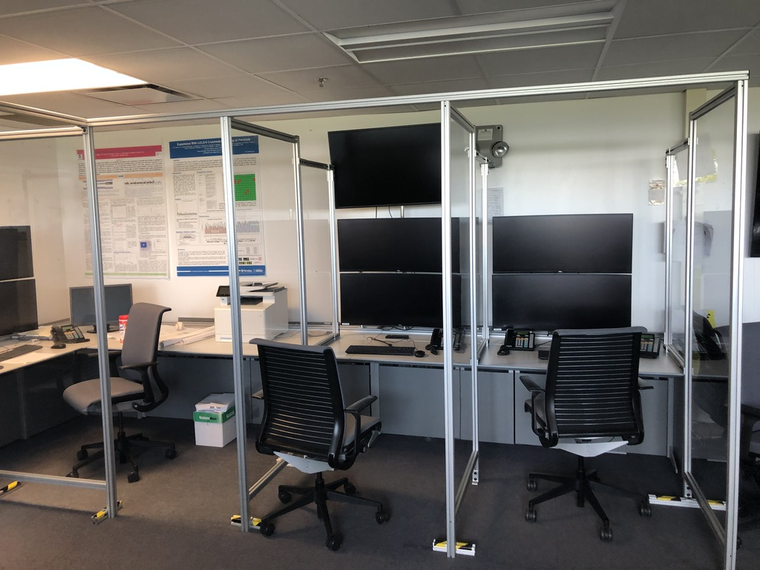
Installation and Commissioning
“Expanded Essential” Return to Work Phase
  PIP2IT
    ~ 60 people brought back thru Round-4 for PIP2IT related work
      Strict task coordination to minimize number of people at PIP2IT facility at one time
        daily work planning and task assignments
        assigned entry doors and work zones
      Social distancing, physical barriers, protective equipment
      Tracking weekly progress to try to quantify efficiency during COVID recovery phase

Slide 21
Installation and Commissioning
PIP2IT Progress
  Restored PIP2IT systems from “Safe State”
    Vacuum, cryo and RF systems
    Cooled HWR back to 2 Kelvin
  Resumed installation/commissioning plan
    SSR1 cryogenic relief line and u-tube installation completed
    PIP2IT roof installed
    PIP2IT cave interlocked (posted as a Radiation & ODH-2 area)
    Began cold RF testing of HWR cryomodule
    Began LEBT/MEBT beam commissioning
    Continued preparation of SSR1 for cooldown
    Kicker assembly has resumed

Slide 22
Installation and Commissioning
Activities that continue to be worked on remotely
  PIP2IT Infrastructure
    Development/management of detailed PIP2IT COVID19 Recovery Plan & schedule
    650 Test Stand Cryo Transfer Line (CTL) Final Design phase
  Building Infrastructure
    Supporting CF design work
      Updating electrical/mechanical requirements & specifications in support of CF 30%-60% design review
    Development of cable database and cable management plan
  Linac Installation
    Developing “Installation Deliverables Lists” to document condition of deliverables from L3’s at time of installation (all lists drafted, 6 of 16 finalized)
    CAD Model updates (LCW piping, electrical layout, 30-60% CF model import)

Slide 23
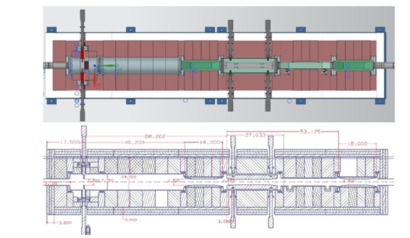
Accelerator Complex
Booster Collimators PDR Review took Place on May 29. Review report was received.
Started work on the new modulators for the MI RF upgrade.
Cross section of the Booster Collimators

Slide 24
Conventional Facilities
Early Conventional Facilities (ECF) Subproject
  Subproject for Site Work and Cryogenics Plant Building
  Subproject Execution Plan in progress
WBS 121.06.03 - Cryogenics Plant Building
  Procurement documents in progress
  A/E Support (construction administration and construction coordination) proposals received and approval in progress
  BCR 271 created to incorporate cost/schedule changes
WBS 121.06.05 - Linac Complex
  60% design review scheduled for August 2020
  Proposal received for 100% deliverables
    Includes F3.5 Service Building
    Includes Linac Tunnel extension option
    Includes Linac Gallery extension option
    Accelerates the completion date to December 2020
    BCR 274 created to incorporate changes

Slide 25
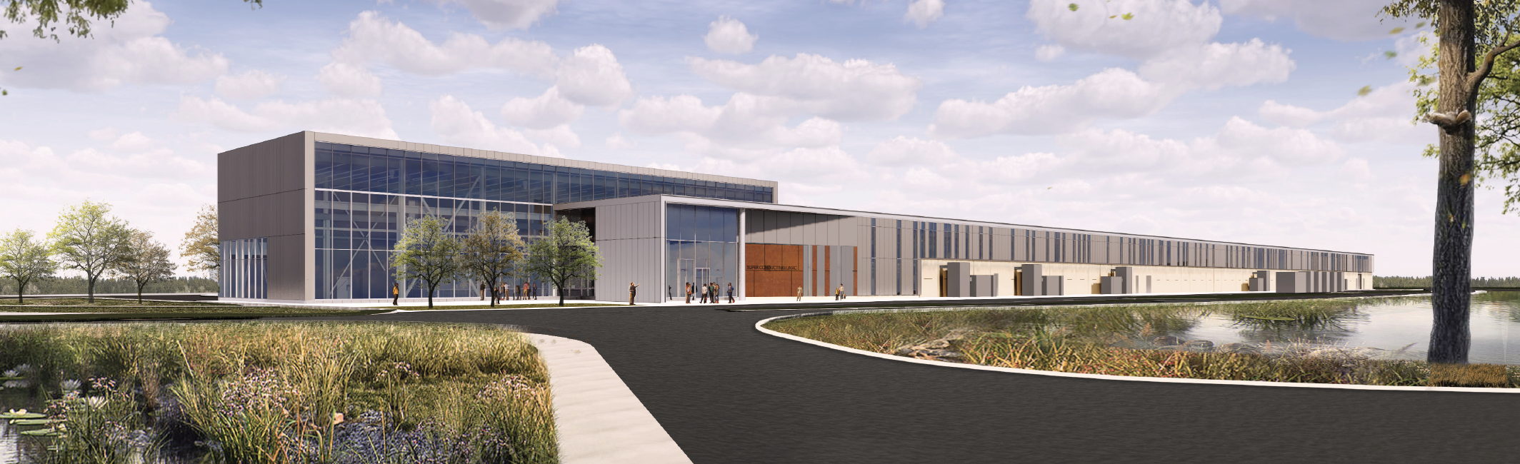
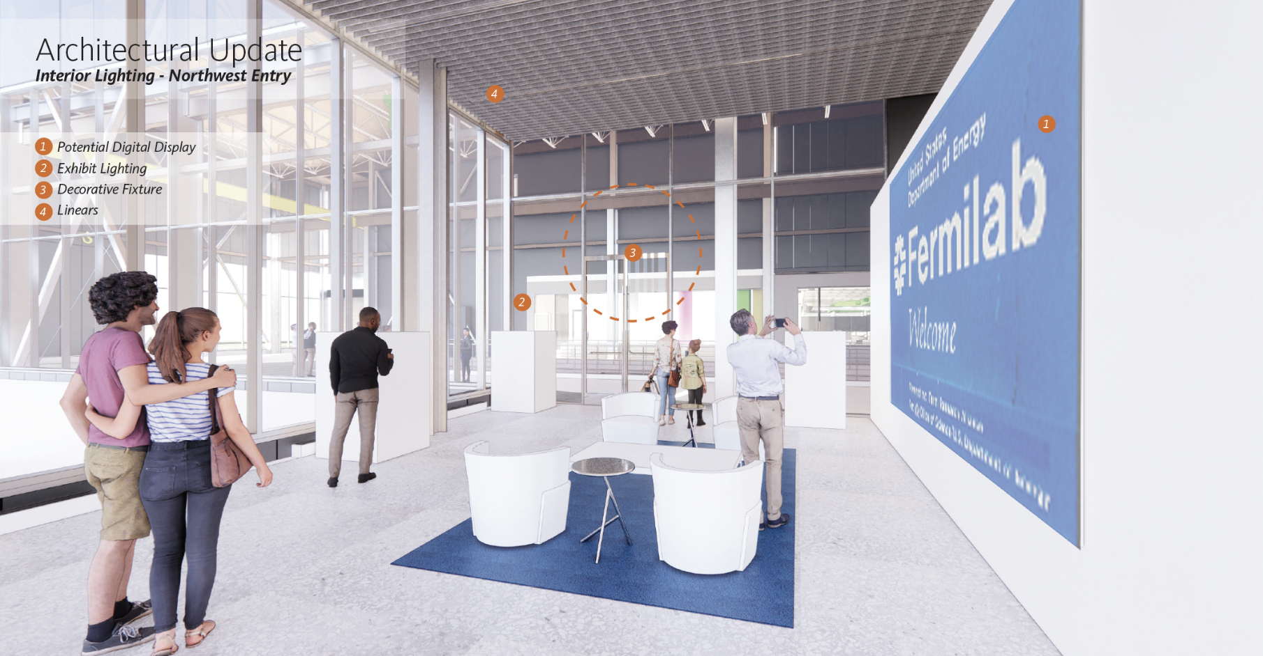
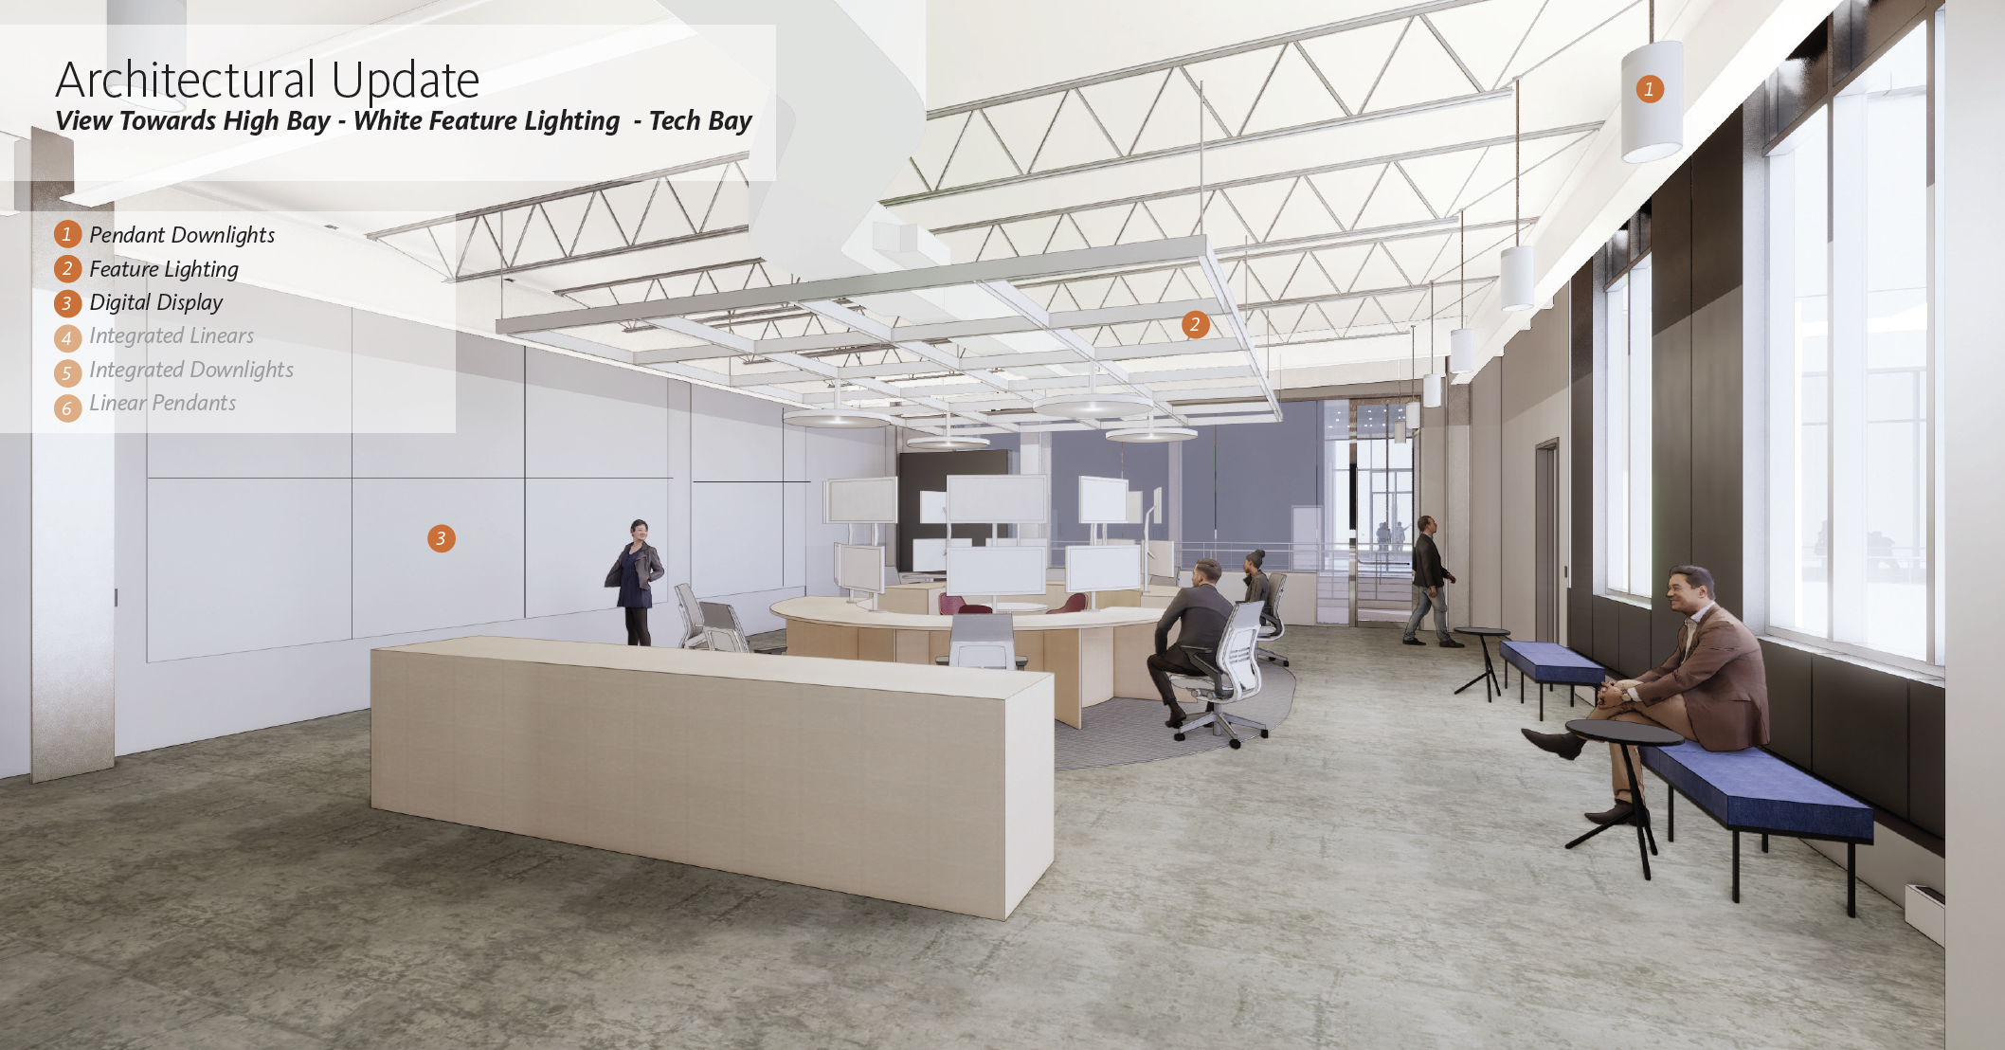
Conventional Facilities

