Slide 1
ND LAr Cryostat and LArTPC Conceptual Design
A. Lambert
07/08/2020
Version: v2 → updated on 07/07/2020 @ 21:23 PCT
See last slide for update details

Slide 2
Who am I
Mechanical Engineer at Lawrence Berkeley Lab since October 2011
Joined DUNE-US in January 2020
Lead Engineer for ND LAr Consortium
LAr Cryostat Engineer
Worked on:
Dark Energy Spectroscopic Instrument (DESI): 2013-2019
Design, analysis, installation for focal plane and fiber systems
Conceptual design through instrument installation at Kitt Peak in Tucson, AZ
LUX-Zeplin (LZ) Dark Matter Experiment: 2016-2020
Procurement manager and technical rep for multiple contracts
On-site vendor visits for periodic status updates and QA acceptance testing
Project X Injector Experiment (PXIE): 2011-2014
Design, analysis and fabrication of radio-frequency quadrupole (RFQ) for PXIE

Slide 3
Outline
Scope
LAr Cryostat Design
Requirements
Design
Interfaces
LArTPC Design
Requirements
Design
Interfaces
Summary

Slide 4
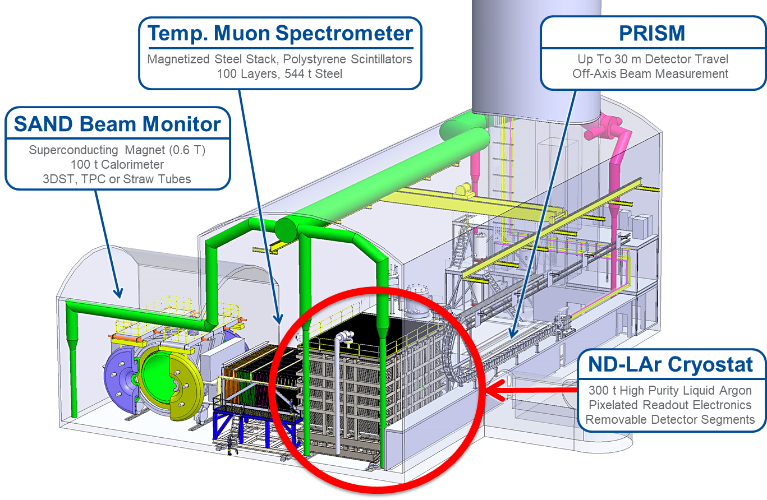
Scope
Conceptual Design
Liquid argon cryostat capable of supporting ArgonCube module row installation
ArgonCube modules capable of hosting 3D pixelated charge and light readout TPCs
ND-LAr Detector
ArgonCube Module TPC Array
Pixelated Readout Electronics
Purified LAr Supply

Slide 5
LAr Cryostat Conceptual Design

Slide 6
LAr Cryostat: Requirements and Specifications
id | Artifact Type | Name | Primary Text
ND-T1.8.1 | Specification | Cryostat Inner Dimensions | The ND LArTPC cryostat inner dimensions must be large enough to host the ND LArTPC detector system.
ND-T1.8.2 | Specification | Downstream Passive Material | The downstream material of the ND LArTPC cryostat (cold structure, warm structure, plus inactive argon when filled) must not substantially attentuate neutrino-induced muons exiting the ND LArTPC.
ND-T1.8.3 | Specification | Cryostat Robust to Movement | The ND LArTPC Cryostat shall be sufficiently robust such that off-axis (PRISM) movements do not substantially impact cryostat performance.
Physics requirements drive engineering design
Liquid argon storage requirements (found in Cold Structure Specification Document DU-1001-3496)
Inner volume defined by the internal membrane is: 5500mm X 6000mm X 9000mm (height X width X length): ~ 297m³
Tank capacity (liquid volume ~82%) is defined by the thickness of the cold membrane vessel layout and is expected to be around ~ 340 metric tones
Residual Heat Input (RHI): < 10 W/m²
Insulation density: 90 kg/m³
Insulation thickness (all included): 0.8 m
Includes primary and secondary membrane
An insulation thickness (all included) of 0.6 m would be desirable if Req. #3 can be satisfied
Design pressure: Maximum allowable working pressure (MAWP) = 350 mbarg. 350 mbarg shall be the set point of the cryostat pressure safety valve
The atmospheric pressure at the site is: 1020.355 mbar-a, cryostat pressure safety valves shall be set at 350 mbar-g with respect to ambient pressure
LAr operating temperature: 86K – 90K

Slide 7
Cryostat Overall Size
Corrugated SS membrane surface
Corrugated SS membrane surface
Insulating Foam
Parameter | Length [mm] | Width [mm] | Height [mm]
Membrane Flat Internal Dimensions | 9000 | 6000 | 5500
10mm Steel Skin Internal Dimensions | 10600 | 7600 | 6300
External Steel Structure Dimensions | 11365 | 8365 | 7065

Slide 8
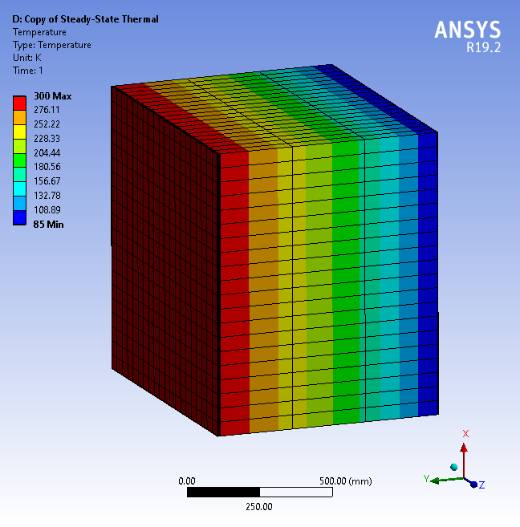
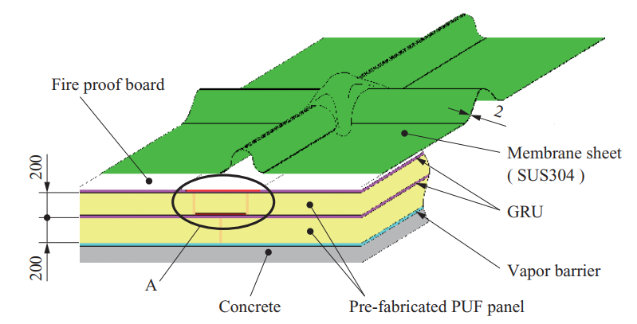
Desired Insulation Thickness
Thickness [mm] | Surface Area [m²] | Heat Flux [W/m²] | Heat Leak [kW]
200 | 273 | 20.0 | 5.5
400 | 273 | 10.0 | 2.7
600 | 273 | 6.7 | 1.8
800 | 273 | 5.0 | 1.4
**Indicates that 600mm insulation thickness may be possible to save space

Slide 9
Cryostat Heat Load Estimate
Estimation of total heat load: 10-15 kW
Heat leak though the cryostat wall and cryostat floor: 1.8 kW
Estimation with 60 cm cryostat foam insulation
(K = 0.0283 W/m-K)
Heat load from ArgonCube Modules: 4.6 kW for 35 modules
Field Shaping Cell: 80 W / module
Pixel Readout: 41 W / module
Light Detection: 10 W / module
Heat leak through module roof: TBD
Similar in construction to cryostat walls (membrane + foam insulation)
Cryogenic system, miscellaneous: 4.2 kW

Slide 10
Subsystems: Cryostat Warm Structure (300K) Design
External structure is based on ProtoDUNE design
I-beams used for external structure
Modular design
Reduced part #
Wall weldments are divided into subassemblies that are joined via bolted connections on beams
Wall weldments have 1.0 cm steel skin on backside, adjacent skins welded together to from moisture barrier
Corner weldments identical at all corners
Removable lid with feedthroughs for cryogenics, high voltage and detector DAQ

Slide 11
Subsystems: Warm Structure (300K) Wall, Base & Corner Design

Slide 12
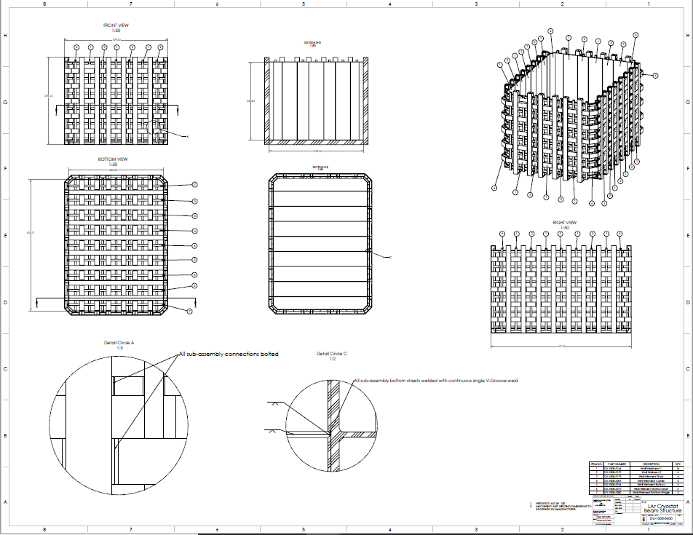
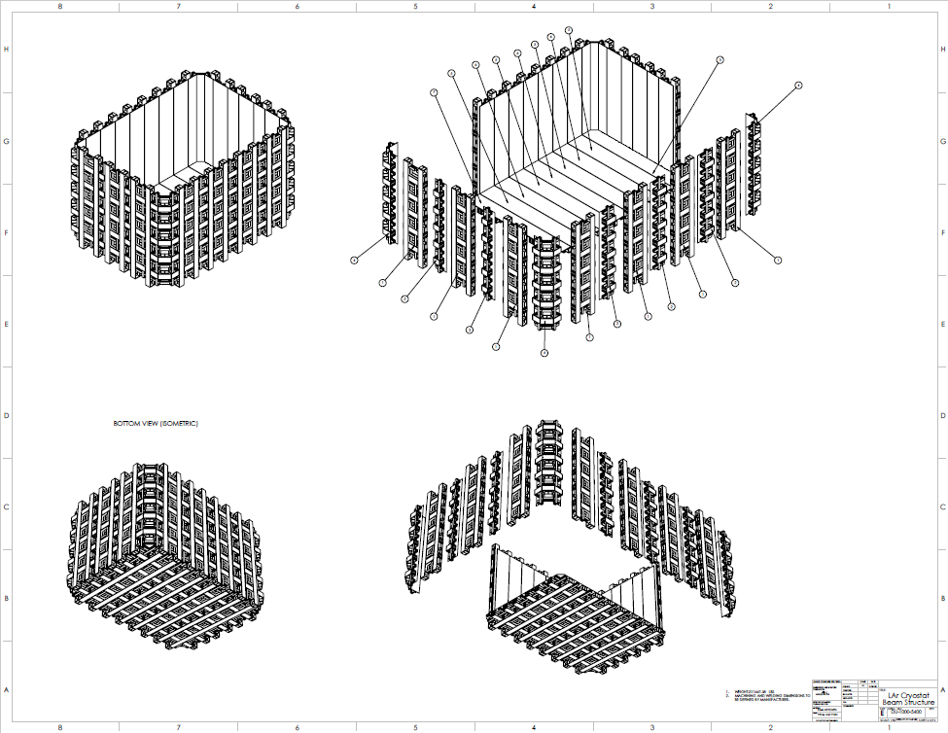
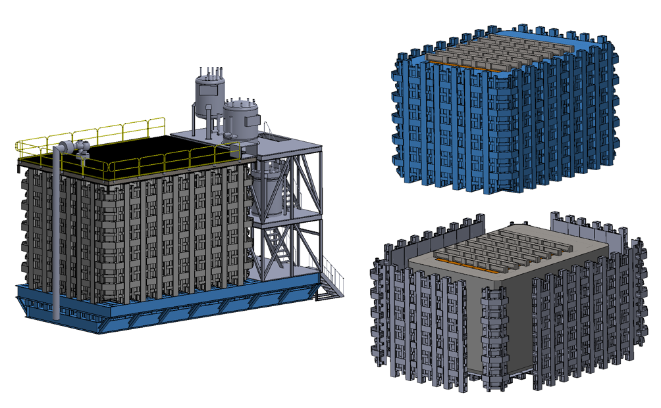
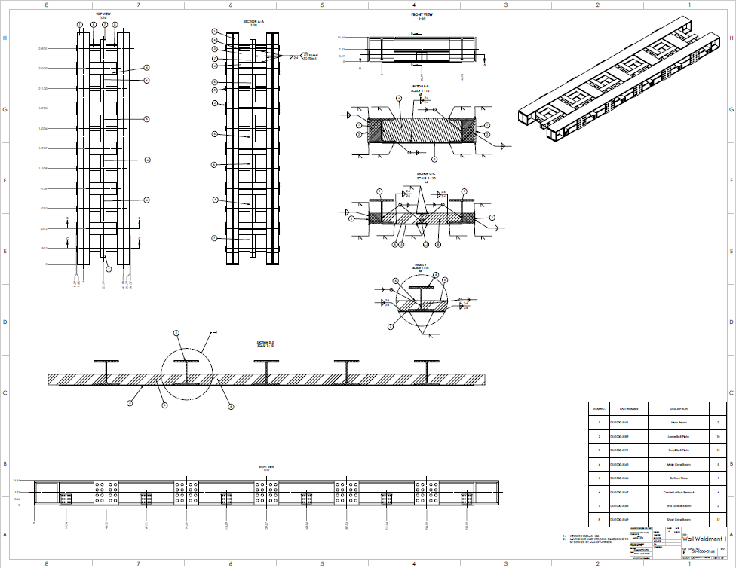
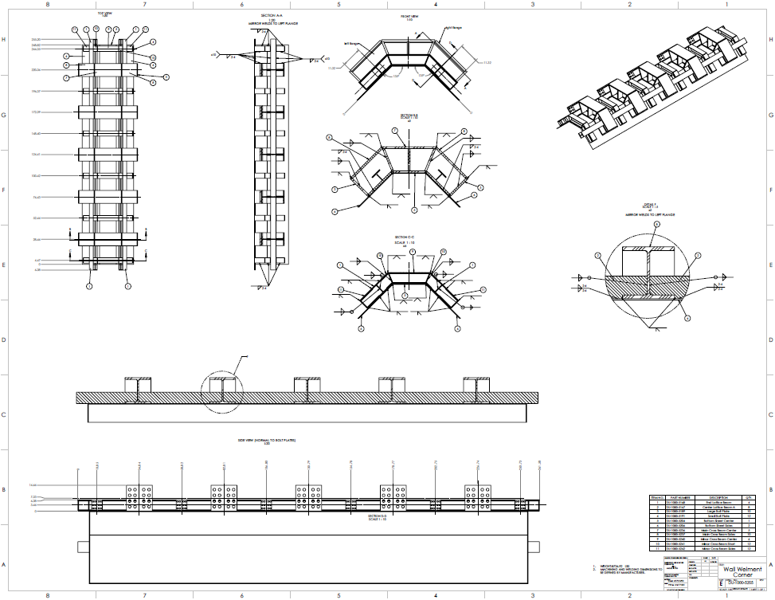
Subsystems: Warm Structure (300K) Conceptual Drawings
Vendor Quotes Based on Following Assumption:
LAr Cryostat consists of an external steel pressure vessel
Vessel is assembled using 7 unique subassemblies

Slide 13
Subsystems: Warm Structure (300K) Composite Window

Slide 14
Subsystems: Warm Structure (300K) Composite Window
Following talk by G. Vallone for window design details

Slide 15
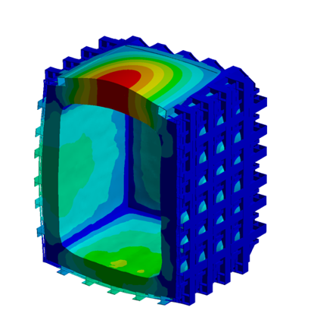
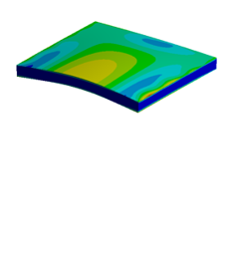
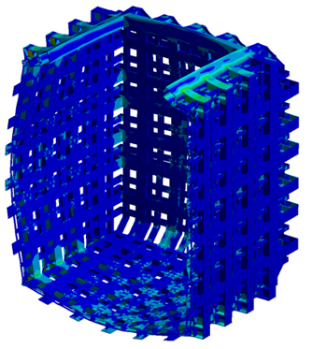
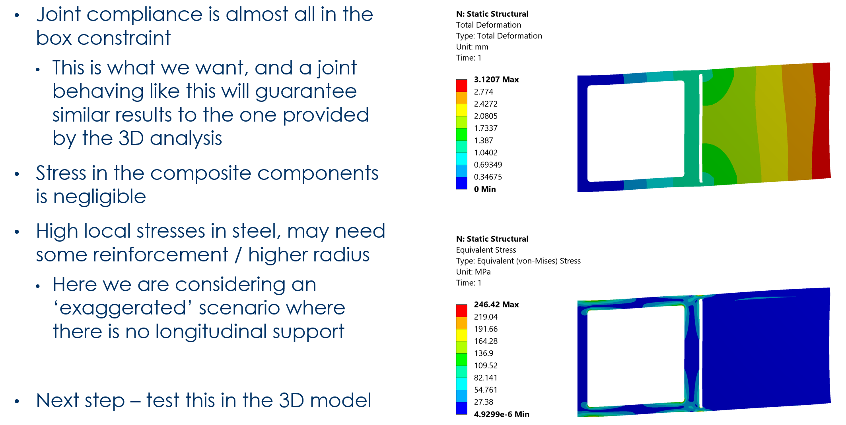
LArTPC Cryostat - Preliminary Engineering Analyses
Following talk by G. Vallone for analysis details
Significant design and analysis effort by LBNL engineering on cryostat structure and composite window
LBNL Composites Group leading composite window design and analysis

Slide 16
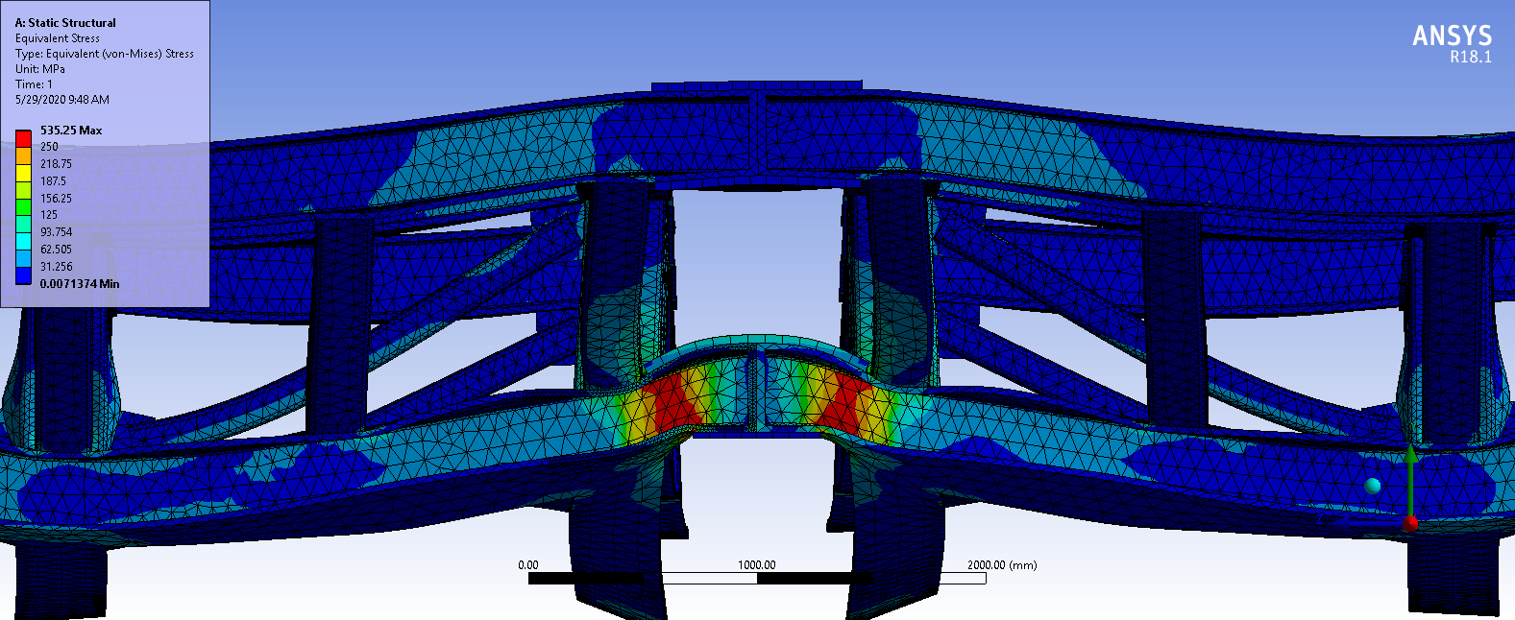
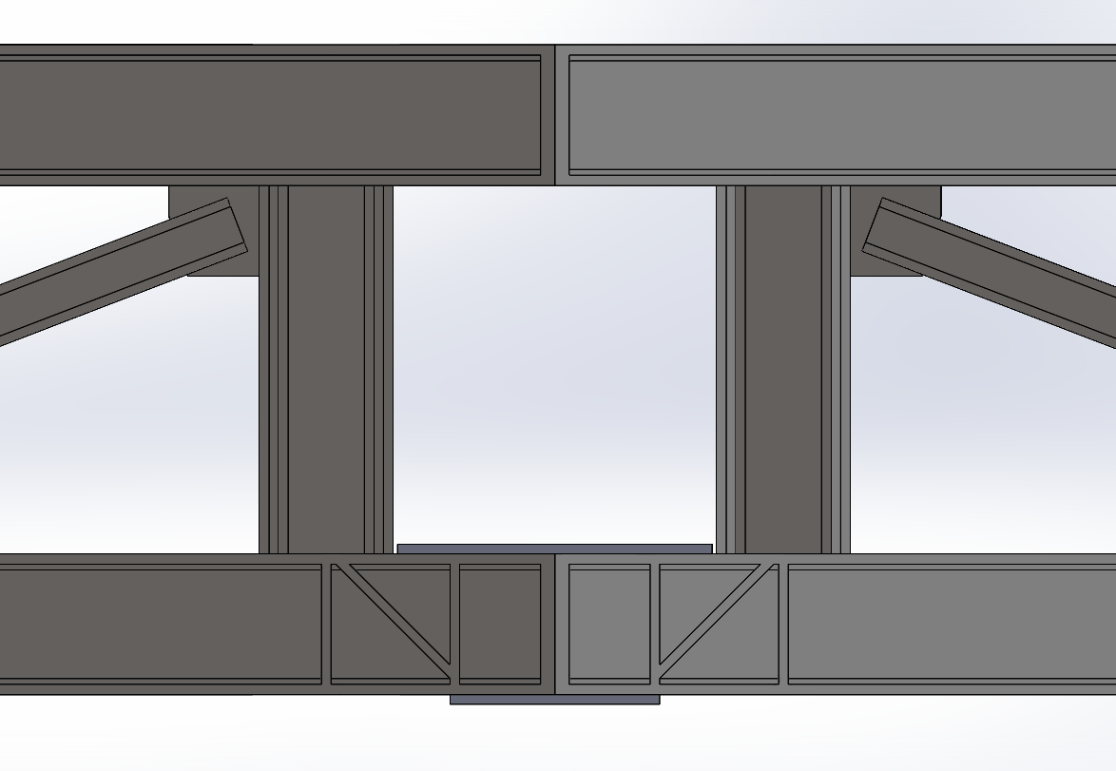
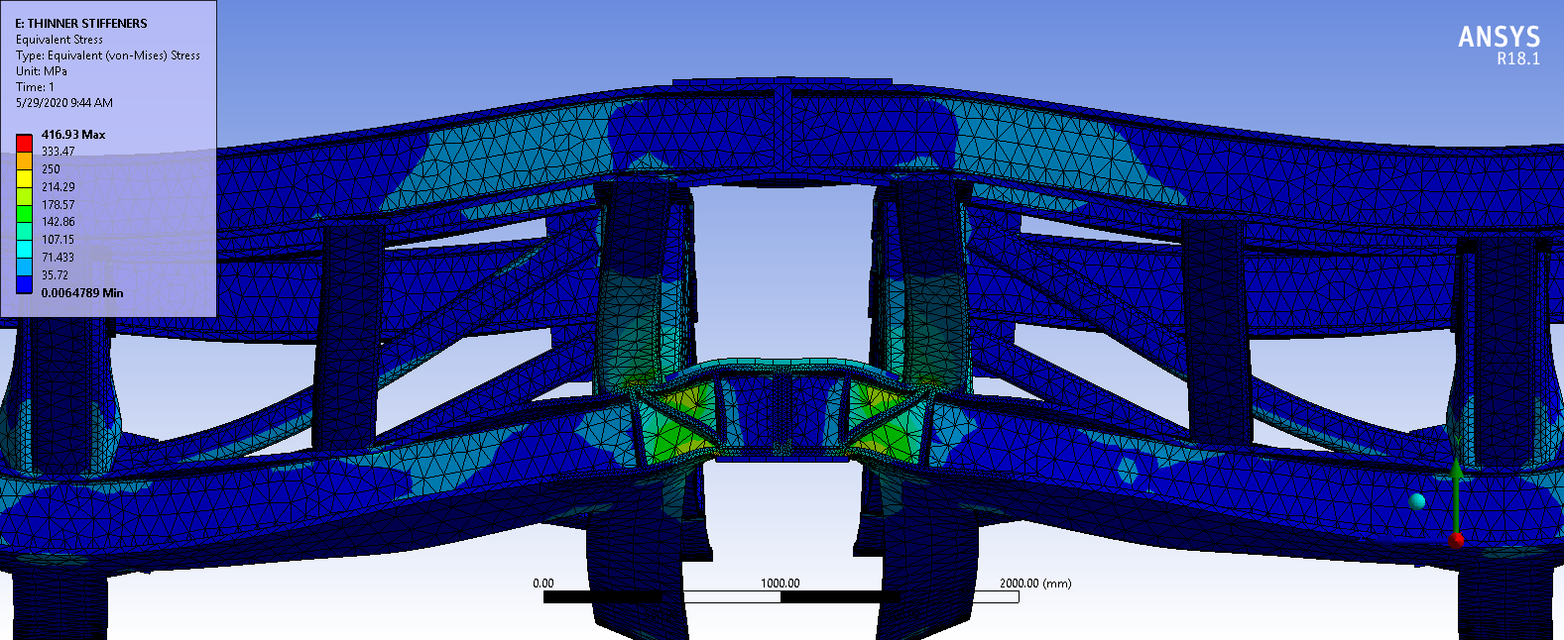
LArTPC Cryostat - Support Structure Analysis Joint Reinforcement
Three Frame Sections
Unsupported vs Stiffened Joint
Section Joint

Slide 17
Subsystems: LArTPC Cryostat Cold Structure (85K)

Slide 18
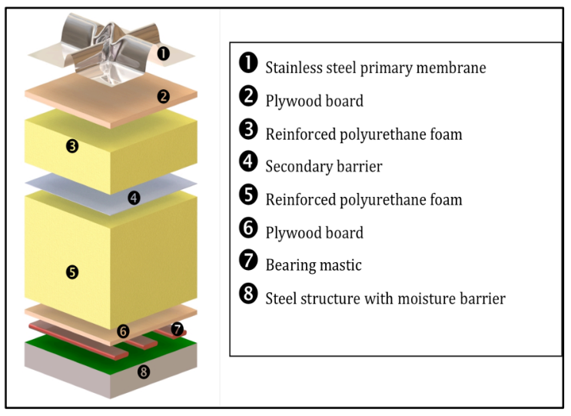
Subsystems: LArTPC Cryostat Cold Structure (85K)
ProtoDUNE SS Membrane
Cold structure is comprised of stainless steel membrane and insulating layer
Technology used for liquid natural gas tanker storage, but has been applied to LArTPC cryostats
ProtoDUNE, 35-ton, SBND
Proprietary technology supplied by commercial vendor
Design, engineering, & installation

Slide 19
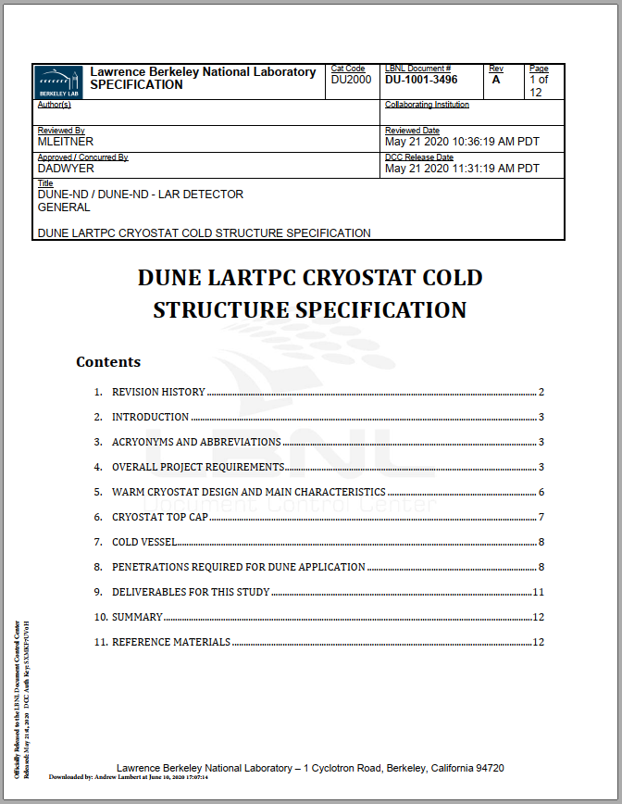
Subsystems: LArTPC Cryostat Cold Structure (85K) Cold Structure Specification Document
Specification Document for the cryostat cold structure; document defines the following features of the cold structure
Overall requirements
Warm structure design
Cryostat lid design
Cold vessel features
Penetrations
Top lid & cryostat walls (LAr pump)
Deliverables for cold structure budgetary quote
Revised into final procurement spec eventually
SS membrane and insulation are supplied by commercial vendors
Proprietary technology that requires early vendor engagement
Specification document is critical to define scope
Released to LBNL DCC

Slide 20
Subsystems: Top Lid (300 K) Modular Structure Design

Slide 21
Subsystems: Top Lid (300 K) Module Installation Order

Slide 22
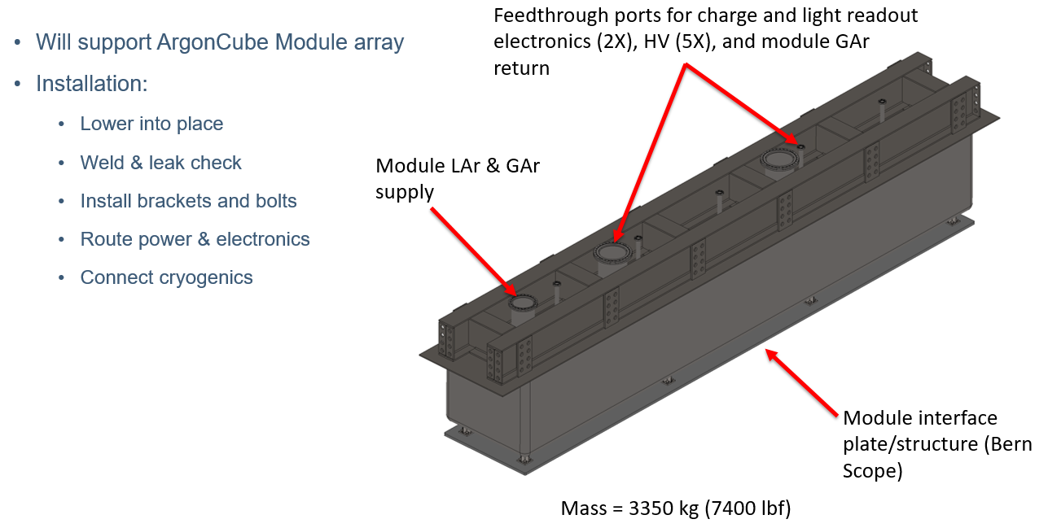
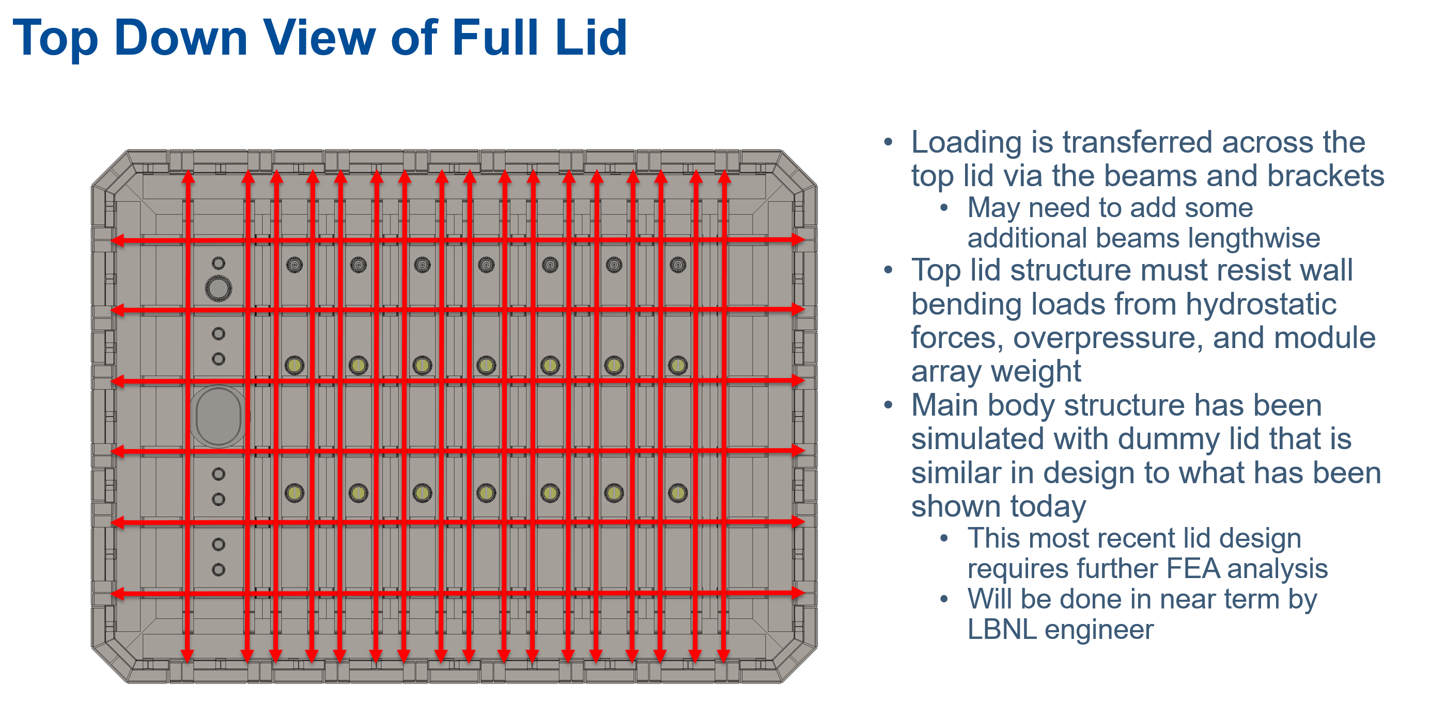
Subsystems: LArTPC Cryostat Top Lid (300K)

Slide 23
Lid Installation Sequence – Cryo Section

Slide 24
Lid Installation Sequence – Cryo Section

Slide 25
Lid Installation Sequence – Cryo Section

Slide 26
Lid Installation Sequence – Cryo Section

Slide 27
Lid Installation Sequence – Cryo Section

Slide 28
Lid Installation Sequence – Module Row 1

Slide 29
Lid Installation Sequence – Module Row 1

Slide 30
Lid Installation Sequence – Module Row 1

Slide 31
Lid Installation Sequence – Module Row 1

Slide 32
Lid Installation Sequence – Module Row 1

Slide 33
Lid Installation Sequence – Module Row 2

Slide 34
Lid Installation Sequence – Module Row 3

Slide 35
Lid Installation Sequence – Module Row 4

Slide 36
Lid Installation Sequence – Module Row 5

Slide 37
Lid Installation Sequence – Module Row 6

Slide 38
Lid Installation Sequence – Module Row 7

Slide 39
Final Section Installation

Slide 40
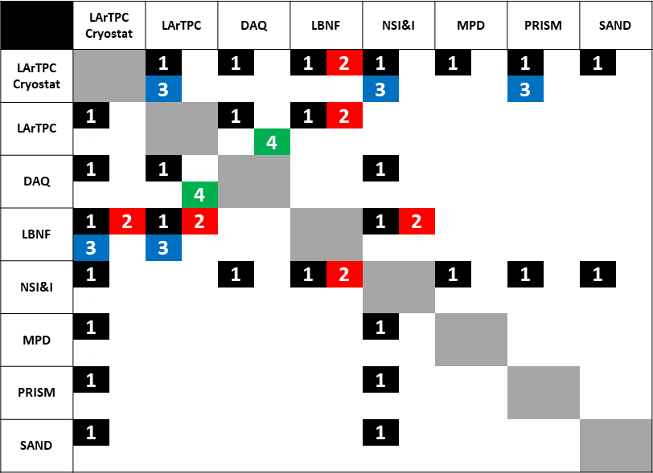
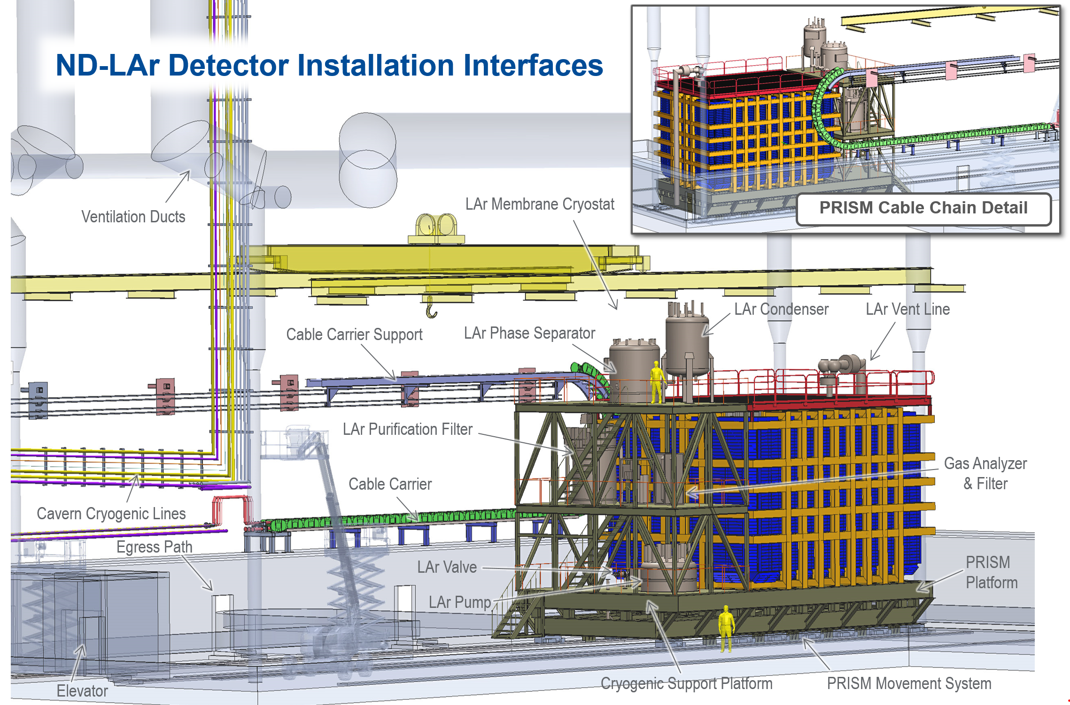
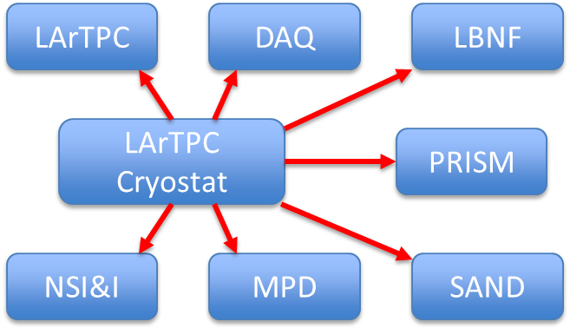
Interfaces
Interface documents for LArTPC Cryostat managed within LBNL Windchill document system, final release to EDMS – documentation in development
Critical Interfaces: LArTPC, NSI&I, PRISM, LBNF
Version control with official review & approval process
N² Matrix to ID Interfaces
LBNF
PRISM

Slide 41
LArTPC Conceptual Design

Slide 42
LArTPC: Requirements and Specifications
id | Artifact Type | Name | Primary Text
ND-T1.1 | Requirement | ND LArTPC Fiducial Mass | The ND LArTPC shall provide sufficient fiducial liquid argon target mass to deliver the required statistical precision (<2%) for the measurement of neutrino-electron elastic scattering.
ND-T1.2 | Requirement | ND LArTPC Active Size | The ND LArTPC active volume shall be large enough to fully contain the ionization signal from beam neutrino interactions on argon, except for forward-going muons and energetic neutrons.
ND-T1.3 | Requirement | Pileup Rejection Efficiency | The ND LArTPC shall be able to efficiently and accurately reject unassociated charge signals (pileup) from the specific neutrino signals of interest.
ND-T1.3.1 | Requirement | 3D Charge Imaging Accuracy | The ND LArTPC will provide accurate 3D charge imaging in the high-pileup ND environment.
ND-T1.3.2 | Requirement | Charge-Light Signal Matching Efficiency | The ND LArTPC shall provide sufficient light-charge signal association to enable accurate pileup rejection.
ND-T1.3.3 | Design Choice | Detector Modularity | The ND LArTPC will be divided into multiple independent LArTPC modules.
ND-T1.3.4 | Requirement | Fraction of interior fiducial volume | Any inactive or degraded regions interior to the ND LArTPC volume must not violate the other stated performance requirements.
ND-T1.4 | Requirement | ND LArTPC Robust to Movement | The ND LArTPC shall be sufficiently robust such that off-axis (PRISM) movements of the detector does not substantially degrade or bias detector performance.
ND-T1.5.1 | Specification | Electric Field Strength | The ND LArTPC shall be able to achieve an equivalent electric field strength as the FD.
ND-T1.5.2 | Specification | Electric Field Uniformity | The ND LArTPC shall provide an electric field within it's fiducial volume as well-defined as the FD.
ND-T1.7.1 | Specification | Photon detection time resolution | The time resolution of the photon detection system shall be sufficient to efficiently discriminate the light signals from separate neutrino interactions at nominal beam intensity.
ND-T1.7.2 | Specification | Photon detection efficiency | The photon detection efficiency shall be high enough to discriminate two light signals from localized energy depositions of ~20% difference in intensity or > 50 cm spatial separation within the ND LArTPC.
Physics requirements drive engineering design
LArTPC engineering requirements in development
Active region defined as > 5000mm in beam direction, >= 7000mm x 3000mm transverse directions
Module size defined as >= 1000mm x 1000mm x 4000mm
Operational temperature range 85K – 300K
Survival temperature range 77K – 350K

Slide 43
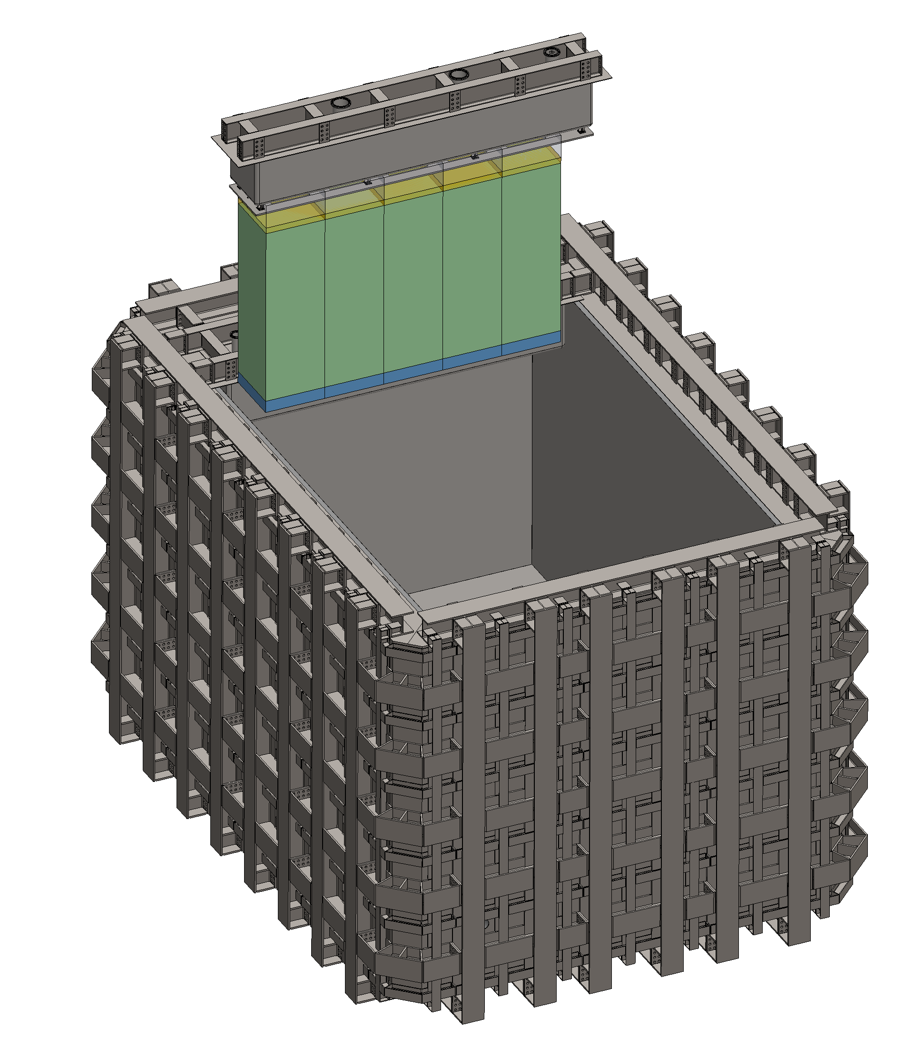
LAr Cryostat and LArTPC Detector
Detector rows are installed to the LAr Cryostat
7 rows total -> 5 x 7 detector module array to instrument a 5m x 7m x 3m active region
LArTPC Detector row
5 ArgonCube modules -> instrument a 5m x 1m x 3m active region

Slide 44
Module Overview Summary
High Voltage Feedthrough
Modular LArTPC utilizing true 3D charge imaging and scintillation light containment via optical segmentation to match charge-light signals -> accurate reconstruction of neutrino-Argon nucleus reactions in a high pile-up environment
Low profile field cage and cathode structure to maximize instrumented region and provide optical segmentation
1m x 1m x 3m nominal module size -> mean of 6 events per module per beam spill -> less ambiguity in neutrino event reconstruction
Cathode & Field Cage Top & Bottom
Charge Readout Plane
Field Cage Side Panel
Light Readout Plane(s)
Anode Support Panel
Anode Support Panel
Light Readout Plane(s)
Field Cage Side Panel
Charge Readout Plane

Slide 45
Module Subsystem Summary
WBS 131.02.03.02.02
High Voltage - Bern
WBS 131.02.03.02.03
Field Structures - SLAC
WBS 131.02.03.02.01
Module Structure - Bern
WBS 131.02.03.02.04
Charge Readout - LBNL
WBS 131.02.03.02.05
Light Readout – Bern/JINR
WBS 131.02.03.02.06
Calibration – MSU/JINR

Slide 46
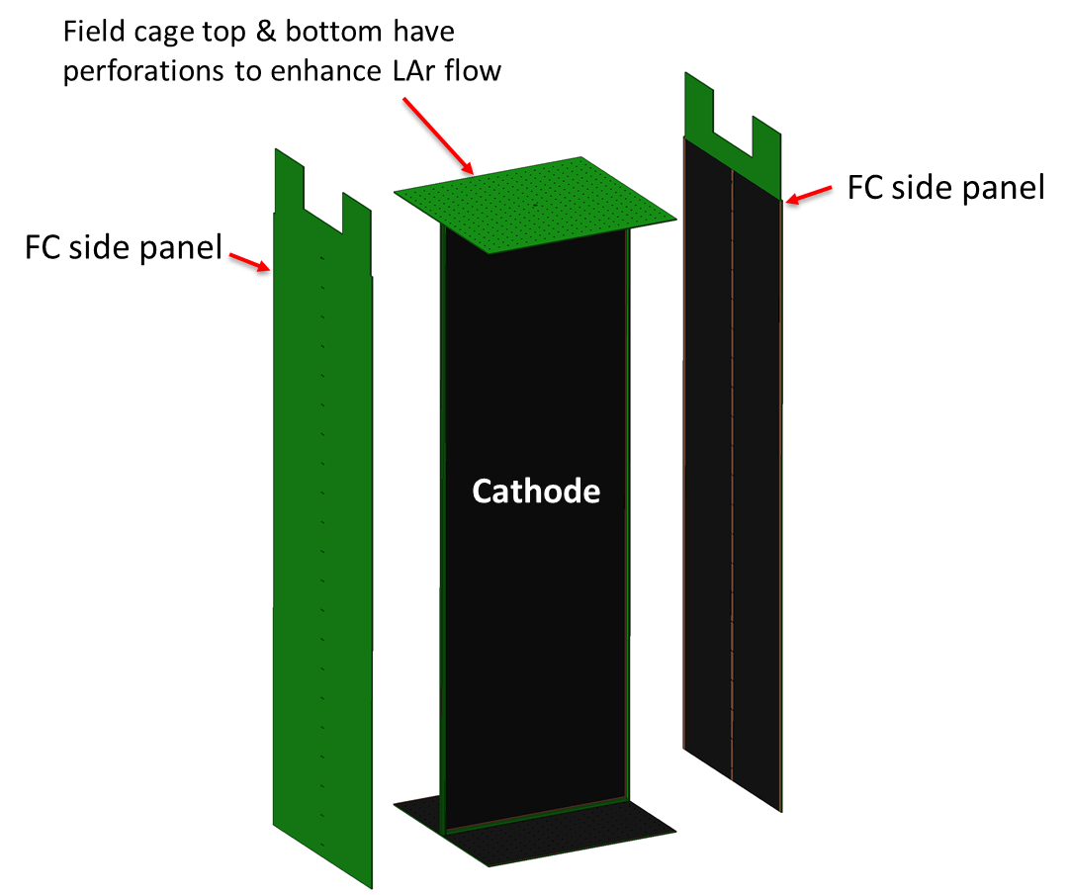
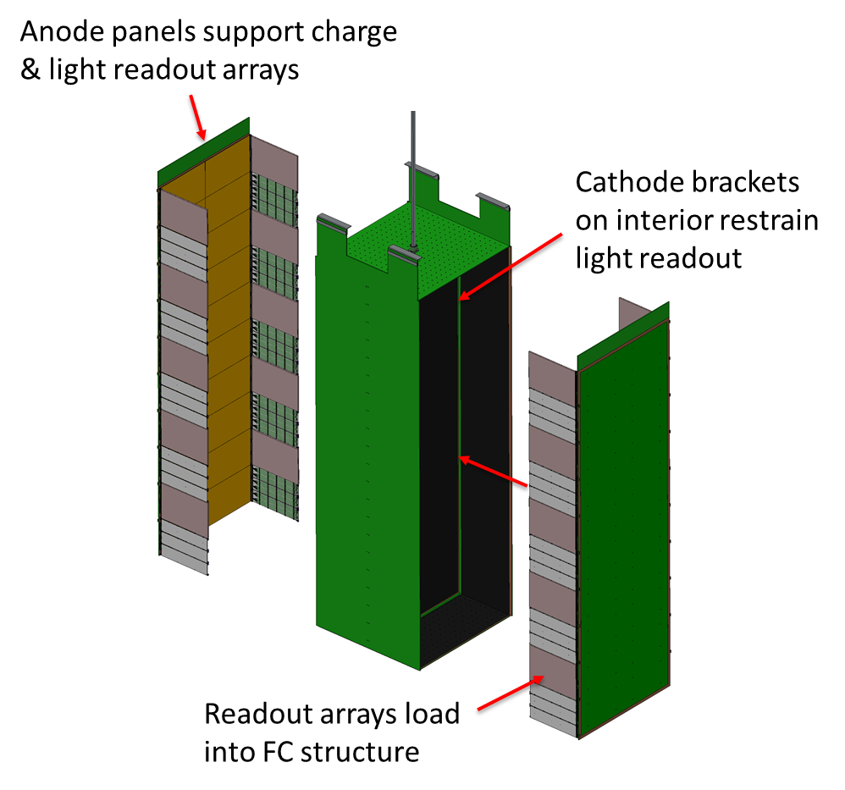
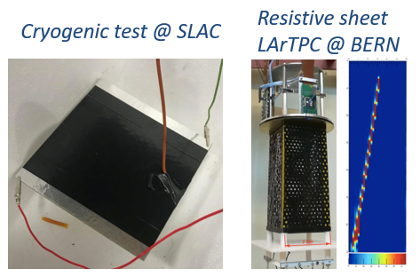
Field Structures (131.02.03.02.03) Field Cage & Cathode – Knut Skarpaas (ME, SLAC)
Central cathode, dual anode with 50cm drift regions
Short drift reduces required HV and associated risks
Resistive polyamide sheet laminated on G10 panels
Reduces risks from accidental HV discharge
No resistor chain; reduce single-point failure risk
Low-profile: maximizes active volume
All G10 construction
Similar density to LAr; reduce signal distortion
Compatible thermal contraction at LAr temp
FC side panels provide optical segmentation
Perforations in Top & Bottom of FC
Institutions:
SLAC, Bern, CSU, MSU,
U-Mich, UCSB
HV input at top of cathode

Slide 47
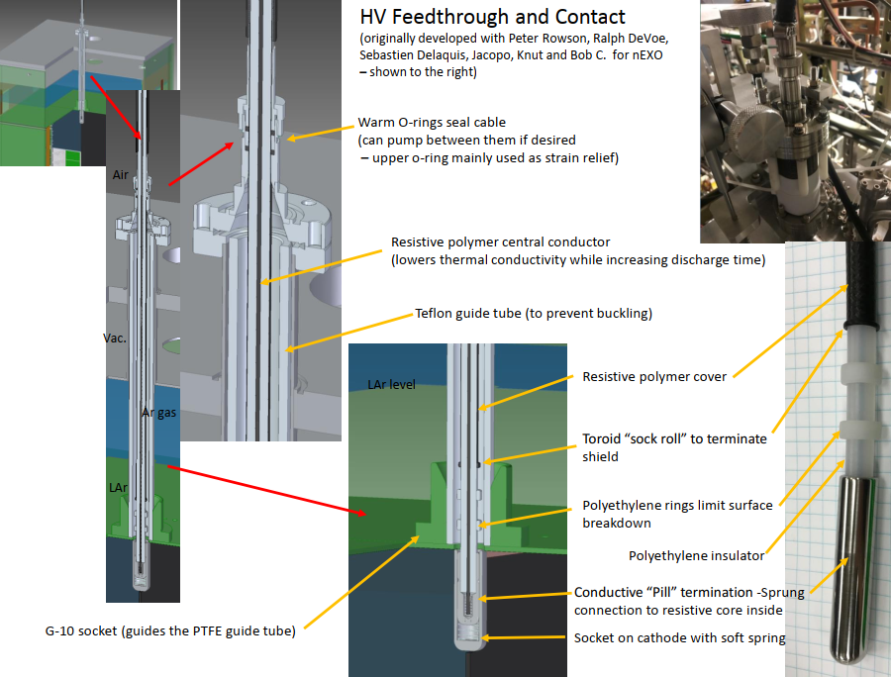
Field Structures (131.02.03.02.03) High Voltage Feedthrough - Knut Skarpaas (ME, SLAC)
High voltage feedthrough input at top of cathode (25 kV)
Resistive polymer central conductor
PTFE tube guide to provide support
Conductive “pill” termination
Designed for (n)EXO and ArgonCube 2x2
Successfully fabricated and tested at SLAC – also successfully used in Univ. of Bern LAr purity tests

Slide 48
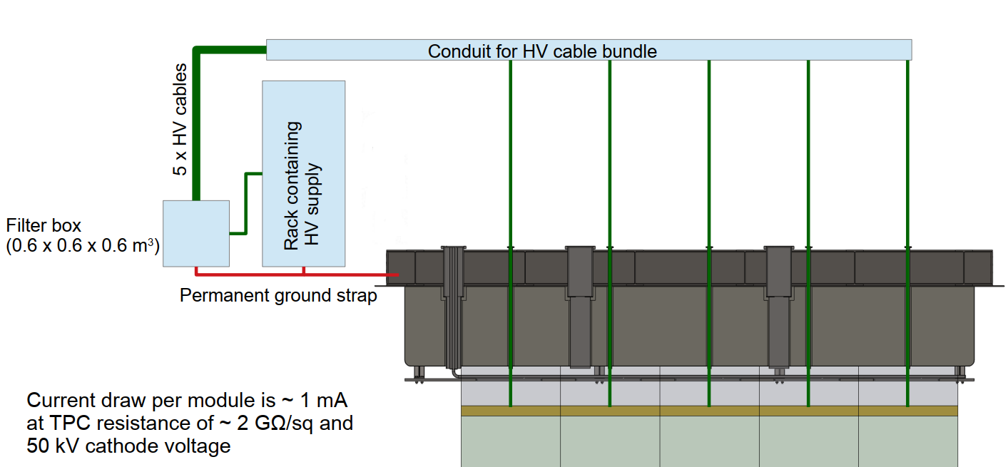
High Voltage (131.02.03.02.02) Power Supply, Distribution, and Filtering – Igor Kreslo (Physicist, Bern)
One power supply serves a row of 5 modules
The power supply is connected to the modules by a single low-pass filter
After the filter 5 resistive cables connect to the HV feedthrough/cathode
The variations in length of the 5 cables are accounted for by adding a resistor for each cable after the filter
For safety and to reduce ground loops, cables are bundled together in conduit until they reach their feedthrough
The jacket of all cables (HV→filter & filter→detector) must share common ground with the filter and detector
The detector and rack grounding must be permanent dedicated lines, regardless of ground loops
Module Row High Voltage Distribution Schematic
HV Cable
Produced by Dielectric Sciences, INC.
Application in nEXO
Resistance: 8.4 kΩ/m
Capacitance: 90 pF/m
HV Filter
Low-pass filter with large capacitor & small resistor to prevent voltage drop
Additional resistors at outlet set to match cathode voltages
HV Supply
Provide 60kV and 5 mA
Within range of standard power supplies
ProtoDUNE recommendation Heinzinger or Fug-Elektronik
HV Breakdown
Monitor current draw
In event of, power supply is cut
Manual feedthrough replacement

Slide 49
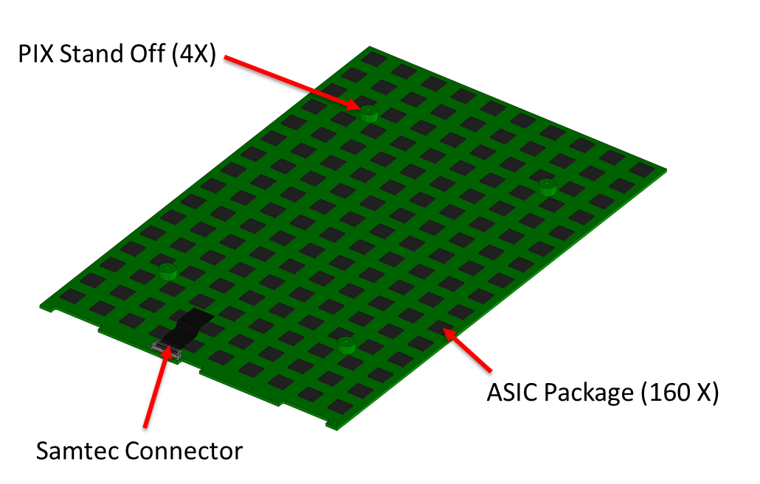
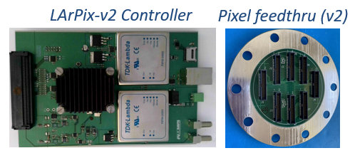
Charge Readout (131.02.03.02.04) Overall Size and Components – Armin Karcher (EE, LBNL)
508 mm
LArPix: Custom pixel readout ASIC
Provides low-noise, low-power, cryogenic readout
SOC: amplification, digitization, triggering, readout
Implements highly-scalable control, I/O architecture
310 mm
Pixels (10240X)
LArPix Controller System: Pac-Man
Leverages commercial Zynq (CPU+FPGA) system with simple custom interface PCB to control large-scale pixel system (~1 controller per 50k pixel channels)
Pixelated charge readout tiles
True 3D imaging; no projective ambiguities
Overcomes signal pileup at DUNE Near Site
Mechanically robust, less sensitive to noise pickup
Scalable design leverages commercial production
Institutions: LBNL, Caltech, CSU, Rutgers,
UC-Davis, UCSB, UPenn, UTA

Slide 50
Charge Readout (131.02.03.02.04) Pixel and ASIC Counts - Armin Karcher (EE, LBNL)
Pixel array on front side with ASIC chip package on backside to readout signal
64 pixels per ASIC chip
16 x 10 ASIC chip layout
> 10,000 pixels per charge readout board
> 200,000 pixels per instrumented drift space
> 400,000 pixels per ArgonCube module
3.5mm x 3.5mm pixels @ 4.0 mm pitch

Slide 51
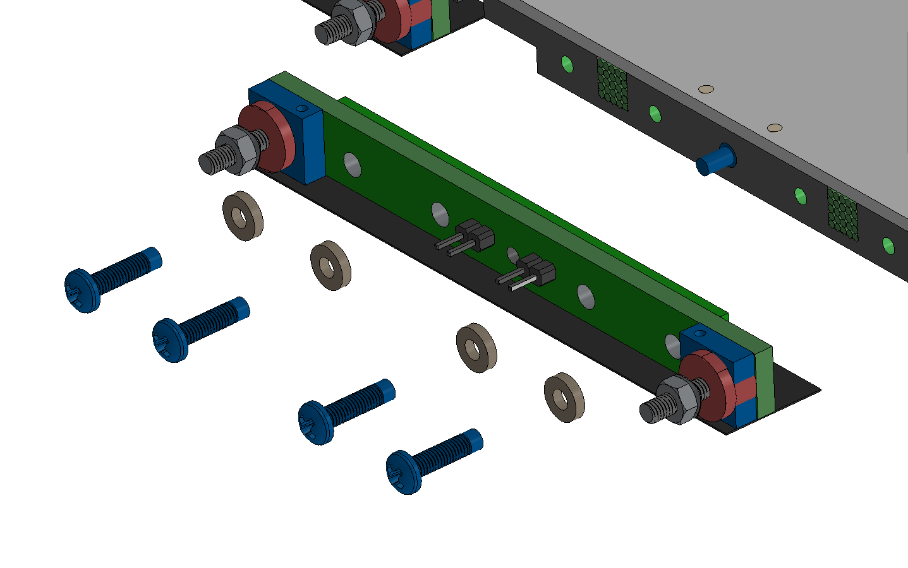
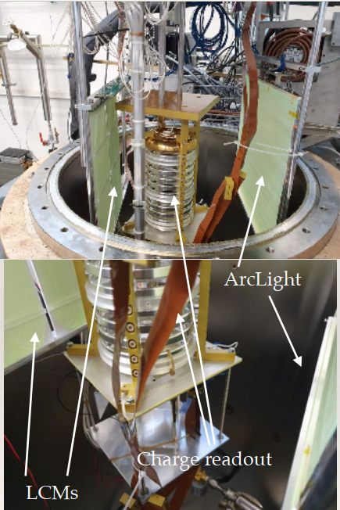
Light Readout (131.02.03.02.05) Light Collection Module (LCM) – Nikolay Anfimov (Physicist, JINR)
SiPMs windows
Shifts UV light (128 nm) into visible light (510nm)
TPB on fibers shift 128 nm to 425 nm -> wavelength shifting fibers shift 425 nm to 510 nm -> Silicon Photomultipliers (SiPMs) detect 510 nm light
Easy to scale -> fibers have long attenuation
High detection efficiency, PDE ~ 1-2 %
PCB with SiPMs attached to the LCM
446 mm
SiPMs
One SiPM PCB per LCM
Three LCMs per LRO array
Six SiPMs per LCM array
300 mm
Bundle goes to SiPM

Slide 52
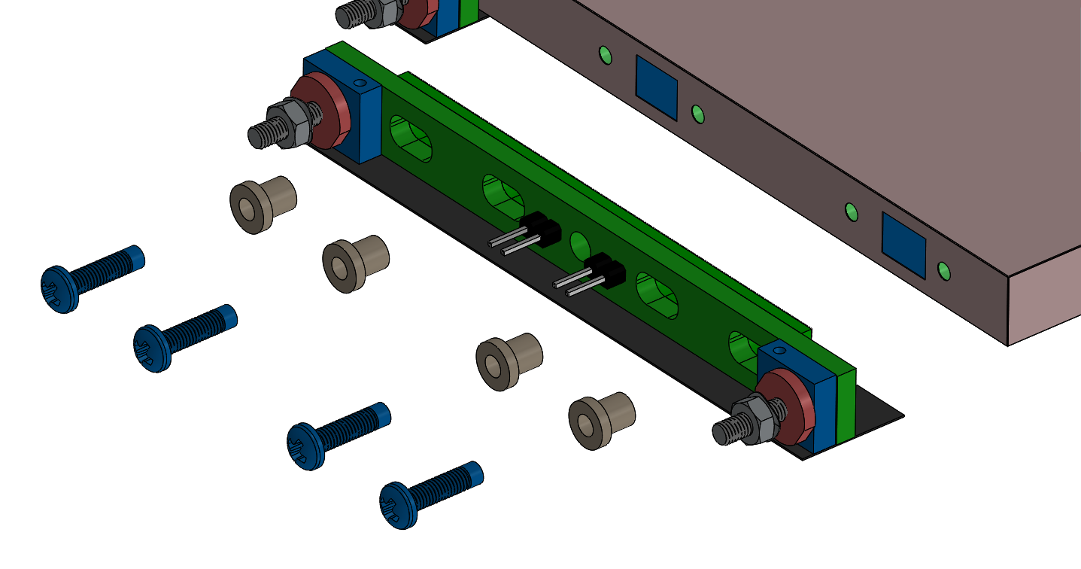
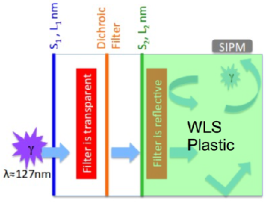
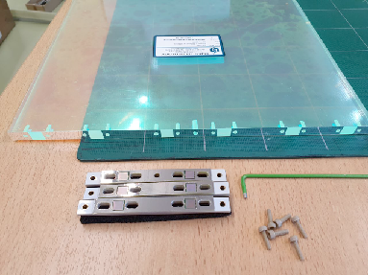
Light Readout (131.02.03.02.05) ArCLight – Igor Kreslo (Physicist, Bern)
Shifts UV light (128 nm) into visible light (425nm)
Wavelength shifting plastic (WLS) traps photons that pass through filters -> random photon movement until capture in Silicon Photomultipliers (SiPMs)
Rigid construction
Good spatial resolution
SiPMs windows
PCB with SiPMs attached to the ArCLight
446 mm
SiPMs
Three SiPM PCBs per ArCLight
Two SiPMs per PCB
Six SiPMs per ArCLight
300 mm

Slide 53
Module Structure (131.02.03.02.01) Feedthroughs and Instrumentation - Roger Hanni (ME, Bern)
Backside of Anode
Feedthroughs
4-way cross conflat flange ports (2x) to bring out detector electronics
Instrumentation
Given the open modules, all cryogenic instrumentation can be part of the cryostat system
For the light and charge readout, the front end electronics can be used to monitor status
Temperature monitors close to the ASICs and in the volume immediately above and below the TPC to monitor heat flow
The temperature monitoring can be achieved with a string of PT100 4-wire sensors mounted behind the anode tiles, in close proximity to the ASICs
Produced in multiple sections of flex connected together using Hirose connectors
Hirose connectors have shown good mechanical results in LN2
Instrumentation RO enclosure and GAr return
5X HV Feedthrough
Charge RO electronics enclosure
Light RO electronics enclosure

Slide 54
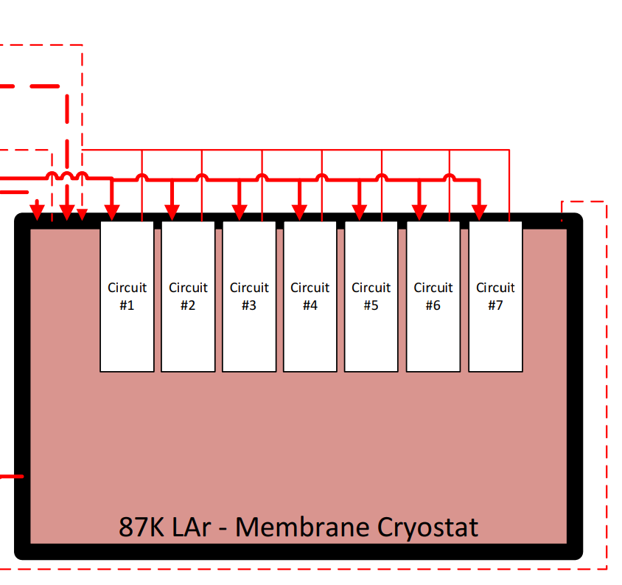
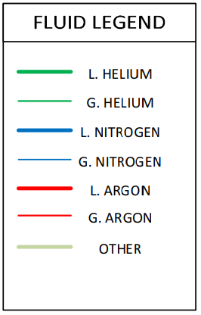
Module Structure (131.02.03.02.01) Cryogenics and Module Support - Roger Hanni (ME, Bern)
Support plate for module attachment as well for mounting clips for cryo-line routing or electronics routing
Liquid lines terminate below LAr liquid surface
Modules and cryostat share common LAr bath
Each module receives a purified LAr supply

Slide 55
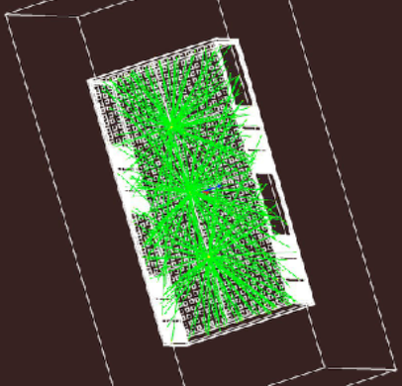
Calibration (131.02.03.02.06) Charge & Light Readout – Kendall Mahn (Physicist, MSU) & Nikolay Anfimov (Physicist, JINR)
Suspend diffuse source in LAr drift region
Light input via optical fiber that is routed to warm feedthrough
Location TBD based on simulation
Rock muons
Plentiful source for charge calibration
Used in similar fashion to cosmic rays found in other large LArTPCs
Exploring additional techniques such as embedded ionization sources – similar to FD calibration
Rock Muons

Slide 56
Module Assembly Single Module
Assemble cathode and field cage structures
Insert anode assemblies into field cage structure
Assemble charge and light readout to anode support

Slide 57
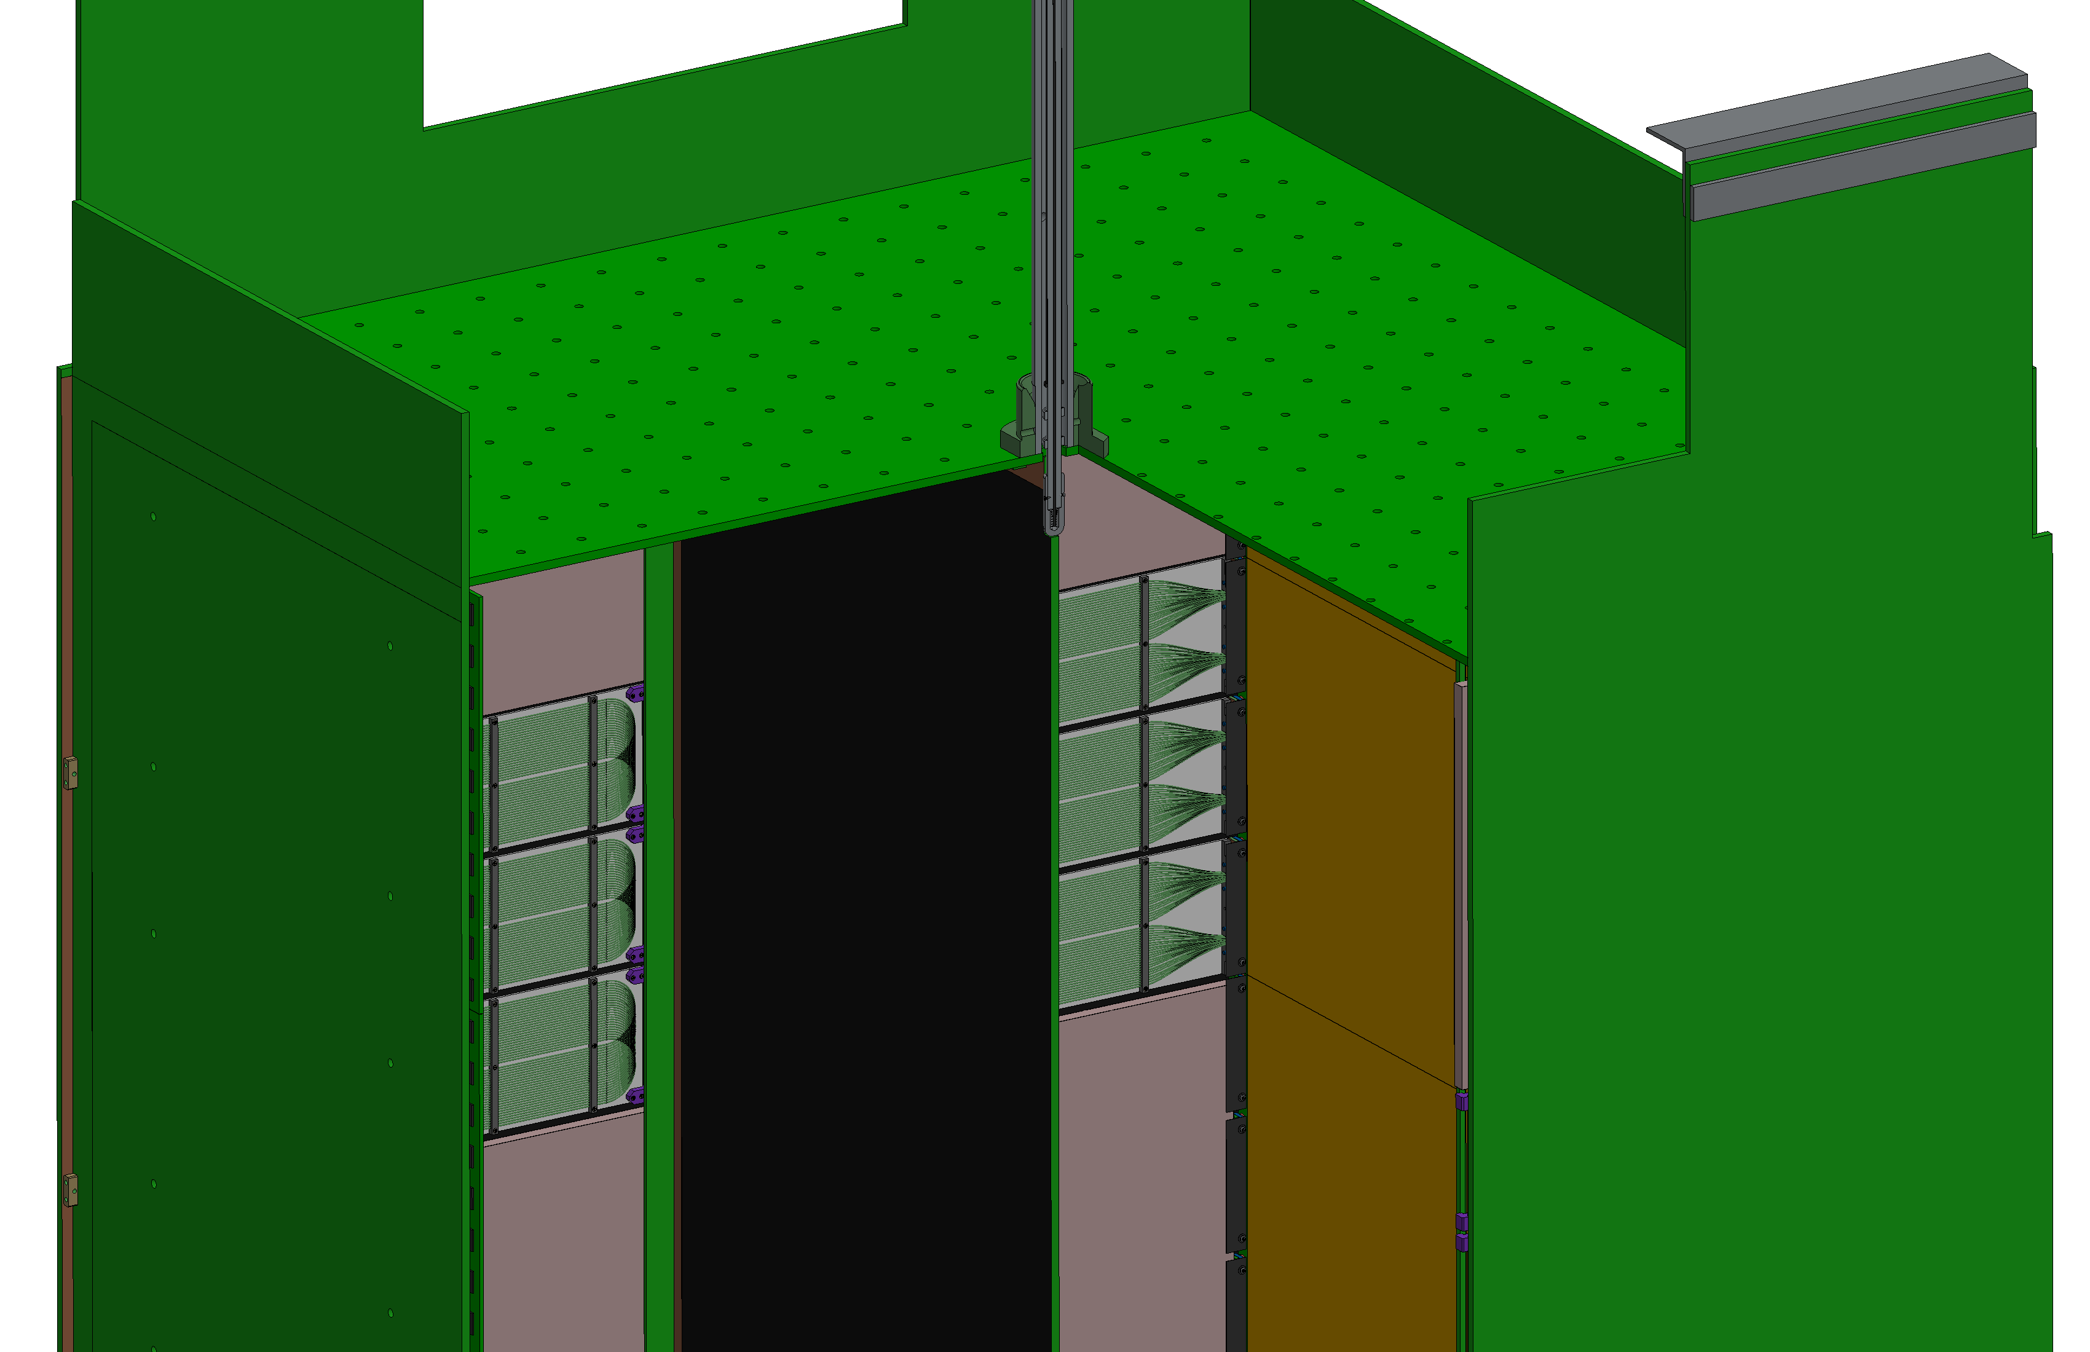
Module Assembly Single Module
Each completed module is warm and cold acceptance tested in dedicated single module cryostat at the Module Integration Facility
Functional and operational testing to verify performance of all subsystems
After successful acceptance testing, modules are packaged and sent to the Near Site surface building for integration into module rows

Slide 58
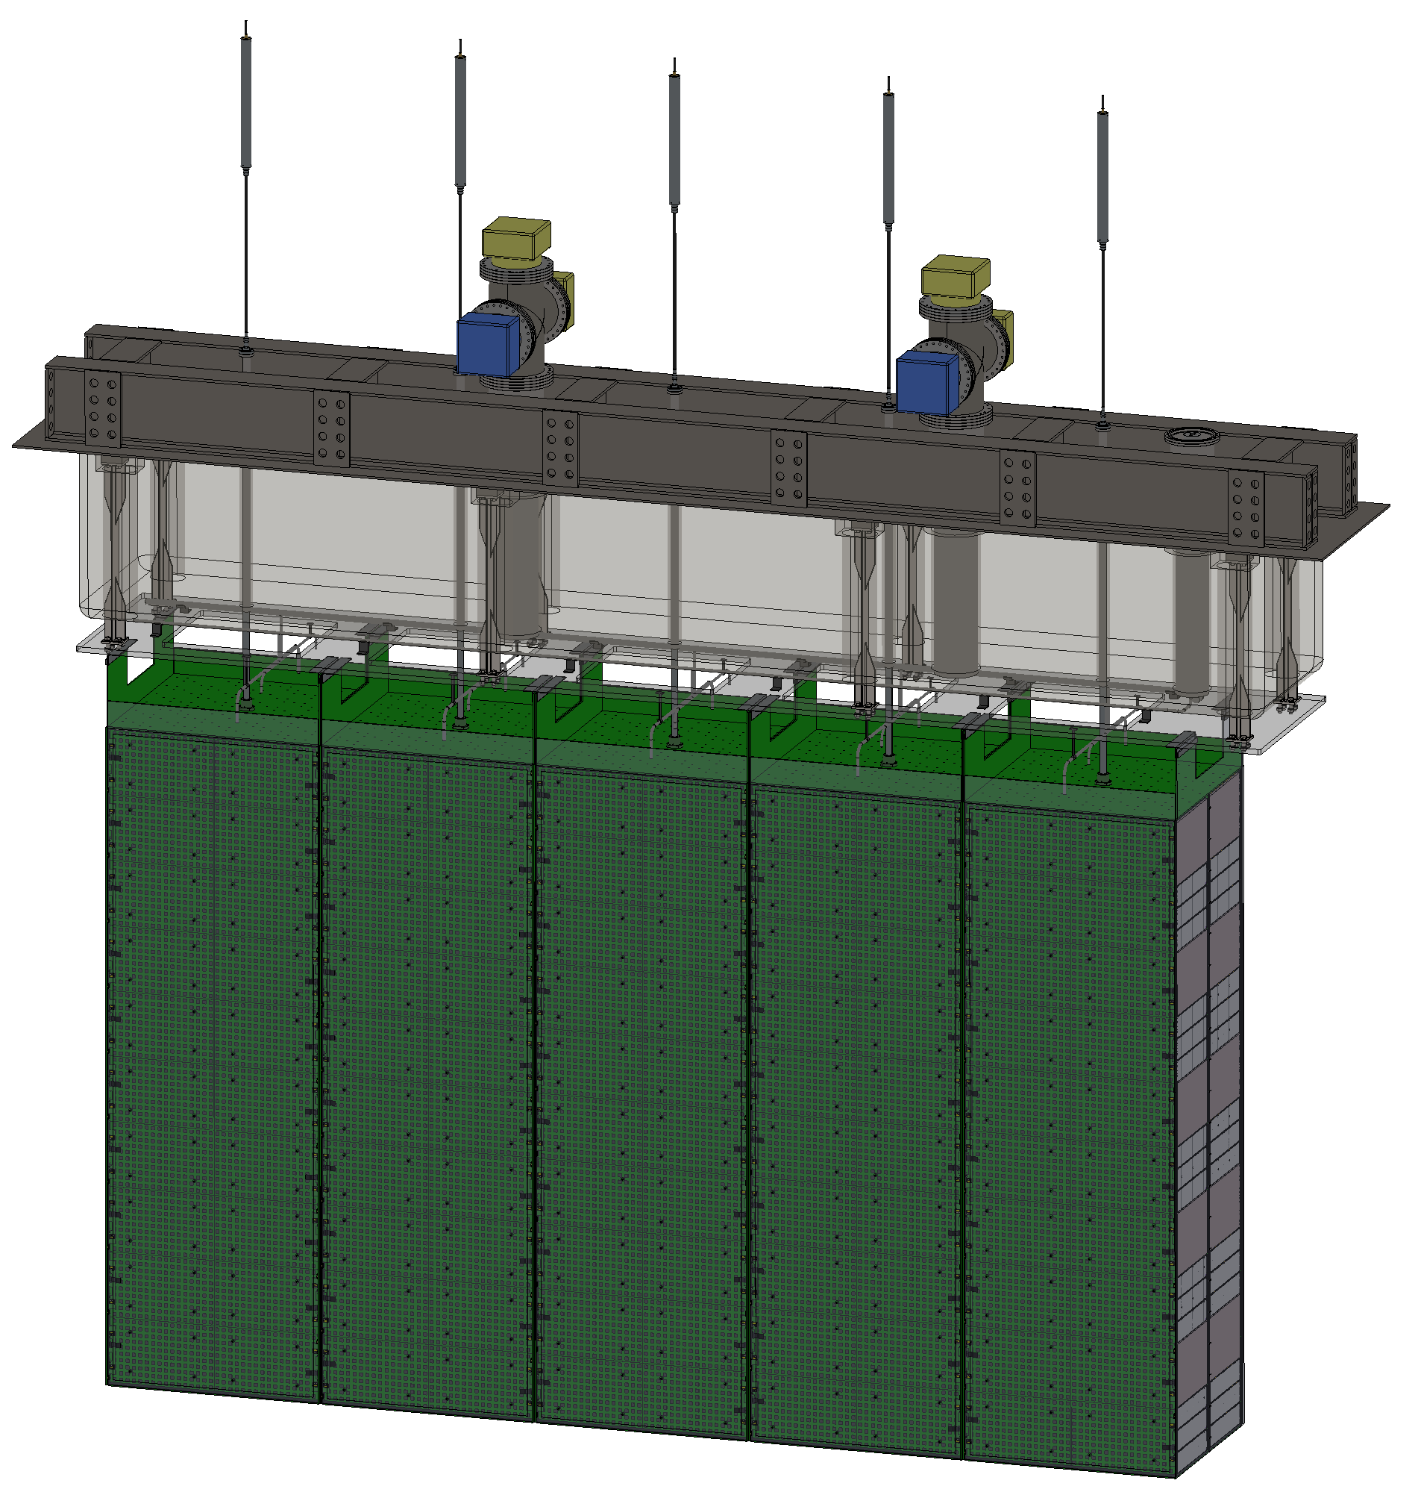
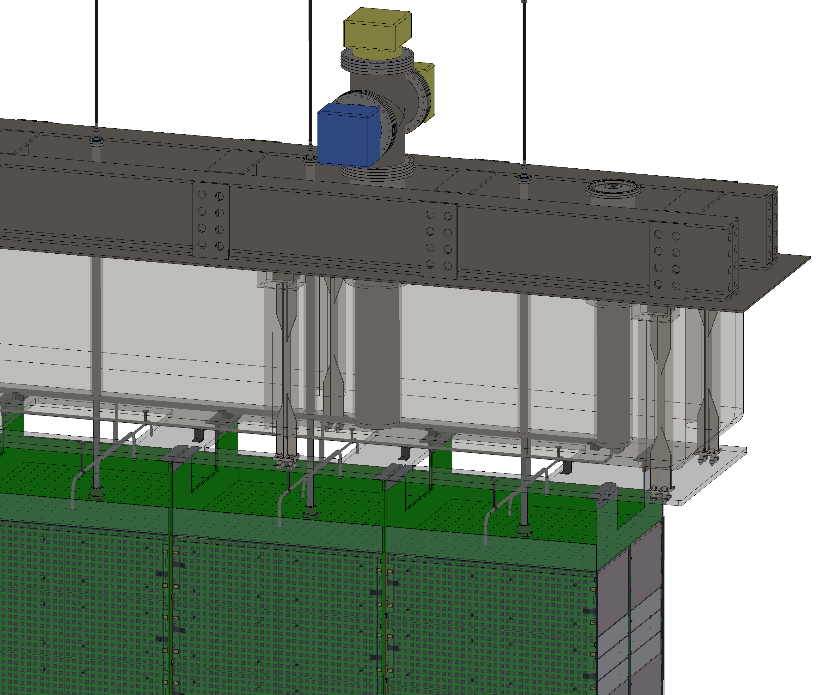
Module Assembly Module Row
Module rows are integrated at Near Site surface building for lowering to caverns and installation to Lar Cryostat

Slide 59
TPC Integration (131.02.03.02.07) Module Integration Facility – Jay Jablonski (ME, CSU)
Assemble, test, qualify, package & deliver 40 full-scale Near Detector LArTPC modules
Assemble full-scale modules: receipt of subsystems to module testing and acceptance
Warm and cold testing (LAr)
Charge and Light Readout
DAQ
Calibration
Cryogenics
HV & Field
Qualify and accept full module
QA testing embedded in assembly process
Final acceptance testing
Package module(s) for storage/transport

Slide 60
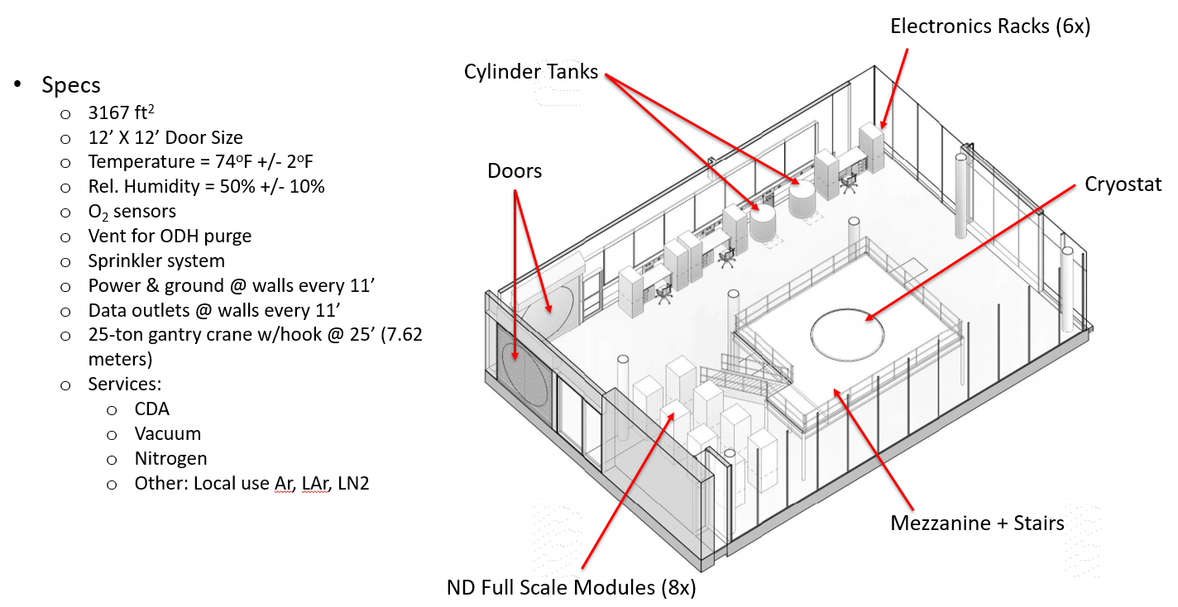
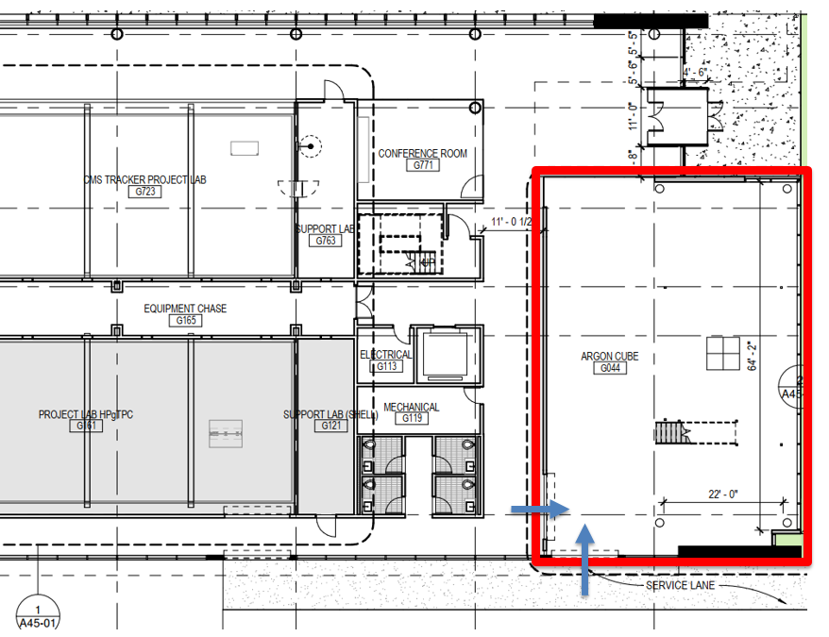
TPC Integration (131.02.03.02.07) Module Integration Facility – Jay Jablonski (ME, CSU)
High-bay sufficient for ~4m-tall module assembly
Cryostat(s) capable of hosting ~4m x 1m x 1m module
Crane with ~4m clearance above cryostat for module installation/removal
System for LAr purification, recirculation, and cooling
Cleanroom for module assembly

Slide 61
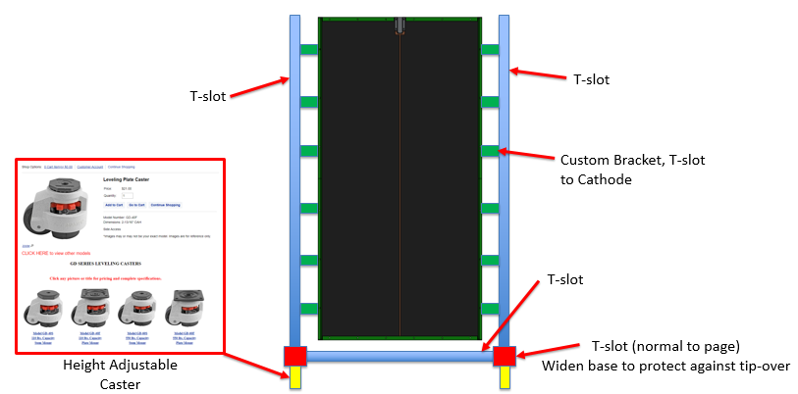
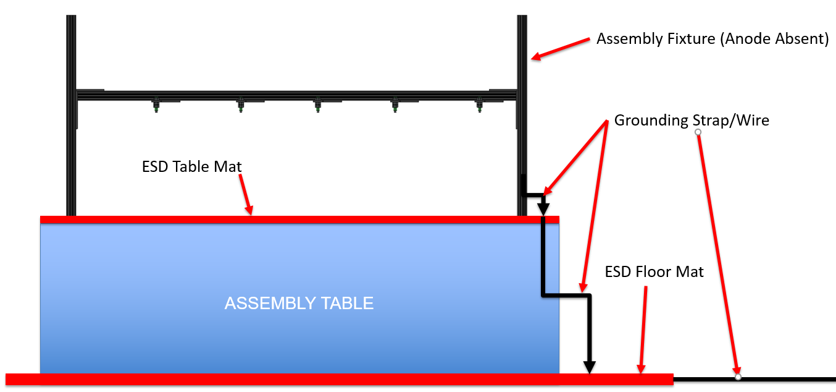
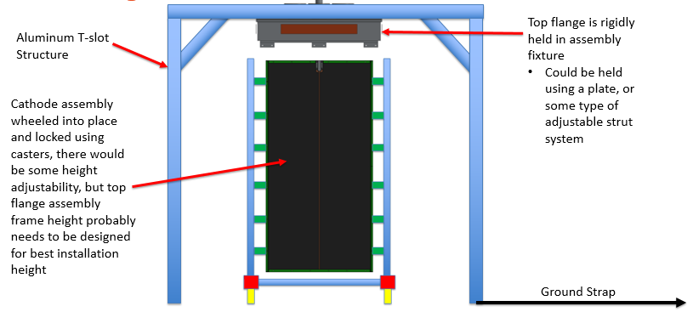
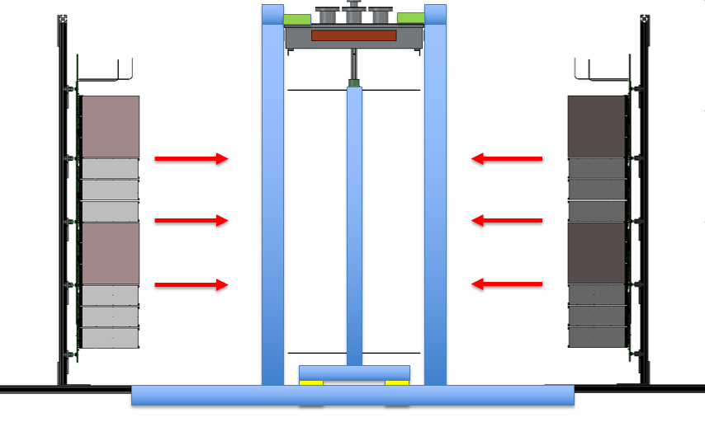
TPC Integration (131.02.03.02.07) Module Integration Facility – Jay Jablonski (ME, CSU)
Design and fabrication:
Assembly fixtures
Handling fixtures
Lifting fixtures

Slide 62
Interfaces
N² Matrix
 | Module Structure |  | High Voltage |  | Field Structures |  | Charge Readout |  | Light Readout |  | Calibration
Module Structure |  |  | 1 |  | 1 | 2 | 1 |  | 1 |  | 1
 |  |  |  |  | 3 |  | 3 |  | 3 |  | 3
High Voltage | 1 |  |  |  | 1
Field Structures | 1 | 2 | 1 |  |  |  | 1 |  | 1 |  | 1
 |  |  | 3
Charge Readout | 1 |  |  |  | 1 |  |  |  | 1
 |  |  |  |  |  |  |  |  |  |  |  | 4
Light Readout | 1 |  |  |  | 1 |  | 1 |  |  |  | 1
 | 1 |  |  |  |  |  |  |  |  |  |  | 4
Calibration | 1 |  |  |  | 1 |  |  |  | 1
Interface documents for LArTPC managed within LBNL Windchill document system with final release to EDMS – documentation in development
Critical Interfaces: Module Structure, Field Structure, Charge Readout, Light Readout
Version control with official review & approval process
Mechanical = physical connection of some kind, i.e. CFF or electrical connector
Mass Flow = flow of some medium, in this case probably argon liquid/gas
Energy Flow = flow of heat or electrical energy, i.e. heat leak into LAr or HV power signal
Information Flow = transfer of some type of data, i.e. standard point source light emission for light RO calibration

Slide 63
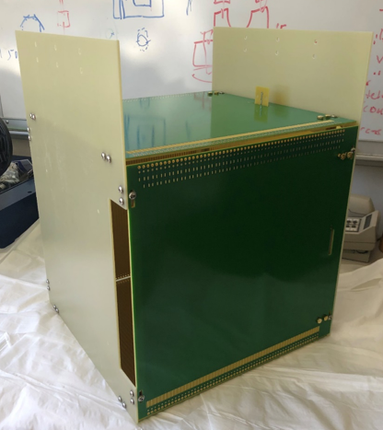
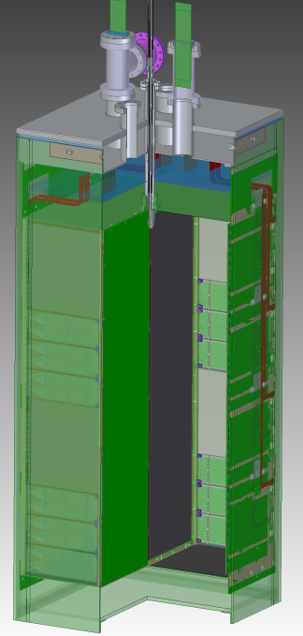
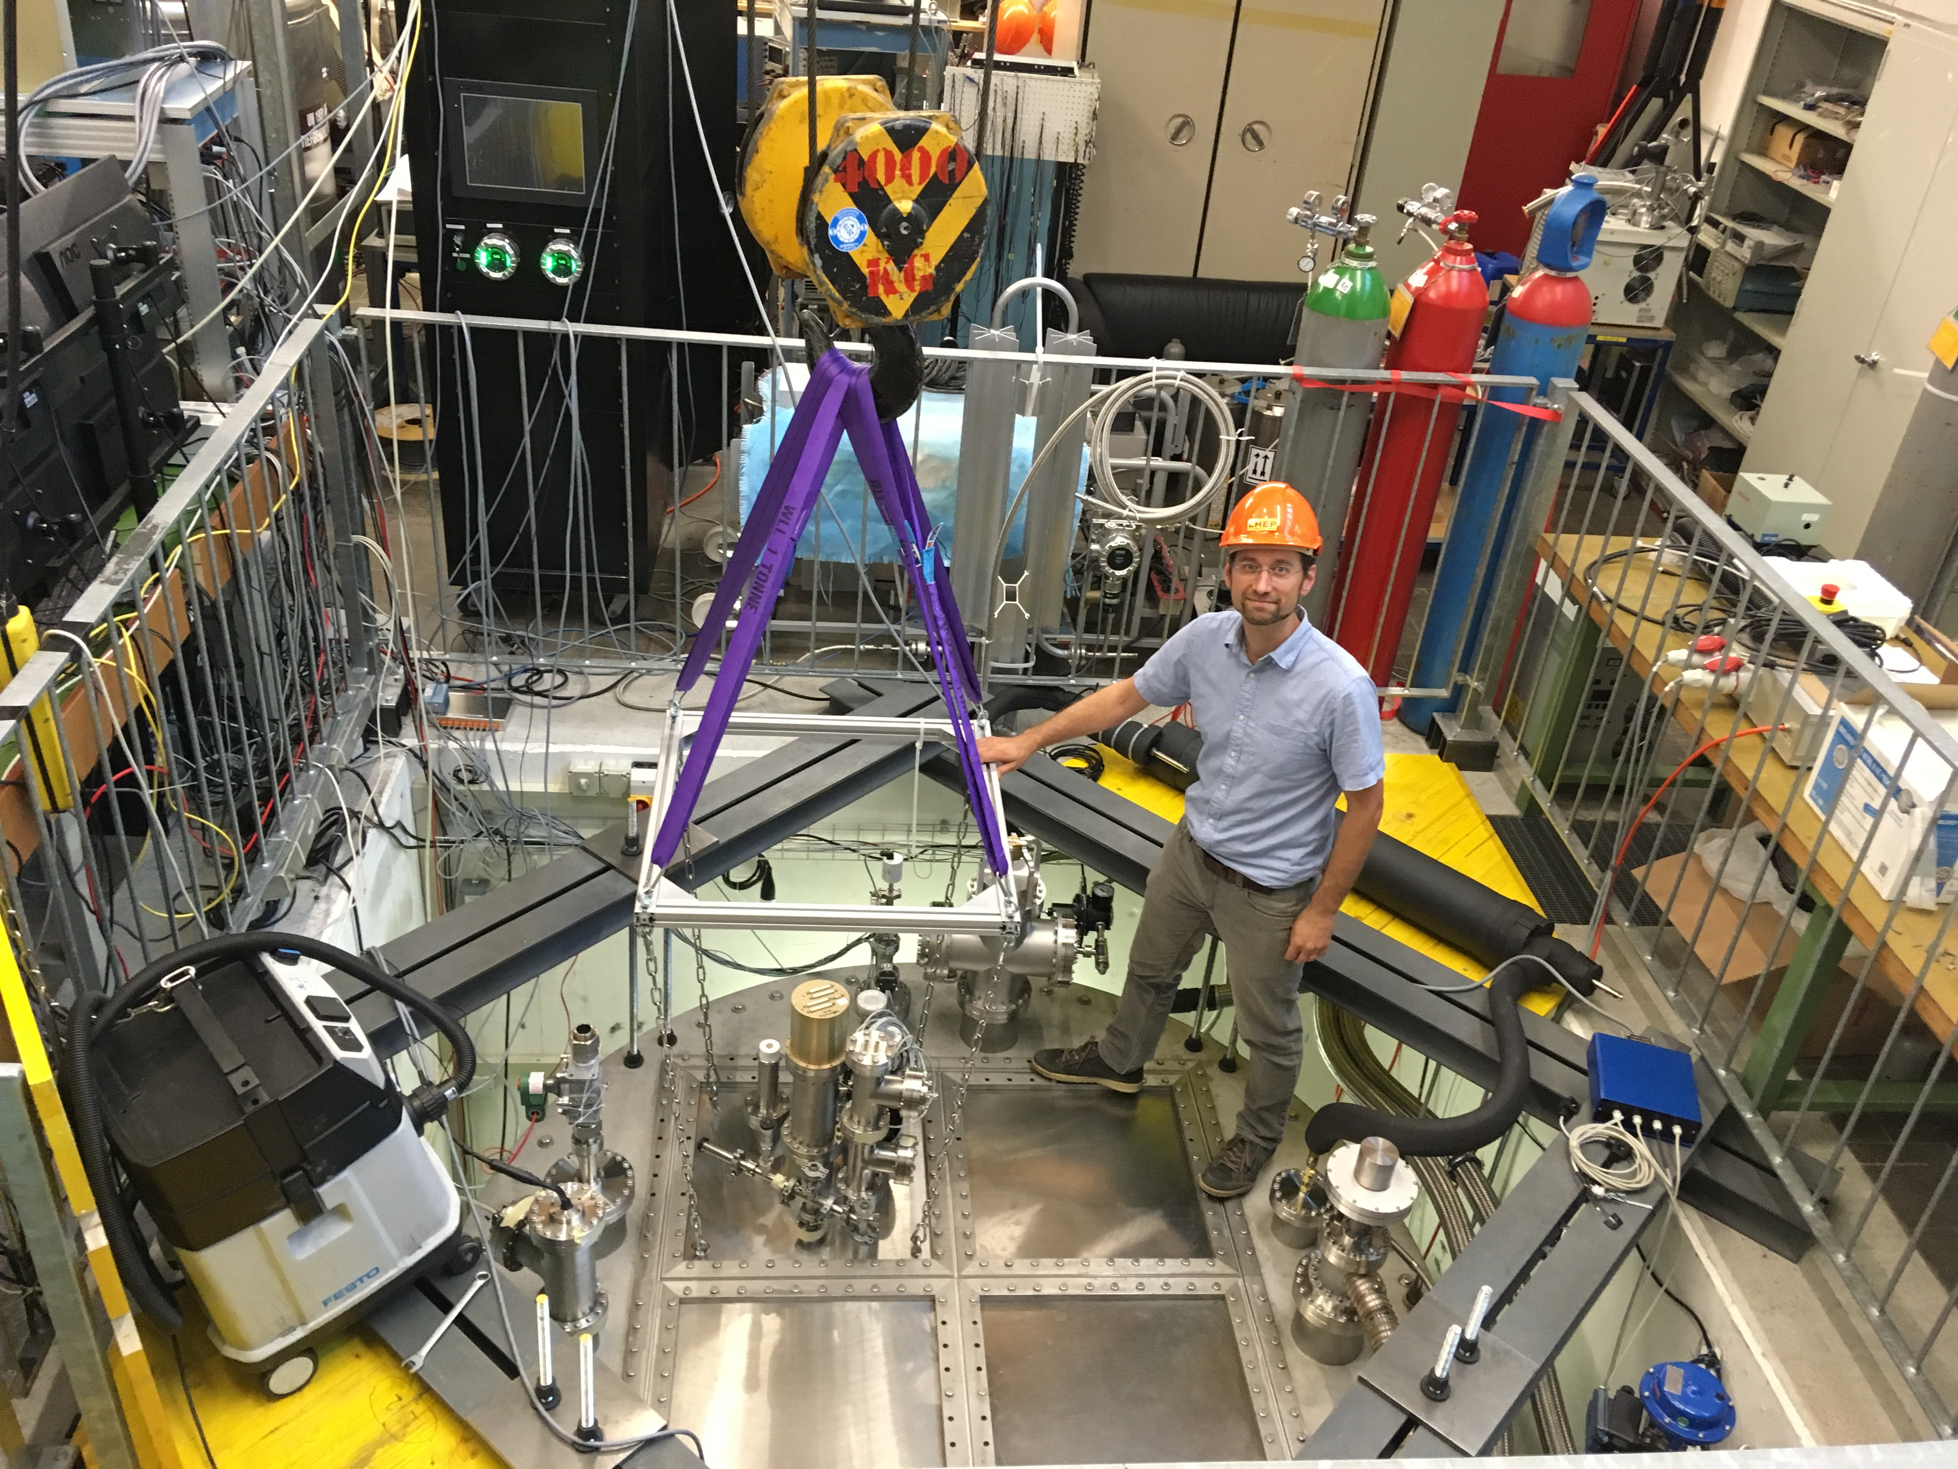
Prototyping Plans
Significant prototyping efforts already completed and planned for LArTPC modules prior to production at the Module Integration Facility (red denotes in-kind contributions)
SingleCube -> ArgonCube Module0 -> ArgonCube 2x2 -> Full Scale Demonstrator (FSD)
Additional smaller subsystem prototyping to develop the technologies for the above integrated prototypes
Dr. James Sinclair: ND LAr Detector Prototyping Program talk @ 11:45AM CDT
DUNE Project
SingleCube
Module 0
2X2
FSD

Slide 64
Engineering Analyses Completed, Ongoing, & Planned
To supplement the experimental prototyping, additional engineering simulations are planned
Completed (see right)
CFD simulation: perforated field cage pressure drop and flow → study proposed perforation pattern and determine impedance to LAr flow → found impedance is negligible compared to LAr liquid head
Ongoing
FEA simulation: effect of field cage perforations on electric field within module → determined flow impedance is OK, now check effects on E-field → being done for Module 0 geometry & will extend to full-scale
Planned
FEA simulation: thermal-structural simulation of full ND module and full ND module row → thermal incursion and thermal stresses at operating conditions, gravitational loading for lifting and handling of ND module and ND module row, and identification of resonant frequencies
CFD simulation: fluid dynamic simulation with conservation of energy (heat) to determine liquid argon circulation patterns within single ND module
Flow through perforations
Pressure drop across perforations
ANSYS FLUENT

Slide 65
Summary
A consistent and feasible conceptual design for the ND-LAr cryostat and ND LArTPC has been developed
Optimization of the cryostat and detector modules are driven by Near Detector physics needs
Effective engineering integration has been established between ND LAr consortium, LAr cryostat group, LBNF cryo group, and DUNE-ND Integration & Installation team
ND LAr Consortia engineering teams for the LArTPC are established and have been effectively working together throughout the ArgonCube Module 0 and 2x2 prototyping effort -> continuity of expertise
Ready to enter Preliminary Design Phase to further detailed design, finalize interfaces and create preliminary drawing packages

Slide 66
v2 changes…
Revised heat load estimates for the cryostat (slide 9)
Consolidated warm structure design slides (slide 11)
Consolidated warm structure concept drawing slides (slide 12)
Updated composite window image (slide 14)
Updated the ArgonCube Module Lid view to include 5X HV inputs (slide 22)
Added a note that the modules and cryostat share a common LAr bath, removed row baffles (slide 54)
Added an engineering analyses slide (slide 64)

