Slide 1
DUNE CDR – Cryostat Structural Analysis
Giorgio Vallone
DUNE CDR: Near Detector
07-09 July 2020

Slide 2
Index
Introduction
Composite Window Design
Structural Analysis
Frame/Window Joint Design
Conclusion

Slide 3
Index
Introduction
Composite Window Design
Structural Analysis
Frame/Window Joint Design
Conclusion

Slide 4
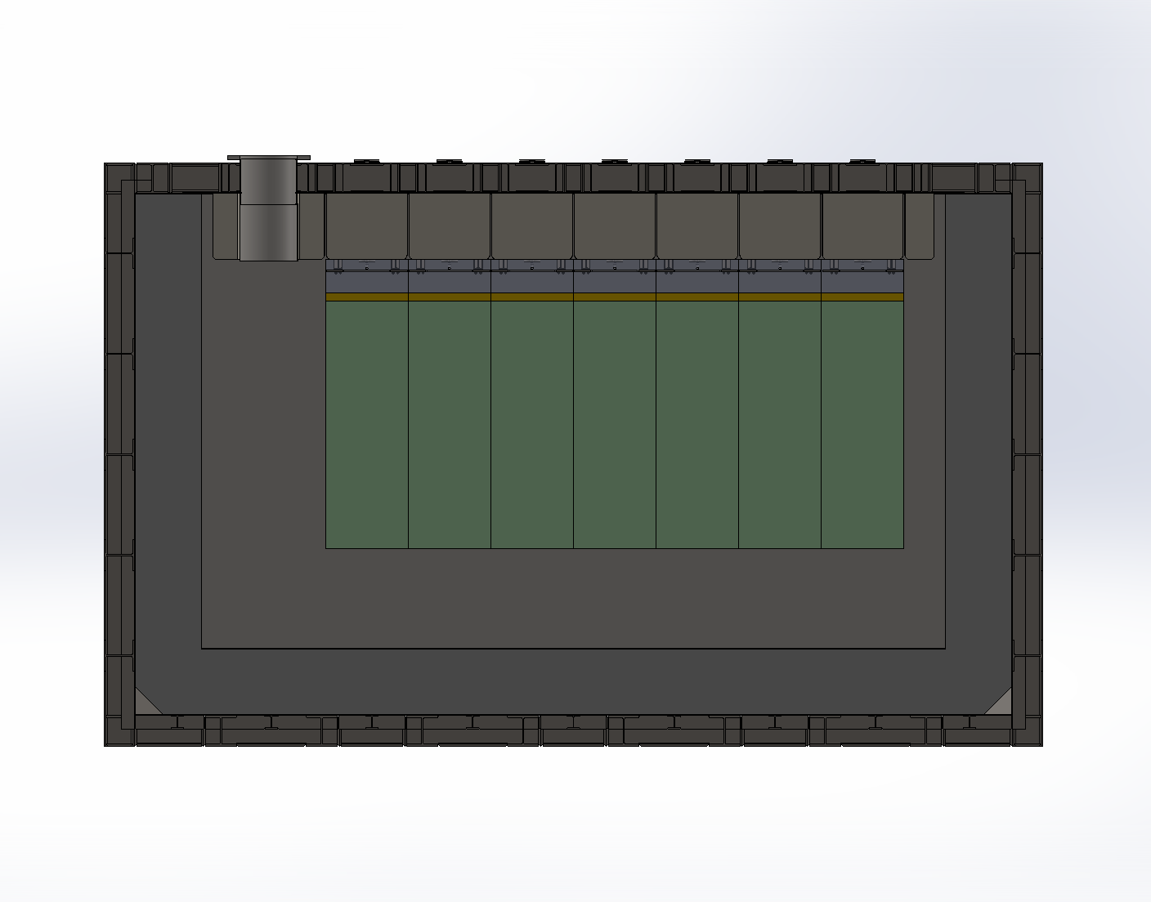
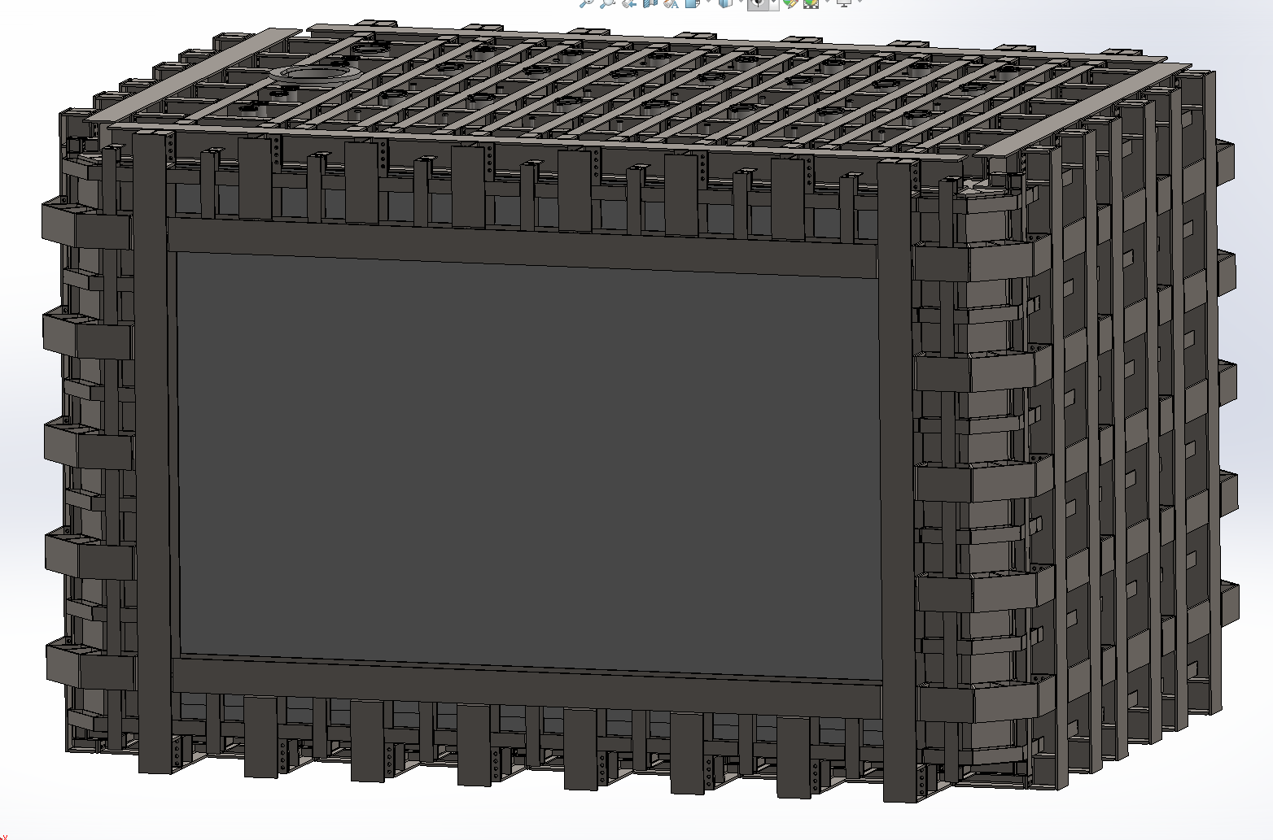
Cryostat Description
Steel Plate 1
Steel Plate 2
Steel Frame
Box Beams
Polyurethane
Liquid Ar
Detector
Composite Window
Liquid Argon enclosed by stainless steel plates / Polyurethane sandwich
One side covered by a composite window (described later) to reduce the impact on the particle beam
Window size: L8156*W3810*T372 (max)

Slide 5
Design Criteria – Applicable Guidelines
The design shall follow the applicable Fermilab Note (FESHM 5031.7: Guidelines for the Design, Fabrication, Installation and Testing of Metallic Membrane Cryostats)
A couple of important points:
If the structural support (…) is made of structural steel, then (…) ANSI/AISC 360 “Specification for Structural Steel Buildings” applies to the design and construction of the steel structure
The following standards (…) are used for the design, fabrication, installation and testing of metallic membrane cryostats: JGA RP-107-02) (…); British Standard BS EN 14620
Level of safety commensurate with ASME Boiler and Pressure Vessel Code, Section VIII as required by (…) 10 CFR 851 Worker Safety and Health Program
The design (…) shall be independently verified and certified by a U.S. licensed Professional Engineer (…) and submitted for review by the Large Quantity Liquid Argon Cryogenic Panel
Following these guidelines we will proceed as follows:
Design the steel structure according to one of the listed standards
Design the composite window following the ASME Boiler and Pressure Vessel Code, Section X – Fiber-Reinforced Plastic Pressure Vessels
Grade IV analysis (ASME BPVC Sec. VIII) + experimental tests to verify the joint between the two

Slide 6
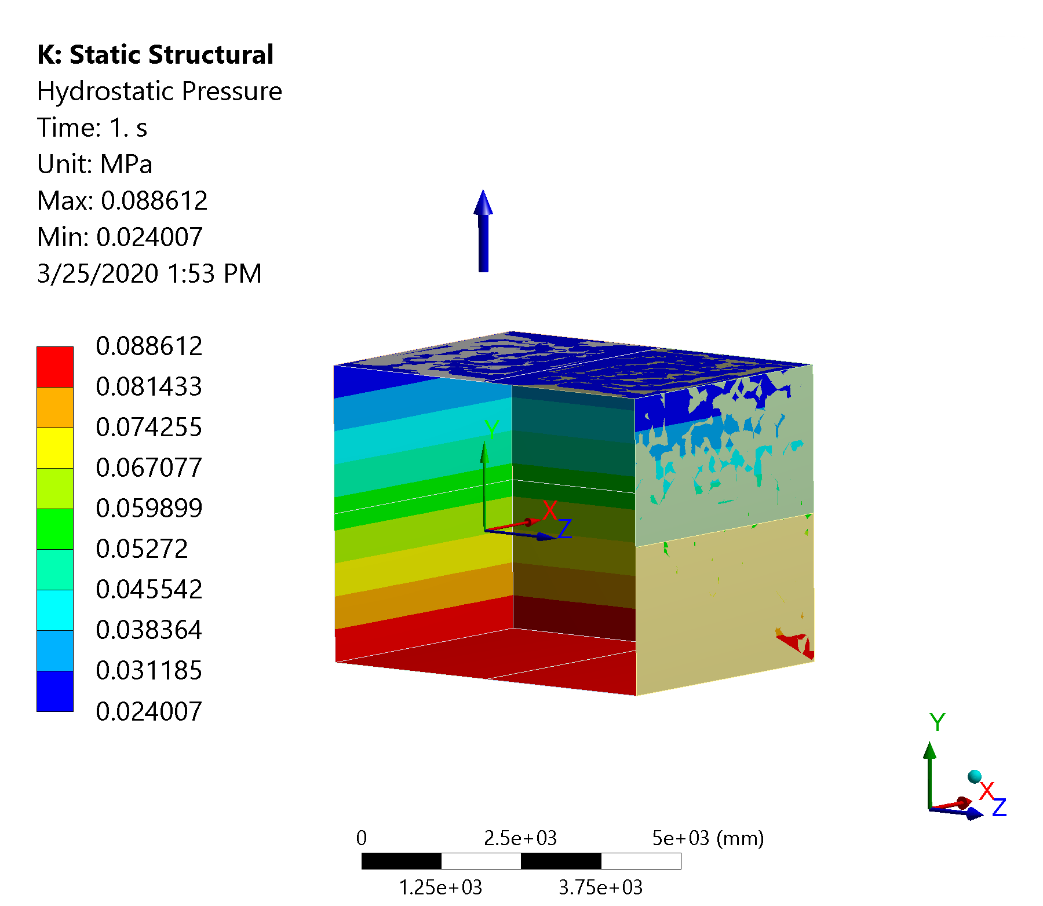
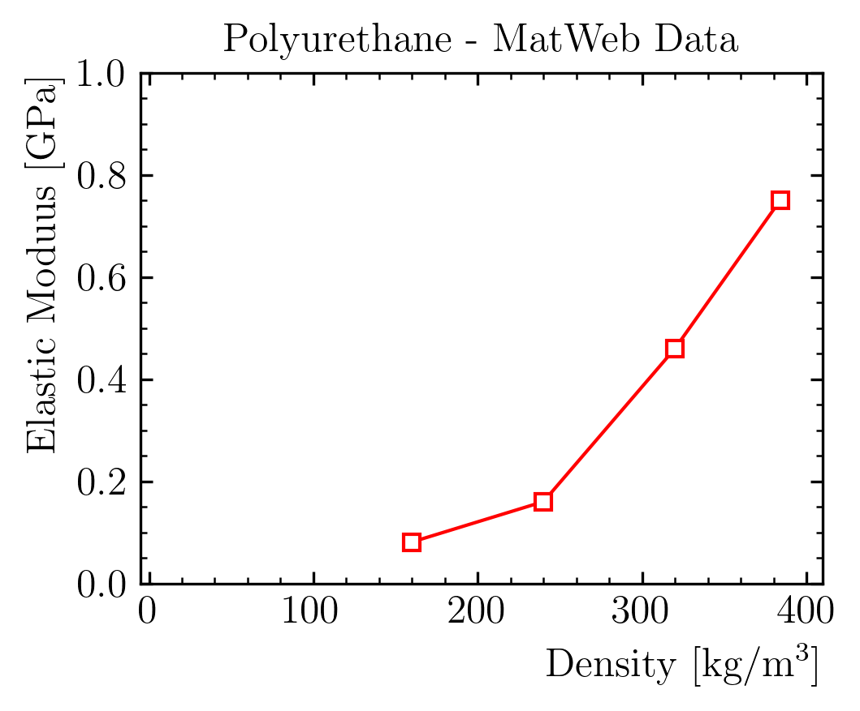
FEA Model Description – Geometry and Material Properties
Geometry:
YZ symmetry
Steel plates, frame: shell elements
Composite plate, foam: solid elements
Foam properties:
Density = 90 kg/m³
E = 10 MPa – Seems a reasonable order of magnitude
𝜈 $→$ 0.5 (incompressible)

Slide 7
FEA Model Description – Boundary Conditions and Loads
Boundary conditions:
Floor b.c. only on y, but probably friction will lock also the other directions
Everything bonded
Loads:
Liquid Argon Hydrostatic Load - Density = 1400 kg/m3 - Liquid Level Height = 4.5 m w.r.t. membrane floor
Overpressure Load = 350 mbar
Gravitational Acceleration

Slide 8
Index
Introduction
Composite Window Design
Structural Analysis
Frame/Window Joint Design
Conclusion

Slide 9
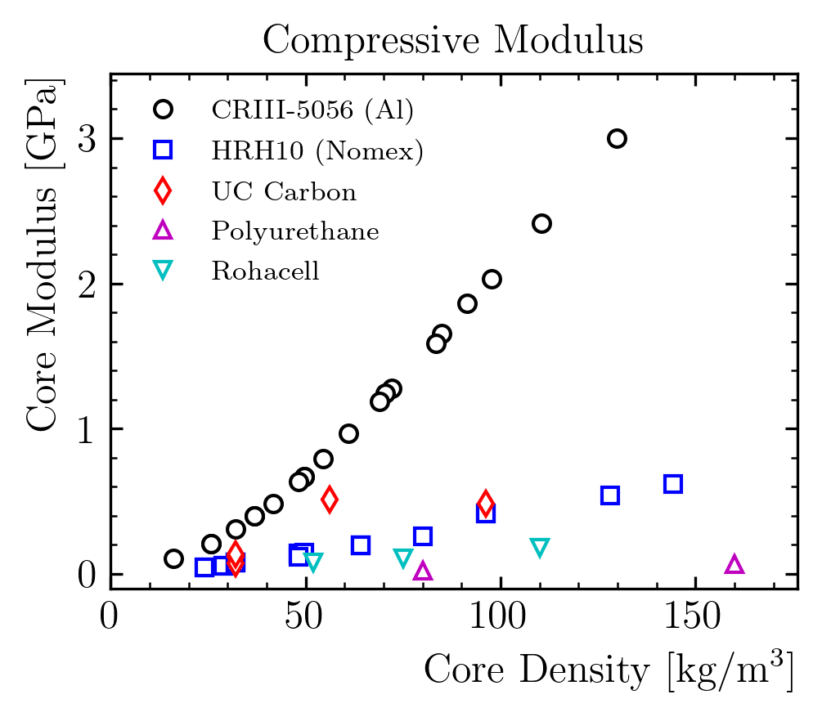
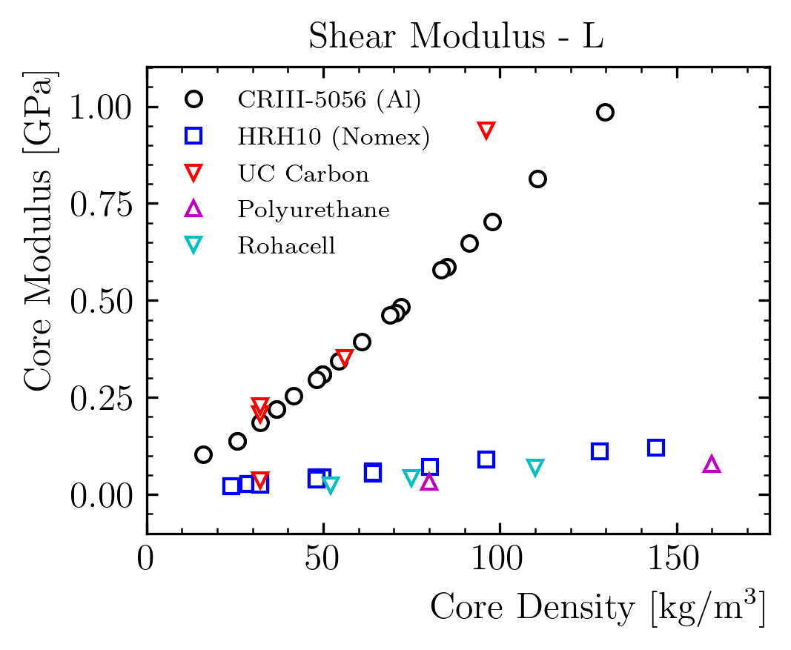
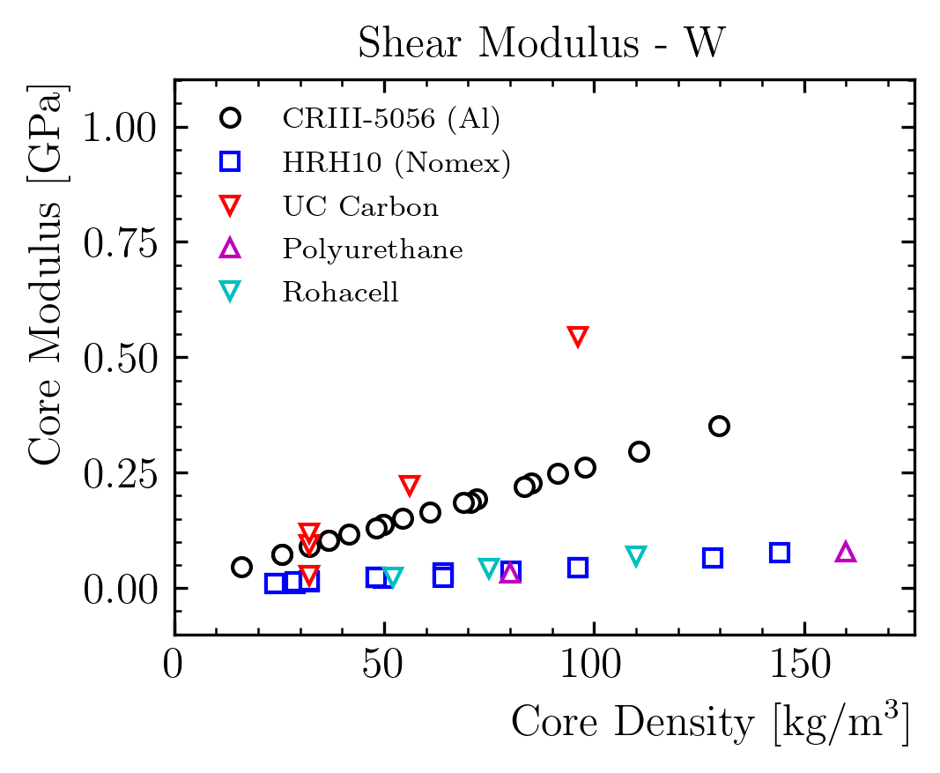
Window Design: Which are the Available Parameters?
Sandwich design
Better than locally stiffened designs for distributed loads (e.g. pressure)
Available parameters:
Skin thickness / Core thickness
Skin material
Core material
Carbon and Aluminum outperform other materials, but they are much more expensive

Slide 10
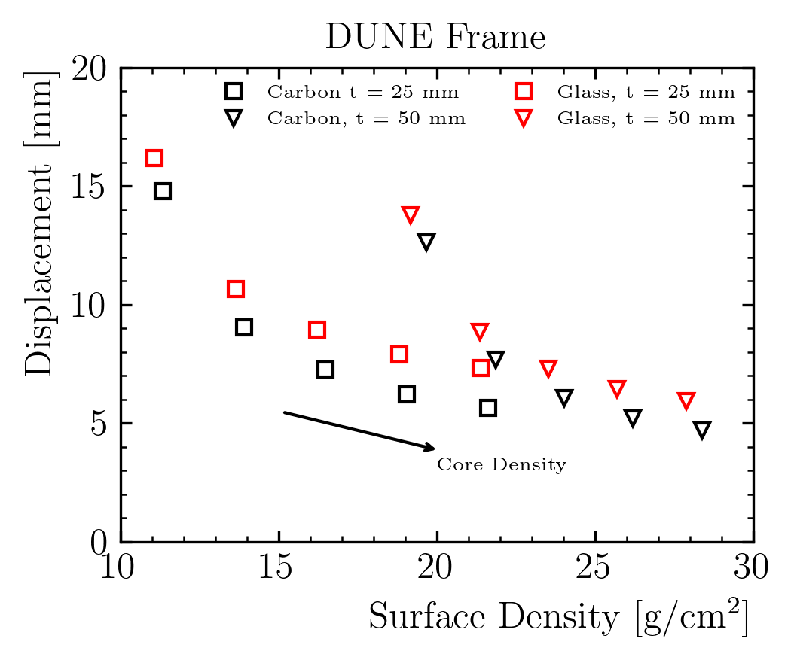
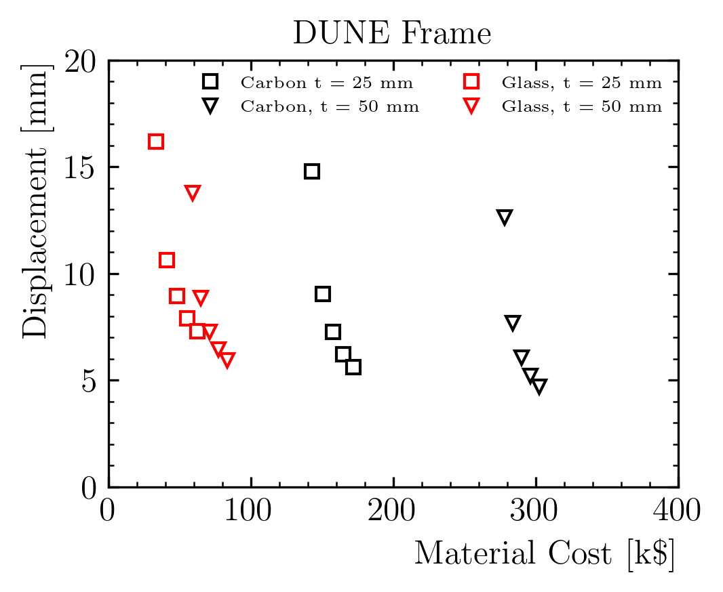
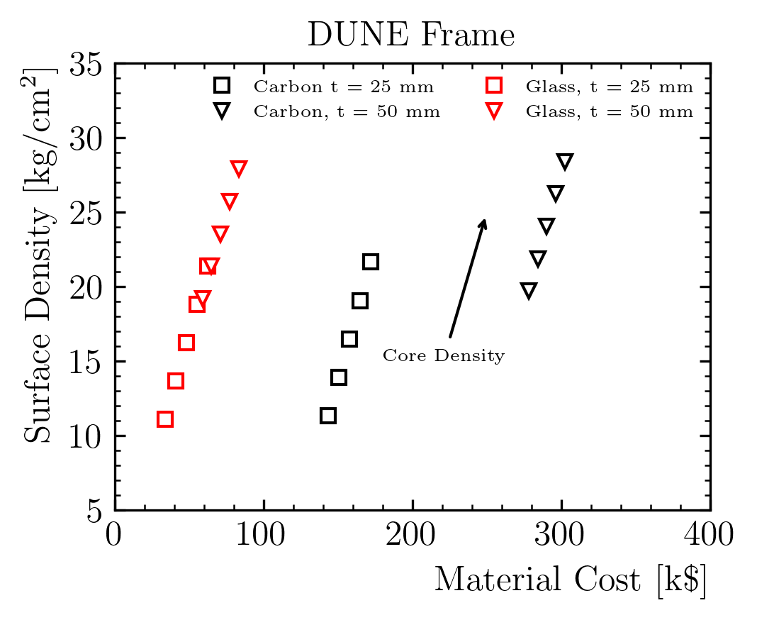
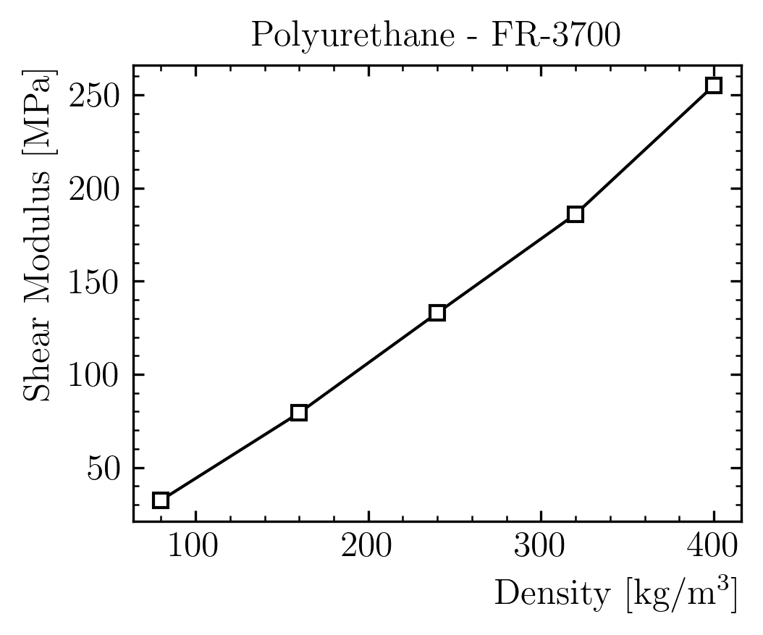
Window Design – Design Space as function of the Parameters
Only solutions with u<10 mm
Parameter space:
Skins in Glass/Carbon Fiber, 25 or 50 mm thick.
Polyurethane core, density from 80 to 400 kg/m³
Carbon fiber costs more but does not bring advantages considering the design requirements
Total mass/attenuation is more important than radiation length
Design point: G10 skin, 25 mm thickness, 250 kg/m3 polyurethane
Trade off between surface density and displacement

Slide 11
Window Design: Surface Density Contribution of the Window
Layer | Material | thickness | rho | rho*t | Contrib.
/ | / | mm | kg/m³ | g/cm² | %
Liquid | Argon | 300 | 1396 | 41.9 | 62.7%
Plate | Steel | 2 | 7000 | 1.4 | 2.1%
Insulation | Polyurethane | 808 | 90 | 7.3 | 10.9%
Window | Composite | 372 |  | 16.2 | 24.3%
Steel Avg. | Steel | 58.3 | 7000 | 40.8
Steel Max. | Steel | 372 | 7000 | 260.4
Total |  |  |  | 66.78 | 100%
Surface density of each component
Target (total) is ~ 50 g/cm²
Composite window contribution ~ 16% of the total
Advantage on steel:
factor ~2.5 on average
1 order of magnitude on the beam locations

Slide 12
Index
Introduction
Composite Window Design
Structural Analysis
Frame/Window Joint Design
Conclusion

Slide 13
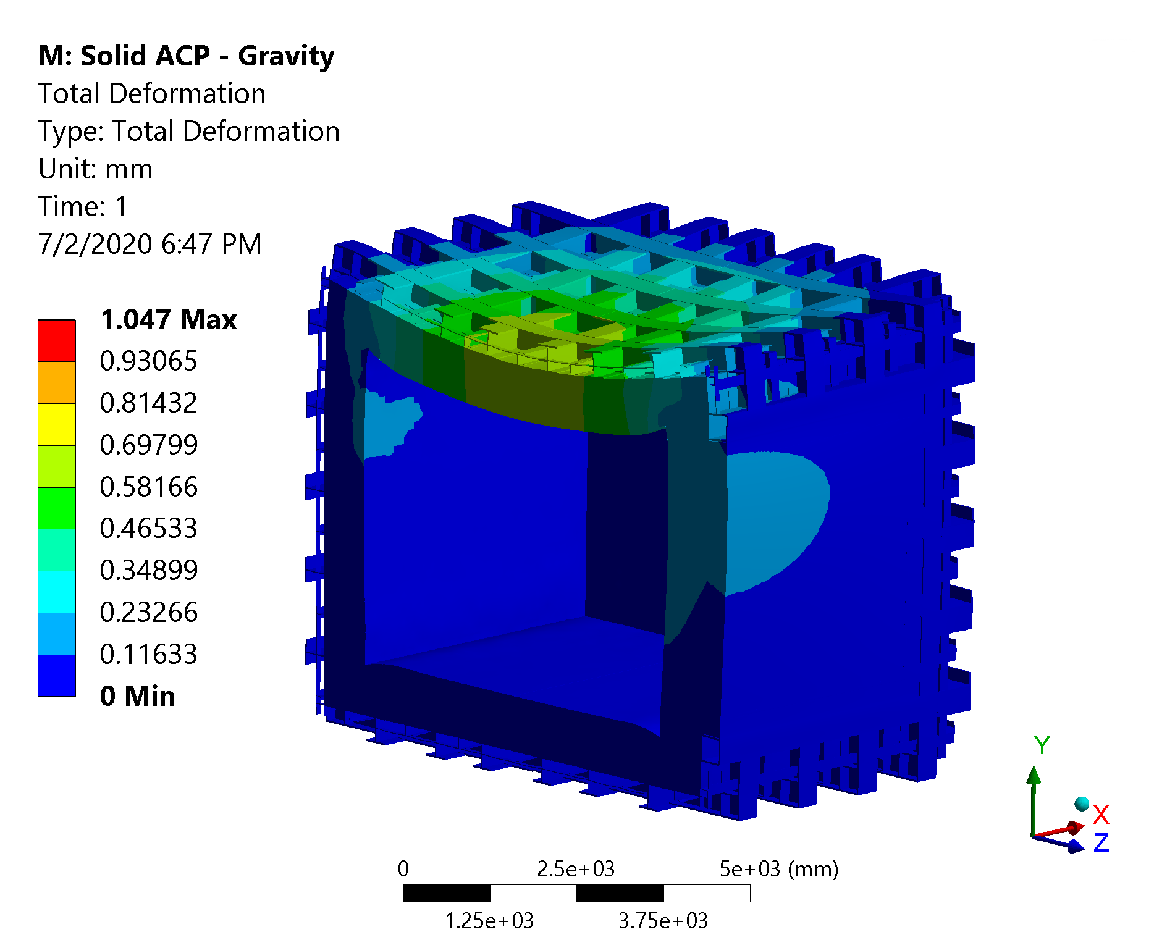
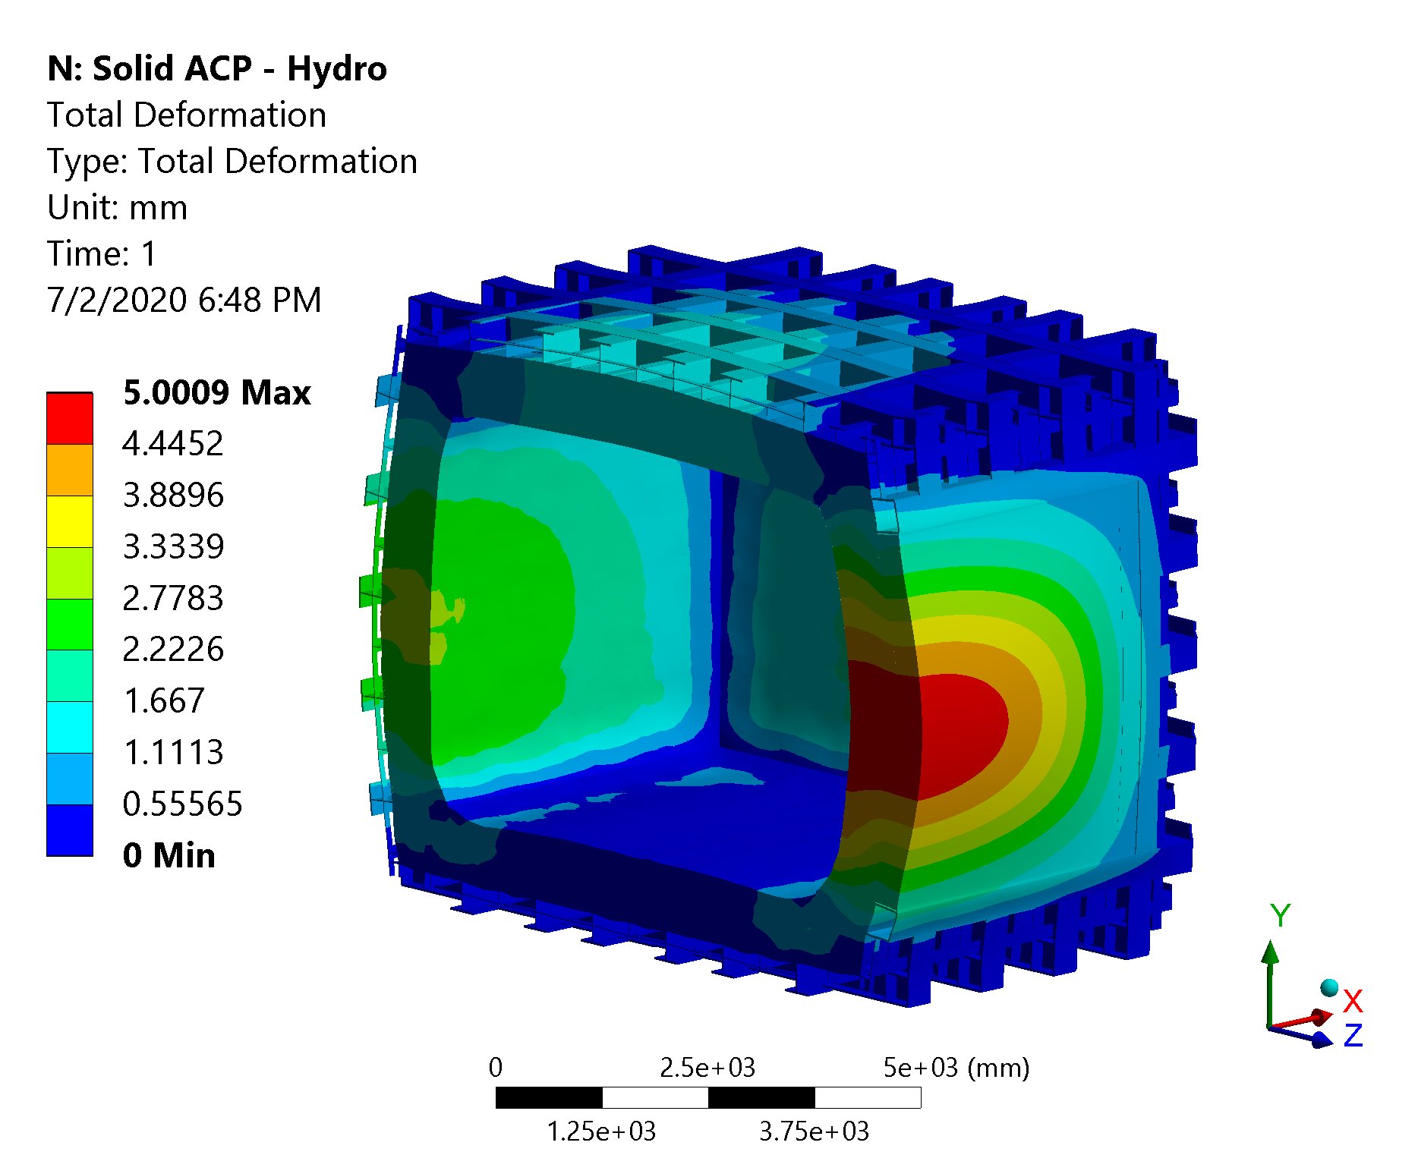
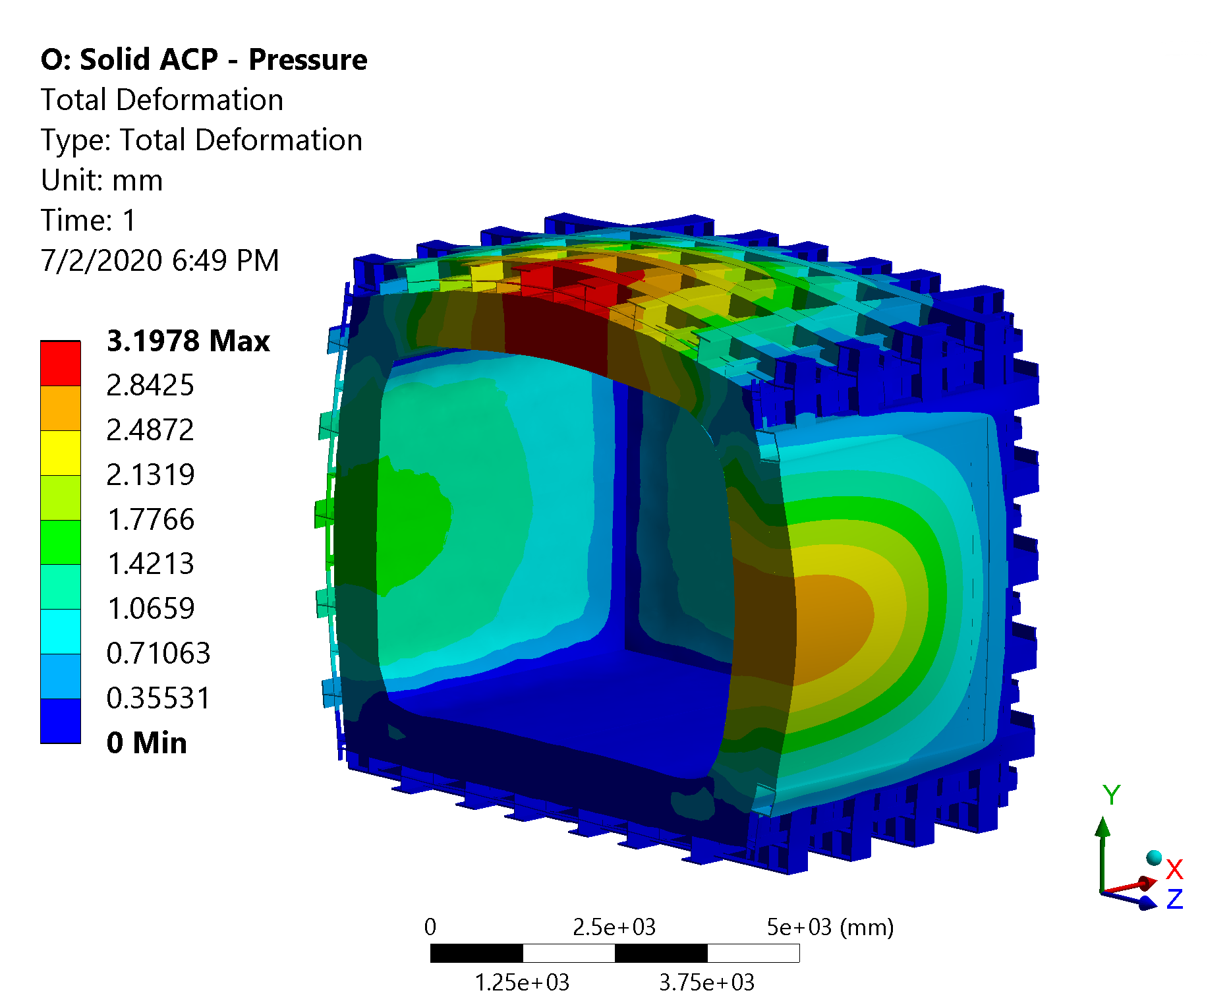
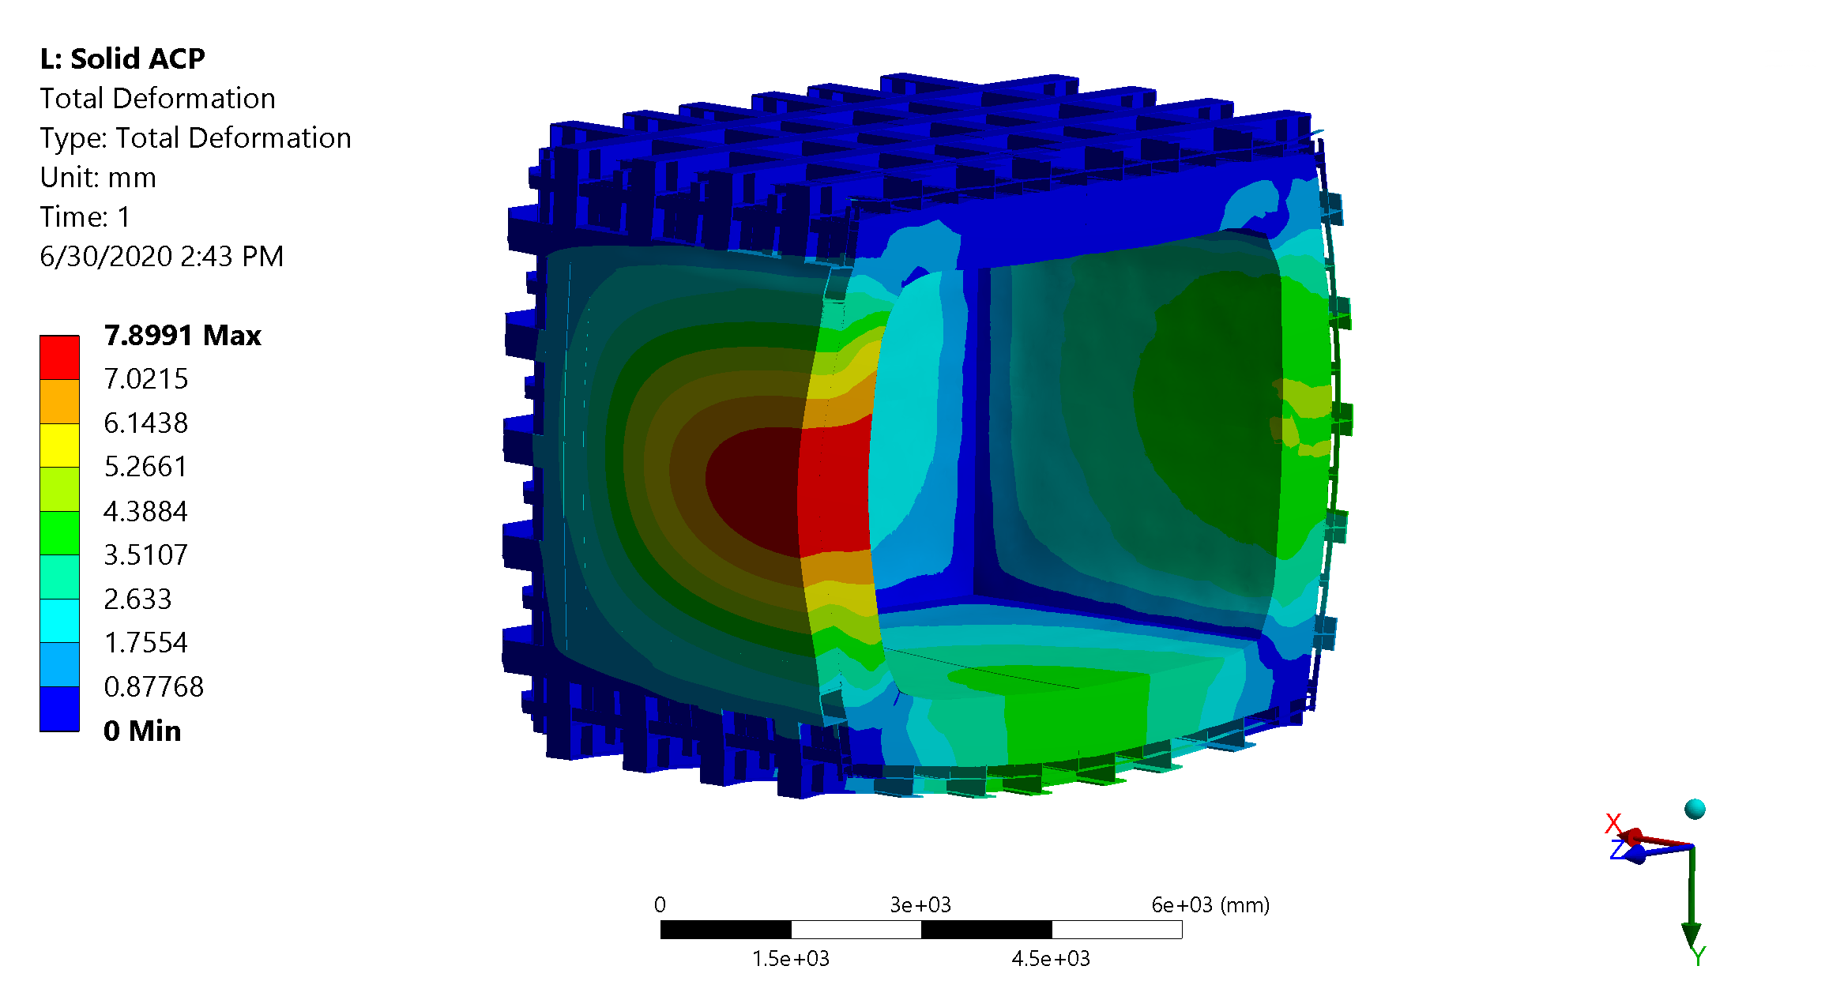
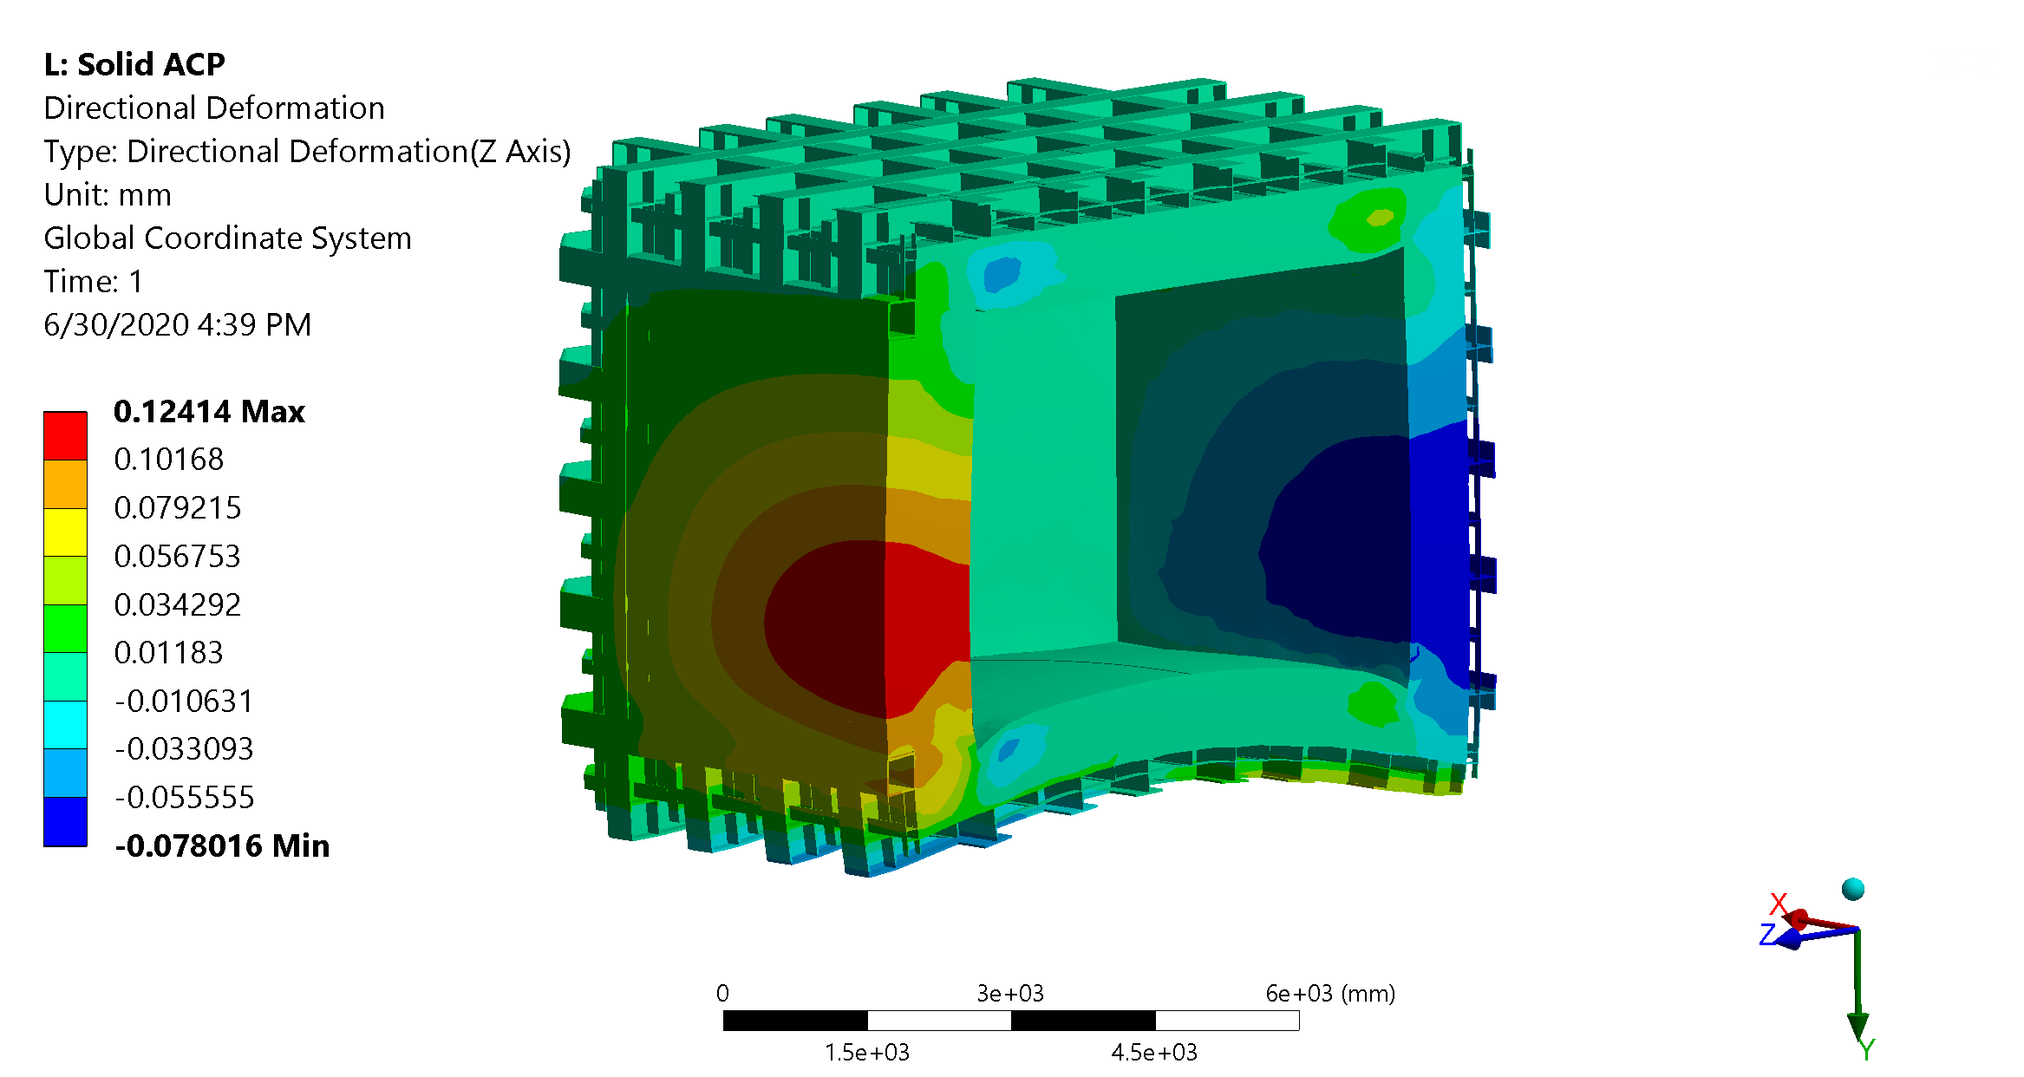
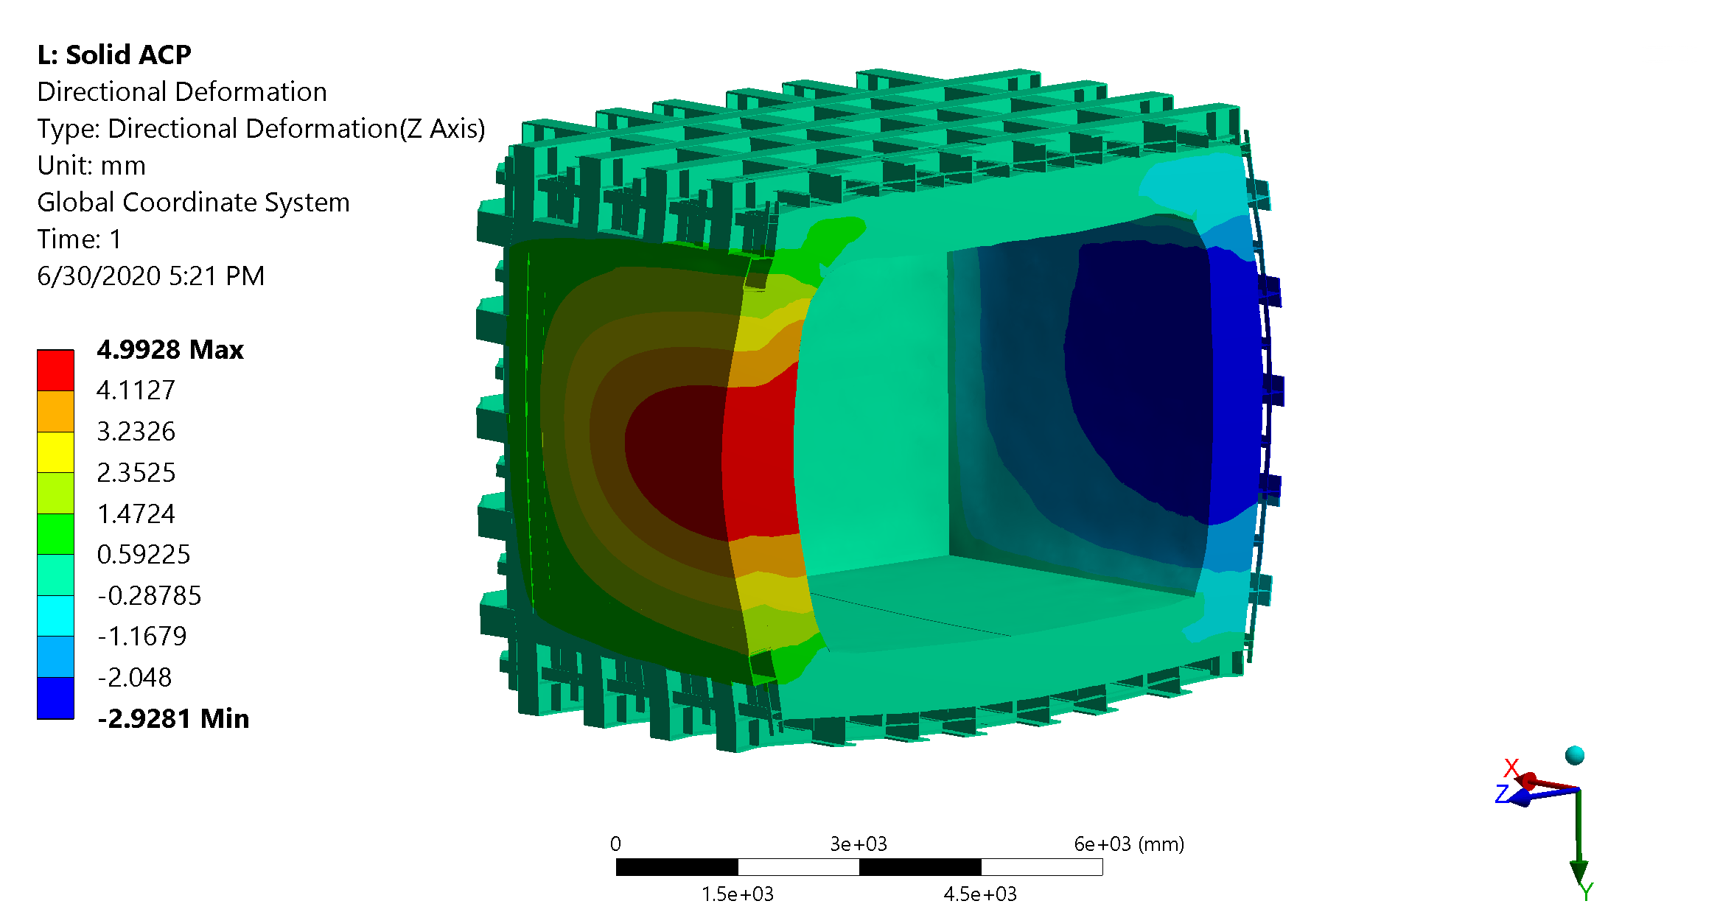
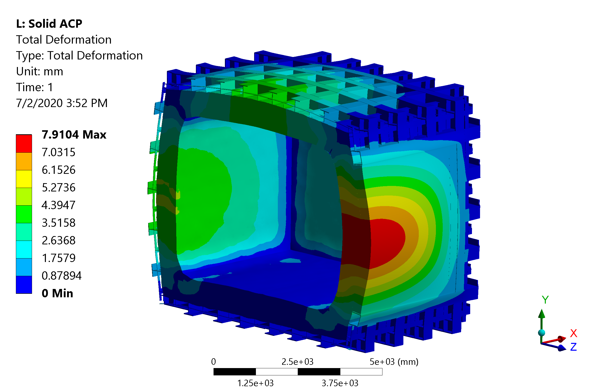
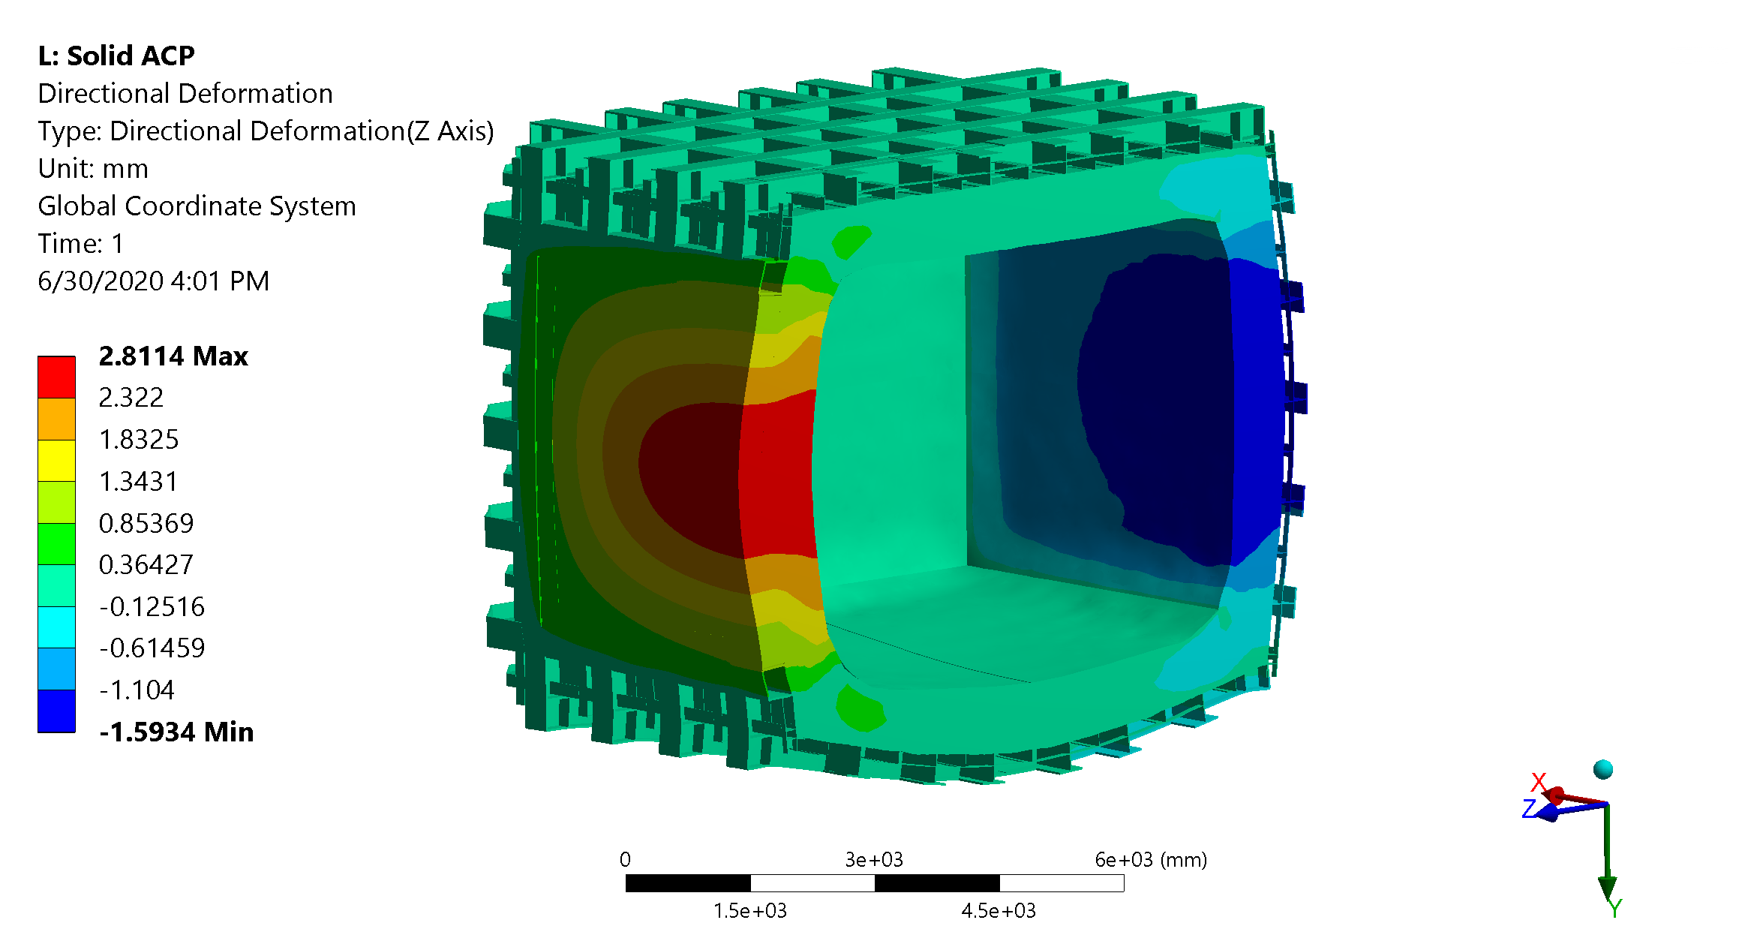
Structural Analysis - Displacements
Gravity
Hydrostatic
Pressure
Total displacement is 7.9 mm
It can still be easily improved, if necessary, but design target is 10 mm
Contributions (plate, z direction):
Gravity: 0.1 mm
Hydrostatic: 5 mm
Pressure: 2.8 mm
All Loads

Slide 14
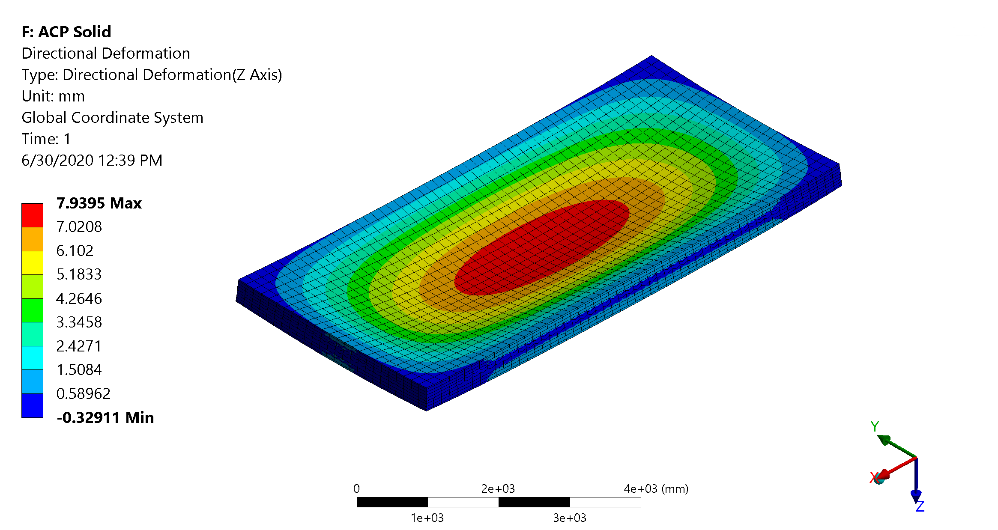
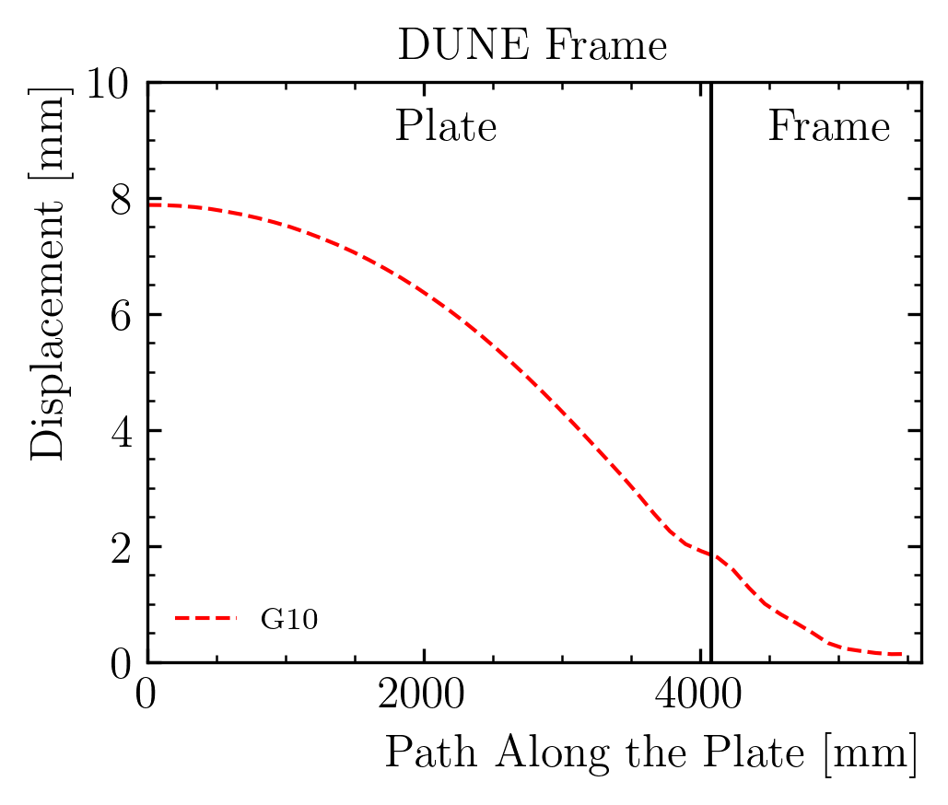
Structural Analysis – Impact of the frame on the displacement
Supported
Fixed
Plate stiffness – simply supported and fixed on the outer edge
Displacement: 7.9 mm or 2.6 mm
Most of the deformation is coming from the frame!
Edge rotation ~ 3.3 mm
Support motion ~ 2 mm

Slide 15
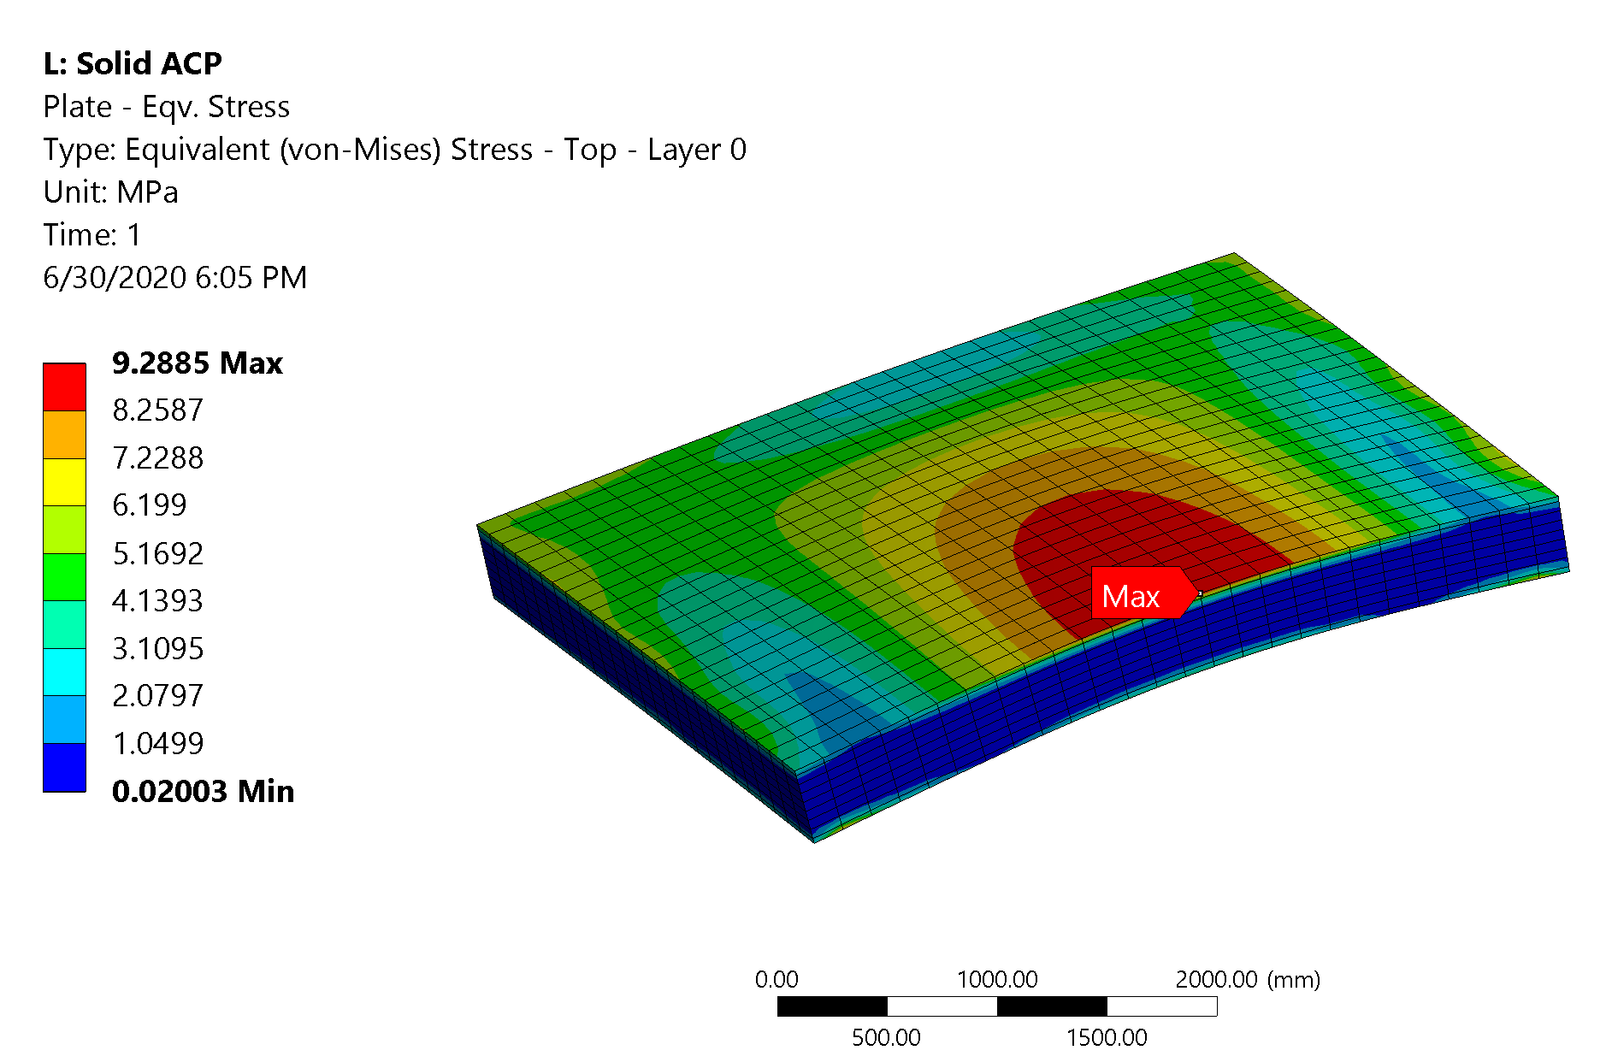
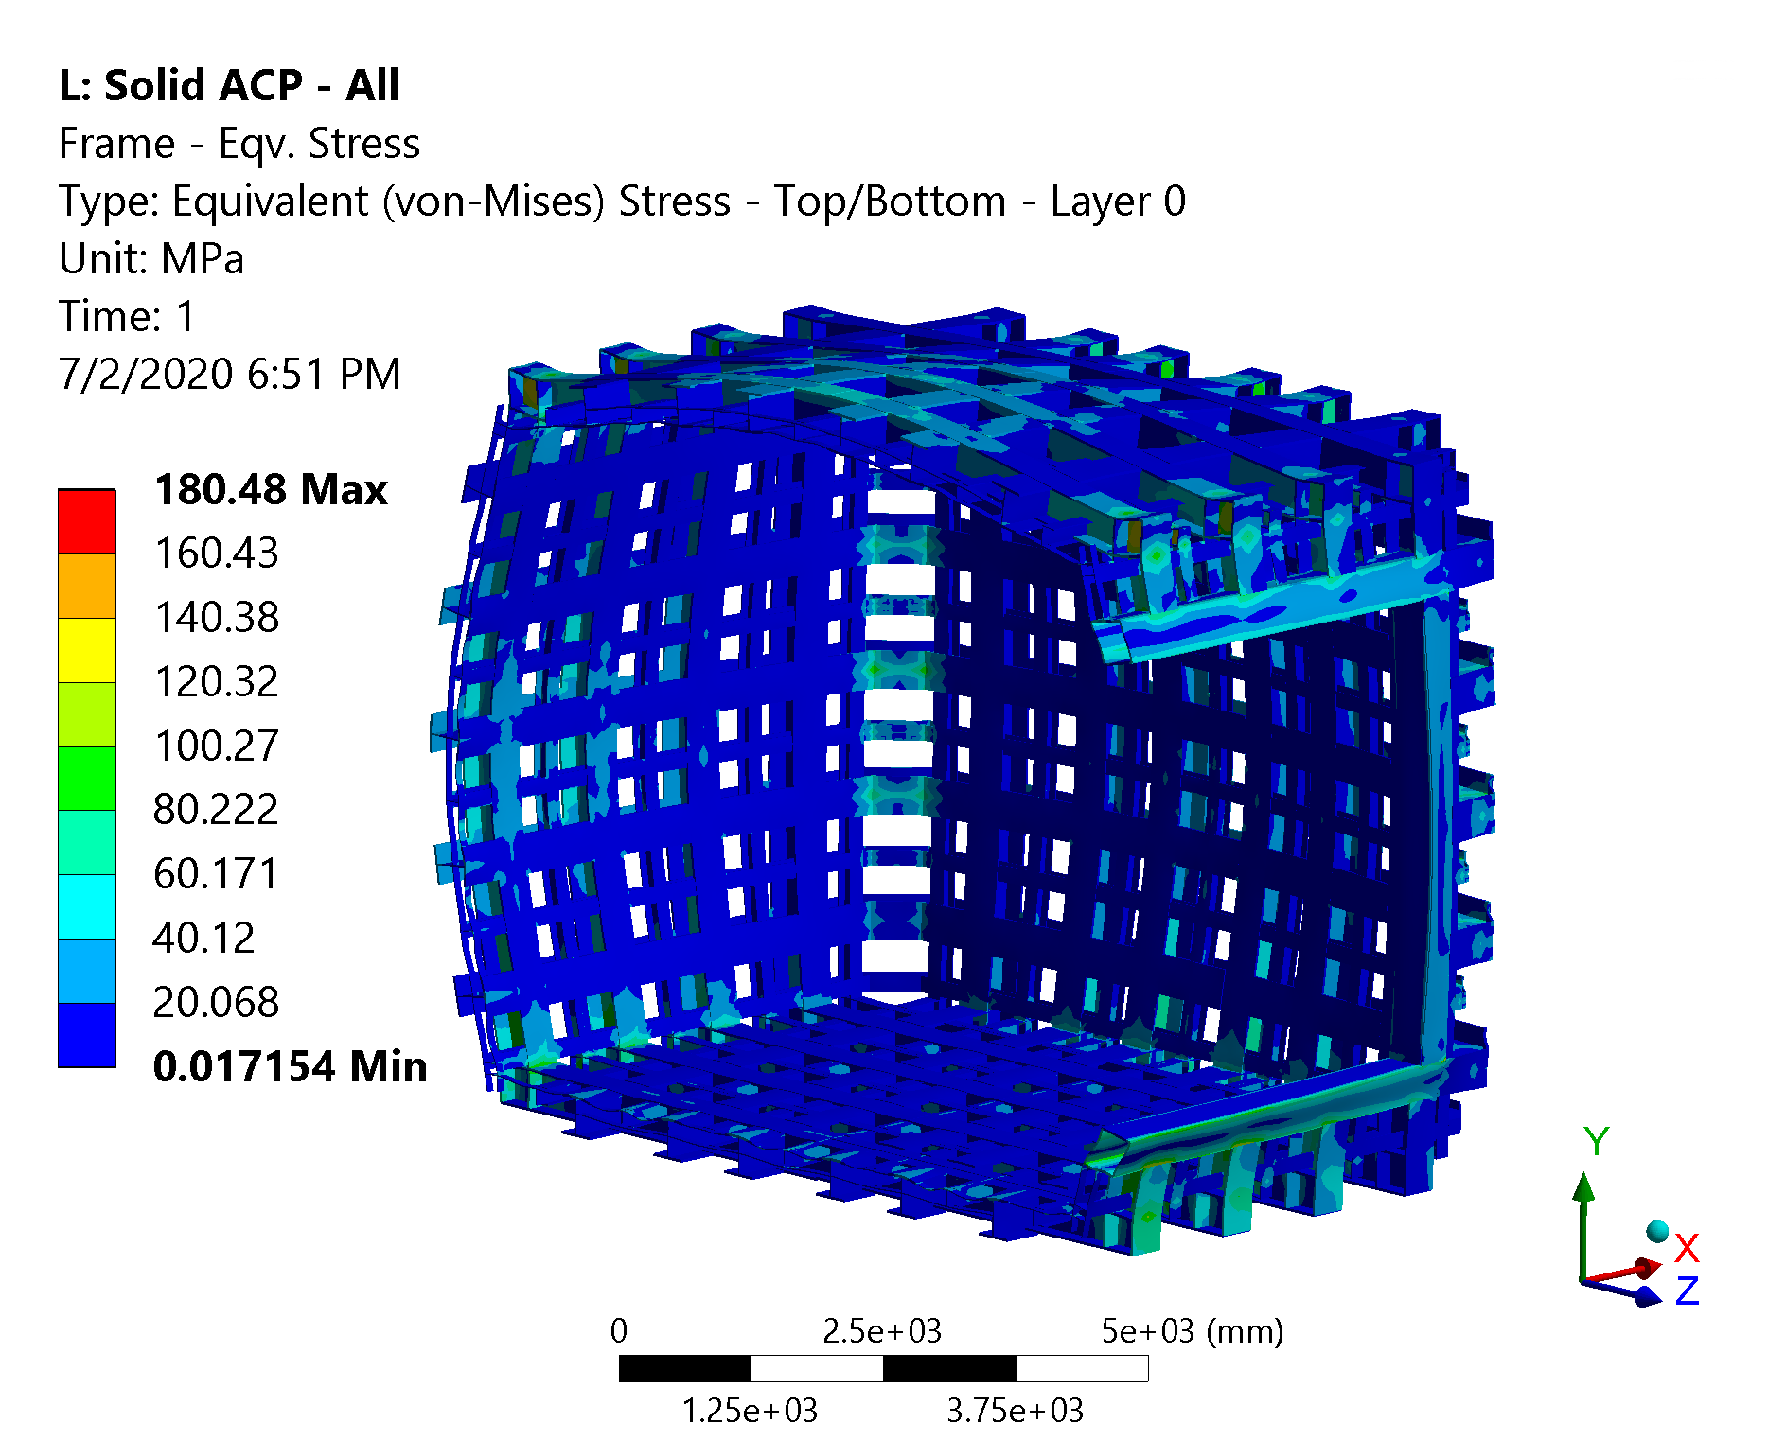
Structural Analysis – Stress Analysis
Negligible stress on the plate
Stress on the steel structure is low almost everywhere
Few joints see local stress spikes (still lower than the yield limit)
Max stress ~ 180 MPa on the square beam joint
This can be easily be reduced adding local reinforcements (as in ProtoDUNE)

Slide 16
Index
Introduction
Composite Window Design
Structural Analysis
Frame/Window Joint Design
Conclusion

Slide 17
Joint Design
Joint selection:
Box beam around the plate for torsional stiffness
A tapered lap joint is not able to satisfy the strength requirements (with a reasonable length). A scarf joint can sustain much higher loads
Production process is more complicated
Design process:
2D analysis to quickly optimize the geometry
Detailed analysis on a 3D model
Submodel critical regions (grade IV analysis)
Experimental verification

Slide 18
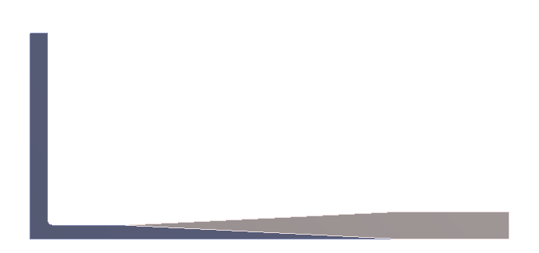
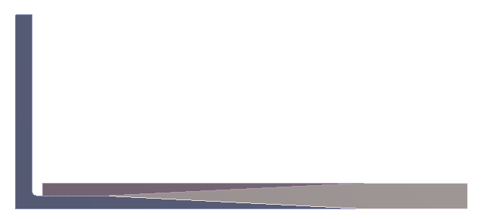
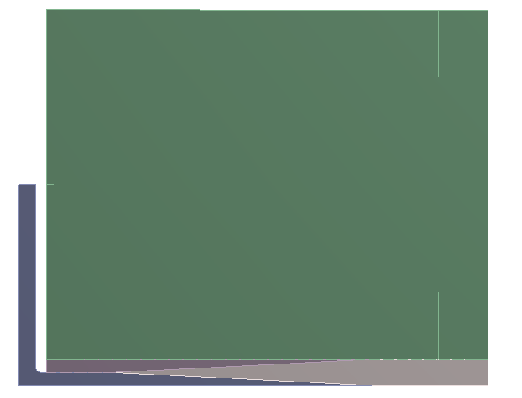
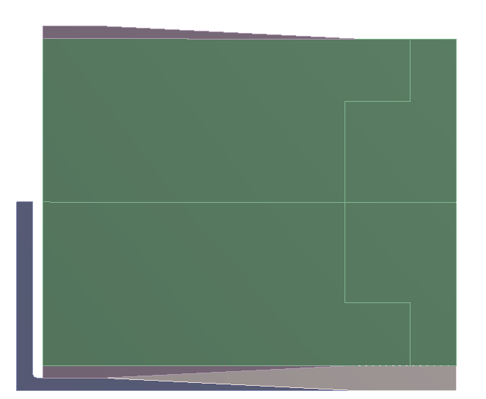
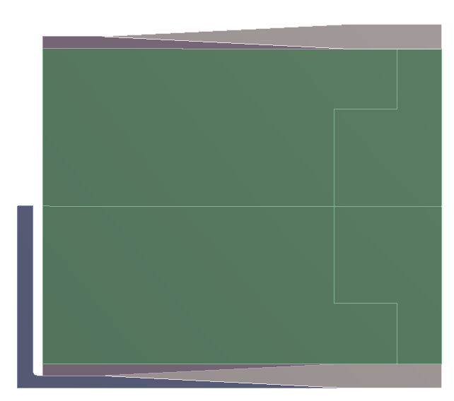
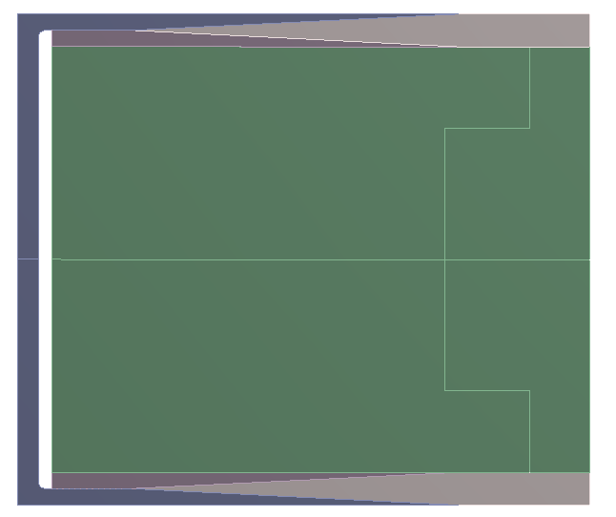
Scarf Joint – Production Process
1
2
3
4
5
6
Lay-up the bottom face sheet on the steel c-joint bottom half
Glue the bottom joint steel ‘shoe’
Glue the core
Glue the top joint steel shoe
Lay-up the top face sheet
Weld the c-joint, then weld to the box beam

Slide 19
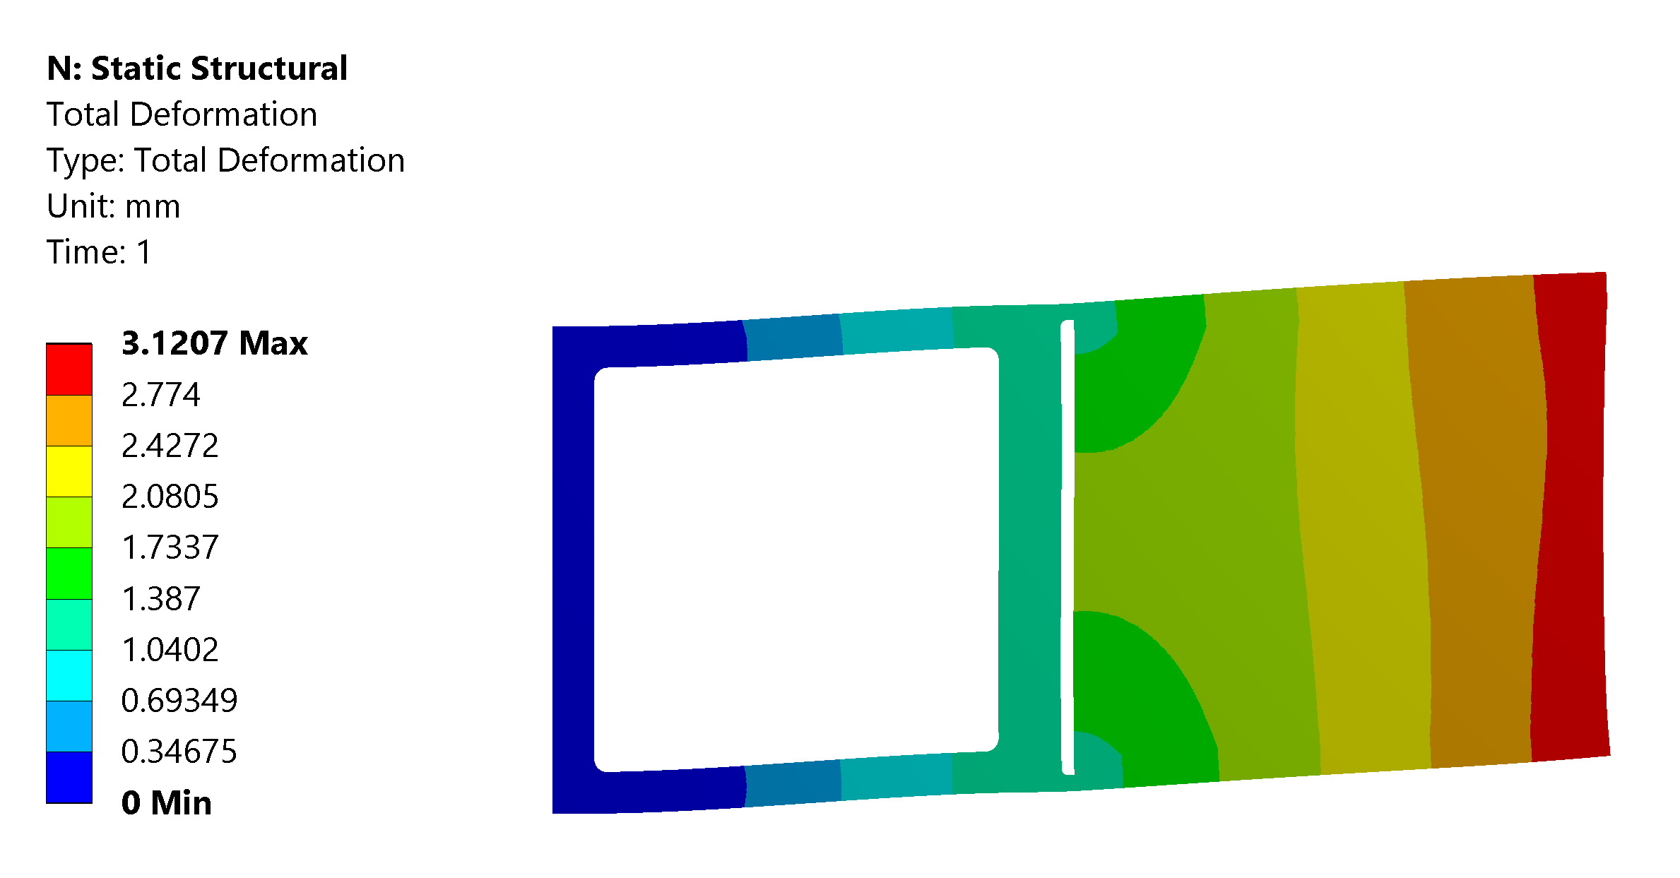
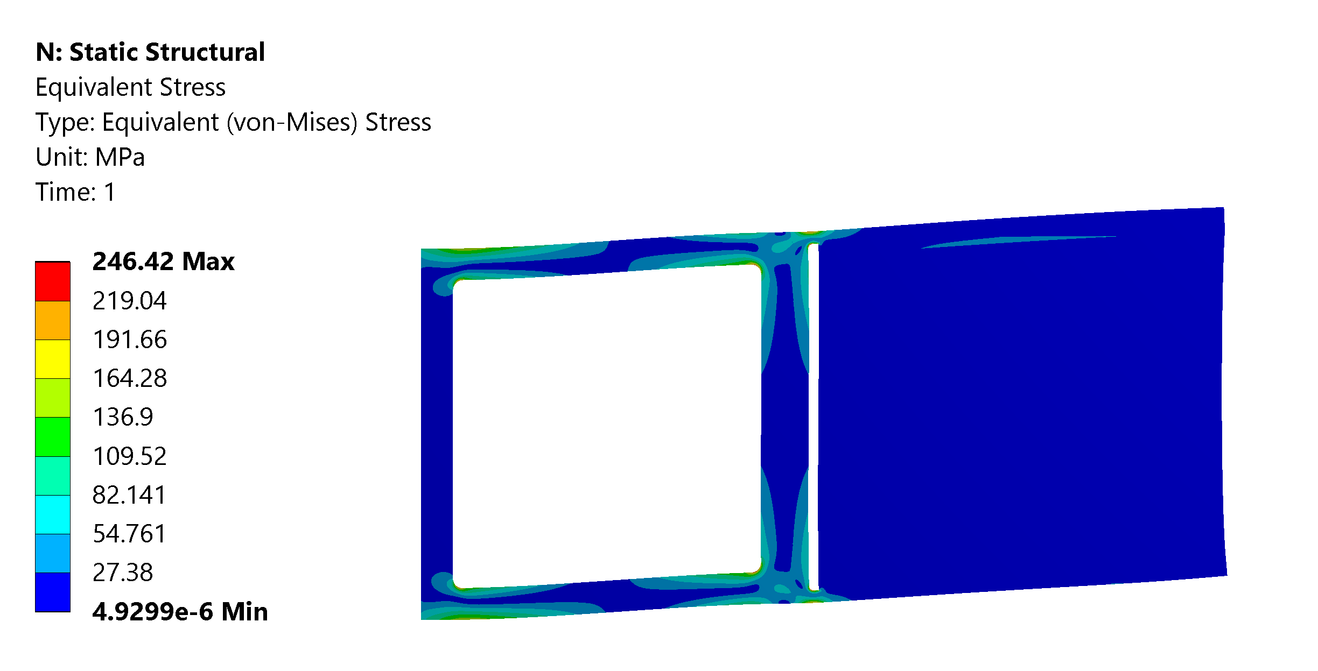
Scarf Joint – 2D Model Results - Compliance
Joint compliance is almost all in the box beam constraint
This is what we want, and a joint behaving like this will guarantee similar results to the one provided by the 3D analysis
Stress in the composite components is negligible
High local stresses in steel,
May need some reinforcement / higher radius
We might decide to accept a small amount of plastic deformation there
Here we are considering an ‘exaggerated’ scenario where there is no longitudinal support

Slide 20
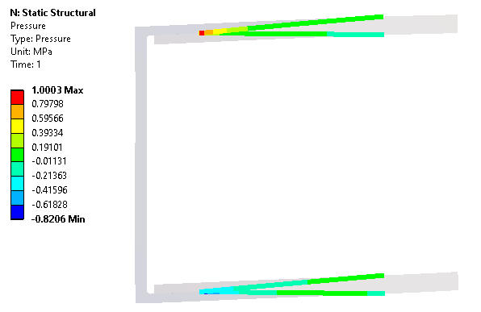
Scarf Joint – 2D Model Results – Glue Strength
Stress allowed in the glue:
5 MPa average on shear stress
10 MPa average on tensile
We are ~1 order of magnitude below
Also the maximum stress in the glue is lower than our average criteria

Slide 21
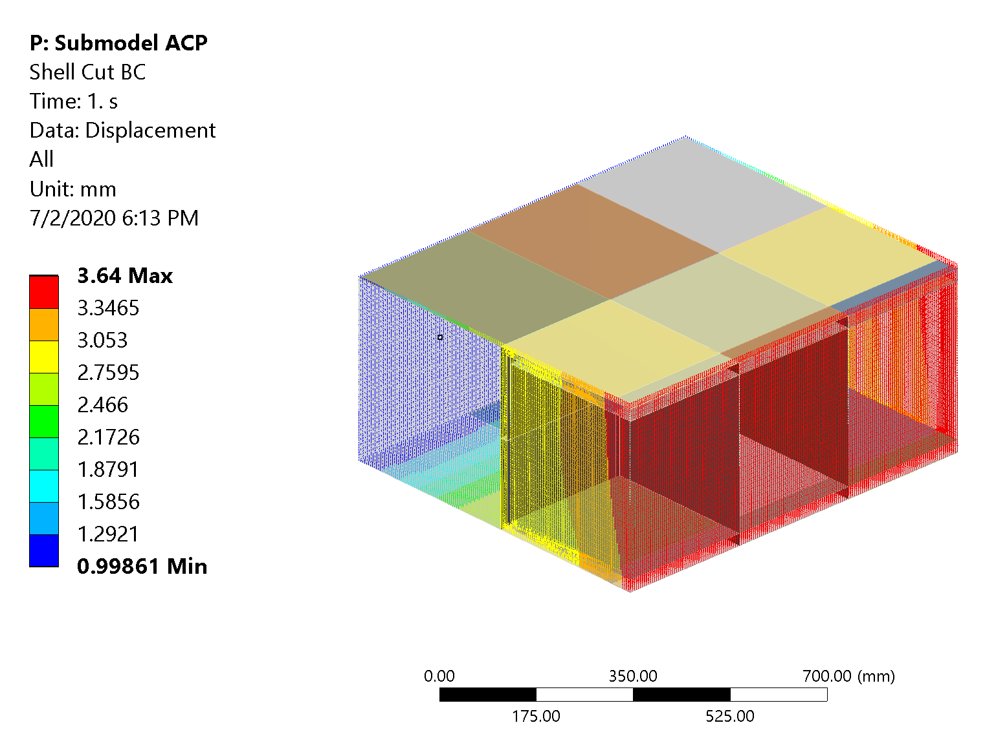
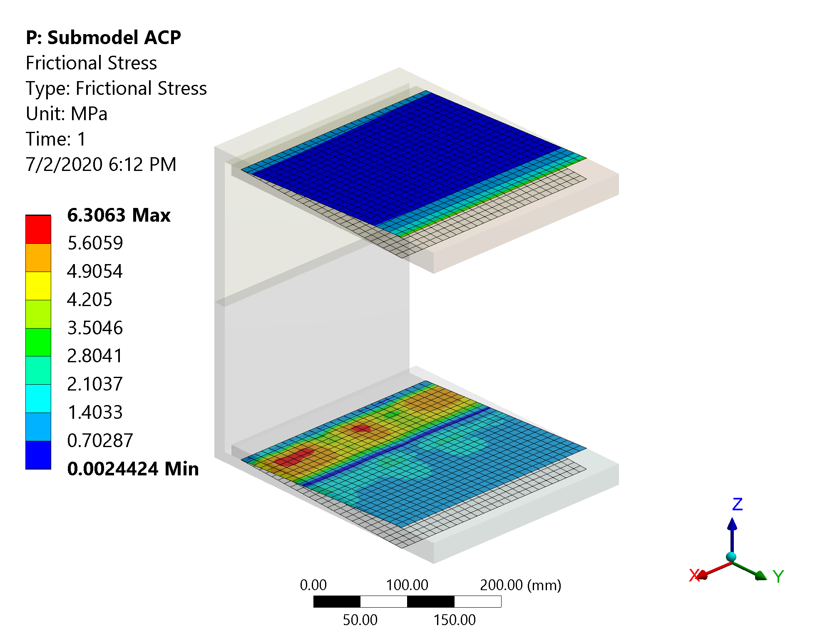
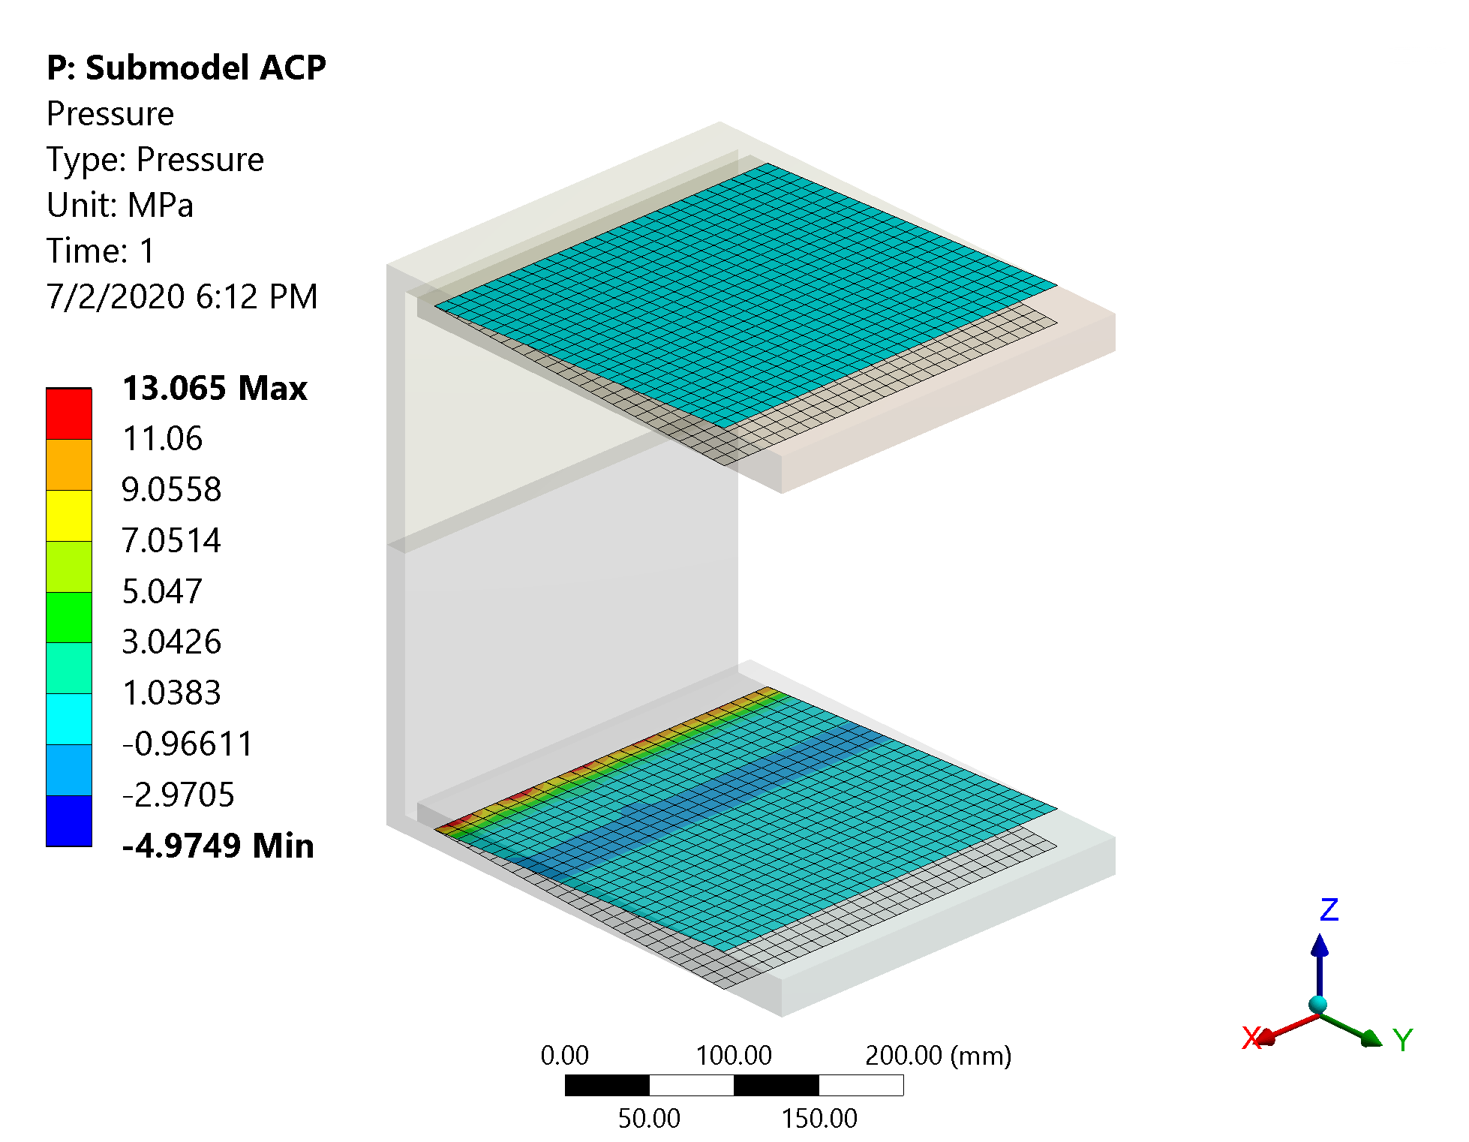
Structural Analysis – Stress Analysis on the Joint
Grade IV analysis example: joint submodel
displacements interpolated from the global model and applied on the cut boundary
Stress allowed in the glue:
5 MPa average on shear stress, 10 MPa average on tensile
Max frictional stress ~ 6 MPa, Max. tension ~ 5 MPa
Criteria satisfied with significant margin

Slide 22
Experimental Verification of the Joint Performances
Prototype plan aimed at the verification of the mechanical strength of the joint
Planned tests:
Stiffness/strength measurements on sub-scale samples
Results used along with numerical models
Stiffness/strength measurement on a real-scale portion of the joint
Thermal cycle the joint:
Important to verify strength
This can happen only in a catastrophic scenario where the Argon leaks
We already have experience with glued joints at -40 °C (e.g. ATLAS)
Back-up plans:
FEA suggests that we will not need them, but...
Increase the glued surface size
Joints of greater complexity can further increase the strength of the joint

Slide 23
Index
Introduction
Composite Window Design
Structural Analysis
Frame/Window Joint Design
Conclusion

Slide 24
Conclusion
The proposed design can meet the requirements:
Displacement < 10 mm
Surface density 16 g/cm²
Strength is ok
An ‘acceptable’ design space was defined
The final design can be decided based on trade-offs (cost, physics performances, mechanical performances)
An analysis procedure was proposed to verify the structure and the composite joint in particular
Experimental tests will be performed in order to verify the strength of the joint and the effect of thermal cycles

Slide 25
Back-up slides

Slide 26
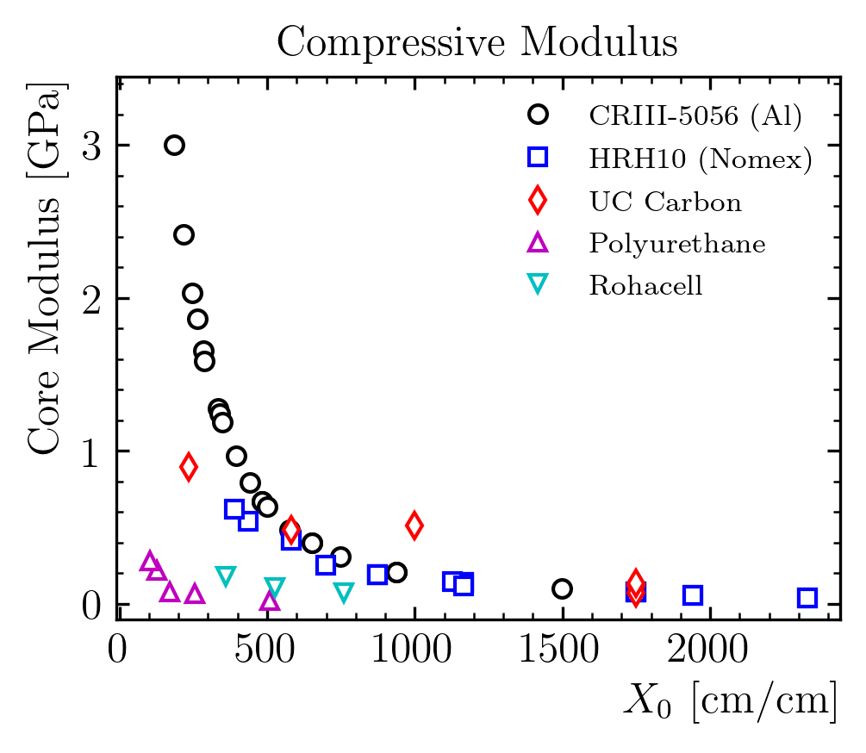
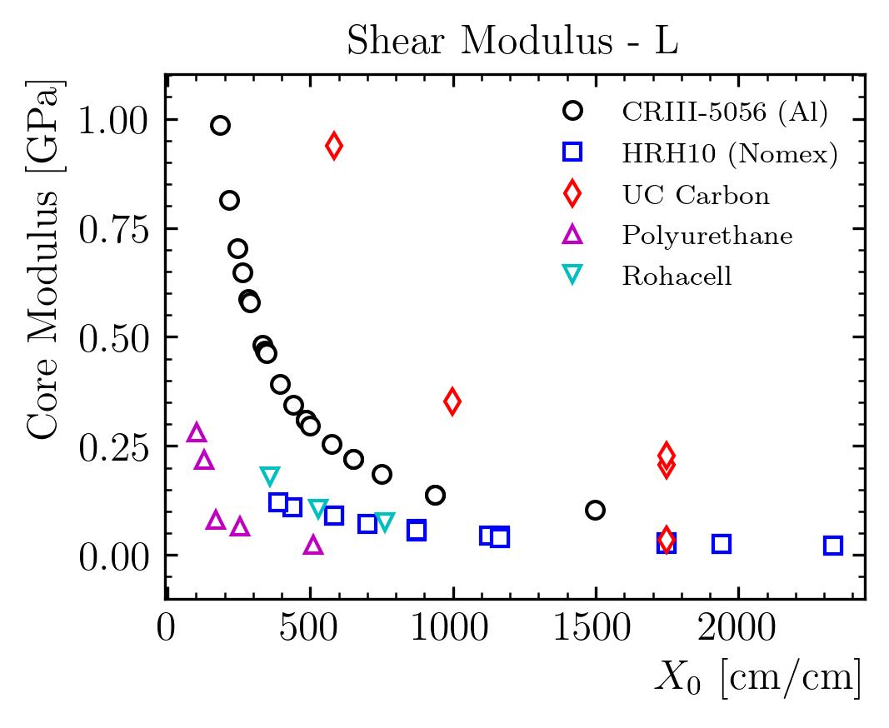
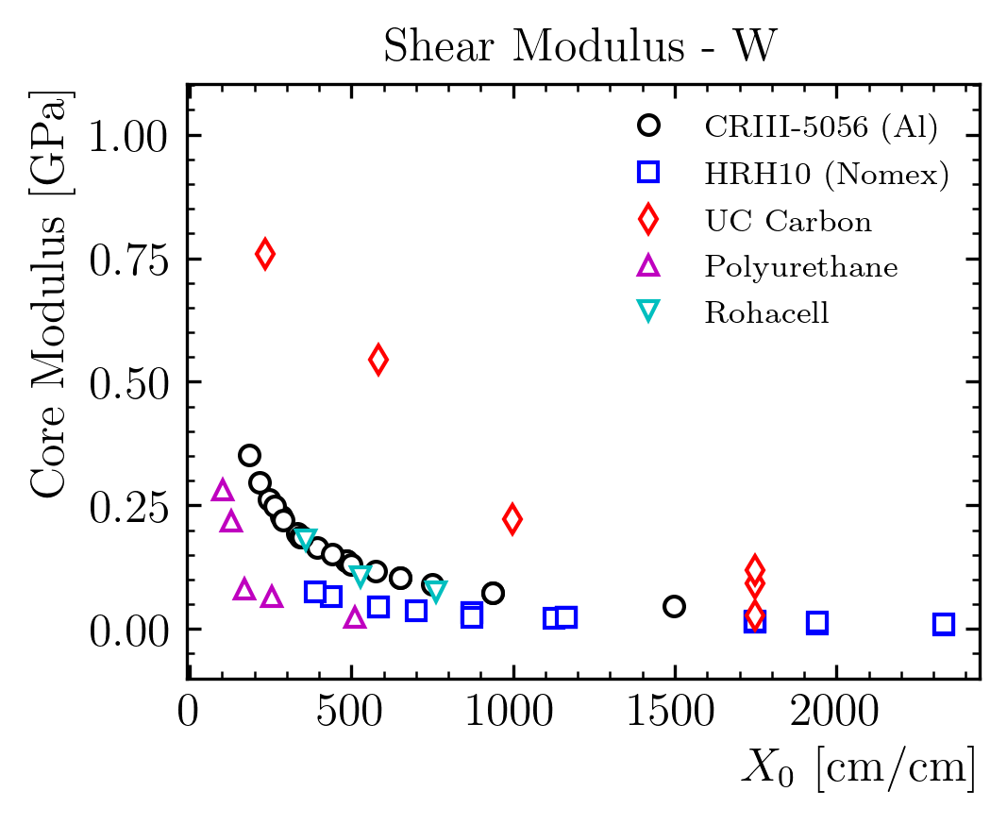
Window Design: Material Selection
Core material mechanical performances vs radiation length

Slide 27
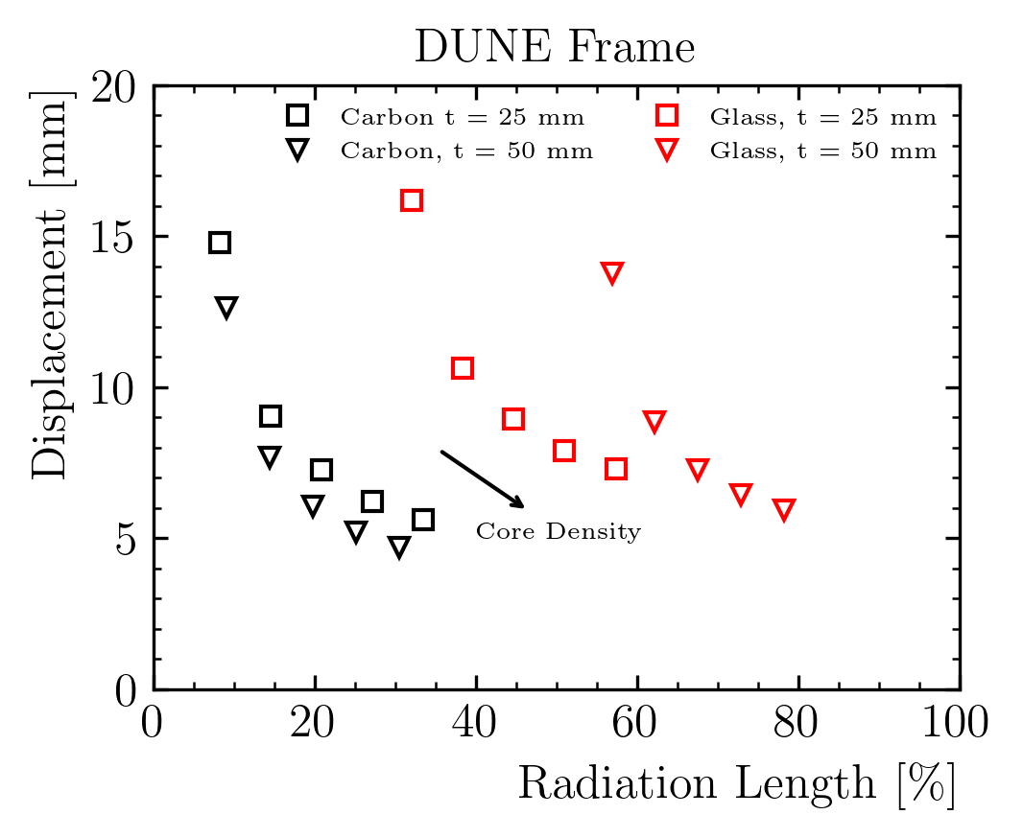
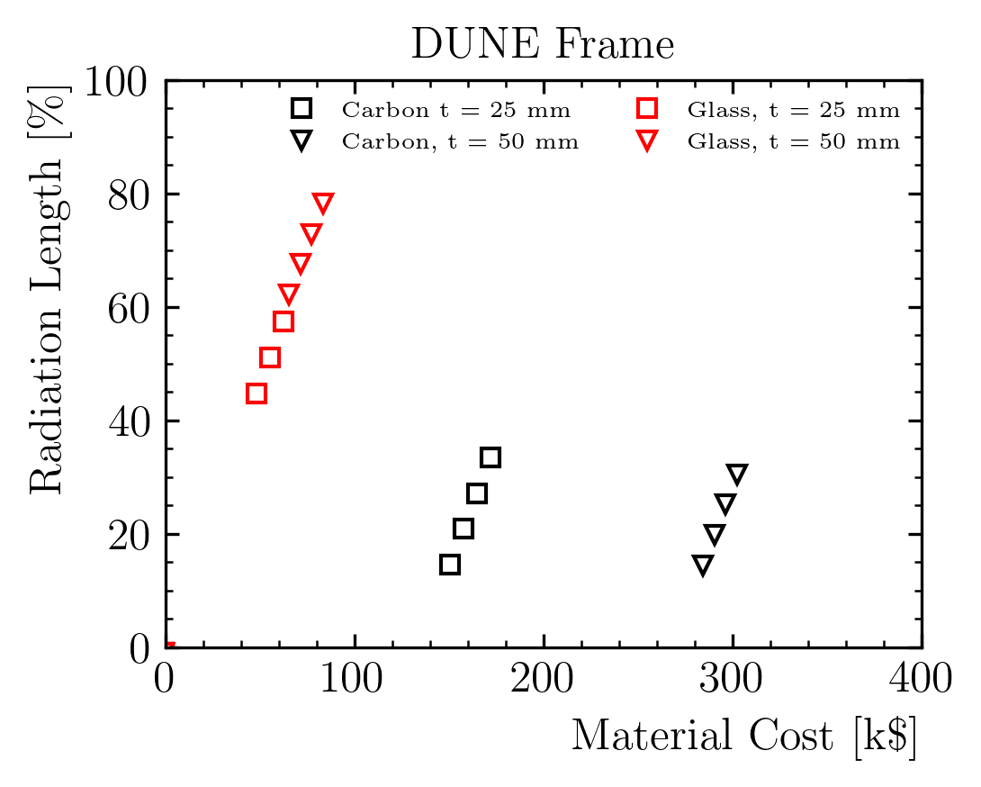
Plate Design - Summary
Considering only FR-3700 series polyurethane
Density from 80 to 400 kg/m3
Shear modulus ~ linear with the density
G10 has higher radiation length than Polyurethane
Last plot: only solutions with disp. < 10 mm
/Update with density and remove rad. Length?

Slide 28
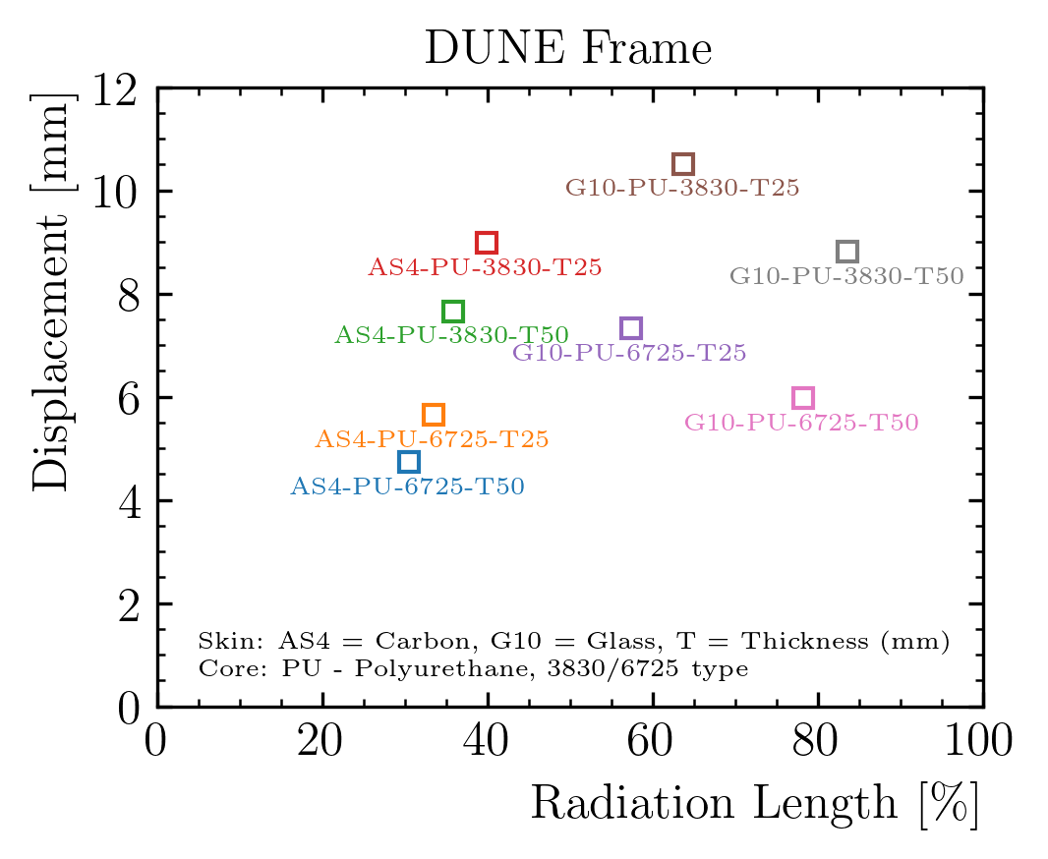
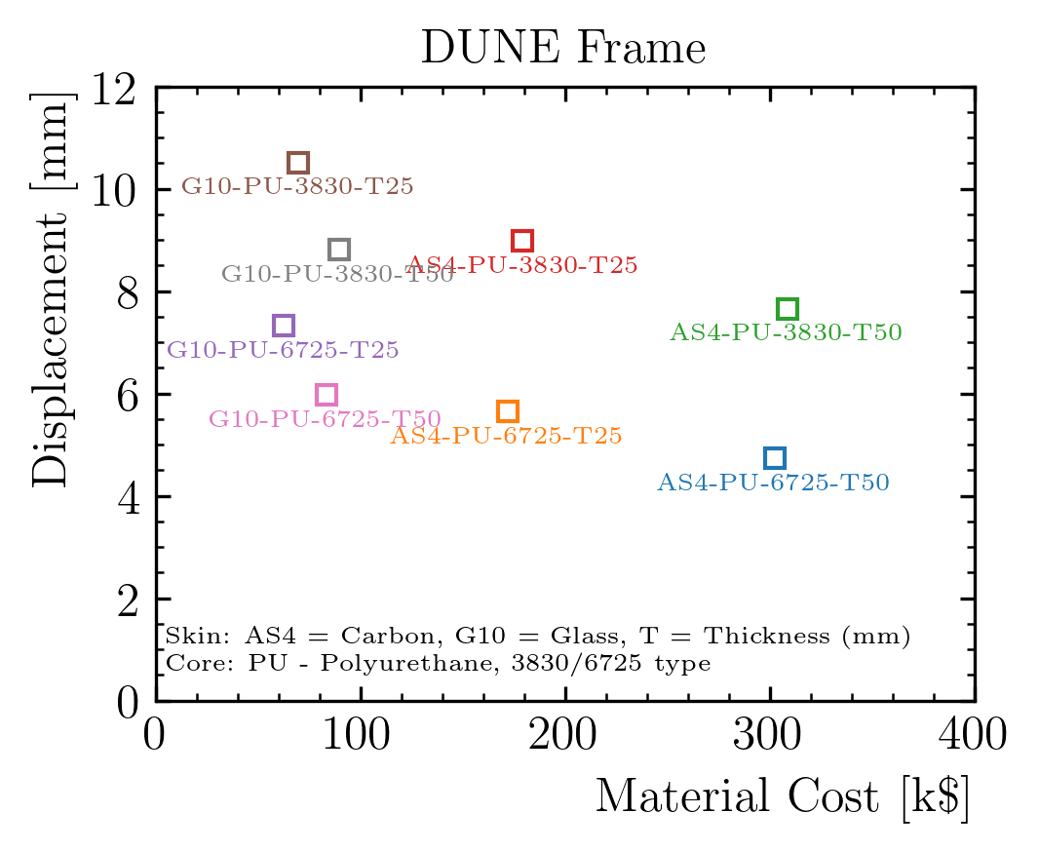
Window Design: Material Selection
G10 can provide sufficient performances but higher radiation length
Carbon fiber significantly more expensive
Joints are a fixed cost, and performance can be like the steel side
Could we consider to extend the window on the whole side? Would this be better?

Slide 29
Window Design: Surface Density Contribution of the Window
Layer | Material | thickness | x0_s | rho | L | x0 | X0 | Contrib. | rho*t | Contrib.
/ | / | mm | g/cm2 | kg/m3 | cm | cm/cm | % | % | g/cm2 | %
Liquid | Argon | 300 | 14 | 1396 | 10.029 | 2.99 | 299% | 67.4% | 41.9 | 62.7%
Plate | Steel | 2 | 1.7 | 7000 | 0.243 | 0.82 | 82% | 18.5% | 1.4 | 2.1%
Insulation | Polyurethane | 808 | 40.8 | 90 | 453.333 | 0.18 | 18% | 4.0% | 7.3 | 10.9%
Window | Composite | 372 |  |  |  | 0.45 | 45% | 10.1% | 16.2 | 24.3%
Steel Avg. | Steel | 58.3 | 1.7 | 7000 | 0.243 | 24.00 | 2400% |  | 40.8
Steel Max. | Steel | 372 | 1.7 | 7000 | 0.243 | 153.18 | 15318% |  | 260.4
Total |  |  |  |  |  | 4.44 | 444% | 100% | 66.78 | 100%
Surface density of each component
Target (total) is ~ 50 g/cm²
Composite window contribution ~ 16% of the total
Advantage on steel:
factor ~2.5 on average
1 order of magnitude on the beam locations

Slide 30
Alternative Joint Design
Test design 1:
G10 links might be connected or not (single piece or core)

Slide 31
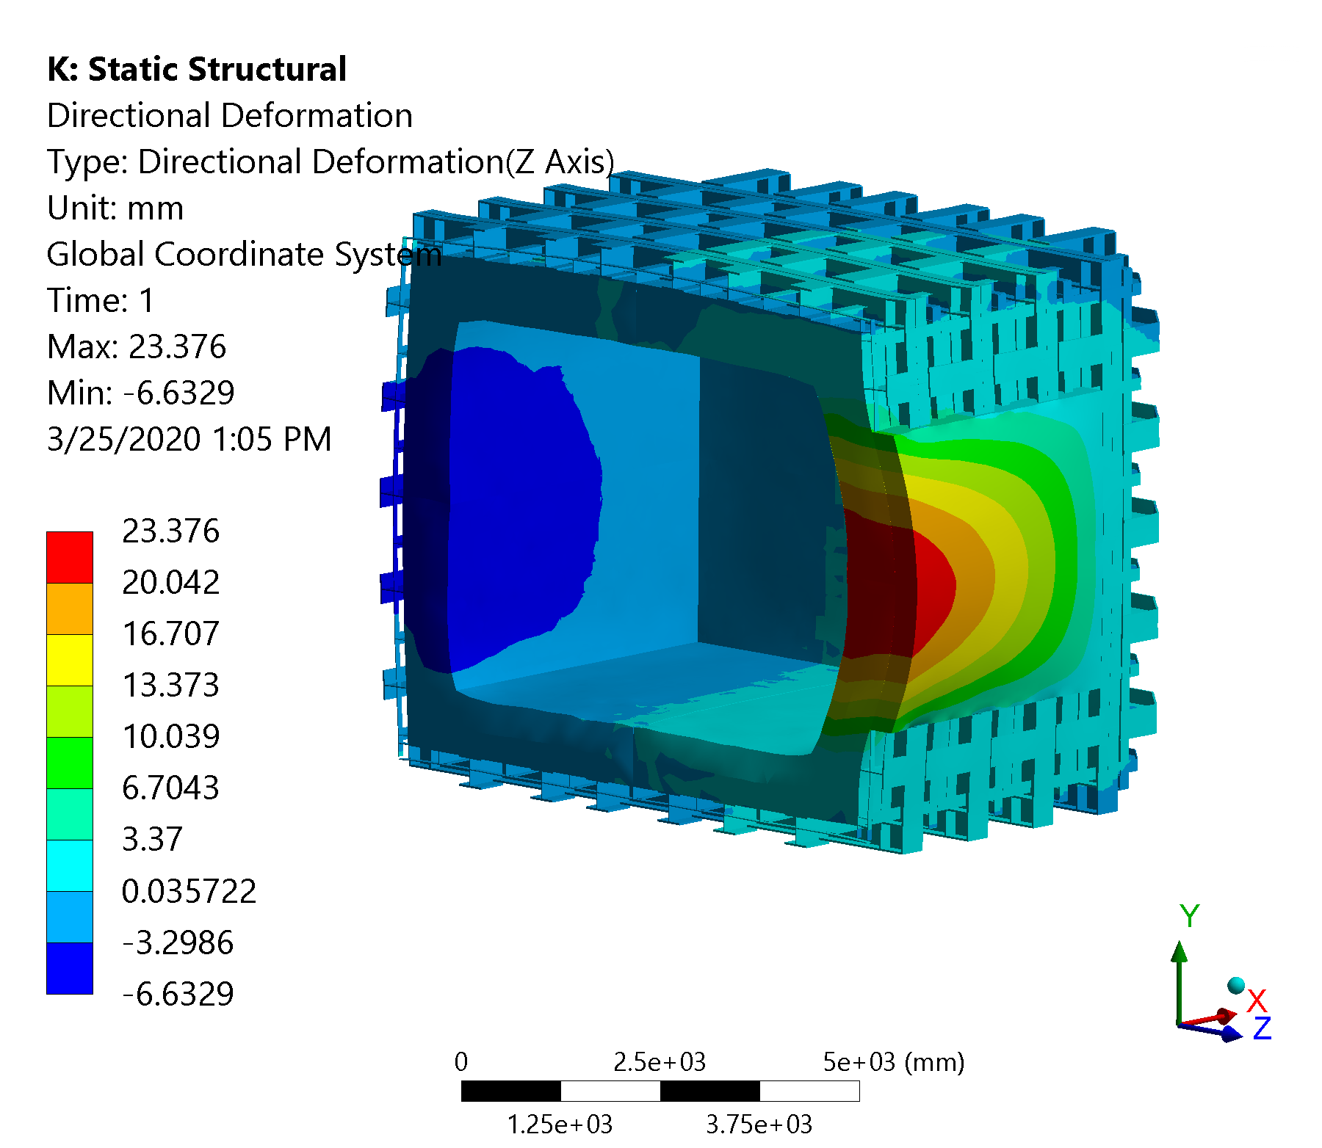
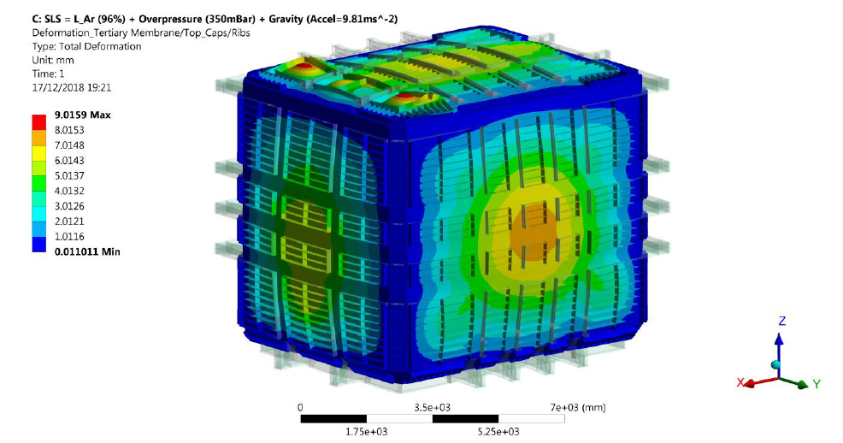
Comparison to Fermilab Technical Report
Comparison with results from Technical Report (EDMS No: 2061797)
We can use the displacement on the side with no window
The roof is not comparable, geometry completely different
Report displacement between 7 and 8 mm
New model displacement is 6.6 mm
Expected as there are more beams in this design

Slide 32
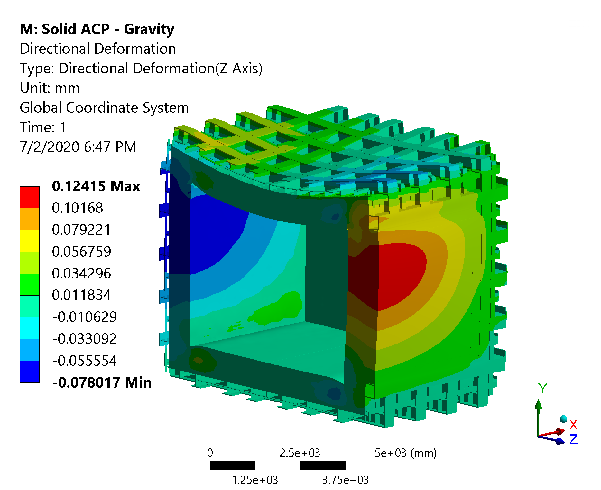
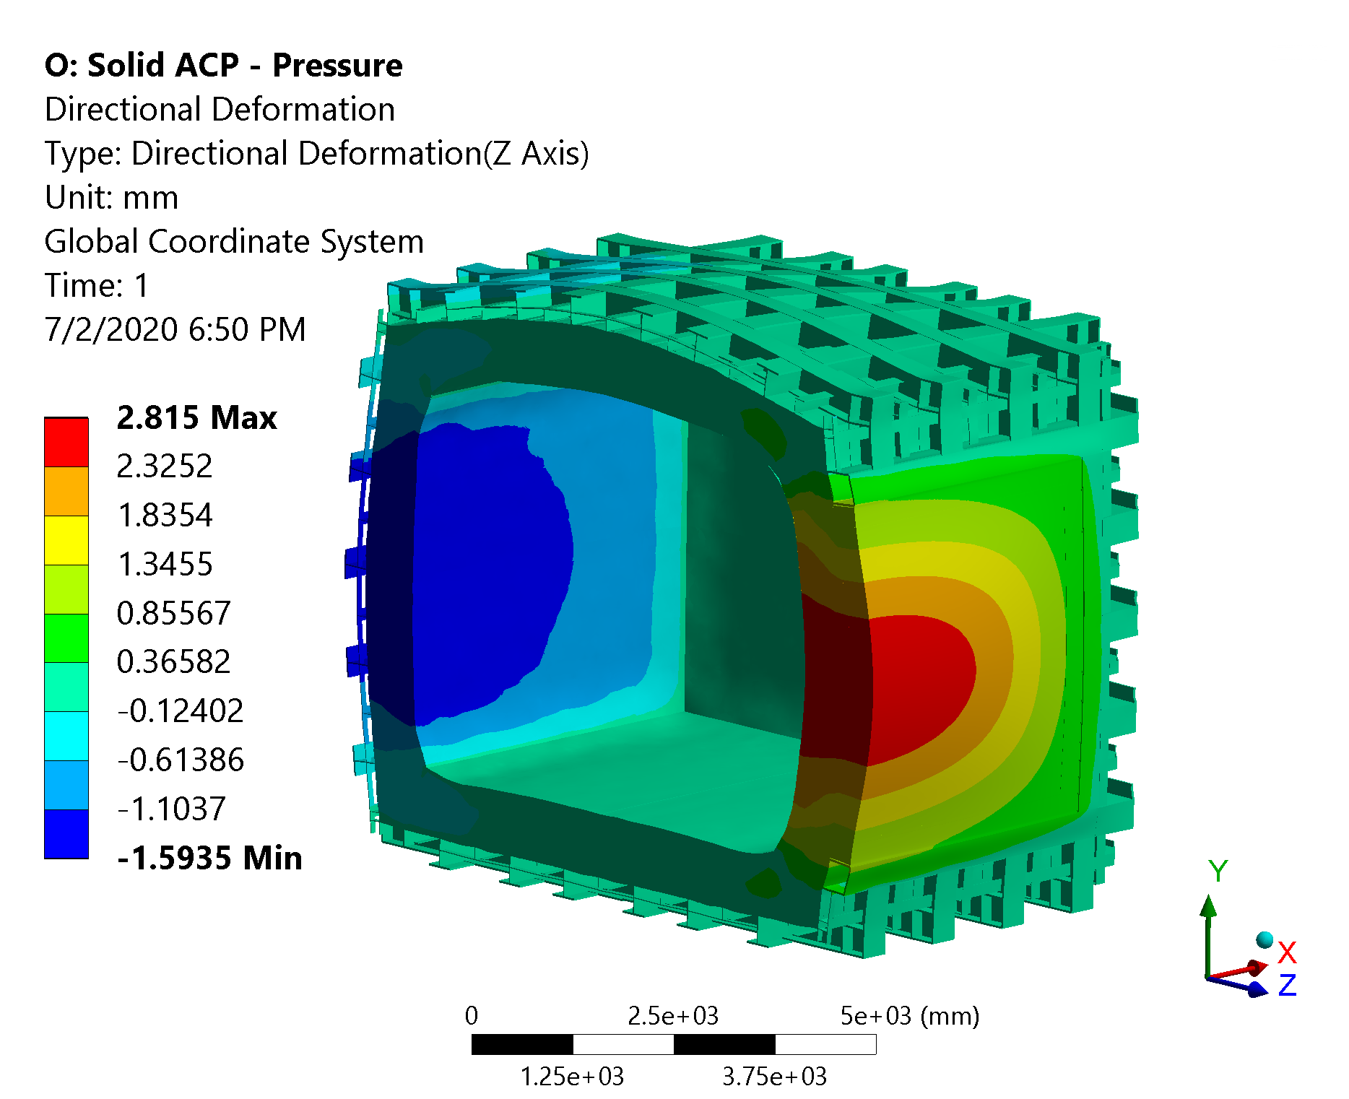
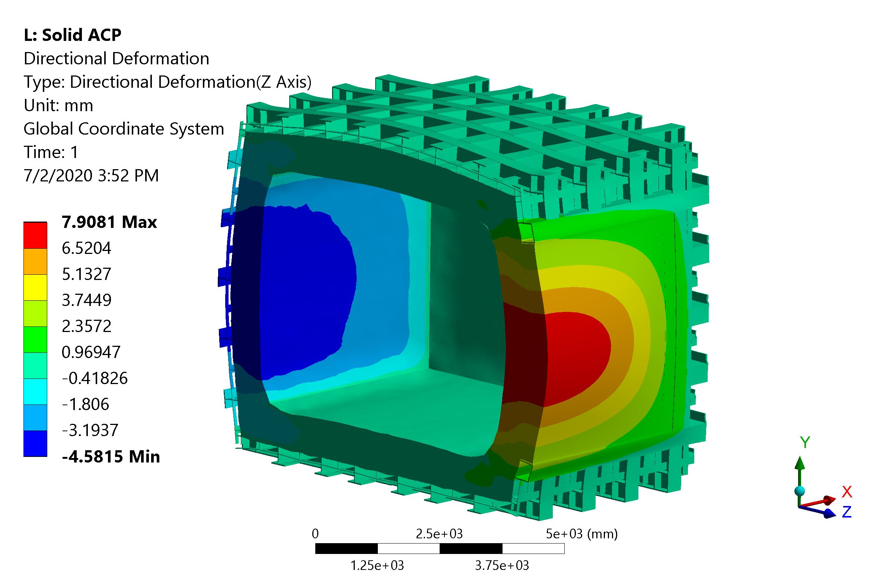
Structural Analysis - Displacements
Gravity
Hydrostatic
Pressure
Total displacement is 7.8 mm
It can still be easily improved, if necessary, but design target is 10 mm
Rotate everything
Contributions (z direction):
Gravity: 0.1 mm
Hydrostatic: 2.8 mm
Pressure: 5 mm
All Loads

