Slide 1
Near Site Cryogenics Overview
David Montanari (on behalf of Near Site Cryogenics Team)
DUNE Conceptual Design Review: Near Detector
7-9 July 2020
DM: Slides have been edited on Jul 8, 2020 (5, 19, 20, 22).

Slide 2
Outline
Scope/Overview
Organization
Layout.
LAr Cryogenics.
LHe Cryogenics.
Process Controls.
Next Items
Schedule.
Summary.

Slide 3
Cryogenics Infrastructure Scope
Cryogenics Infrastructure planned to support LAr Detector and SAND with capability to support future additional detector with SC magnet (MPD).
LAr Cryogenic Systems includes design, procurement of materials, installation and testing of cryogenic systems for LAr detector (LAr/LN2).
  Includes Cryogen Receiving, transport underground, liquefaction and purification sub-systems, associated instrumentation and monitoring equipment.
LHe Cryogenics includes design, procurement of materials, installation and testing of cryogenic systems for magnets (SAND + capability to support future SC magnet).
  Includes He transport underground, liquefaction cryoplant, distribution, associated instrumentation and monitoring equipment.
Process Controls includes design, procurement of materials, installation and testing of process controls infrastructure supporting LAr/LHe cryogenics.
  Includes readout modules, PLC architecture, HMI/SCADA.
Notes:
READ.

Slide 4
Near Site Cryogenics Infrastructure Organization
Created in Dec-2019, previously part of Near Detector Integration.
Project Manager:
  David Montanari (LBNF).
Lead Cryogenics Systems Engineer:
  Mark Adamowski (LBNF).
Engineers:
  Joaquim Creus (Fermilab/APS-TD) → NS LAr cryogenics.
  Li Wang (LBL) → NS LHe Cryogenics.
  Trevor Nichols (Fermilab/ND) → NS Process Controls.
  Ian Young (Fermilab/PPD) → NS Process Controls.
  Erik Voirin (Fermilab/PPD) → CFD modeling (as needed).
Design and Drafting support:
  Mike Delaney (LBNF).
  Justin Tillman (Fermilab/ND, until early Jun-2020).
  Andrew Lawrence (LBL).
LBNF, APS-TD, ND, PPD labor and LBL.
Support from Project:
  Matthaeus Leitner (LBL) → Installation & Integration
  Jack Fowler (Duke University) → Systems Engineering.
  Mike Andrews (LBNF/DUNE) → ES&H.
  Kevin Fahey (LBNF/DUNE) → QA.
Notes:
Talk about % and not full FTEs.

Slide 5
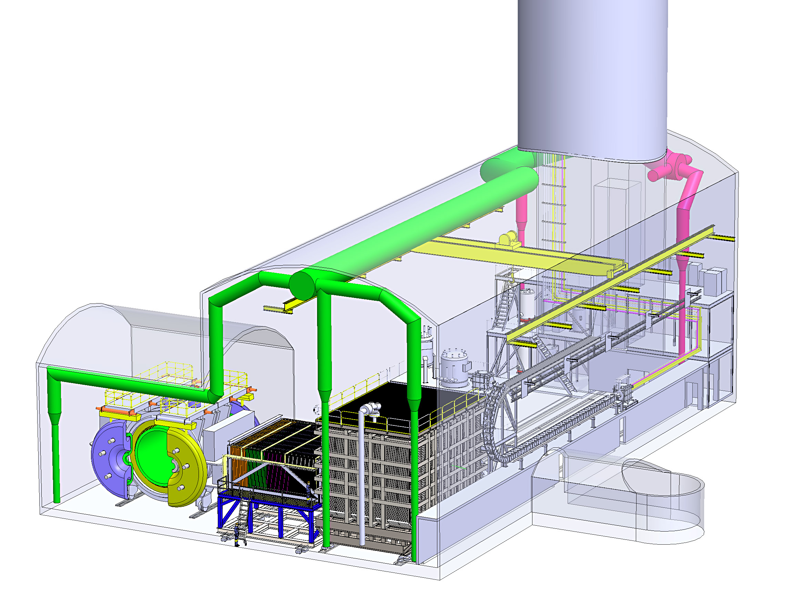
Near Detector (ND): Project Scope And Baseline Design (Day-one configuration)
DM: This slide has been edited.
NS Cryogenics supports:
SAND
LAr Detector.
Temp. Muon Spectrometer
Magnetized Steel Stack, Polystyrene Scintillators
100 Layers, 544 t Steel
PRISM
Up To 30 m Detector Travel
Off-Axis Beam Measurement
SAND Beam Monitor
Superconducting Magnet (0.6 T)
100 t Calorimeter
3DST, TPC or Straw Tubes
ND-LAr Detector
300 t High Purity Liquid Argon
Pixelated Readout Electronics
Removable Detector Segments
Courtesy of M. Leitner
cavern according to latest NSCF 100% preliminary design submittal

Slide 6
High level Requirements (more later)
SAND
  Thermosiphon cooling requirements:
    55W at 4K.
    530W at 70K shield.
  Cooldown with mixing chamber in the magnet top insert.
  Total LHe volume of 200 liters.
  Cold mass 10 Tons.
https://edms.cern.ch/document/2387229
LAr Detector
  Electron lifetime of 3 ms.
  System volume 318 Tons of LAr.
  Membrane cryostat technology.
  Detector moves 30 meters once a month at 1 cm/minute.
  Liquid distribution to 7-off rows with
  five ArgonCube modules each.
  Centralized LAr purification system.
https://edms.cern.ch/document/2391482

Slide 7
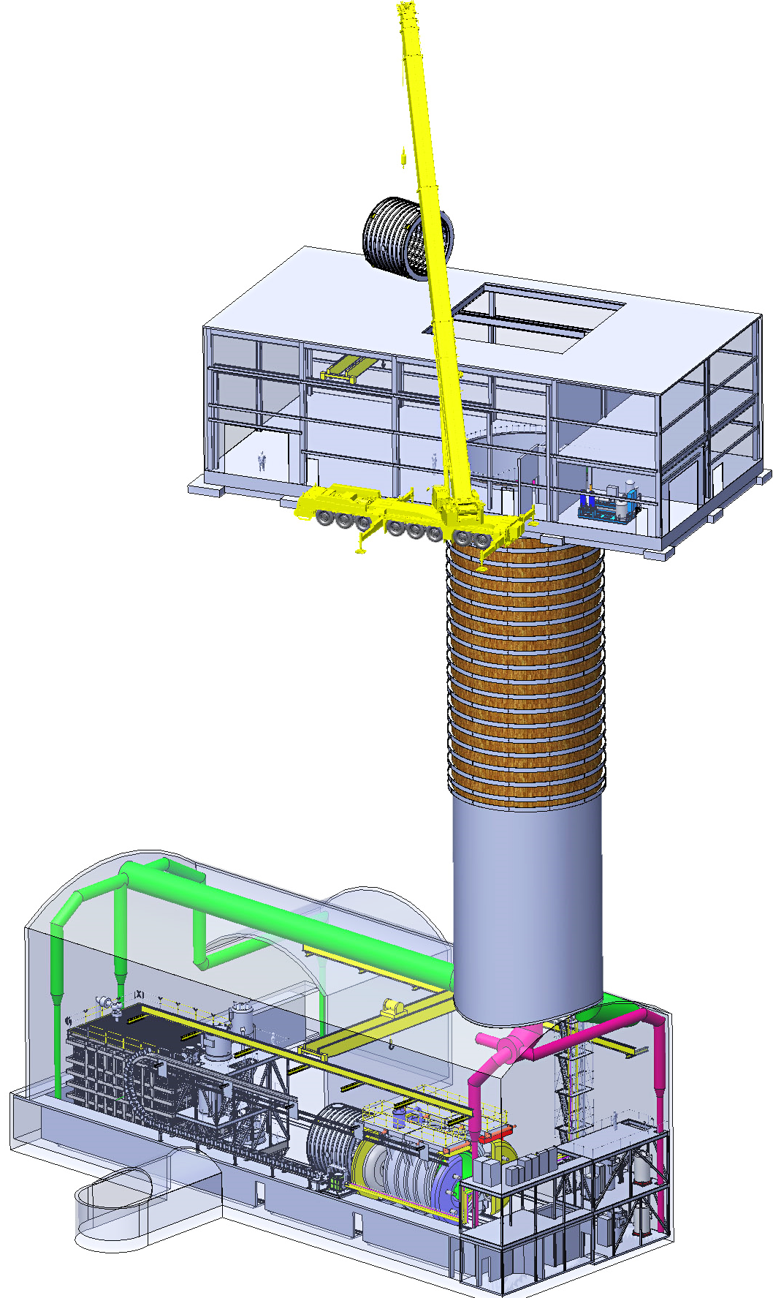
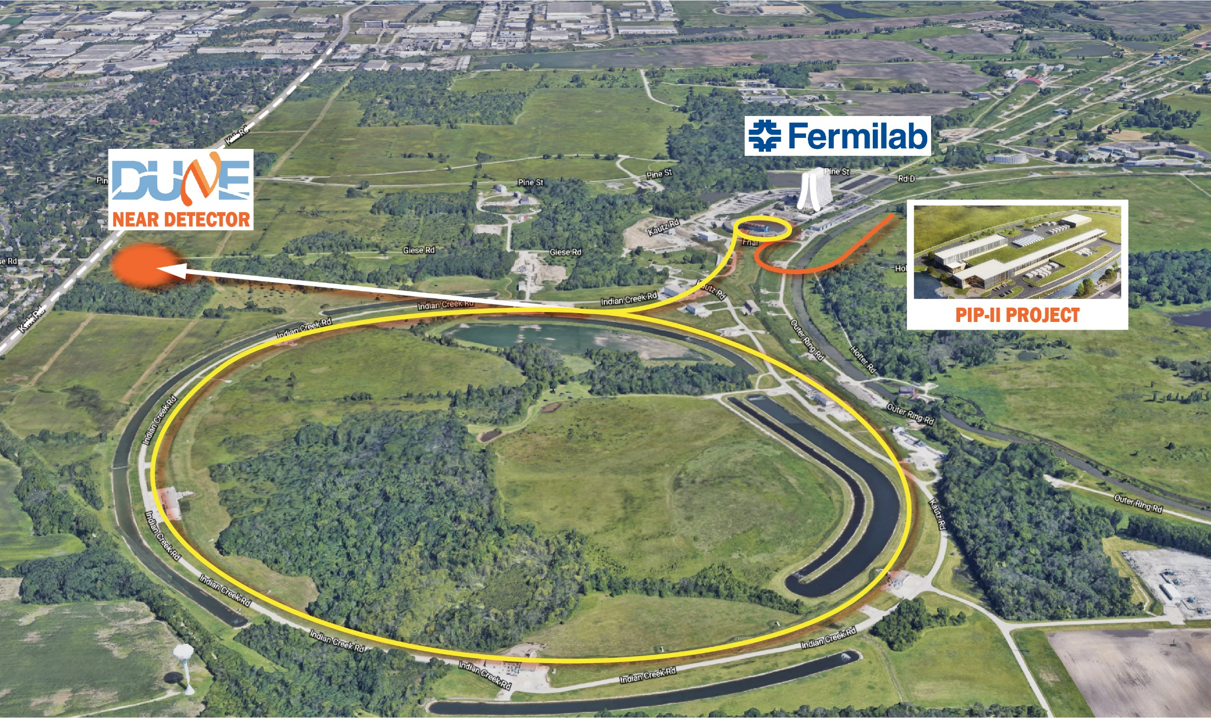
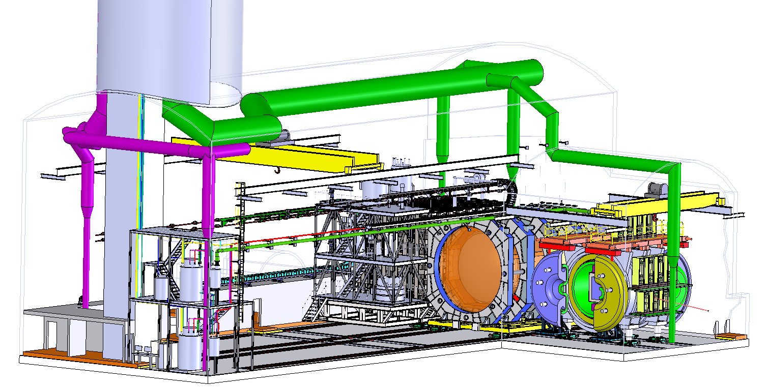
Near Site complex
Cryo surface facilities not shown.
LAr Cryogenics supporting LAr Detector.
LHe Cryogenics supporting SAND. Upgradable to support future SC magnet.
SAND Alcove
LHe Cryogenics
LAr Cryogenics
LAr Detector
Courtesy of M. Leitner

Slide 8
LAr Cryogenics

Slide 9
Relevant Requirements (partial list)
EDMS 2390106
Requirements from DOORS requirements management:
Electron lifetime of 3 ms required for experiment.
Each row of 5 ArgonCUBE detector elements receives its own LAr stream from a common LAr distribution/purification. There are 7-off rows.
The estimated heat loads are:
    From the cryostat 3 kW;
    From the detector electronics within the cryostat 12 kW;
    From the LAr pumps 0.5 kW (assuming 1 pump in operation);
    From the piping and purification vessels 1.0 kW.
Vessel internal size of L x W x H = 9.0 m x 6.0 m x 4.5 m (318 ton LAr).
Detector moves 30 meters once a month at 1 cm/minute.

Slide 10
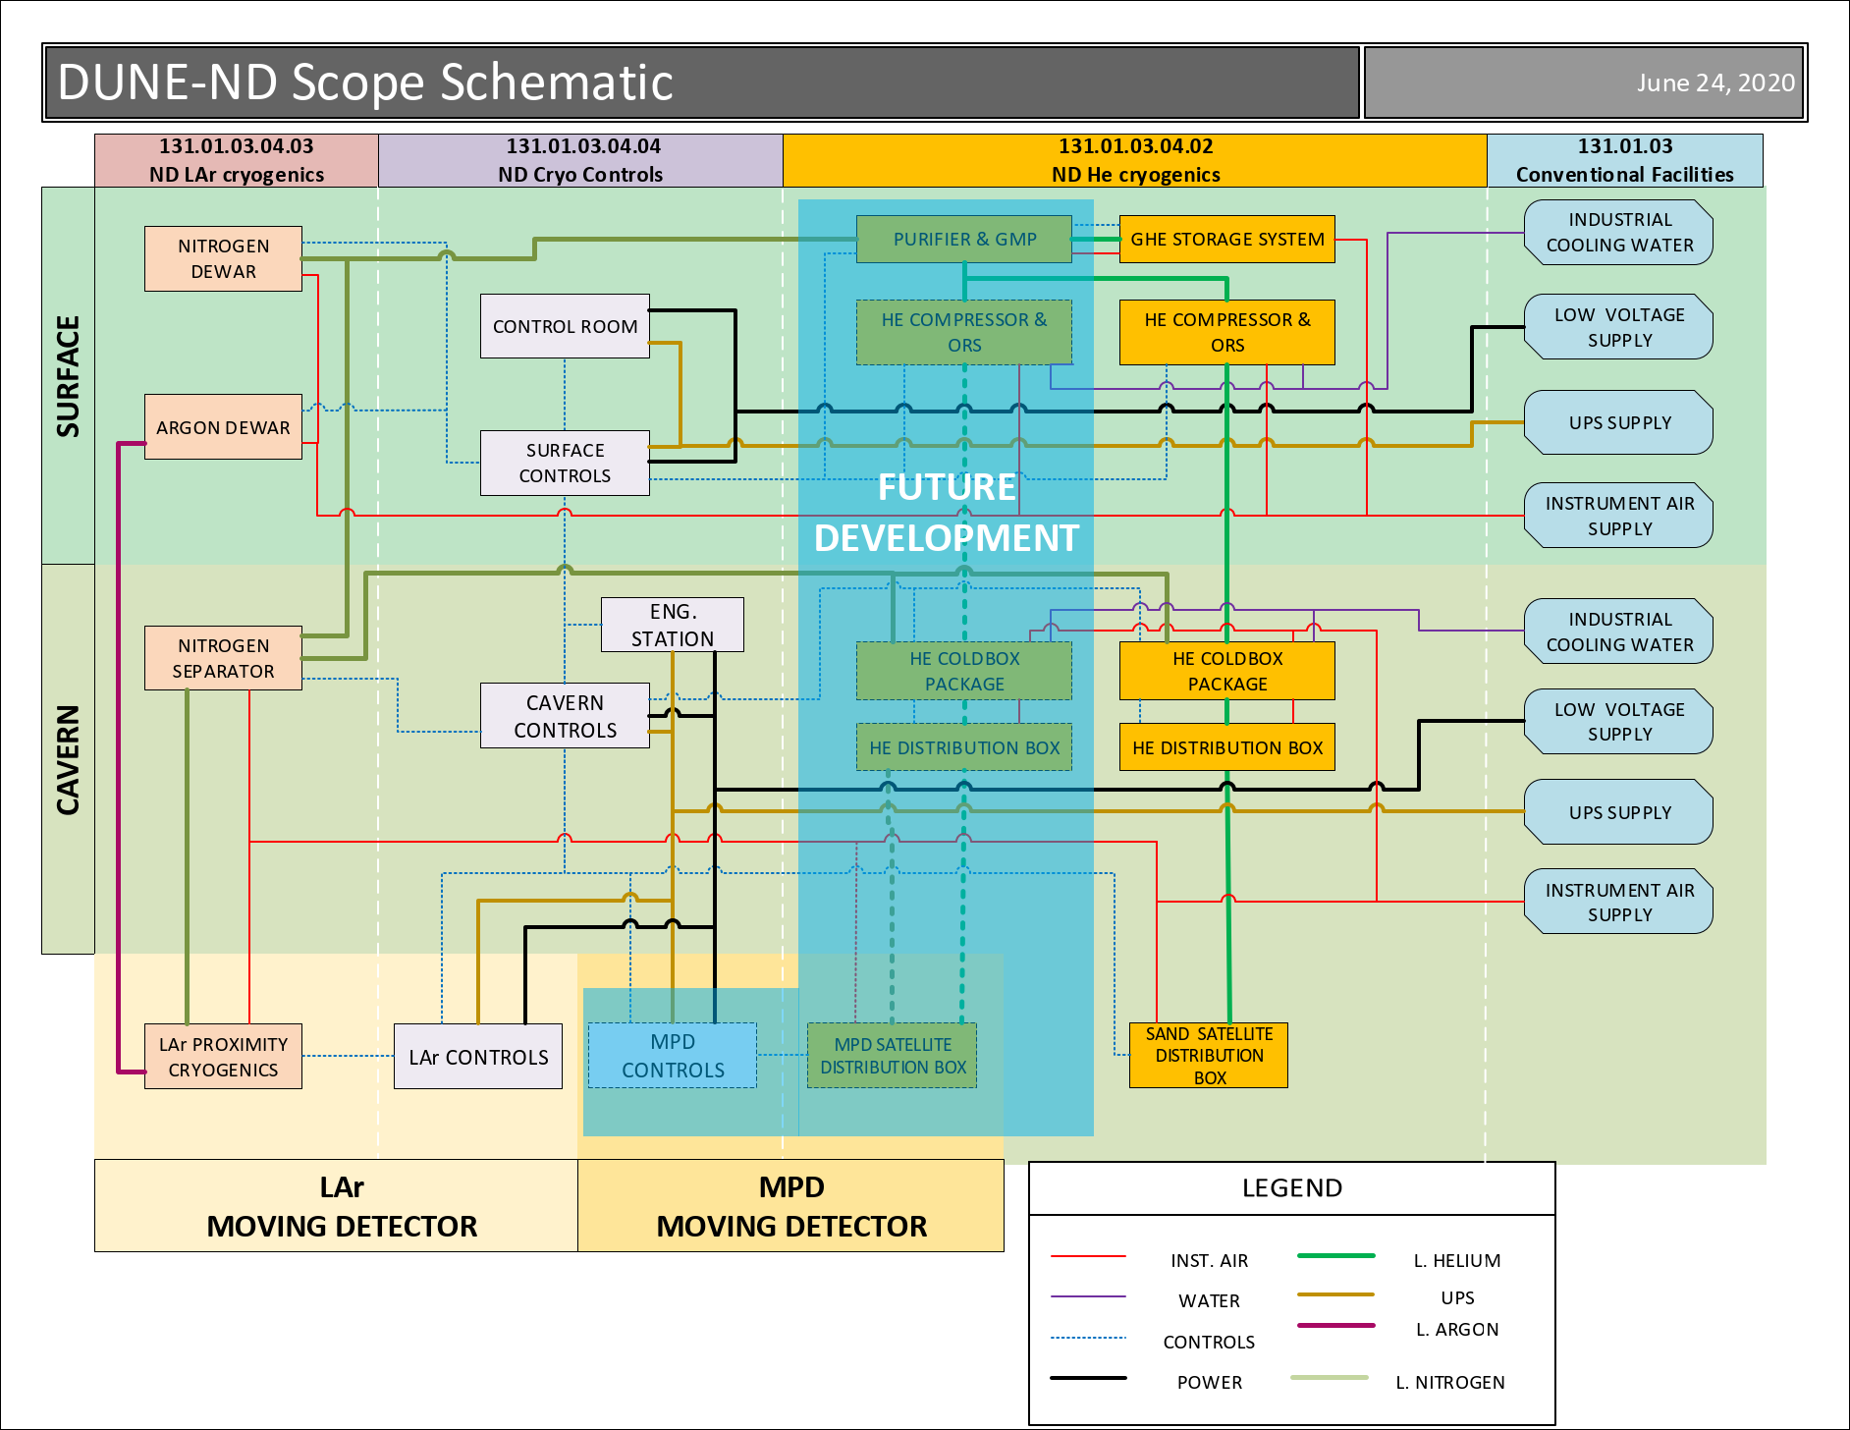
Interfaces
LINK: EDMS 2339685
NS Conventional Facilities ICD
  Industrial utilities (LV, IA).
  HVAC ( + ODH mitigation).
  External layout.
  Cavern layout.
NS Integration ICD
  Energy chain.
  Moving platform.
  Cryostat integration.
    Internal cryogenics.
    ArgonCube modules.
NS He cryogenics ICD
NS Cryo Controls (CF ICD + Spec).

Slide 11
Modes of Operation
Piston Purge: Vessel purged of Air contaminants with GAr flowing from a gas manifold at membrane vessel base. Expected to involve 10 volume changes and last two days.
  1.1 Water desorption: Since ArgonCube modules have a lot of G10 surface, warm dry gas will be flown to help dry G10 surface. Process parameters and details being worked out at Bern, Switzerland. Cold trap might be used as well.
Cooldown: Vessel and detector are cooled down with LAr sprayers fed from a Tube-shell 24kW condenser cooled by LN2. Location of sprayers being discussed.
Cryostat Fill: Liquid argon deliveries are tested for quality. Argon flows on-pass to purification system, is treated in phase separator and enters the cryostat in a liquid distribution manifold.
Purification Mode: The detector is expected to work in this mode for years. The circulation pump valve box suction receives argon from a side penetration in cryostat. Discharge flows to purification valve box, then phase separator and back in the cryostat distributed in the 7-off ArgonCube modules. Condenser collects cryostat boil-off and phase separator flashing diverted into circulation pump suction.
Activation/Regeneration: Purification system is based on Copper Oxide and Molecular Sieve. Copper Oxide is activated and regenerated by flowing a non-flammable mix of Argon/Hydrogen heated to 500 K. Molecular Sieve bed regenerated with a flow of gas at 500 K.
Empty: ND-LAr is 215-ft deep underground. In order to empty it, heaters with a total power of 45 kW will be placed in different parts of the vessel to boil the argon off in two weeks.

Slide 12
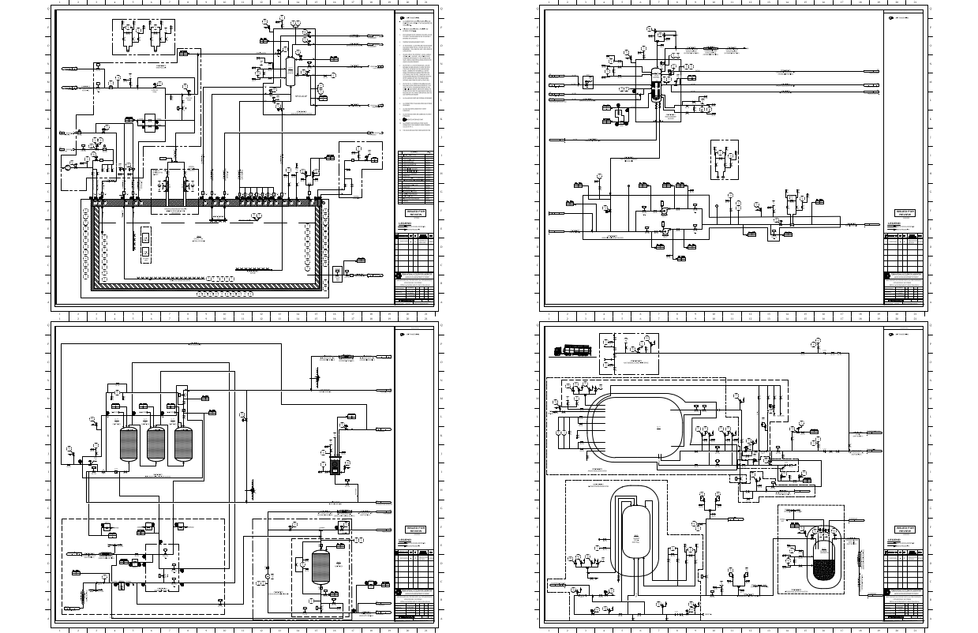
Design
LINK: EDMS 2370342
P&IDs and functions very similar to SBN-ND.
Supply of liquid argon to 7-off ArgonCube strings. Agreed on simplified Argon distribution.
Details of Internal Cryogenics to be worked out.
Supply of LN2 to He services to surface and cavern.
Integrated design and VIE with AutoCAD Plant.
Use of PBS to define equipment naming in documentation, P&ID, 3D and interfaces.
Possibility to reuse existing equipment from Fermilab and CERN.

Slide 13
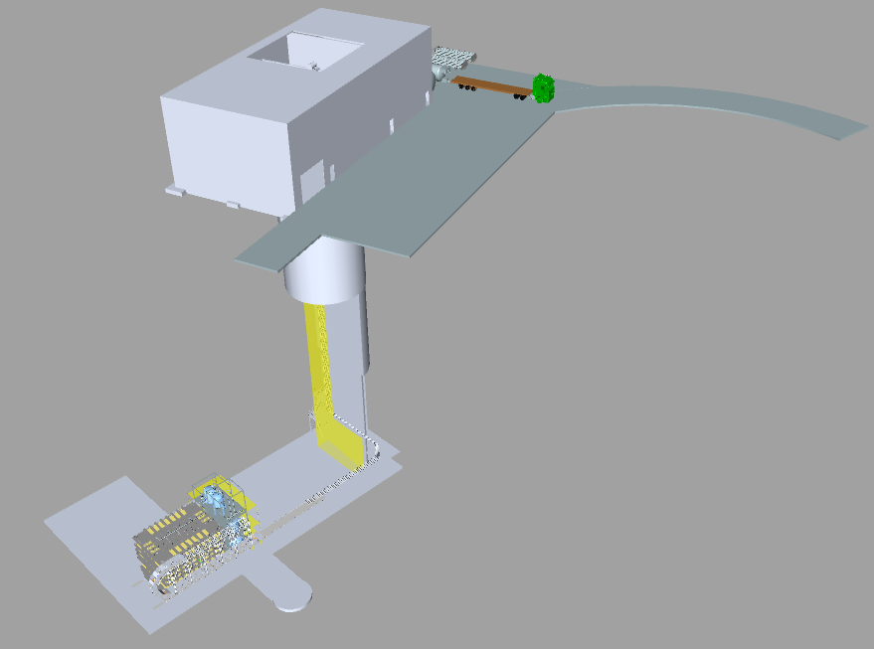
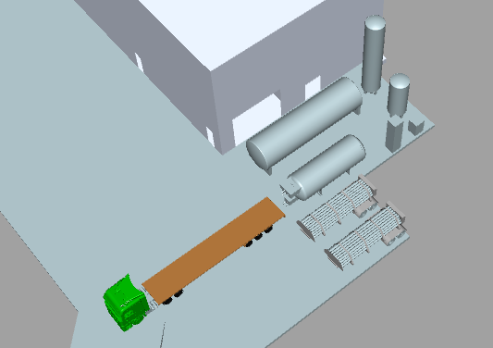
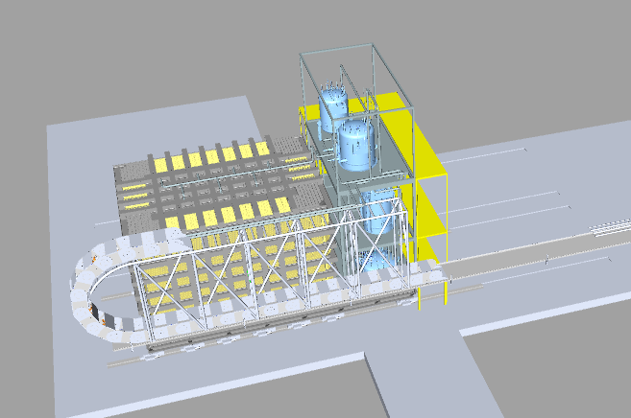
Layout
LINK: EDMS 2339713

Slide 14
LHe Cryogenics

Slide 15
SAND Cooling Requirements (1/2)
https://edms.cern.ch/document/2387229/1
Coil assembly | Parameter
Central Field (T) | 0.6
Layers | 2
Turns/layer | 368
Ampere-turns | 2.14 MA-T
Operating Current (A) | 2902
Design Current (A) | 3000
Inductance at full field (H) | 3.4
Stored energy (MJ) | 14.32
Discharge voltage (V) | 250
Peak Quench Temperature (K) | 80
Conductor | 10 mm x 5 mm Al stabilized NbTi Rutherford cable, Rutherford cable co-extruded with high purity aluminium, wrapped with two half lapped layers of 0.125 mm glass tape.
Coil winding method | internally wound coil; a two layer coil wound on flat with a full vacuum impregnated insulation system
Coil support bobbin | 5083 aluminum cylinder
Coil shell inner diameter (m) | 5.19
Coil Cold mass (ton) | 10 (~8.5)
Radiation shield | two 5 mm thick solid aluminum cylinders with cooling pipes attached to the outside of each
Vacuum Case
Vacuum jacket | 12 mm thick externally rolled and welded machined cylinder with external strengthening ribs
 | 12 mm thick internal rolled and welded machined cylinder with internal strengthening ribs - calorimeter support
 | Two 40 mm thick end plates with double o-ring machined grooves
Vacuum case length (m) | 4.32
Vacuum case inner diameter (m) | 4.86
Vacuum case outer diameter (m) | 5.76
Vacuum case mass (ton) | 26
Iron return yoke mass (ton) | 475
Service Turret | supply and control of LHe including JT valve; supply and control of 70 K helium for radiation shields; gas cooled 3,000 A current leads; Instrumentation connections to the coil and radiation screens; LHe reservoir: 150 liter

Slide 16
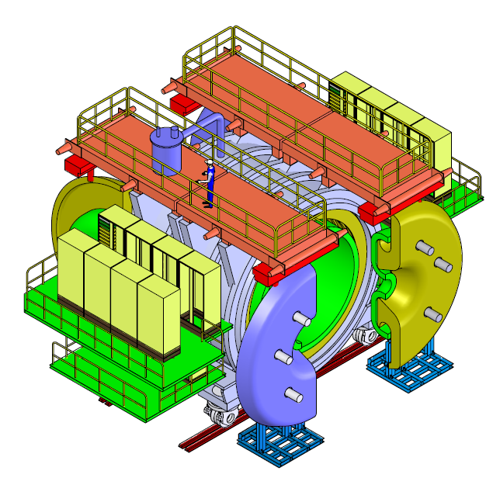
SAND Cooling Requirements (2/2)
https://edms.cern.ch/document/2387229/1
Coil cooling scheme | indirectly cooled through a LHe thermosiphon cycle
He supply from cold box | 3 bara/ 5K with expansion from 3 to 1.2 bara/4.4K inside the magnet
Thermal shield cooling method | 70K forced cold GHe flow
Current leads | a pair of GHe cooled 3kA leads, cooled by helium vaporized from LHe reservoir in the Turret, 0.4g/s
4 K radiation and conduction (W) | 55
Current leads' cooling flow (g/s) | 0.4
70 K radiation and conduction (W) | 530
Operating temperature (K) | 4.42
Operating pressure (bara) | 1.2
LHe in magnet w/Turret (liter) | ~200
LHe reservoir in Service Turret (liter) | ~150
300-70K cool down scheme | 300K and 70K GHe mixing forced flow, 4~5 bara
70-4K magnet cool down scheme | 3 bara/5K GHe forced flow
Coil cold mass (ton) | ~10

Slide 17
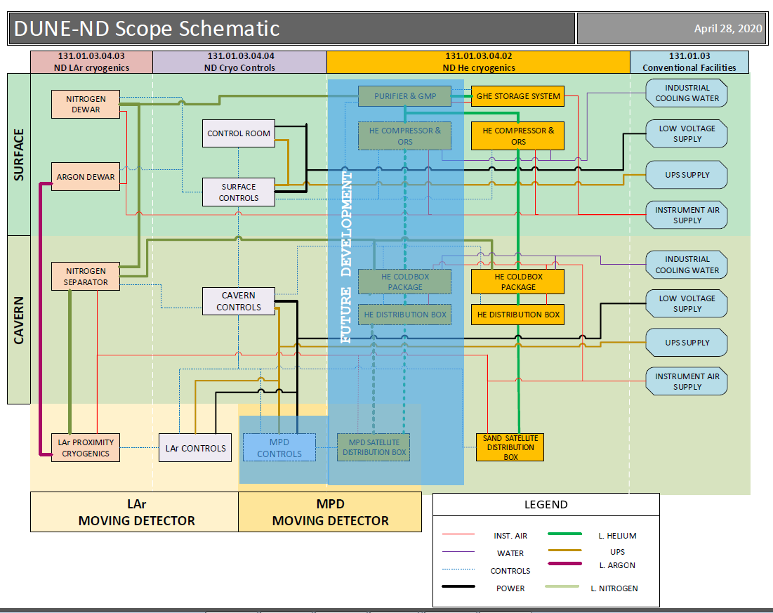
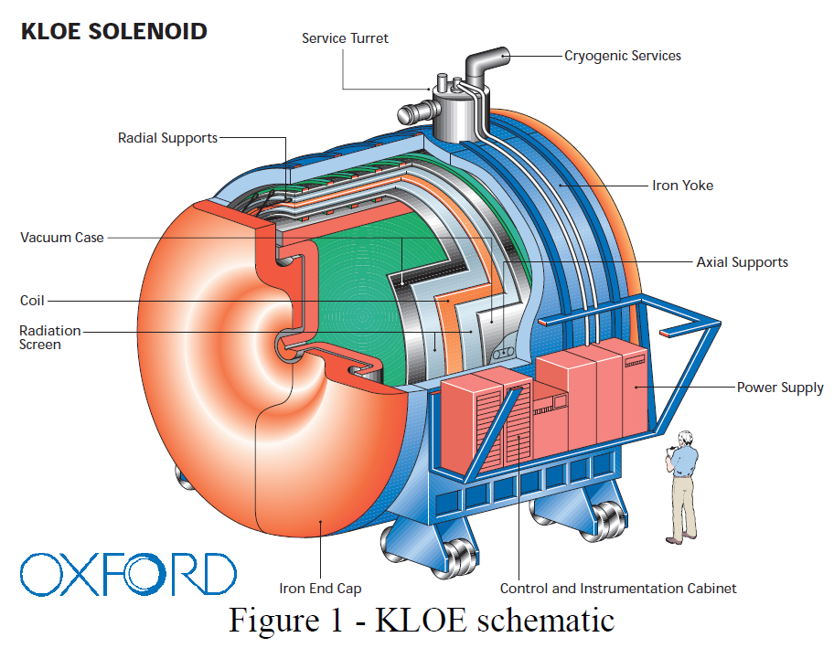
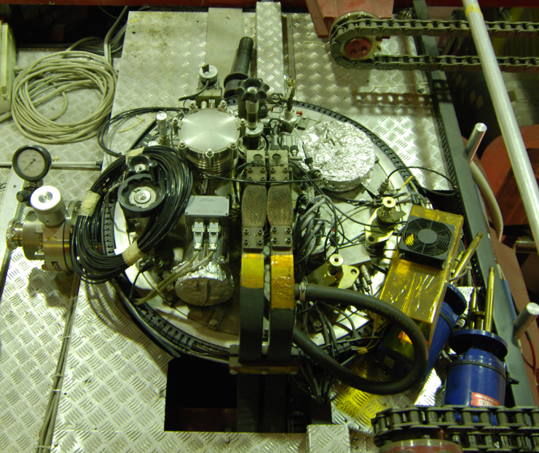
Interfaces
LAr system:
  LN2 phase separator.
  LN2/GN2 transfer lines.
SAND magnet:
  Service turret.
Integration & Installation:
  Energy Chain.
  Platform.
  Near Site Cryo Controls.

Slide 18
Modes of Operation
Based on old SAND magnet cooling system:
Cool down processes.
300-77 K cool down: SAND magnet and thermal shields.
77-4 K cool down: SAND magnet and current leads w/ thermal shields at 70-80K.
Normal operation.
Quench process.
Cool down after quench.
Warm-up.
Failure modes (vacuum loss, power outage, etc.).

Slide 19
Design Schemes
DM: This slide has been edited.
Preliminary design supports SAND magnet, with upgrade capabilities to also support a future magnet.
Two Schemes are considered (both under design) and will be determined based on available installation space and bottoms-up cost estimates:
  Scheme I: One smaller He refrigerator with LN2 precool (~200 W at 4.5 K). Will require another smaller refrigerator and another LN2 precool for future magnet.
  Scheme II: One larger He refrigerator without LN2 precool to support SAND magnet (4-500 W at 4.5 K). Will require LN2 precool for future magnet.
Scheme I being pursued. However recent design developments (increased heat load) may lead to reconsider Scheme II.

Slide 20
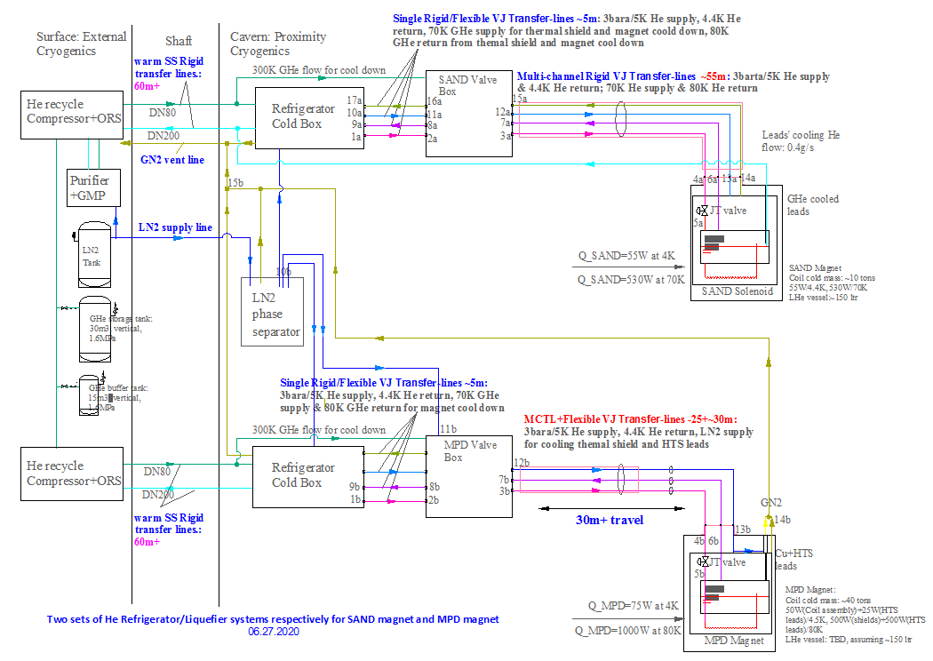
Process Flow Diagram (Scheme I)
DM: This slide has been edited.
https://edms.cern.ch/document/2387228/1
One 200 W / 4.5 K order of magnitude He Refrigerator system with LN2 precooled cold box is under design to only serve the SAND magnet.
LN2 phase separator shared with LAr system.
Includes interfaces to be able to connect to future magnet cooling system.
Another 200W/4.5K order of magnitude He Refrigerator system with LN2 precooled cold box will be added to serve a future magnet later.
Interfaces to cryo-system for future magnet
To support Future Magnet

Slide 21
Preliminary P&ID for SAND magnet cooling system
https://edms.cern.ch/document/2387228/1

Slide 22
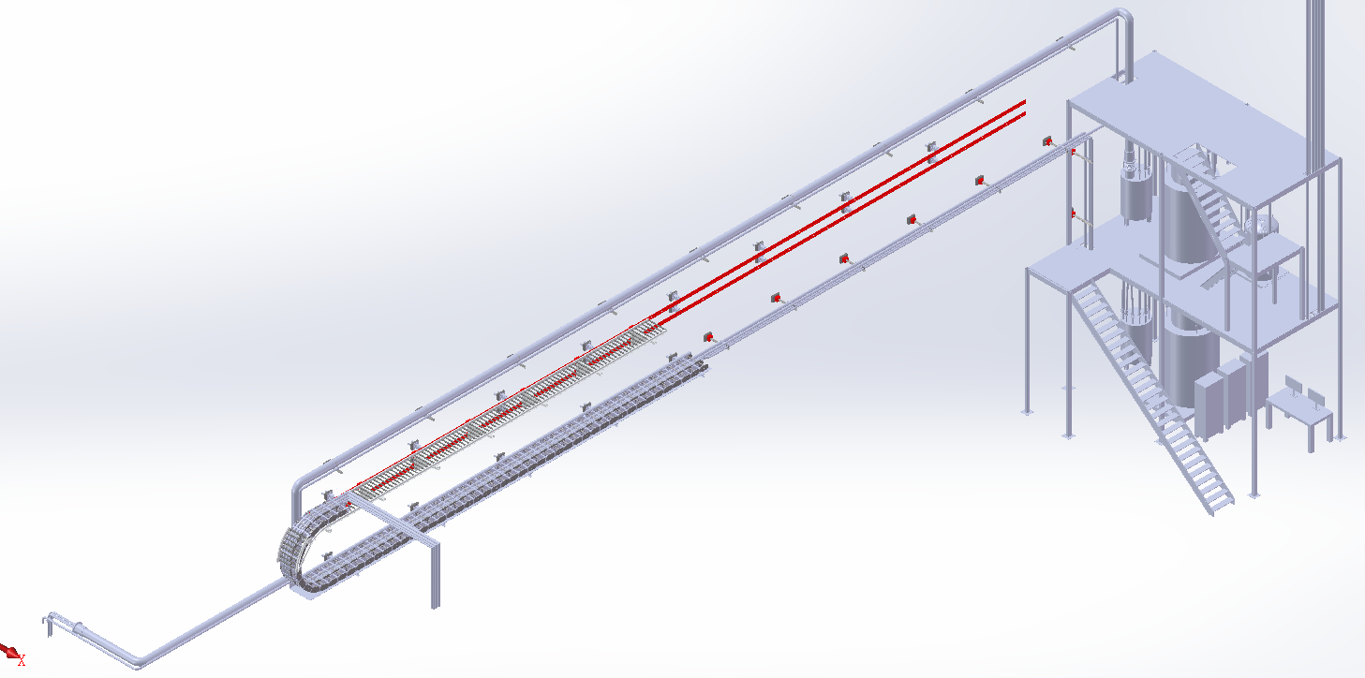
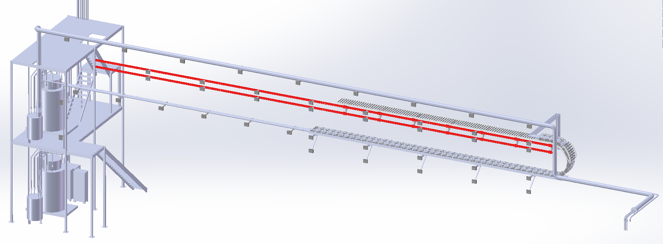
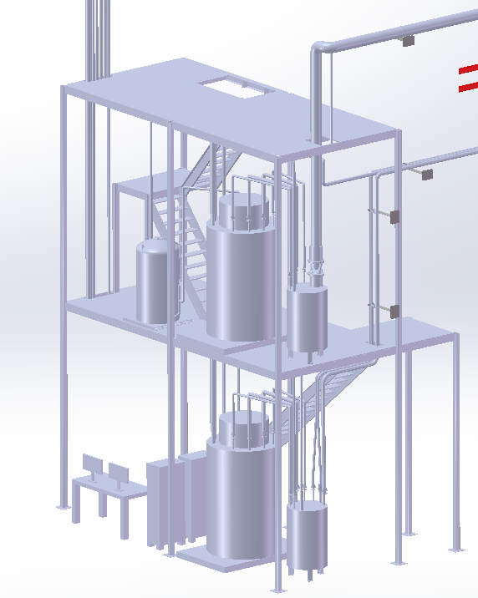
Layout Plan
DM: This slide has been edited.
Preliminary design of VJ cryo-transfer lines under development to optimize routing and reduce their length (heat load).
MCTL for future movable magnet
FTL on Energy Chain
MCTL for SAND
to future movable magnet
LN2 separator
SAND CB+DVB
Future Magnet CB+DVB
to SAND magnet

Slide 23
Process Controls

Slide 24
Process Controls
Main Cryo controls system:
  Designed for autonomous operations. Under normal conditions does not require human operators.
  With redundancy to reduce system downtime.
  Exhibit control over all cryo equipment at Near Site (either directly or indirectly).
Safety Integrated System:
  Provides ODH protection.
  Provides cryostat overpressure protection.
  Decoupled from main to allow for main system updates without interfering with safety safety system.
Developed:
  System architecture.
  PLC Controls strategy.
  HMI/SCADA Strategy.
  I/O counts and I/O maps.
  Preliminary Drawings (Main and safety PLC and control cabinets mechanical and electrical drawings).

Slide 25
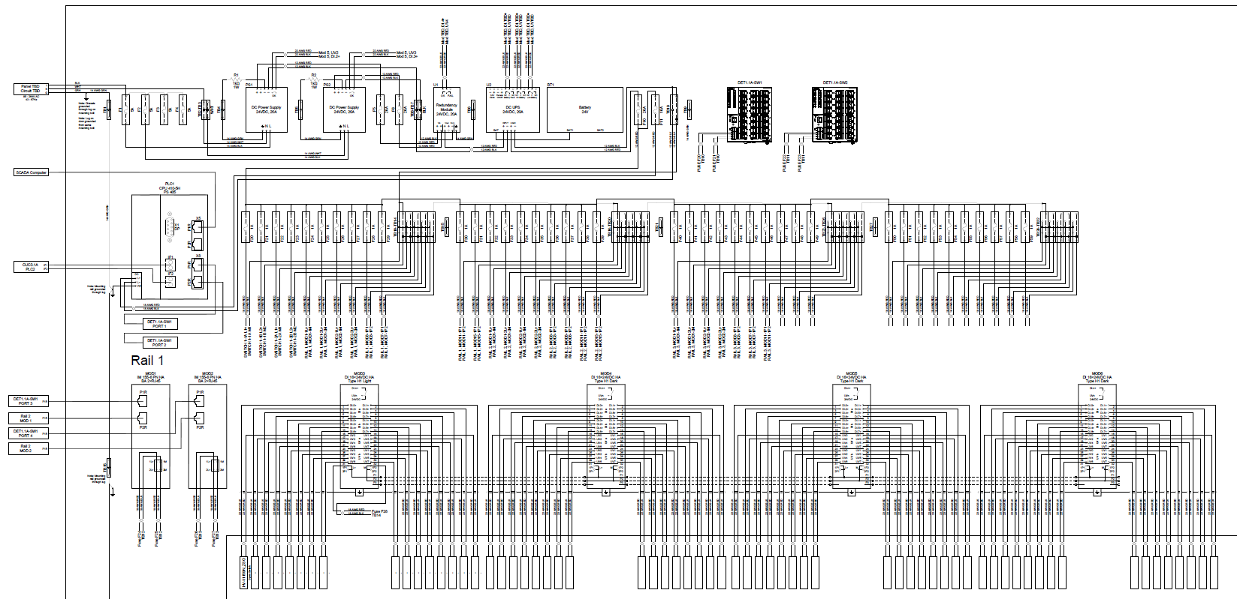
Sample Cabinet Electrical Diagram PLC – Sample drawing

Slide 26
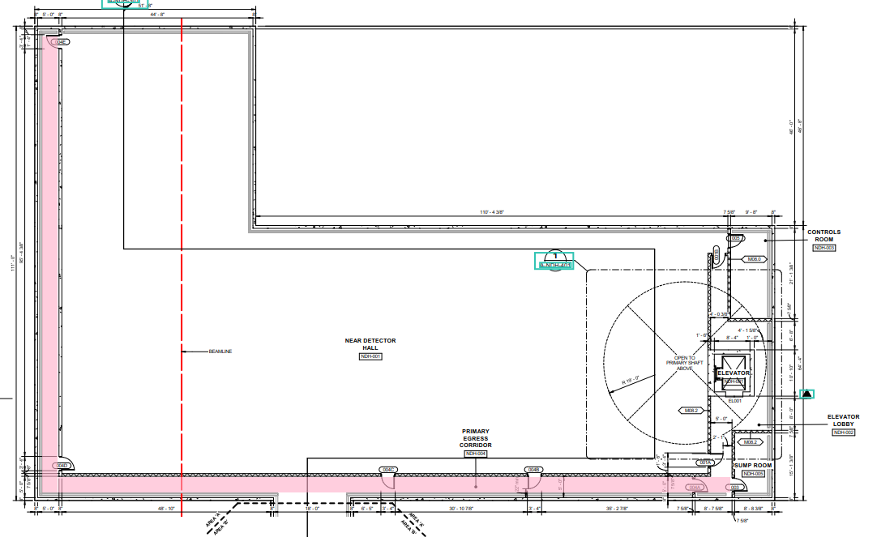
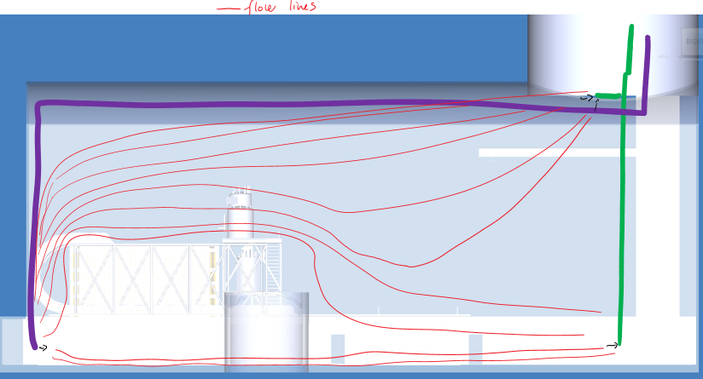
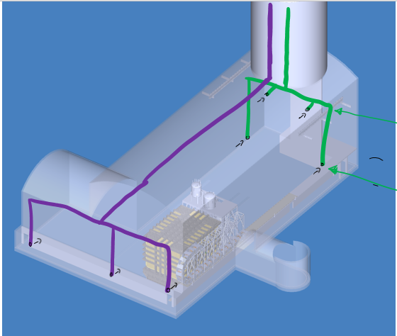
ES&H
ODH 1 + escape pack with OA 7500 CFM.
Shared ODH mitigation with HVAC.
Escape corridor at the cavern level.
LBNF cryo safety panel engaged with concept.

Slide 27
Design Status
Design work started in Dec-2019 and proceeding with high priority.
Tremendous progress to date:
  Preliminary Design (pipe and equipment sizing, process parameters, etc.).
  3D layouts.
  P&IDs.
  Main cryo controls and safety controls strategy and cabinet drawings.
  ODH strategy socialized with LBNF Cryo safety review panel.
Preliminary Design Reviews (PDRs) on Jul 1-2, 2020.
Process Controls WBS fully implemented in P6. Ian Young is Manager and CAM.
LAr Cryogenics WBS fully implemented in P6. Joaquim Creus is Manager and CAM.
LHe Cryogenics WBS being developed. Conceptual-level estimates being updated with detailed bottoms-up estimates. Values expected to be inline with current estimates. Li Wang is Manager. Will become CAM once bottoms-up completed.

Slide 28
Next Steps
LAr Cryogenics:
  Finalize LAr Cryogenics Detector requirements.
  Finalize Interfaces between cryogenics and LAr Detector.
  Possibility to reuse valve boxes from Fermilab/SBN (??) and CERN/ProtoDUNEs (✓).
LHe Cryogenics:
  Confirm SAND Detector requirements.
  Finalize Interfaces between cryogenics and SAND.
  Obtain design and manufacturing documentation for SAND magnet and its operation at LNF.
Process Controls:
  Update design and plan as LAr Cryogenics and LHe Cryogenics advance.
  Complete drawings.
ODH:
  Complete definition of requirements for NSCF.

Slide 29
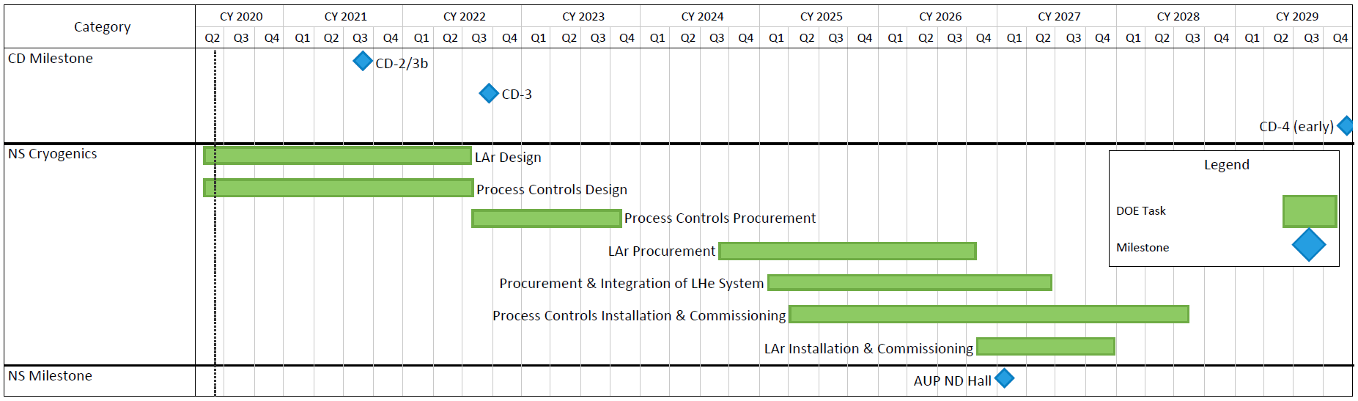
NS Cryo Summary Schedule
LHe Engineering

Slide 30
Summary
Management and Engineering structure in place and functioning.
Highly qualified and motivated team.
Design of all items proceeding at fast pace and with high priority.
Working with Integration and Near Detector to address requirements and interfaces.

Slide 31
Thanks

Slide 32
Backup

Slide 33
Reuse valve boxes from DUNE related experiments
As presented in Value Engineering request VE-3 Cryo, the following valve boxes from SBN or ProtoDUNE are proposed to be reused:
GAr purification vessel: The vessel purification capacity is oversized for ProtoDUNE, fully capable.
LAr condenser: The tube shell 24kW condenser design is capable to handle the cool-down and normal operation loads. Also the nitrogen vessel works well as a secondary phase separator.
LAr circulation valve box: The valve box has all the functions enabled. If the valve box with B&N 1.63 kg/s was donated, they would have to be replaced by smaller capacity specified to fit in the current pump casing.
Valve boxes that can’t be reused
LAr purification vessel: The vessel is oversized for 1.63 kg/s and almost does not fit in the ND-LAr platform.
Argon Phase Separator: Additional LAr outlets required for ArgonCube.
Nitrogen Phase Separator: Larger vessel and vent valve required, multiple outlets

Slide 34
LAr Cryogenics Schedule
LINK: EDMS 2339685
 | 2020 |  | 2021 |  | 2022 |  | 2023 |  | 2024 |  | 2025 |  | 2026 |  | 2027
Preliminary Design
Final Design
Procurement
Manufacturing
Installation
Commissioning

Slide 35
Previous LAr TPC experiences with similar systems
The following experiences have helped establish the LAr purification and membrane cryostat technologies, operating procedures, best practices and lessons learned that try to be implemented in this system:
FNAL LAPD -> LAr purification
FNAL 35-Ton Prototype -> LAr purification, membrane cryostat
FNAL MicroBooNE -> LAr purification
CERN WA105-182 -> LAr purification, membrane cryostat
CERN ProtoDUNE Single Phase -> LAr purification, membrane cryostat
CERN ProtoDUNE Dual Phase -> LAr purification, membrane cryostat
SBN – FD -> LAr purification
SBN – ND ( under construction) -> LAr purification, membrane cryostat

Slide 36
ES&H and Quality Assurance/Quality Control (QA/QC)
CHARGE QUESTION 5
ES&H:
  Team is involved with LBNF Cryo Safety panel for ODH considerations.
QA/QC:
  Following LBNF/DUNE QA plan.
  LBNF QA Manager will assist in the development of QA Plans, as needed, and review Manufacturer’s QC Plans.
  Equipment manufacturers will follow their facility’s QA/QC Program.
  Subcontractors will be responsible for QC of installation.
  Cryogenic team will perform oversight of fabrication and installation.
  Fabrication and Installation QA/QC documentation will be maintained.

Slide 37
LAr Cryogenics Doc list
Document | Item | Cat. | ID | Rev | Title | Date | Class | Author | Status
EDMS 2385443 | 000 | DOC |  | Rev 1 | DOC List | 5/29/2020 | PM | J Creus | APPROVED
EDMS 2385428 | 001 | DOC |  | Rev 1 | PDR Presentation - 15 min | 6/16/2020 | PM | J Creus | APPROVED
EDMS 2370356 | 002 | DOC |  | Rev 1 | Basis of Estimates | 5/12/2020 | PM | J Creus | APPROVED
EDMS 2381764 | 003 | DOC |  | Rev 1 | Risk register | 6/4/2020 | PM | J Creus | APPROVED
DOCDB 19258 | 004 | DOC |  | Rev 1 | Value Engineering Request CRYO-3 | 6/9/2020 | PM | J Creus | APPROVED
EDMS 2339749 | 005 | DOC |  | Rev 1 | ICD: LA cryo - CF | 3/3/2020 | ICD | J Creus | APPROVED
EDMS 2385478 | 006 | DOC |  | Rev 1 | ICD: LAr cryo - ND I&I: Energy Chain, Cryostat. | 6/12/2020 | ICD | J Creus | APPROVED
EDMS 2385477 | 007 | DOC |  | Rev 1 | ICD: LAr cryo - He for shared Nitrogen supply | 6/4/2020 | ICD | J Creus | APPROVED
EDMS 2339713 | 008 | DRW | F10135040 | Rev 1 | 3D model | 4/28/2020 | ENG | J Tillman | APPROVED
EDMS 2370889 | 009 | DRW | F10135040 | Rev 1 | 2D drawings | 5/12/2020 | ENG | J Tillman | APPROVED
EDMS 2370342 | 010 | DRW |  | Rev 1 | P&ID drawing | 6/2/2020 | ENG | M Delaney | APPROVED
EDMS 2380142 | 011 | DOC |  | Rev 1 | PBS: Product Breakdown Structure | 5/29/2020 | ENG | J Creus | APPROVED
EDMS 2376034 | 012 | DOC |  | Rev 1 | Preliminary ODH analysis | 10/3/2019 | ENG | M Adamowski | APPROVED
EDMS 2380152 | 013 | DOC |  | Rev 1 | Purification system sizing | 4/9/2020 | ENG | J Creus | APPROVED
EDMS 2385846 | 014 | DOC |  | Rev 1 | VI&E List | 6/17/2020 | ENG | J Creus | APPROVED
EDMS 2390106 | 015 | DOC |  | Rev 1 | ND-LAr detector requirements documentation | 6/25/2020 | ENG | J Creus | APPROVED
EDMS 2390126 | 016 | DOC |  | Rev 1 | ND-LAr process parameters for RFI application notes | 5/4/2020 | ENG | J Creus | APPROVED

Slide 38
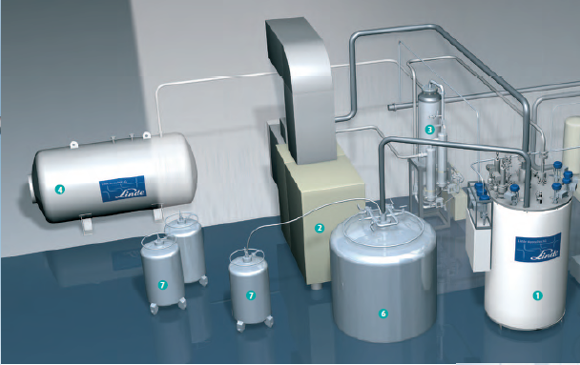
Commercial Refrigerator/Liquefier
Linde-He Refrigerator/Liquefier: Dynamic gas-bearing turbine technology
Series No. | Liquefaction rate at 4.5K (L/hr) |  | Refrigeration at 4.5K (W) |  | Power Rating (kW)
 | w/LN precooling | w/o LN precooling | w/LN precooling | w/o LN precooling
L70 | 40-70 | 20-35 |  |  | 45~75
LR70 |  |  | 130-190 | 100-145
L140 | 90-140 | 45-70 |  |  | 90~132
LR140 |  |  | 255-400 | 210-290
L280 | 200-290 | 100-145 |  |  | 160~250
LR280 |  |  | 560-900 | 445-640
Air Liquide-He Liquefier: Static gas-bearing turbine technology
 | Liquefaction rate at 4.5K (L/hr) |  | Refrigeration at 4.5K (W) |  | ELECTRIC POWER (kW) | MAXIMUM EFFICIENCY (kW/(L/hr))
 | w/LN precooling | w/o LN precooling | w/LN precooling | w/o LN precooling
HELIAL SL | 30 to 50 | 15 to 25 |  |  | 45 to 55 | 1.0
HELIAL SF |  |  | 100-300 |  | 45 to 132
HELIAL ML | 75 to 150 | 35 to 70 |  |  | 75 to 132 | 0.9
HELIAL MF |  |  | 300-600 |  | 132 to 210
HELIAL LL | 215 to 330 | 110 to 145 |  |  | 160 to 250 | 0.75
HELIAL LF |  |  | 600-1000 |  | 210 to 315

Slide 39
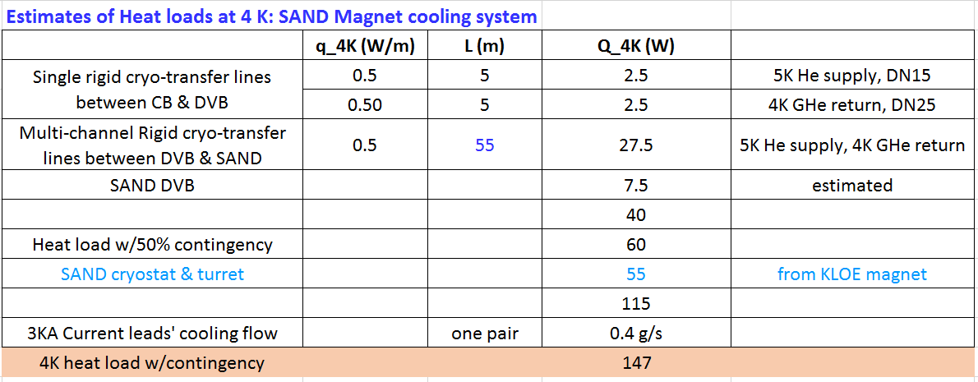
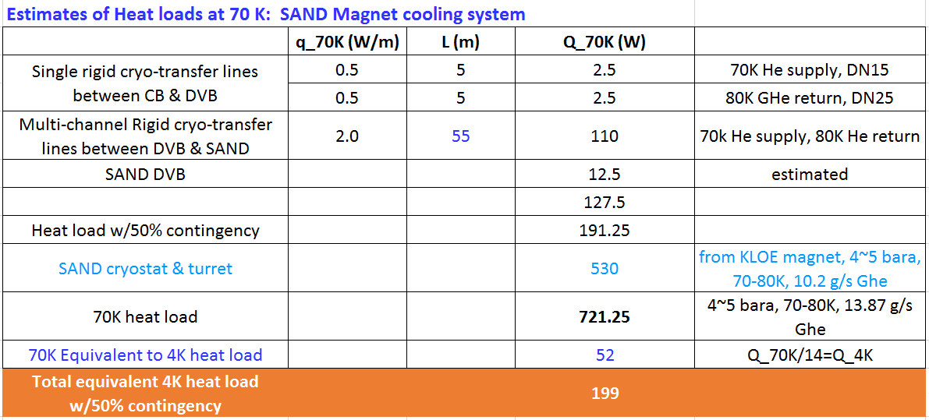
Estimates of Heat Loads: SAND cooling system
https://edms.cern.ch/document/2387227/1
Assuming:
Q_SAND include contingency, only add 50% contingency to Q_lines and Q_DVBs.
Cooling capacity: at least 200W at 4.4K w/ 70K Ghe supply

Slide 40
Main Components
https://edms.cern.ch/document/2387227/1
  Surface:
  He recycle compressor + ORS + GMP + He Purifier
  GHe storage/buffer tanks
  Warm piping/valve system
  LN2 tank
  Shaft:
  Warm Ghe transfer lines (HP/LP)
  LN2 supply cryo-lines
  GN2 vent lines
  Cavern:
  He Refrigerator cold box & its control system
  Distribution valve box
  Vacuum-jacketed cryogen transfer lines
  LN2 phase separator
To support Future Magnet

Slide 41
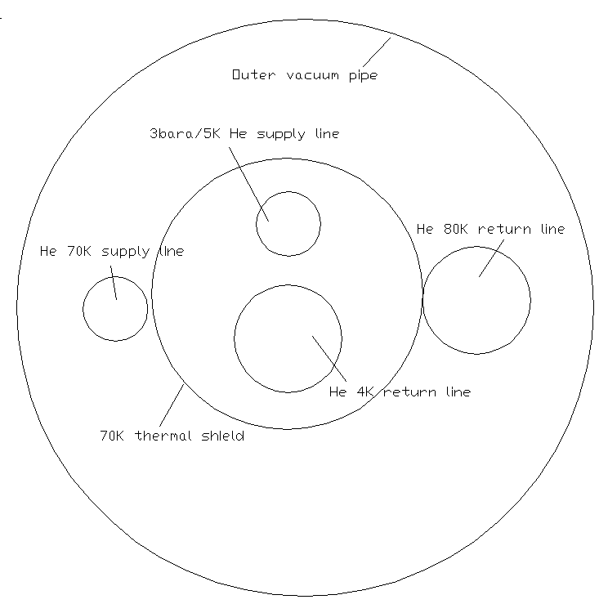
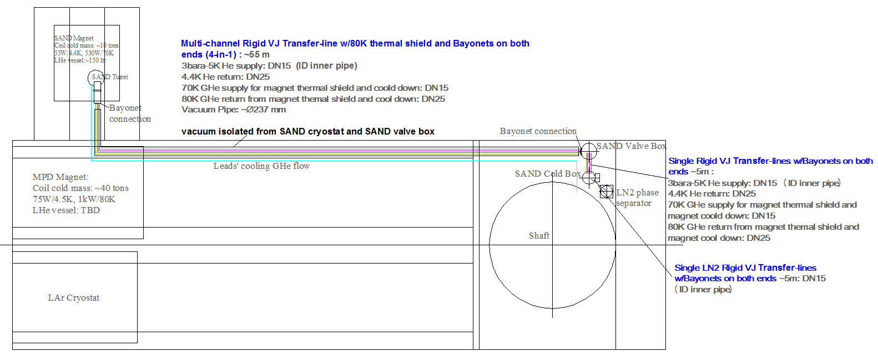
Layout Plans (1/3): Proximity Cryogenics for SAND magnet
https://edms.cern.ch/document/2390133/1

Slide 42
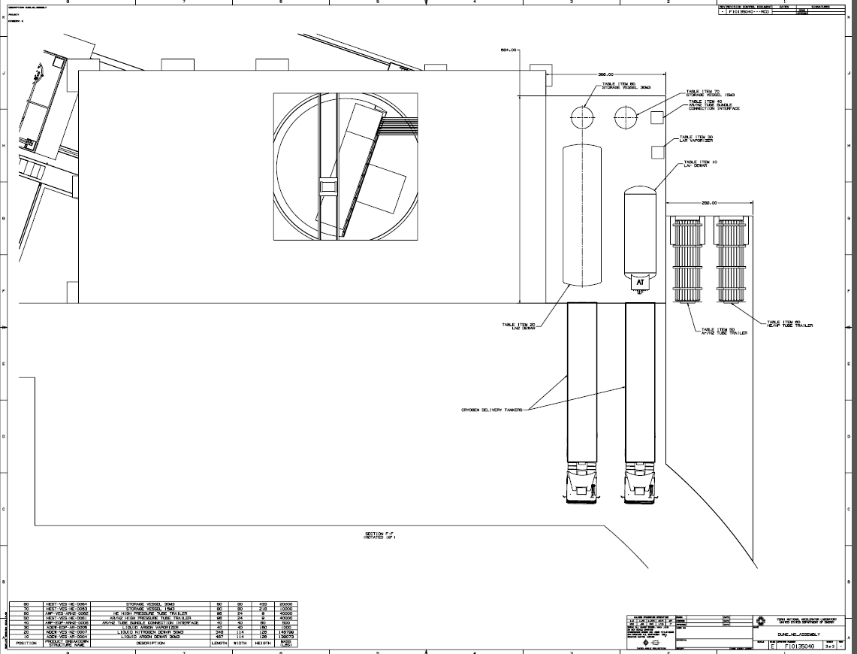
GHe storage/buffer tanks
https://edms.cern.ch/document/2387227/1
Position | Product Breakdown Structure name | Description | Length | Width | Height | Mass
 |  |  | in | in | in | lbs
70 | HEST-VES-HE-0063 | Storage Vessel 15m3, vertical, 1.6MPa | 80 | 80 | 218 | 10,000
80 | HEST-VES-HE-0064 | Storage Vessel 30m3, vertical, 1.6MPa | 80 | 80 | 433 | 20000

Slide 43
Process Parameters & System Sizing (1/2)
https://edms.cern.ch/document/2387227/1
SAND Cooling System
 | Work point | P (bara) | T (K) | Mass flow rate (g/s) | Inner Din - VJ Cryo-lines
3bara/5K He suspply | 1a | 3.0, negligible pressure drop | 4.94 | 5.038 | DN15 (15~18mm)
 | 2a |  | 5
 | 3a |  | 5.06
 | 4a (before JT valve) |  | 5.38
 | 5a (after JT valve) | 1.2 | 4.42, x=0.363
4K He return | 6a | 1.2, negligible pressure drop | 4.42, x=1 | 4.638 | DN25 (25~30mm)
 | 7a |  | 4.78
 | 8a |  | 4.91
 | 9a |  | 4.98
70K Ghe supply | 10a | 5.0, negligible pressure drop | 68.8 | 10.2 | DN15 (15~18mm)
 | 11a |  | 68.85
 | 12a |  | 68.96
 | 13a |  | 70.00
80K Ghe return | 14a | 1.2~1.5, neligible pressure drop | 80.00 | 10.2 | DN25 (25~30mm)
 | 15a |  | 81.04
 | 16a |  | 81.16
 | 17a |  | 81.21

Slide 44
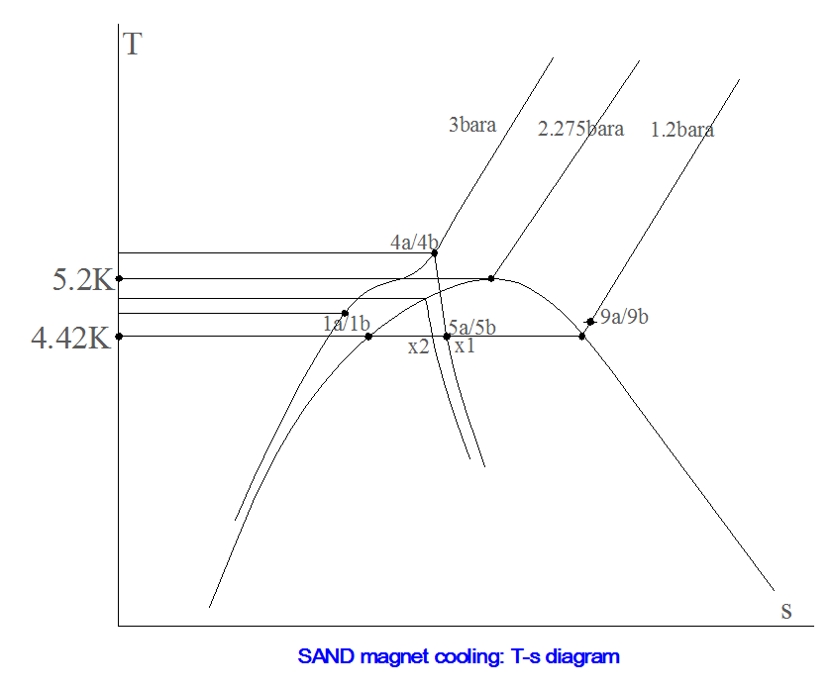
Process Parameters & System Sizing (2/2): T-s Diagram
T at P=3bara before JT valve will be in the range of 4.42~5.876K. If T is higher than 5.876K, there will be no liquid helium generated after JT throttle.
For SAND magnet cooling, the mass flow rate supplied from cold box at 3 bara will be > 5.0 g/s and its temperature lower than 5 K.
In order to lower down the temperature before JT valve, heat loads resulting from VJ cryo-transfer lines need to be reduced as much as possible, or a LHe subcooler may be adopted.

Slide 45
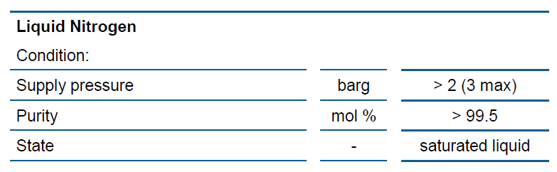
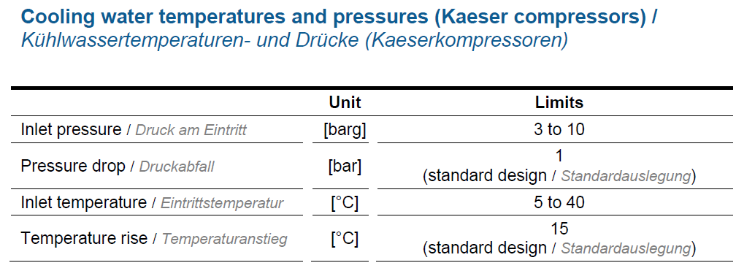
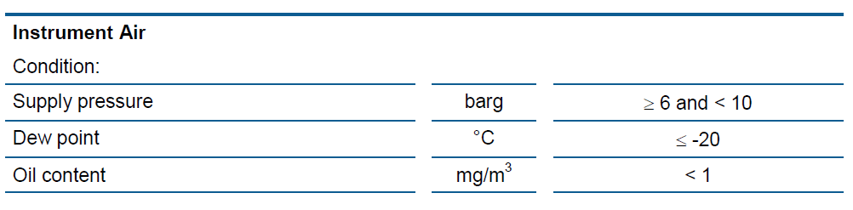
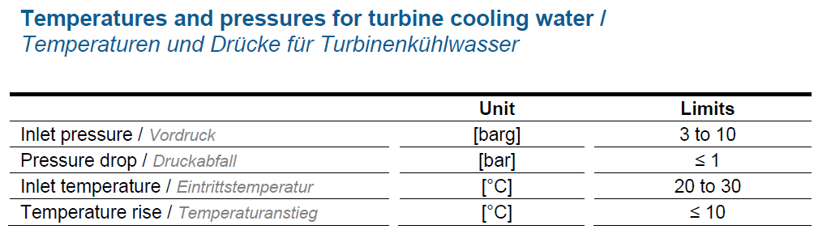
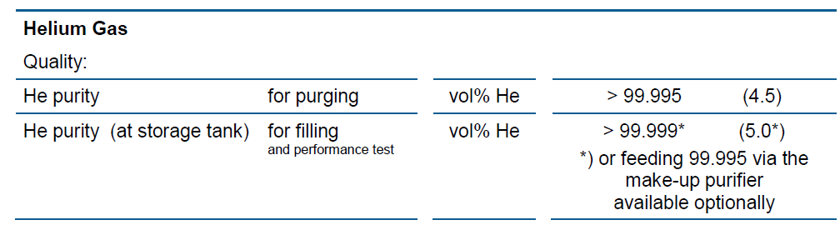
Specifications of Utilities
https://edms.cern.ch/document/2387227/1
* Data from Linde Kryogenik AG.

Slide 46
LHe Cryogenics Doc list
DUNE Near Site: LHe Cryogenics for Magnets
Folder | EDMS ID | Title | File Name | Upload Date | Author | Note
P&ID for LHe Cryogenics | 2387228 (v.1) | DUNE ND LHe Cryogenics Preliminary P&ID | DUNE_ND_LHe_Cryoplant_Preliminary_PID_LW_06182020.dwg | 2020-6-21 | L. Wang
 |  |  | DUNE_ND_LHe_Cryoplant_Preliminary_PID_Only_SAND.pdf | 2020-6-25 | L. Wang
 |  |  | DUNE_ND_LHe_Cryoplant_Preliminary_PID_Scheme_I.pdf | 2020-6-25 | L. Wang
 |  |  | DUNE_ND_LHe_Cryoplant_Preliminary_PID_Scheme_II.pdf | 2020-6-25 | L. Wang
 |  |  | DUNE_ND_LHe_Cryoplant_Preliminary_PID_Only_SAND_Update.pdf | 2020-6-28 | L. Wang
 |  |  | DUNE_ND_LHe_Cryoplant_Preliminary_PID_Scheme_I_Update.pdf | 2020-6-28 | L. Wang
 |  |  | DUNE_ND_LHe_Cryoplant_Preliminary_PID_Scheme_II_Update.pdf | 2020-6-28 | L. Wang
Layout Plans | 2390133 (v.1) | LHe cryogenics Preliminary layout plans in Cavern | DUNE_ND_LHe_Cryoplant_Preliminary_Layout_MPD_magnet_cooling.pdf | 2020-6-25 | L. Wang
 |  |  | DUNE_ND_LHe_Cryoplant_Preliminary_Layout_SAND_magnet_cooling.pdf | 2020-6-25 | L. Wang
 |  |  | DUNE_ND_LHe_Cryoplant_Preliminary_Layout_SAND_magnet_cooling_Update.pdf | 2020-6-28 | L. Wang
 |  |  | DUNE_ND_LHe_Cryoplant_Preliminary_Layout_MPD_magnet_cooling_Update.pdf | 2020-6-28 | L. Wang
Cost Estimates | 2387232 (v.1) | BOE of DUNE ND LHe Cryogenics | LBNF_NearSite_LHeCryogenics_CostEstimate_LW_20200621update.pdf | 2020-6-22 | L. Wang
 |  |  | LBNF_NearSite_LHeCryogenics_CostEstimate_LW_20200621update.xlsx | 2020-6-25 | L. Wang
 | 2387233 |  | LBNF_NearSite_LHeCryogenics_CostEstimate_LW_20200621update.xlsx | 2020-6-25 | L. Wang
Design Documents | 2387227 (v.1) | DUNE ND LHe Cryogenics Design | DUNE_ND_LHe_Cryogenics_Preliminary_Design_LW_20200618.xlsx | 2020-6-25 | L. Wang
 |  |  | DUNE_ND_LHe_Cryogenics_Preliminary_Design_LW_20200627update.xls | 2020-6-28 | L. Wang
 |  |  | DUNE_ND_LHe_Cryoplant_Calculation_Model.pdf | 2020-6-25 | L. Wang
 |  |  | DUNE_ND_LHe_Cryoplant_Calculation_Model_Update.pdf | 2020-6-28 | L. Wang
 |  |  | DUNE_ND_LHe_Cryogenics-PDR-July2020_V1.pptx | 2020-6-25 | L. Wang
 |  |  | DUNE_ND_LHe_Cryogenics-PDR-July2020_V2.pptx | 2020-6-28 | L. Wang
 |  |  | kloe-Cryo-PID.pdf | 2020-6-21 | L. Wang | Publication or Engineering reports regarding KLOE magnet & its cooling
 | 2387229 |  | kloe-Cryo-PID.pdf | 2020-6-21 | L. Wang | Publication or Engineering reports regarding KLOE magnet & its cooling
 |  |  | The_DAONE_Cryogenic_System.pdf | 2020-6-21 | L. Wang
 |  |  | 3DST-SAND_Assy_2020-03-04.PDF | 2020-6-21 | L. Wang
 |  |  | 00614583.pdf | 2020-6-21 | L. Wang
 |  |  | P00022550_The_KLOE_Detector_Techinical_Proposal_1993.pdf | 2020-6-28 | L. Wang
 |  |  | Status_of_DAONE_and_KLOE_1999.pdf | 2020-6-28 | L. Wang

Slide 47
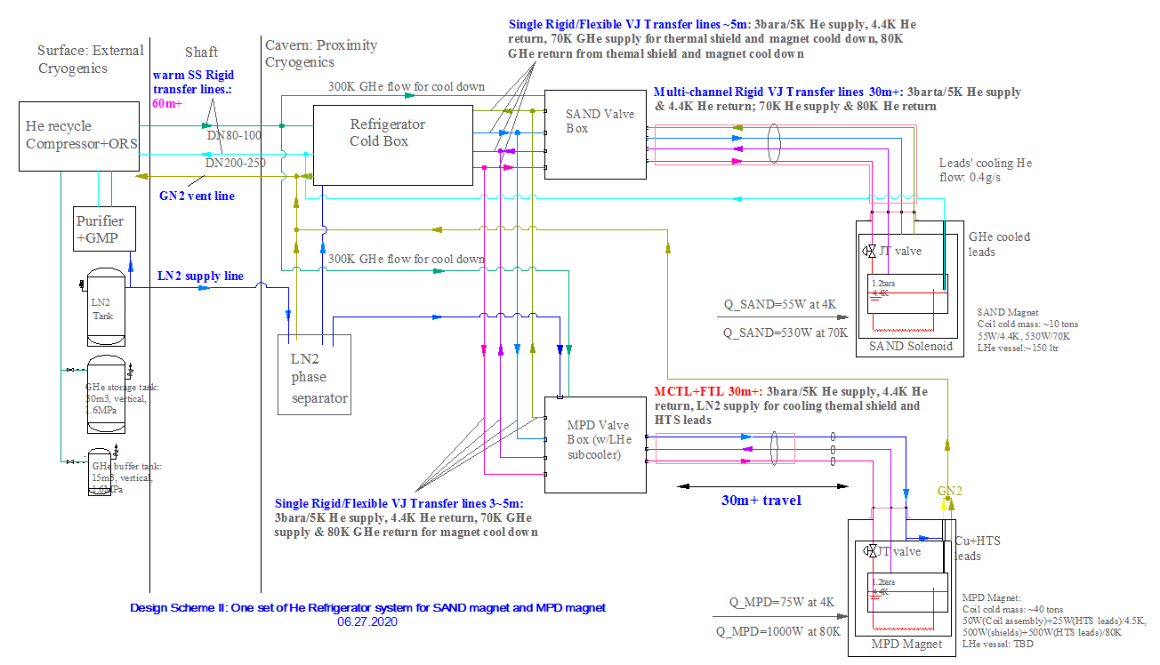
Process Flow Diagram (2/2): Design Scheme II
https://edms.cern.ch/document/2387228/1
One 400~500 W / 4.5K He Refrigerator system without LN2 precool is used to serve the SAND magnet.
No LN2 is needed for SAND cooling system.
Interfaces upgradable to support future magnet cooling system.
The 400~500W/4.5K He Refrigerator system with LN2 precool will be used to cool both SAND and MPD magnet later.
Interfaces to cryo-system of future magnet
To support Future Magnet

Slide 48
Cooling Requirements for SAND Magnet and MPD Magnet
https://edms.cern.ch/document/2387227/1
 | SAND magnet | MPD magnet
Coil cooling scheme | thermosiphon circulation LHe flow system through cooling channels welded to the outside of the coil support cylinder, a solenoid magnet indirectly cooled through a Lhe thermosiphon cycle | Thermosiphon
He supply from cold box | 5.2 K and 3 bara with expansion from 3 to 1.2 bara inside the magnet
Thermal shield cooling method | 70K forced cold GHe flow: 50 K gas for thermal shields removed at the 1st turbine output | cooled by force LN2 flow
Current leads | a pair of GHe cooled 3kA leads, cooled by helium vaporized from Lhe reservoir in the Turret | a pair of conduction-cooled 10kA HTS leads; cooling approach to cold ends of Cu leads/warm ends of HTS leads at 80K : conduction-cooled using LN2 circuit; cooling approach to cold ends of HTS leads: conduction-cooled by Lhe
4 K radiation and conduction (W) | 55 | 50 at 4.7K
HTS power lead pair 4.7 K heat load (W) | N/A | 25
Current leads' cooling flow | 0.4 g/s Ghe | N/A
70 K radiation and conduction (W) | 530 | 500 at 80K
HTS power lead pair 80 K heat load (W) | N/A | 500
Operating temperature (K) | 4.42 | 4.7
Operating pressure (bar) | 1.2
Lhe in magnet w/Turret (ltr) | ~200
Lhe reservior in Service Turret (ltr) | ~150
300-70K cool down scheme | 300K and 70K Ghe mixing foced flow, 4~5 bara | Ghe forced flow
70-4K cool down scheme | 5K 3bara Ghe forced flow | Ghe forced flow

Slide 49
Design Schemes: Comparison
https://edms.cern.ch/document/2387227/1
 | Scheme I | Scheme II
 | SAND+MPD: two refrigerator systems | SAND and MPD later: one refrigerator system
Customized Refrigerator capacity | 2 x ~200W/4.5K | SAND: ~200W/4.5K; SAND+MPD: 400~500W/4.5K
 | Two ~200W refrigerators w/LN precool | SAND: one 400~500W refrigerator w/o LN precool; SAND+MPD: one 400~500W w/LN precool
External Cryogenic Facilities | 2 x~200W refrigerators He recycle compressor + ORS & GMP control cabinet | 1 x 400~500W refrigerator He recycle compressor + ORS & GMP control cabinet
 | shared Ghe storage/buffer tank
 | LN2 tank & 2xHe purifiers | LN2 tank & 1x He purifier
 | 2x (Warm piping/valve system+ LN2 supply cryo-line) | 1x (Warm piping/valve system+ LN2 supply cryo-line)
Cavern Shaft | 2 sets of warm HP (DN80) / LP (DN200) He piping, LN2 supply cryo-line/GN2 vent line | One set of warm HP (DN80) / LP (DN200) He piping, LN2 supply cryo-line/GN2 vent line
Cavern | 2 x ~200W refrigerators Cold Boxes + 2x DVBs | one 400~500W refrigerator Cold Box + 2x DVBs
 | shared LN2 phase separator

Slide 50
Preliminary P&ID for Scheme II
https://edms.cern.ch/document/2387228/1
To support Future Magnet

Slide 51
Preliminary P&ID (Scheme I)
https://edms.cern.ch/document/2387228/1
To support Future Magnet

