Slide 1
DUNE Near Detector PRISM Design
Robert Flight
DUNE CDR: 30% Near Detector Design Review
8 July 2020

Slide 2
DUNE Near Detector PRISM Transport System
Review topics
PRISM Specifications
Detector weights
System components and specs - speeds/times/acceleration
Transport system - movement considerations for SAND
Existing Hilman examples
Prototype plans
PRISM movement safety
Energy chain application

Slide 3
PRISM Specifications
Overall movement time for detectors
8 hours to travel 30.5m
"Gentle" accelerations and low speed of motion
Accelerate to 0.17cm/sec², top speed 10.2cm/min (1.7mm/sec [0.066”/sec])
"Minimal" vibrations to minimize sloshing & LAr module movements
Verify FEA analysis with the prototype
Smoothness of rollers/beams during movement
Precision of location
+/-3cm, with a goal of +/-1cm
Monitoring of location, +/- 1cm, with a goal of +/-1mm
Hilman powered rollers satisfy the movement and location needs
Can be controlled locally or remotely
Commercially available product
Goals to be confirmed with prototype and testing

Slide 4
Transport system movement detector weights Primary Design
Approximate loads:
LAr detector – 900 tonne
MPD – 800 tonne
SAND – 900 tonne
20 tonne of side reaction loads from magnets
20 tonne side load creates a 33 tonne unequal loading on the transport wheels. Not enough to unseat the rollers
KLOE
MPD
LAr Detector

Slide 5
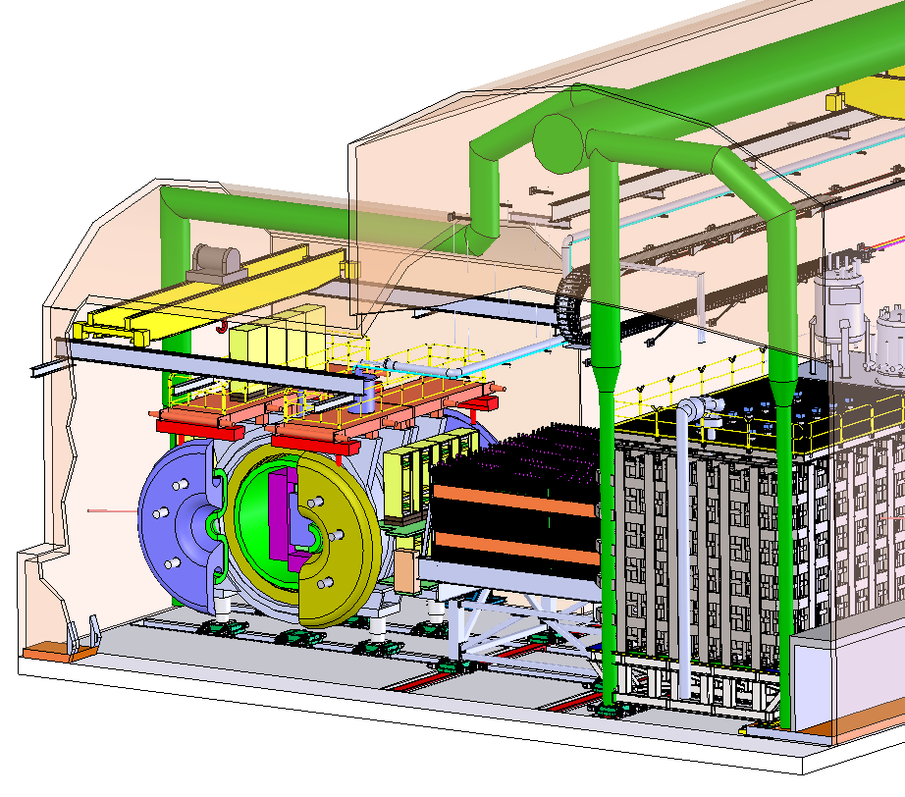
Transport system movement detector weights Fallback Design
Approximate loads:
LAr detector – 900 tonne
Muon Spectrometer – 600 tonne
SAND – 900 tonne
20 tonne of side reaction loads from magnets
SAND
MUON
SPECTROMETER
LAr Detector

Slide 6
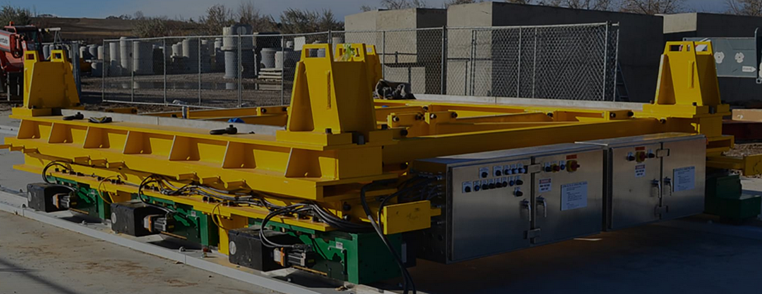
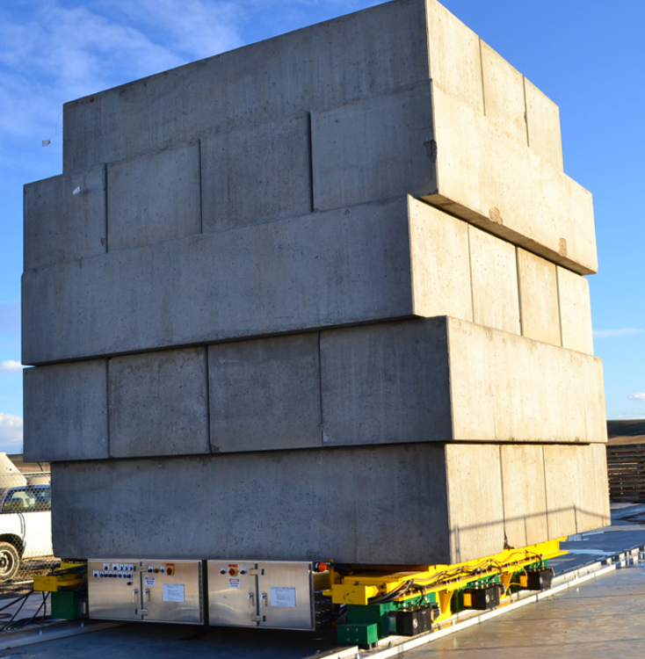
Transport system movement plans
Use Hilman Powered rollers to move detectors
This example shows (6) 100 ton electric motorized roller assemblies moving a 400 ton test load at 1 ft/min for a nuclear waste conversion plant.

Slide 7
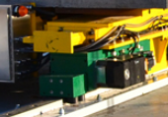
Transport system movement plans
Use Hilman Powered rollers to move detectors
Guide rollers at the 4 corners are sufficient to handle the side loads

Slide 8
Transport system movement plans
This video shows it’s slow, smooth, and can bridge gaps

Slide 9
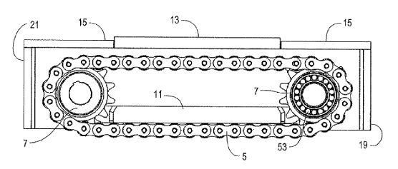
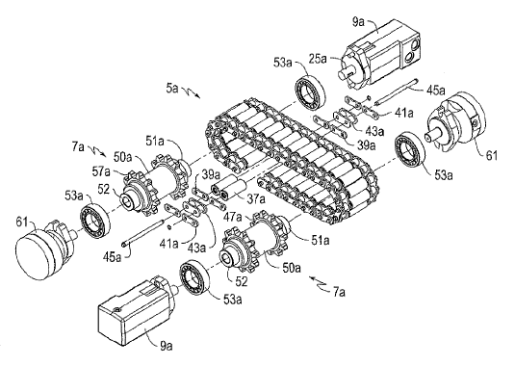
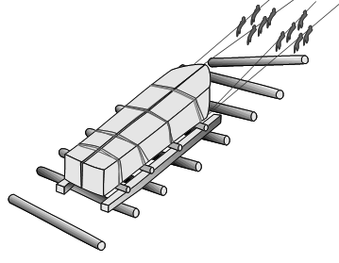
Hilman Powered Skate
It’s the modern version of rolling stuff on logs
The recirculating rollers support the load at plate #11
Similar to a motor driven bulldozer track

Slide 10
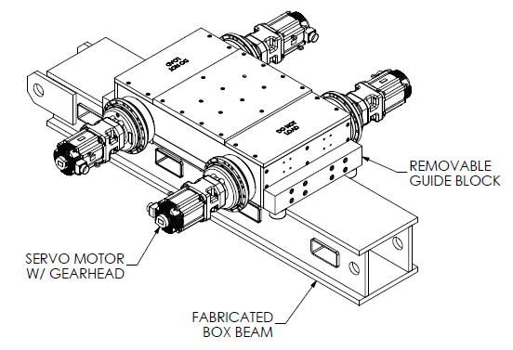
Hilman Powered Skate
“skate”
Hilman 200 Tonne capacity unit
Leading & Trailing brushes sweep debris off rails (not shown)
“rail”

Slide 11
Transport system movement plans
Planned total travel is within 8 hours
1 hour preparation at the beginning and at the end
6 hrs remain for travel time
Average speed is 8.5cm/min [3.3in/min] over 30.5m
Multiple stops within the 30.5m are planned, actual locations to be flexible per run
Choosen stop locations within 3cm with a goal of 1cm, verify location using servo motor counts and laser distance measurement of 1cm, goal of 1mm
Location changes may be a 1 week apart
Complete movement is planned to be unmanned, controlled remotely

Slide 12
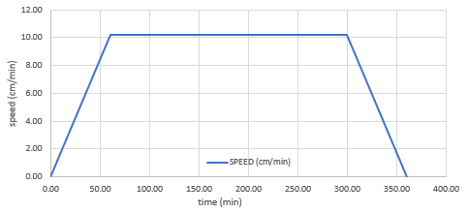
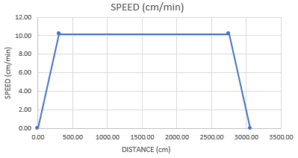
Transport system movement speeds
Speed-time-distance charts for 30.5m travel within 6 hrs
Acceleration works out to be 0.17cm/sec²
Does this create sloshing? Or other issues?
Analysis performed at FNAL and Mockups to be tested at Stony Brook

Slide 13
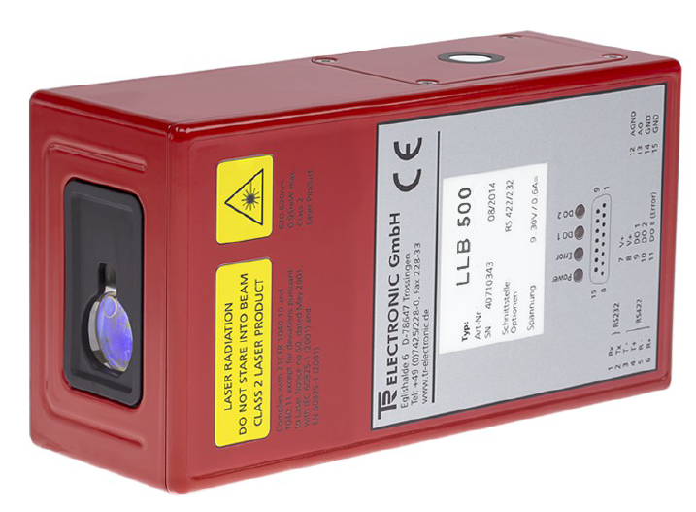
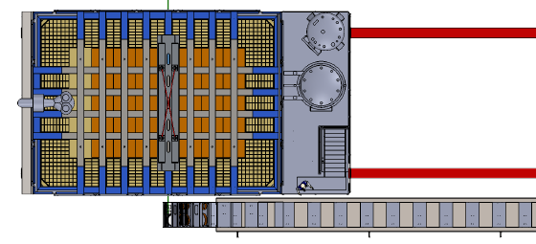
Transport system location monitoring
Position sensing, 2 redundant systems
Primary source is to use the Hilman servomotors as the position encoder
Secondary source, the Laser distance sensor removes errors of possible roller errors within the Hilmans
Both provide mm level accuracy

Slide 14
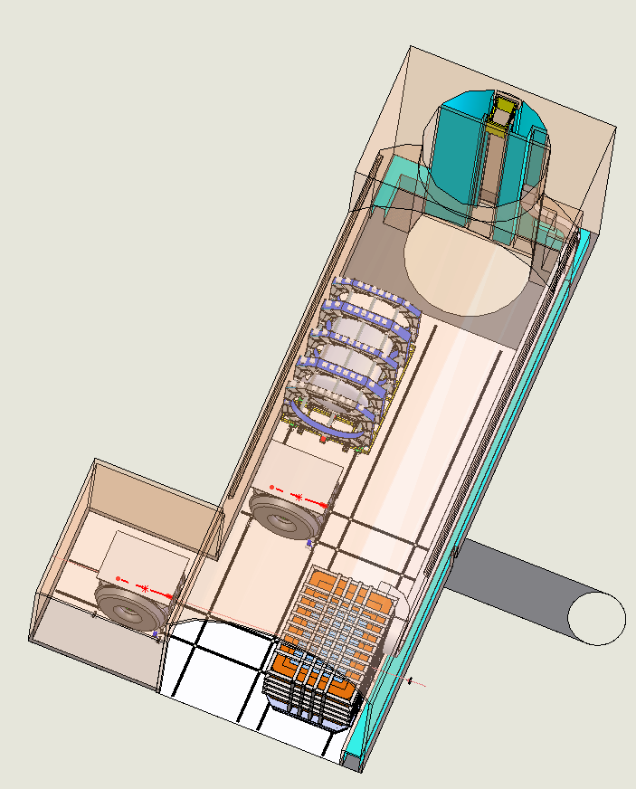
Transport system SAND movement plan
SAND movement zigs & zags around detectors
Track rail spacing needs to be equal to allow zig-zag
Transport speed can be faster than other detectors, TBD
Controlled movement performed locally
Transport system design affects the design of all detectors

Slide 15
Hilman Costs
One system would be used for each detector
Hilman units are a commercially available product, a plug ‘n’ play system
On site costs not included
Future plans
Visit Hilman in NJ
Better understand the details of their proposal
Refine specs, requote, etc
Order a 4 unit system for prototype, then reuse for a ND detector

Slide 16
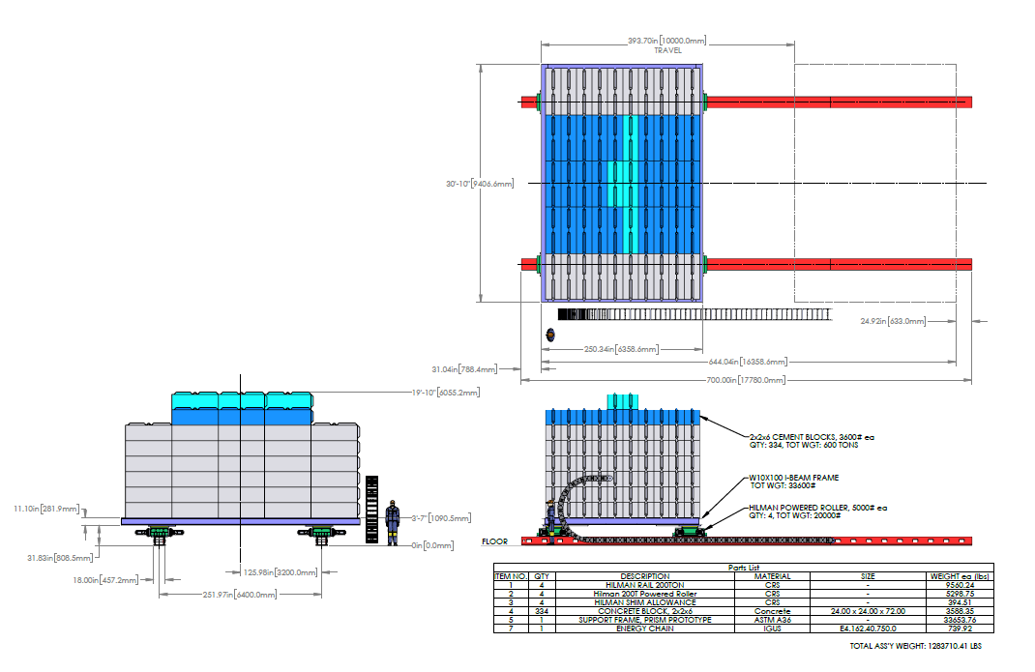
Prototype plans
600 tonne , (4) powered Hilmans
FEA analysis planned to simulate sloshing and module movements
Dry prototype shown
Wet prototype version to be based upon FEA analysis
Vibration sensors, various motion profiles, etc based upon analysis
Components reused for detectors
Test powered units combined with free rolling units

Slide 17
Prototype Plans
Developing prototype location plans at Stony Brook

Slide 18
PRISM movement safety
Hilmans will have brushes to sweep debris out of the way, off the rails
Auditable alarms and flashing lights precede movements to alert local personnel
Provisions for an emergency stop
Movement safety requirements will follow FNAL & OSHA safety requirements and procedures

Slide 19
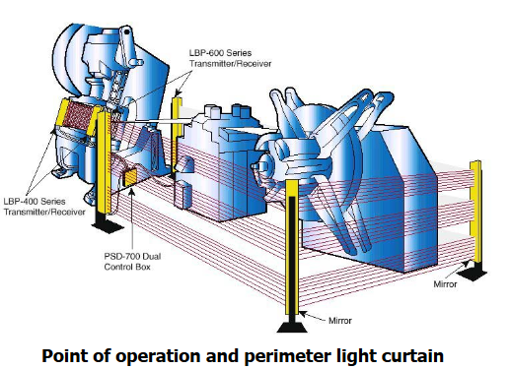
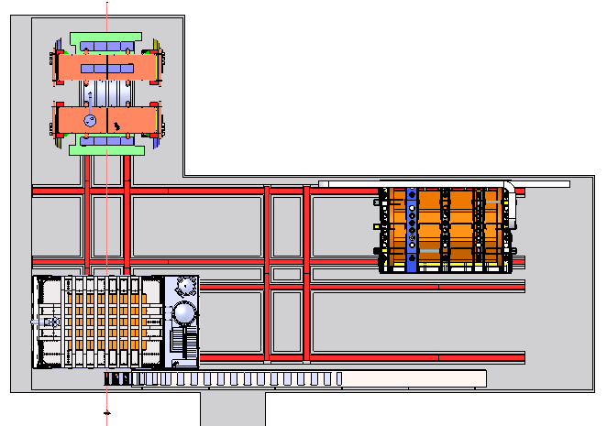
Perimeter Light Curtain for E-Stop
Create a perimeter laser beam curtain that moves with each detector
Break the curtain anywhere to stop movement
A common use of this device type is on elevator doors

Slide 20
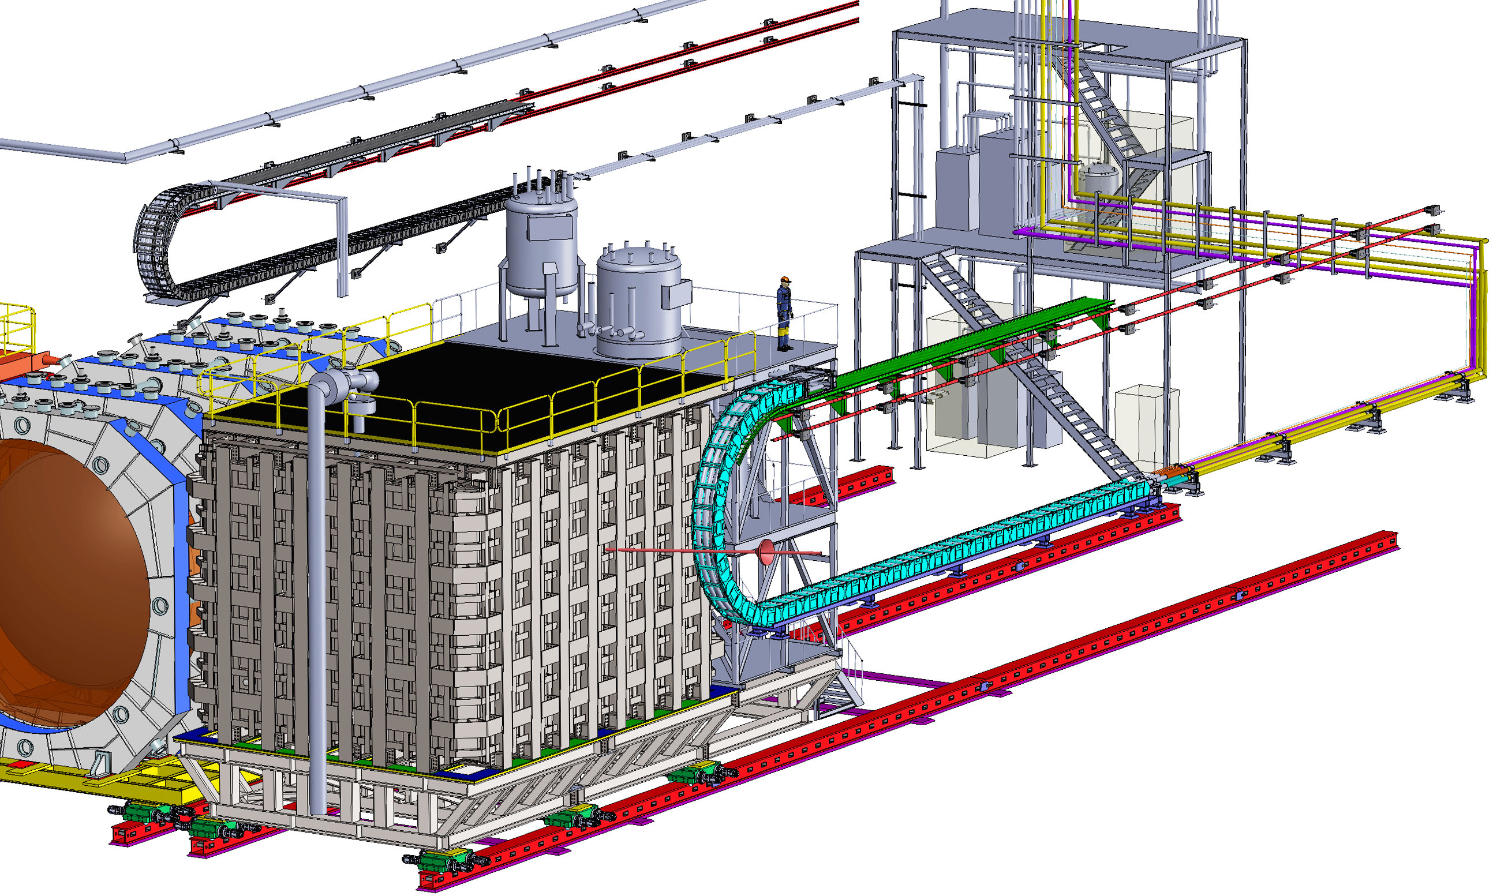
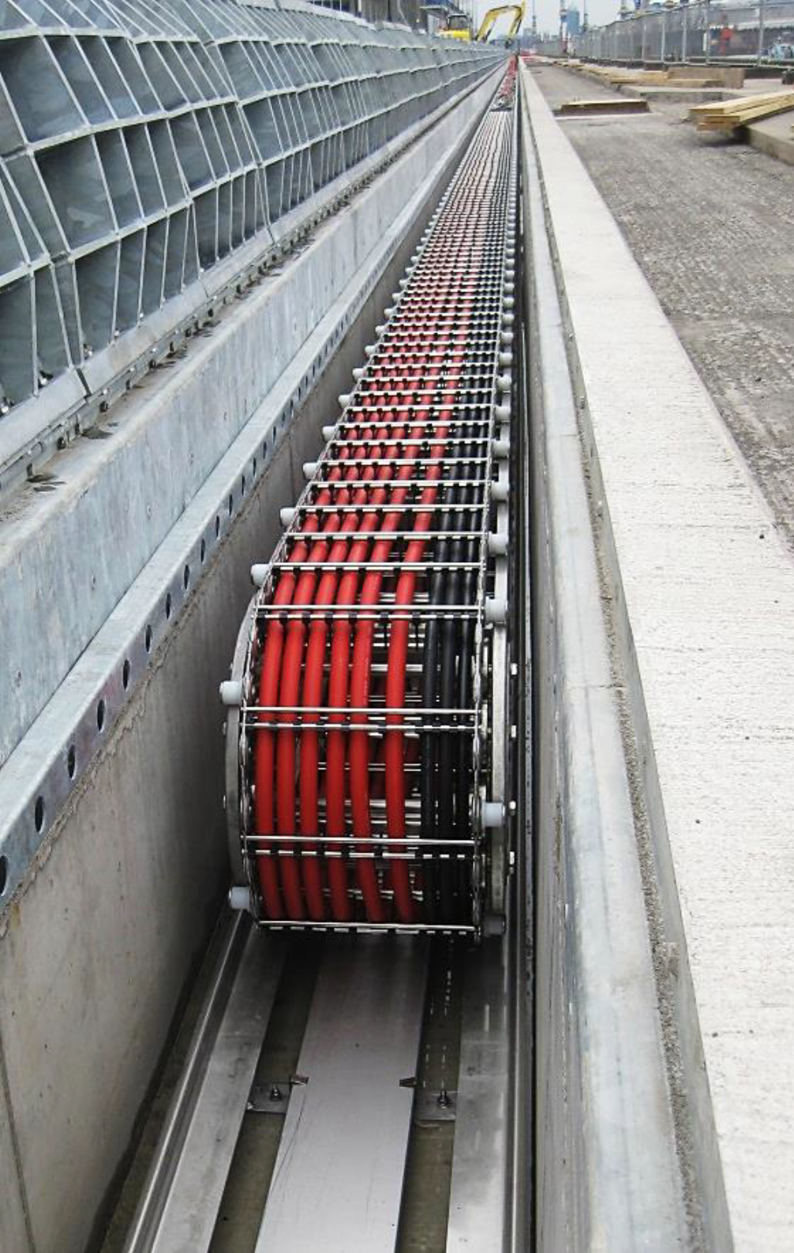
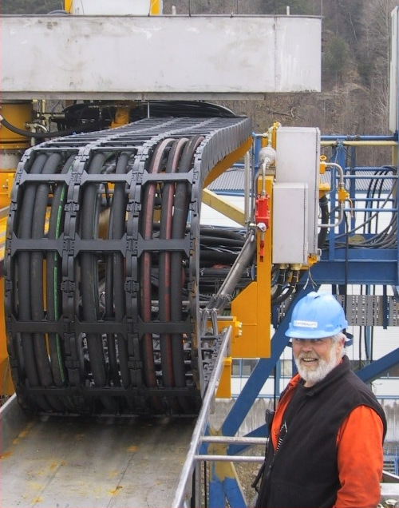
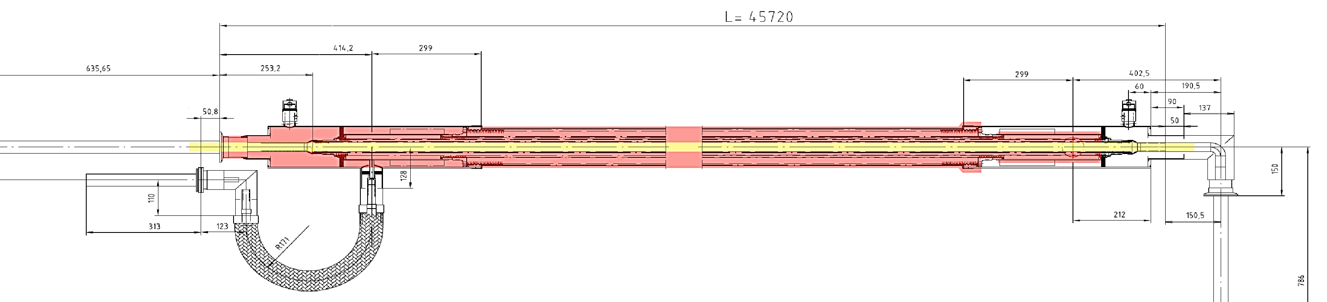
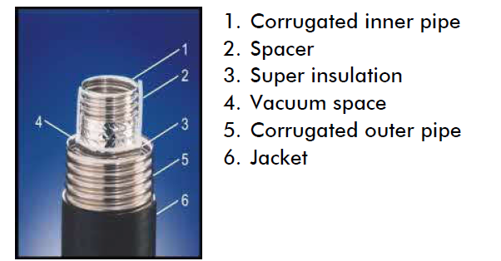
Energy Chain Application
Cryogenic Line Guides Require a Commercial Design Solution
Metal Guide Option
Plastic Guide Option
Vacuum Jacketed Lines
Commercially Available
Guide Designs Needs To Resist “Coil-Up” Under Vacuum Load

Slide 21
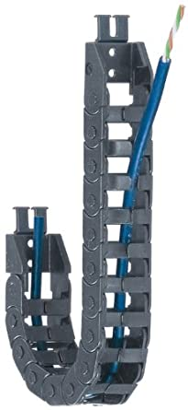
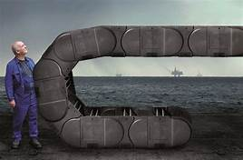
Energy Chain Application
Examples
Commercially available product
We are working closely with the supplier to have a successful product application
Plastic chain parts to reduce vibrations
Similar design steps are being applied to the MPD and the MUON Spectrometer

Slide 22
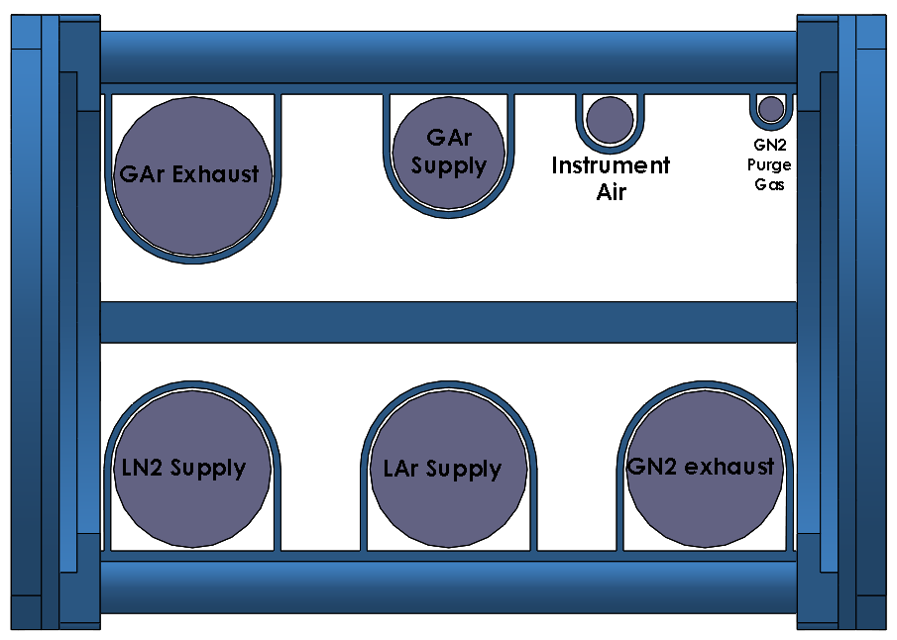
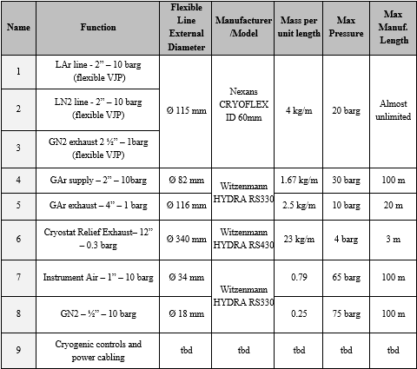
Energy Chain Application
IGUS E4-350-500
Internal Cross section: 350mmx500mm
Weight: 65.7 kg/m
Cryogenic layout provided to IGUS for a design proposal. The inclusion of electric and control cabling is in process.

Slide 23
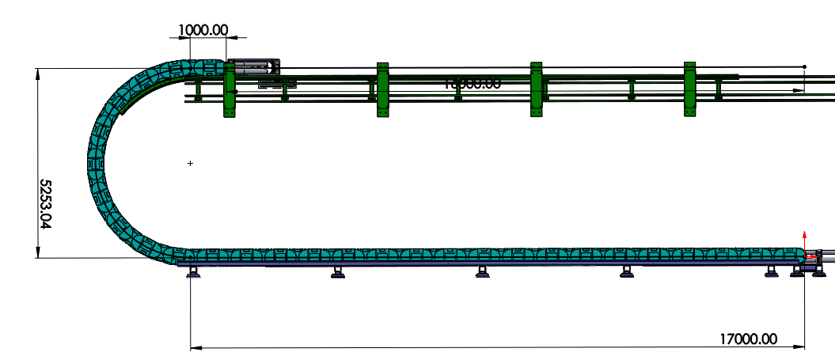
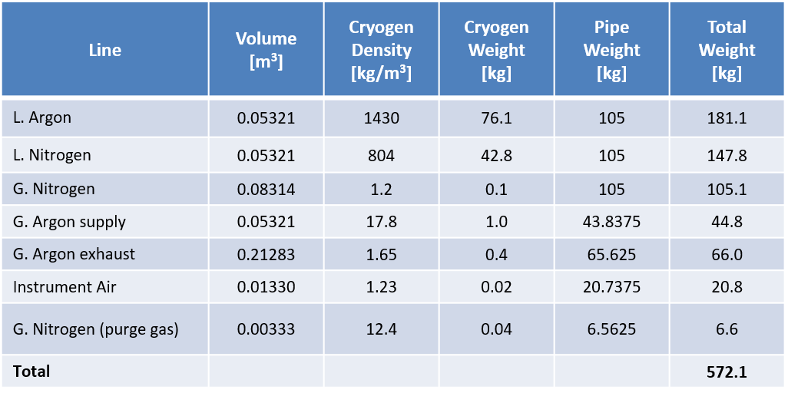
Energy Chain Application
Energy Chain Sizing
Translating support
Length of energy chain: 26.25 meters
16 m for necessary travel
8.25 m in energy chain bend
1 m relief at both ends
Weight of Energy Chain
Cryogenic Piping(filled): 572.1 kg
Igus Chain(65.7kg/m): 1,724.6 kg
Total Weight: 2,296.7 kg

Slide 24
Summary Costs
Support Frames are in individual detector BOEs
ND-LAr support frame is in cryostat BOE (131.02.03.03.02)
Spectrometer frame is in muon spectrometer BOE (131.02.03.04)
SAND frame needs to be reconfigured -> SAND cost, not US scope
Floor Rails are in PRISM BOE
Rails for all three detectors (LAr, Spectrometer, SAND) plus installation is in PRISM BOE (131.02.03.08.02)
Movement System (rollers, control interface, safety system, position sensor, hardware)
ND-LAr movement system plus common tooling is in PRISM BOE (131.02.03.08.02)
Spectrometer movement system is in I&I BOE (131.04.02.02)
SAND Movement system -> SAND cost, not US scope
Energy Chains
LAr and spectrometer chain procurements plus pre-assembly are in PRISM BOE (131.02.03.08.02)
Energy chain cavern wall mounts, assembly, installation are in I&I BOE (131.04.02.02)
N/A
$ 1,071,882
$ 970,235
$ 921,915
N/A
$ 379,883
N/A
Total PRISM Cost:
$ 3,343,915

Slide 25
Overall Summary
Goals are well defined
The major system components use commercial products to satisfy the goals
Prototype the system to verify analysis
For commonality of parts and systems
Similar design approach has been applied to the MPD and MUON Spectrometer
Commonality of parts helps reduce costs

Slide 26
Supporting documents

Slide 27
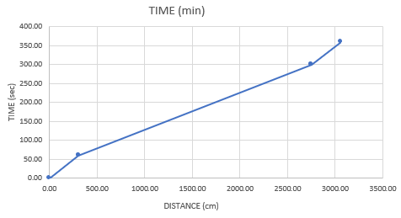
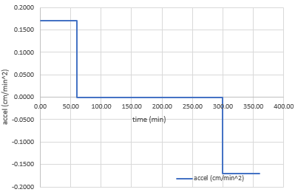
Transport system movement speeds
Charts for 30.5m travel within 6 hrs
Time vs distance
Acceleration is 0.17cm/sec²

Slide 28
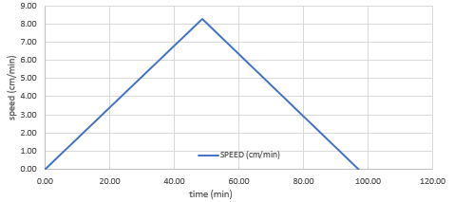
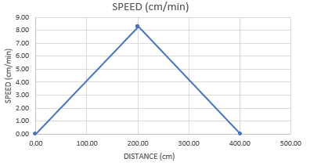
Transport system movement speeds
Speed-time-distance charts for 4m travel within 1.6 hrs
Acceleration is 0.17cm/sec²

Slide 29
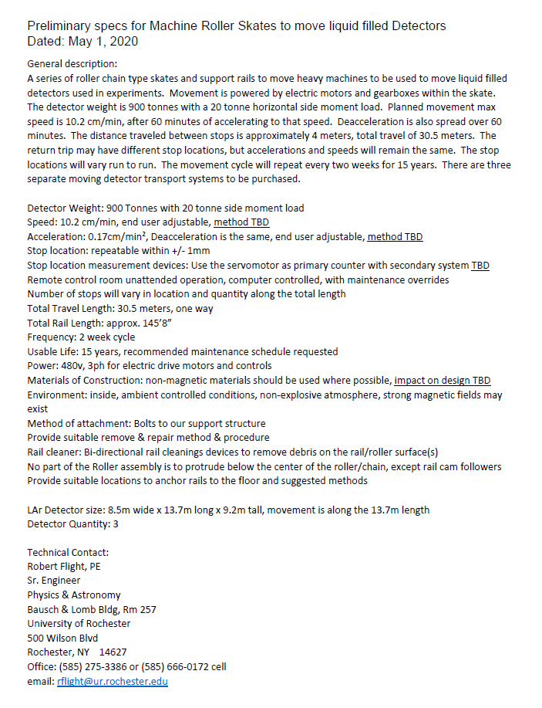

Slide 30
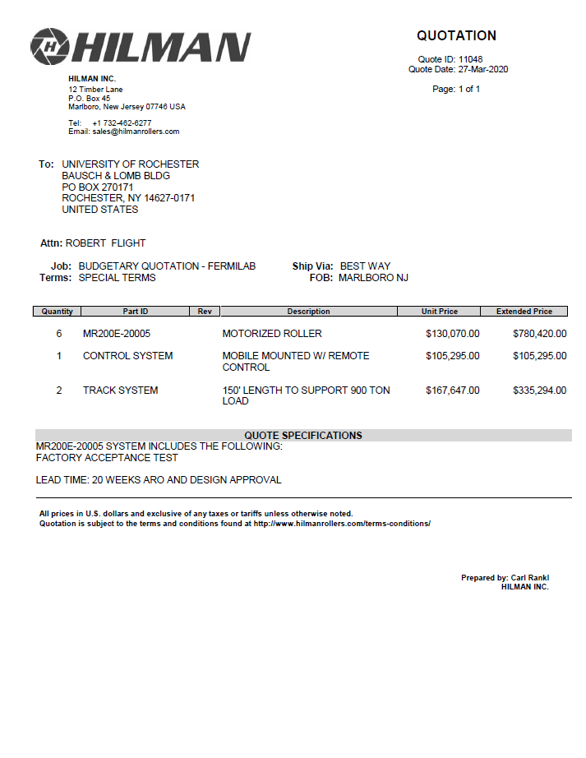
Preliminary Hilman hardware costs
Does not include any on site costs

Slide 31
Who am I
Licensed Mechanical Engineer
30+ years of experience
17 years working on research projects
Minerva, T2K, CMS
CHICO, TIGRESS, JANUS
FRIB
Medical device R&D
Prior industrial experiences included factory assembly and automation equipment and project management

