Slide 1
DUNE Far Detector Single Phase Timing System An Introduction
David Cussans
FDR
21/07/2020

Slide 2
What it Does
Distribute to everywhere in DUNE Far Detector:
synchronized clock
time-stamp
Only Single Phase system is considered here
Dual phase takes a IEEE-1588 (White Rabbit) signal from same GPS system as Single Phase
Requirements in EDMS at https://edms.cern.ch/document/2396273/1
Synchronization within a cavern O(ns)
Needed for linkage between APAs
Synchronization to universal time (UTC) O(us)
Needed for linkage to neutrino production time
Overall system description in EDMS at https://edms.cern.ch/document/2395356/1

Slide 3
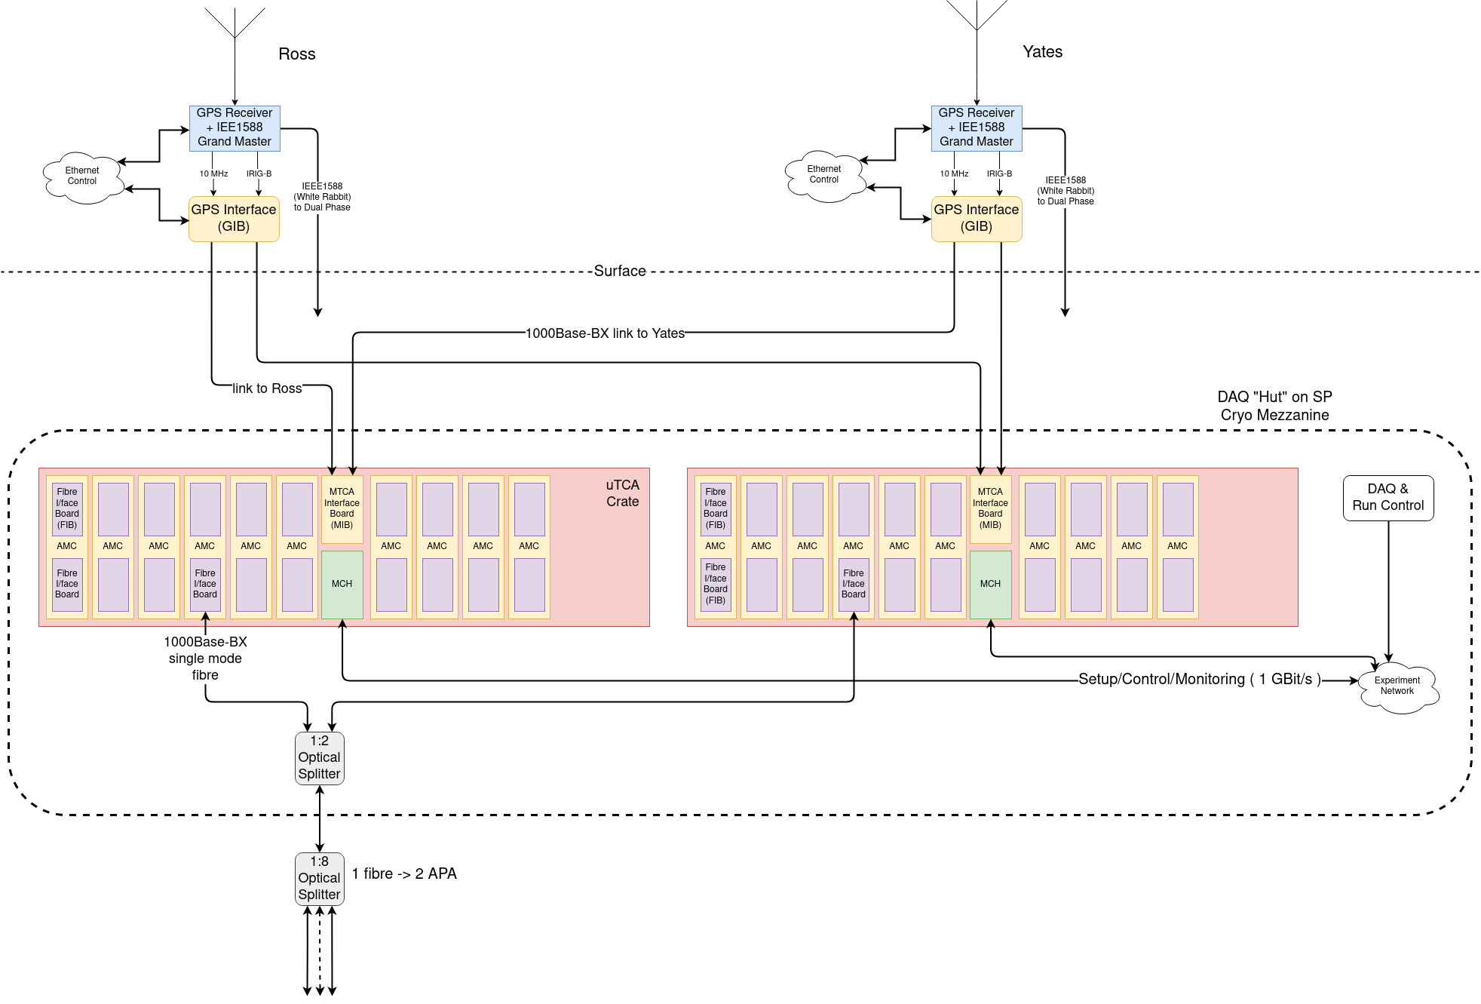
Overall System

Slide 4
Surface Components
GPS Disciplined Oscillator

Slide 5
Surface Components
GPS Disciplined Oscillator
10MHz clock
Time code (IRIG)

Slide 6
Surface Components
GPS Disciplined Oscillator
GPS Interface (GIB)

Slide 7
Surface Components
GPS Interface (GIB)
Clock/data to redundant systems in cavern

Slide 8
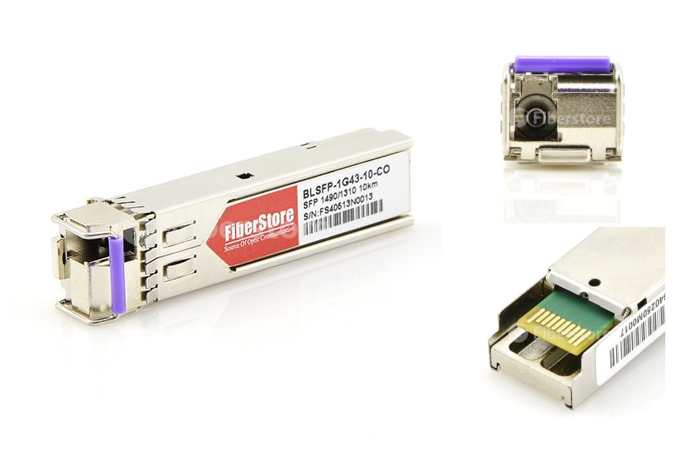
Protocol & Transport Mechanism
Clock and timing data encoded onto serial stream
Transport over optical fibre
1000Base-BX (Bidirectional, on single SM fibre)
8b/10b encoded data (DC balance)
312.5MBit/s (slow enough for general purpose FPGA I/O)
Used to generate 62.5MHz clock at endpoint
Locked to 125MHz clock in DP cavern(s)

Slide 9
Protocol & Transport Mechanism
All messages distributed to all endpoints. Only some respond.
Two types of messages
Fixed length, fixed latency.
Used to distribute time-stamp
Used to distribute triggers in PD1
Broadcast to entire “partitions” (groups of endpoints)
Variable length
Used to distribute delay settings.
Addressable to individual endpoints
Return path (optical transmitter) from endpoint to master is enabled/disabled under control of master
Allows the use of passive optical splitting.

Slide 10
Protocol & Transport Mechanism
Bi-directional link allows round trip delay measurement
Master → Endpoint → Master
Adjust delay to bring all endpoints into alignment
Endpoint maintains a 64-bit timestamp
Aligned to UTC at initialization
Increments with recovered clock
Checked against master every ~ 100ms
Protocol and endpoint interface described in https://edms.cern.ch/document/2395364/1

Slide 11
Underground Components
MicroTCA Crate
DAQ “Hut” on
Cryo Mezzanine

Slide 12
Underground Components
MicroTCA Crate
DAQ “Hut” on
Cryo Mezzanine
MicroTCA Interface (MIB)

Slide 13
Underground Components
MicroTCA Crate
MicroTCA Interface (MIB)
FMC carrier AMC (AFC)

Slide 14
Underground Components
MicroTCA Crate
MicroTCA Interface (MIB)
FMC carrier AMC (AFC)
Fibre Interface (FIB)

Slide 15
Underground Components
Fibre Interface (FIB)
1000Base-BX SFP

Slide 16
Underground Components
1000Base-BX SFP
”Hot Swap” between crates using 2:1 splitter
Multiple endpoints from single fibre with 1:4 splitter
1:2 Optical Combiner/Splitter
1:4 Optical Combiner/Splitter

Slide 17
Components
GPS Disciplined Oscillator
10MHz clock
Timecode (IRIG)
Also has IEEE-1588 output (White Rabbit)
Using Spectracom SecureSync for tests
Rear
view
10MHz
IRIG
IEE-1588 (SFP)

Slide 18
Components
GPS Interface Board (GIB)
Encodes onto 312.5 Mbit/s serial link on 1000Base-BX
MicroTCA crate – COTS
MicroTCA interface Board (MIB)
Receives signals from GIB
COTS AMC in MTCA crate
Prototyping with Open Hardware AFC
Fibre Interface Board (FIB)
Mounts on AMC, houses 1000Base-BX SFP
Custom boards – GIB, MIB, FIB, described in separate talk

Slide 19
Uptime, Reliability
Requirement for v. high uptime -->
GPS at top of each shaft
Hot-swap crates
Can swap individual fibres
Cross check two systems for reliability

Slide 20
Firmware
Firmware aims to be as generic as possible
The Cold Electronics consortium was able to port the example Endpoint firmware we provided from Xilinx to Altera
Aiming for modularity and simplicity – relatively few different entities
Central timing system uses COTS boards using Xilinx FPGAs
Using IPBus Build (ipbb) build system
Scriptable build system.
Works well with CI
Git used for development.
“software-like” development flow.
Clone main branch, create feature/bugfix branch, develop, merge
Notes:
Three boards use same firmware blocks
Blocks already developed for PD-1
Good f/ware development environment
Dave N. will answer details if asked to. (As original f/ware architect).
Development methodology known to work for large, distributed teams (CMS, DUNE trigger primitives)

Slide 21
Firmware
Simulation test benches exist for main functions.
Some have simulated Ethernet Interface – allows use of same software as real hardware
Many features tested in ProtoDUNE1
Which features tested, which will be tested described in separate talks.
Overview of firmware at https://edms.cern.ch/document/2395358/1
Repository at https://gitlab.cern.ch/protoDUNE-SP-DAQ/timing-board-firmware

Slide 22
Software
Set of interfaces (services) that are used by central configuration, control, monitoring
Interface library (API) used by services
Testing and commissioning with Python based scripts
Calling underlying APIs to hardware
Communication with FPGAs using IPBus
UDP/IP based.
Small footprint – no soft-core CPU
Developed by CMS.
Widely used in HEP.
Timing system integrated with ArtDAQ for PD1
New framework for PD2
See other talks for ProtoDUNE-1 experience, future development and test plans
Software framework described in EDMS https://edms.cern.ch/document/2395368/1

Slide 23
Summary
The Timing system for the Single-Phase DUNE Detectors will deliver a clock and time stamps to all “endpoints” in caverns.
Designed for high level of reliability (cross check between two GPS masters)
Designed for high level of availability (swap between hardware using passive optical splitting)
Only small number of different custom boards
See separate talk
Based on COTS FPGA boards with existing firmware support
Core functionality demonstrated at ProtoDUNE-1
See separate talk
More details of development and testing plan in separate talk
Project schedule and installation described in separate talk

Slide 24
BACKUP SLIDES

Slide 25
Why Not White Rabbit?
ProtoDUNE-SP initially had a triggered triggered readout
Needed way of distributing messages with fixed latency
Not provided by IEEE-1588 ( could extra functionality onto the same Ethernet link, but would be tricky)
Wanted have endpoints as simple as possible
DUNE-SP timing system has much simpler firmware
Current WR implementations need a soft-core CPU in FPGA
(c.f. relatively small state machine in endpoint block)
Designed for passive optical splitting – allows redundant masters.
Simple redundancy of master difficult for WR
Do not see a reason for moving away from a system that has worked at ProtoDUNE

Slide 26
Optical Power Budget
 | dB / dBm
1:2 splitter loss (max) | 4.40 | See https://img-en.fs.com/file/datasheet/blockless-plc-splitters-datasheet.pdf
1:8 splitter loss (max) | 10.60 | see https://www.fs.com/uk/products/11959.html
fibre attenuation ( 1db/km) | 0.30 | https://www.thefoa.org/tech/loss-est.htm
1000Base-BX-20 Tx power (min) | -9.00 | https://www.fs.com/au/products/75335.html
1000Base-BX-20 Rx power (max) | -23.00
power budget = Tx – Rx – losses (1000Base-BX-20) | -1.30
1000Base-BX-80 Tx power (min) | -2.00 | https://www.fs.com/uk/products/75352.html
1000Base-BX-80 Rx power (max) | -24.00
power budget = Tx – Rx – losses (1000Base-BX-80) | 6.70
1000Base-BX-120 Tx power (min) | -1.00 | https://www.fs.com/uk/products/75356.html
1000Base-BX-120 Rx power (max) | -31.00
power budget = Tx – Rx – losses (1000Base-BX-120) | 14.70
Need 80km 1000Base-Bx SFPs

Slide 27
Test MTCA Crate in Bristol
COTS AMC with
Custom FMC (FIB)
Hot swap fans
Front-back airflow
Power module
110/240V input
Hot-swap
MCH
(interface to crate
IPBus on Ethernet)
MicroTCA Chassis
Test timing
endpoints
Passive optical
Splitter

