Slide 1
PIP2IT Overview
Eduard Pozdeyev
PIP2IT Operational Readiness ORC
August 25, 2020

Slide 2
Outline
PIP2IT Goals, Scope, and Schedule
Commissioning Stages
Progress with Commissioning and Installation
Lessons learned: HWR EMI
Commissioning Plan and MPS
PIP2IT is a Radiation Generating Device
Commissioning Roles and Responsibilities
Introduction to Following Talks

Slide 3
PIP2IT As the Front End of PIP-II Linac
PIP2IT is the near-complete Front End of the PIP-II linear accelerator including the Warm Front End and the first two Cryomodules (HWR and SSR1)
PIP2IT serves as a testbed for PIP-II front end and critical systems to retire/reduce technical risks
4 HB650 CMs,
833 MeV
9 LB650 CMs,
517 MeV
7 SSR2 CMs 177 MeV
HWR and 2 SSR1
CMs 32 MeV
WFE
2.1 MeV
PIP2IT

Slide 4
PIP2IT Layout and Parameters
Beam commissioning parameter envelope (as in the shielding assessment)
Parameter | Value | Unit
Energy | 25 | MeV
Pulse length | 550 | $μ$s
Beam intensity per any given hour | 4.95E17 | H- per hour
Current averaged over 1 µs | 2 | mA
22 MeV (nominal)
30 keV
H-
2.1 MeV
IS LEBT
RFQ
MEBT
HWR
10 MeV
SSR1
HEBT
Dump

Slide 5
PIP2IT Commissioning Stages
Stage 1: Ion source, RFQ, MEBT (2.1 MeV)
MEBT has been commissioned in 2016-2018
MEBT has been re-commissioned this Summer and is in active beam operations and beam testing
Stage 2: HWR, SSR1, HEBT, Dump (22 MeV)
Scope of this ORC
Air Gap
Stage 1: Active Beam Ops
Stage 2: Scope of this ORC
Ion source and LEBT
30 keV
Dump
MEBT
2.1 MeV
HWR
10 MeV
SSR1
HEBT
RFQ
22 MeV

Slide 6
Commissioning Goals and Duration
Goals
Demonstrate PIP-II critical technologies
HWR and SSR1 cryomodule, cavity test
MEBT kickers and absorber
Accelerator Systems (LLRF, Instrumentation, MPS)
Accelerate beam in SRF CMs, validate beam optics, and quantify beam parameters
Conduct additional tests and studies aimed at improving reliability, stability, and understanding of limits
Schedule
PIP2IT will be converted into PIP-II CM Test Facility in Feb 2021
PIP2IT will be stored until PIP-II High Bay Building is available
Extended schedule is available in backup

Slide 7
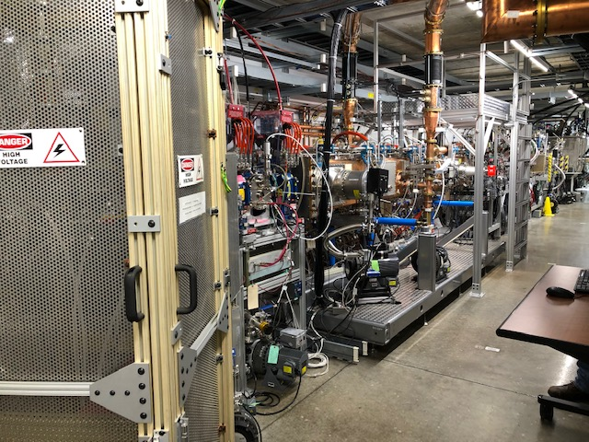
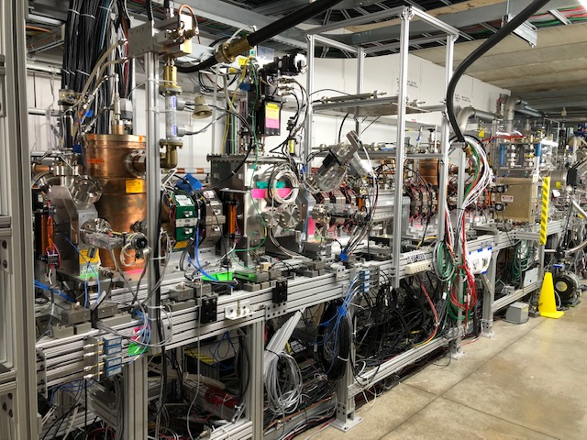
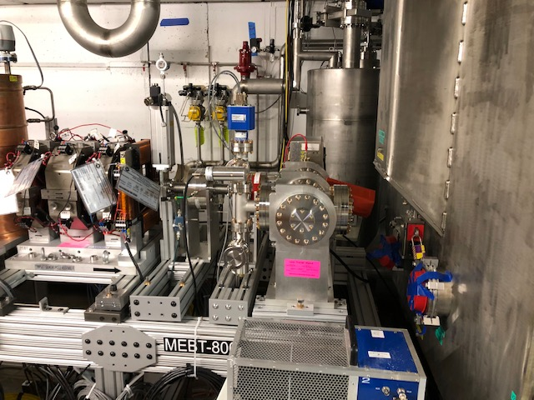
MEBT Installed and Commissioned with Beam
Most of MEBT beam line components installed and commissioned with beam in 2016 – 2018
New absorber was installed in 2019
MEBT was recommissioned in Summer 2020 and is operated with beam up to the absorber
2020 beam measurements consistent with earlier results
Beam is used to verify instrumentation, MPS, optics
More details in A. Shemyakin’s talk

Slide 8
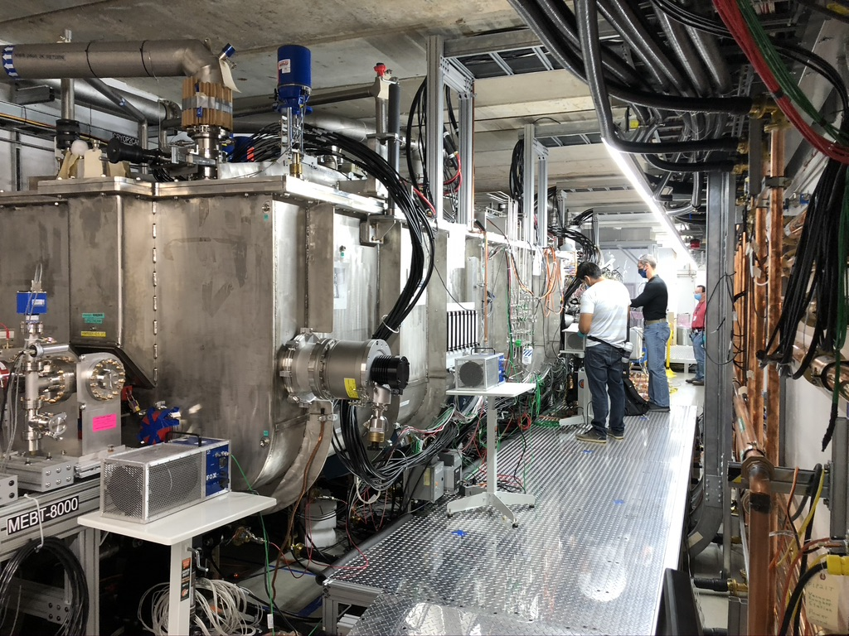
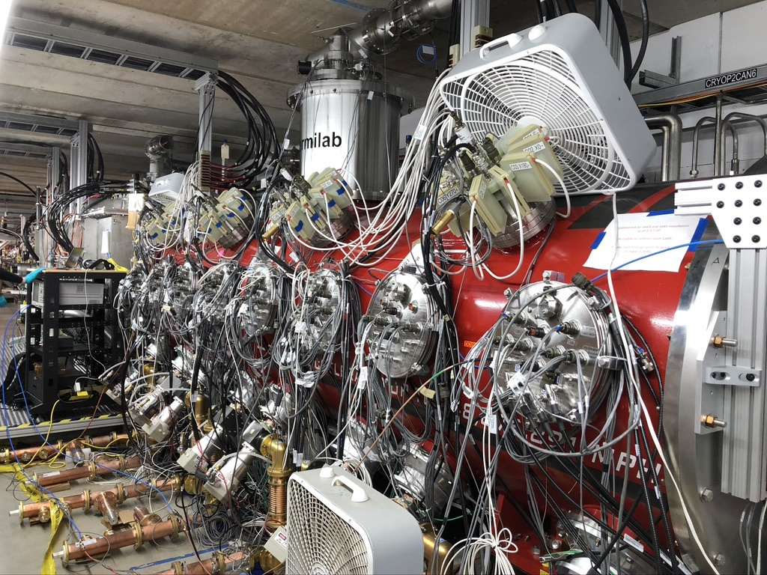
Installation of CM and HEBT Complete
HWR Cryomodule
CM is at 2K since Feb 2020
Solenoid testing completed
Cavity testing in SEL mode completed
SSR1 Cryomodule
CM is at 2K since July
Solenoid testing completed
Low power Cavity 1 RF testing started
HEBT and Dump
Beam line components installation complete (except air gaps)
More in C. Baffes’ talk

Slide 9
Learning Lessons: HWR RF EMI
Issue: RF power was coupled out from HWR cavities through the coupler HV bias cable (~1.5%)
Behavior was observed at Argonne and is “normal”. We could not find record of this information transferred to FNAL.
Signal was broadcasted due to inefficient EMI shielding in the coupler HV monitor
RF power interfered with ODH monitors in the building
RF leakage was measured periodically during testing but not when cavity power was increased
The FESHM chapter that regulates nonionizing radiation was under development and had not been released yet
Corrective measures taken
Operations stopped
Notch filters installed, monitor boxes modified to reduce EMI
Additional antennas were installed in the PIP2IT cave
Travelers updated to include EMI verification after new system assembled and as power is ramped up
Safety verifies nonionizing radiation at a high power with a calibrated probe

Slide 10
Steps Leading to Start of Beam Testing
Installation, test, and readiness status are tracked through Vector Travelers by system owners and Installation Manager
ORC process ensures that the accelerator is ready for operation and includes safety considerations as well as equipment protection.
LEBT ORC 1703 – Approved by Reviewers
MEBT ORC 1732 – Approved
HWR Cryo ORC – Approved
HWR RF System ORC 1711 – Approved
SSR1 Cryo ORC – Approved
SSR1 RF ORC 1756 – Approved
HEBT ORC 1755 – In progress
AD / PIP-II Management approval through PIP-II ES&H Manager
System owners and stakeholders sign off technical readiness verification list for critical systems (Vector Traveler)
Similar to AD procedure

Slide 11
Beam Commissioning Plan Developed
Plan for PIP2IT Phase 2 Beam Commissioning has been developed and Documented (PIP-II DocDB 4429)
Commissioning plan includes
Commissioning goals (definition of success)
All required steps including instrumentation and MPS tests
Beam parameters such as the beam energy, current, pulse length
List of additional tests and studies aimed at improving reliability, stability, and understanding of limits
Weekly operational schedules are developed based on the commissioning plan
More details in A. Shemyakin’s talk

Slide 12
MPS Integrated into Beam Commissioning Plan
Commissioning starts with pulse length not exceeding 10 us.
This pulse length does not require fully featured operational MPS. The machine is safe even if beam is lost.
The maximum pulse length (10 us) is enforced by MPS.
MPS, Instrumentation are verified with short pulses
Beam intensity (pulse length) is increased gradually after MPS and other systems are positively tested with beam
MPS configuration and beam parameters at each step are reviewed by the PIP2IT MPS Config. Committee
MPS Configuration Committee includes stakeholders and relevant system owners
The committee approves MPS requirements, configuration, changes.
More in A. Warner’s presentation

Slide 13
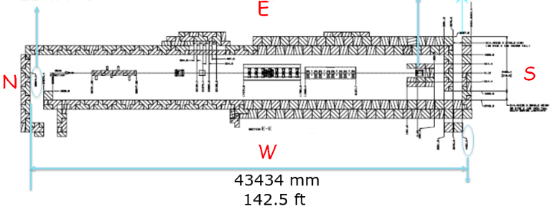
PIP2IT Is A Radiation Generating Device
Exempt from DOE O 420.2C, managed under FESHM and FRCM
R&D facility, room sized accelerator with a single beam, a single-entry point, and a safety system
More in talks by J. Anderson and A. Olson
Emergency
exit only
Main entry/exit

Slide 14
Comm. Roles and Responsibilities Defined
PIP-II Project Director
AD and Safety
As a tenant, PIP2IT follows AD processes and guidelines
AD approves ORCs and, along with PIP-II PD, start of beam commissioning
Follow lab safety regulations and training
Commissioning L2
Commissioning L3
PIP2IT Commissioning Lead
Develop commissioning plan
Plan and lead beam commissioning activities to execute the commissioning plan
Requirements for resources required to execute weekly plans
Lead off-line commissioning data analysis
PIP2IT Ops. Coordinator
Interface with MCR
Technical contact for AS systems and maintenance
Develop and maintain procedures
Trains and authorizes operators
Coordinate shift schedule
Ensures availability of operational tools
PIP2IT Installation Coordinator
Coordination of installation and activities
Installation schedule
COVID HA and work planning
PIP-II ES&H Manager
Manages and coordinates PIP2IT specific safety issues
PIP2IT System Owners
Responsible for their scope, including operational support
Special systems:
HWR testing
SSR1 testing
PIP2IT Operators
Execute shift plan developed by the commissioning lead
Follow operational instruction by Ops. Coordinator
MPS Config. Committee
MPS configuration control oversight

Slide 15
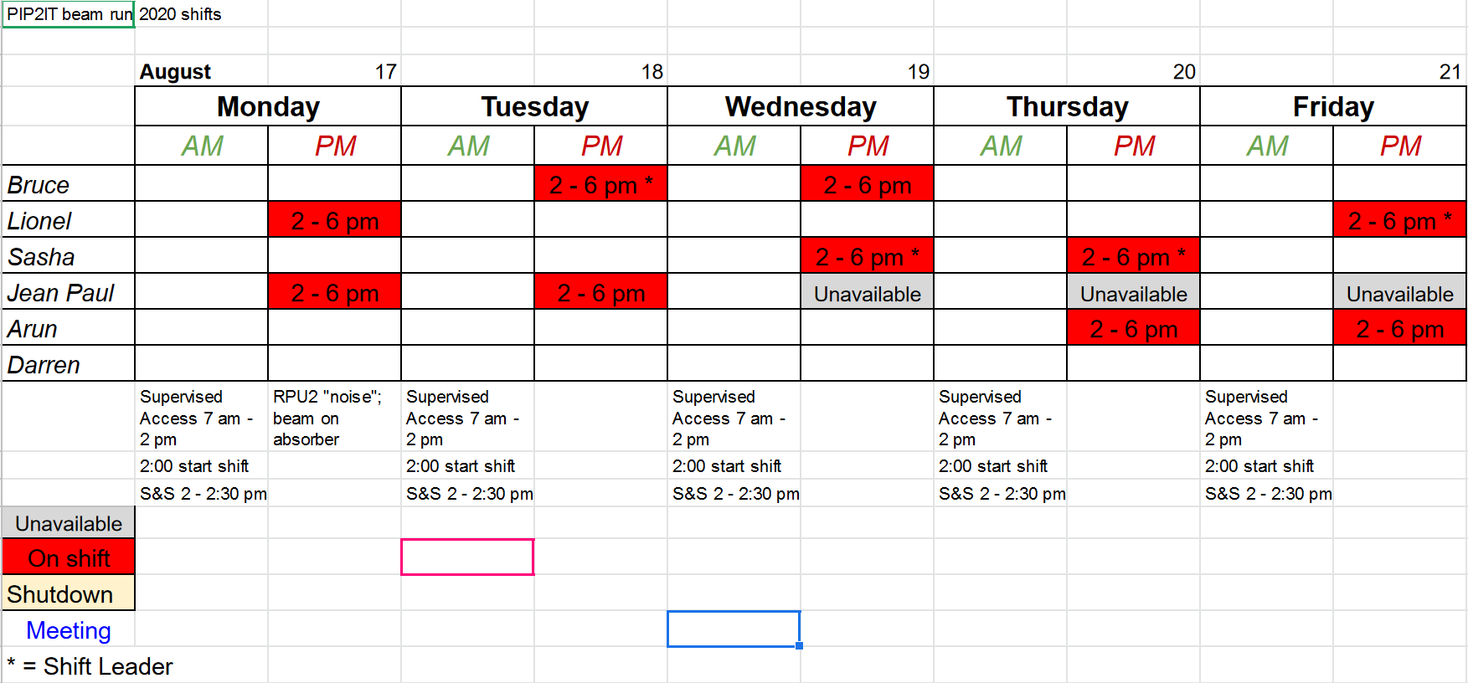
Experienced Operators/Experts Available
PIP2IT beam commissioning experts have experience commissioning MEBT in 2016-2018 and 2020
OJT developed and is available to train more operators
Cryomodules are operated by experts: Ozelis, Sukhanov
CM procedures will be added to OJT once they are finalized
More details in D. Crawford talks

Slide 16
ORC Presentations Address Charge Questions
Has an adequate hazard analysis for this phase of commissioning been developed?
Has an appropriate commissioning plan been developed?
Has the Radiation Safety Interlock System been installed and approved in accordance with the Fermilab Radiological Control Manual (FRCM)?
Has a Configuration Management plan been developed for the Machine Protection System?
Have the procedures necessary for commissioning been developed and approved?
Have qualified staff members been trained and are available to perform the commissioning within the established roles, responsibilities, authorities and accountabilities?
Is the necessary accelerator hardware, beamline controls and monitoring systems in place and adequate to support the commissioning and operations of PIP2IT Facility?
Talk # | Speaker | Talk title | Charge questions
3 | J. Anderson | Safety Documentation and Analysis | 1
4 | A. Olson | Safety Systems | 3
5 | C. Baffes | Hardware Readiness | 7
6 | B. Hanna | ORCs | 7
7 | A. Warner | MPS Configuration | 4
8 | D. Crawford | Work Planning
9 | A. Shemyakin | Commissioning Plan | 2
10 | D. Crawford | Operations Procedures | 5,6

Slide 17
Backup

Slide 18
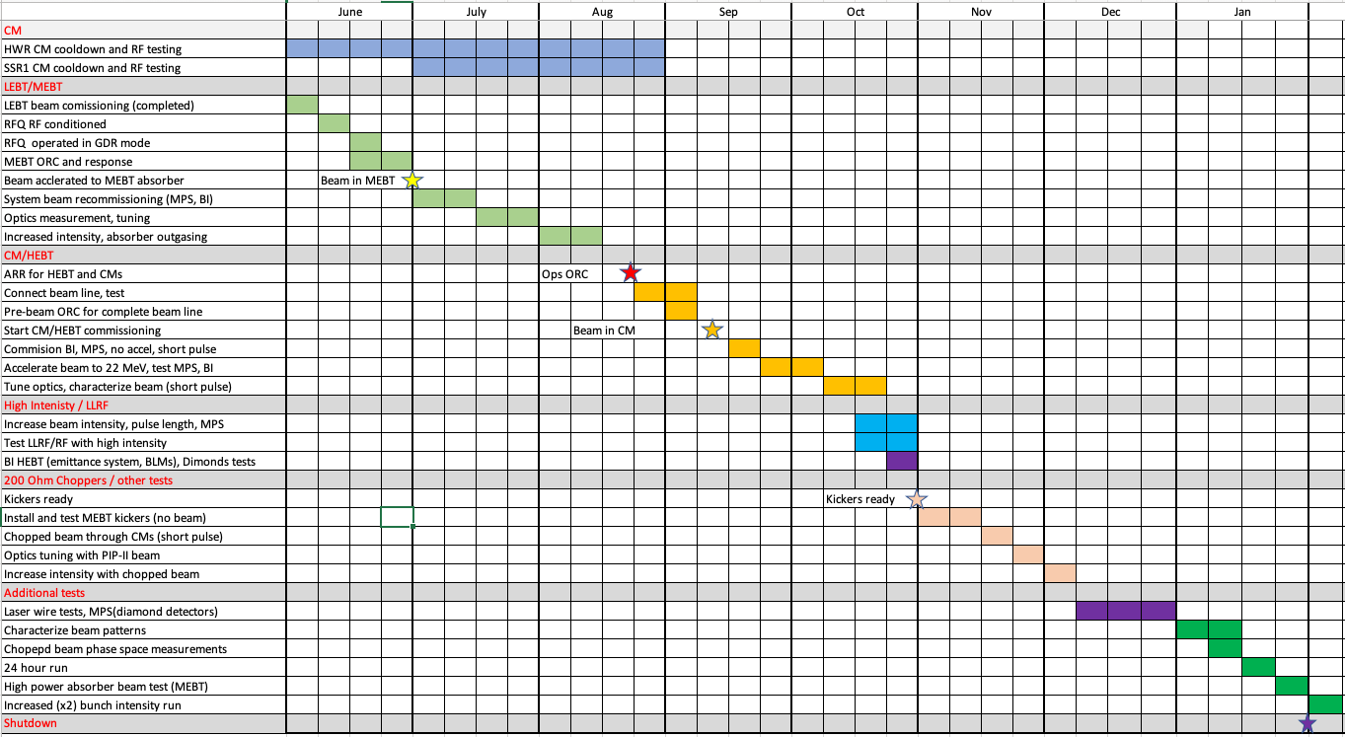
PIP2IT Schedule Developed and Tracked
PIP2IT will be converted into PIP-II CM Test Facility in Feb 2021

