Slide 1
Beam commissioning plan
Alexander “Sasha” Shemyakin
PIP2IT Operational Readiness ORC
August 25, 2020

Slide 2
Outline
Goals
Preparations for the full beamline run
Commissioning of the “MEBT” configuration
Commissioning stages and additional measurements
Summary

Slide 3
PIP2IT beam commissioning goals
From “Plan for Phase 2 of PIP2IT Beam Commissioning and Post-Commissioning Beam Tests”
PIP-II DocDB# 4429
Primary beam commissioning goals:
Accelerate beam to 22 MeV and verify its energy in HEBT
If time permits, complete additional beam commissioning goals:
Evaluate beam properties in HEBT
LEBT
RFQ
MEBT
HWR
pSSR1
HEBT
dump
Parameter | Maximum value | Unit
Energy | 25 | MeV
Pulse length | 550 | $μ$s
Beam intensity per any given hour | 4.95E17 | H- per hour
Current averaged over 1 µs | 2 | mA

Slide 4
Preparations for the beam run in the full line
Commissioning plan has been developed
Hardware installation, systems commissioning, documents
Presented in other reports today
Preparation of optics files and tuning procedures
Re-commissioning of the Warm Front End (WFE)
Was operational in 2018 with beam power up to 5 kW
Changes
New MEBT absorber; low-particulate treatment of section near HWR, re-arrangement of diagnostics; “production” kickers (coming in Nov ’20) – see C. Baffes talk
MPS upgrade – see A. Warner’s talk
Important for testing programs and verifying the optics
Next slides

Slide 5
Re-commissioning of the Warm Front End
Re-commissioning was made in the “MEBT” configuration
M61 scrapers are fully inserted to prevent further beam propagation; MEBT valve is closed
Beam can be delivered to the MEBT absorber or M61 scraper
LEBT, RFQ, and most of MEBT are re-commissioned
Details on the next slides
No chopping in the MEBT (not ready yet)
LEBT
RFQ
M11 scrapers
MEBT absorber
RFQ valve
M0 scrapers
Kickers with protection electrodes
RPU #1
RPU #2
M61 scrapers
MEBT valve

Slide 6
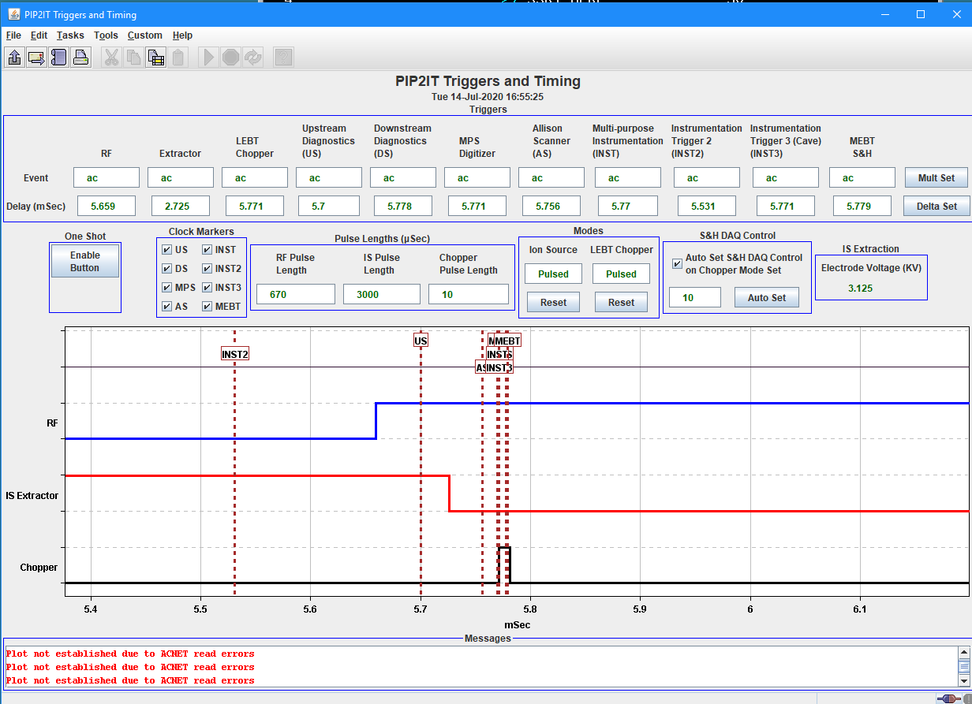
10 µs beam commissioning
Started by verifying performance of all systems at the safe short pulse length, 10 µs
MPS, RF, LLRF, instrumentation, optics, collimation, programs
For MPS commissioning, used extra measures to prevent running with long pulses
Fixed ~ 30 µs overlap between modulator and RFQ pulses
Administrative control of the LEBT chopper pulse length
No beam in MEBT if timing of the LEBT chopper pulse is outside of the overlap between RFQ and IS modulator pulses.
All available MPS channels were tested with the beam
Comparison of beam current readings; losses to M61S scraper and kicker protection electrodes; RF trips; etc.

Slide 7
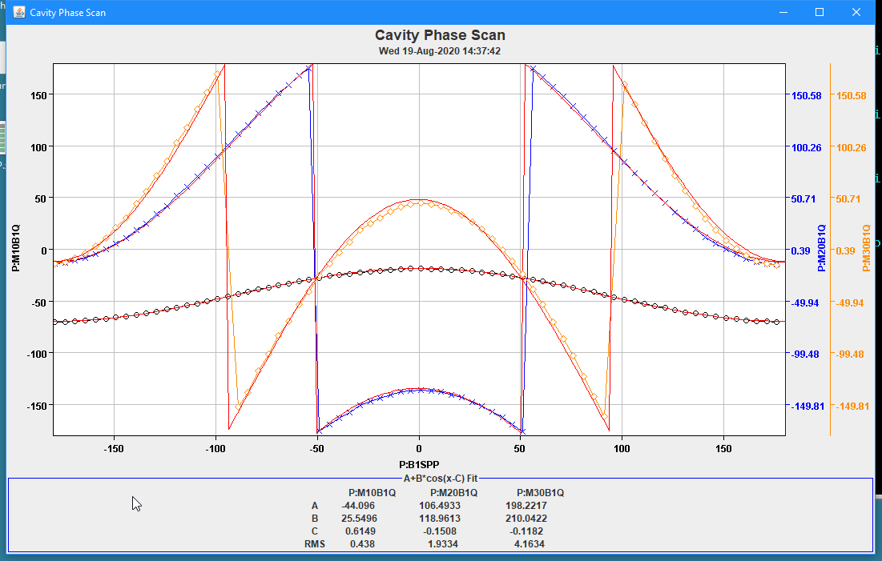
10 µs measurements: buncher cavity phasing
Procedure: make all tuning at 10 µs
Increase the pulse length at otherwise fixed settings
Example: Cavity phasing is performed at 10 µs
The same program will be used for phasing of SRF cavities
Example of cavity phasing measurement: BPM phases as function of the buncher phase. Also fitting curves are shown.

Slide 8
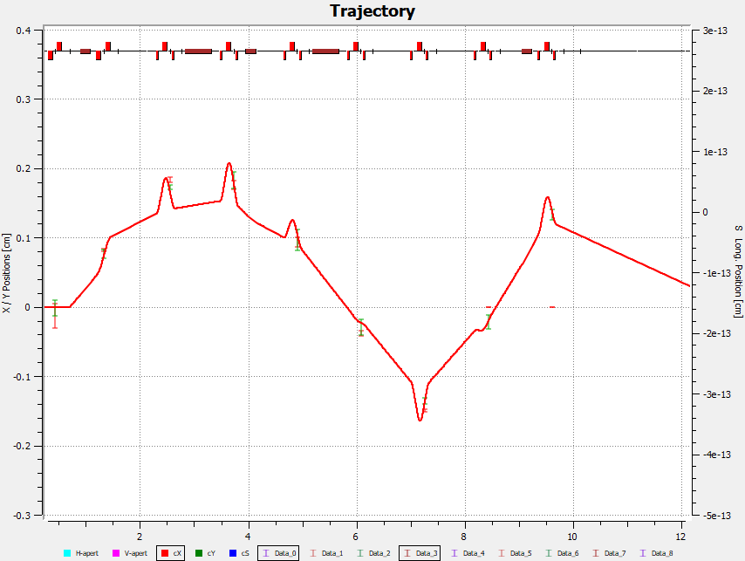
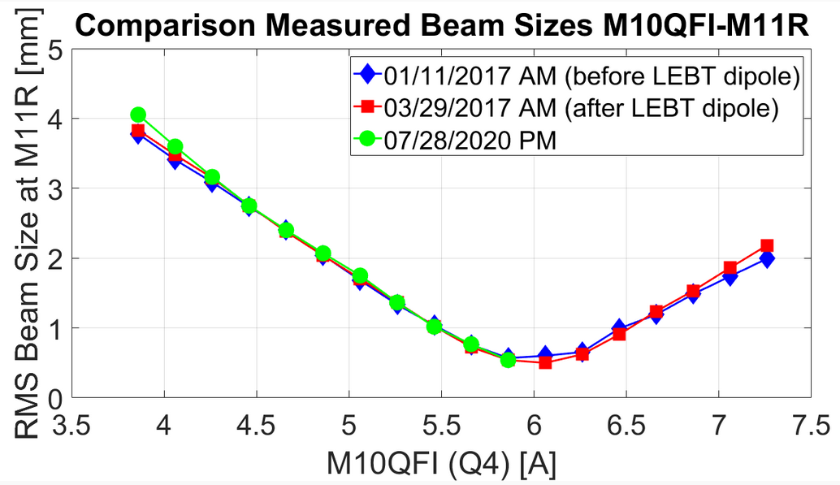
10 µs measurements: Beam optics
Beam optics has been verified with differential trajectories and beam size measurements
18 January 2018
23 July 2020
Example of differential trajectory measurement: response of the trajectory to change in M00CXI corrector by 0.4 A (points). Solid line – OptiM model.
A. Saini
Example of quadrupole scan measurement: horizontal beam size as a function of the current in the upstream quadrupole.
J.-P. Carneiro

Slide 9
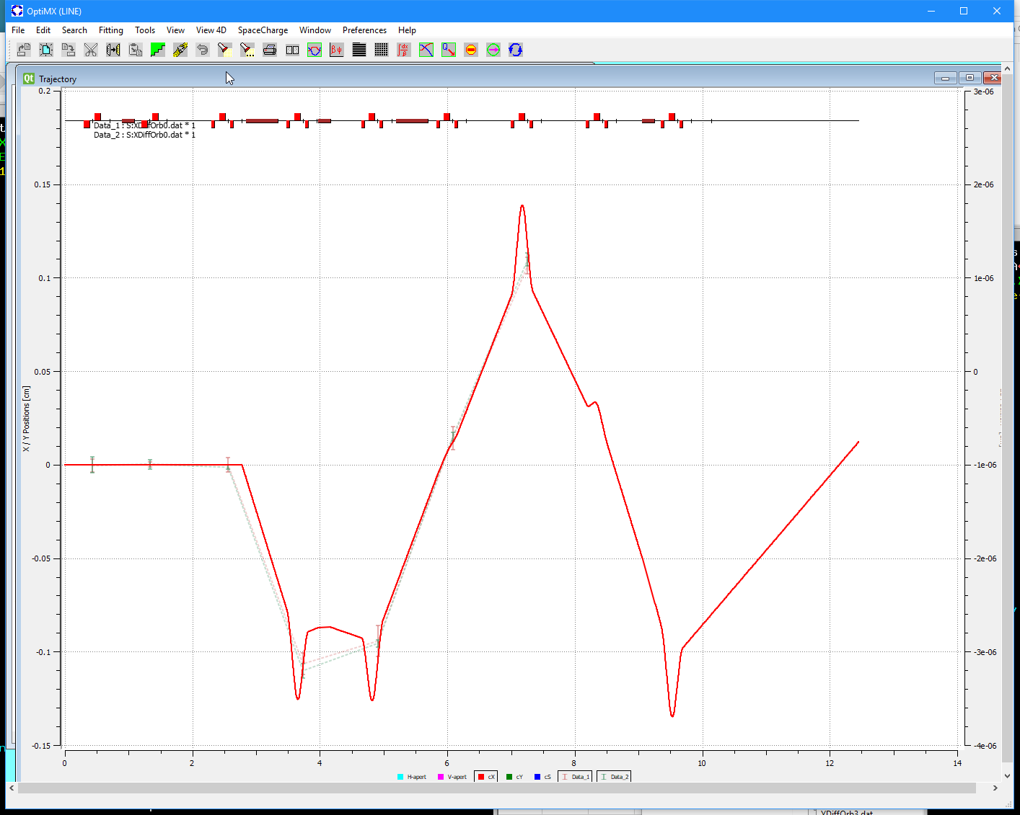
Preparation for the full beamline run
For magnet settings expected for the full-line run, determined positions of 8 scrapers at the beginning of the MEBT
All scrapers are moved to the same offset in number of the corresponding beam rms width, N∙σ
“5 mA” settings: N=3 (to use when kickers will be available)
“2 mA” settings: N= 1.3
Expected to be the main mode for full line commissioning
“0.2 mA” settings: N= 0.6
For the first passing of the beam through the full line
Average beam power at 10 µs x20 Hz x2.1 MeV < 0.1 W
BPMs still should provide reasonable transverse positions
Differential trajectory measurement at 0.2 mA. Solid line – OptiM model. A. Saini

Slide 10
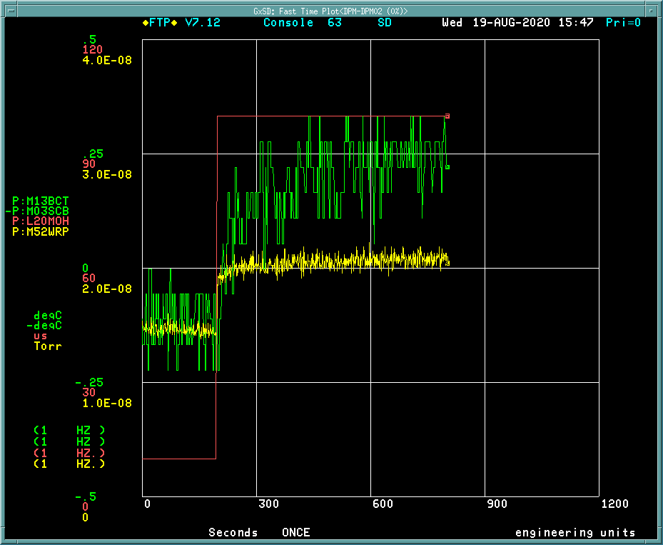
Longer pulse operation
With the entire beam placed to the MEBT absorber, the pulse length was gradually increased to 0.1 ms (20 W beam power)
With all MPS channels are activated
Work in progress to increase the pulse length to 0.55 ms
Pulse length increase from 10 to 100 µs
Temperature rise at the absorber center ~0.4C
Pressure increase in the absorber box ~6 nTorr
Response of vacuum and temperature to the increase of the pulse length from 10 to 100 µs. 20 Hz, 5 mA.

Slide 11
Beam commissioning plan
3 stages plus additional measurements
Pass the beam through the cryomodules without acceleration
Accelerate the beam to 22 MeV with minimum duty factor
Measure the main beam characteristics
Additional measurements
Gradually increase the beam power to PIP-II beam parameters
Similar to how it has been done in the “MEBT” configuration
More detailed beam characterization
Tuning and most of measurements are performed in Diagnostic Mode (as it is being done now)
Beam pulse duration is limited to 10 µs
Insertion devices are allowed

Slide 12
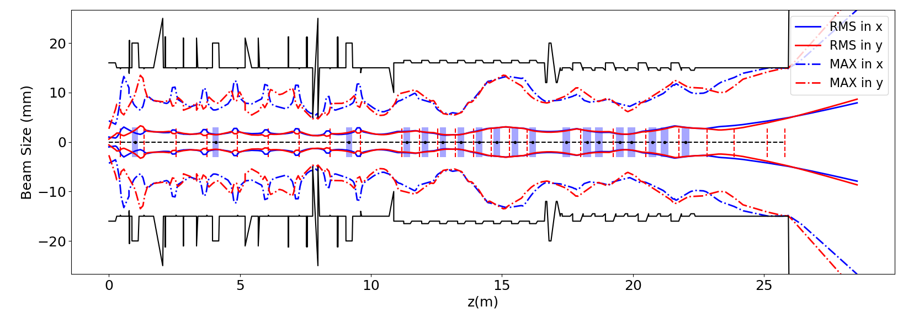
1. Beam through cryomodules without acceleration
Goal: test all systems while minimizing the risks
Inject a pencil beam prepared with scraping in MEBT
2.1 MeV x (≤ 2 mA) x (≤ 10 µs) x (≤ 20 Hz) => 0.01 - 1 W
Set solenoids for low-energy transport
Observe the beam in BPMs; pass to the dump
Check polarities of magnets, BPMs; ACCTs etc.
Measure optics with differential trajectories
Beam trajectory through the MEBT and cryomodules at 2.1 MeV, 2 mA. Ram Prakash.

Slide 13
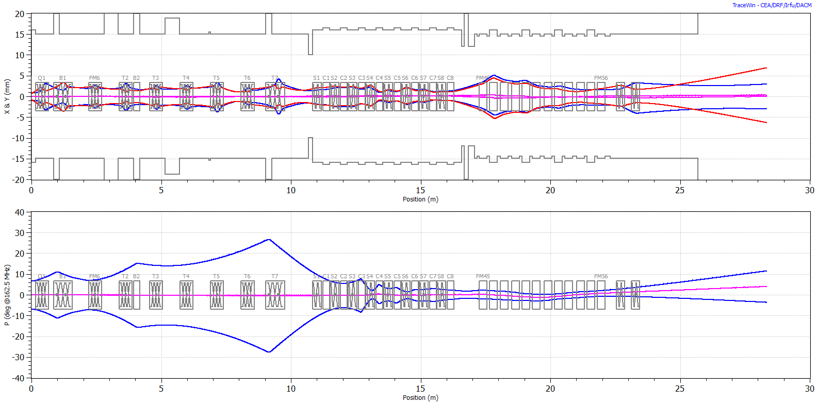
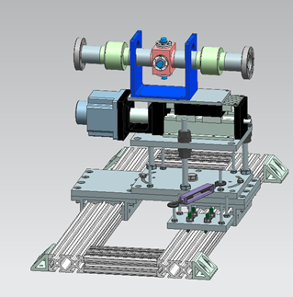
2. Accelerate the beam to 22 MeV
Set solenoids and cavities to nominal values for acceleration
2 or 3 first HWR cavities are not operational with beam
Might be still able to get to full energy by sacrificing the emittance
Phase cavities, accelerate the beam (5 - 10 µs pulses)
Measure the beam energy in HEBT with a movable pickup
Movable pickup
Beam envelopes for acceleration to 22 MeV without first two HWR cavities.
J.-P. Carneiro

Slide 14
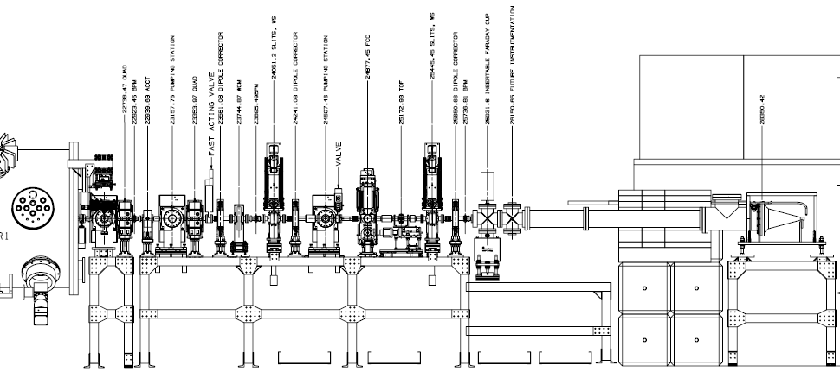
3. Measurements of the main beam characteristics
In Diagnostic mode, measure
differential trajectory response to correctors; tune optics model
beam size with Wire scanners in HEBT
2D phase portraits with the slits in HEBT; calculate emittances
2D spacial intensity distribution with the slits
bunch length with Fast Faraday Cup as a function of the last SSR1 cavity’s phase and amplitude; calculate the longitudinal emittance.
HEBT with the beam dump.

Slide 15
Additional measurements – “PIP-II parameters”
Accelerate 2 mA x 0.55 ms x 20 Hz to full energy
First, with heavy scraping in MEBT
Compensate beam loading at 0.55 ms
Commission the MEBT chopping system
When “production” kickers are installed (~ Nov 2020)
Demonstrate the “Booster injection” bunch pattern
Accelerate 2 mA x 0.55 ms x 20 Hz to full energy
With removal of 60% of bunches by the MEBT chopper
Reliability run at “PIP-II” parameters (24 hrs)

Slide 16
Additional measurements (2)
High power test of the MEBT absorber (in MEBT at 2.1 MeV)*
Residual population of the cleaned buckets
In HEBT, with Resistive Wall Current Monitor
Correlations between transverse-longitudinal planes in HEBT
4D distribution in HEBT
Emittance dilution due to chopping (measured in HEBT)
Beam orbit transverse jitter*
Laser wire*
Acceleration of bunches with intensity twice larger than nominal
*May be done without injecting the beam to cryomodules

Slide 17
Summary
The beam was re-commissioned in the “MEBT” configuration
All subsystems are operational
MPS was tested with all available channels
Confident that a beam pulse limit is enforced
Settings for the beam transport in the full line are prepared
Tested within the “MEBT” configuration
Commissioning plan is developed
Staged approach
Follows the same logic of gradual increase of the beam power as was implemented in the “MEBT” configuration
Commissioning will use the same procedures and programs

