Slide 1


Magnets 302.2.06
Coil Fabrication at BNL
Jesse Schmalzle - BNL
HL-LHC AUP CD-3 Director's Review – July 28-30, 2020

Slide 2
Outline
Scope
Technical Status and Progress
Readiness for CD-3
Interfaces
Organization
QA / QC
Approved BCRs
COVID
Schedule
Cost and Schedule Performance
Estimate at Completion
Risks
ES&H
Summary

Slide 3
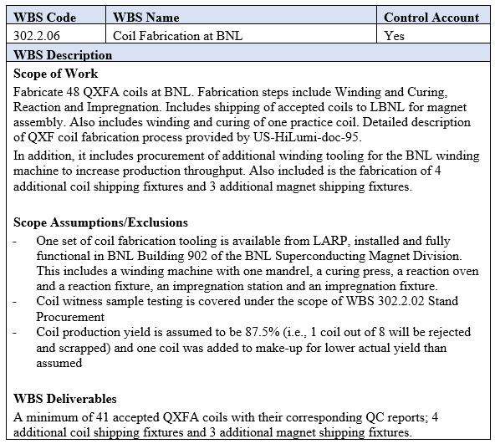
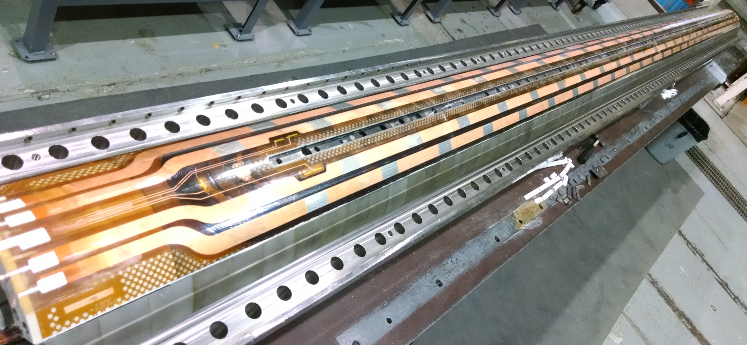
WBS 302.2.06 - Scope
Charge 1
Fabricate 48 coils (pre-series + series coil).
  Fabrication includes winding, curing, reaction, impregnation and shipping.
  Deliver a minimum of 41 accepted coils.
  Production yield assumed to be 87.5% (1 in 8 rejected).
Fabrication included 11 pre-series coils.
CD-3b includes fab of first 7 series coils.
CD-3 fab of remaining 30 series coils.
Impregnated Coil
WBS Dictionary (US-HiLumi-doc-39)

Slide 4
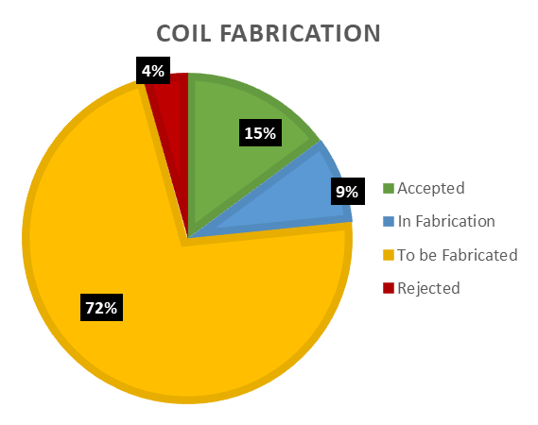
WBS 302.2.06 - Technical Status & Progress
Charge 3
Coil fabrication to date:
  7 coils completed & accepted.
  4 coils in progress.
  2 coils rejected.
  1 coil complete but on hold.
Assumed yield 87.5 %.
  Early production yield a bit lower.
Additional rate tooling has been received and put into service:
  Winding mandrel.
  Reaction & Impregnation tooling.
  Shipping fixtures.
Coil design is mature, build to print.
Design is the same at FNAL & BNL:
  BNL working to FNAL Coil Drawings.

Slide 5
WBS 302.2.06 – Readiness for CD-3
Charge 12
Readiness for CD-3:
  Fabrication of the last pre-series coil is underway.
  BNL Coil fab production readiness review completed April.
  Start of series coil fabrication under CD-3b is underway.
CD-3:
  Complete series coil fabrication.

Slide 6
WBS 302.2.06 - Interfaces
Charge 4
Coil Fabrication interfaces with several other activities.
  Q1/Q3 Cryo-assembly Interface Control Matrix (US-HiLumi-doc-219).
Interface control documents (ICDs) detail the flow of materials and data from one WBS to another.
  Receive cable and coil parts from FNAL (US-HiLumi-doc- 270).
  Receive reaction witness samples from FNAL (and send them back after reaction) (US-HiLumi-doc-279).
  Send completed coils to LBNL (US-HiLumi-doc-309).

Slide 7
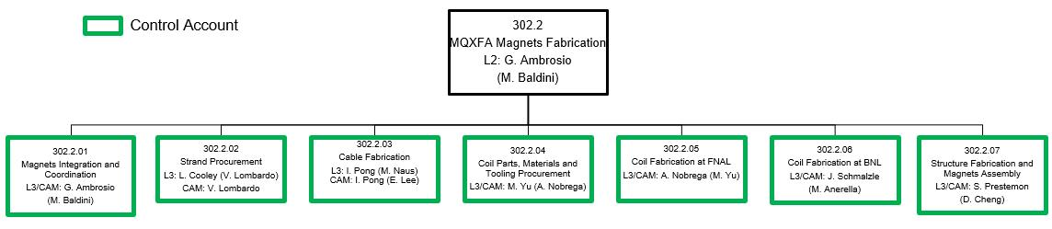
WBS 302.2.06 - Organization
Charge 11
Organization Chart - US-HiLumi-doc-104
Technical Support
R. Ceruti
D. Carleton
M. Hartsough
G. Jochen
T. Levine
D. Milidantri
M. Milidantri
W. Themann
T. Van Winckel
BNL Superconducting Magnet Division – team with many years of coil / magnet fabrication experience.

Slide 8
WBS 302.2.06 - QA / QC
Charge 8
AUP Quality Assurance Plan (US-HiLumi-doc-80).
Coil Fabrication quality assurance plans include:
  Electrical checks – in process and final checks before shipping coils.
  Mechanical measurements (coil azimuthal size, length).
  Reaction witness samples for each coil.
  Manufacturing & Inspection Plan (MIP) - approved by CERN.
  Data will be saved to CERN Manufacturing & Test Folders (MTFs).
Detailed travelers (work control procedures) for all fabrication steps.
  QA representatives review and approve all travelers.
QA Plan in QXFA Series Coil Production Specification (US-HiLumi-doc-2986).
Electrical QA for QXFA Coil Fabrication (US-HiLumi-doc-521).

Slide 9
WBS 302.2.06 - QA / QC
Charge 8
Cause and corrective actions for rejected / on hold coils:
  Coil 205 – cable damaged during winding.
    Cause: slack in cable, cable dropped off guide pulley when resume after pause.
    Corrective action: improved tooling – added guard, revised procedure – incorporated interlock.
    Partially wound coil was unwound, coil parts were recovered.
  Coil 208 – cable damaged during curing.
    Cause: cable out of position during curing
    Corrective action: improved tooling – added clamps, revised procedure – inspect / verify.
    Coil dismantled, coil parts recovered.
  Coil 210 – cable strands damaged during prep for impregnation.
    Cause: damage occurred while scraping away excess solder after lead splicing.
    Corrective action: revised procedure – eliminated use of scraper, added silicone pad to help prevent buildup of excess solder, brush away excess liquid solder while hot, use soldering iron to remove excess hardened solder if needed.
    Repair - Area around damage was solder filled, then proceeded with impregnation.

Slide 10
WBS 302.2.06 - Approved Baseline Change Requests
Charge 4,11
BCRs approved:
  BCR 0064 – adjustment for coil 205 rejection.
    Impact: cost ($232k), schedule none.
  BCR 0065 – added impregnation of short coil for QH qualification.
    Risk mitigation (RT-302-2-01-017). Impact: cost $162k, schedule none.
  BCR 0078 – coil mapping.
    Update to assignments of coils to magnets due to coil rejections. Impact: cost ($386k), schedule none.
  BCR 0081 – administrative correction.
    Correction where some actual cost were added to budget in error. Impact: cost ($217k), schedule none.
  BCR 0117 – FY20 rate update.
    Update to FY20 charge rates. Impact: cost $431k, schedule none.
  BCR 0139 – one additional coil at BNL (one also at FNAL).
    Impact: cost $292k.
  BCR 0145 – ETC 2020
    Adjusted coil fab labor estimate. Impact: cost ($548k), schedule none.
  BCR 0144, 0149, 0154 – COVID

Slide 11
WBS 302.2.06 – COVID
Charge 9
Coil fabrication was halted for approximately 3 months while BNL was closed.
AUP coil fabrication was made a priority on re-start.
  Coil techs were included with 1st group to return.
We are currently working under guidelines.
  Avoid working in close proximity wherever possible.
  Require PPE for operations that require close proximity.
    Face mask, glasses/face shield, gloves…
  Minimize tool sharing.
  Frequent hand washing.
We expect efficiency to be somewhat impacted.
  Will be tracking coil fabrication duration and labor hours to quantify the impact.
  BOE’s to be revised later this year to include COVID impact.

Slide 12
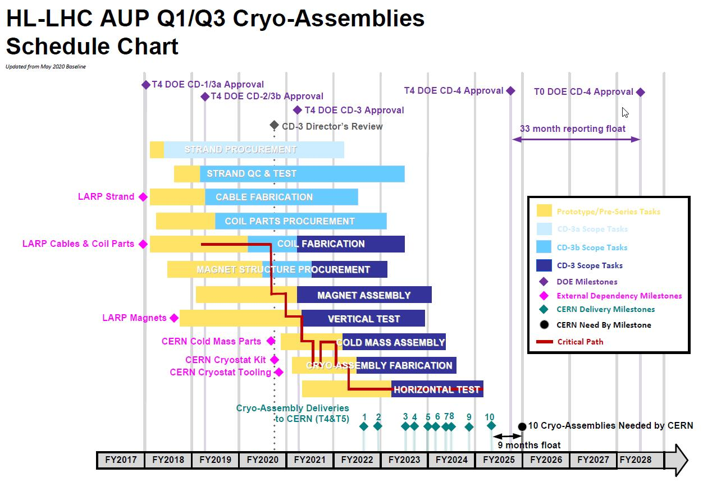
WBS 302.2.06 - Schedule
Charge 2,5
Coil fab is on / near the critical path.

Slide 13
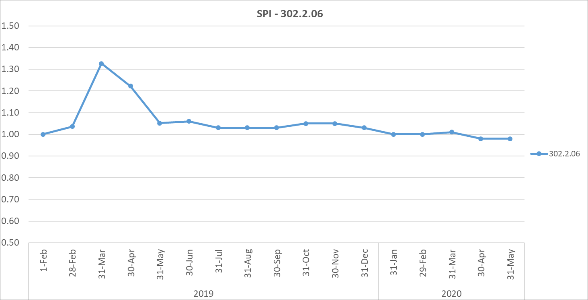
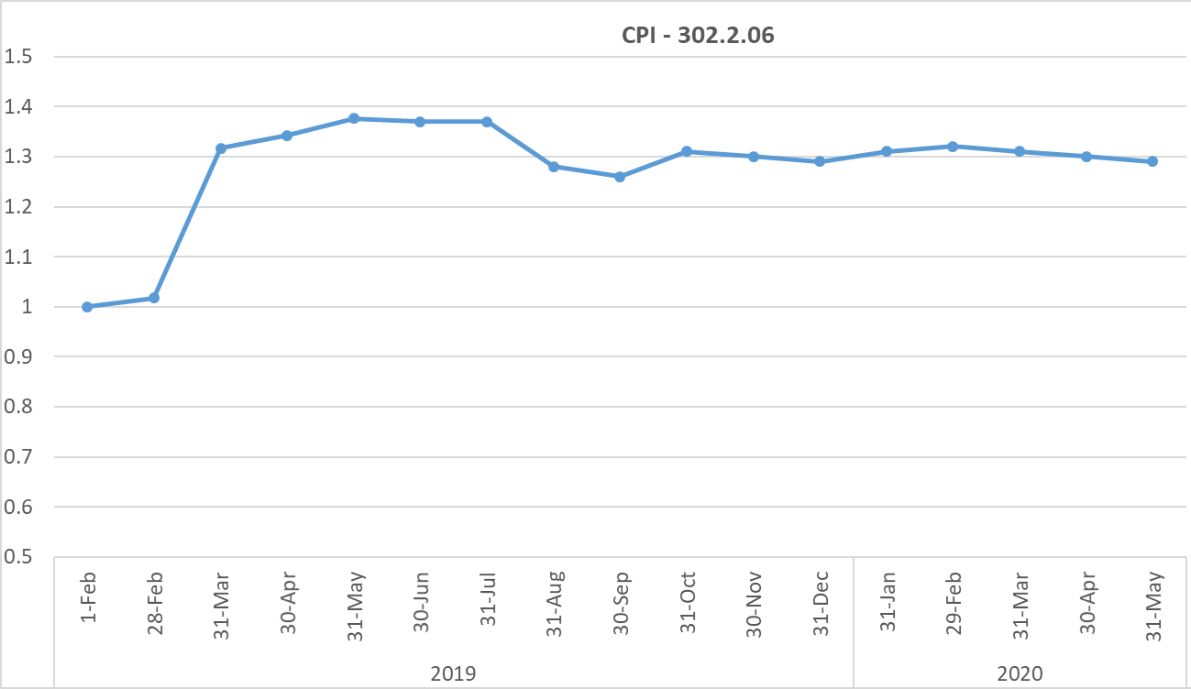
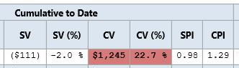
WBS 302.2.06 – Cost & Schedule Performance
Charge 11
Variances:
Early coils under budget.
  Estimate for early coils included a learning curve multiplier (new activities, new techs).
  Fabrication did not required the full learning curve multiplier.
  Coils no longer include multiplier.
Additional tooling fabrication completed under budget.
SPI
CPI

Slide 14
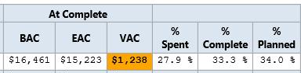
WBS 302.2.06 – Estimate at Completion
  EAC = $15.2M
  Variance at Complete (VAC):
    Early coils under budget - have not required full learning curve multiplier.
    Additional tooling fabrication completed under estimate.
    Production yield variances.
  Estimate to complete – $15.2 - $4.2 = $11.0M (EAC-Actual CTD)

Slide 15
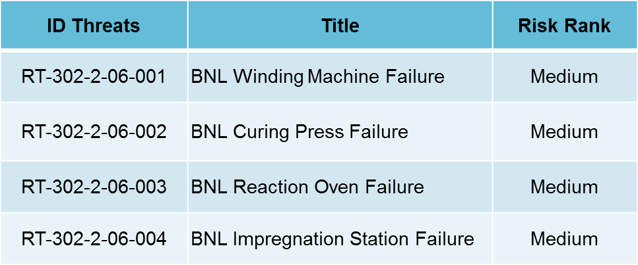
WBS 302.2.06 – Risks
Charge 6
Coil fab risks included in risk register (US-HiLumi-doc-79).
  Equipment / Machines have been historically reliable.
  Have some critical spare components on hand.
  Risk of coil failure above assumption is addressed in WBS 302.2.01 (RT-302-2-01-002).
    Coil production yield is assumed to be 87.5% (ie 1 coil out of 8 rejected).

Slide 16
WBS 302.2.06 – ES&H
Charge 8
AUP Hazard Analysis (US-HiLumi-doc-1121).
  Coil fabrication ES&H considerations:
    Chemicals (Boron Nitride, Mold release, Epoxy, Soldering flux).
    Electrical Hazards (Hipot checks, Impulse checks).
    Liquid Argon (cryogen).
    Lifting/Handling.
  Precautions taken include:
    Training, PPE, ventilation, etc.
    Dedicated fixtures for lifting coil, react / impreg fixtures. Reviewed, load tested and approved.
ES&H representatives review and approve all travelers.
COVID – preliminary plans for working under guidelines.
  Avoid working in close proximity wherever possible.
  Require PPE for operations that require close proximity.
    Face mask, glasses/face shield, gloves…
  Minimize tool sharing.

Slide 17
WBS 302.2.06 – Summary
Coil fabrication is underway.
  Pre-series coils are nearly complete.
  Series coils are underway.
  Interfaces are flowing smoothly.
  Early yield a bit lower than planned – tooling and procedures updated to improve yield.
  Assessment of COVID impact ongoing.
  ESH&Q remains a priority.
  Coil fabrication is on schedule and under budget.
  Thank you. Questions?

Slide 18
-
Back Up Slides…

Slide 19
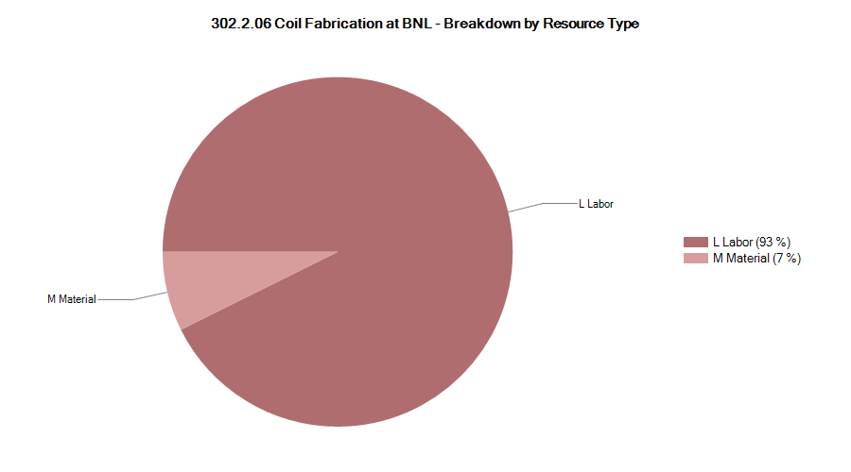

Resource Type Breakdown
93% Labor, 7% M&S
Fully burdened values.

Slide 20
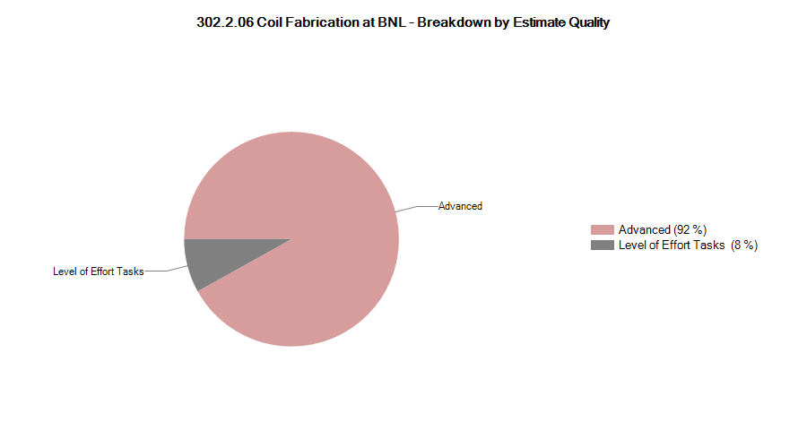
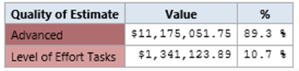

Estimate Quality
.

Slide 21
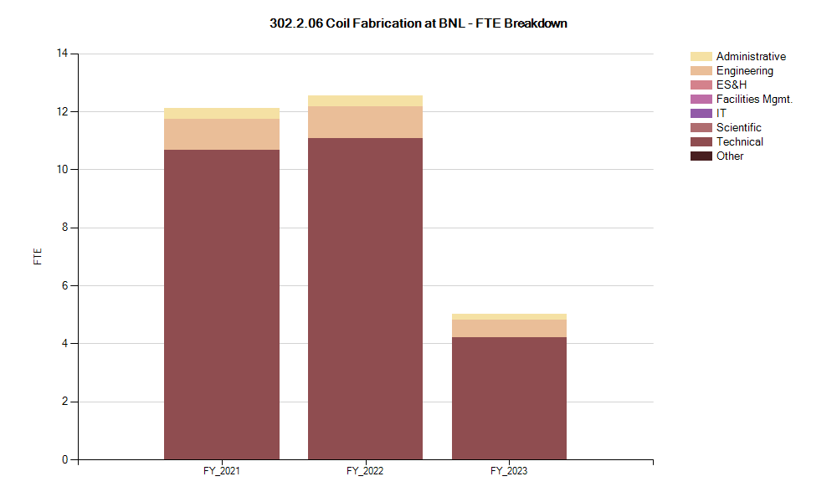

FTE Breakdown
.

Slide 22
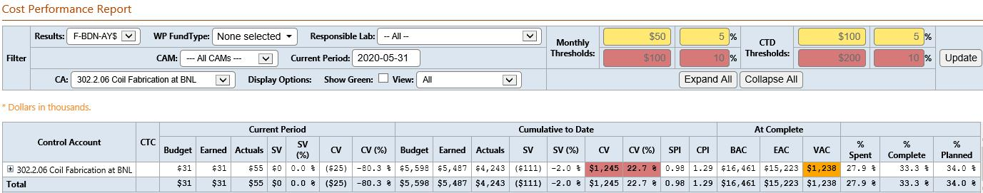
Cost Performance Report
BAC = $16.5M
Cumulative SPI = .98, CPI = 1.29

