Slide 1
Theory Overview :
CLFV at muon scale
佐藤 丈（SATO, Joe）
(埼玉大学、Saitama University)
J-Parc Symposium
令和（Reiwa)） 02年 7月3日(2020/07/3rd)

Slide 2
1.Introduction ～ Lepton Flavor in SM
The Standard Model
Lepton
+Higgs boson H
? ? ?
ν_{e} | ν_{μ} | ν_{τ}
R R R
Chiral Thoery
ν_{e} | ν_{μ} | ν_{τ}
L L L
No RH neutrino
e | μ | τ
R R R
L<->R nonsymmetric
e | μ | τ
L L L
1st generation
u ^{r,g,b} | c ^{r,g,b} | t ^{r,g,b}
R R R
Lepton Flavor (e-like,μ-like,τ-like)
is exact symmetry and conserved
u ^{r,g,b} | c ^{r,g,b} | t ^{r,g,b}
L L L
d ^{r,g,b} | s ^{r,g,b} | b ^{r,g,b}
R R R
d ^{r,g,b} | s ^{r,g,b} | b ^{r,g,b}
L L L
Quark

Slide 3
Lepton Flavor in SM
Conserved “Charge” resulting from massless neutrinos
Electron, muon, tau number
Opposite(-1) for anti particles
１ １
１ １
１ １
Example of conservation
０ ＝ １＋（－１）

Slide 4
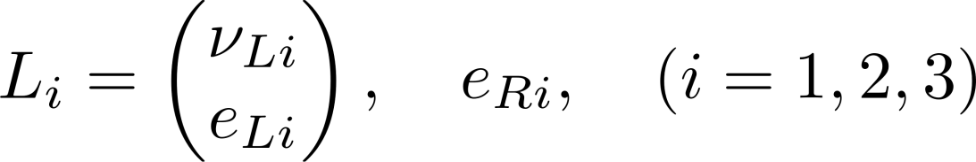
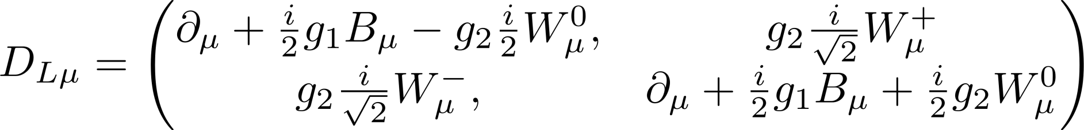




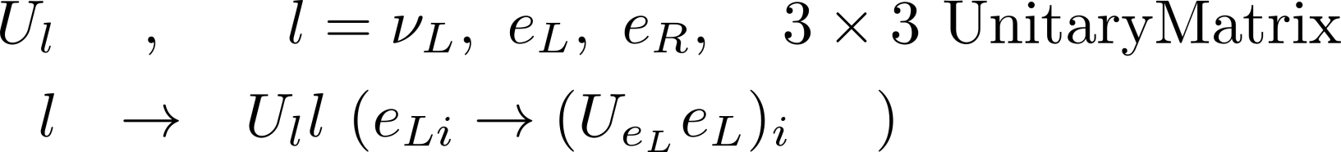

Derivation of lepton flavor charge
Lepton Part Only
Kinetic Part
Sum of 3 species of Weyl sprinors
Invariant under 3 independent unitary transformation
independent

Slide 5
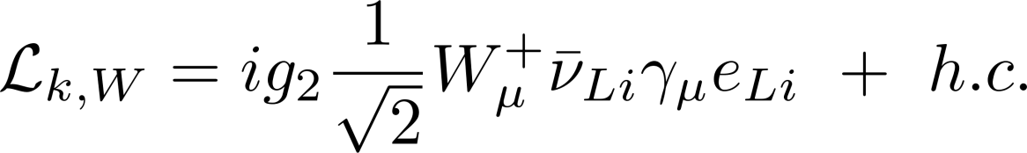



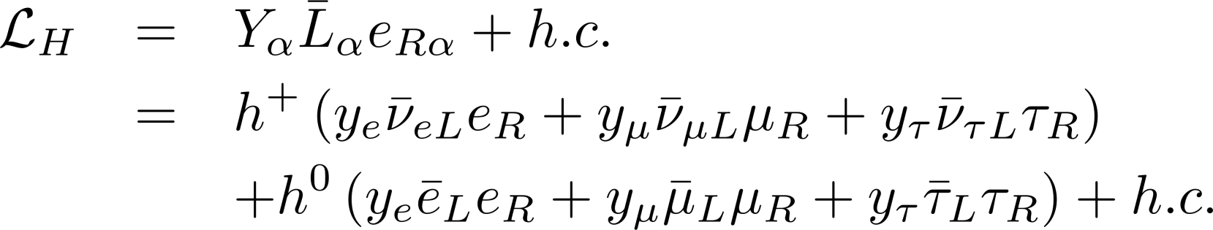
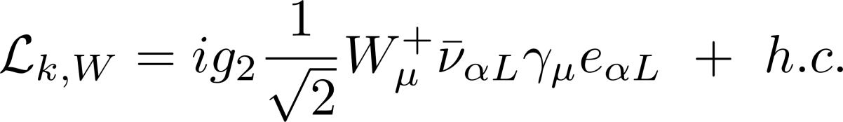
To make it invariant
Is necessary. Reduction of symmetry
2 independent Unitary matrix
Higgs Part
３×３complex :: diagonalized by 2 unitary matrices
Definition of lepton flavor
Flavor eigenstate = charged lepton mass (=physical) eigenstate
Since
kinetic term is invariant
Kinetic terms under flavor basis !!

Slide 6
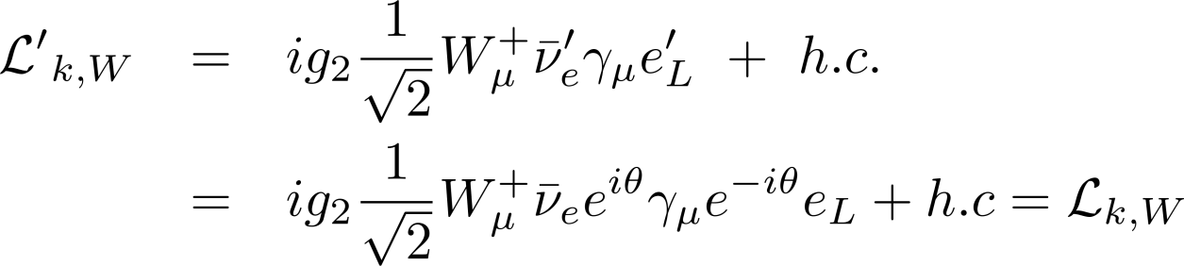
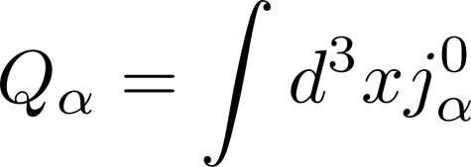
Residual symmetry ：：Lepton Flavor
Grouped with “same flavor”
→Lagrangian is invariant under phase shift of each flavor
→Lepton flavor conservation
e.g
Phase transformation of electron flavor
From Noether’s theorem Consered current exists
In each flavor the conserved current is given by
“Charge” is expressed as follows and it conserve

Slide 7

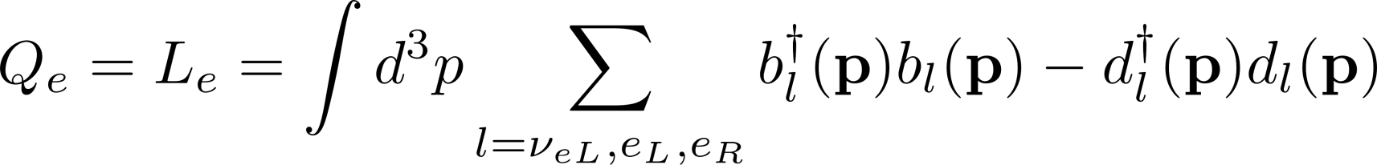
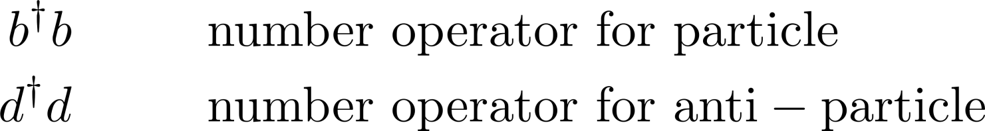



For example , that is, electron flavor charge is given in terms of creation and annihilation operators of electrons
Electron and electron neutrino
Positron and anti-electron neutrino
Similarly muon and tau flavor charge is defined.

Slide 8
Lepton Flavor is conserved under SM
Electron, muon, tau number
Opposite(-1) for anti particles
１ １
１ １
１ １
If SM is correct,
in all process, these numbers are conserved
Contraposition
If non-conserved is found, SM is not correct

Slide 9
With additional particles and hence additional operator in Lagrangian,
in general, under the transformation
+ appropriate transformation for extra particles
Lagrangian is not invariant
→Lepton flavor cannot be defined
→Lepton flavor “ charge” defined under SM Lagrangian
cannot be conserved

Slide 10
Status of LFV with charged lepton
1 ＝ ０＋０
０ ＝ １＋０
Annu. Ref. Nucl. Part. Sci. 2008. 58:315-41
W. J. Marciano, T.Mori, and J. M. Roney
No observation of CLFV
No doubt on SM from CLFV

Slide 11
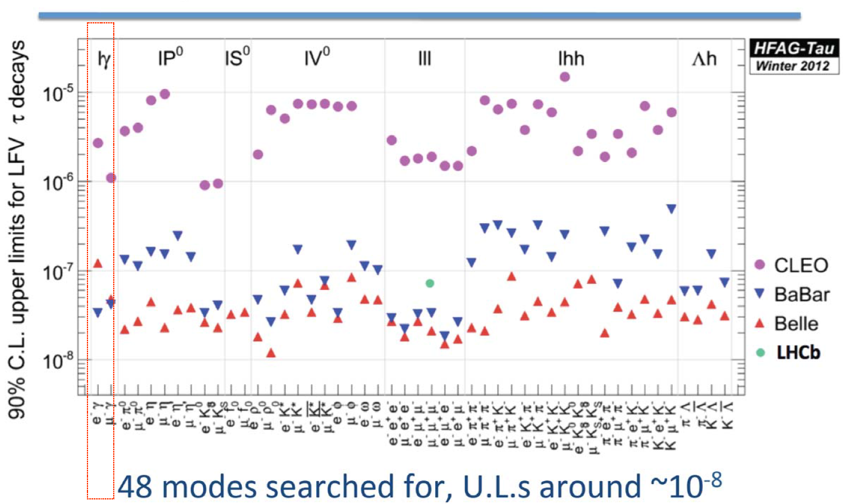
τdecay

Slide 12



2. Lepton flavor violation
For LF to be defined, Lagrangian must be invariant under this transformation with appropriate transformation on extra particles
If new Lagrangian is not invariant
→Lepton flavor cannot be defined
→Lepton flavor “ charge” as defined under SM Lagrangian cannot be conserved
Simplest example
Neutrino mass term with RH neutrinos (SM singlets) :: Dirac mass term
Flavor basis α is fixed by charge lepton mass.
We cannot rotate lepton doublet.
If and only if nature choose to be diagonalized by rotating only ,
Then , and hence LF is defined as a result of
Appropriate transformation ,,, Lucky case

Slide 13

In general, we need by unitary transformation to get mass basis for neutrino
→Lepton flavor cannot be defined
→Lepton flavor “ charge” as defined under SM Lagrangian cannot be conserved
Diagonalized mass
In another words flavor basis do not coincide with mass basis
Interaction with W boson、
Mass base mix with each other. ->Flavor changing processes appear
seed of neutrino oscillation
「対角的」でなくなる。→ニュートリノ振動の種

Slide 14

Incidentally, dirac mass terms, in general, conserve
lepton number
＋ ＋ =
can happen
1 ＝ １＋０
Lepton number = A part of particle number
= (particle =1 & antiparticle=-1)
c.f. Majorana mass term leads lepton number (in general particle number) violation
neutrinoless double beta decay
not necessary neutrino majorana mass term

Slide 15






3. Neutrino oscillation
In SM, neutrino flavor is defined with paired charged lepton
Beta decay, electron is emitted (Le=1) = anti-electron neutrino emitted (Le=-1)
→electron number 0=1+(-1)
Neutrino oscillation
If lepton flavor conserves,
Flavor =mass
Flavor states = particle states
as a whole
detection
creation

Slide 16



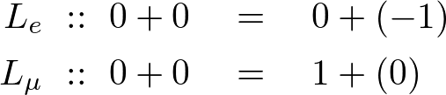
If neutrino is massive,
Neutrino oscillation
If massive,
Flavor states ≠ particle states
as a whole
detection
creation
LFV!! Logically SM is incorrect !!

Slide 17

To insist it is due to neutrino oscillation, more information has been accumulated
If neutrino is massive,
Maki,Nakagawa,Sakata
Flavor eigenstate
Interaction state
Mass eigenstate
Particle state
Propagation of nuetrinos：As a particle = mass eigenstate
Creation of neutrinos ： week interaction accompanied
with partner charged lepton
Superposition of mass eigenstates
Multiple propagation of neutrinos
Quantum interference
= Neutrino Oscillation

Slide 18
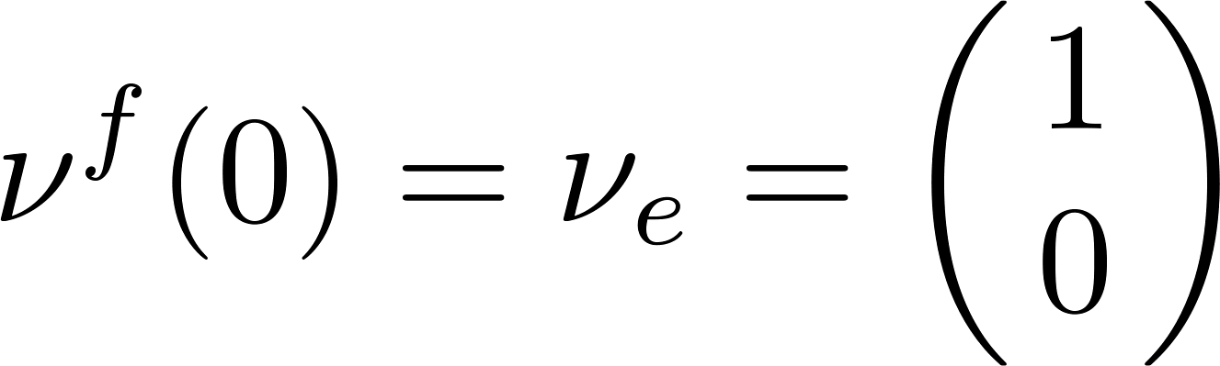
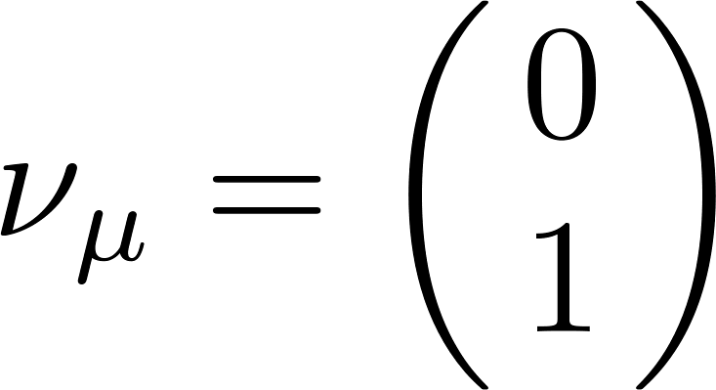
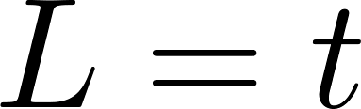

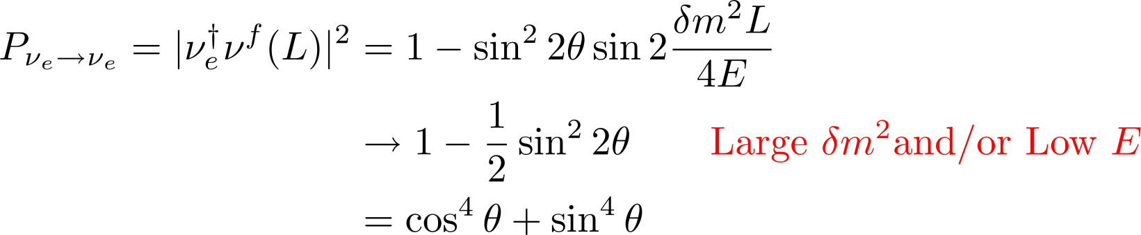

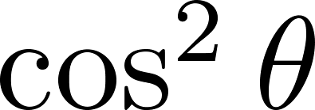
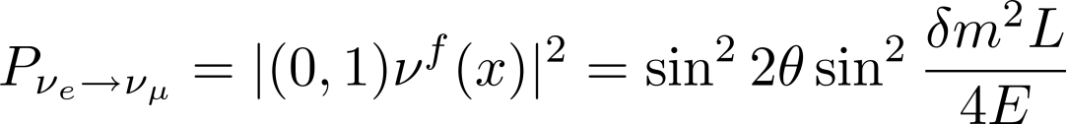
Reactor Neutrino Example
electron neutrino is emitted
Two flavor approximation
incidentally
At a distance
survival probability of
Quantum interference（oscillation）
Quantum effect disapper
Merely transition
Ampitude of this transition
Similarly sin^2θ for 2nd state
incidentally

Slide 19


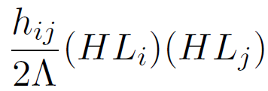

As a result,
We have to explain neutrino masses and lepton mixings → Lepton Flavor Violation
Neutrinos
Neutral (Electromagnetic and color), real under SU(2)
Tiny mass（also mass pattern）
Neutral :: two types of mass term
Dirac ： “partner” is necessary. It is neutral (= no charge) under SM
so-called Right-Handed(RH) neutrino . Higgs doublet can be reused
Majorana： self mass term. Within renormalizable, we need to introduce SU(2) triplet
If nonrenormalizable, with cutoff without new particle
though, indicates new physics = new particle

Slide 20
For example, majorana mass can be new scale Λ. It is singlet under SM
Is allowed
With Dirac mass term , we have mass term for neutral particle under EM
Eigenstate values are neutrino masses. Especially
Seesaw
Particle states
Gell-mann et al, Yanagida
Is RH neutrino Majorana masses. Graphycally
10¹⁶ GeV

Slide 21
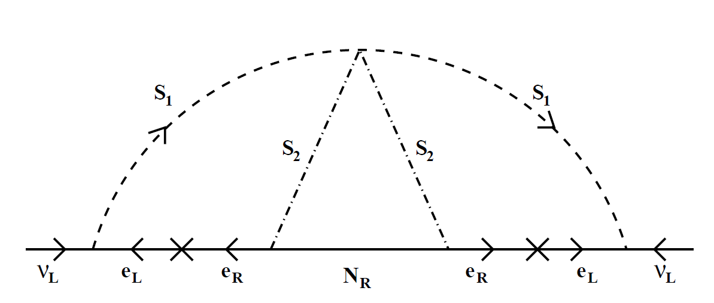
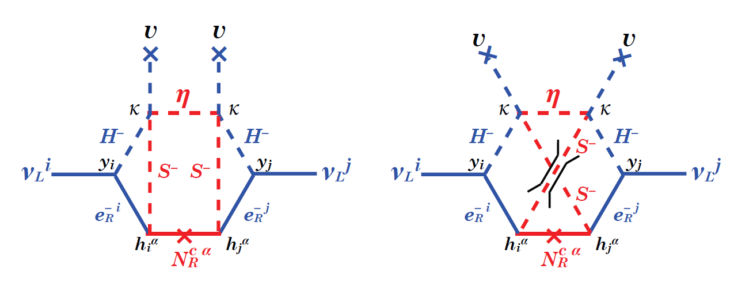
Is not necessary. Different type of models
Another example = loop correction Zee model・radiative seesaw
Krauss etal
Aoki etal
Majorana mass term for left-handed neutrinos

Slide 22
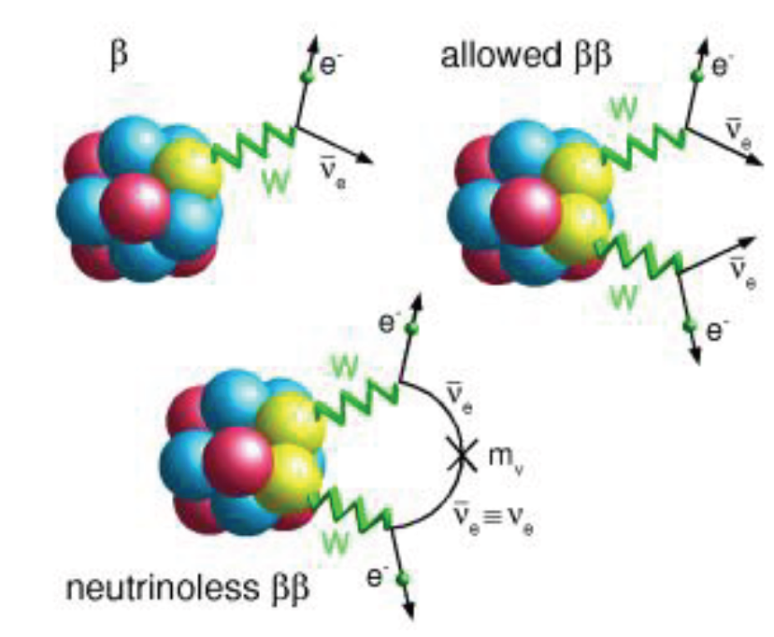


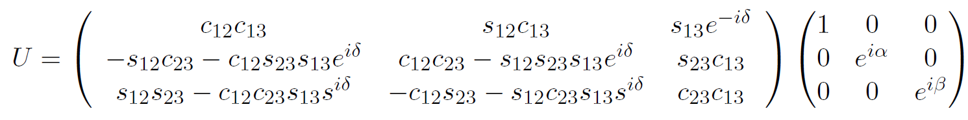

Majorana mass term
“violates”
Not only Lepton Flavor
But also Lepton Number
Lepton number changing process
Ecample
Romanino
Also in muonic atom

Slide 23
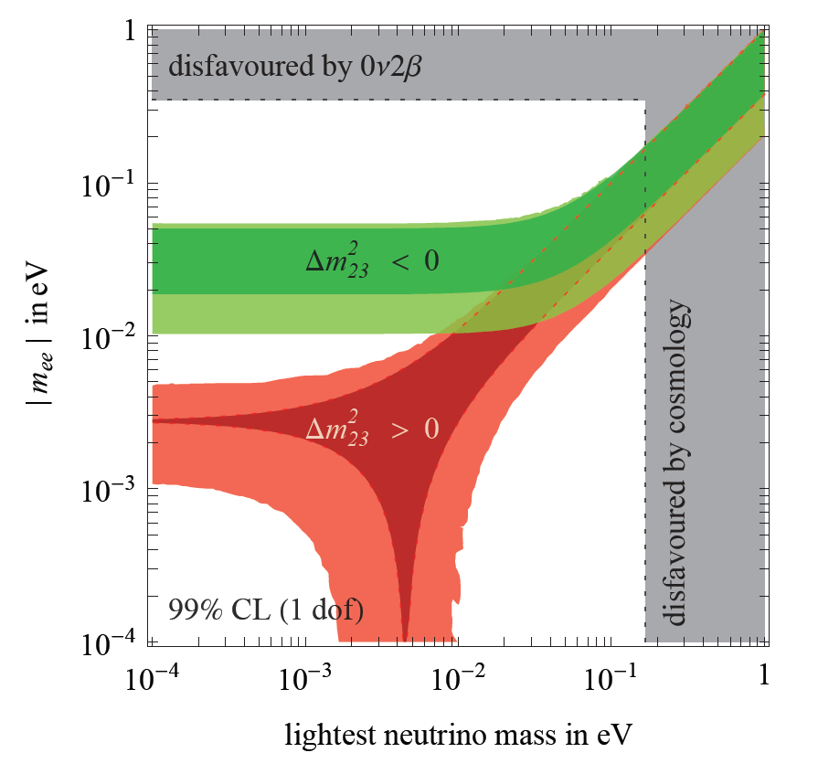
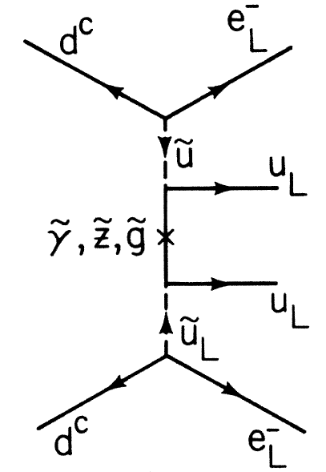

prediction from neutrino oscillation and constraint from Neutrinoless double beta decay
Two kinds of prediction from neutrino oscillation
Normal hierarchy (NH) and inverted hierarchy (IH)
Note
“ Majorana mass for left-handed neutrino →neutrinoless double beta decay “
Always holds but conversion is not true !!
Example from SUSY
Lepton flavor violation and particle number violation has different origin !!!
Majorana mass term ≠ neutral
Majorana mass term = real representation,
can be charged
Mohapatra 1986

Slide 24
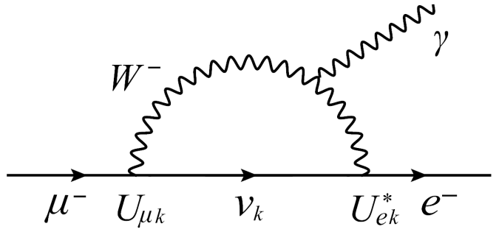
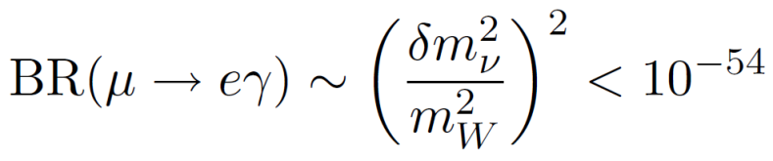
4.Charged Lepton Flavor violation
Lepton Flavor is exact symmetry in SM
as long as neutrinos are massless
Charged Lepton Flavor Violation (cLFV) through Lepton Mixing
in the neutrino oscillation
But …
Invisible, eternally
Strong suppression of FCNC by GIM
Detection of the LFV signal
Clear evidence for beyond SM
Notes:
First I will review the motivation to study charged lepton flavor violation and current experimental status though many of them are overlapped with the previous speakers. The reason that CLFV is important and interesting is very simple. That is the lepton flavor is an exact symmetry in the standard model since neutrinos are massless. Therefore for example muon cannot decay into electron and photon since in this process muon number and electron number are violated. Of course nowadays we know that lepton number is not conserved from the fact that there is neutrino oscillation. In the oscillation phenomena we know that Lepton flavor is not conserved. We have to include at least neutrino mass and lepton mixing into the SM. It cause in principle charged lepton decay with lepton flavor violation. However it is strongly suppressed with an minimum introduction of masses. Branching ratio in this case is proportional to the neutrino mass square deference which appear in this form due to GIM mechanism and we have to conclude that we cannot observe charged lepton flavor violation. In other word FCNC is strongly suppressed due to the mechanism. Therefore if we can observe CLFV then we have to introduce new physics beyond the SM in a deeper level.

Slide 25
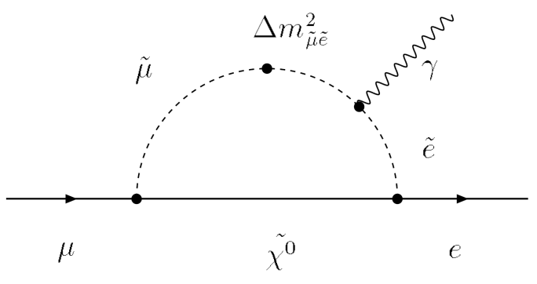
Indeed, in physics beyond SM,
Large FCNC is expected
Particularly Combining with neutrino oscillation
Large FCNC in charged lepton is expected
(must appear ??)
e.g. a supersymmetric model
Enhancement of LFV through the slepton mixing
Detectable at future experiments
Search for LFV with charged lepton
is inevitable
Notes:
Indeed in general in physics beyond the SM often large flavor changing neutral current is expected. In physics beyond the SM we have to care neutrino masses and lepton mixing in addition to other ingredients. In this case we often introduce new LFV sources other than neutrino masses and we can expect large branching ratio of CLFV processes. For example in the most exhaustedly studied model, supersymmetric standard with R parity, we get a prediction of large branching ratio of CLFV processes through slepton mixing which is a new source of lapton flavor violation. The prediction is so large that we will soon observe CLFV. Therefore CLFV search is very important.

Slide 26
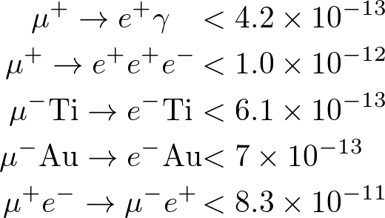
cLFV from muon decay
Upper limit on Br
Annu. Ref. Nucl. Part. Sci. 2008. 58:315-41
W. J. Marciano, T.Mori, and J. M. Roney
Long history
Notes:
There has been many searches for charged lepton flavor violation. For example there are four type for CLFV processes with muon. At this moment we have upper limit for the branching ratios around 10^-12. Historically they have changed as shown in this graph. For example the green triangles present the upper limit on mu e conversion. It has changed in this way.

Slide 27
cLFV from tau decay
Upper bound ~ 1/# of taus
Notes:
Of course there has been CLFV searches including taus. It is the summary graph for CLFV from taus. The upper limits for these process are around 10^-7 or 10^-8. Including efficiency this number means that the upper limit is given by the inverse of number of taus which we human beings have gotted till now.

Slide 28
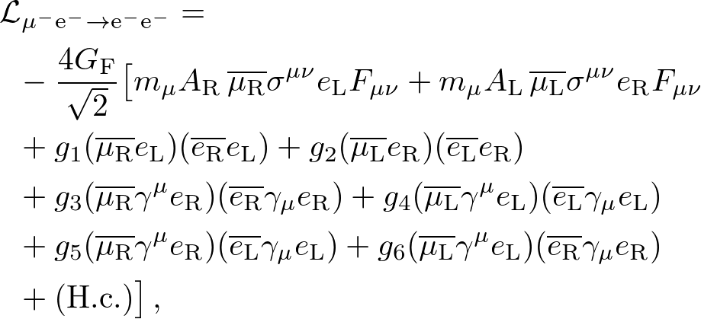



Effective operators for (muon)CLFV
Notes:
From now on I am listing important features to understand model predictions of CLFV. To be concrete I will explain them in the case of muon decay. For taus please change muon and other daughter particles appropriately. First we should make it clear whether CLFV processes are caused by tree or loop. In general mu e gamma process can be caused only by loop effect due to gauge symmetry. Gauge symmetry forbids to appear and hence it appears as dipole operator only. On the contrary mu to 3e process and mu to e conversion process can be caused both by loop and tree. For example, if there is a dipole operator of mu to e gamma, then by attaching the electroweak current qqgamma we can get a relevant operator for mu to e conversion. Of course they are induced by exchange of a particle which mediates lepton flavor violation.

Slide 29
Effective operators for CLFV
A) Loop vs Tree
:: Loop only, dipole
Gauge Symmetry forbids tree contribution
:: Loop and Tree
e.g. Loop = dipole + quark bilinear =
～ α smaller than μ->eγ
Tree :: singlet particle is necessary for conversion!
Charge 2 is OK for μ -> 3e
Leptoquark is OK for μ -> e
Notes:
From now on I am listing important features to understand model predictions of CLFV. To be concrete I will explain them in the case of muon decay. For taus please change muon and other daughter particles appropriately. First we should make it clear whether CLFV processes are caused by tree or loop. In general mu e gamma process can be caused only by loop effect due to gauge symmetry. Gauge symmetry forbids to appear and hence it appears as dipole operator only. On the contrary mu to 3e process and mu to e conversion process can be caused both by loop and tree. For example, if there is a dipole operator of mu to e gamma, then by attaching the electroweak current qqgamma we can get a relevant operator for mu to e conversion. Of course they are induced by exchange of a particle which mediates lepton flavor violation.

Slide 30
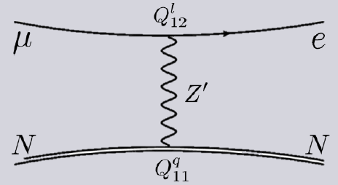


Tree, e.g.
No direct relation with MEG
NO suppression
We can parameterize the relative strength
～ α :: dipole type, say SUSY with R parity
In general, Model Dependent
Notes:
There are many kinds of mediators have been considered. For example let’s imagine that there is a new vector particle which violates lepton flavor. Then we get a diagram for mu to e conversion. This diagram prediction for mu to e conversion is completely irrelevant withmu to e gamma process. To indicate this situation, we often write this kind of effective lagrangian. This is for mu to e gamma and this is for mu to e conversion. The relative strength is indicated by the parameter kappa here. The most exhaustedly studied model, that is minimal supersymmetric model with right-handed neutrino with R parity gives kappa the fine structure constant of course though the kappa is model dependent.

Slide 31
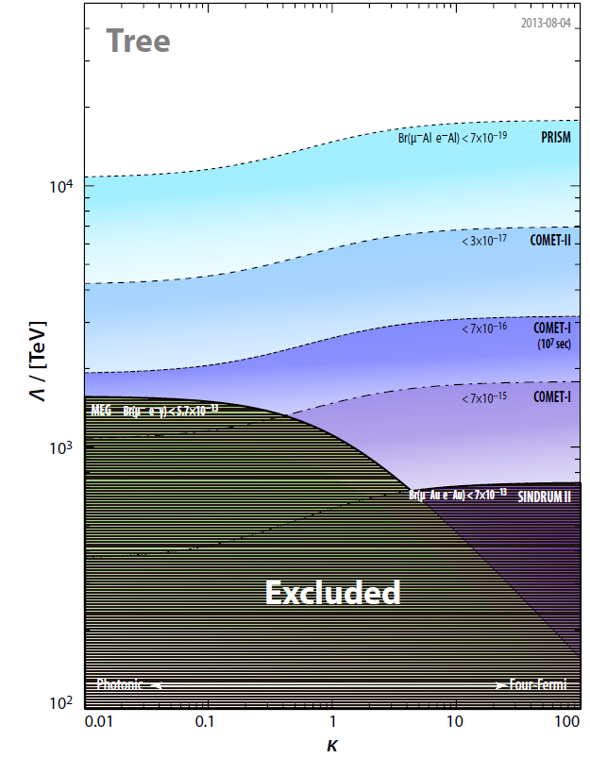



MEG
Notes:
Then as a function of kappa the branching ratio more exactly a effective scale which are searched for mu to e gamma and mu to e conversion is drawn in this way. Sorry this graph is a little bit old since it was drawn for COMET CDR. It is shown here to catch a glimpse for model dependence . This line shows the sensitivity for MEG experiment while these lines are for mu to e conversion. As I explained if MSSM is the case we have to see this vertical line and hence naively mu to e gamma experiment gives better sensitivity to new physics. However in general we cannot say which is better. It is quite model dependent.

Slide 32
B) Vector vs Scalar
cLFV is mediated by new particle(s)
Vector Boson ::
Boson with broken gauge
So-called Z’ Model, Extra U(1) from SO(10) GUT
Kaluza-Klein mode of gauge
Higher dimensional models have massive modes of gauge bosons
Scalar Boson ::
From symmetry = SUSY
Extension of Higgs :: more 2plet, 3plet for nu mass
Explanation for new physics
Notes:
Next I classify models. To have observable CLFV process we need to introduce new particles which violate lepton flavor as I mentioned at the introduction. Such a new particle must be vector or scalar particle as they couple with two charged lepton. There are many example of such models. There arise many kind of massive vector bosons from broken gauge symmetry and KK mode of ordinary gauge bosons. Also there are many kinds of candidate for such scalars from symmetry such as SUSY, from extened higgs sector and so on.

Slide 33
Example from Vector type interaction
If Vector boson has no charge
and
can occur at tree level
in a wide sense Z’ model
irrelevant
Notes:
For vector case in many case they are electrically neutral and they can mediate LFV at tree level. It means mu to 3 e and mu to e conversion can occur at tree level while still mu to e gamma occur at loop . They are irrelevant with each other.

Slide 34
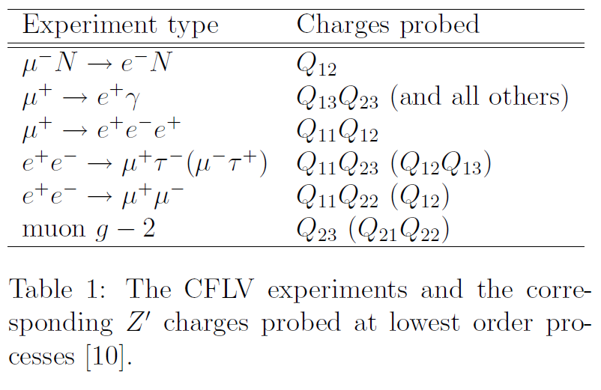

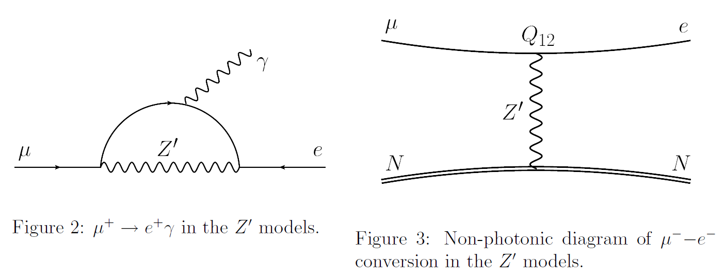
cLFV Interaction
Different Q’s !!
Notes:
I will call such a vector boson Z’. The LFV coupling of Z’ is often parametrized by these large Q. For mu to e gamma process which is given by this diagram depends on Q13 and Q23 , and maybe other combination while mu to e gamma is dependent on Q12 only.

Slide 35
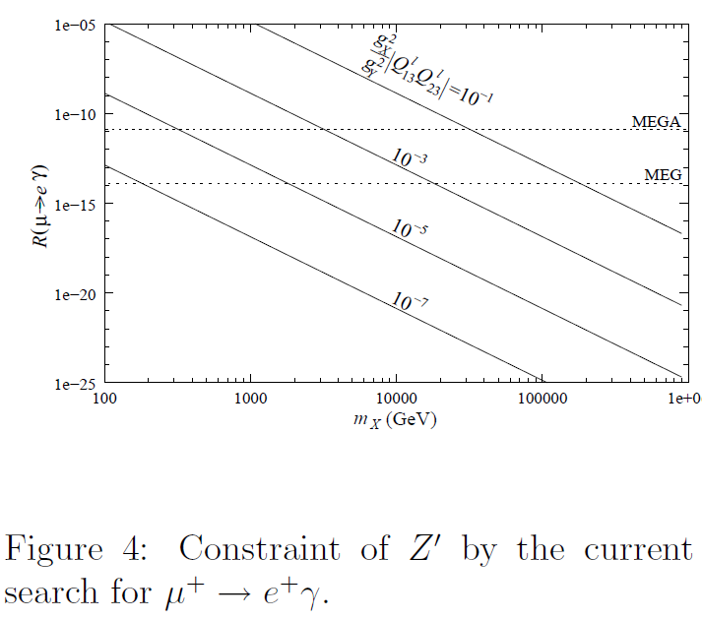
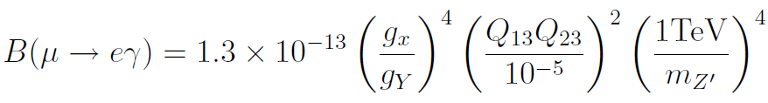
Brandon Murakami
10TeV
Notes:
Since we have not observed any CLFV process in muon decay we have constraints on these LFV couplings Q’s in addition to Z’ mass. It is depicted by this graph. If Q’s are large enough, say it is 10^-3, we can say we have explored by MEG the Z’ mass to be 10 TeV. However anyway it is dependent on these combination and by varying Q’s we have to say we have explored Z’ mass up to, say 100GeV.

Slide 36
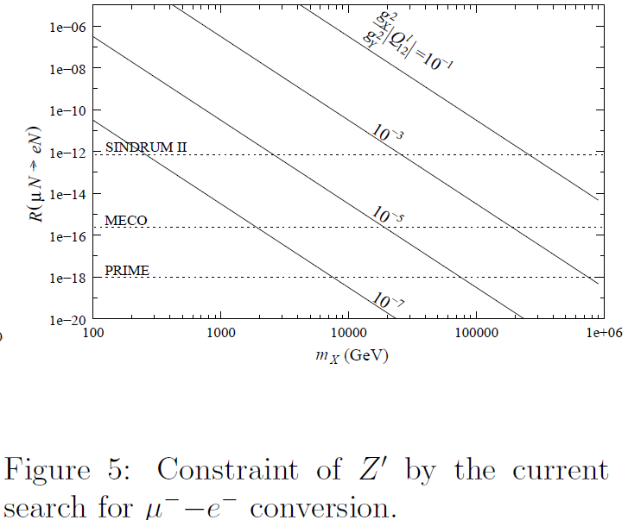
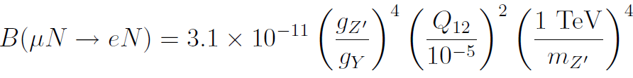
Brandon Murakami
10TeV
Notes:
Similarly we get information on Z’ mass from mu to e conversion with a assumption of different Q’s, here . They are completely independent.

Slide 37
Direct Search at LHC ,excluded < 3TeV
Notes:
Incidentally there is a constraint for Z’ mass with some assumption. For example here Z’ is assumed to decay into ee mainly. In terms of previous slide Q11 is assumed to be large enough. By “approperate” assumption we may evade this constraint

Slide 38


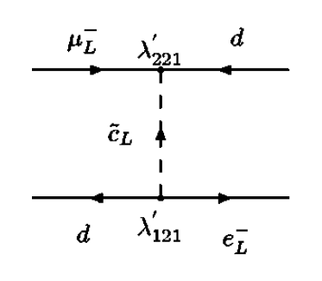

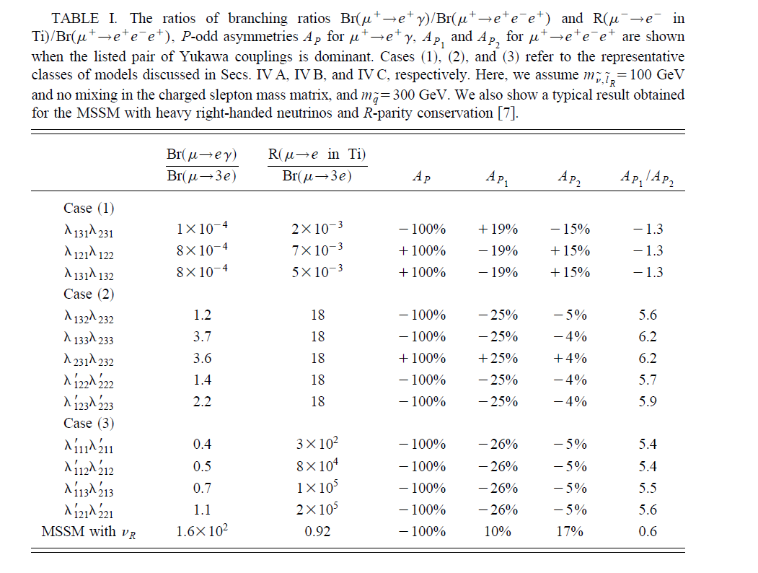
Example from Vector type interaction
If R parity is broken,
Tree contribution may dominate for conversion
Leptoquark
While
Induced by loop
distinction
of models
Andre´ de Gouveˆa, Smaragda Lola, and Kazuhiro Tobe
Notes:
New scalar can contribute CLFV process largely if R parity is broken. In this model we have this lagrangian. In this case mu to e conversion and mu to 3e decay could have same branching ratio while mu to e gamma is strongly suppressed due to the gauge symmetry.

Slide 39
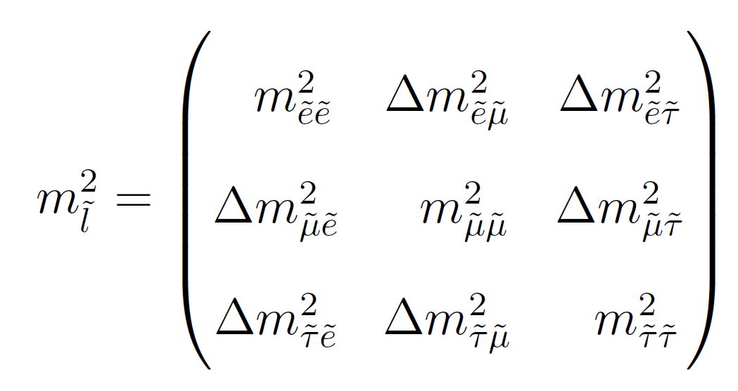
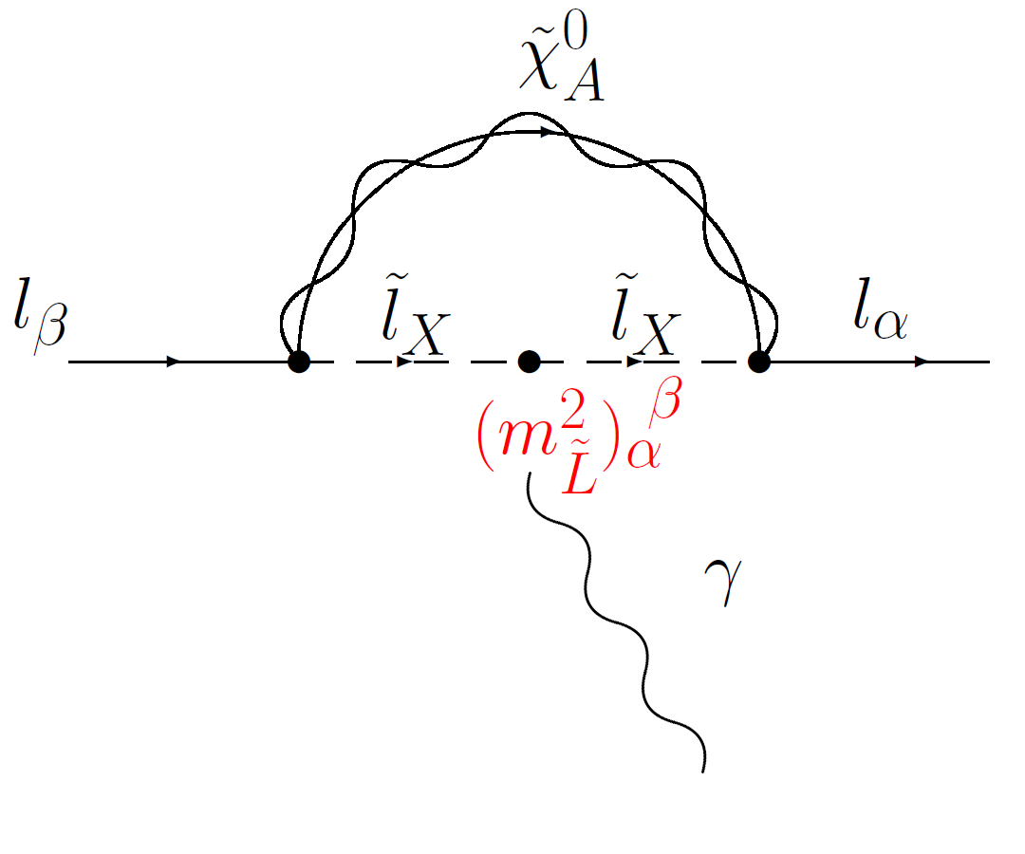

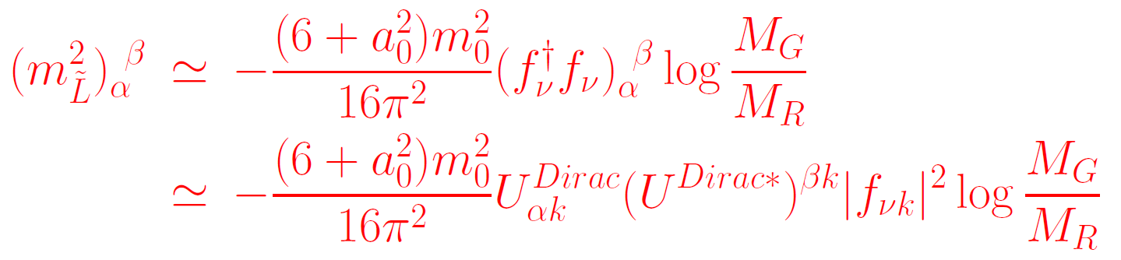
Orthodox scenario
Source of LFV
=
Slepton mixing
CMSSM + RH neutrino
Most exhaustedly studied
Dipole dominant
Notes:
SUSY with R parity is most popular candidate for new physics. By adding right-handed neutrino we can explain neutrino masses and the lepton mixing. In this model LFV seeds are found in scalar lepton mixing. In this model we will have CLFV process even if at some high energy scale, say GUT scale, there is no LFV such source , that is the off-diagonal element of this matrix is 0. They are radiatively induced In this way. In this kind of model there is no tree contribution for CLFV. Loop effect is always domiant.

Slide 40
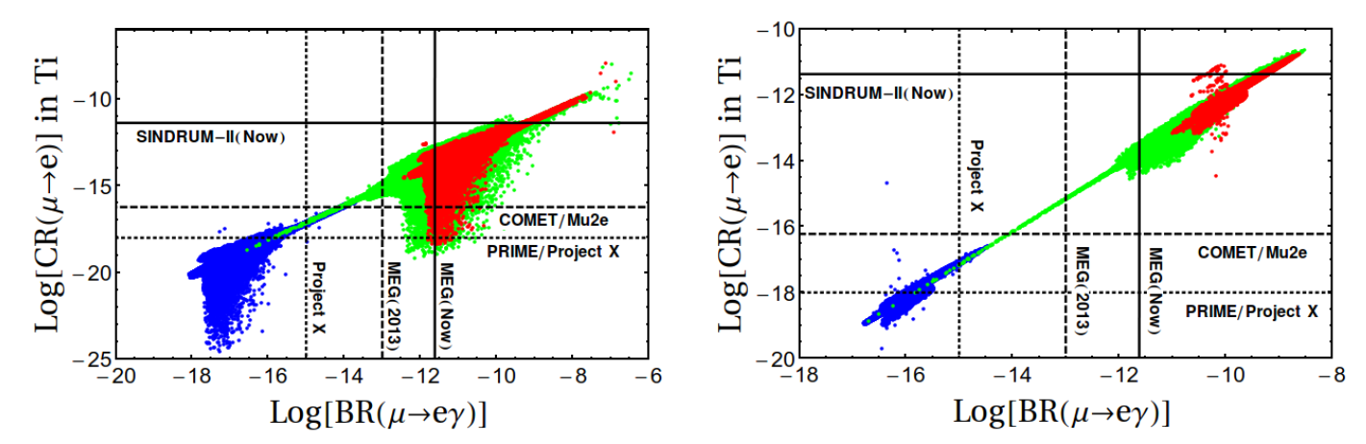
1207.7227 Calibbi et al
Notes:
We can “predict” large CLFV. These plot is an example of correlation between mu to e gamma and mu to e conversion. This area is allowed now. We may observe these CLFV very soon.

Slide 41
5.Summary
Lepton Flavor
Exact Symmetry in ｔhe Standard Model
If SM is correct then LF conserves
<-->
LFV then SM is not correct
Neutrino Oscillation
Manifestation of Lepton Flavor Violation
-->
SM must be extended so that neutrinos are massive
Neutrino masses
Dirac or Majorana? Tree or Indused?
If Majorana --> Lepton Number is also violated
neutrinoless double beta decay,
in muonic atom
Notes:
Let me summarize my talk. Charged lepton flavor violation is a very clean signal for physics beyond the SM. Though it has not been observed yet many searched have been and will be down in muon and tau decays and LFV final states. Here I made a classification of operators for LFV. We have to care new operators come dominantly from loop or tree, and caused by scalar and vector. As an example of how to confirm a model for CLFV I showed one example from SUSY model without R parity.

Slide 42


Charged Lepton Flavor Violation
SU(2) connection indicates LFV in Charged lepton
Clean signal for Physics beyond the Standard Model
Not observed yet though many searches have been done
Muon decay , Tau decay, LFV in final state(decay product)
Classification of new physics
Tree vs Loop : :always loop effect
Scalar vs Vector
Model dependence
Most precise measurements with muon
and
Which one will be observed first?
Example of model dependent analysis with other signals
Notes:
Let me summarize my talk. Charged lepton flavor violation is a very clean signal for physics beyond the SM. Though it has not been observed yet many searched have been and will be down in muon and tau decays and LFV final states. Here I made a classification of operators for LFV. We have to care new operators come dominantly from loop or tree, and caused by scalar and vector. As an example of how to confirm a model for CLFV I showed one example from SUSY model without R parity.

Slide 43
Back Up

Slide 44
Connection among CLFVs
an Example
J.S & M.Yamanaka
Phys. Rev. D91 055018-1-17, 2015
MEGII experiment updates/discovers(?)
COMET/DeeMe/Mu2E will discover(?)
In near future
Sensitivity is same.
If COMET find CLFV first then …?
Notes:
Then what kind of things we should consider once CLFV process is found. In very near future mu to e gamma and mu t e conversion may be observed.
Both may be found or one of them may be found or none of them may be found. As an example we consider the case mu to e conversion is found and mu to e gamma is not found. From now on please imagine you join COMET and no to join to any other experiment…

Slide 45
μ-e conversion and then ?
If μ-e conversion is found, while other cLFV processes will never be found
E.g.
R-parity violating SUSY gives such a situation
Tree contribution for CLFV
Scalar/Vector with LFV
Direct coupling with qq and μ-e
No correlations among cLFVs
How to confirm the scenario?
Notes:
In this case we have to conclude that there is a tree contribution to CLFV. It can be both scalar and vector. It also must couple with qq. This condition is satisfied by SUSY with RPV foreample. Though to be concrete I will use a term of RPV SUSY model, in other models with appropriate change the discussion here will be applicable.

Slide 46
Aim of this work
To find out distinctive signals to discriminate the scenario and other new physics models
To show the feasibility to determine the parameters in the RPV scenario through observing the signals
How to confirm a model?
Notes:
Here I would like to explain how the model can be confirmed in some sense. To do so we need to know what is the prediction of the model for other experiments and whether they are measured there

Slide 47
R-parity violating SUSY
Candidate of new physics: R-parity violating SUSY
Consistent with experimental/theoretical status
New physics is required to cancel Higgs quadratic divergence
TeV scale SUSY predicts grand unification of interactions
So far no typical SUSY signals have been observed
Omit the term to
avoid proton decay
RPV terms in superpotential in SUSY
Offers LFV Scalar
Notes:
There are several motivation to employ RPV SUSY. However here it is important that in this model that there are seeds of LFV. It offers LFV scalar

Slide 48
Framework of our scenario
Naturally realized by RG evoltion
with universal masses@GUT scale
Slepton contribution to RPV: only 3rd generation
Different generation of left- and right-handed leptons
λ
(i k and j k)
ijk
≠
≠
Assumption to realize
the interesting situation
RPV terms in superpotential in SUSY
Notes:
In the following analysis we assume that 3rd generatio sleptons are the dominant mediator for LFV process. It can be justified by universal masses at GUT Scale. Therefore in this coupling I must be 3 and hence j must be 1 or 2 since I and j must be different. Then k must be 2 or 1 to have mu to e conversion.

Slide 49
Framework of our scenario
Naturally realized unless we introduce additional sources of flavor violation
For quarks, flavor diagonal components are much
larger than off-diagonal components
λ’ λ‘
>
>
(j k)
ijj
ijk
≠
RPV terms in superpotential in SUSY
Notes:
To have mu to e in this case quark couping must be flavor diagonal that is j=k component must be dominant. They are required by the fact that mu to e conversion is observed.

Slide 50
Exotic processes in the scenario
μ-e conversion@tree level
Negligible rates of other
cLFV processes
Notes:
In this case lagrngian is given by this form. Indeed we have a tree process for mu to e conversion while we do not have a contribution mu to e gamma at even one-loop.
With this lagrangian we also donot have mu to 3e process.

Slide 51
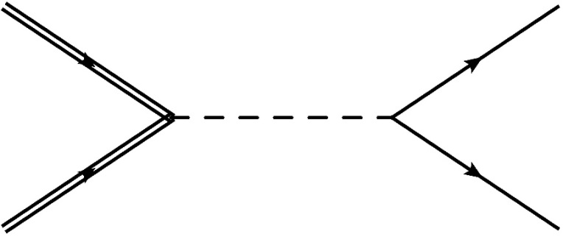
Current bound for the scalar with LFV
Notes:
Of course there is a search for such new particle at LHC though mass bound is strongly dependent on the coupling.

Slide 52






Correlations of distinctive signals
Contour plot of
sneutrino mass
collision energy
μ-e conversion search is a strong tool for exploring RPV
PRISM explores all parameter space wherein LHC can survey
Notes:
What our prediction is displayed in this graph. Mu to e process depends on the combination of lambda a purely leptonic coupling and lambda’ a lqd coupling. Therefore the detectability depends on this slant line. In this case we may observe the scalar resonance in mu e channel and dijet channel. In mu e channel the detectability depends on both coupling, since it must be created. For the creation of the scalar lambda’ onlu contribute, while for it to decay into mu e lambda must be large enough otherwise
It decay into two jets as a inverse process of the creation. Therefore the crosssection for pp to mu e is given by this kind of
Lined. To observe it only lambda’ is important as long as lambda is not so large. Therefore we get this line for constant crosssection of pp to two jets.

Slide 53
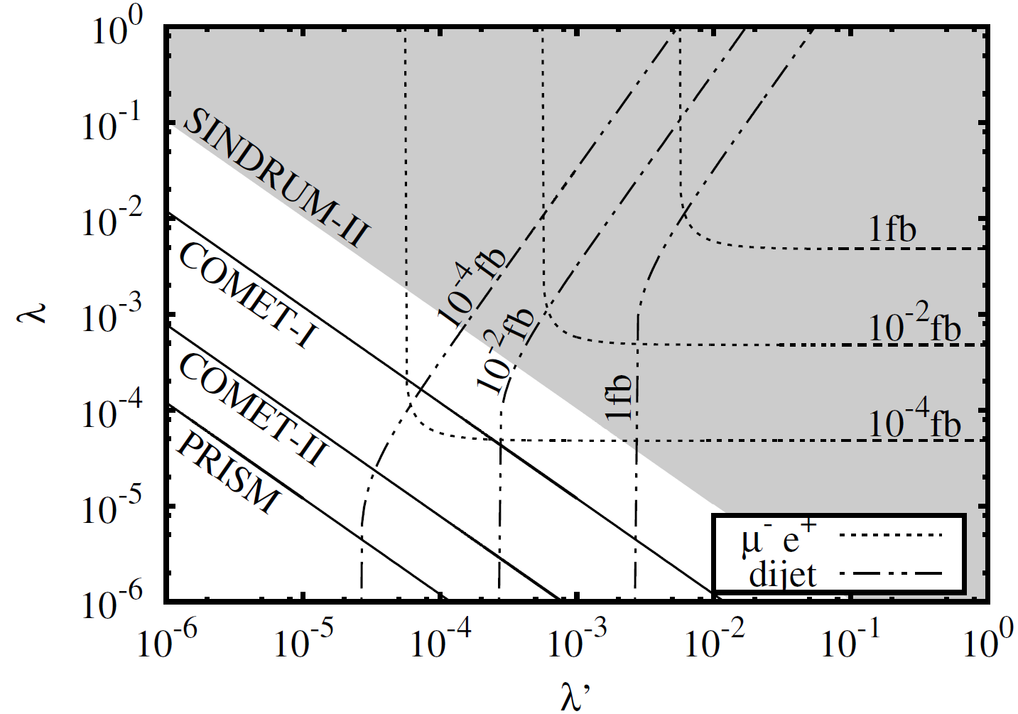
Correlations of distinctive signals
Contour plot of
sneutrino mass
collision energy
COMET/DeeMe found m-e conversion white band
Notes:
Then mu to e conversion is found means that the parameter is in this region.

Slide 54
Correlations of distinctive signals
Contour plot of
sneutrino mass
collision energy
COMET/DeeMe found m-e conversion white band
Dijet resonance is found with 10 fb⁻² white small region
Notes:
If LHC finds dijet resonance of 1GeV with the luminosity of 100 fb inverse,

Slide 55
Correlations of distinctive signals
Contour plot of
sneutrino mass
collision energy
μe resonance is found with 10 fb⁻⁴ blue star point
J-PARC and LHC precisely determine the RPV parameters!
Notes:
Then combining all the result we can pin down the parameter in this model here. With other models we can do same things.

Slide 56


More on coupling discrimination
Non Standard Interaction
Pion decay in scalar channel – chiral enhancement
Exotic decay
ILC with polarization
LHC signal is same for 312(LH e) and 321 (RH e)
Can you distinguish them ?
312 : LH electron only
Notes:
To get further information we need other experiment, we need to observe other modes. Example of outside of LHC, neutrino oscillation experiment may be useful since
this model extra decay channel for pion decay. It is called Non Standard Interaction. In this model this decay is enhanced by so called chiral enhancement and the prediction is given by this form. Unfortunately including the current upper bound for mu to e conversion its size is of 10^-6 which is outside of the reach of next generation neutrinoexperiment. However this NSI only depends on not 321 but 312 so it is useful todiscriminate the model. Note that mu to e conversion is dependent on both
312 and 321 couplings. Also linear collider can be useful to discriminate the model since they can choose the polarity of the initial electron. In this way we can select models.

Slide 57
Scalar type
SUSY :: Still main target!?
2< doublet higgs :: SUSY is restricted version
{
Higgs triplet :: doubly charged
Radiative generation of neutrino masses
Krauss etal
sometimes doubly charged
Is more relevant
Notes:
There are several scalar candidates. Supersymmetry is still a main target of new physics which predicts many new scalars . Also in other contexts people introduce scalars. For example to explain neutrino mass we often introduce triplet higgs which is scalar. Also to explain neutrino mass by radiative generation we have to introduce new scalar with lepton flavor violation. In this example mu to 3 e is most relevant.

Slide 58
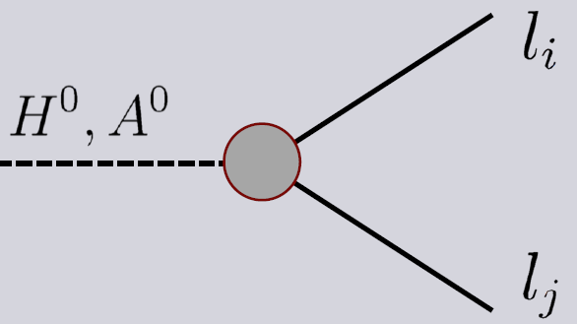
SUSY
Neutral scalar : Heavy neutral higgs , sneutrino
With R-Parity
Scalar (Higgs) can contribute at tree level
Naïve 2< doublets, this coupling can be large, though…
In SUSY , slepton mixing must be contributed , that is, the couplings has same or less magnitude as dipole
Furthermore, these higgses are probably very heavy
Notes:
In SUSY we have mny new scalars like this. It is a kind of multi-higgs model. In multi-higgs doublet models flavor changing coupling with extra higgs often arise. Heavier higgs can couple with different lapton flavor and it contribute CLFV process.

