Slide 1
AF5: Accelerators for Rare Processes and PBC +FNAL UPGRADE Path Opportunities
Eric Prebys, UC Davis
Mike Lamont, CERN
Robert Milner, MIT

Slide 2
AF5 Areas of Interest
Low energy hidden sector searches
Helioscopes (e.g. BabyIAXO/IAXO)
Haloscopes using resonant cavities (e.g. ADMX) or other methods (e.g. MADMAX)
Light-shining-through-walls experiments (e.g. JURA, STAX)
Light Dark Matter searches
Direct detection WIMP searches (primarily addressed by the Cosmic Frontier).
Proton beam dump experiment: new proposals (e.g. BDF/SHiP), re-purposed existing experiments (e.g. NA62, MiniBooNE, SeaQuest)
Electron beam dump experiments: NA64, LDMX, BDX
Long lived particles at colliders (LHC, SuperKEKB)
Precision measurements and rare decays
Ultra-rare or forbidden decays/reactions:
Kaon sector (NA62, KOTO, KLEVER}
Lepton sector (TauFV, Mu3e, MEG,mu2e/mu2e-II)
Precision measurements:
Permanent EDM
in protons/deuterons (CPEDM)
in strange/charmed baryons (LHC-FT)
Anomalous magnetic moment of muon (g-2)

Slide 3
Goals of AF5
Our aim is to identify specific accelerator and accelerator-related technologies that benefit one or more experimental areas.
Beam intensity/bunch structure
Esp. as it relates to PIP-II
Targetry for electron and proton beam dump experiments
Magnet and RF technology for dark sector experiments
Novel storage rings: g-2, EDM, etc
Facilitating accelerator technology, particularly for muons: induction linacs, FFAGs, etc

Slide 4
Areas of Focus Relevant to This Meeting
Magnet and RF Technology required by next generation Dark Matter/Hidden Sector searches
Figure of merit for magnets?
Stored energy?
Total flux?
Figure of merit for RF
Frequency?
Q?
Gradient?
In particular, which of these areas require R&D separate from standard HEP R&D

Slide 5
(cont’d)
Electron Beam Dump Experiments?
Energy?
Beam Power?
Beam Structure Requirements?
Future prospects at places like JLab
Are there opportunities for low energy, intense beams, of the sort that could be produced by the FAST facility at FNAL?

Slide 6
Proton Beam Experiments
Similar questions as electron beam dump experiments
Energy?
Power?
Bunch structure?
Will such experiments require purpose-built accelerator hardware to provide these needs.
This brings us to…

Slide 7
Direction for PIP-II and Beyond at FNAL
This Snowmass cycle represents a unique opportunity to inform the direction for Fermilab upgrades for the next two decades. Specifically
The 800 MeV program at PIP-II
The upgrade path to (finally) replace the Fermilab Booster. Will it be
A rapid cycling synchrotron
An 8-GeV linac
A hybrid
Extend PIP-II linac (to what energy?)
Follow with an RCS

Slide 8
Reminder: PIP-II
The centerpiece of PIP-II is an 800 MeV linac, which will replace the existing 400 MeV linac, allowing more beam to be injected into the (original) Booster.
The linac will allow the selection of bunches on a bunch by bunch basis, up to a maximum of 162.5 MHz
Because of the Booster and Main Injector cycle times, the high energy (8 GeV+) program can only use ~1% of the output of this linac

Slide 9
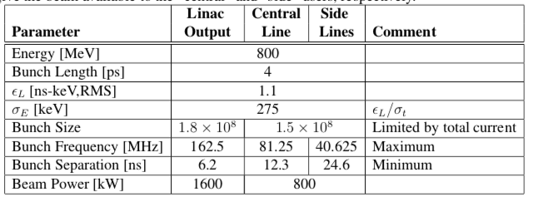
PIP-II Parameters
Assuming an RF splitter for excess beam
Issues: lots of beam, but bunches are small
Can we fix this

Slide 10
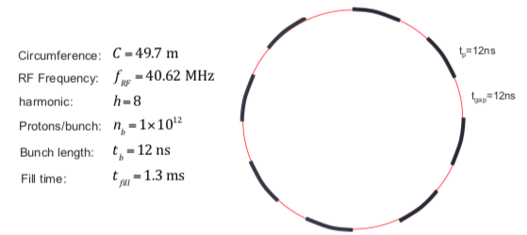
Possibility: Compressor Ring
We could inject PIP-II bunches into a dedicated compressor ring to create fewer, high intensity bunches.
Considering the needs of a future muon to electron conversion experiment, we are working on a strawman design.
Would be easy to get to about 10-20 kW. The 100 kW needed by the experiment will be challenging.
Can other people take advantage of such a ring, and what are their needs?

Slide 11
Needs/opportunities for PIP-III
Assuming a hybrid upgrade path
This path is unlikely unless there’s a physics program to drive the intermediate energy!
800 MeV
E=?
PIP-II Linac
Extension
New Rapid Cycling Synchrotron

Slide 12
Questions for Hybrid Upgrade
What is the best energy for the linac extension?
Will the bunch structure be adequate, or will we need a compressor ring?
If we need a compressor ring, would it be efficacious to build that compressor ring, and use it for the 8 GeV compressor until the higher energy beam became available?

Slide 13
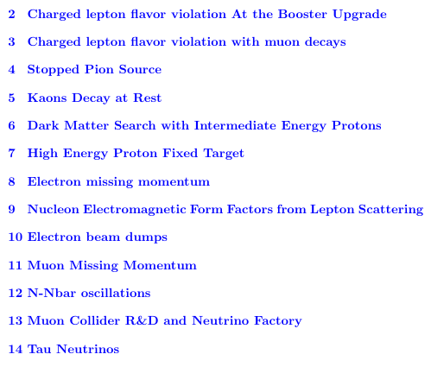
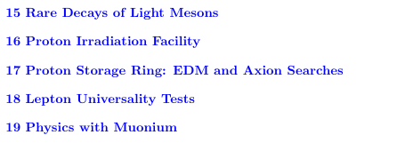
Ongoing Effort
A working document has been started to discuss options and opportunities for the Booster Replacement
“Physics Opportunities for the Fermilab Booster Replacement”*
https://www.overleaf.com/project/5eb2d7df7284de0001b56d9e
*Contact Roni Harnek (roni@fnal.gov) to comment or contribute.

