Slide 1
Open-Midplane Dipole Magnet Field Homogeneity
Bob Weggel
5/19 & 5/20/2011

Slide 2
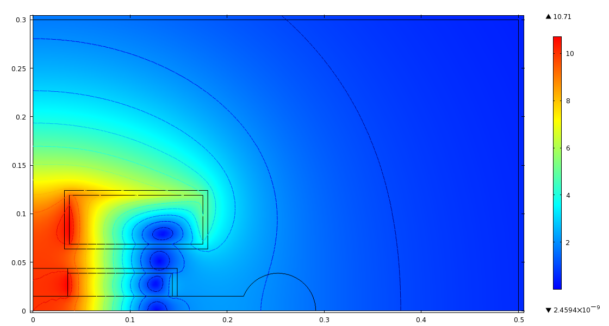
Illustrative OMD. 1st-quadrant windings X-section & contours of field magnitude B ≡ (B_{x}²+B_{y}²)^{½}; central field B₀ ≡ B(x=0,y=0). Muon beam is at [0, 0]; keyhole accommodates energy absorber.

Slide 3
Design Goals and Constraints
Vertical force on inboard coil must be away from midplane.
Central field B₀ = 10 T @ 200 A/mm² overall current density.
Midplane half-gap = 15 mm for OMD’s of this presentation.
Web between bars should be robust, to withstand stresses.
Design OMD magnets of better and better field homogeneity.

Slide 4
OMD Ring-Magnet Questions
1) How good can the field homogeneity be?
2) How good does it need to be? 0.01%? Width? Height?
3) How big (high) does the midplane gap need to be?

Slide 5
Dependence of Field Ratio B_{max}/B₀ & Megamp-meters of Superconductor on Half-Height of OMD Magnet Gap
An OMD magnet of 75-mm gap half-height uses ~2¼ times as much conductor as a magnet of 15 mm half-height. The field ratio may be ~120% instead of ~107%.

Slide 6
Radii of Field-Homogeneity Contours
1.0 mm @ 10 ppm
3.0 mm @ 100 ppm
9.0 mm to 10.3 mm @ 1,000 ppm

Slide 7


Equations for Magnetic Field
For a bar of infinite length, rectangular-cross section and carrying a uniform current density J, the vertical field B_{y} is:
where c_{B} = −μ₀ j/2𝜋; u_{i} and v_{j} are shorthand for a_{i}−x and b_{j}−y, the horizontal and vertical distances, respectively, from a corner [a_{i}, b_{j}] of a bar cross section to the field point [x, y]. B_{x} is of the same form, with u_{i} and v_{j} interchanged.

Slide 8

Equations for Magnetic Force
The vertical component of force, F_{y}, between two parallel bars of conductor has 16 terms of the form:
where c_{F} = μ₀ j₁ j₂ / 12𝜋; u and v are shorthand for u_{i,m} and v_{j,n}, the horizontal and vertical distances between bar corners [a_{i}, b_{j}] and [a_{m}, b_{n}]; i, j, m and n each run from 1 to 2. F_{x} is similar, with u and v interchanged.

Slide 9

Inhomogeneity Coefficients for Bar

Slide 10

Inhomogeneity Coefficients for Wire

Slide 12
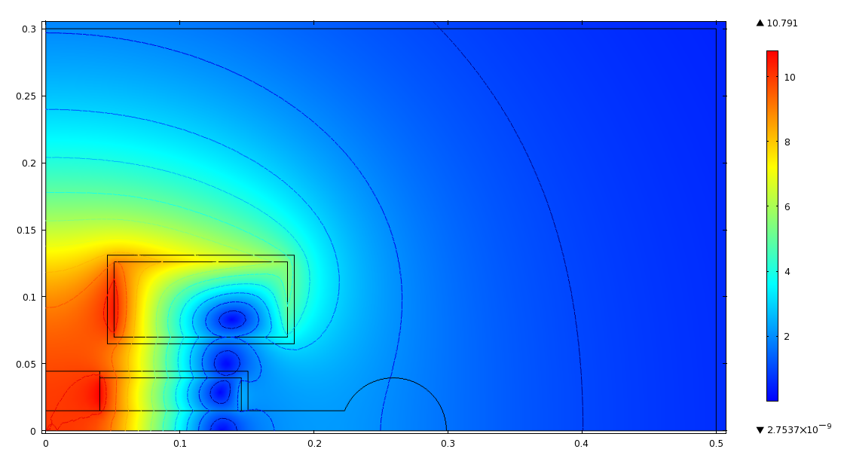
OMD magnet with ∂²B/dx² = ∂²B/dy² = 0; B_{max}/B₀ = 108%.

Slide 13
Radii of Field-Homogeneity Contours
5.6 mm @ 10 ppm
9.8 mm to 10.0 mm @ 100 ppm
17.1 mm to 18.2 mm @ 1,000 ppm

Slide 14
Comparison of 2nd & 4th-Order OMD’s
1,000 ppm: 9.0 mm→ 17.1 mm in x, 1.03 mm → 18.2 mm in y
10 ppm: 1.0 mm → 5.6 mm in both x & y

Slide 15
OMD with field homogeneity of 6th order; both bars ∆x >> ∆y.

Slide 16
Radii of Field-Homogeneity Contours
22 mm to 23 mm @ 10 ppm
32 mm to 34 mm @ 100 ppm
45 mm to 52 mm @ 1,000 ppm

Slide 17
OMD of 6th order; outboard bar ∆x << ∆y; B_{max}/B₀ = 118%.

Slide 18
Radii of Field-Homogeneity Contours
21 mm to 22 mm @ 10 ppm
30 mm to 34 mm @ 100 ppm
42 mm to 78 mm @ 1,000 ppm

Slide 19
Field magnitude of open-midplane dipole magnet with field homogeneity of 8th order. B_{max}/B₀ = 119%.

Slide 20
Radii of Field-Homogeneity Contours
30 mm to 32 mm @ 10 ppm
40 mm to 43 mm @ 100 ppm
52 mm to 60 mm @ 1,000 ppm

Slide 21
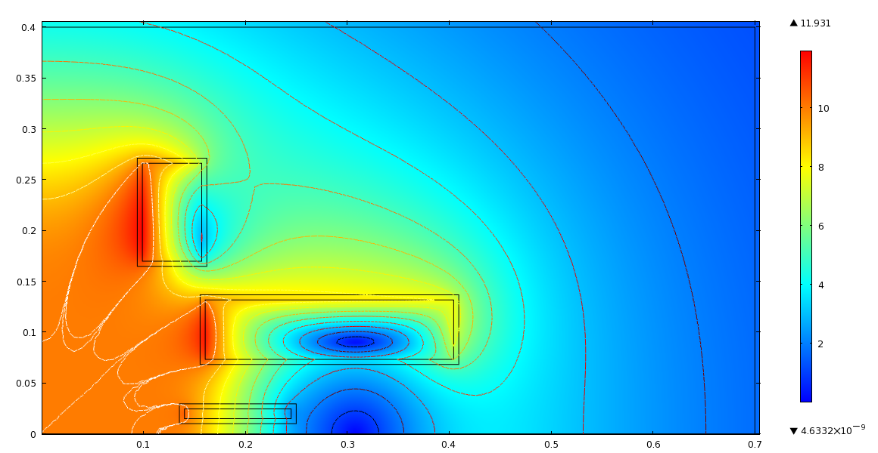
Field magnitude of OMD magnet with homogeneity of 12th order. White contours are ±0.01%. B_{max}/B₀ = 119%.

Slide 22
Radii of Field-Homogeneity Contours
77 mm @ 10 ppm
~100 mm @ 100 ppm
~120 mm @ 1,000 ppm

