Slide 1
Open Midplane Dipole Design and
Proof-of-Principle Demonstration for Muon Collider Ring Dipole
http://www.bnl.gov/magnets/staff/gupta
Ramesh Gupta
Brookhaven National Laboratory

Slide 2
Overview
Open Midplane Dipole Design
  Benefits and challenges
High Field Open Midplane Dipole R&D under LARP funding
  Significant progress/innovations in magnetic and mechanical design (BNL) and energy deposition (FNAL - Mokhov) in an integrated design approach
Open Midplane Dipole SBIR for MAP with PBL
  Design optimization for MAP – R. Weggel (next presentation)
  Energy Deposition Calculations – X. Ding (tomorrow morning)
  Proof of Principle Demo Magnet (key part of this presentation)
Possible benefits of HTS in a hybrid design
Summary

Slide 3
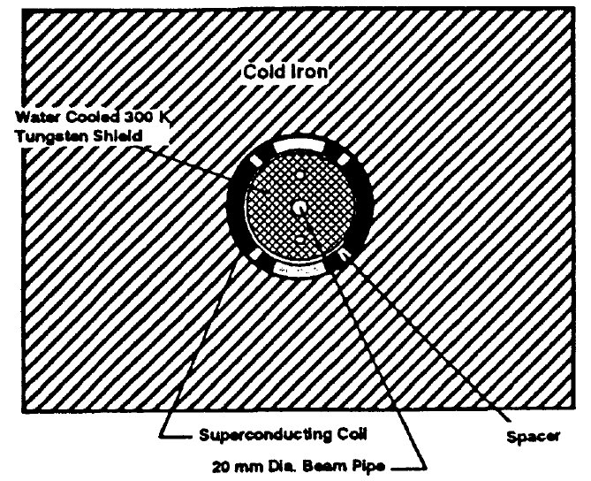
Motivation for
Open Midplane Dipole Design
Superconducting coils in muon collider dipoles are subjected to a large number of decay particles (a few kW/m) from short lived muons. One way to protect the coils is to use Tungsten liner. However, that significantly increases size of the magnet.
Angular distribution of the decay particles is highly anisotropic with a large peak at the midplane (Mokhov).
In an “open midplane dipole” design they are trapped in non-superconducting material at the midplane. Different versions of this design have been examined earlier by M. Green and P. McIntyre, etc.
Conventional cosine theta design with Tungesten Liner
An ideal or true open midplane design will be with no structure at all at the midplane (horizontal axis).

Slide 4
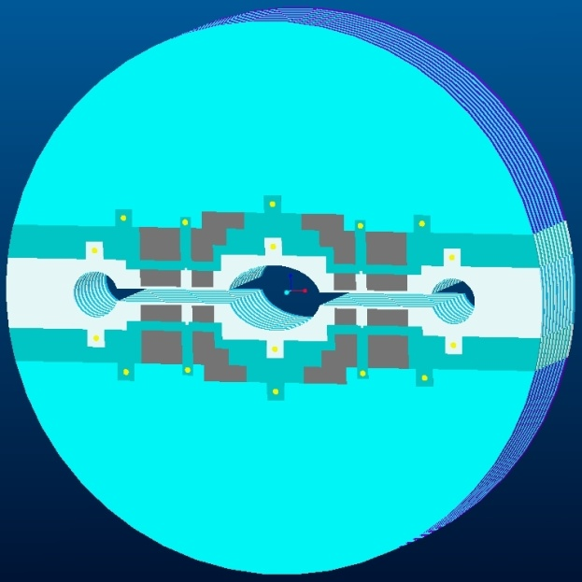
An Ideal Open Midplane Design
An ideal open midplane design will have no structure on the axis
Particles from muon decay will, therefore, deposit energy in a warm absorber that is sufficiently away from the superconducting coils or support structure.
In a partial “open midplane design”, although there is “no conductor” at the midplane, there could be some “other structure” between the upper and lower halves of the coil to help deal with Lorentz forces.
Those designs, though significantly reduce energy deposited in coils from direct hit, could still face heat from secondary showers produced by the other structure. In addition, the energy deposition in that cold structure itself could be significant.
Therefore, an “ideal” or “true” open midplane dipole should be preferred, if a viable design can be proven.

Slide 5
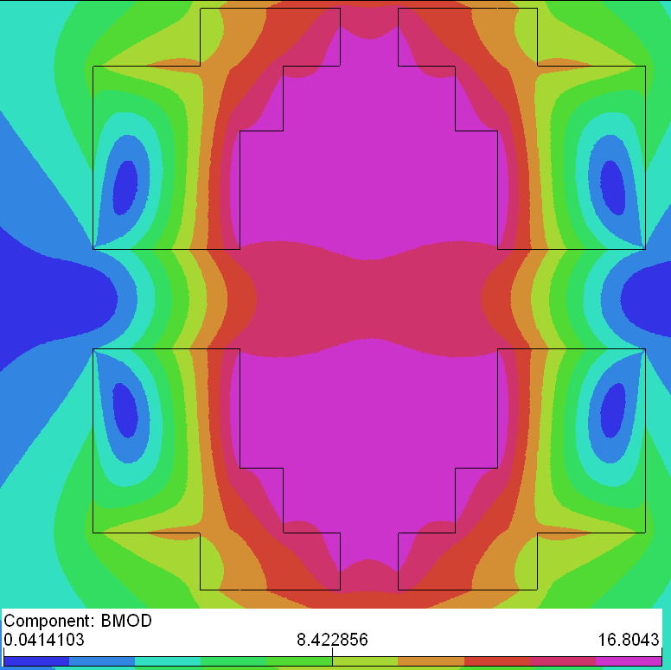
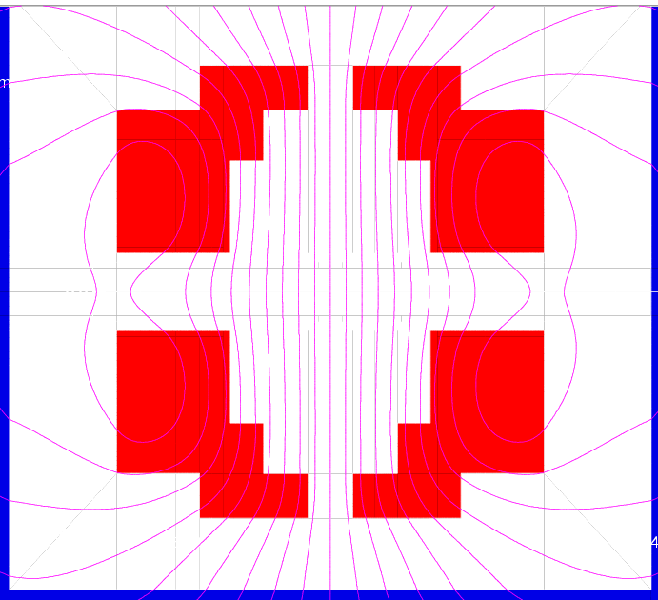
Challenges associated with the “Ideal” or “True” Open Midplane Dipole Design
#1 In usual cosine theta or block coil designs, there are large attractive forces between upper and lower coils. How can these coils hang in air with no structure in between?
#2 The ratio of peak field in the coil to the design field appears to become large for large midplane gaps.
#3 The large gap at midplane appears to make obtaining good field quality a challenging task. Gap requirements are such that a significant portion of the cosine theta, which normally plays a major role in generating field and field quality, must be taken out from the coil structure.
Several innovative solutions were developed to overcome above challenges (at least theoretically) with a significant funding from LARP. However, the funding was terminated before those solutions could be proven.

Slide 6
Progress on Open Midplane Dipole (OMD) Design
(work performed under the auspices of LARP)

Slide 7
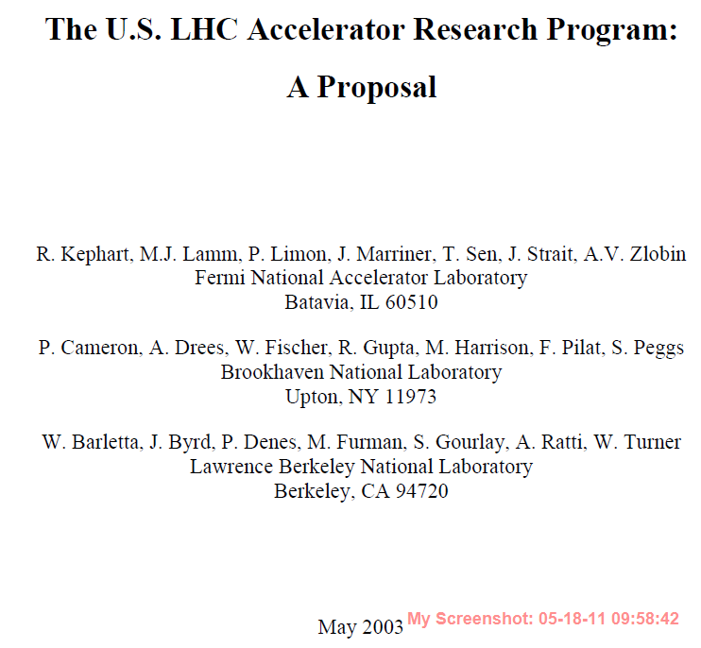
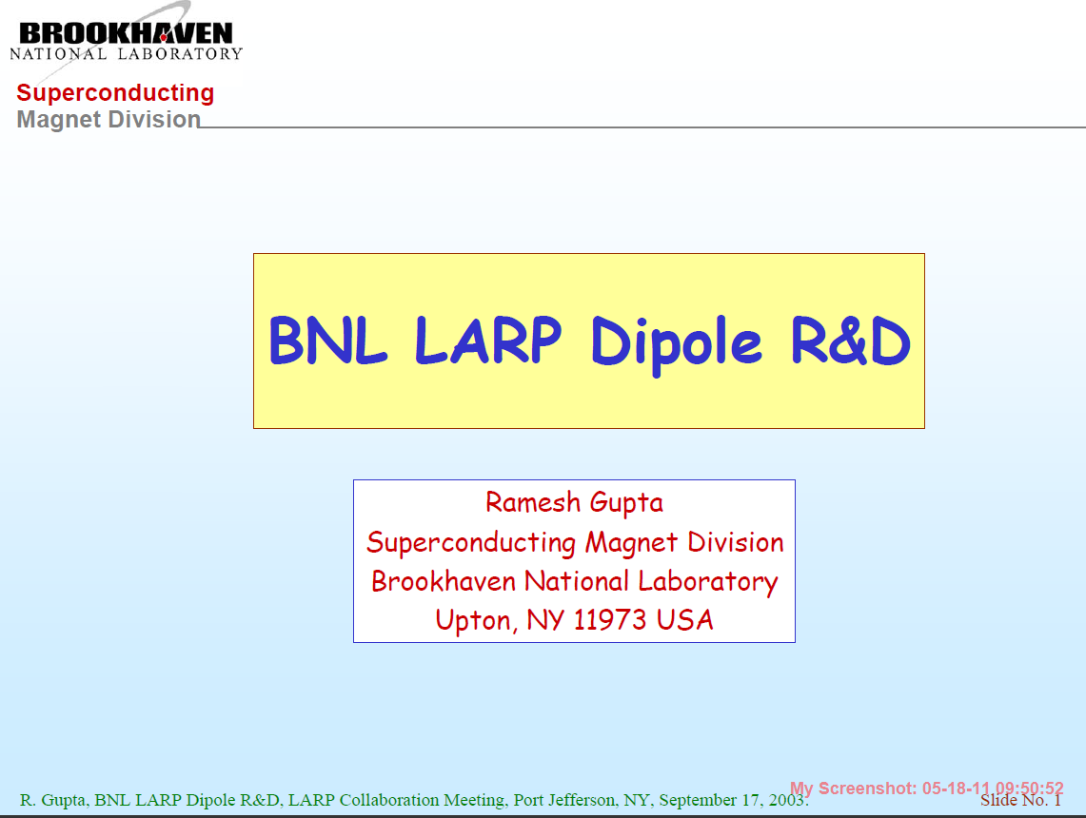
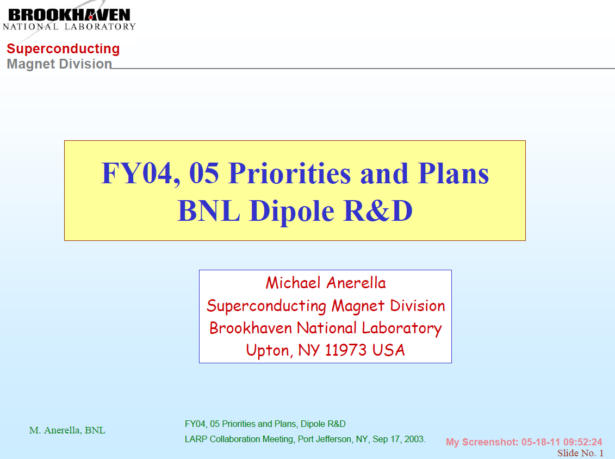
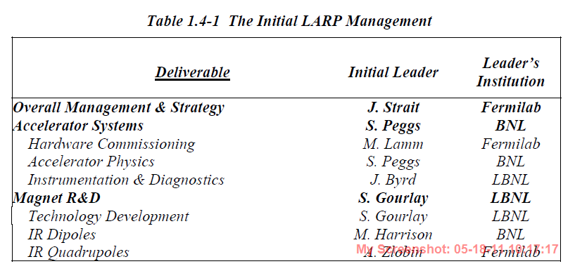
LARP OMD Magnet R&D Program
(first proposed in 2003)
May 2003
September 2003
September 2003

Slide 8
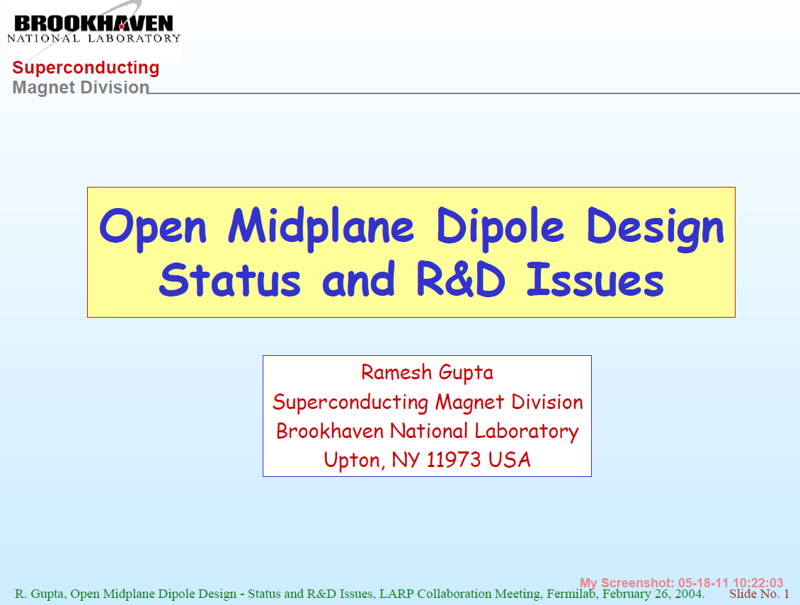
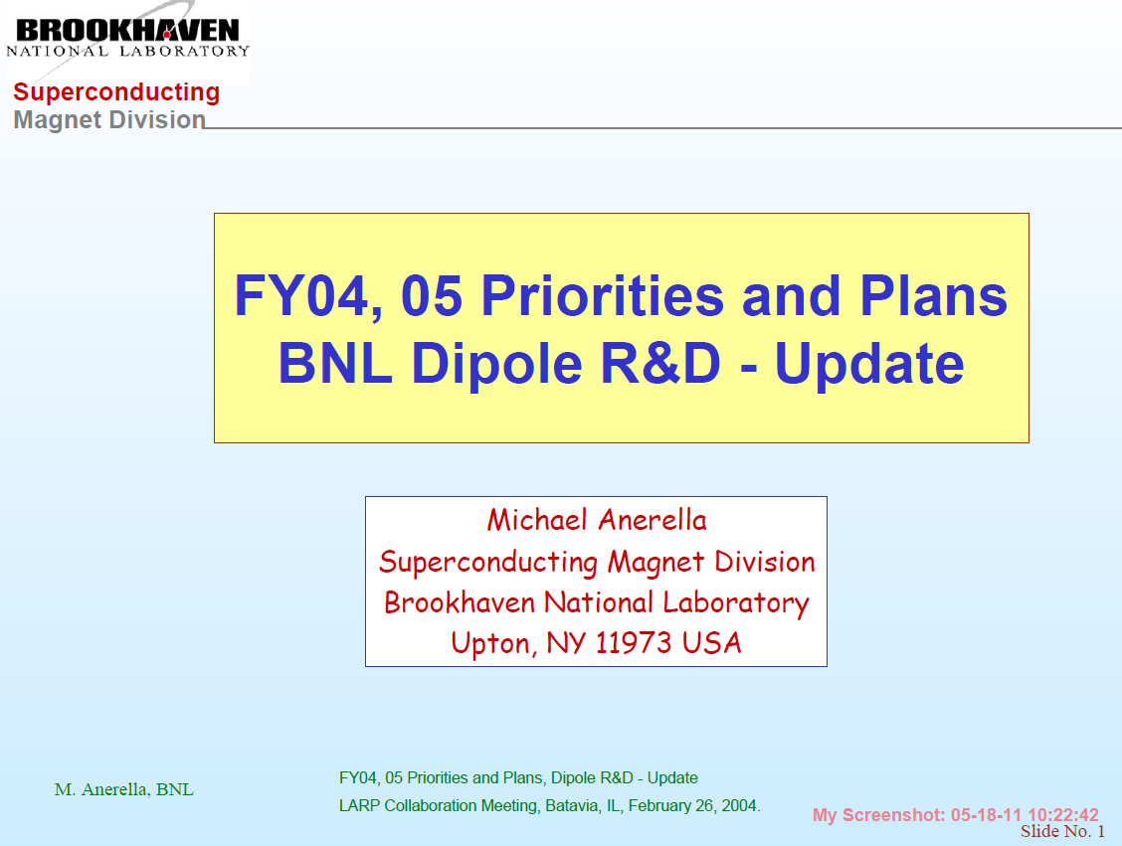
LARP Collaboration Meeting (Feb 2004)

Slide 9
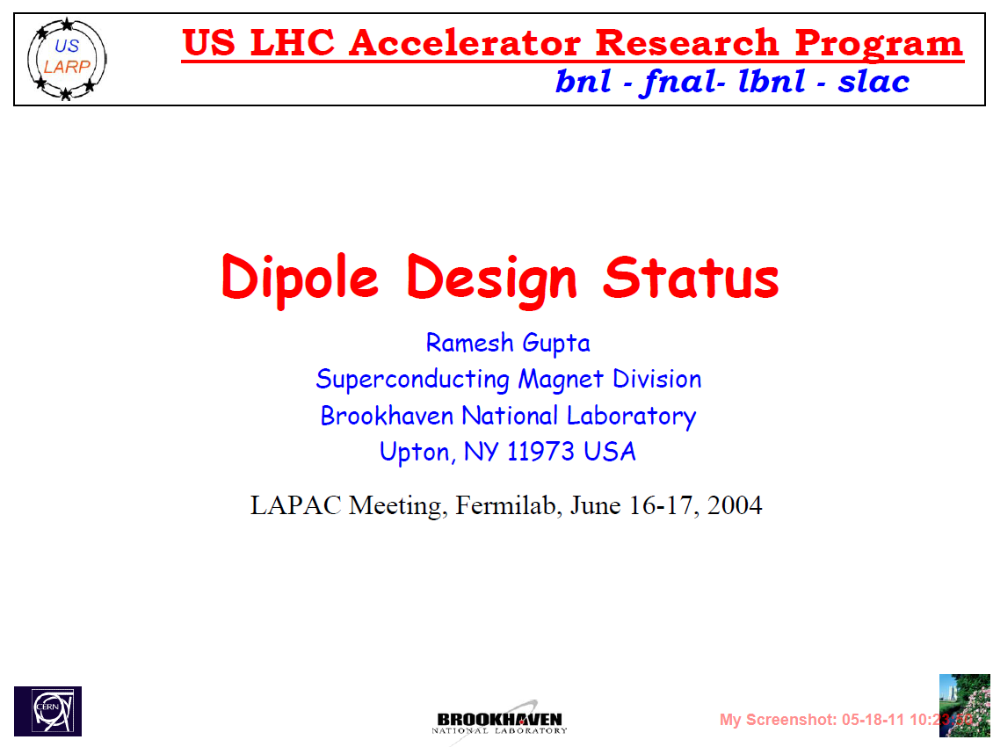
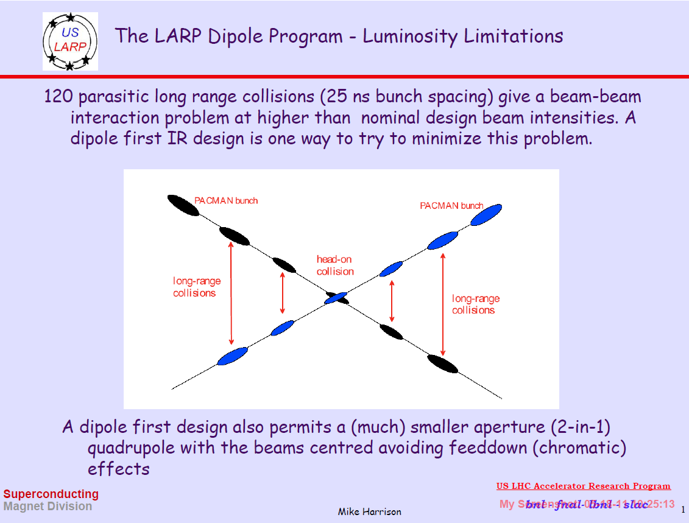
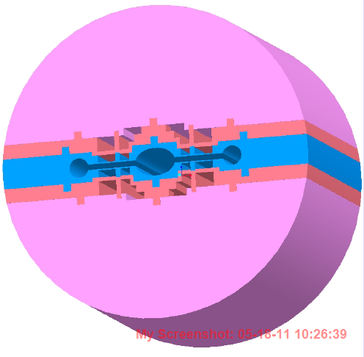
LAPAC Meeting
(June 2004)
Mike Harrison

Slide 10
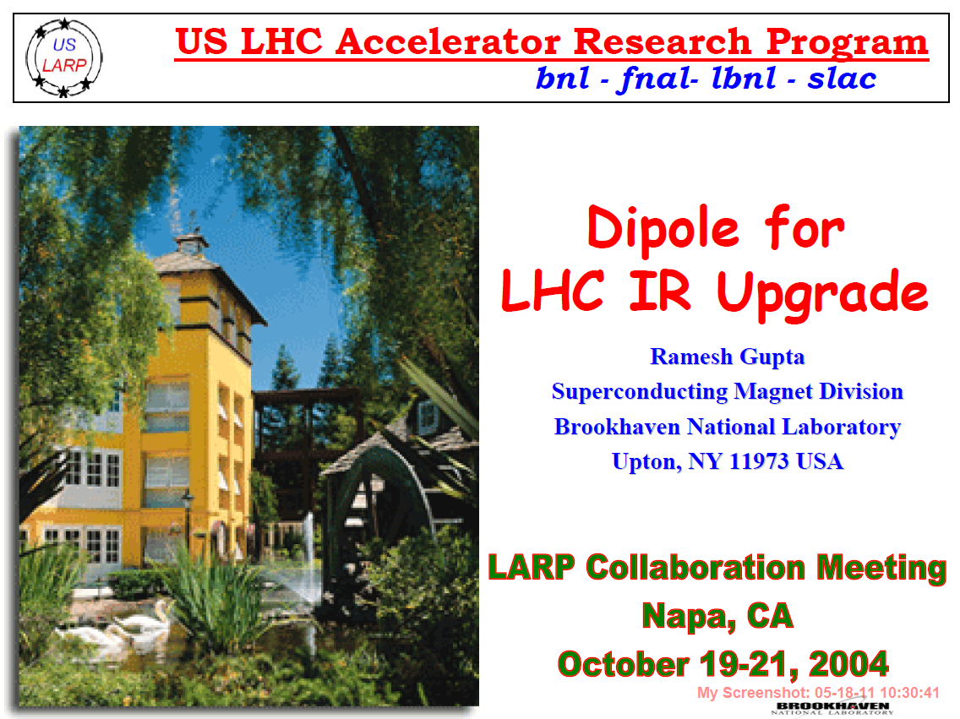
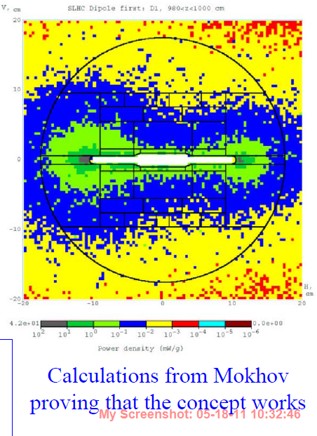
LARP Collaboration Meeting (October 2004)
Integrated Design Optimization:
magnetic, mechanical and energy deposition (Mokhov, Fermilab)

Slide 11
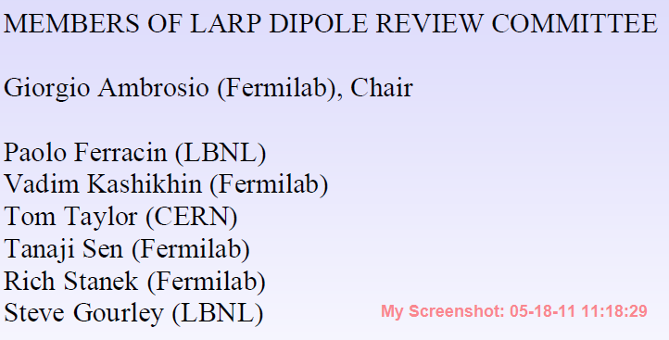
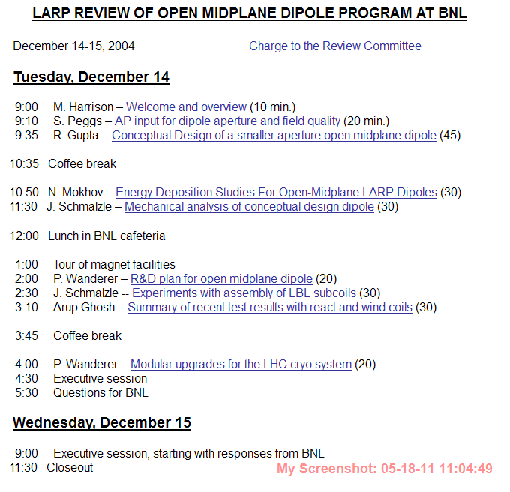
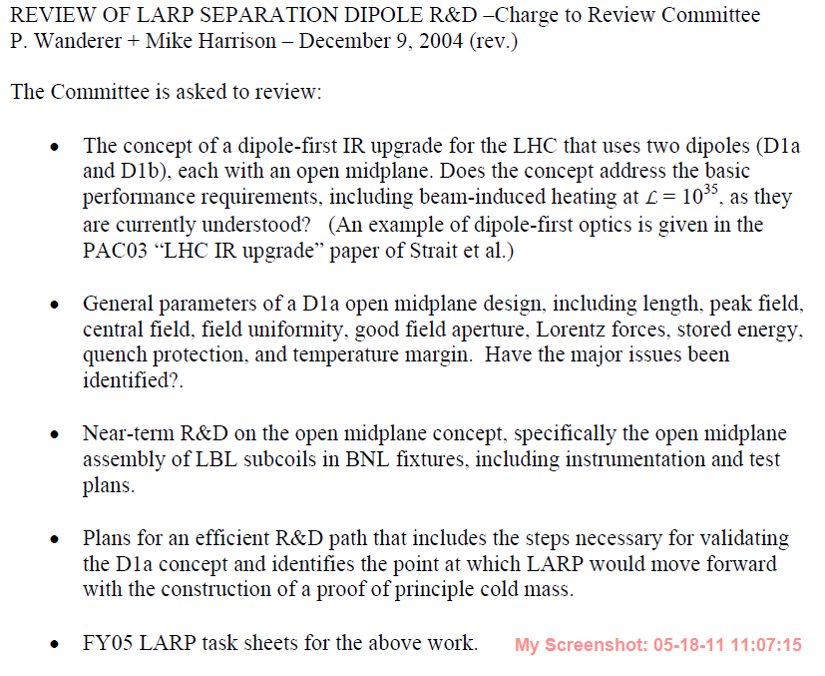
LARP OMD Review - Dec. 2004
(arrows points to issues & SBIR related to MAP)

Slide 12
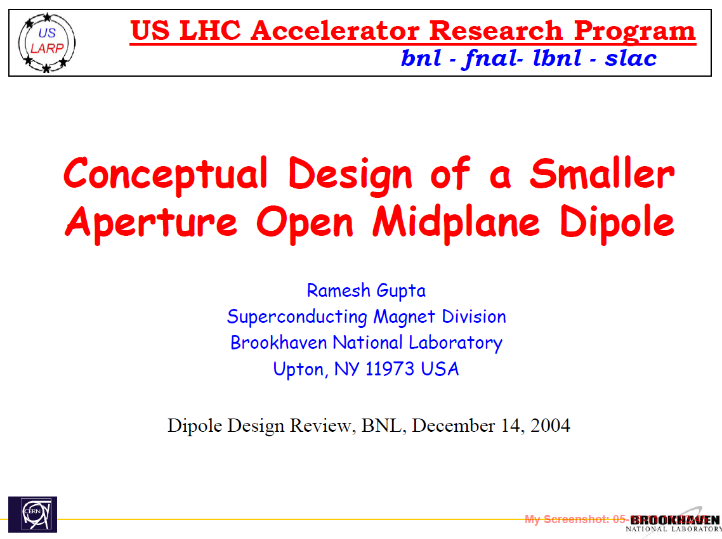
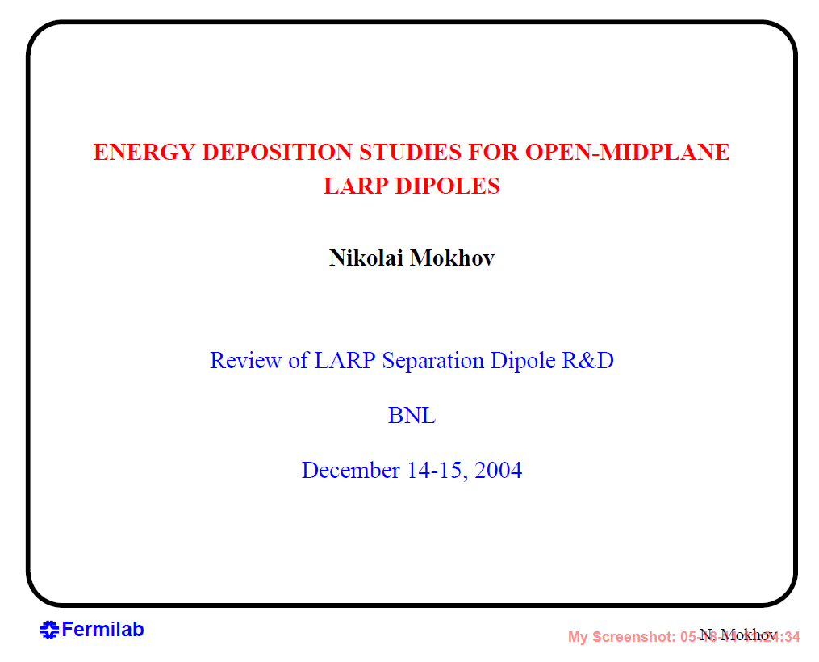
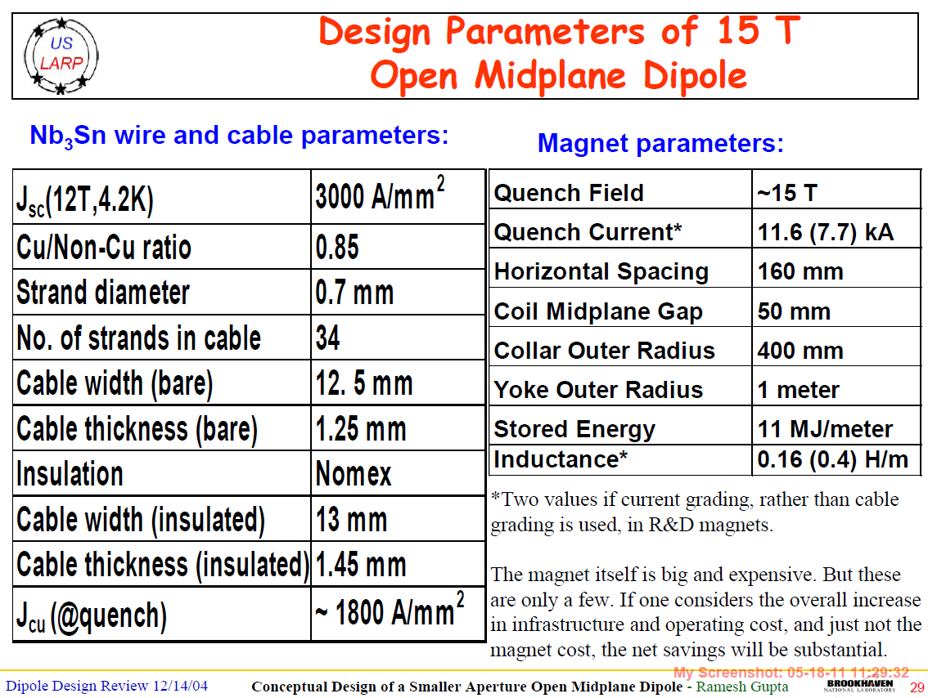
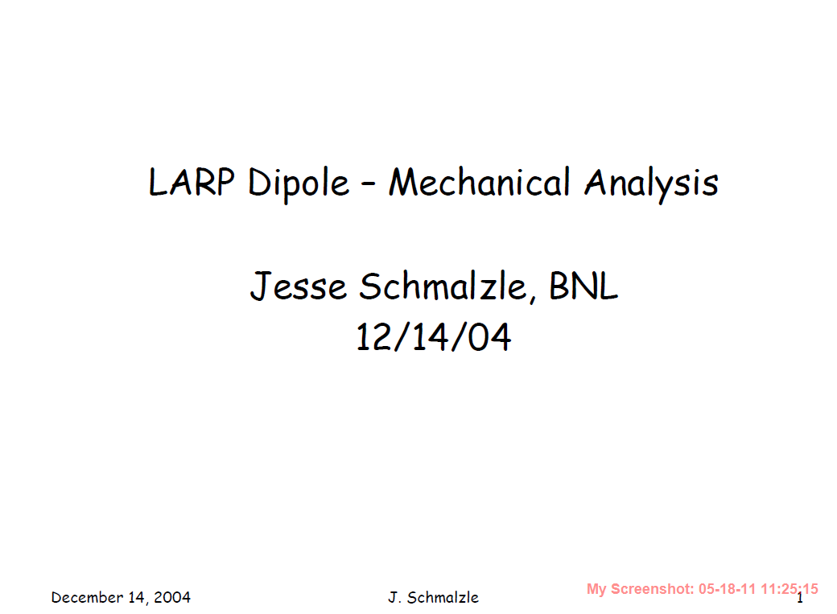
~15 T OMD Design Presented at Dec 2004 LARP Review

Slide 13
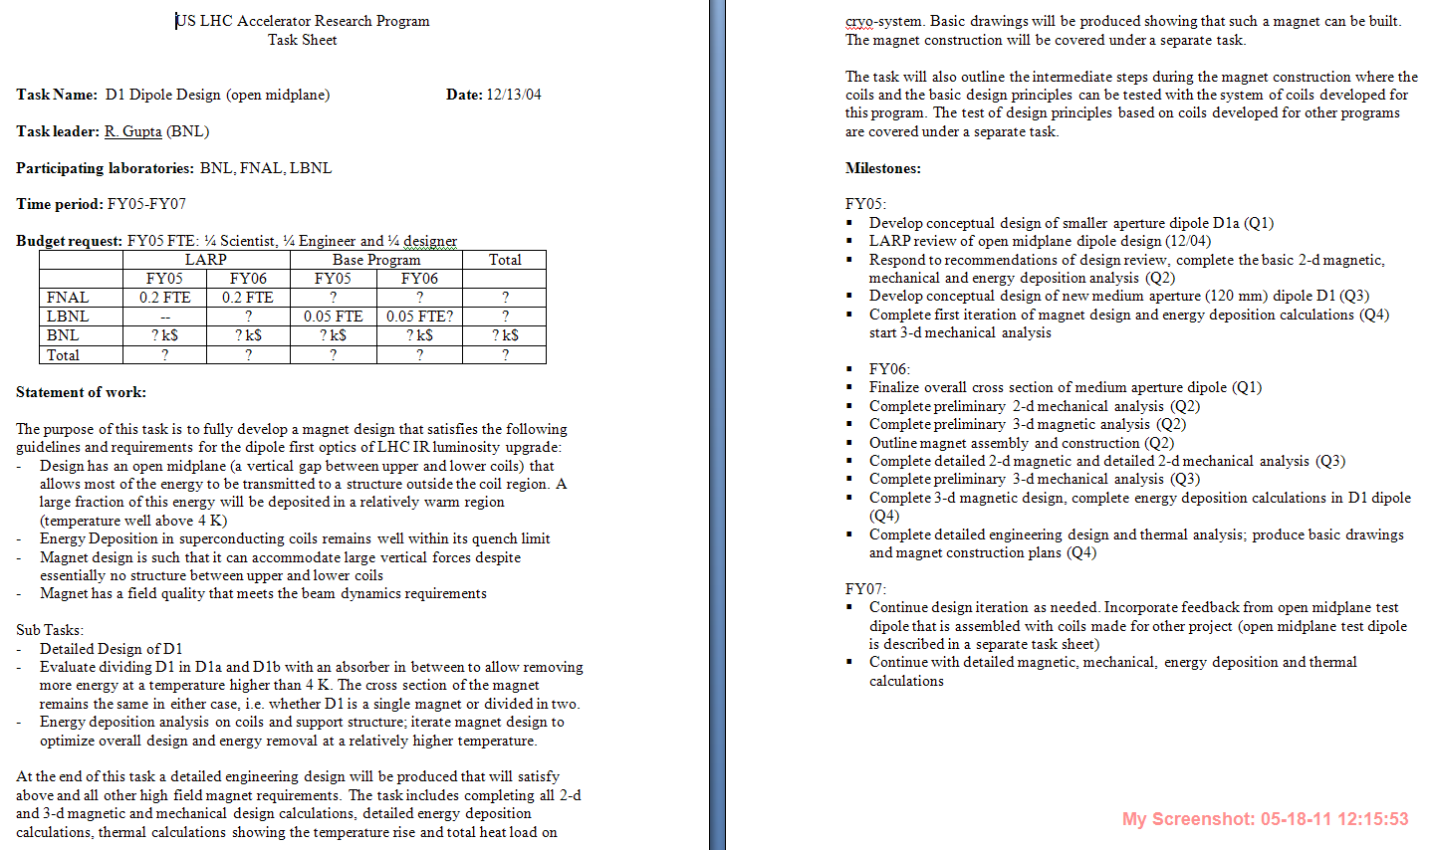
LARP Task Conceived

Slide 14
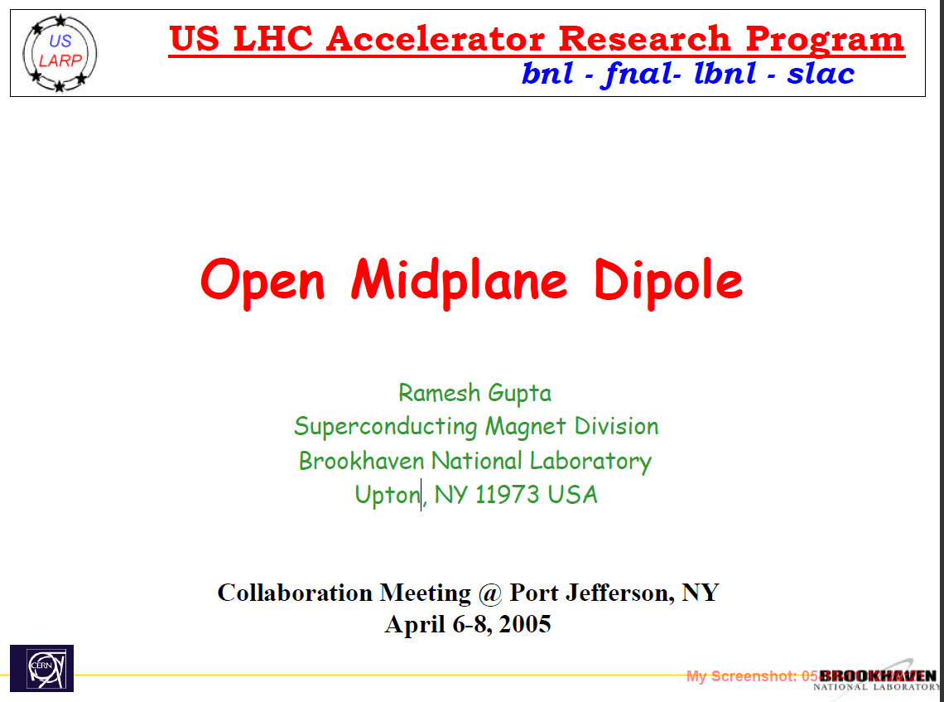
LARP Collaboration Meeting (April 2005)

Slide 15
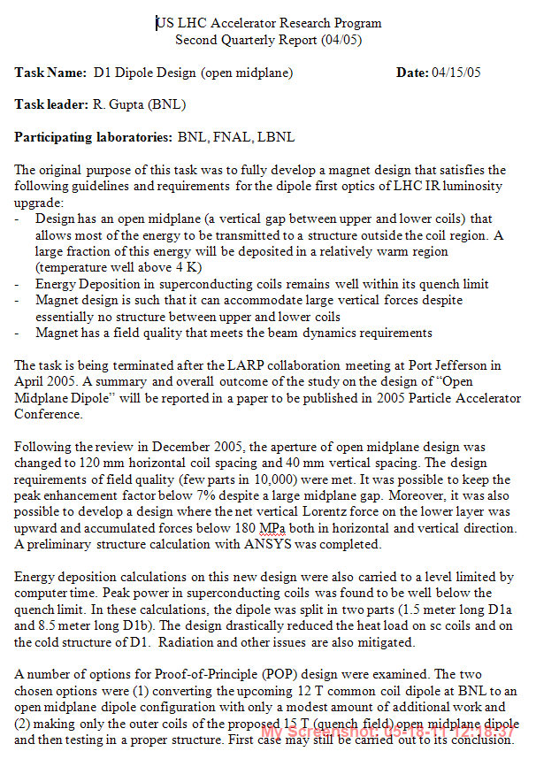
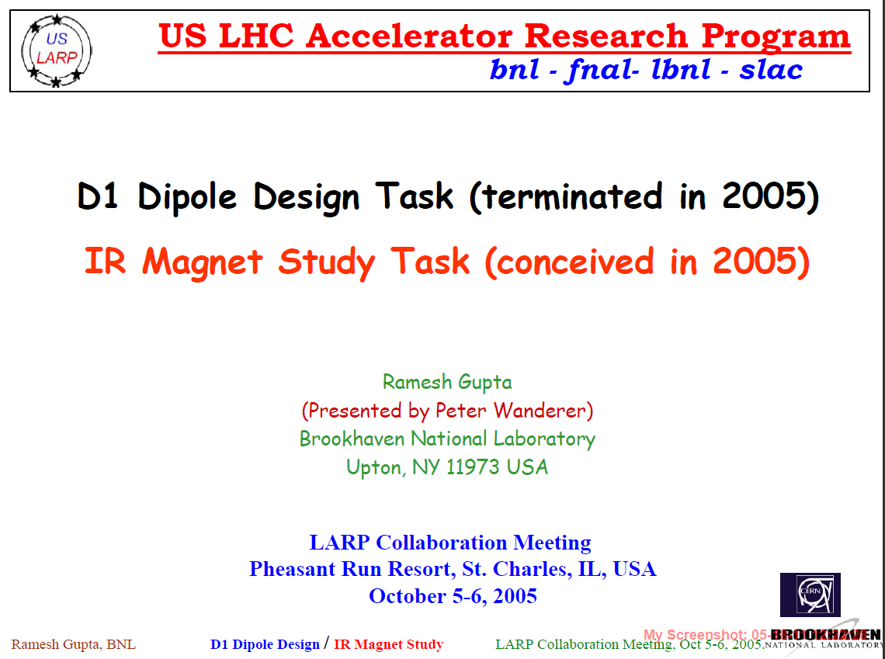
LARP Task Terminated
(decision made April 2005)
(work summarized in a PAC paper)

Slide 16
A Brief Summary of
Significant Technical Progress on
Open Midplane Dipole Design
During 2 Years of LARP R&D

Slide 17
Overcoming Challenges
Recall the three major technical challenges:
How to deal with large Lorentz forces towards midplane in a design with missing structure between the coils at midplane?
How to control the excessive peak field (common problem in split-pair solenoid)?
How to obtain a good field quality?

Slide 18
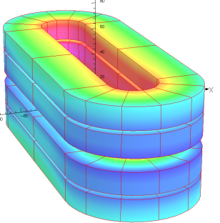
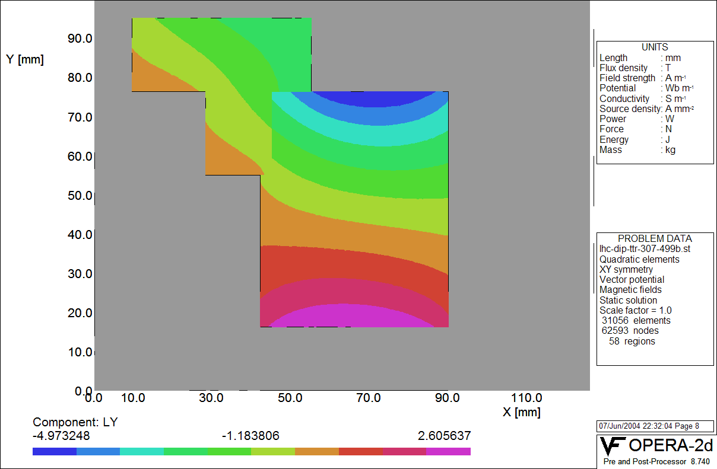
Challenge #1: Lorentz Forces between coils A new and major consideration in design optimization
In conventional designs the upper and lower coils rest (react) against each other. In a truly open midplane design, the target is to have no structure between upper and lower coils. Structure generates large heat loads and the goal is to minimize them.
Original Design
New Design Concept to navigate Lorentz forces
Lorentz force density
(Vertical)
Zero vertical force line
Since there is no downward force on the lower block (there is slight upward force), we do not need much support below if the structure is segmented. The support structure can be designed to deal with the downward force on the upper block using the space between the upper and the lower blocks.

Slide 19
Vertical Forces at 15 T
(design optimized to first order)
Net upward vertical force on lower double pancake coil
Downward vertical force on upper double pancake coil is taken by the support structure between two double pancake coils
Net Force per quadrant:
Horizontal = 11 MN/m; Vertical –5.4 MN/m

Slide 20
Horizontal Forces at 15 T
L_{x}
ABS(L_{x})
BMOD

Slide 21
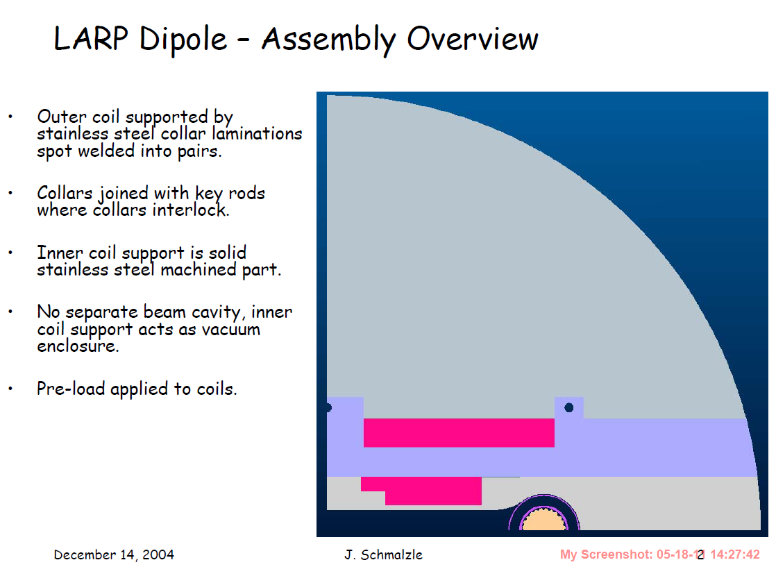
Mechanical Design and Analysis (1)
J. Schmalzle (12/04)

Slide 22
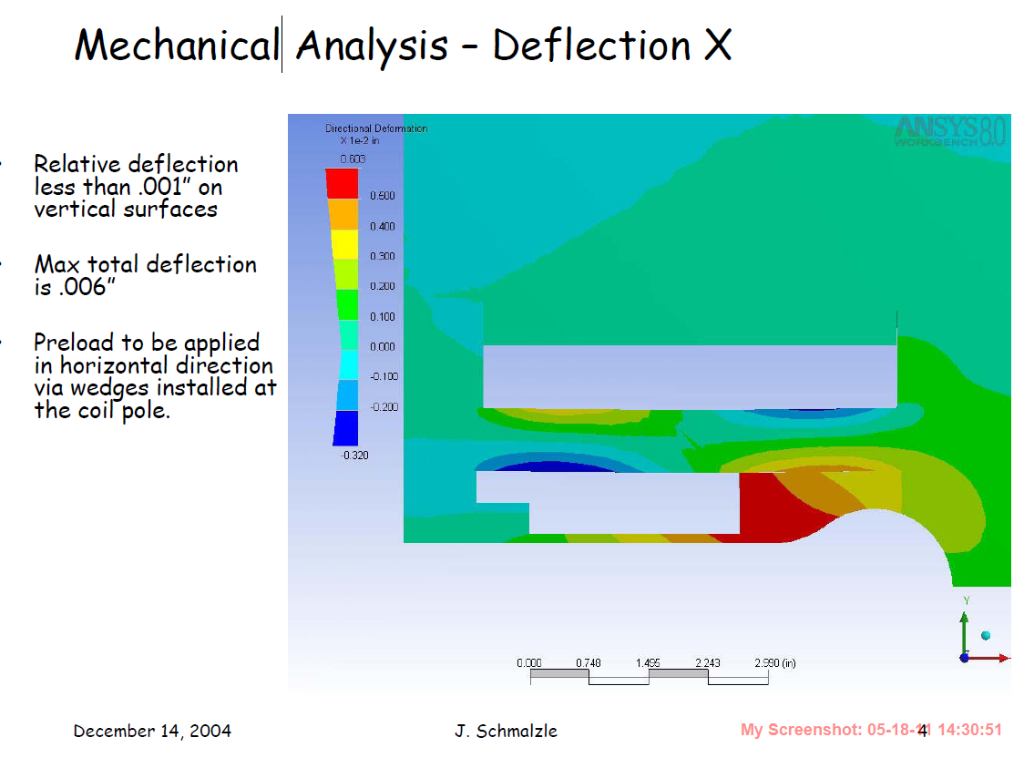
Mechanical Design and Analysis (2)
J. Schmalzle (12/04)

Slide 23
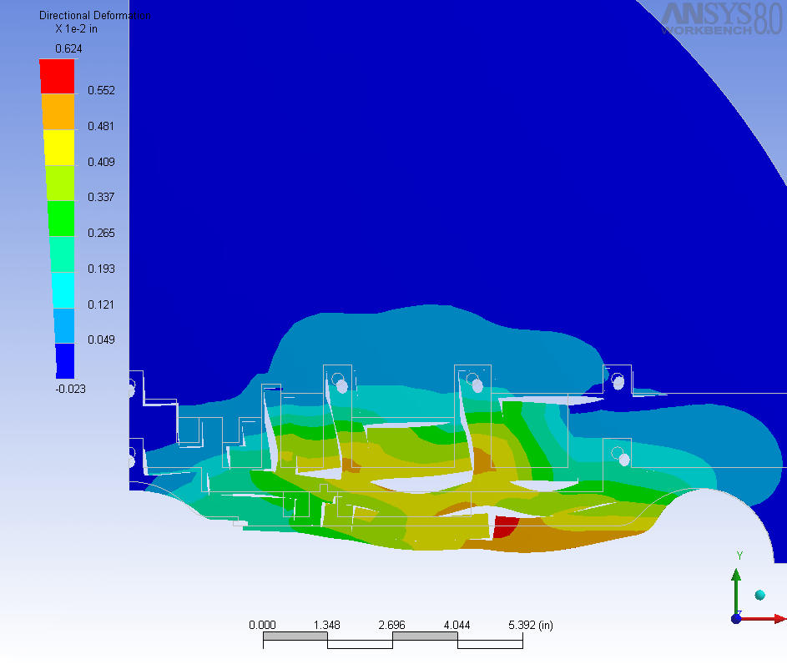
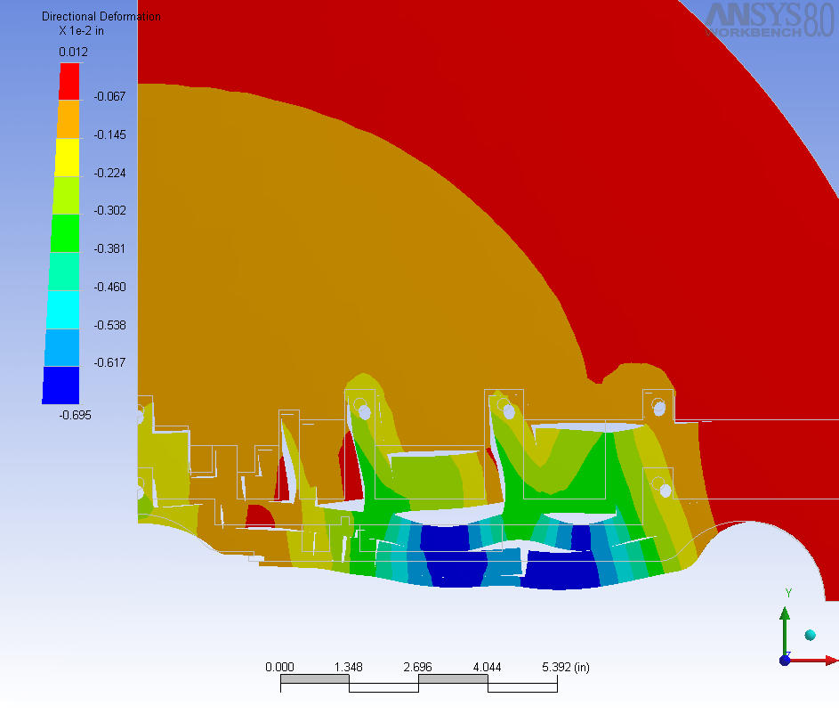
Mechanical Analysis
(J. Schmalzle)
X-deflections
Y-deflections
In a more optimized design the relative values of the x and y deflections are 3-4 mil (100 micron) and the maximum value is 6-7 mil (170 micron)
Above deflections are at design field (13.6 T). They are ~1-2 mil higher at quench field.

Slide 24
Challenge #2: Peak Field
Several designs have been optimized with a small peak enhancement: ~7% over B_{o}
Relative field enhancement in coil over the central field
Similar to that in optimized cosine theta designs
Quench Field: ~16 T with J_{c} = 3000 A/mm², Cu/Non-cu = 0.85
Quench Field: ~15.8 T with J_{c} = 3000 A/mm², Cu/Non-cu = 1.0

Slide 25
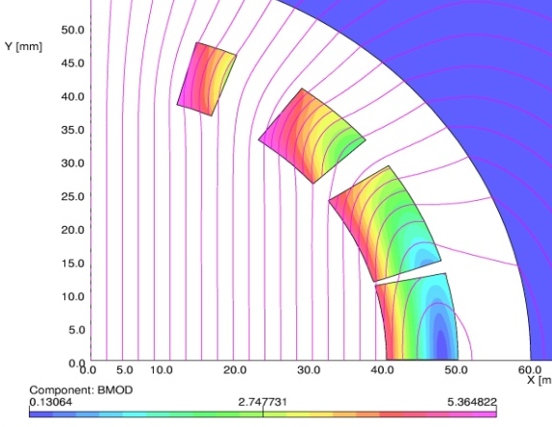
Challenge #3: Field Quality
Coil-to-coil gap in this design = 34 mm (17 mm half gap)
Horizontal aperture = 80 mm
Vertical gap is > 42% of horizontal aperture
(midplane angle: 23º)
Conventional cosine theta
What part of cosine(θ) is left in that famous cosine(θ) current distribution
now?
This makes obtaining high field and high field quality a challenging task !
Open midplane design
We did not let prejudices come in our way of optimizing coil - e.g. that the coil must create some thing like cosine theta current distribution !

Slide 26
Field Harmonics and Relative Field Errors in an Optimized Design
Proof: Good field quality design can be obtained in such a challenging design:
Area where field error is <10⁻⁴
(Beam @ x=+/- 36 mm at far end)
(Max. radial beam size: 23 mm)
Geometric Field Harmonics:
40 mm is ½ of horizontal coil spacing
Harmonics optimized by RACE2dOPT
Field errors should be minimized for actual beam trajectory & beam size.
It was sort of done when the design concept was being optimized by hand.
Optimization programs are being modified to include various scenarios. Waiting for feed back from Beam Physicists on how best to optimize.
However, the design as such looks good and should be adequate.

Slide 27
Field Uniformity in an Optimized 15 T Open Midplane Dipole Design
Proof that good field quality can be obtained in such a wide open midplane dipole design:
The maximum horizontal displacement of the beam at the far end of IP is +/- 36 mm.
The actual field errors in these magnets will now be determined by construction, persistent currents, etc.
Relative Field Errors
Note:
The scale is a few parts in 10⁻⁵.

Slide 28
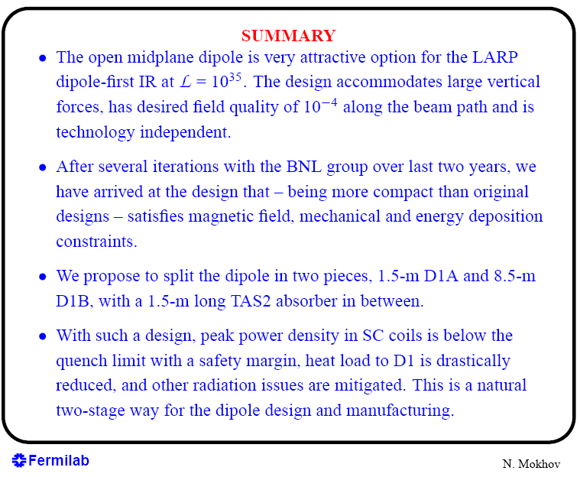
Energy Deposition Summary (Nikolai Mokhov 04/05)

Slide 29
Summary of Optimized Open Midplane Nb₃Sn Dipole Designs for LARP
For more information (publications + talks): http://www.bnl.gov/magnets/Staff/Gupta/

Slide 30
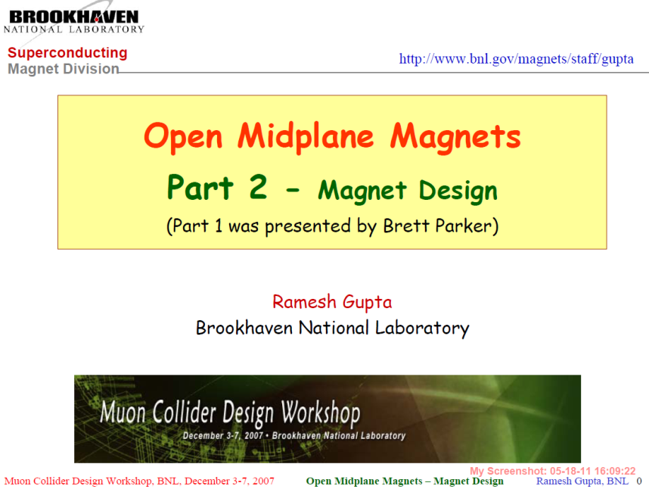
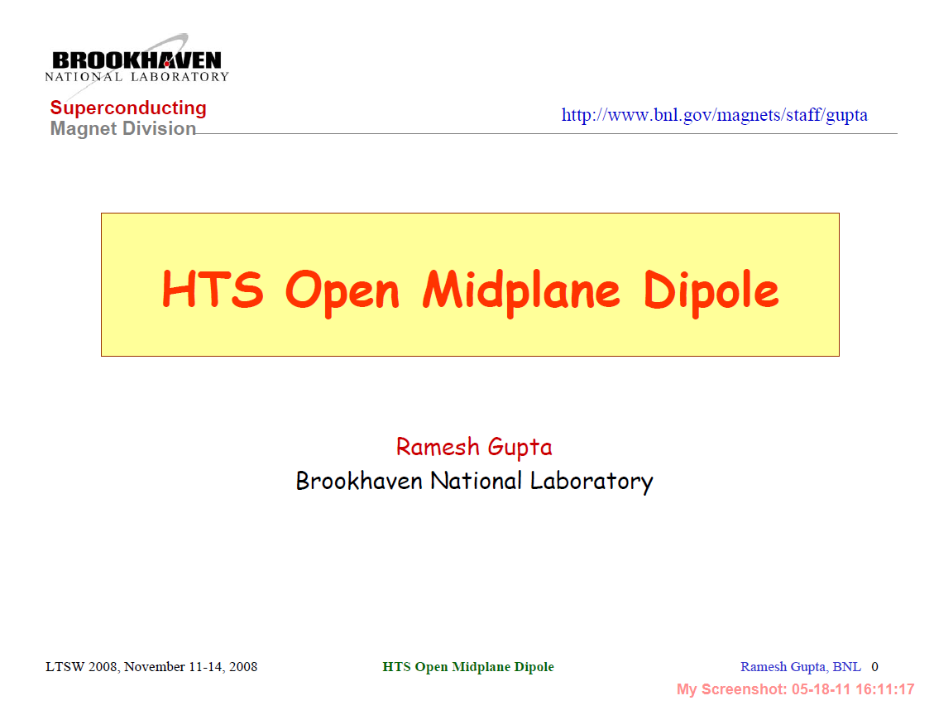
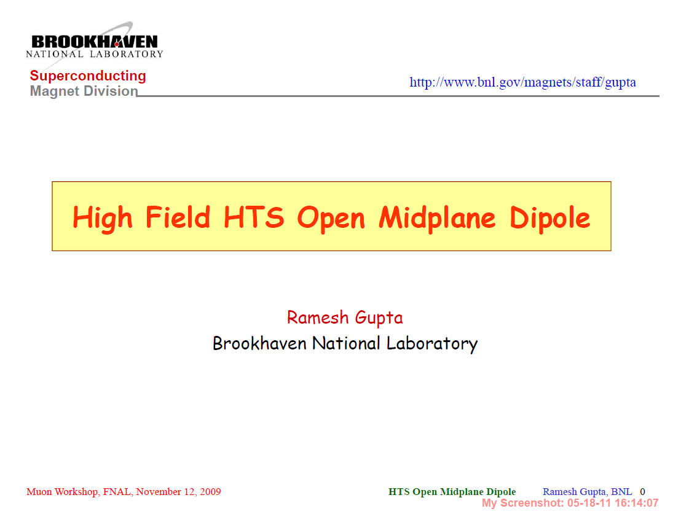
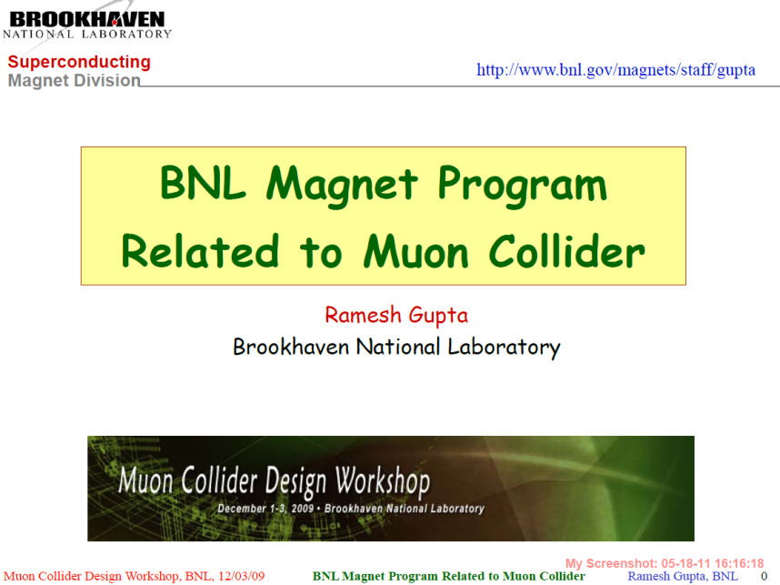
Open Midplane Dipole Design for Muon Collider (several presentations)
December 2007
November 2008
December 2009
November 2009

Slide 31
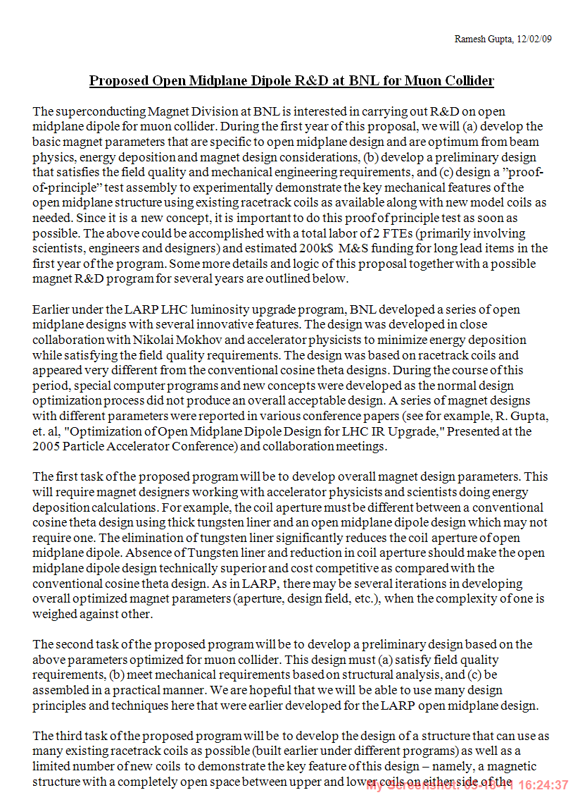
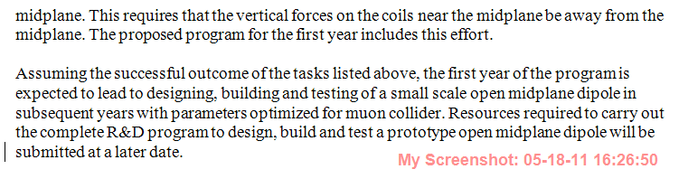
BNL Request to Perform R&D on Open Midplane Dipole for Muon Collider
(did not get funded)

Slide 32
Open Midplane SBIR with PBL
Phase I, Bob Weggel, PI (next speaker), got funded last year
Phase II proposal under process this year, Bob Weggel, PI (more in next talk)
  A part of Phase II is to demonstrate a Proof-of-Principle Magnet (BNL Lead)
  Another part is to optimize ~10T, ~15T and 20T OMD designs with required magnetic and mechanical (Bob Weggel Lead)
  Third part is energy deposition calculations for above designs for a series of magnets with feedback to magnet designs so that they can be iterated as done during LARP (Ding Lead)

Slide 33
Importance of Proof-of-Principle Demonstration of Open Midplane Dipole
Such a demonstration is required since the open midplane dipole design is significantly different from other superconducting magnets previously built.
Model calculations alone, however convincing, are not sufficient. One has to demonstrate in a real magnet. It would be desired that the field on conductor in this demo magnet is in the same range as in current designs (~10 T).
A successful demonstration of key features of a Proof-of-Principle magnet would make this design to be considered more seriously for muon collider.

Slide 34
Proof-of-Principle (PoP) Structure for Open Midplane Dipole
Guiding principle:
Forces on the coil blocks near the midplane should be away from the midplane so that we can have a truly open midplane magnet to allow radiation near zero degree pass unhindered.
(design should not require any structure at the midplane to support the coils on either side of the midplane)

Slide 35
A Significant Goal of the PBL/BNL Phase 2 SBIR
Design, fabricate and test a proof-of-principle open-midplane dipole with the following features:
Magnetic Lorentz forces on the inboard conductors hold them away from the midplane, so that they need no midplane support.
The short-sample field should be ~10 T.
The conductor is Nb₃Sn, as in a full-size OMD.
The OMD incorporates most pertinent cold-mass components—support structure, iron yoke & keyhole to accommodate a hypothetical warm absorber.
The OMD meets all constraints on stress, strain and deformation.
Next few slides: preliminary design
(to be further optimized during the course of Phase II)

Slide 36
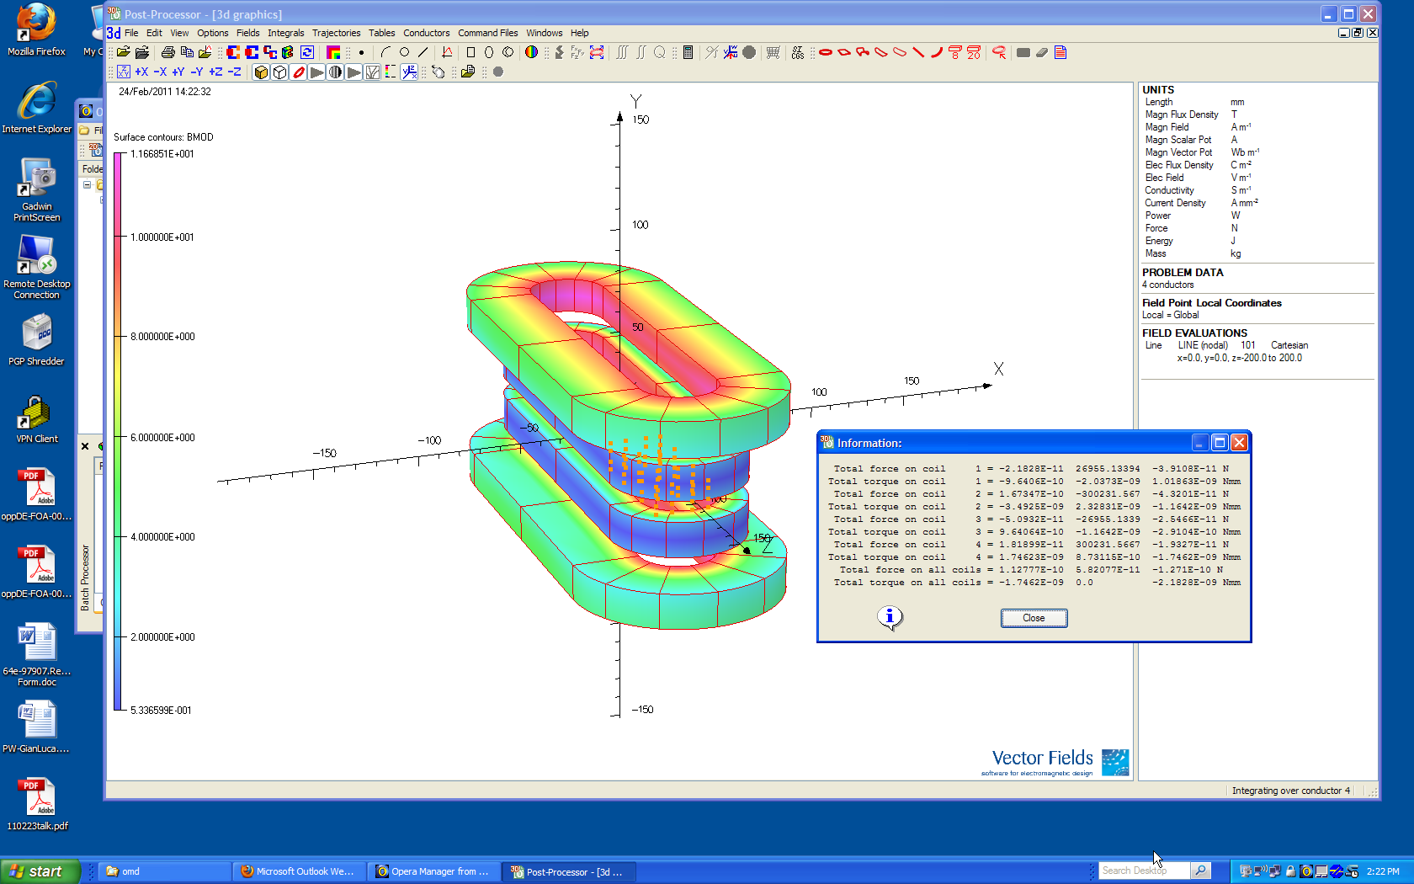
Navigation of Lorentz Forces in the Preliminary Design of PoP
Forces on coils closer to midplane are away from midplane
Field superimposed on coils

Slide 37
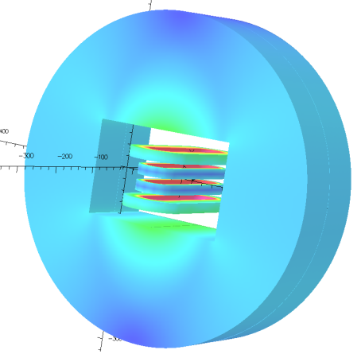
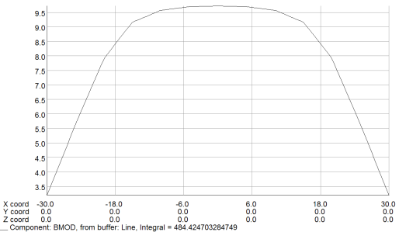
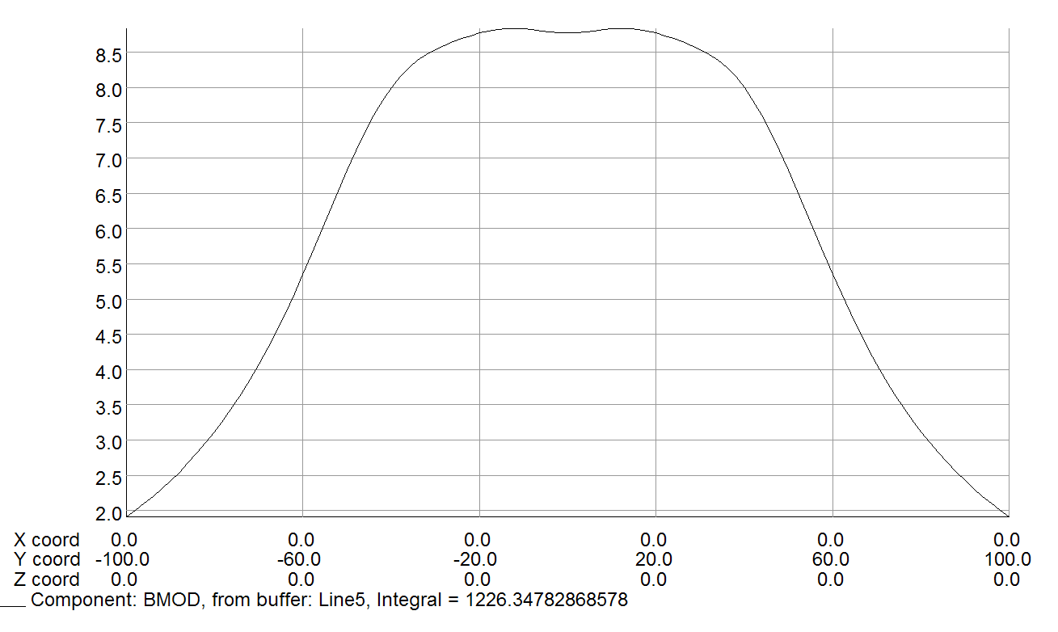
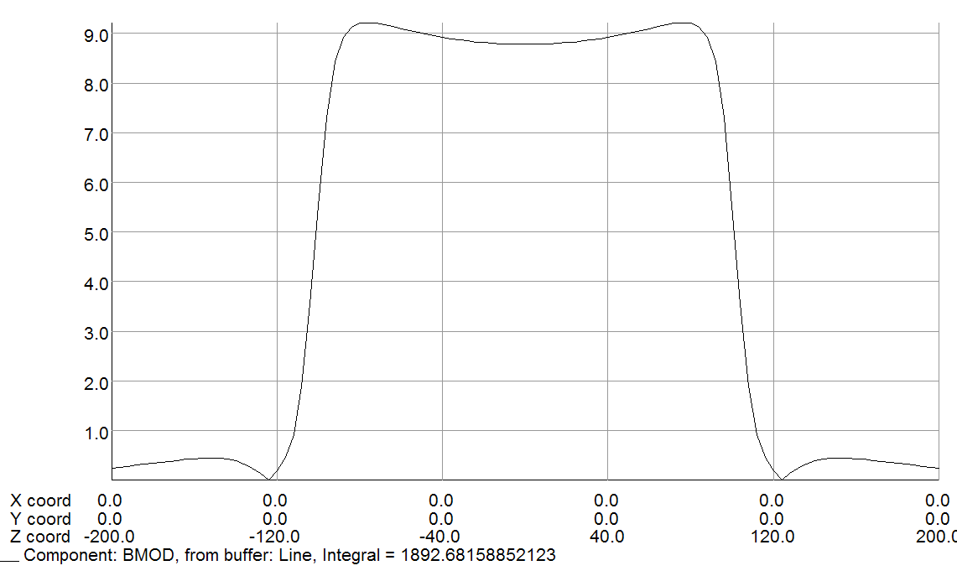
Preliminary Magnetic Model of PoP
Bx
Bz
By

Slide 38
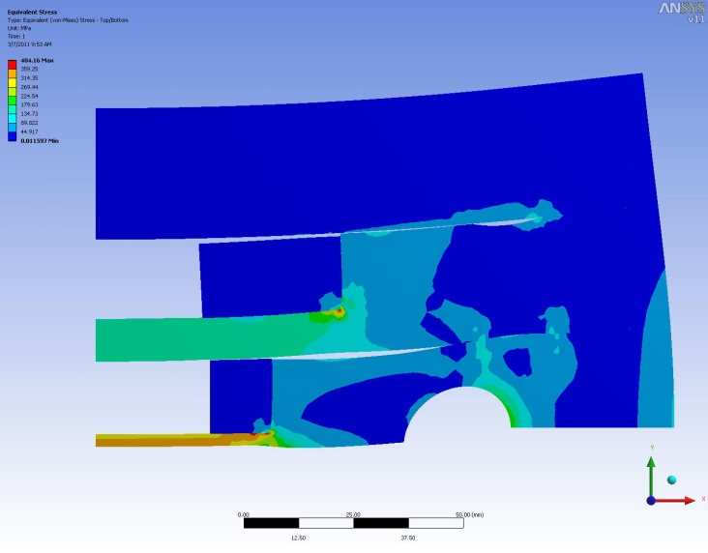
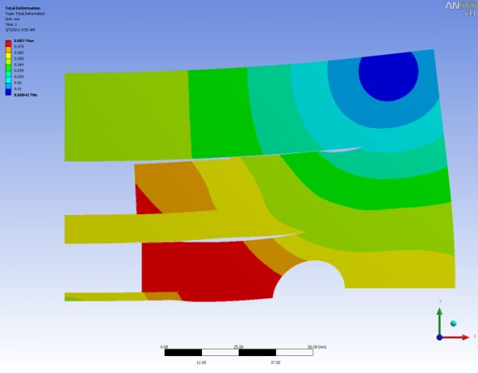
Preliminary Mechanical Analysis of PoP
Left: Von Mises stress at B₀=10.7T(design 9.7T), Max≈ 400 MPa
Right: Total deformation δ; δmax = 87 μ; Max. δ of coil ≈ 20 μ.

Slide 39
Cost-effective Program to fit SBIR Budget
Use either existing coils or existing tooling to fabricate the coils
  LBL SM coils (the type of which are fabricated at BNL and FNAL also)
Use as many features and proven technology as possible
  The goal of this proposal is to prove new magnet structure design, and not to spent unnecessary resources on already proven Nb3Sn coil technology
  Use as many proven design features as possible
Use simple bolted structure

Slide 40
Preliminary Structure of PoP
Conductor is brown; structure is grey (stainless steel) or blue (iron).
The four white circles are for tie rods to restrain end plates that resist end forces. Alternatively, SS shell may be used.
The midplane gap would, in a muon collider, accommodate a beam pipe and, at its dumbbell ends, tungsten absorbers.

Slide 41
Open Midplane Designs With HTS (High Temperature Superconductors)
HTS could generate very high fields (say ~20 T).
HTS may be used in a hybrid designs with Nb₃Sn coils.
HTS could tolerate large energy deposition and operate with larger increase in local or global temperature.
HTS could also remove energy more efficiently at higher temperature, as in FRIB

Slide 42
Possible Demonstration of HTS Open Midplane Dipole using FRIB HTS Coils
FRIB coil of HTS. B₀ ≈ 1.4 T at 50 K and ≈ 5 T at 4 K

Slide 43
Summary
Open midplane dipole designs could play a significant role in μ⁺μ⁻ collider ring magnets, as energy deposition from decay particles at the midplane may limit the performance of superconducting coils and/or significantly increase the operating cost.
The design concept was significantly developed under LARP funding.
A successful demonstration of open midplane dipole will be a significant technical progress for the community and will allow this design to be seriously considered for muon collider ring magnets.
It is possible to design, build and test a Proof-of-Principle magnet within the SBIR funding. A successful demonstration may open a way to build a more optimized design under a regular program.
HTS could play an important role in high field open midplane design. HTS can generate very high fields and could tolerate and remove large heat loads more efficiently.

