Slide 1
Forward Multiparticle Spectrometer for LHC
A new subsystem for CMS Run 4 (HL-LHC)
~ 90– 125m downstream of IR-5 (IR-1 option)
Two operational modes (distinct physics – some common elements):
A) Charged and neutral TeV hadron production spectra
in p + p, p + O, O + O low pileup short runs.
Read out with full CMS detectors
35 Tm spectrometer magnet D1 (will be) already there!
B) Search for new light long-lived decaying neutrals
in p + p at high luminosity (LLPs) or interacting DM?
Independent trigger & read out
Steel absorber and 35 Tm sweeping magnet D1 (will be) already there!
TODAY
SMP-HAD 03.20
Guaranteed physics in
unexpored phase space
EXO – LLP 03.27
BSM discovery potential

Slide 2
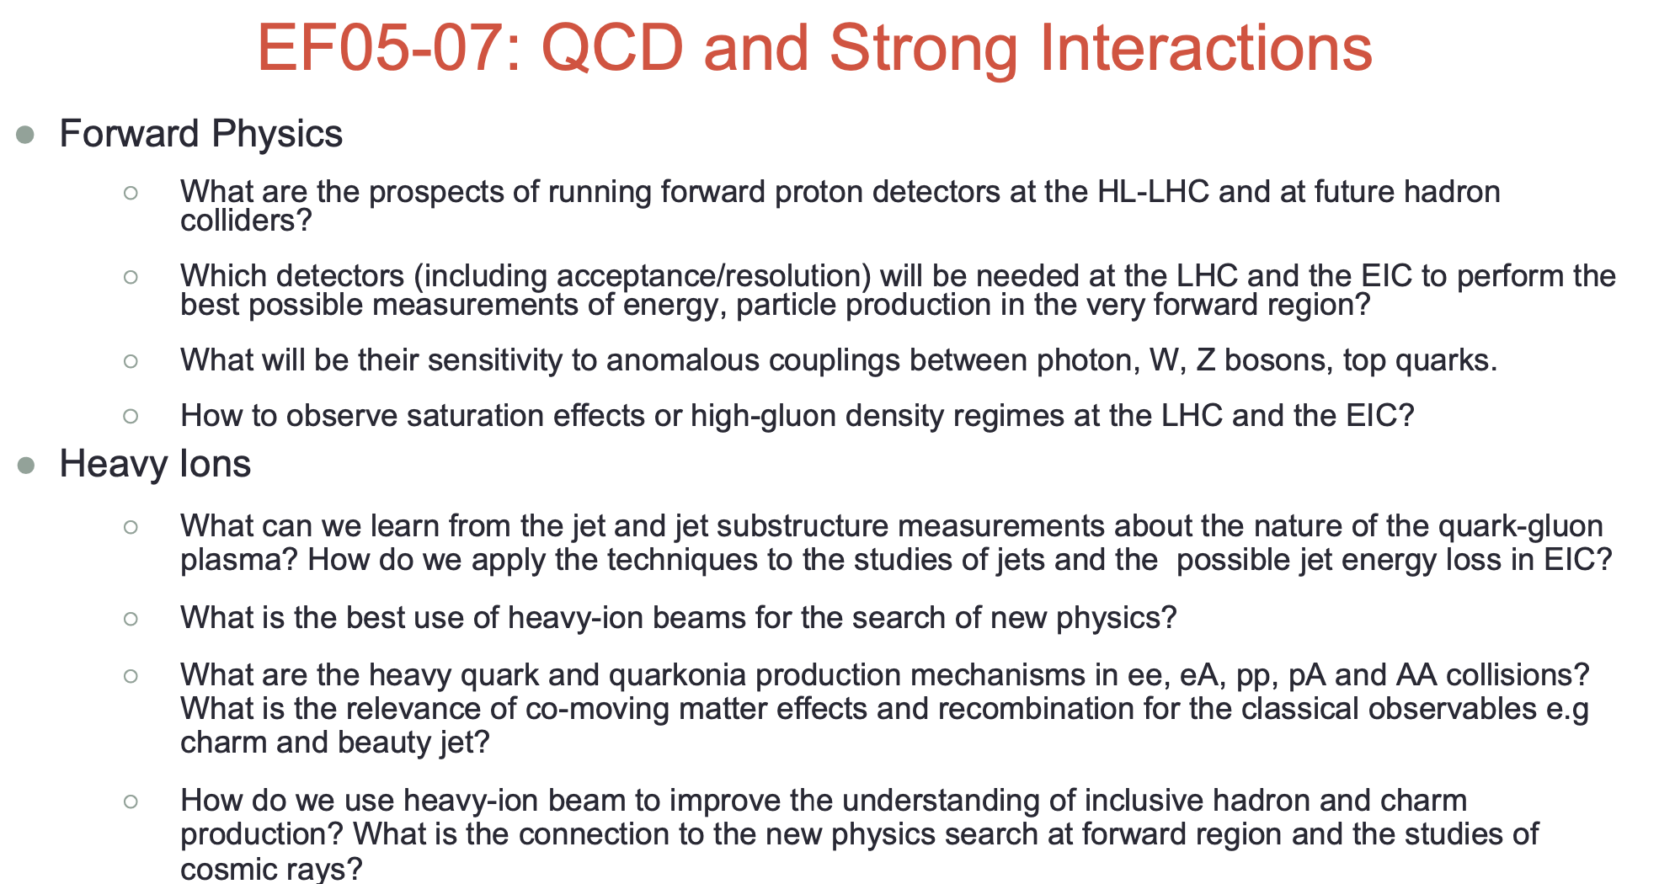
Issues addressed by this Expression of Interest

Slide 3
PHYSICS GOALS for FMS L&R Charged particles (not complete!)
Precise measurements of Feynman-x (x_{F}) spectra at small p_{T} (< ~2 GeV) of:
π+, π-, K+, K-, p, p, d, d, t, t, … possibly K⁰_{s} → π+π- , Λ⁰ → pπ (acceptance under study).
In p+p and p+O and O+O collisions (for cosmic ray showers in atmosphere)
Intrinsic charm: p = {uudcc} giving leading D⁰ → K⁺π⁻ & K⁻π⁺
Full reconstruction challenging but → forward muons
Other reconstruct-able particles: J/ѱ → μ⁺μ⁻ (6%) ; 𝛶(1S) → μ⁺μ⁻ (2.5%)
These are ‘intrinsically’ important + to understand μ and ν in cosmic ray showers.
Energy Frontier and Cosmic Frontier are Snowmass Frontiers (already US priorities)
Production of light nuclei and antinuclei – antiprotons, antideuterons, antitritons, He³
Needed to understand background to Galactic Center 𝛾-ray excess (Dark Matter Annihilation?)
Low Q² frontier of QCD needs further understanding
deuterons, tritons
CAVEAT: Acceptance etc. to be calculated with detectors defined
Diffraction dissociation – products, e.g. p → n π+, p (π+ π-), Λ⁰ K⁺

Slide 4
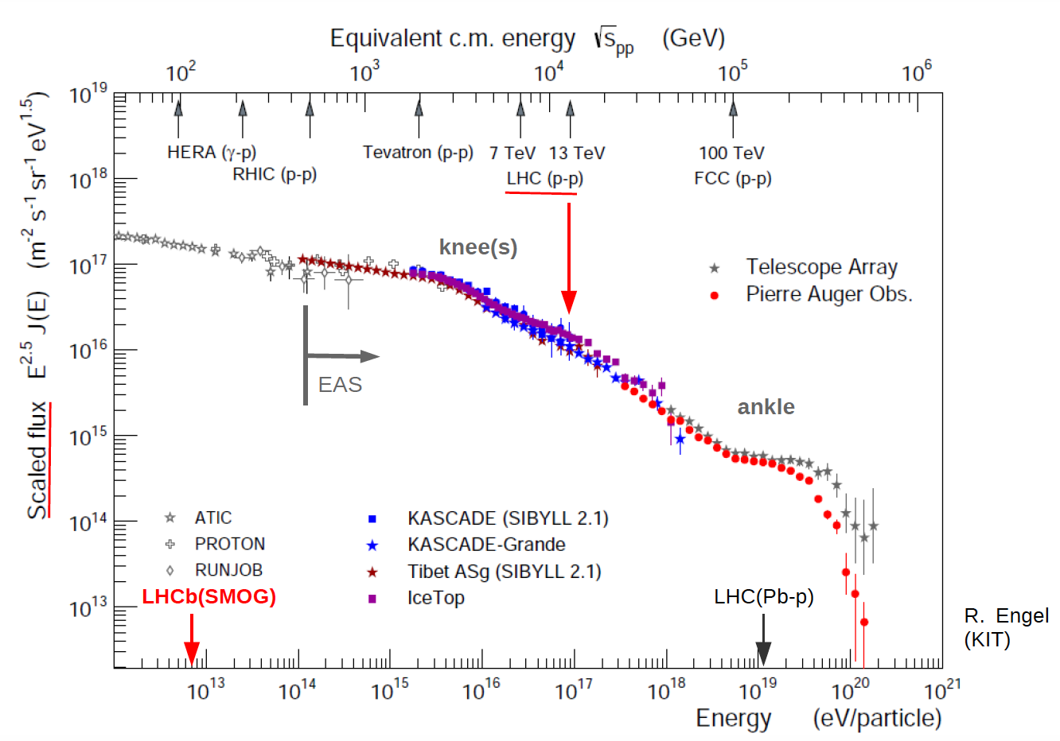
Cosmic ray spectrum, flux x E^{2.5}
CERN ISR
√s (max) = 62.5 GeV
x 220 in √s = x 50,000 in E(CR)
COSMIC FRONTIER too
ALL FT expts

Slide 5

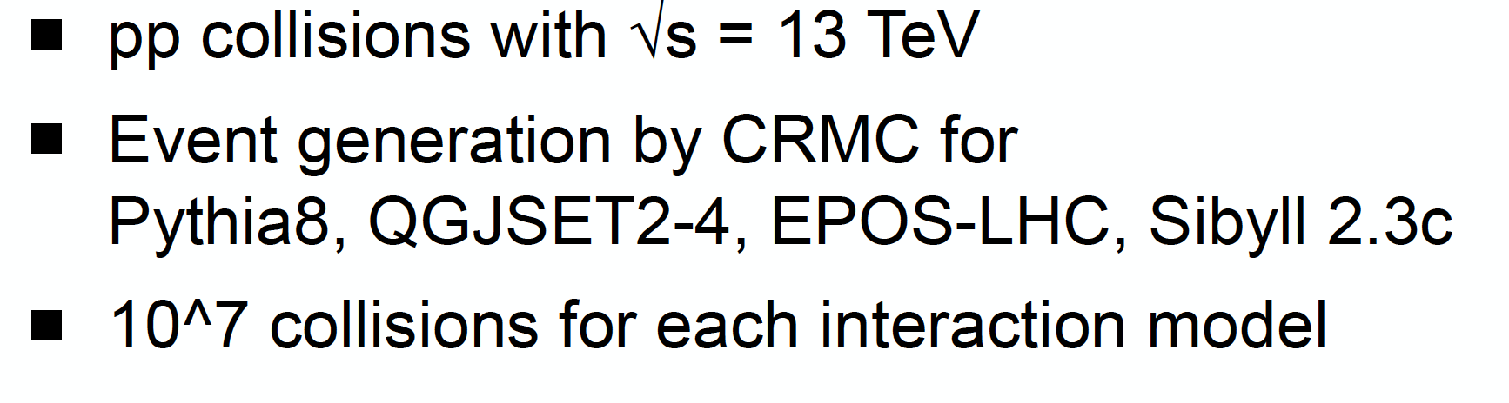
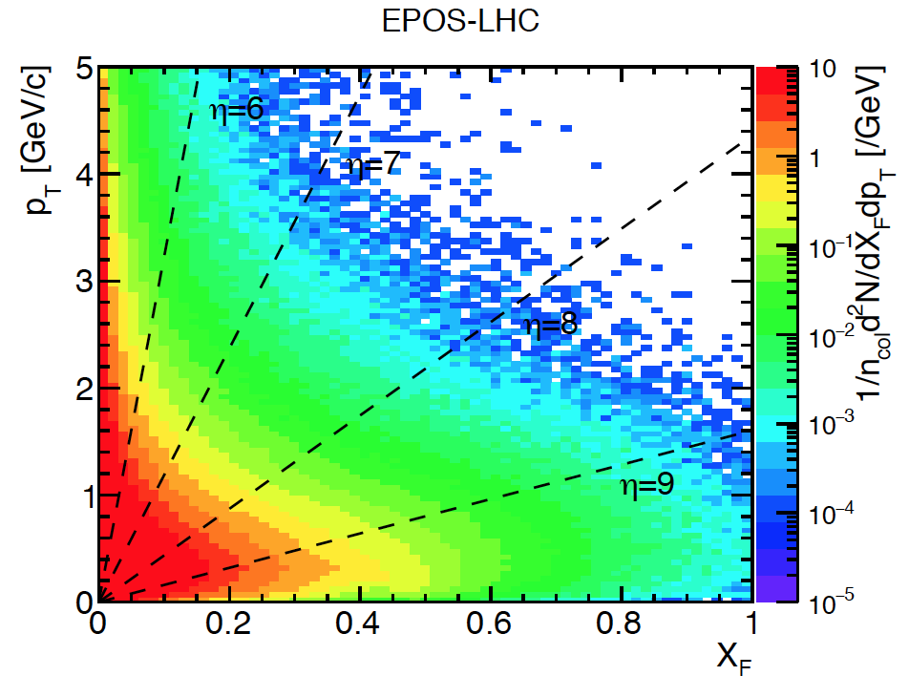
(Dec 5th 2019)
η = 6
η = 8
η = 4.5 (LHCb charm)
is θ =1.3º → Forward
but not “very forward”
η = 7
1.4 TeV
Feyman x_{F} = p_{z}/p_{BEAM}
Density of charged pions in p_{T}, x_{F}. Most have p_{T} < 1 GeV/c and |η| > 7 – unexplored region
TOTEM & PPS (p’s at x_{F} > 0.9) and ZDC & LHCf measure neutrals (n + K⁰_{L} , π⁰ →γγ) at θ ~ 0º

Slide 6
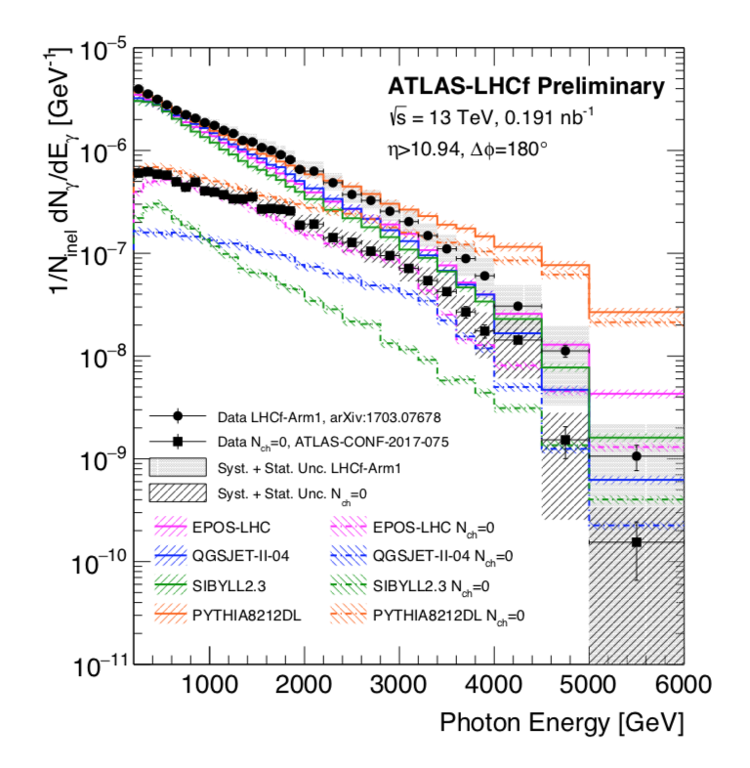
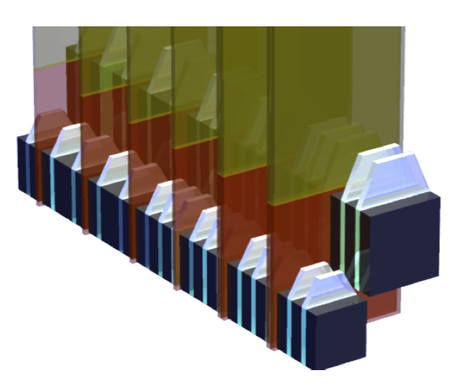
LHCf is a small 0º calorimeter measuring photon-like and n-like showers
Only 1.6 λ_{I} and 4 cm in size, σ(E)/E ~ 40% for neutrons.
Low-PU, High β* runs
X 40
Arm 1: 2cm x 2cm & 4cm x 4cm
Arm 2: 2.5 x 2.5 & 3.2 x 3.2 cm
ZDC in CMS
7 λ_{I} and 8cm x 10 cm
Must be smaller for Run 4
-include it for low-PU runs
With FMS we can measure spectra small p_{T} & up to p_{z} ~ 3 TeV
of charged : π, K, p, d, t, (and anti-d,t) – μ
and decaying neutrals : K, ϕ, Λ, …? . & D⁰ → K- π (some acceptance)

Slide 7

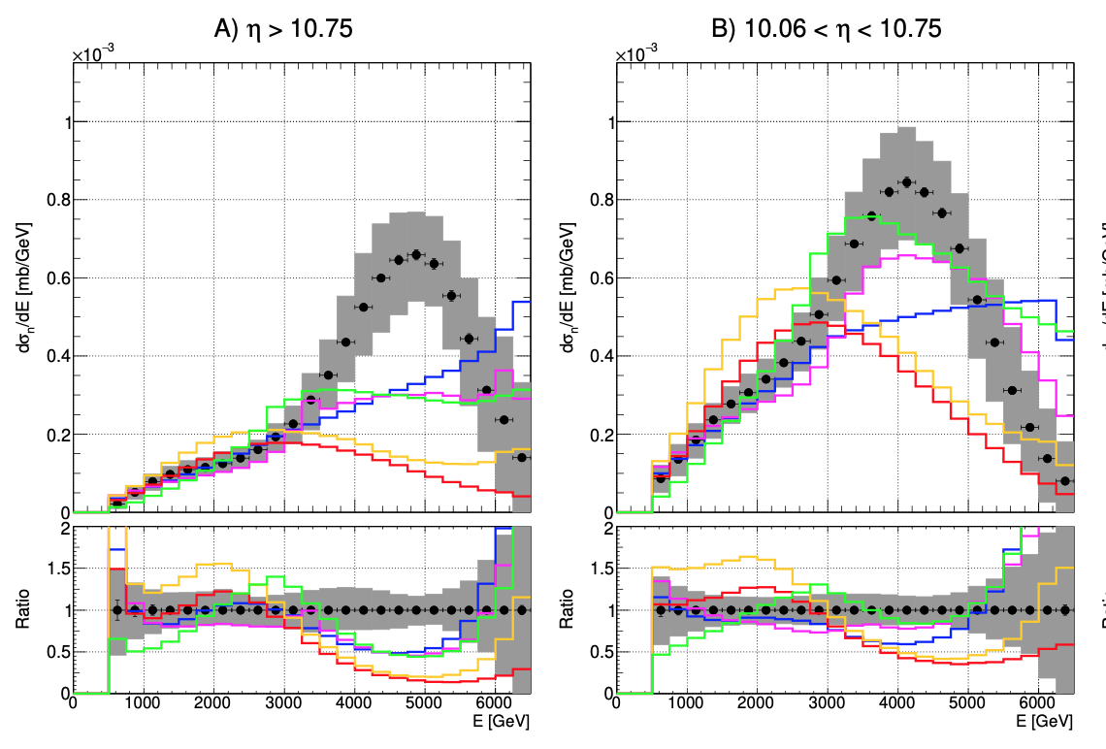
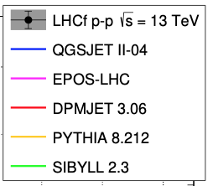
Neutral hadrons very forward – mostly n – some Λ, K⁰ (FMS can measure - tbd)
JHEP07 (2020) 016
Is peak p → n π⁺ by π(Regge) exchange?
Not in models, was seen at 0º at ISR
Need to improve models to fit forward data - but that need data!
On many different particles!

Slide 8
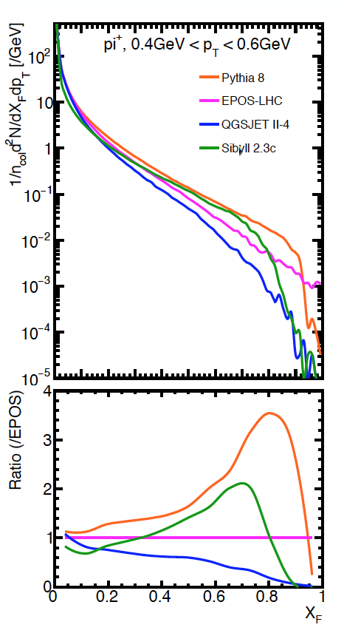
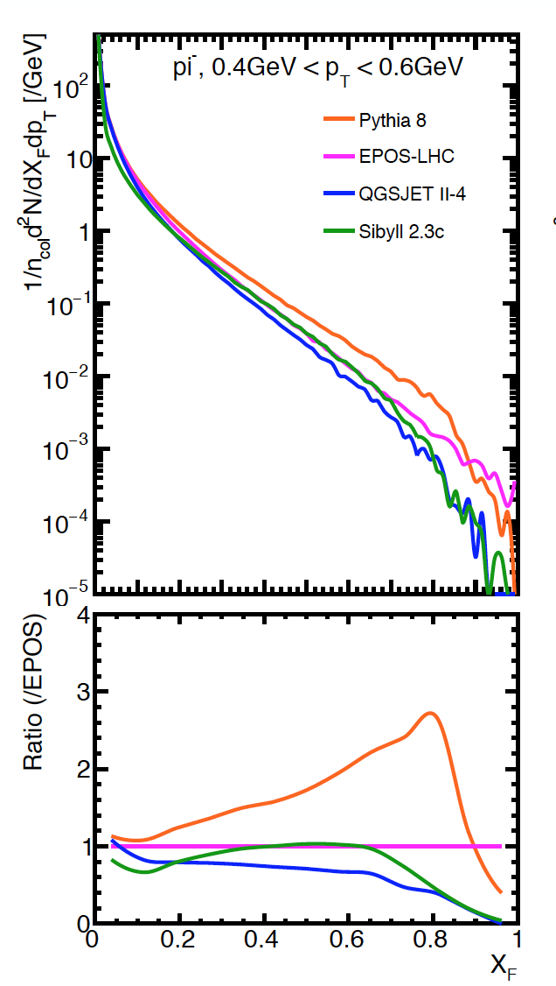
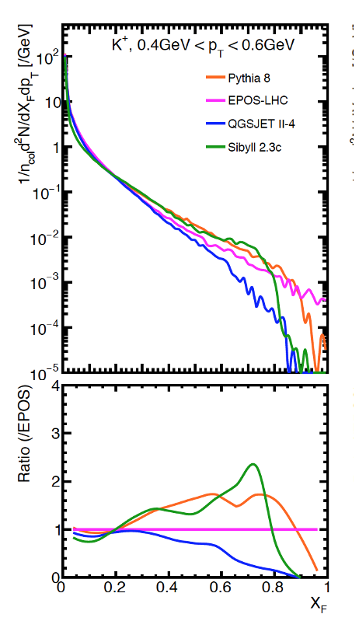
Comparison of Monte Carlo generators, Low-p_{T} π and K (H. Menjo)
π⁻
K⁺
π⁺
Feynman x_{F} = p_{z}/p_{BEAM}
(PYTHIA8: QGSJET II-4) ~ 50 at x_{F} = 0.8
No Data! FMS reach → ~ 0.3
Higher x_{F} may be possible with
Bent crystal channelling ??

Slide 9
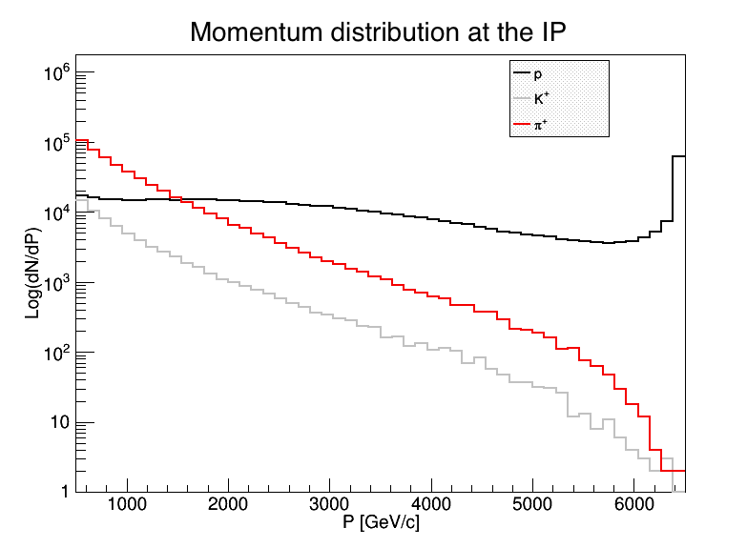
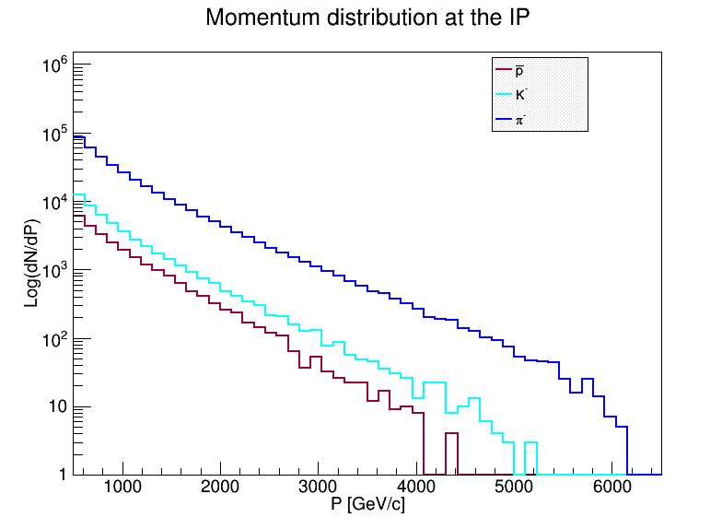
DPMJET prediction (Prob. Too high)
Very uncertain! Illustration only
Spectra generated by /DPMJET-MARS
With 10⁶ pp events, √s = 13 TeV
(N.Mokhov and O.Fornieri)
In 1 second, with 2808 bunches,
Have 30 x 10⁶ bunch crossings and
30 x 10⁶ x μ(= interactions/X) events.
Notes:
At 0.5 TeV (~ central)
π⁺ = π⁻ & K⁺ ≅ K⁻ & K/π ~ 10%
p’s > π⁺ above 1.5 TeV and flattish;
High x_{F} peak from diffraction
K⁻(s-ubar) steeper than K⁺ (u-sbar)
π⁻ (d-ubar) steeper than π⁺ (u-dbar)
Antiprotons < K⁻ but only by a factor ~ 0.5
Anti-deuterons/tritons/He³ to measure too
FMS
p
Number per 125 GeV/c bin
π+
K+
~ 1 x Acc/bin/sec if μ ~ 3
FMS
Number per 125 GeV/c bin
π-
p-bar
FMS higher x_{F}
for K⁰, Λ
K-
Neutrons not = protons, K⁰ not = K^{+/-}

Slide 10
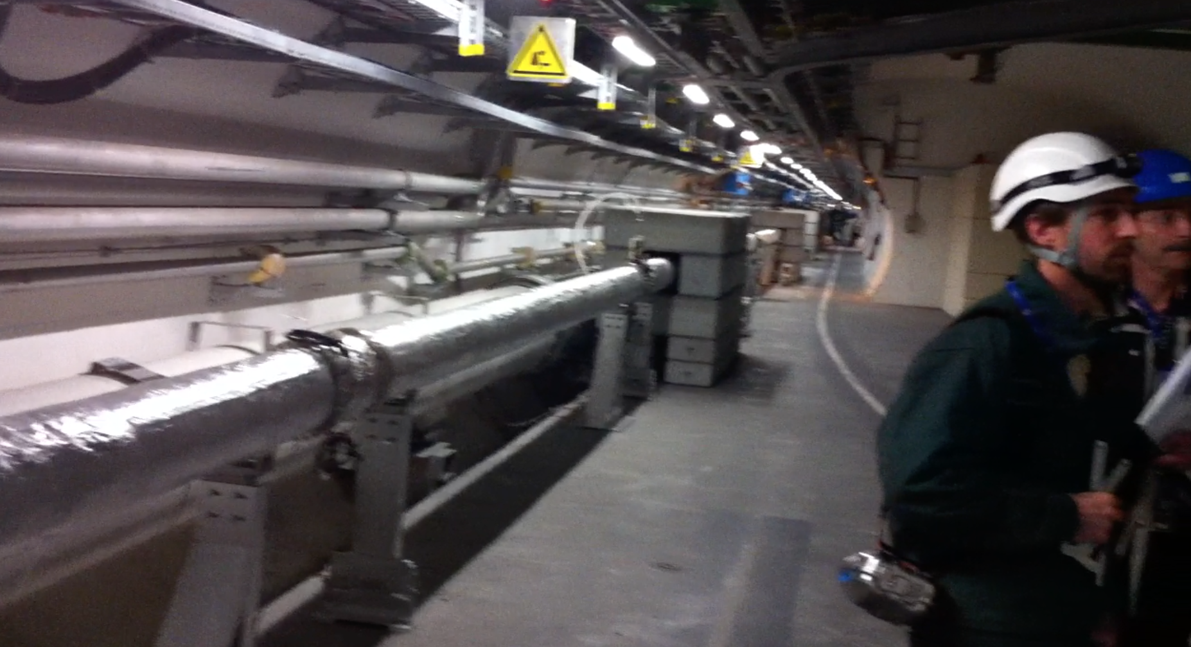
Region looking along LHC tunnel, beam separation dipoles & CMS way behind me.
20 cm diameter straight pipe with both beams for 50 m. (Cladding)
Make this pipe larger diameter: 20 cm → 80 or 100 cm

Slide 11
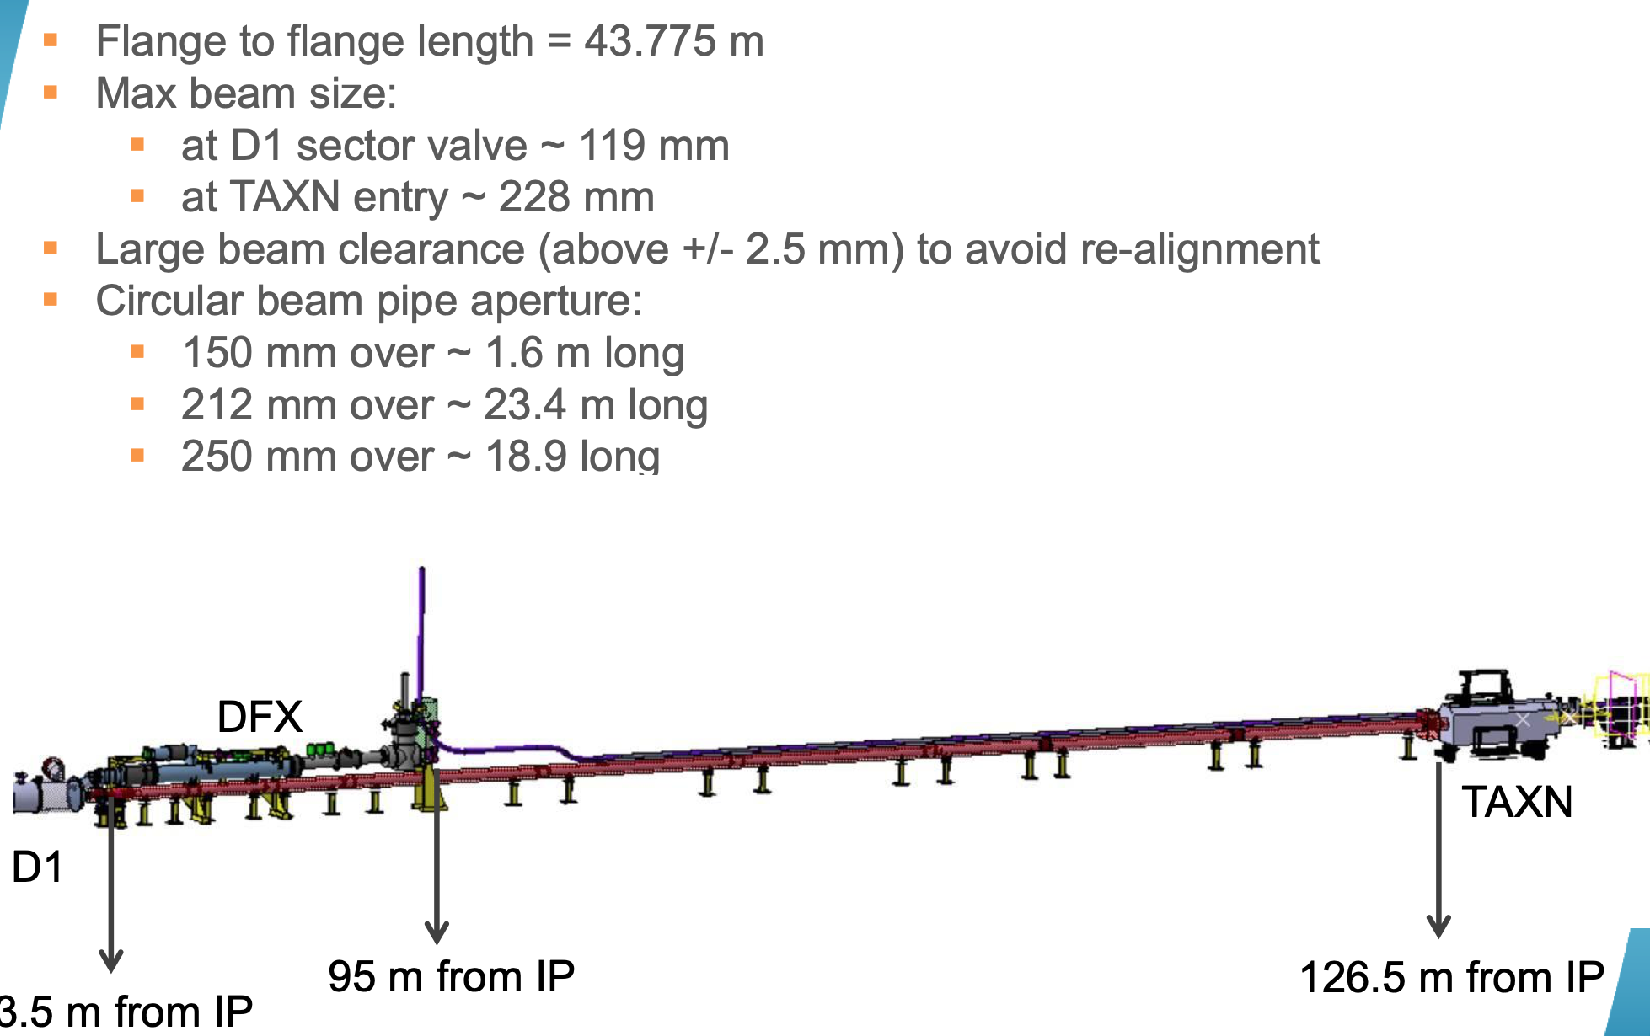
Vincent Baglin (CERN, LHC)
Present plan for Run 4:
Propose e.g. :
212 mm over 12 m long
1000 mm over 20 m long
250 mm over 10 m long
8

Slide 12
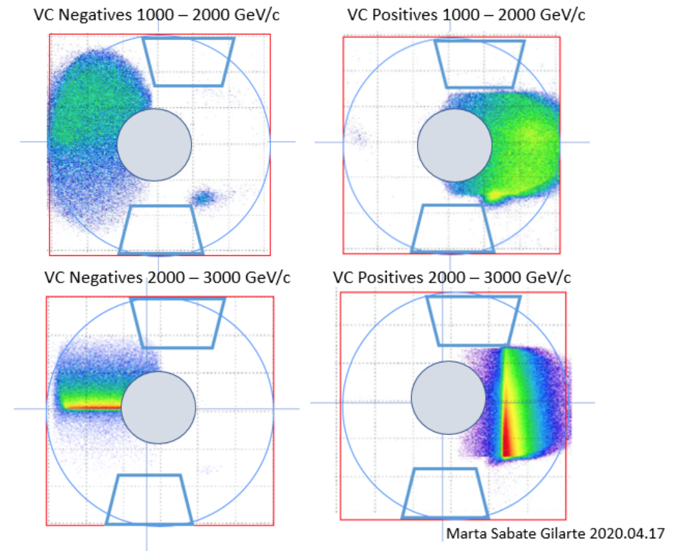
Marta Sabate-Gilarte
NEGATIVE particles 1 – 2 TeV
(through D1 aperture)
POSITIVE particles 1 - 2 TeV
(through D1 aperture)
At z = 126 m
No primary charged
Particles UP & DOWN
& no direct neutrals (35-50m steel)
R = 30 cm (40 cm is possible)
Thin back window between
12.5 cm and 40 cm (perp.)
1 mm steel (Be better?)
Beam pipe into TAXN
12.5 cm radius
p_{z} > ~ 3 TeV
HADRON spectroscopy in L&R quadrants
in low pile-up short runs (Mode A)

Slide 13
FMS – Charged L&R arms - OVERVIEW
Very forward charged particle production – how to measure it
Use new superconducting D1 dipole (Integral B.dL = 35 Tm) as a spectrometer magnet.
Downstream of IR 5 as extension of CMS in Run 4 (2027+)
Straight section in vacuum from ~ 80 m to ~ 127 m.
Larger beam pipe R = 40 cm (cf R = 12 cm now)
for charged particles to emerge through thin windows: + & - sides - Low pile-up only
Detectors over 10 – 12 m in front of TAXN at 127 m:
Precision tracking (silicon strips or pixels) over ~ 2 m (θ_{x}, θ_{y} to a few μrad)
[Possible targets + tracking to study multi-TeV π, K, p, p interactions]. --- bonus!
Imaging Hadron Calorimeter for energy measurement and muon filter
Muon tracking behind calorimeter (and behind D1)
Transition Radiation Detectors for γ = E/m in 10³ – 3. 10⁴ region (novel)
As developed for CMS at HL-LHC

Slide 14
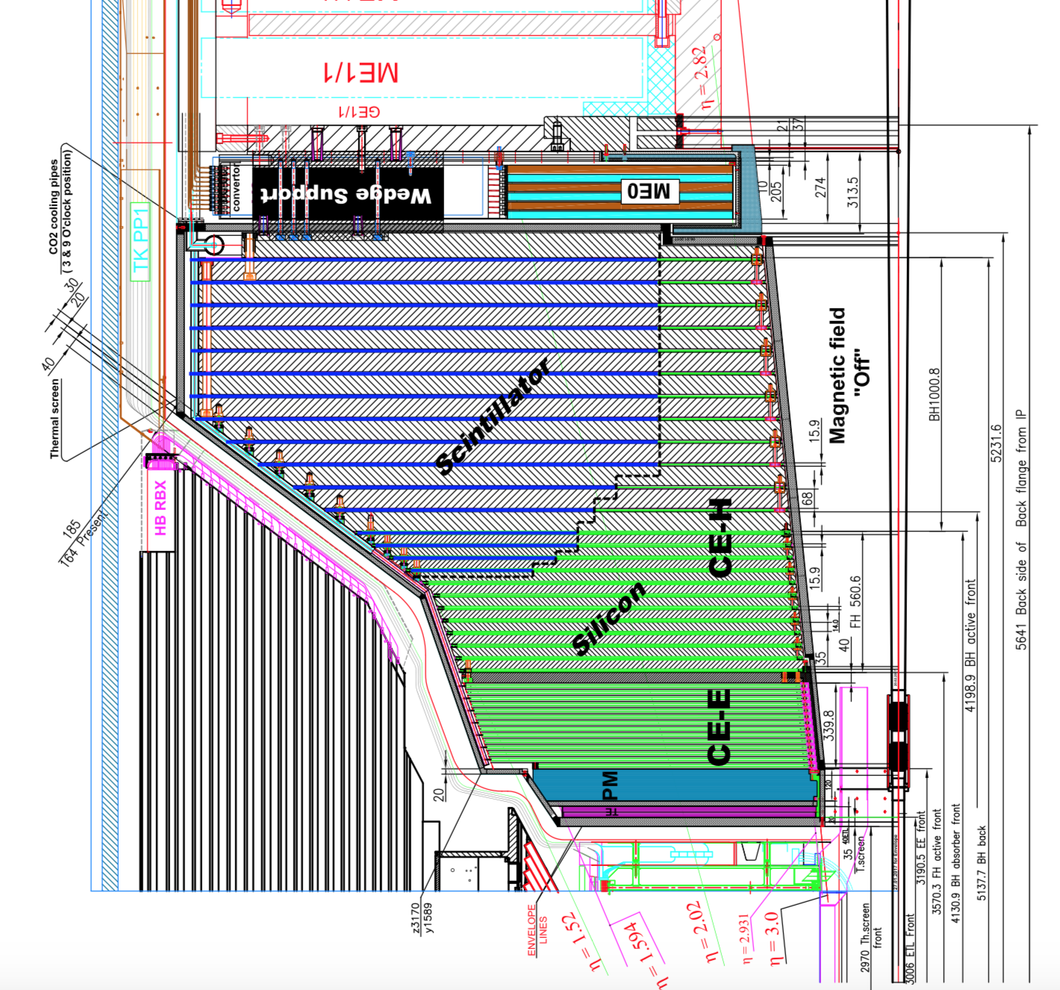
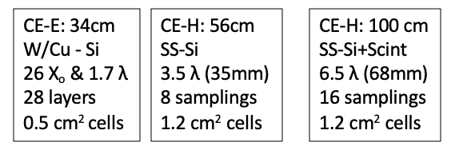
FORWARD MULTIPARTICLE SPECTROMETER
TOP VIEW (bending) SCHEMATIC (provisonal dimensions)
D1 35 Tm
DIPOLE
R = 40 cm
1 mm SS
Thin window
R = 8 cm
Wire grid
if needed
R_{OUT} = 35 cm
R = 12.5 cm
NEG LINER
EM
HGCAL
HAD
Fe TOROID
& GEMs
Fe TOROID
LHC VACUUM
DECAY VOLUME
Si TRACKER
TRD +
TRACKER
LEFT (-)
HOD+TRK
1 – 3 TeV h⁺
TAXN
RIGHT (+)
3
1
1
20 m
2
3
2.5
2.5
= LENGTH (m)
Z = 91 m
Z = 116 m
Z = 126 m
HGCAL
IR 5 / CMS
COLLISIONs
Idea: Use only CMS detector technology
Run 4 (or reuse/recycle some Run 3?)
Plus TRD for π/K/p ID in TeV region – new.

Slide 15
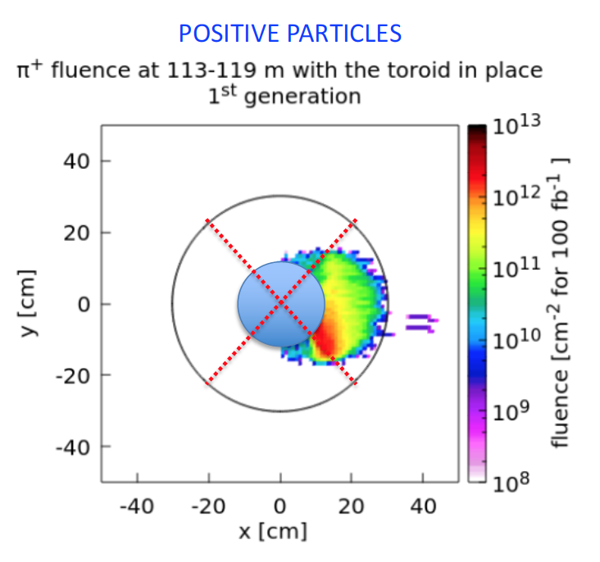
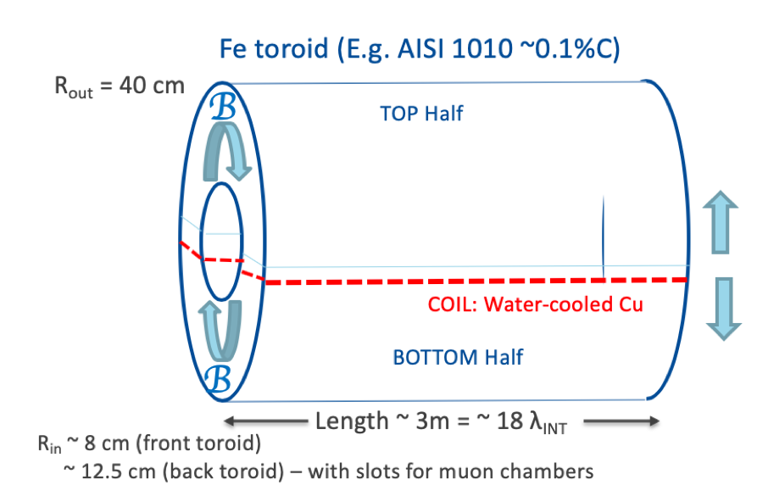
After D1 & before enlarged pipe
Limiting aperture for charged hadrons
Extra shielding and muon deflector
Especially for LLP search

Slide 16
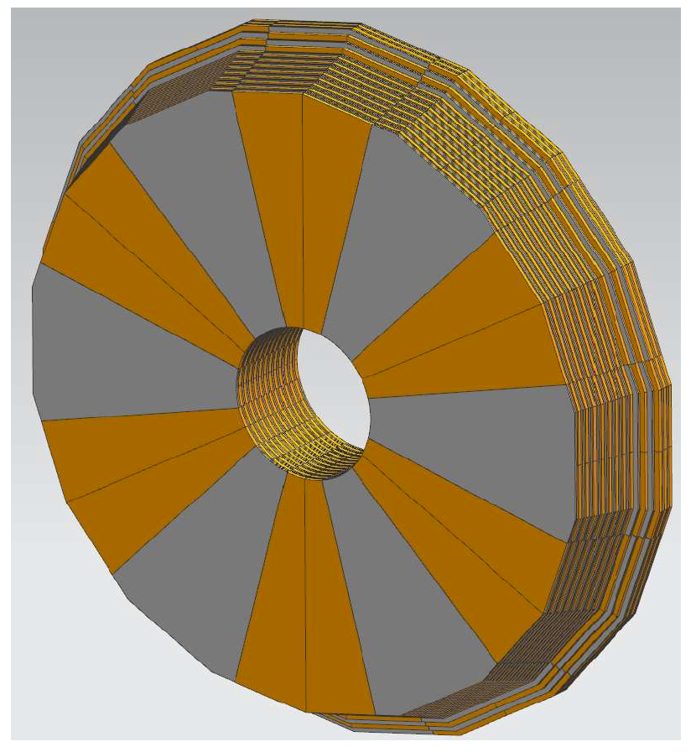
Tracking
Precision tracking immediately behind vacuum pipe window – as thin as allowed (ribs)
No field behind D1 so straight tracks.
Hadron identification : π, K, p, d, .. TRANSITION RADIATION DETECTOR
- incorporates tracking
CALORIMETER (toroid for μ deflection)
FH. FMS
Imaging: readout with Si pads/cells ~ 1 cm²
R_{inn} ~ 40 cm. Cf FHS 10 cm
R_{out} ~ 180 cm. Cf. FHS 30 cm
Angled Not angled
Area ~ 10 m². Area ~ 0.25 m²
FHS < hole size
MUON CHAMBERS
TO DO: Layout a detector combination with Run 4 detectors as default
and simulate.

Slide 17
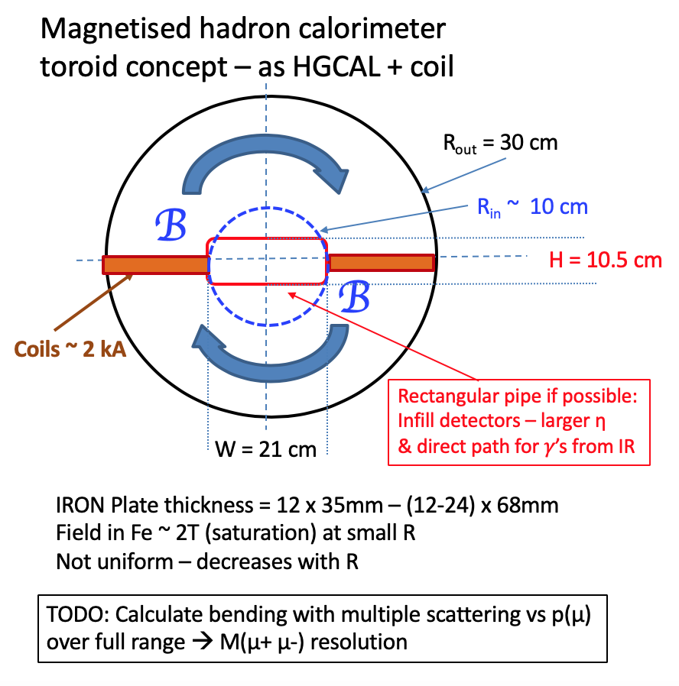
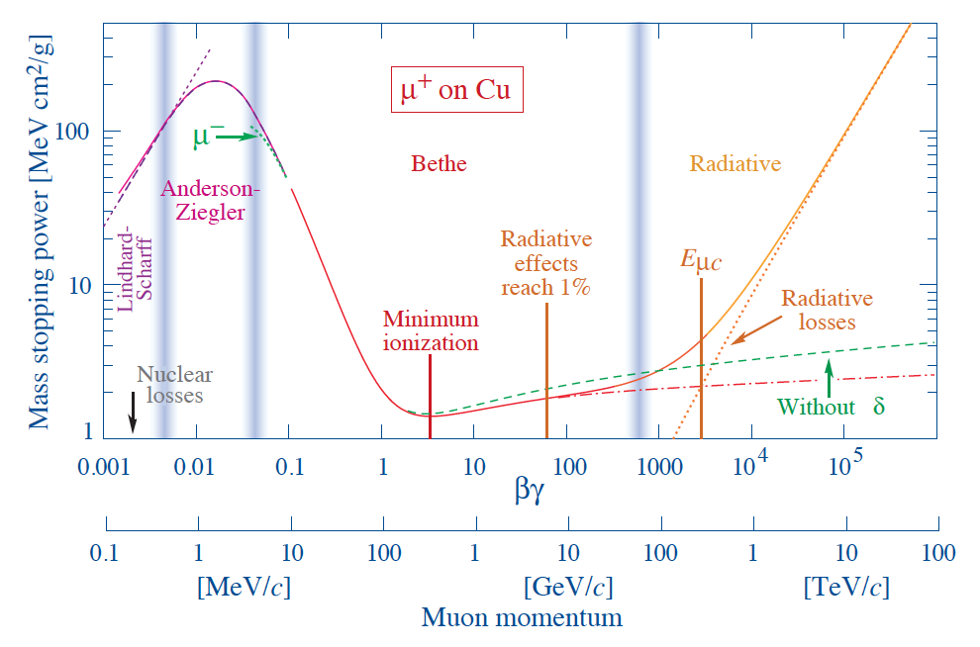
Total signal of μ-track through Calo
Several possible μ-tracking technologies
0.25 m² x N (~4?) layers
GEMs suitable, and
almost “off-the-shelf” now.
Note: shielded by TAXN at back

Slide 18
ANOTHER POTENTIAL USE OF FHS:
Inelastic (& elastic?) cross sections of multi-TeV π±, K±, etc.
IDEA:
Behind TRD-Tracker have multi-TeV identified π±, K±
Can put in front of calorimeter a thin target followed by short tracker:
Known momenta ~ TeV
π±, K±
TRD
CALORIMETER
Thin TARGETs
CH₄, C - subtract
Very simple addition:
𝜎_{inel}, N_{ch}, 𝜎_{el},

Slide 19
Forward production of antinuclei : antideuterons, anti-He?
How produced in pp? Coalescence model.
pbar + nbar close in phase space (< p₀ parameter ~ 25 MeV?) stick together.
(In Small Angle Spectrometer at ISR we measured high x_{F} antideuteron production)
Renewed interest for dark matter annihilations in galaxy center
Need to know Standard Model production. (Cholin’s talk at Dublin 2019)
Very clean signature in SAS:
Negative curvature → p/Q, dE/dx → |Q|, Calorimeter → E, TRD → E/m, ToF →β
Anything novel? E.g. strangelets in heavy ion (pO and OO) fragmentation region?
(Light quasi-stable nuclei with s-quarks replacing d-quarks -unusual Q/M)

Slide 20
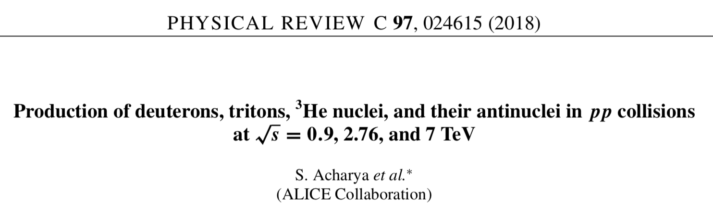
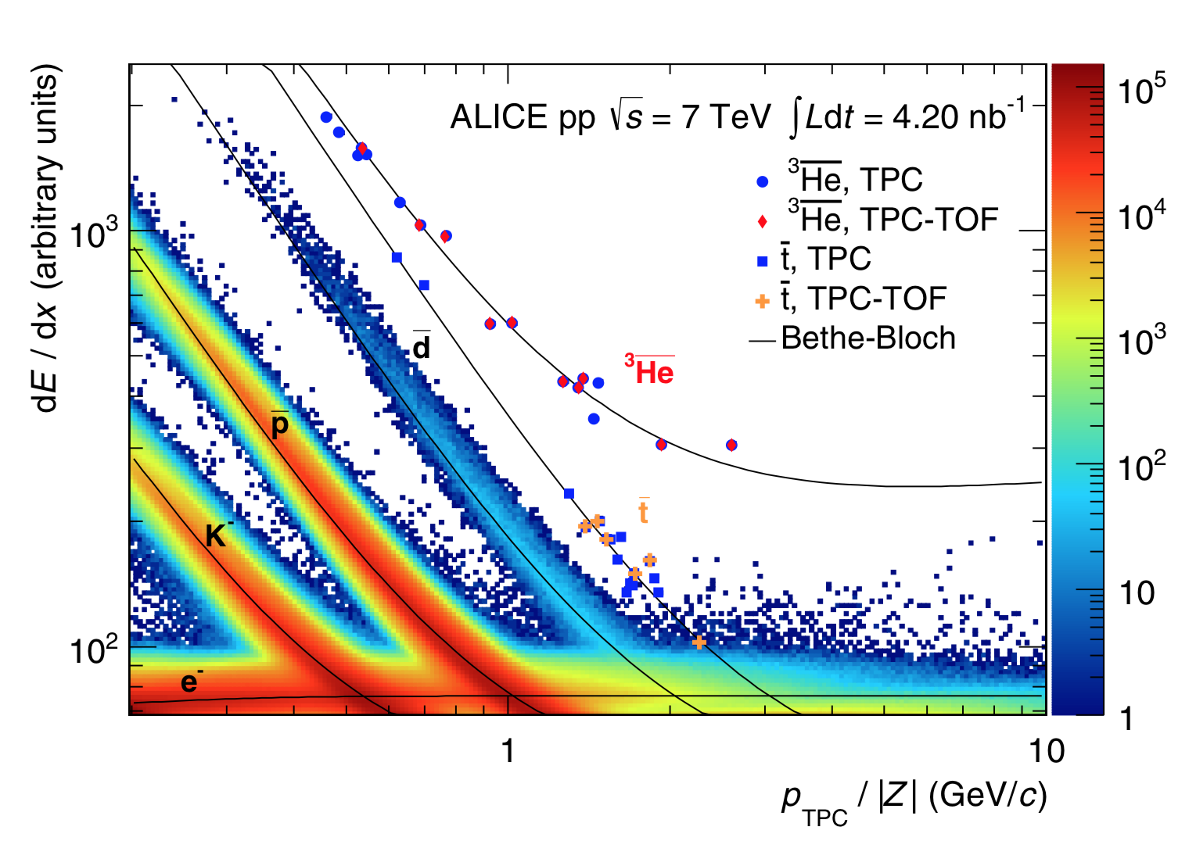
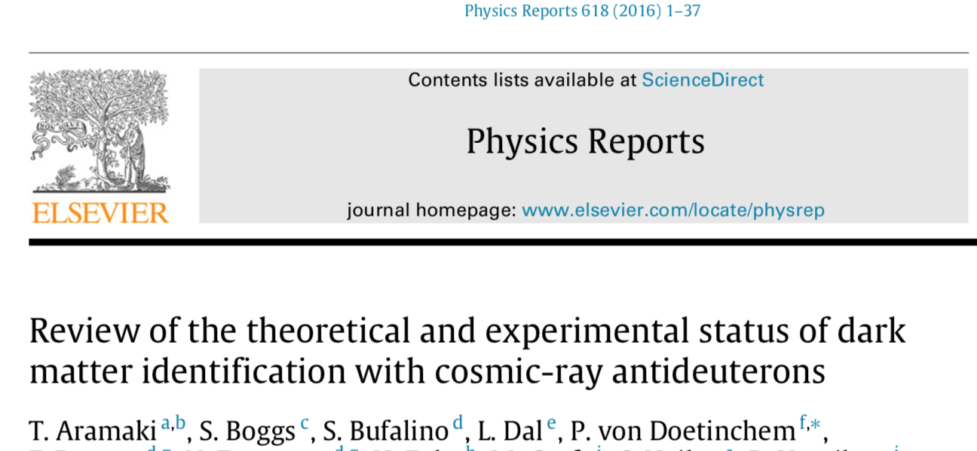
ALICE has best LHC data on antinuclei so far: Central region: |y|< 0.5 at $\sqrt{s}=$7 TeV pp.
Topical interest, possible signals
of dark matter annihilation in galaxy
Can probably make a special trigger
for « heavier than protons »
& get high statistics. ??

Slide 21
FHS as a Multi-particle Spectrometer
Acceptance for 2 or more particles from same event. (If pile-up, ~ 20ps timing can help)
Positive and negative particles on R & L sides of pipe, near horizontal plane.
Acceptances calculated by M. Sabate-Gilarte for some channels …
Details will need to be calculated for real design of system – and backgrounds
Potentially:
J/ψ, ψ(2S) → μ+μ-, χ_{c} → J/ψ + γ, Drell-Yan μ+μ-
K⁰_{s} → π⁺π⁻, Λ → p π. P* → n π+ (with ZDC)?
D⁰ → K⁺π⁻ … χ_{c} → π⁺π, K⁺K⁻, etc.
Λ_{c} → pKπ ?
Very forward charm and beauty also inferred from single leading e or μ
Leptons can be identified : Track + EM calorimeter & muon chambers behind HCAL
Muons from π, K decay will be known, and their decay lengths are very long!
γcτ (π) = 139 km at 2.5 TeV ! But abundant and - > forward HE μ-neutrinos! (FASERν)
γcτ (K+) = 18.5 km at 2.5 TeV !
γcτ (D⁰) = 16.5 cm at 2.5 TeV !

Slide 22
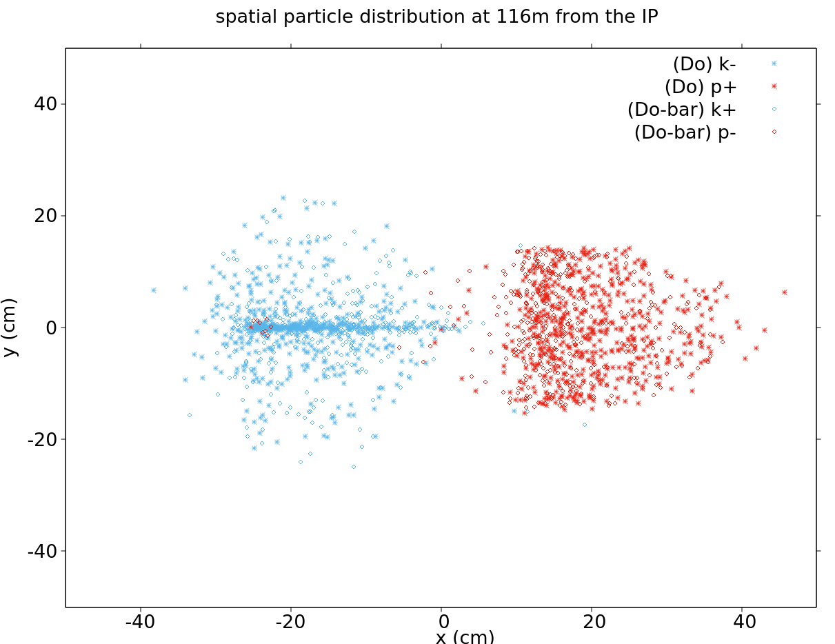
We have acceptance for D⁰ → K+ π- Plot from M. Sabarte-Gilarte (CERN)
UP & DOWN : LLP search at HL
LEFT & RIGHT : Hadrons at Low lumi
Back big pipe
Thin window
R ~ 40 cm
Outgoing pipe
R ~ 12.5 cm

Slide 23
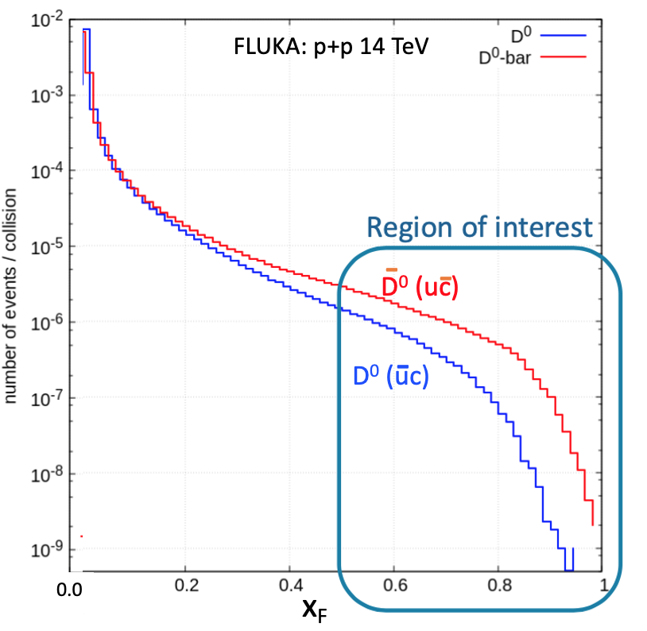
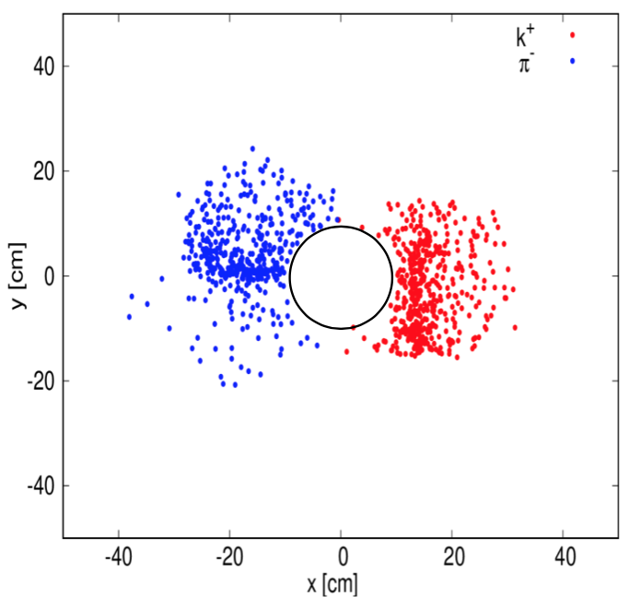
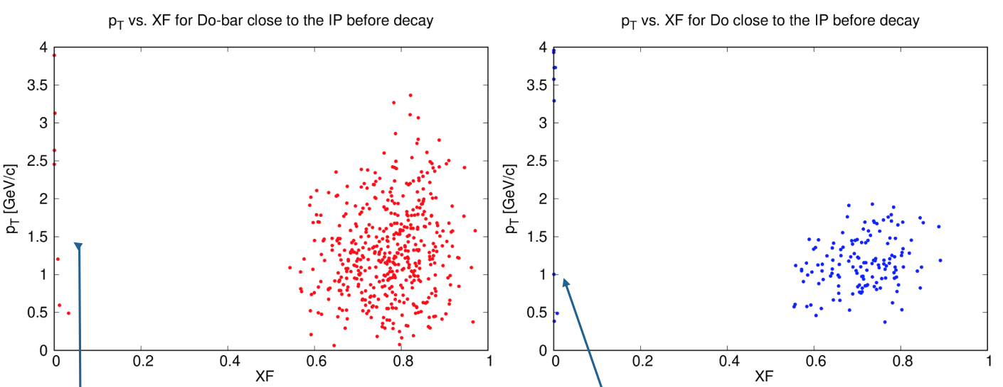

Slide 24
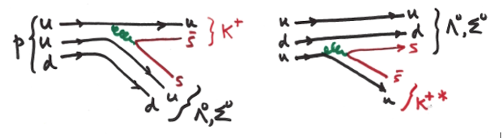
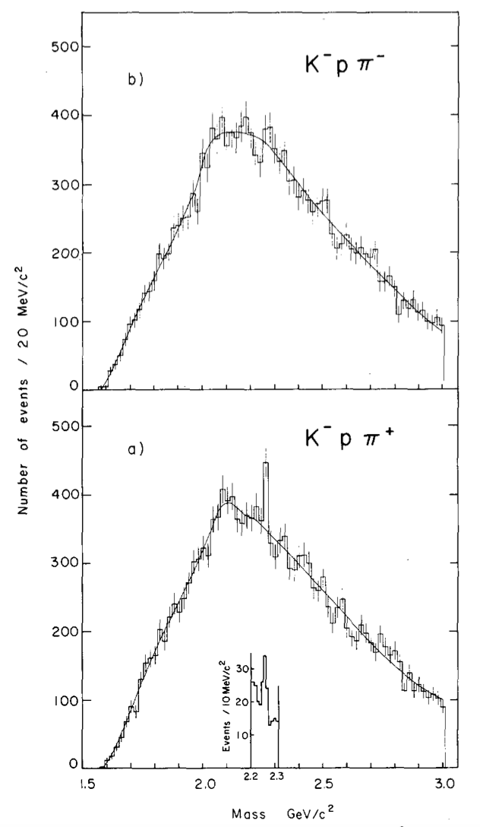
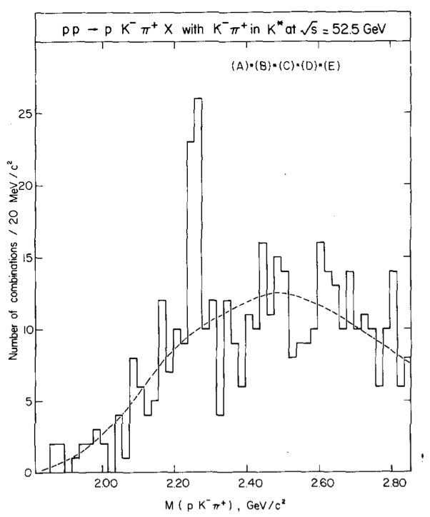
Λ_{c}⁺ (udc) → p K- π+ signals at ISR – high x_{F}
Leading ud picks up c (enhanced if intrinsic charm)
u
p
d
Λ_{c}⁺
c
u
D⁰
c
b)
FMS has acceptance : require excellent tracking and p K- π+ identification

Slide 25
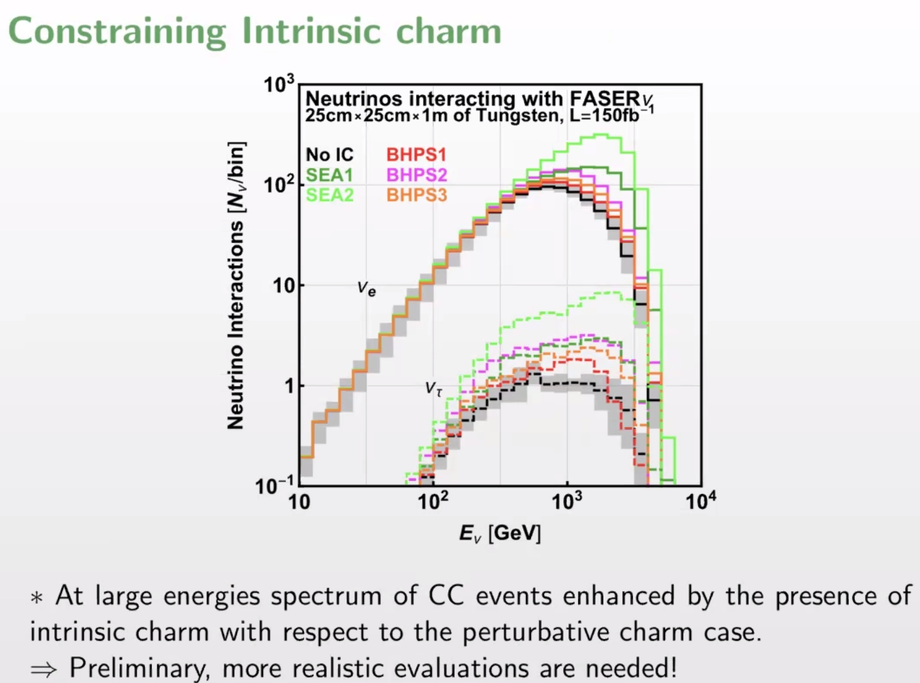

Slide 26
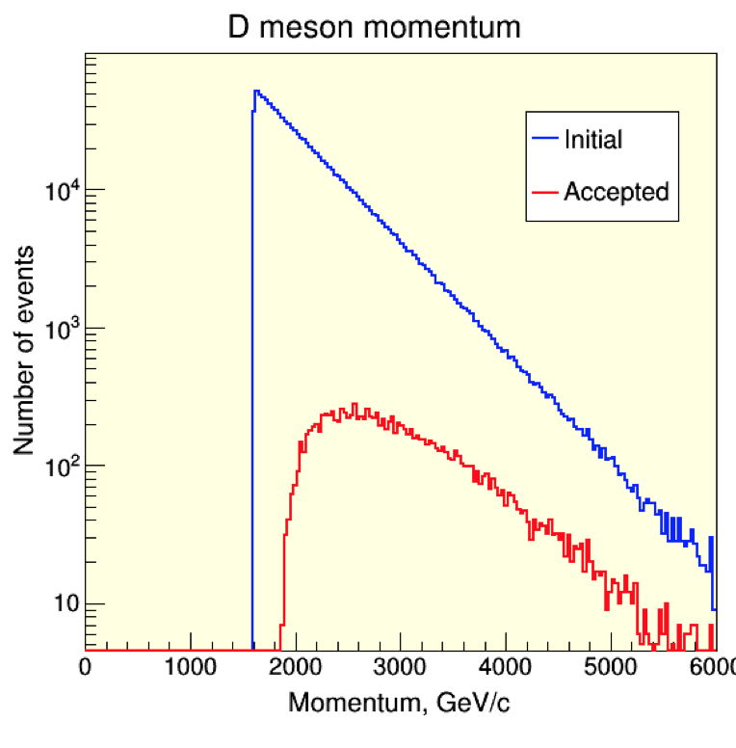
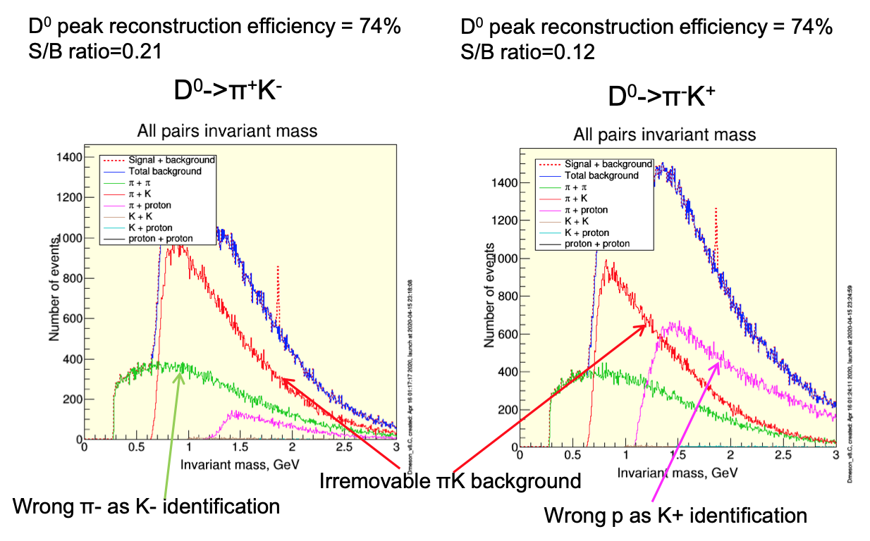
Preliminary study
Some acceptance for D⁰ → K π but it is very challenging:
Acceptance small – OK if very well known – signal could be much bigger (Brodsky)
p >> π+ >> K+ so mis-identification critical … TRD challenge
Even with perfect identification, irremovable K π continuum is large.
Unlike central production, do not see decay vertex and γcτ (D⁰) = 16.5 cm at 2.5 TeV !
… which smears mass resolution from ~ 6 MeV to ~ 16 MeV
A. Romaniouk, Mike Cherry

Slide 27
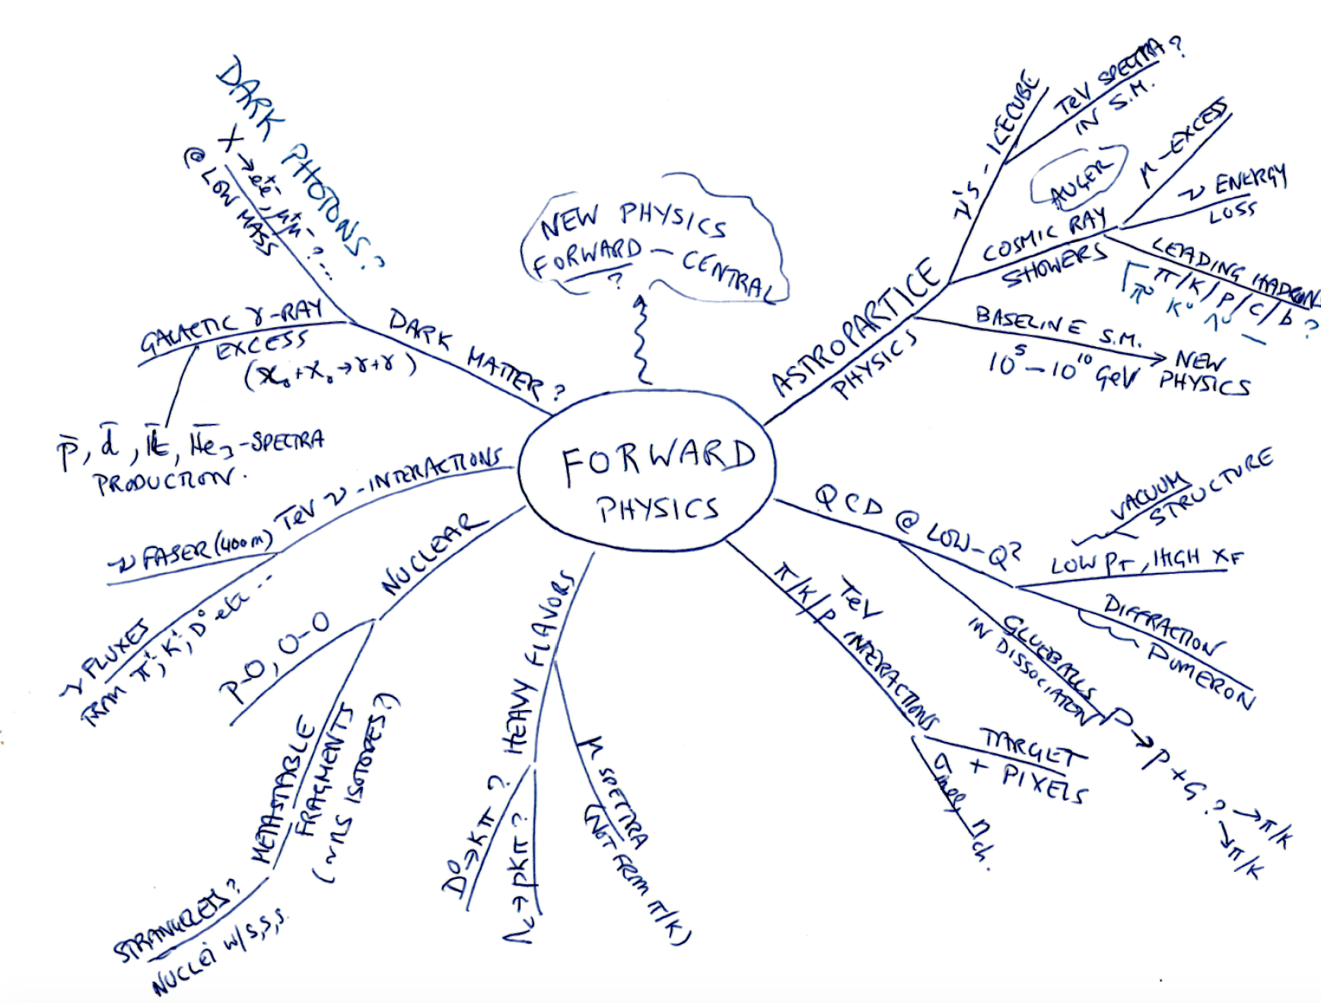

Slide 28
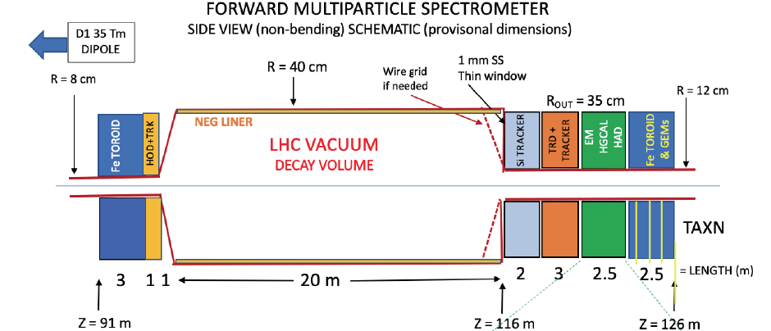

Long Straight Sections downstream of IR1 (ATLAS) and IR5 (CMS) for LLP/DM searches
Beam pipe (high vacuum) can be enlarged to R ~ 40 cm over > = 20 m length
LLP SEARCH
DECAYING LLP
35 – 50 m steel
STABLE DM - INTERACTING
At R > 8 cm straight path from collisions through 30 – 50 m steel (200 - 320 λ_{INT})
Charged particles → Left and Right quadrants, swept away from Up and Down
Decays in vacuum →
Search for DM interacting in VF-HGCAL : energy, shower start, direction, time-of-flight
h⁺h⁻ , jets
Letter of Intent to be submitted to Snowmass WGs EF09, EF10
Expression of Interest to be submitted to CMS

Slide 29
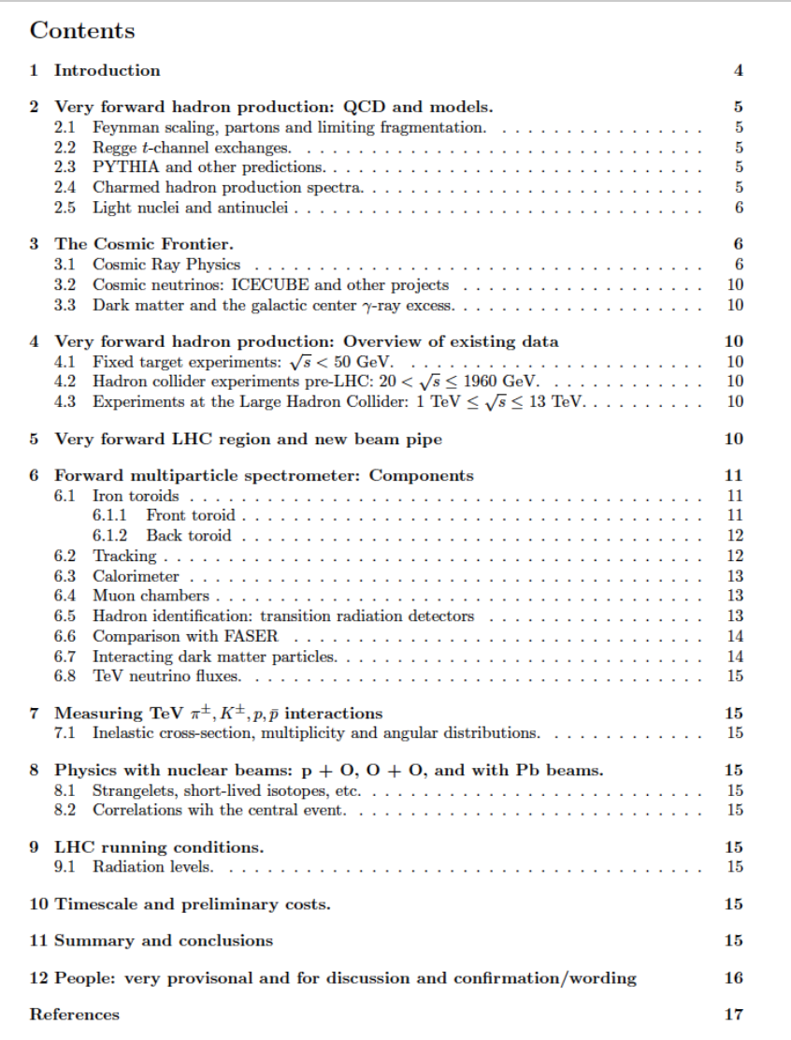
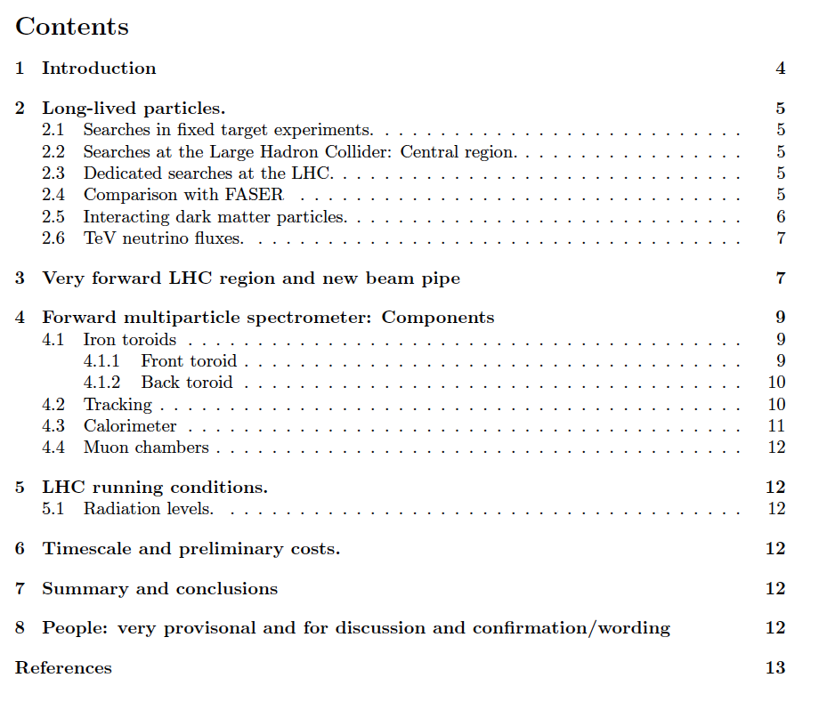
Skeleton of eventual EoI FMS-Hadrons
Draft contents – to be developed
Not expected to submit until:
> LLP search at HL is agreed
> TRD system implemention understood
(Instrumentation frontier WG)
Skeleton of EoI FMS-LLP > CMS
Draft contents – to be developed

Slide 30



SUMMARY
The very forward region between D1 (80m) and TAXN (126m) – great location & potential
Spectrometer magnets in place Q1-Q3 & D1 – TeV charged hadrons to L & R quadrants
Can be measured with larger beam pipe at low luminosity (p+p, p+O, O+O)
Excellent tracking, calorimetry, muon detectors area ~ % of endcap upgrade + TRD needed.
Important for QCD, neutrino fluxes, leading charm, antinuclei, …
> EoI to Snowmass , also to Instrumentation frontier for TRD develoment, TeV hadron ID
Search for LLPs decaying in 20+ m vacuum pipe – case looks very strong.
< GeV → 10+ GeV to many final states: 𝛾 𝛾, e+e-, e μ, μ+ μ- , c+cbar, jets, …
Dark matter interacting in long calorimeter – maybe, unique, to be studied.
> EoI to Snowmass and EoI to CMS in preparation for Run 4
Includes big pipe, front and back (with μ) toroids – infrastucture in place for
eventual hadron mode spectrometer (TRD & differently optimised detectors in L&R)
NEEDED : to grow a team to make this happen! Leadership opportunities too.
Adiyaman Univ. D.S.Cerci, S.Cerci +, Univ. Istanbul (S.Ozkorucuklu +)

Slide 31
Thank you
Back-ups →

Slide 32
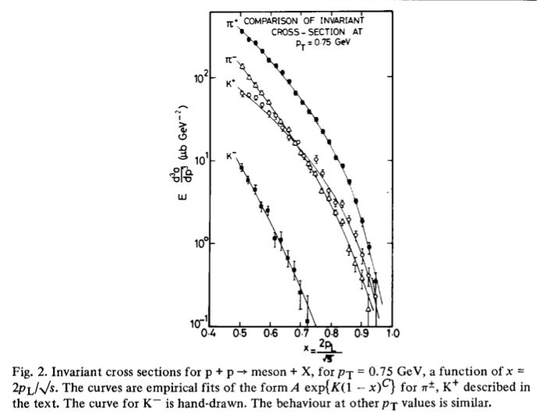
√s = 45 GeV,
CHLM (MGA inter alia) SAS @ ISR
Nucl Phys B 140 (1978) 189
√s = 45 GeV
Small transverse momentum
p_{T} (Mean p_{T} ~ 350 MeV/c)
42 years ago !
Valence quark counting:
π+ = u dbar. (2)
π- = ubar d. (1)
K+ = u sbar. (1)
K- = ubar s. (0)
Low mass diffraction dissociation.
Feynman scaling (1969):
Spectra fn(p_{T,} x_{F}) not √s
Non-interacting partons, not QCD
Ignores thresholds (c,b)
Feynman x_{F} = p_{z}/p_{BEAM}

Slide 33
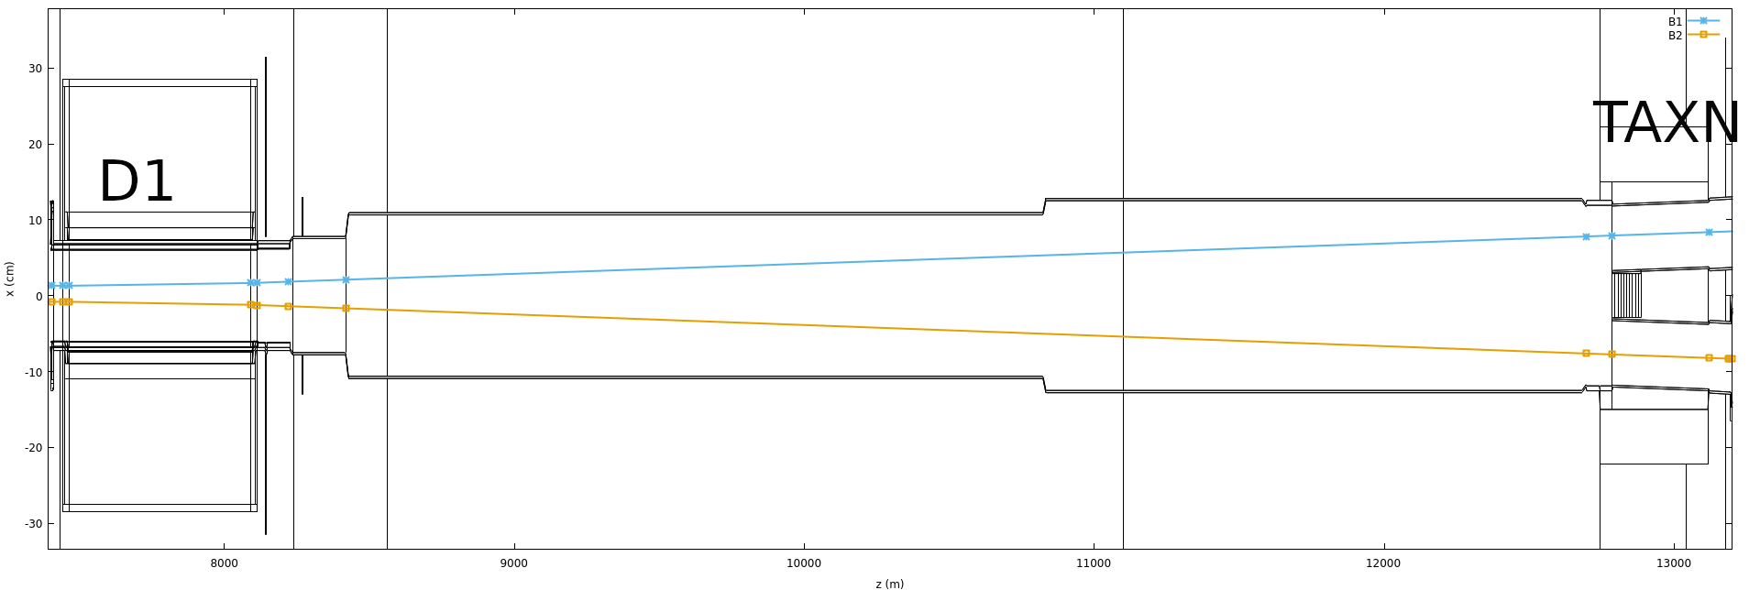
Pipe region as currently planned for Run 4
TOP VIEW
New superconducting
Dipole 35 Tm
+30cm
p
p
-30cm
120m
80m
Propose: new pipe with radius ~ 30 cm, length ~ 30 m

Slide 34
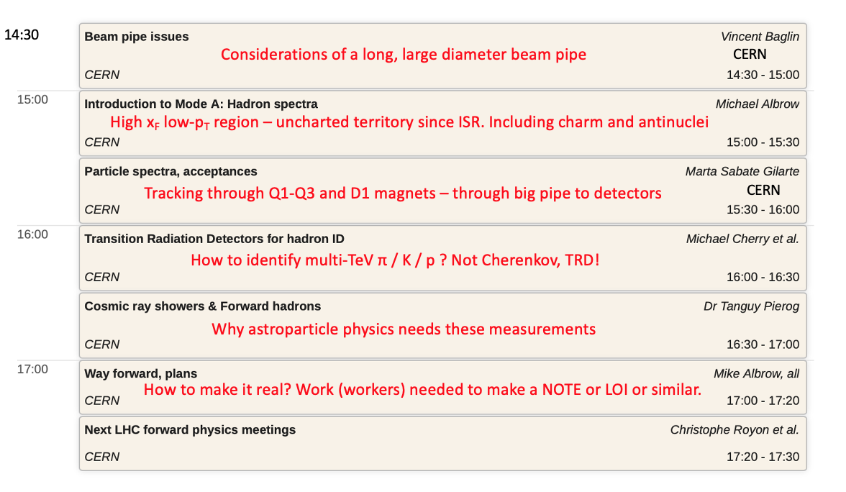
Two half-day meetings on Forward Multiparticle Spectrometer April 16+17 2020
Purpose: present and discuss ideas. Critique and distinguish possible and not possible
Plan next level of studies and especially who will contribute to a write-up / note /doc
===
Friday 17th: Mainly measurement of very forward hadrons in pp, pO, OO at low luminosity

Slide 35
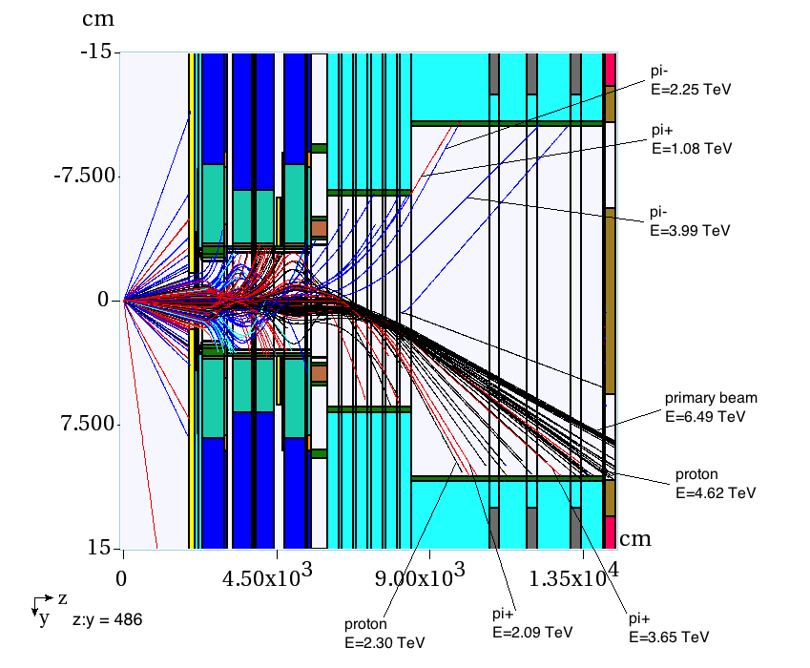
200 inelastic collisions at Pt 5 2018 ( 13 TeV, β* = 0.55 m): MARS
Nikolai Mokhov
Ottavio Fornieri
If μ = 50 this is 4 bunch crossings
TOP VIEW
Scale factor x:z = 486:1
Negatives
From interaction
INCOMING P
Neutrals
Λ → pπ-
New D1 S/C
Being redone
Marta and Francesco
For 14 TeV and Run 4.
New D1, beam pipe
Positives
Hitting pipe: 0.5 π- and 1 π+ and about 2 protons / 50 collisions. Near horizontal plane

Slide 36
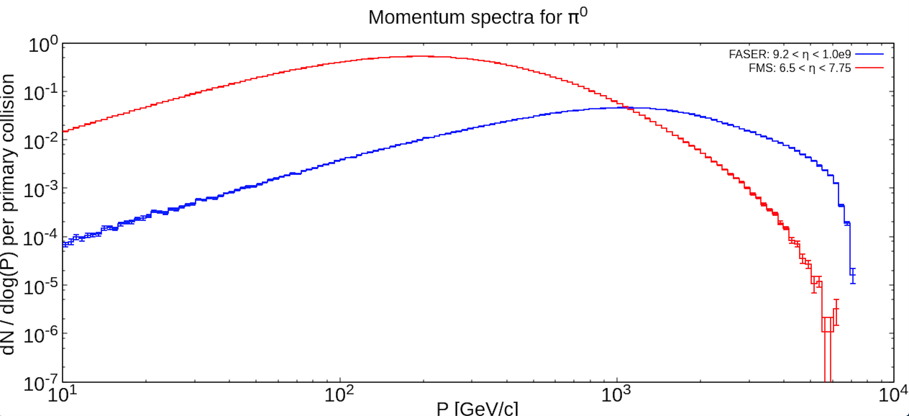
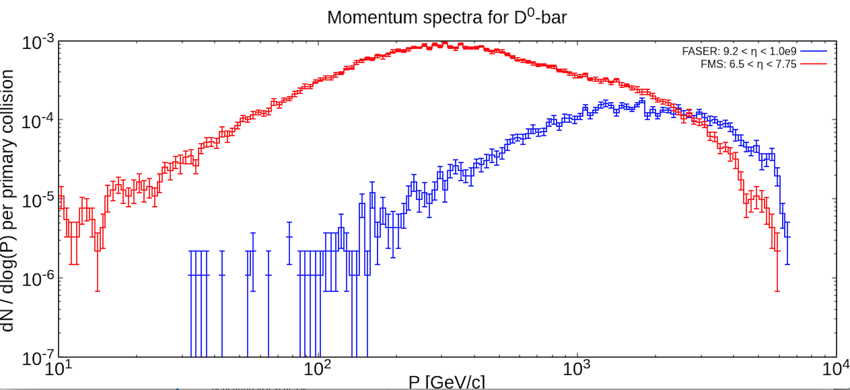

Slide 37
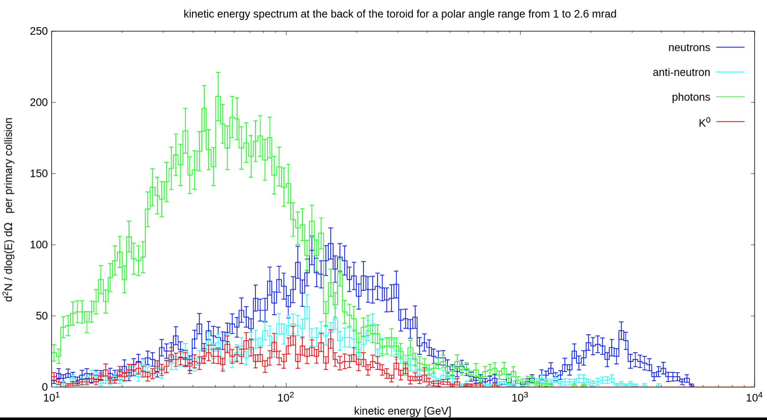
Marta email 20200611
Integrating > 50 GeV:
Regarding the neutral flux behind the toroid, you can find enclosed the
energy spectra we have got. Integrating them above 50 GeV, it yields:
4e-3 photons / collision. 0.004 x 150/X = 0.6/X
3e-3 neutrons / collision. 0.003 x 150/X = 0.45/X
1e-3 antineutrons / collision. = 0.15/X
0.8e-3 neutral kaons / collision 0.12/X

Slide 38
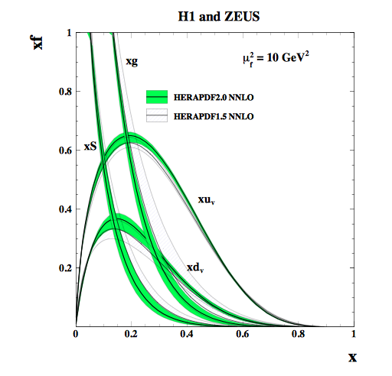
x_{Bjorken} = x_{Bj} = p(parton)/p(proton)
Major industry at HERA, and these PDFs
needed for hard (partonic) interactions at LHC
x_{Feynman} = x_{F} = p(hadron)/p(proton)
x_{F} – x_{Bj} relationship, but less direct than
in deep inelastic scattering.
E.g. p → π⁺ is from leading u adding a dbar
p → π⁻ is from leading d adding a ubar
Ratio at high x reflects u:d in p
u
u
u
d,c,bbar
d
u
d, c, b
d
Leading π⁺, D⁰, B⁺ (?)
t-channel baryon
exchange
Diffraction dissociation
Brodsky: Intrinsic charm – p has {uudcc} component (1-2%?) → high x_{F} Λ_{c} and D⁰

Slide 39
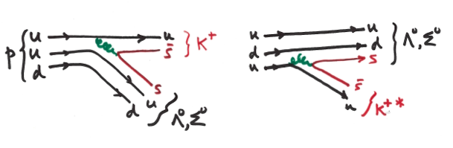
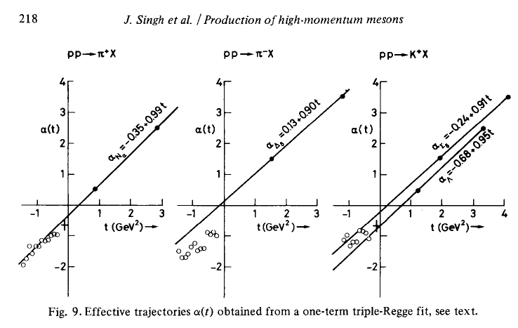
Challenge to theorists
Strong Interactions at low-Q²
Hadron level ~ Regge theory
Parton level ~ QCD (non-perturbative)
Leading (high x_{Bj}) u-quark or [ud] di-quark picks up an sbar or s in “string-breaking”
or from s-sbar sea, to make a leading K⁺ or Λ⁰, Σ⁰
γcτ(Λ) at 4.4 TeV is 316 m, → pπ- (acceptance?). Σ⁰ --> Λ⁰ + γ (100%, prompt)
Virtual (negative mass², t-channel) exchanged
baryon or meson described in
Regge phenomenology :
Analyticity, unitarity and crossing symmetry
+ continuous complex angular momentum.
Derive it from QCD !! ?
Dissociation products sharing
beam momentum (p opposite?)
Quark line description of leading K⁺ or Λ⁰, Σ⁰

Slide 40


A. Fedynitch, F. Riehn, R. Engel, T.K.Gaisser and T. Stanev, arXiv:1806.04140
All central region
Maximum x_{F} = 0.1 by LHCb, only at high p_{T}
because 2.0 < y < 4.5 (central)

Slide 41

A. Fedynitch, F. Riehn, R. Engel, T.K.Gaisser and T. Stanev, arXiv:1806.04140
To illustrate the uncertainties in expected ν fluxes from cosmic ray showers
Refining and tuning the models will impact UHE CR and ν physics

Slide 42


