Slide 1
Cryostat Assembly Status Update
R. Rabehl
June 29, 2020

Slide 2
Documentation
Cryostat assembly:
A working draft of a CERN cryostat assembly procedure and MIP are available (CERN EDMS 2369655 and 2369656, respectively).
Working on a time estimate for cryostat assembly based on steps listed in the draft assembly procedure. Teleconferenced with CERN last week to arrive at time estimates for each step. Total estimated hours is less than what is assumed in present BOE.
Detailing of some steps is still needed, including important ones such as:
Alignment
Installation of IFS/CLIQ/k-mod interface boxes
Wiring/checkout/hipot requirements of IFS/CLIQ/k-mod
Vacuum Vessels
First unit is at CERN; vendor is still working, but travel restrictions to witness acceptance tests will have an unknown impact on subsequent units

Slide 3
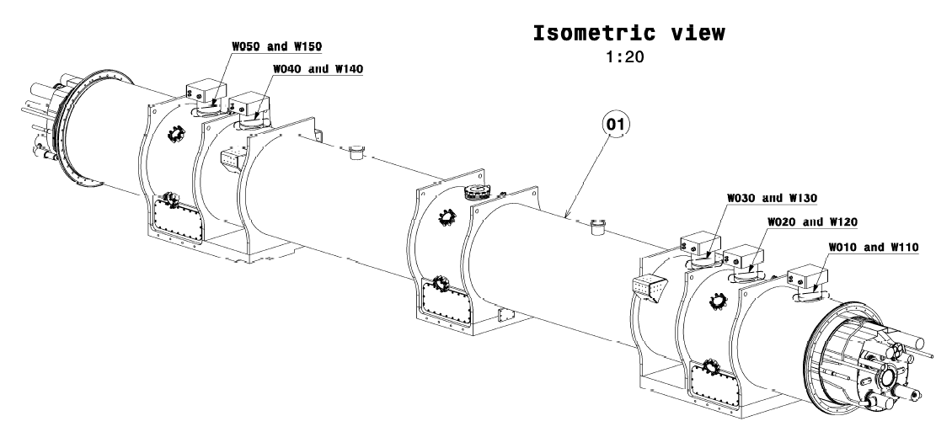
Documentation
Cryostat assembly:
CERN drawings
Assembly drawings for First Unit are completed, review/approval process in progress – concludes this week
Will need to be updated for CLIQ/IFS/k-mod interface box details, which are not yet finalized.
Assembly drawings for Series Units are next
Difference between First Unit and Series Unit drawings is vacuum vessel details.

Slide 4
Documentation
Tooling:
ORC documentation requirements compiled.
Through CERN, the design report for the Fermilab tooling has been requested.
Applus+ provided the power requirements for the tooling, which we are reviewing.
US Embassy visa appointments were scheduled for July 23, with travel to Fermilab at the end of August.
Visa appointments were cancelled by the U.S. Embassy. Two Applus+ people were planning to travel on J-1 visas but now they will try to cancel the entire process and enter the U.S. under the ESTA visa waiver program, like their colleagues.
If travel is not possible, a Plan B is remote installation oversight by Applus+ (e.g. daily Zoom meetings)
Applus+ has decided to assemble the tooling with their own staff and subcontract only alignment services. One of the local companies already referred to them should be able to provide this.
Applus+ has also requested help for some details, such as:
Borrowing Fermilab hand tools
Who will supply the grout for finishing the tooling legs/floor interface
Where to stay during their visit
We are very close to the 2-month date prior to installation where Applus+ needs to provide documentation. Working with CERN to complete this.
Received a draft tooling installation procedure (aka, Integration Plan) from which we will write hazard analyses.

