Slide 1
PPD Department Heads Meeting ESH/DSO Presentation June 2020
Raymond Lewis & Katie Swanson

Slide 2
Face Coverings (Face Masks) in Stockroom
Disposable and cloth face coverings (masks)
2650-051000 MASK, FACE, FABRIC, 3-PLY, DISPOSABLE, ELASTIC EAR LOOPS
Quantity available on 6/30: 6070
2650-051500 MASK, FACE, FABRIC, 3-PLY COTTON, LAUNDERABLE, EAR LOOPS, ANTI-MICROBIAL FINISH
Quantity available on 6/30: 763
Fabric contains silver and copper. Some individuals may have skin sensitivities to metal and ions incorporated in this product.
FESS DSO is monitoring face covering (mask) orders and D/S DSOs consulted if there are any questions about quantities being ordered

Slide 3
Sanitizers in Stockroom
1620-085200 Sanitizer, hand sanitizer, gel, 16 oz. pump bottle
Quantity available on 6/30: 190
1620-085300 Sanitizer, hand sanitizer, liquid, 75% by volume isopropyl alcohol, in 12 oz. spray bottle
Quantity available on 6/30: 467
Can be used as a hand or surface sanitizer
1620-085400 Sanitizer, hand sanitizer, gel, 70% alcohol, 33.8 oz. pump bottle
Quantity available on 6/30: 113
Spray, disinfectant (Lysol)
1620-089000, 144 in stock on 6/30
1620-089100, 52 in stock on 6/30
1620-089500 Wipes, disinfectant (Lysol)
Out of stock on 6/30
FESS DSO is monitoring sanitizer orders and D/S DSOs consulted if there are any questions about quantities or types being ordered

Slide 4
Wall-Mounted Sanitizing Stations
Refills not available for the alcohol-based wall-mounted hand sanitizing stations
New stations with a formulation using Benzalkonium Chloride have been installed.
This product is not as effective against certain viruses as alcohol-based sanitizers, but its anti-viral properties complement hand washing.
Labels have been added to these dispensers to provide that information.

Slide 5
Work Planning reminders
IMPACT training- Old HA database will go away someday.
Work Planning and Control Training: Thank you for your continued participation!
Please contact Katie to get your group trained.

Slide 6
FESHM Updates
No chapter updates in May or June
FESHM 2060 Hazard Analysis Form updated to include COVID-related checkbox reminders. The updated form is available in Word and writeable PDF format and on IMPACT.
FESHM 4270, Static Magnetic Fields, is out for lab-wide comment until July 10, 2020
Major revision based on lessons learned from Muon g-2
Magnetic Region (MR) Boundary terminology developed
Low and High projectile boundaries defined, and associated signage described
MR Hazard Management controls defined
MR Status Management requirements defined
Chemical Storage Best Practices document will be distributed in July
Developed in response to an injury to a PPD employee when a bottle of corrosive liquid fell from cabinet as the door was opened, and liquid splashed into employee’s eye

Slide 7
Reminders and Updates
“Working Safely in the Era of COVID-19 and the Return to On-site Work” [FN000684/CB/01] course has been added to Training Plans of personnel for whom one of these ITNA questions is checked:
This individual works onsite at Fermilab or will soon be working at Fermilab.
The individual's primary work location will be the Sanford Underground Research Facility (SURF)
Currently 1156 people have yet to take the class
Personnel should take the course no later than the day they return to the site
Overdue ESH Training and Medical Evaluations/Surveillances email send to All-Hands on June 17 from Amber Kenney
Personnel should not come on site to complete in-person training, medical evaluations or surveillances until they have been notified to return on site as part of the return to on-site work process.

Slide 8
Reminders and Updates 2
Requirements for wearing masks in government vehicles has been clarified in the “Working Safely in the Era of COVID-19 and the Return to On-site Work” course and in the Exposure Risk Chart.

Slide 9
Training and ITNA Status for employees – as of 6/30/2020

Slide 10
Getting to this training data via FermiDash

Slide 11
Select Training

Slide 12
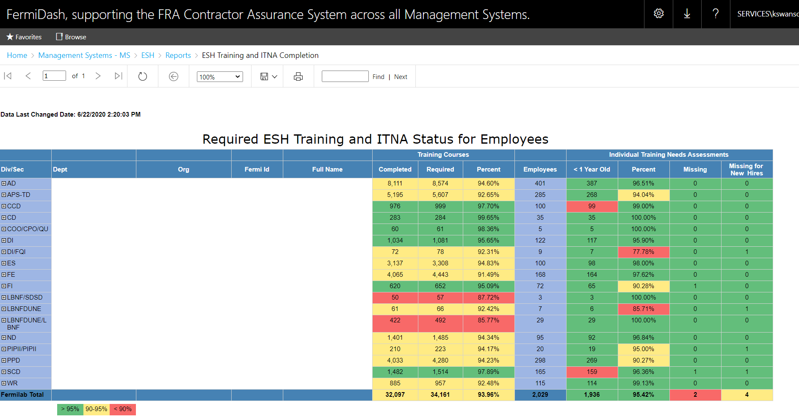
Lab status

Slide 13
Utilize “+” icons to drill down to individuals

