Slide 1
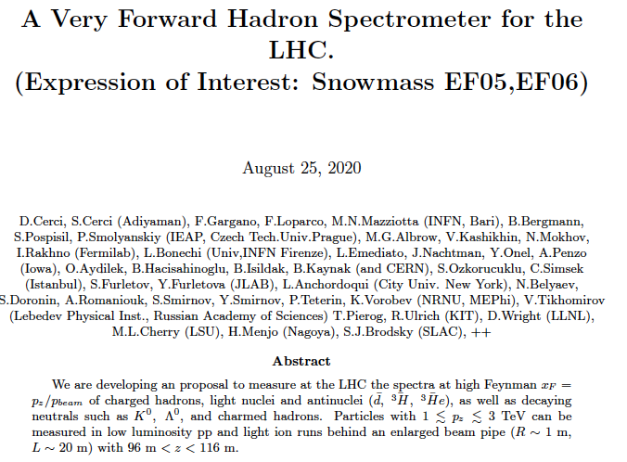
deniz.sunar.cerci@cern.ch
Forward Multiparticle Spectrometer for LHC
~ 90– 125m downstream of IR-5 (IR-1 option)
Charged and neutral TeV hadron production spectra
in p + p, p + O, O + O low pileup short runs.
Can be read out with full CMS (or other central) detectors
35 Tm spectrometer magnet D1 (will be) already there!
Guaranteed physics in
unexpored phase space
Name list as of Aug 25,
growing. Overlap with
CMS/LLP & TRD EoI names.
Still time to join:
Contact : D. Sunar Cerci (Adiyaman)
Deniz.sunar.cerci@cern.ch
&
albrow@fnal.gov
Simulations started
Adiyama & Istanbul

Slide 2
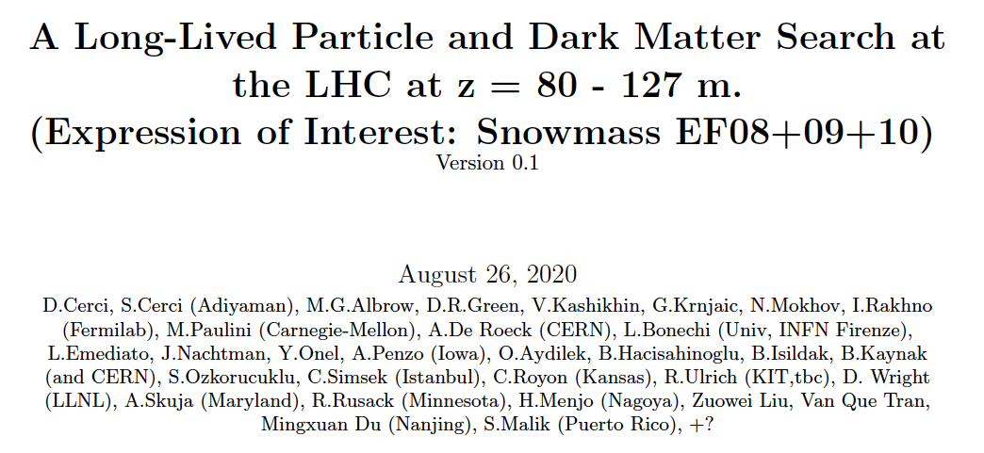
This Expression of Interest is not specifically for a CMS extension, generic, could be at any IR.
CMS IR5 and ATLAS IR1 favored (no beam injection hardware complications)
But ALICE (HI physics focus) and LHCb (Charm & Beauty focus) have physics alignment.
Does not want high luminosity – rather special “short” runs with no pile-up, μ ~ 1
It could in principle be done by a new collaboration – but full event study desirable.
Distinct physics from a separate EoI for a Long-lived penetrating particle search with CMS
BUT in common: 20m long 1m diameter beam pipe, Fe toroids, tracking, calorimeter and muon chambers.
BUT this needs 1 TeV – 3.5 TeV hadron identification, TRDs needed (EoI to Instrumentation)
Plan: White Paper April
→ CMS? depends on Big Pipe
& TRD plan.
Overlap in names but
this is CMS + theorists
(My other talk today)

Slide 3
Issues addressed by this Expression of Interest

Slide 4
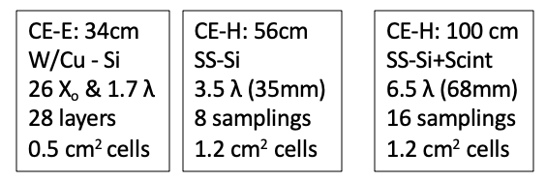
FORWARD MULTIPARTICLE SPECTROMETER
TOP VIEW (bending) SCHEMATIC (provisonal dimensions)
D1 35 Tm
DIPOLE
R = 40 cm
1 mm SS
Thin window
R = 8 cm
Wire grid
if needed
R_{OUT} = 35 cm
R = 12.5 cm
NEG LINER
EM
HGCAL
HAD
Fe TOROID
& GEMs
Fe TOROID
LHC VACUUM
DECAY VOLUME
Si TRACKER
TRD +
TRACKER
LEFT (-)
HOD+TRK
1 – 3 TeV h⁺
TAXN
RIGHT (+)
3
1
1
20 m
2
3
2.5
2.5
= LENGTH (m)
Z = 91 m
Z = 116 m
Z = 126 m
HGCAL
IR 5 / CMS
COLLISIONs
Idea: Use only CMS detector technology
Run 4 (or reuse/recycle some Run 3?)
Plus TRD for π/K/p ID in TeV region – new.

Slide 5
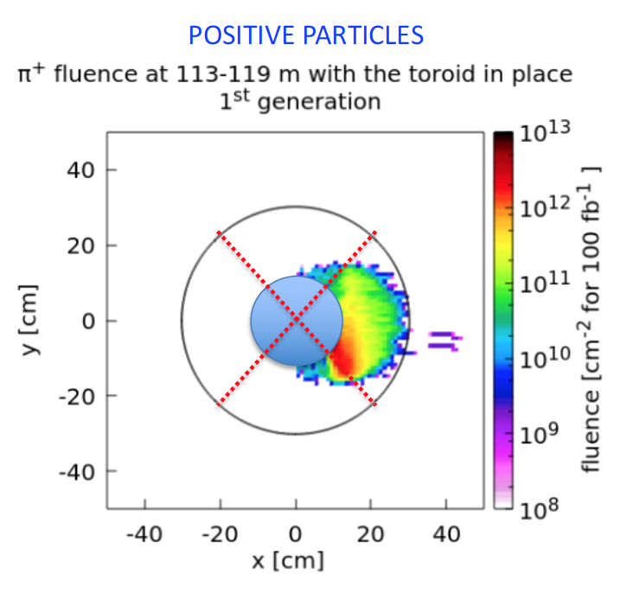
After D1 & before enlarged pipe
Limiting aperture for charged hadrons
Extra shielding and muon deflector
Especially for LLP search

Slide 6
FMS – Charged L&R arms - OVERVIEW
Very forward charged particle production – how to measure it
Use new superconducting D1 dipole (Integral B.dL = 35 Tm) as a spectrometer magnet.
Downstream of IR 5 as extension of CMS in Run 4 (2027+)
Straight section in vacuum from ~ 80 m to ~ 127 m.
Larger beam pipe R = 40 cm (cf R = 12 cm now)
for charged particles to emerge through thin windows: + & - sides - Low pile-up only
Detectors over 10 – 12 m in front of TAXN at 127 m:
Precision tracking (silicon strips or pixels) over ~ 2 m (θ_{x}, θ_{y} to a few μrad)
[Possible targets + tracking to study multi-TeV π, K, p, p interactions]. --- bonus!
Imaging Hadron Calorimeter for energy measurement and muon filter
Muon tracking behind calorimeter (and behind D1)
Transition Radiation Detectors for γ = E/m in 10³ – 3. 10⁴ region (novel)
As developed for CMS at HL-LHC

Slide 7
PHYSICS GOALS for FMS L&R Charged particles (not complete!)
Precise measurements of Feynman-x (x_{F}) spectra at small p_{T} (< ~2 GeV) of:
π+, π-, K+, K-, p, p, d, d, t, t, … possibly K⁰_{s} → π+π- , Λ⁰ → pπ (acceptance under study).
In p+p and p+O and O+O collisions (for cosmic ray showers in atmosphere)
Intrinsic charm: p = {uudcc} giving leading D⁰ → K⁺π⁻ & K⁻π⁺
Full reconstruction challenging but → forward muons
Other reconstruct-able particles: J/ѱ → μ⁺μ⁻ (6%) ; 𝛶(1S) → μ⁺μ⁻ (2.5%)
These are ‘intrinsically’ important + to understand μ and ν in cosmic ray showers.
Energy Frontier and Cosmic Frontier are Snowmass Frontiers (already US priorities)
Production of light nuclei and antinuclei – antiprotons, antideuterons, antitritons, He³
Needed to understand background to Galactic Center 𝛾-ray excess (Dark Matter Annihilation?)
Low Q² frontier of QCD needs further understanding
deuterons, tritons
CAVEAT: Acceptance etc. to be calculated with detectors defined
Diffraction dissociation – products, e.g. p → n π+, p (π+ π-), Λ⁰ K⁺

Slide 8
FHS as a Multi-particle Spectrometer
Acceptance for 2 or more particles from same event. (If pile-up, ~ 20ps timing can help)
Positive and negative particles on R & L sides of pipe, near horizontal plane.
Acceptances calculated by M. Sabate-Gilarte for some channels …
Details will need to be calculated for real design of system – and backgrounds
Potentially:
J/ψ, ψ(2S) → μ+μ-, χ_{c} → J/ψ + γ, Drell-Yan μ+μ-
K⁰_{s} → π⁺π⁻, Λ → p π. P* → n π+ (with ZDC)?
D⁰ → K⁺π⁻ … χ_{c} → π⁺π, K⁺K⁻, etc.
Λ_{c} → pKπ ?
Very forward charm and beauty also inferred from single leading e or μ
Leptons can be identified : Track + EM calorimeter & muon chambers behind HCAL
Muons from π, K decay will be known, and their decay lengths are very long!
γcτ (π) = 139 km at 2.5 TeV ! But abundant and - > forward HE μ-neutrinos! (FASERν)
γcτ (K+) = 18.5 km at 2.5 TeV !
γcτ (D⁰) = 16.5 cm at 2.5 TeV !

Slide 9
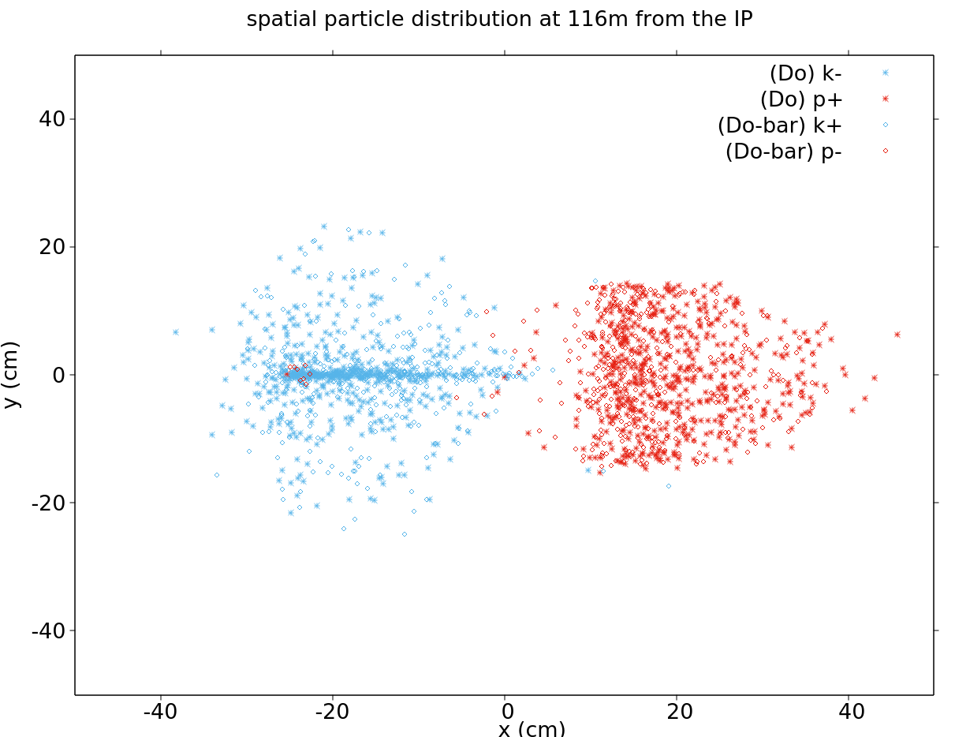
We have acceptance for D⁰ → K+ π- Plot from M. Sabarte-Gilarte (CERN)
UP & DOWN : LLP search at HL
LEFT & RIGHT : Hadrons at Low lumi
Back big pipe
Thin window
R ~ 40 cm
Outgoing pipe
R ~ 12.5 cm

Slide 10
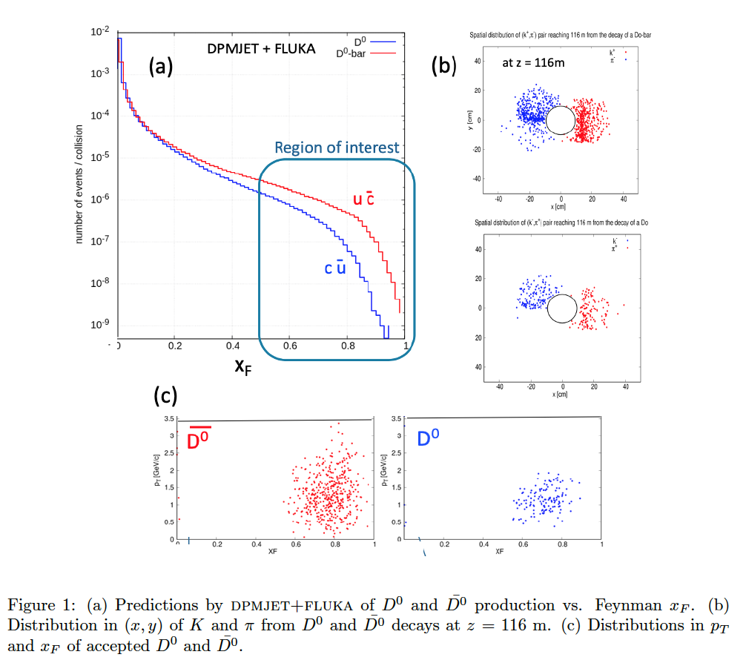
Challenge and benchmark: Measuring high-x_{F} charm, D⁰ amd also Λ_{c}⁺ → p K⁻ π⁺
Single π±, K±, p± spectra relatively easy! Also (anti)deuterons, (anti)tritons, ³He
Charm pushes hadron identification and momentum resolution (combinatorial b/g)
Meaursed at higher x_{F} because decay products have p < ~ 3.5 TeV
Charm interesting for QCD,
Proton wave-function,
Neutrino flavors …

Slide 11
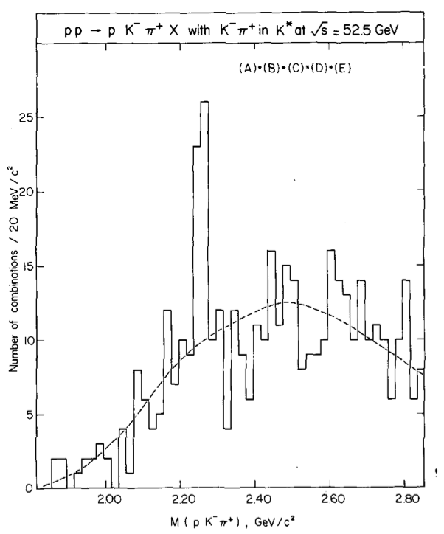
Λ_{c}⁺ (udc) → p K- π+ signals at ISR – high x_{F}
Leading ud picks up c (enhanced if intrinsic charm)
u
p
d
Λ_{c}⁺
c
u
D⁰
c
b)
FMS has acceptance : require excellent tracking and p K- π+ identification

Slide 12
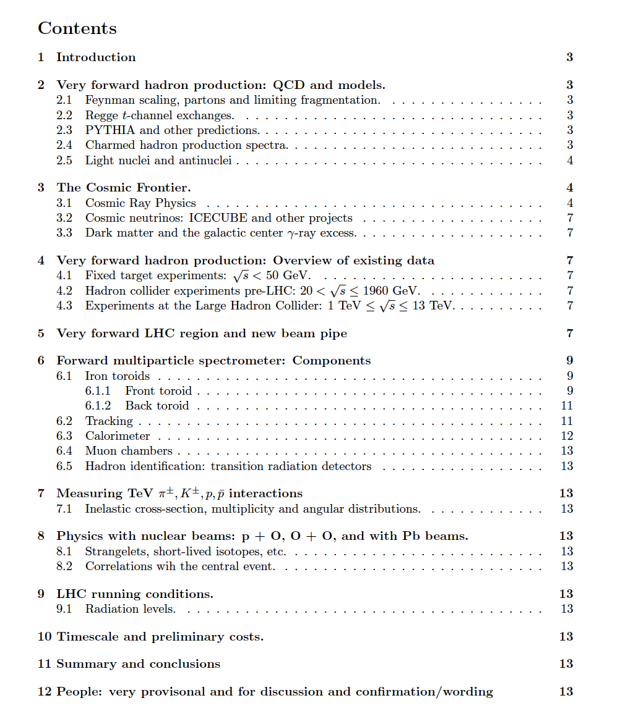
Preview of what a White Paper (April) might contain.
It could become a proposal to the LHC : Add to existing experiment (CMS may have big pipe, ALICE has similar, or even a new experiment

Slide 13
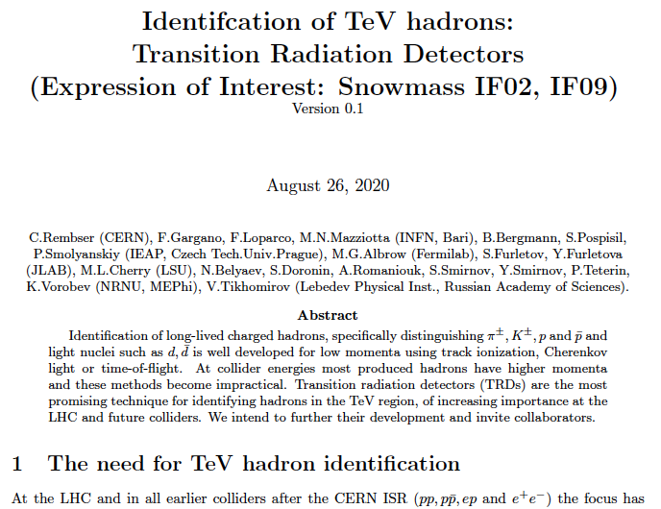
Another Expression of Interest to Instrumentation Frontier
Draft - names can be added – ask albrow@fnal.gov for text trdsnoweoi.pdf
Generic: not specific to any experiment.
Growing need for forward physics at FT, LHC and beyond – FCC ++

Slide 14
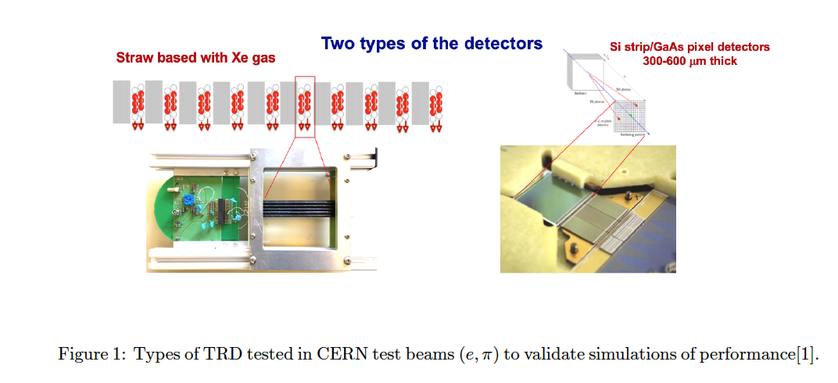
Instrumentation EoI for TRD development (TeV hadron identification)

Slide 15
ANOTHER POTENTIAL USE OF FHS:
Inelastic (& elastic?) cross sections of multi-TeV π±, K±, etc.
IDEA:
Behind TRD-Tracker have multi-TeV identified π±, K±
Can put in front of calorimeter a thin target followed by short tracker:
Known momenta ~ TeV
π±, K±
TRD
CALORIMETER
Thin TARGETs
CH₄, C - subtract
Very simple addition:
𝜎_{inel}, N_{ch}, 𝜎_{el},

Slide 16
Forward production of antinuclei : antideuterons, anti-He?
How produced in pp? Coalescence model.
pbar + nbar close in phase space (< p₀ parameter ~ 25 MeV?) stick together.
(In Small Angle Spectrometer at ISR we measured high x_{F} antideuteron production)
Renewed interest for dark matter annihilations in galaxy center
Need to know Standard Model production. (Cholin’s talk at Dublin 2019)
Very clean signature in SAS:
Negative curvature → p/Q, dE/dx → |Q|, Calorimeter → E, TRD → E/m, ToF →β
Anything novel? E.g. strangelets in heavy ion (pO and OO) fragmentation region?
(Light quasi-stable nuclei with s-quarks replacing d-quarks -unusual Q/M)

Slide 17
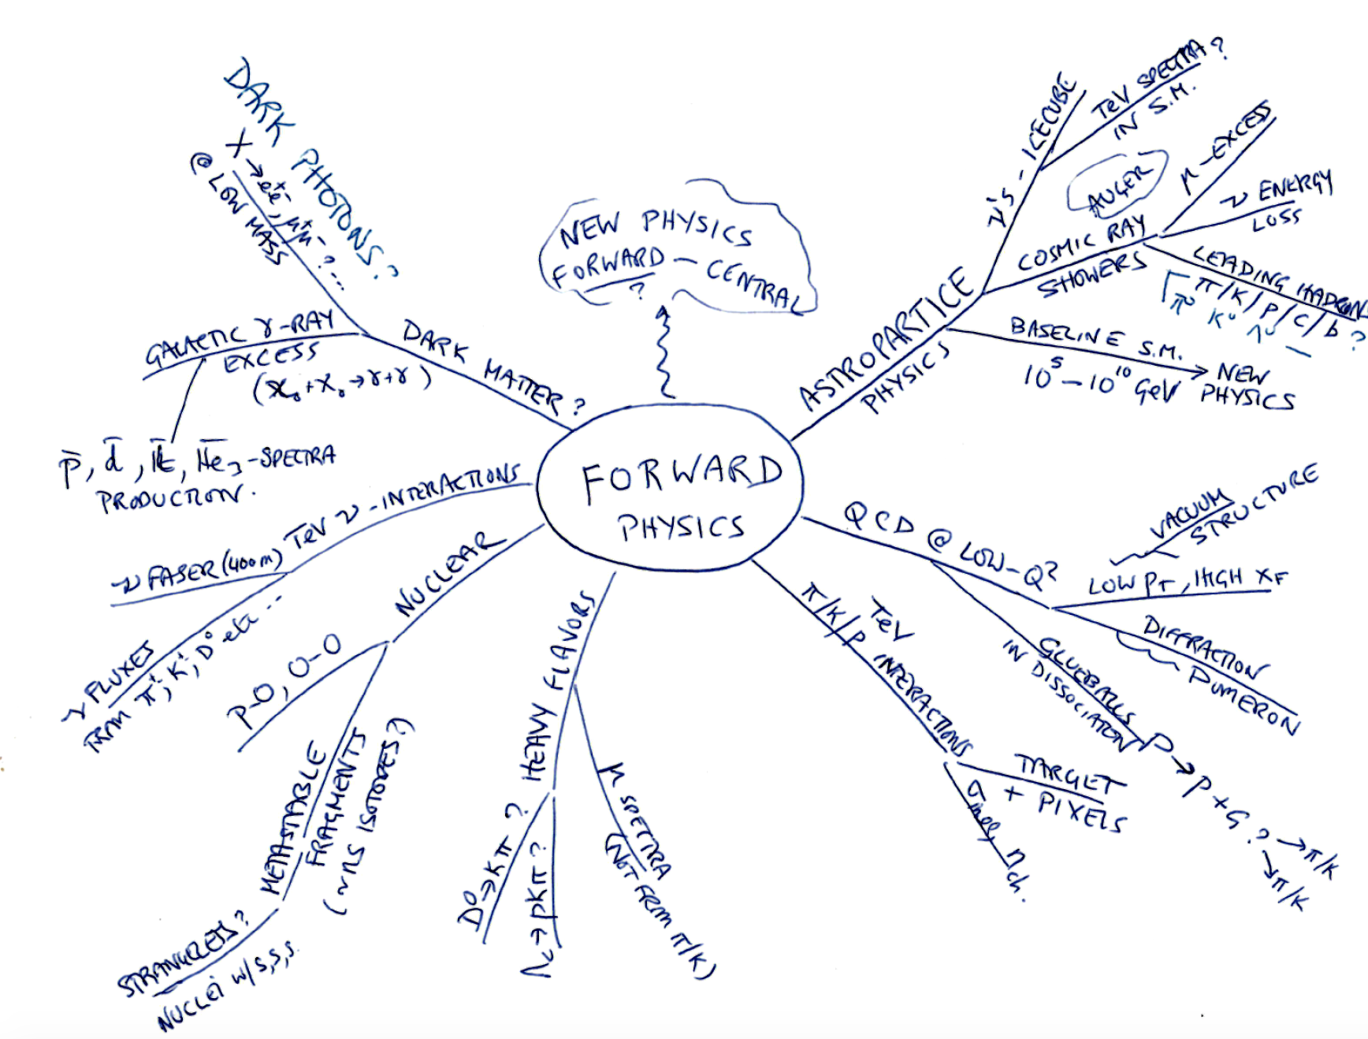

Slide 18
SUMMARY
The very forward region between D1 (80m) and TAXN (126m) – great location & potential
Spectrometer magnets in place Q1-Q3 & D1 – TeV charged hadrons to L & R quadrants
Can be measured with larger beam pipe at low luminosity (p+p, p+O, O+O)
Excellent tracking, calorimetry, muon detectors area ~ % of endcap upgrade + TRD needed.
Important for QCD, neutrino fluxes, leading charm, antinuclei, …
> EoI to Snowmass , also to Instrumentation frontier for TRD development, TeV hadron ID
.
> Synergy with LLP+DM search EoI to Snowmass and EoI to CMS in preparation for Run 4
Includes big pipe, front and back (with μ) toroids – infrastucture in place for
eventual hadron mode spectrometer (TRD & differently optimised detectors in L&R)

Slide 19
Thank you
Back-ups →

Slide 20
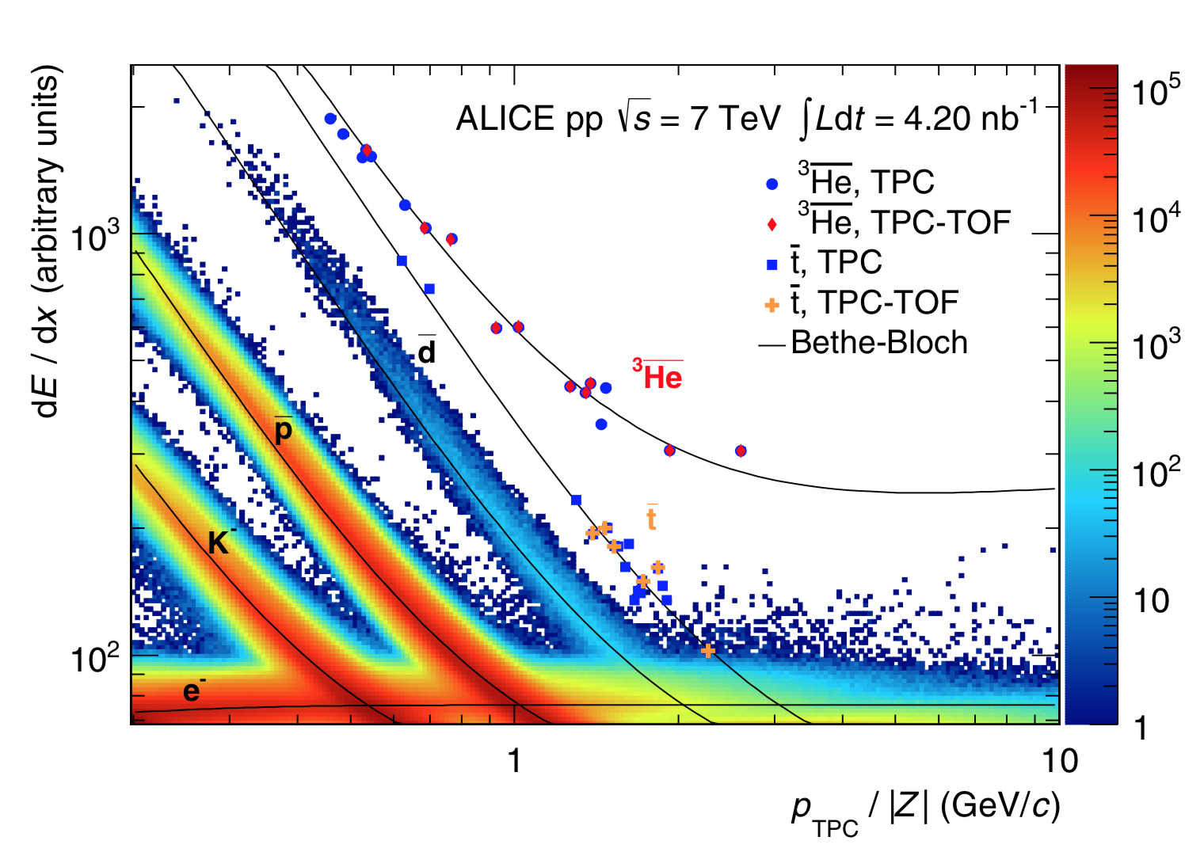
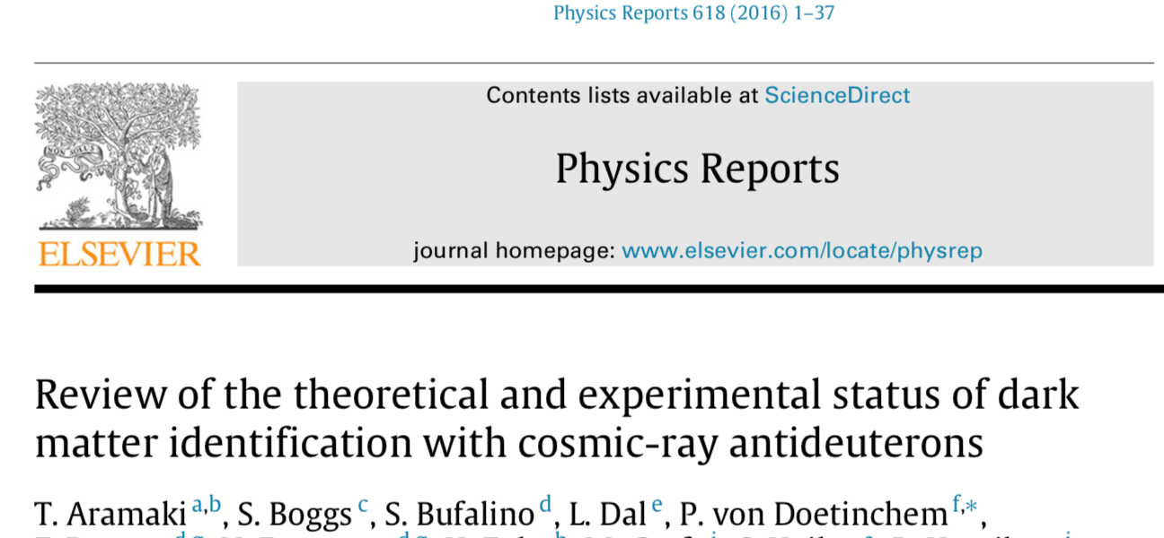
ALICE has best LHC data on antinuclei so far: Central region: |y|< 0.5 at $\sqrt{s}=$7 TeV pp.
Topical interest, possible signals
of dark matter annihilation in galaxy
Can probably make a special trigger
for « heavier than protons »
& get high statistics. ??

Slide 21
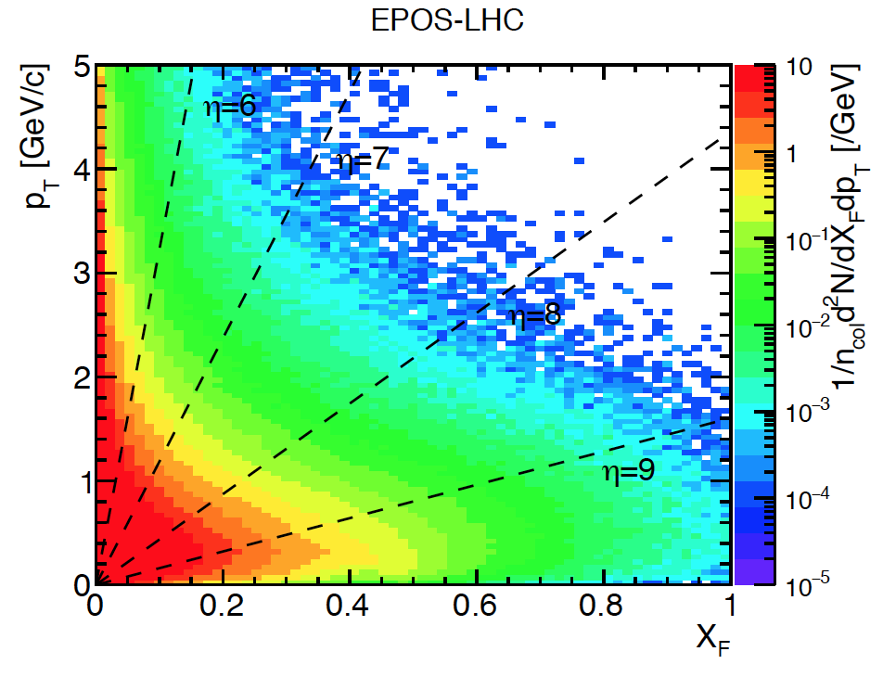
(Dec 5th 2019)
η = 6
η = 8
η = 4.5 (LHCb charm)
is θ =1.3º → Forward
but not “very forward”
η = 7
1.4 TeV
Feyman x_{F} = p_{z}/p_{BEAM}
Density of charged pions in p_{T}, x_{F}. Most have p_{T} < 1 GeV/c and |η| > 7 – unexplored region
TOTEM & PPS (p’s at x_{F} > 0.9) and ZDC & LHCf measure neutrals (n + K⁰_{L} , π⁰ →γγ) at θ ~ 0º

Slide 22
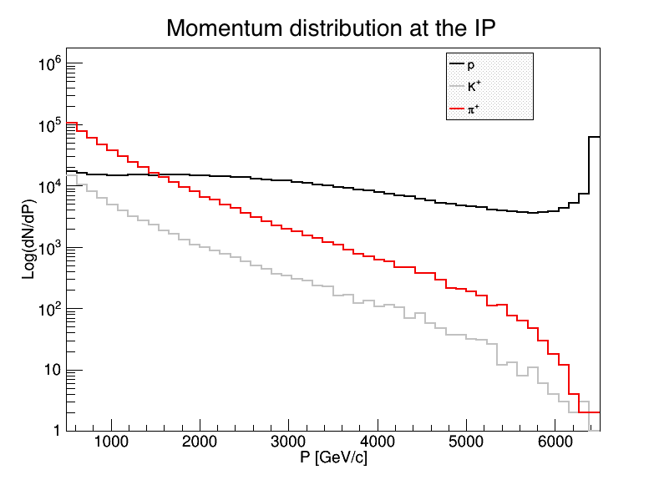
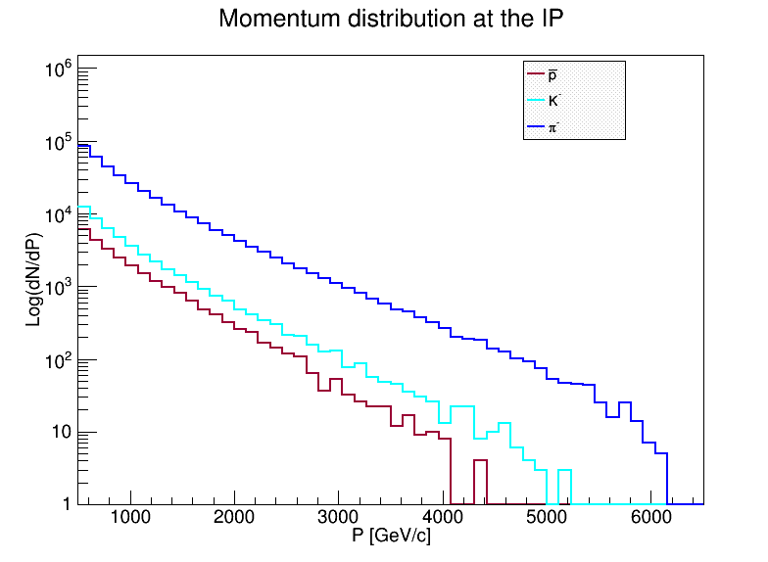
DPMJET prediction (Prob. Too high)
Very uncertain! Illustration only
Spectra generated by /DPMJET-MARS
With 10⁶ pp events, √s = 13 TeV
(N.Mokhov and O.Fornieri)
In 1 second, with 2808 bunches,
Have 30 x 10⁶ bunch crossings and
30 x 10⁶ x μ(= interactions/X) events.
Notes:
At 0.5 TeV (~ central)
π⁺ = π⁻ & K⁺ ≅ K⁻ & K/π ~ 10%
p’s > π⁺ above 1.5 TeV and flattish;
High x_{F} peak from diffraction
K⁻(s-ubar) steeper than K⁺ (u-sbar)
π⁻ (d-ubar) steeper than π⁺ (u-dbar)
Antiprotons < K⁻ but only by a factor ~ 0.5
Anti-deuterons/tritons/He³ to measure too
FMS
p
Number per 125 GeV/c bin
π+
K+
~ 1 x Acc/bin/sec if μ ~ 3
FMS
Number per 125 GeV/c bin
π-
p-bar
FMS higher x_{F}
for K⁰, Λ
K-
Neutrons not = protons, K⁰ not = K^{+/-}

