Slide 1
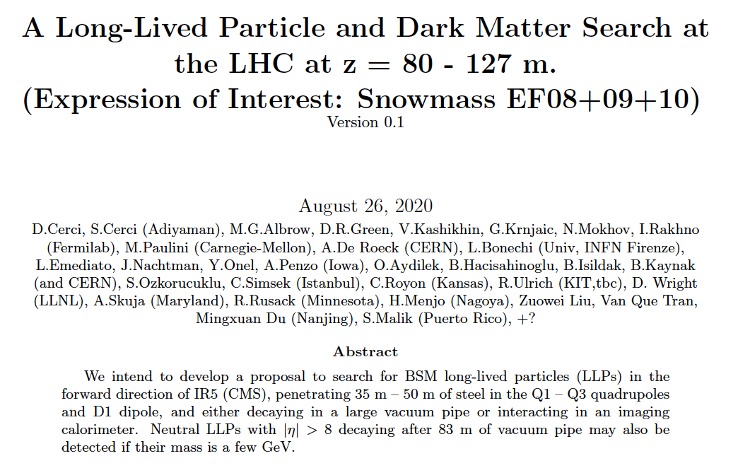
Long-Lived Particle and Dark Matter Search
at HL-LHC (2027+) at z = 82 – 126m
Are we looking in the wrong direction?
Let’s look FORWARD to it! (I know, FASER will be)
A new subsystem for CMS Run 4 (HL-LHC)
82– 126m downstream of IR-5
Name list still growing,
Invitation still open → Friday!

Slide 2
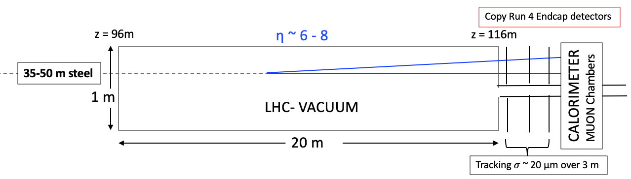
BSM Physics at LHC – looking forward to it!
Maybe new BSM particles are light (< ~ 10 GeV) but weakly or semi-strongly interacting
Most produced light particles have low p_{T} and large p_{z} : go along the beam pipes.
++ Search at high luminosity for new very long-lived particles e.g. dark photons, ALPs etc.
Penetrating 35-50 m steel before entering ~ 20m long 1m diameter decay volume – Vacuum!
IR5 & CMS Central
TAXN at 127m
For Run 4 at full luminosity : Straight section, LHC can make a big vacuum (beam) pipe
LLP’s penetrate 35-50m of steel and decay in vacuum.
Set of Endcap upgrade detectors (~ 0.4 m²) detects decay products:
X⁰ , A’ → e+e-, μ+μ-, e μ , 𝛾𝛾 , 𝜏⁺ 𝜏⁻ , c c , b b , Jet + Jet. Studies needed, reconstruction etc.
If dark photon A’ mass < 1 GeV (π⁰, η⁰, η(958) decays) FT experiments have higher fluxes
If M(A’) > 1 GeV LHC should be much better!
_
_

Slide 3
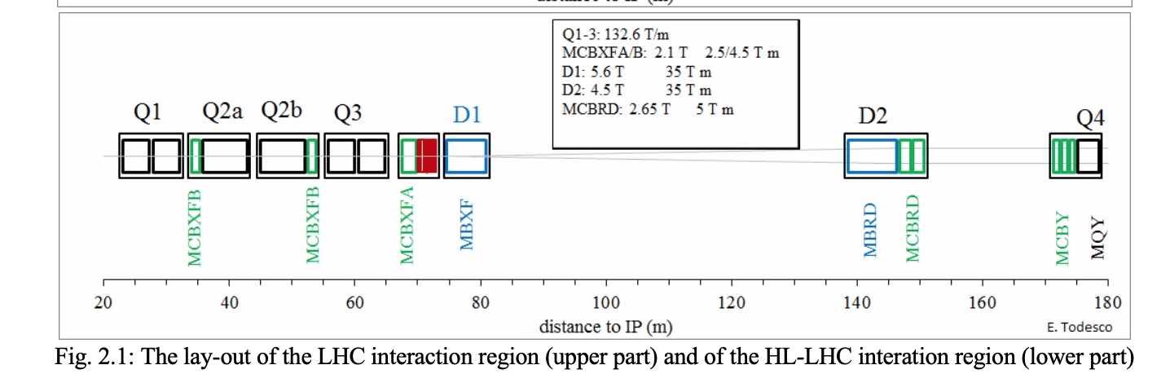
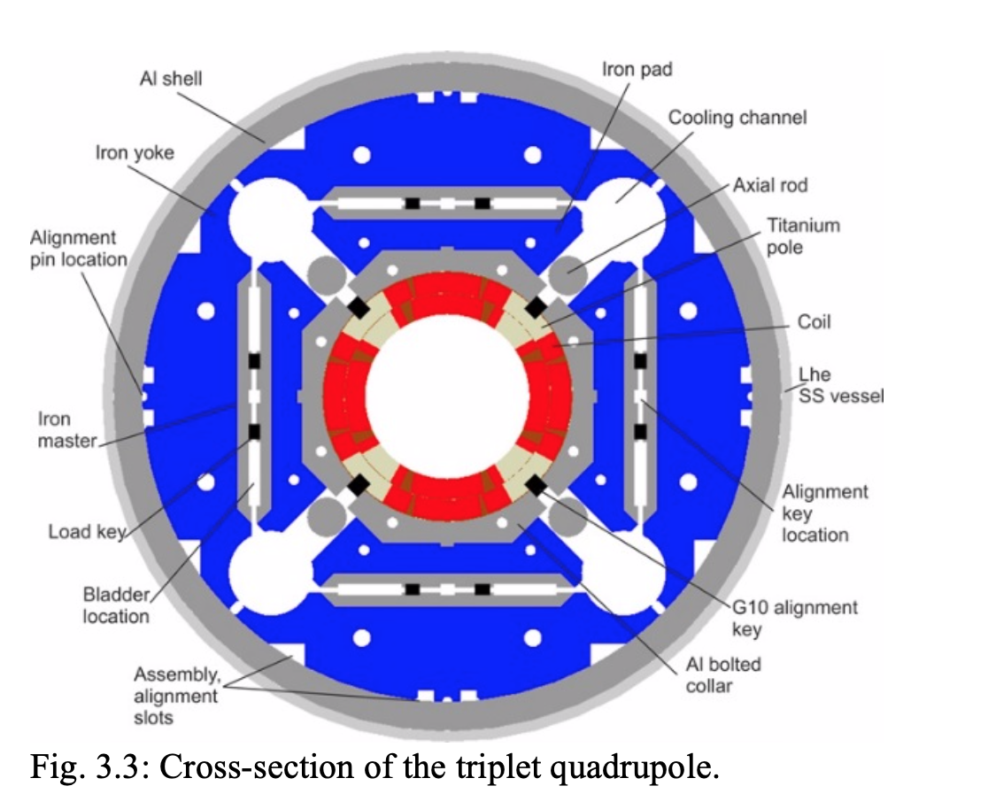
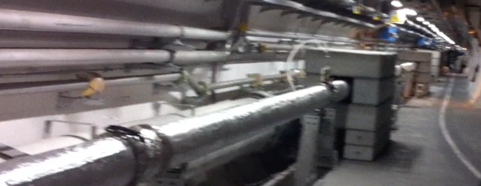
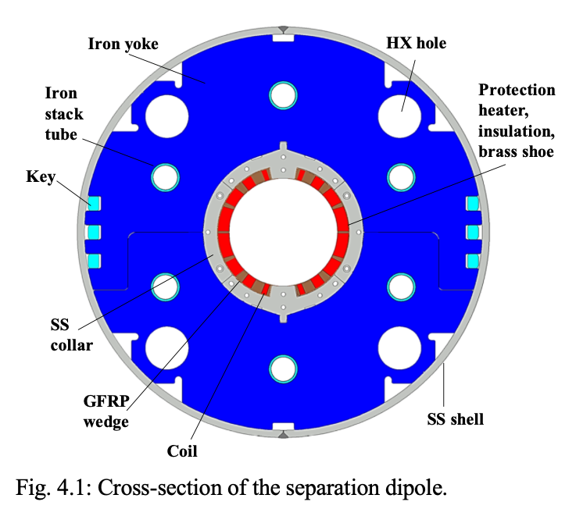
RUN 4 – HL LHC
~21.5 m Fe
~6.25m Fe
IR5, IR1
TAXN
BEAMS
NOTHING
~46m bare pipe (as now), R ~ 12 cm
Propose to replace with larger R ~ 50 cm, L = 20m
Large vacuum volume for LLP decays
Separation dipole D1
150 mm aperture,
35 Tm integrated field
OD ~ 40 cm
Pipes, holes, to be covered with extra Fe toroid

Slide 4
Will submit a 3-page LoI to Snowmass EF08, 09,10
Saturday August 29th (this week!)
Names can still be added!
(longer)

Slide 5
Vladimir Kashikhin, FNAL
Magnetised Fe Toroids around “small” beam pipe
At front as absorber & muon deflector, at back with muon momentum measurement
Fe cylinder (E.g. AISI 1010 ~0.1%C)
B
TOP Half
COIL: Water-cooled Cu
Field in Fe B ~ 2T at inner radius
~ 1T at outer radius
Field on beams small & add shield
COIL: Water-cooled Cu
B
BOTTOM Half
100 GeV Muons bend in 3m @ 2T = 18 mrad
& Mult. Scatt. θ_{RMS} ~ 2 mrad
R_{inner} ~ 10 cm. R_{outer} ~ 50 cm → Area 0.35 m²
Length ~ 3m = ~ 18 λ_{INT}
Top and bottom halves separate.
(Each half weighs ~ 3T if L = 3m)
FRONT CYLINDER @ z ~ 90m
Behind separation dipole D1 and FMX
BACK CYLINDER @ z ~ 120m - muons
Gaps with detector layers
FRONT: Hodoscope and short tracker front and back, in front of decay volume
BACK : Muon chambers before, in gaps, behind : muon momenta, Calo leakage

Slide 6
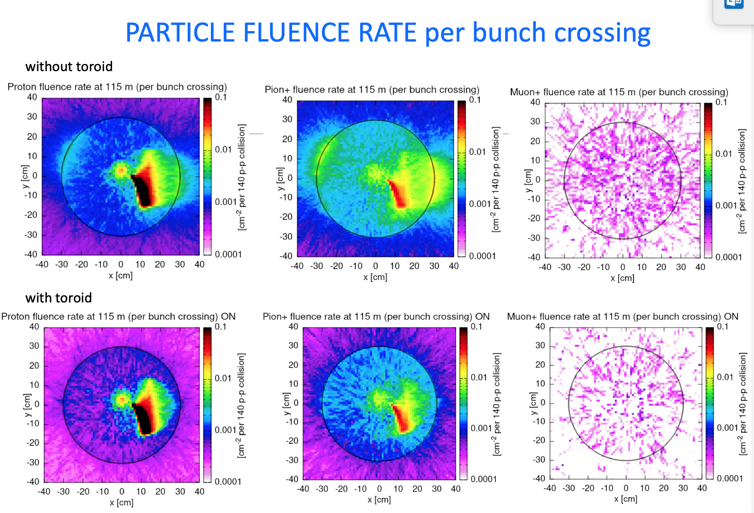
Charged particles per HL bunch crossing, 140 collisons, per cm²
New Superconducting 35 Tm dipole D1 deflects charged paricles to Left & Right.
Ignore pipe drawn at R = 30cm, we can probably have R = 50 cm (TBC)
Choose clean UP&DOWN areas (asymmetry because of V-crossing angle)
M.Sabate-Gilarte
& F.Cerutti (CERN)
PROTONS
PIONS (+)
MUONS (+)
LLP
LLP
Reduction with front 3m toroid:
LLP
LLP
10⁻⁴/cm²/X

Slide 7
Potentially* search for highly penetrating X⁰ decaying in vacuum to:
𝛾𝛾 (no tracks - or conversion - to high granularity EM calorimeter)
e⁺e⁻ if M(X) > 2 MeV (track pair and high granularity EM calorimeter)
e±μ∓ if M(X) > 108 MeV (Muon through calo & muon chambers) not from 𝜏⁺𝜏⁻
μ⁺μ⁻ if M(X) > 212 MeV (Muon pair through calo & muon chambers)
𝜏⁺𝜏⁻ if M(X) > 3.6 GeV (e⁺e⁻ or μ⁺μ⁻ or e ± μ∓ or e/μ + hhh ?)
cc if M(X) > ~ 4 GeV (== e⁺e⁻ charm factory event boosted to TeV!)
bb if M(X) >~ 10 GeV
OR: Not decaying but DM interacting in calorimeter (very good imaging, timing!) ?
* All need proper study with simulation & realistic set-up and backgrounds.
INVITATION to participate!

Slide 8
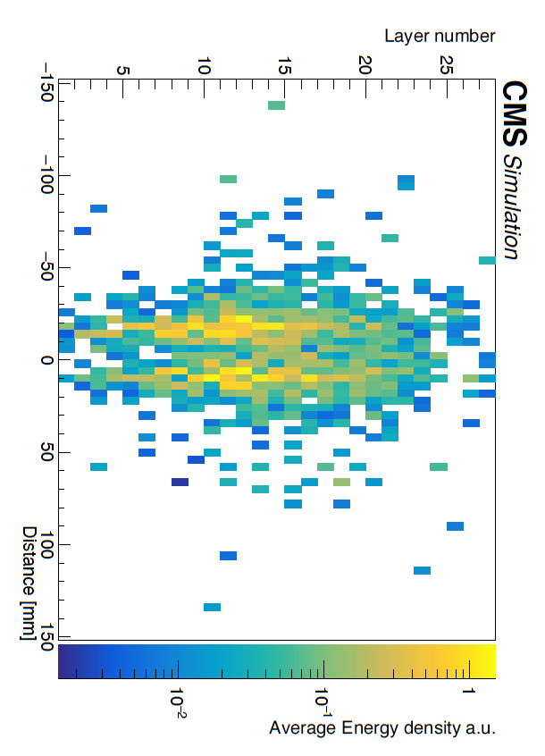
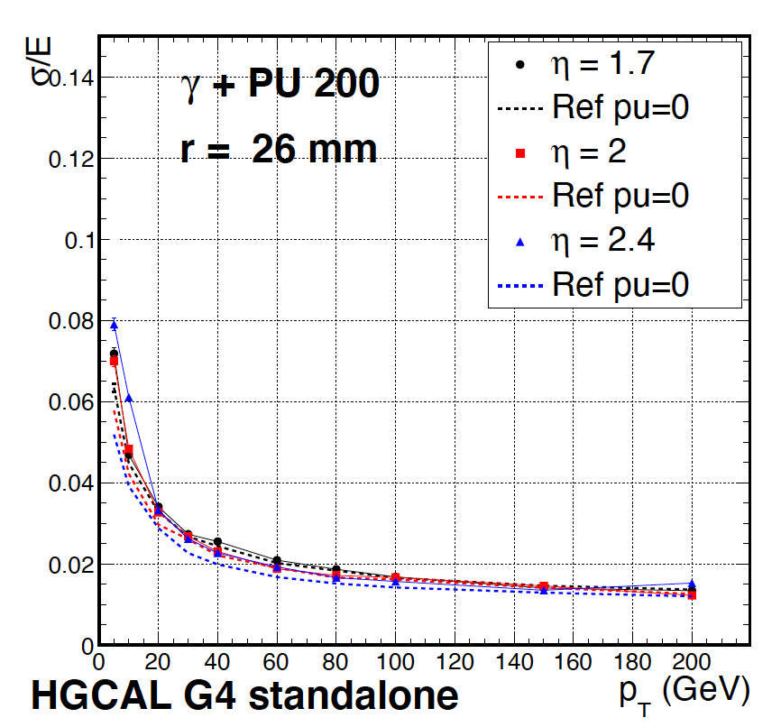
Can we see X⁰ → 𝛾 + 𝛾 ?
From CMS-TDR-019
Critical issue probably shower pointing:
vertex resolution, X⁰ trajectory and ⍺
Single shower position resolution ~ 1mm
Angle resolution < 7 mrad (25 GeV showers)
𝜎(M) probably < ~ few %
> Needs proper simulation
X⁰
𝛾
⍺
d_{min}
L
𝛾
From CMS-TDR-019 Fig 5.2
Simulation two 80 GeV parallel photons separated by about 30mm.
From CMS-TDR-019 Fig 5.1
If conversion in tracker – no field so no spread

Slide 9
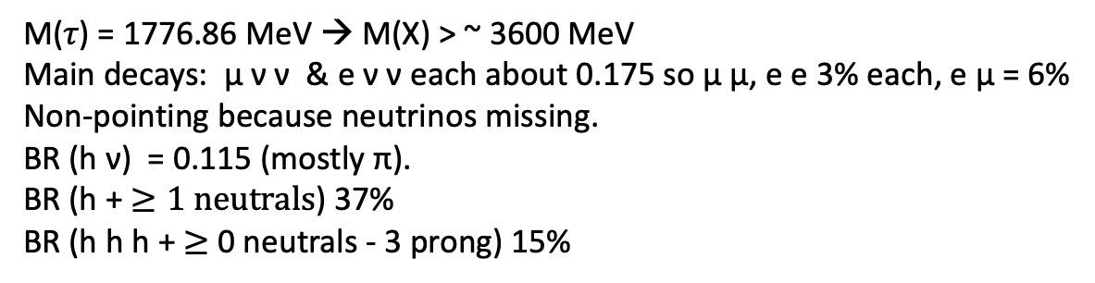
Can we see X⁰ → 𝜏 + 𝜏 ?
M(𝜏) = 1776.86 MeV → M(X) > ~ 3600 MeV
Main decays: μ ν ν & e ν ν each about 0.175 so μ μ, e e 3% each, e μ = 6%
Non-pointing because neutrinos missing.
BR (h ν) = 0.115 (mostly π).
BR (h + $≥1 neutrals$) 37%
BR (h h h + $≥$ 0 neutrals - 3 prong) 15%
e, μ, h
e, μ, h
h
h
e, μ, h
h
Can we see X⁰ → c + c , b + b ?
Consider e+e- events above open charm threshold 2 x M(D⁰) = 3730 MeV
Boosted to high p_{z} (acceptance?) and decay in pipe
All need simulation: collaboration invited!

Slide 10
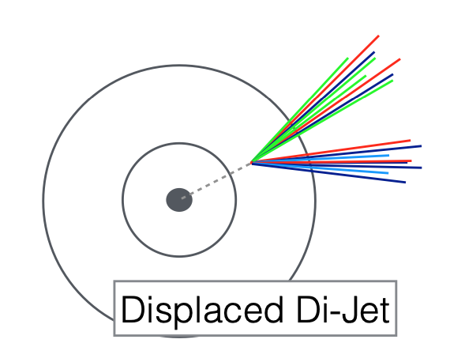
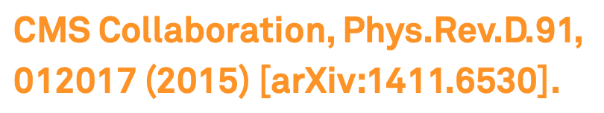
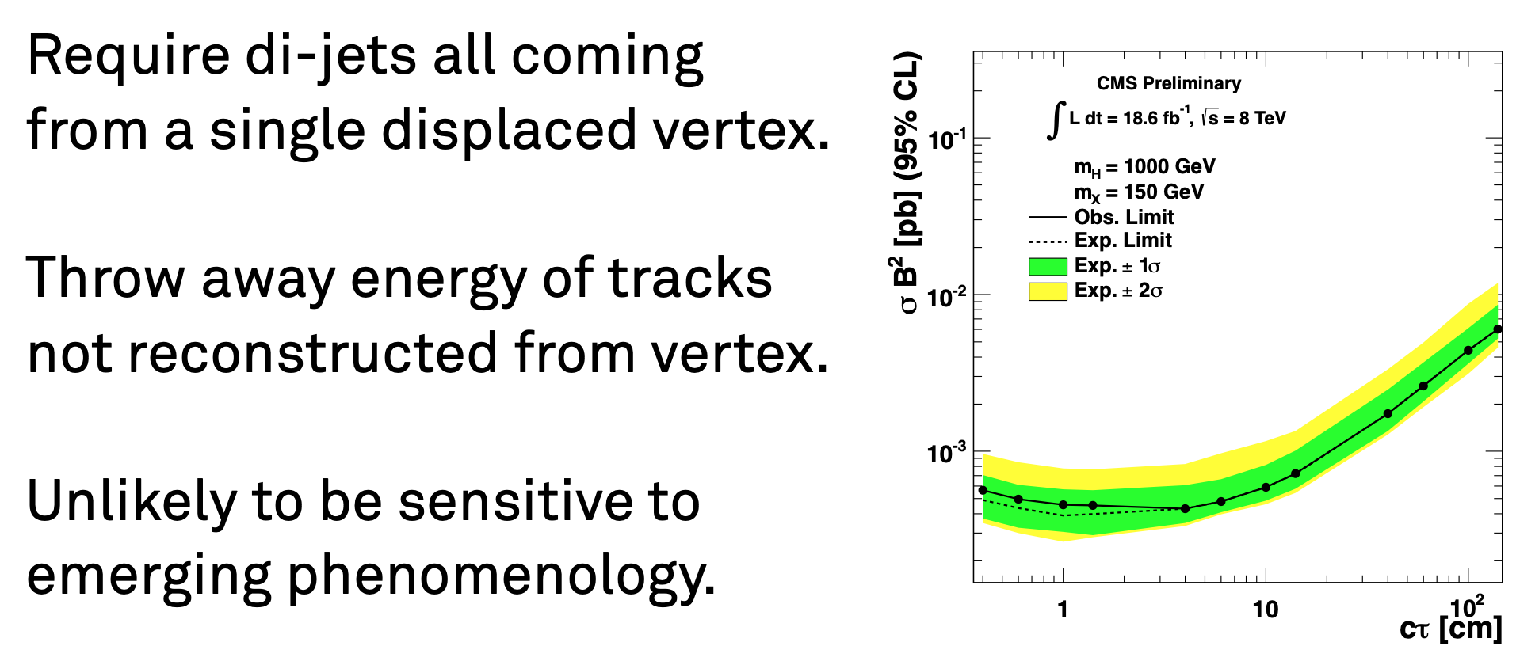
Can we see X⁰ → Jet + Jet?
CMS Central
Transverse view
1 m → 10 m – 1000 m+
Thin window
Precision tracking
Imaging Calorimeter
60 cm
LHC VACUUM
~ 30 m
OR EVEN?? Not decaying but interacting unusually in calorimeter?

Slide 11
Dark Matter particle penetrating then interacting. (Shower pointing back important)
Interaction length ~ 100 – 1000 x hadronic (semi-strong, not weak)
Depth of 1st interaction and Time-of-Flight mitigates neutron b/g
M = 5 GeV/c² at 200 GeV/c
is 100 ps later than neutron

Slide 12
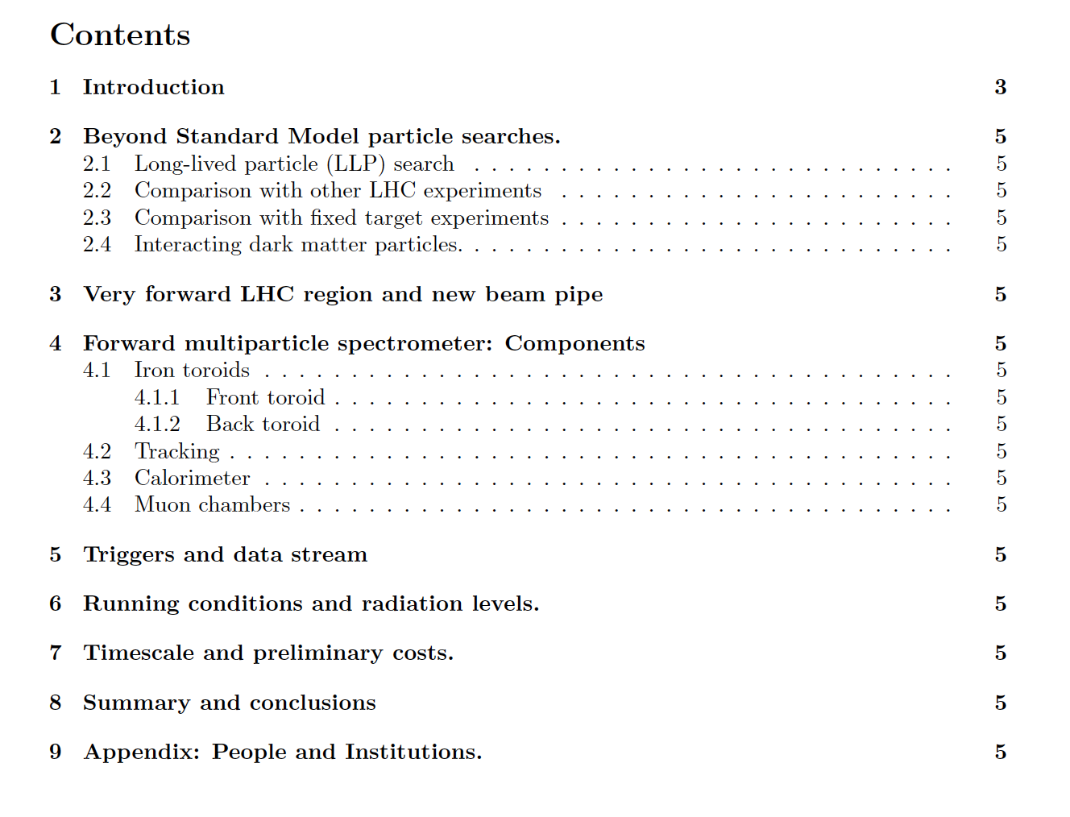
Opportunities for you to help develop this idea and make it happen!
Contact albrow@fnal.gov and/or Dan Green dgreeen@fnal.gov
See talks Monday 14th Aug at https://indico.cern.ch/event/947044/
Skeleton of Expression of Interest to CMS (November 2020?)
Sections to be written
Adiyaman & Istanbul
started GEANT studies
Only using CMS
Endcap upgrade
detectors on small scale
Added value!

Slide 13
SUMMARY:
Developing idea: Forward Multiparticle Spectrometer for CMS Run 4
EoI → Snowmass EF08/09, EoI → CMS this Fall
High Lumi neutral mode: important LLP & DM(?) discovery potential
Many opportunities to participate for theorists, CMS (and non-CMS?) experimenters
Simulate beam line, magnets as absorbers etc.
Assemble a possible configuration of Run 4 detectors as spectrometer elements
Simulate vertexing (x, y, z) from track pairs (or 4?) in tracker, resolutions
Simulate sensitivity to LLPs as fn (M, ε² / 𝜏, 𝜎) … including 𝜏⁺ 𝜏⁻, c-cbar? (LHC > SPS-FT)
Simulate sensitivity to VLLPs or stable DM intracting in Calorimeter
& understanding (and mitigating) all possible backgrounds.

Slide 14
Thank you
Interested? Names can be added until Friday
Back-ups →

Slide 15
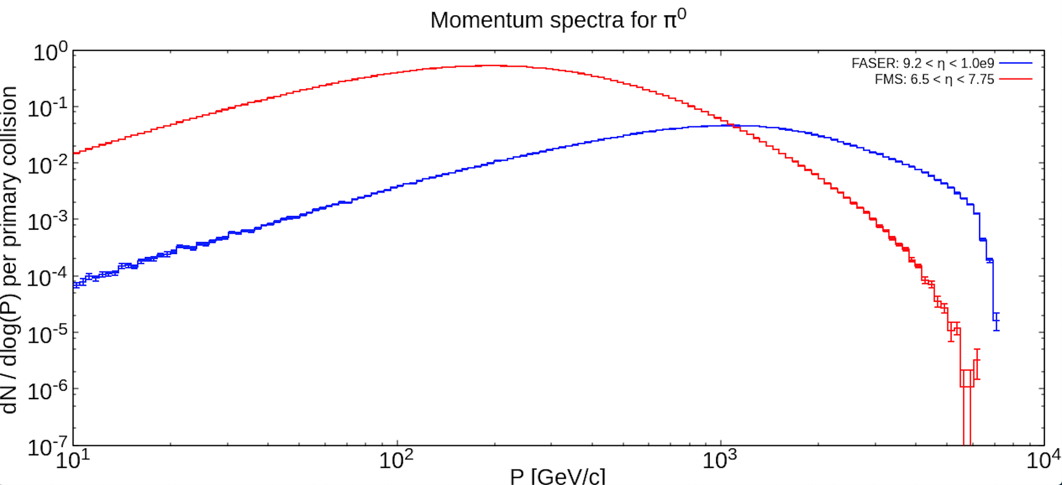
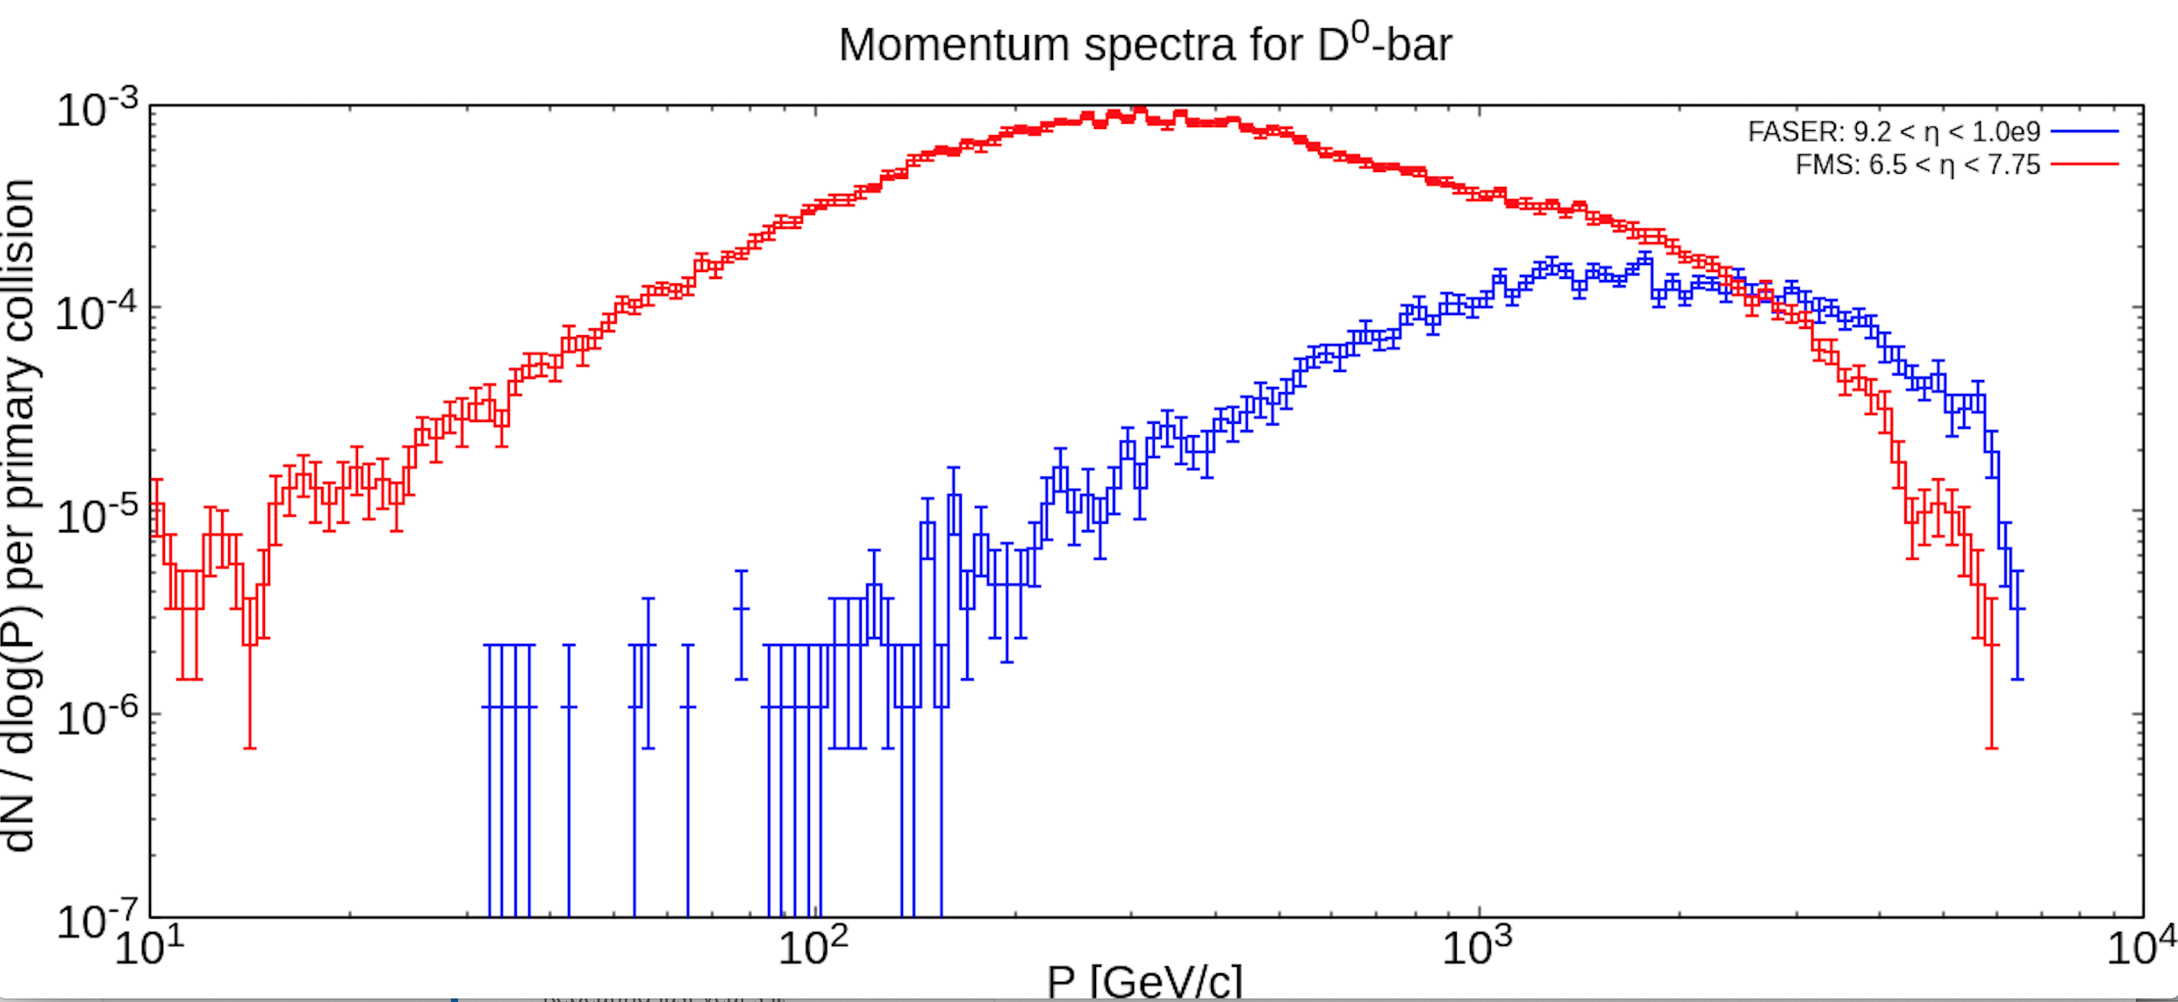
FLUKA (DPMJET) predictions from Marta Gilarte 20200605 – indicative
Predictions for LLPs (fn. M_{X}) being
Studied (Zuowei Liu Nanjing Gp)
x100
x100
Note: This is FASER Run3
Run4 plans much more coverage
(R = 1m)

Slide 16
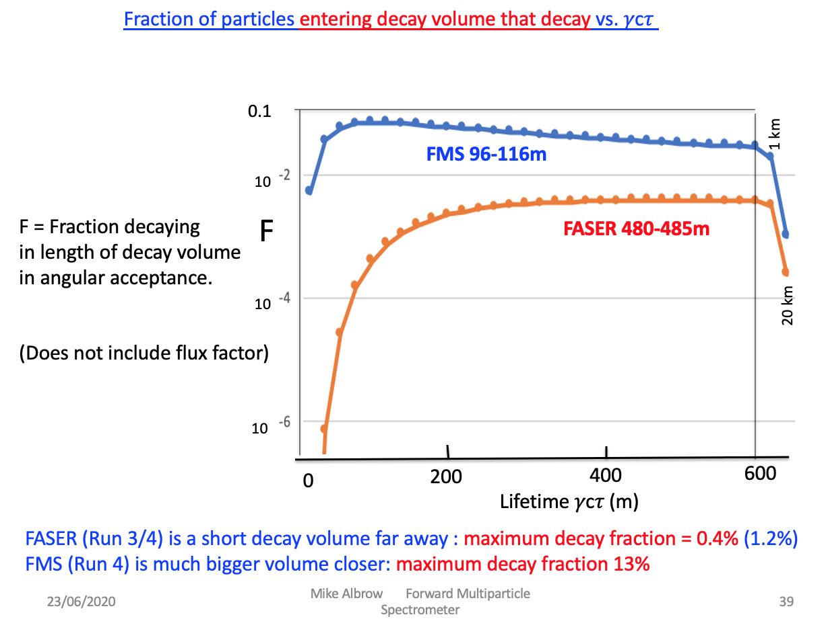
FASER? FASER got this ball rolling, rapid LHCC approval shows support for this physics
Will get early data in Run 3. Propose upgrade for Run 4 (FMS time?) 5m long, 2m diameter.
If good Run 3 candidates(discovery?) FMS can study in (much) greater detail – case v. strong!
If only limits on M(A’) < 1 GeV (from π⁰, η(548), η’(958) → 𝛾 A’ decays)
Search region M(A’) > 1,5,10 … GeV FMS strength!
L = 20m Vacuum decay volume, diam = 1m but 4x closer so ΔΩ x 4, high p_{T} favors higher M.

Slide 17
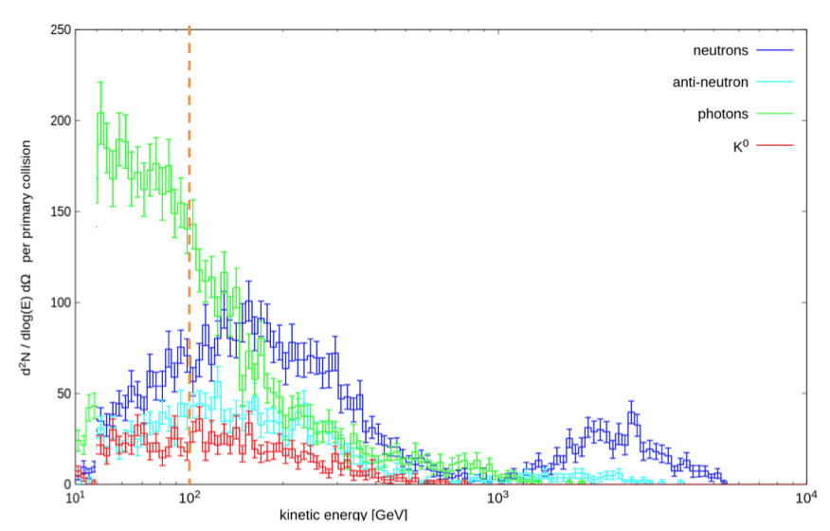
FLUKA: Neutral particles penetrating 35-50m steel absorbers (Q1-Q3 + D1 +)
Note: This is per unit solid angle. U&D quadrants dΩ = 5 x 10⁻⁶
> ~ 10⁻² / bunch crossing (140 int.) above ~ 600 GeV
F. Cerutti & M. Sabate-Gilarte

Slide 18
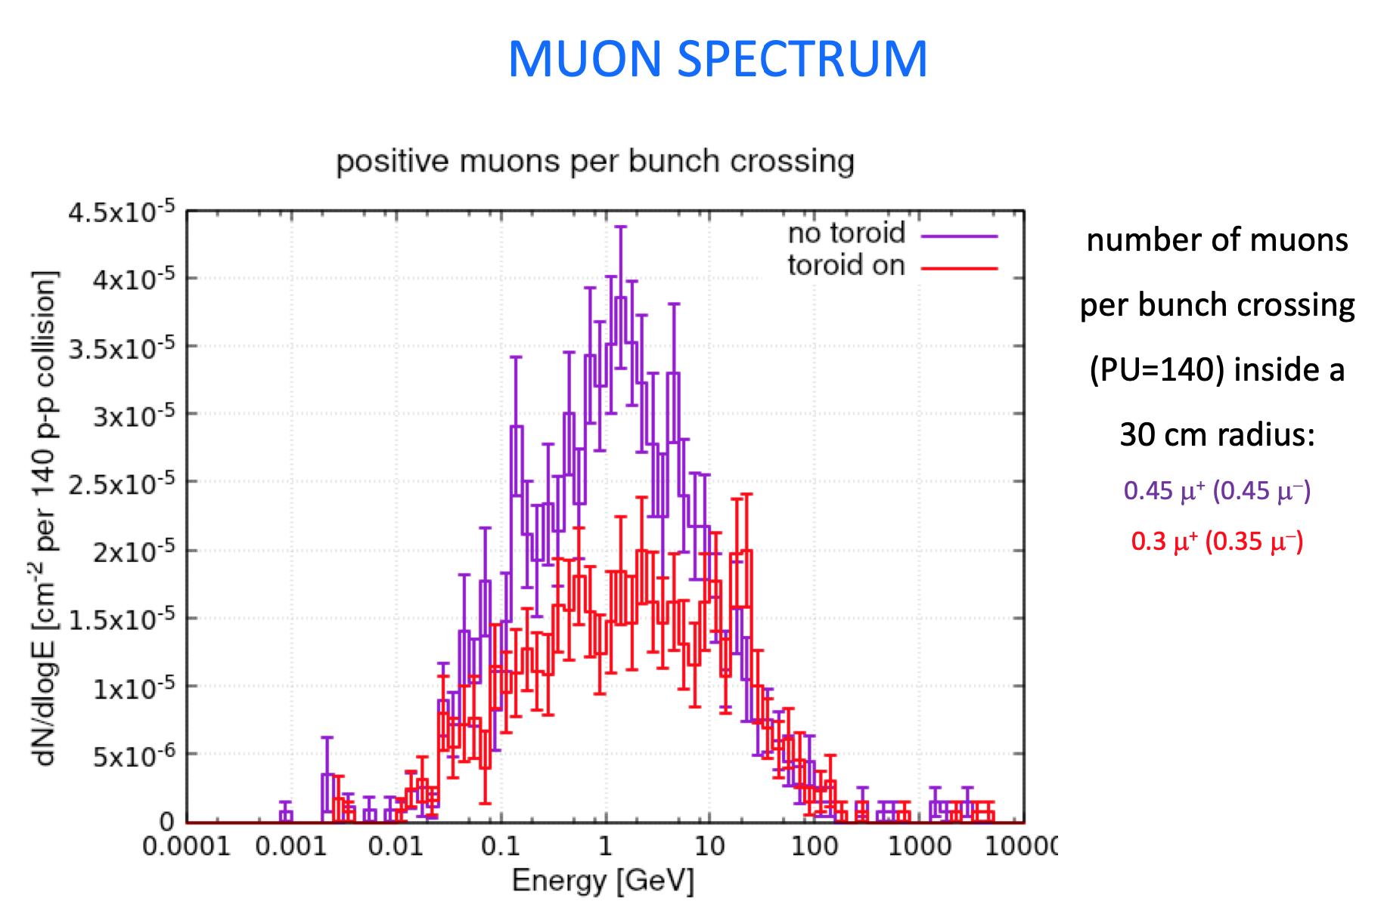
FLUKA calculation of neutral particles emerging from back of D1 steel.

Slide 19
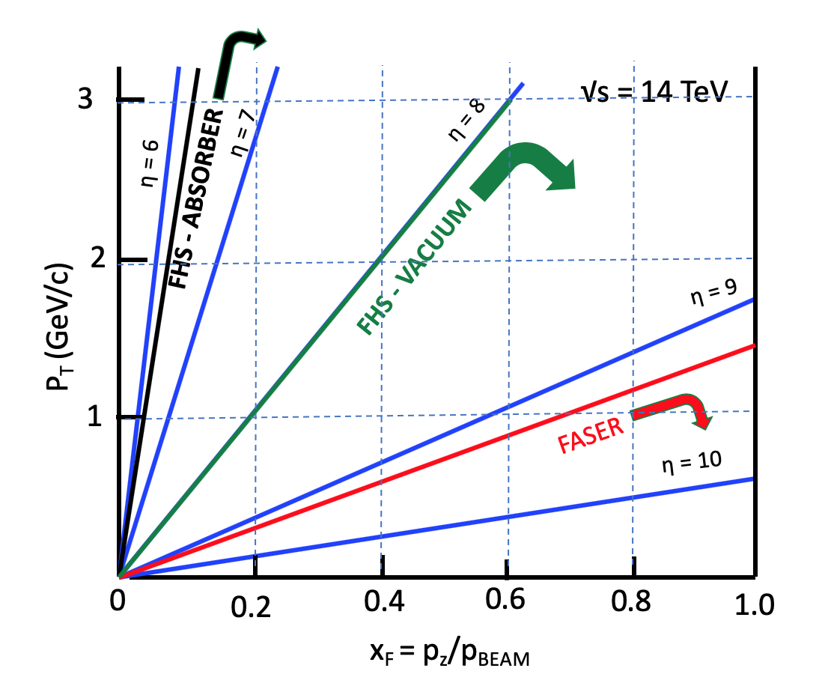
Coverage through steel absorbers > 200 Λ_{INT}
Approximation: Zero crossing angle
R = 50 cm @ 116 m, η = 6.14
R = 12.5 cm @ 120 m, η = 7.6
FASER Run3

Slide 20
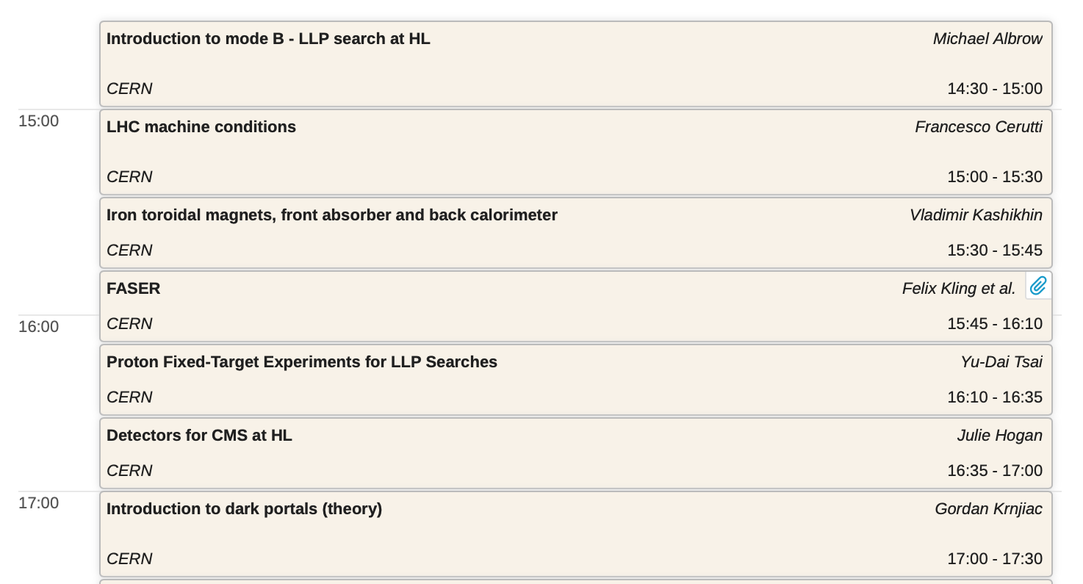
16th +17th April 2020 workshop: https://indico.cern.ch/event/868473/
Search for penetrating but decaying LLPs - 𝛾c𝜏 ~ 10 m → >~ few km
CERN
times
(Friday)
14:30
CERN
FNAL
Thursday 16th April

Slide 21
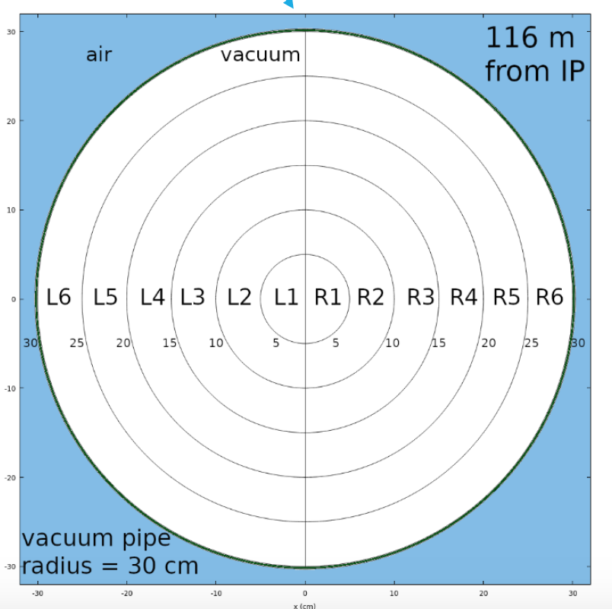
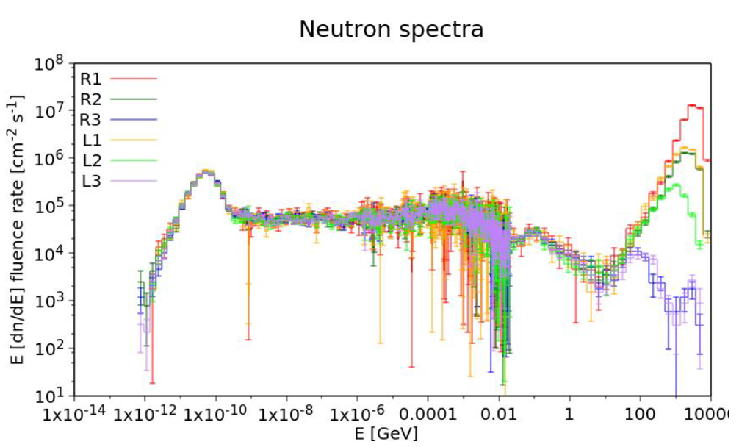
Neutron spectra (M. Sabate-Gilarte talk 20200416)
R= 10 – 15 cm
Interest for LLP search: R = 15 – 40 cm
Zones 4,5,6,(+7)
GeV

Slide 22
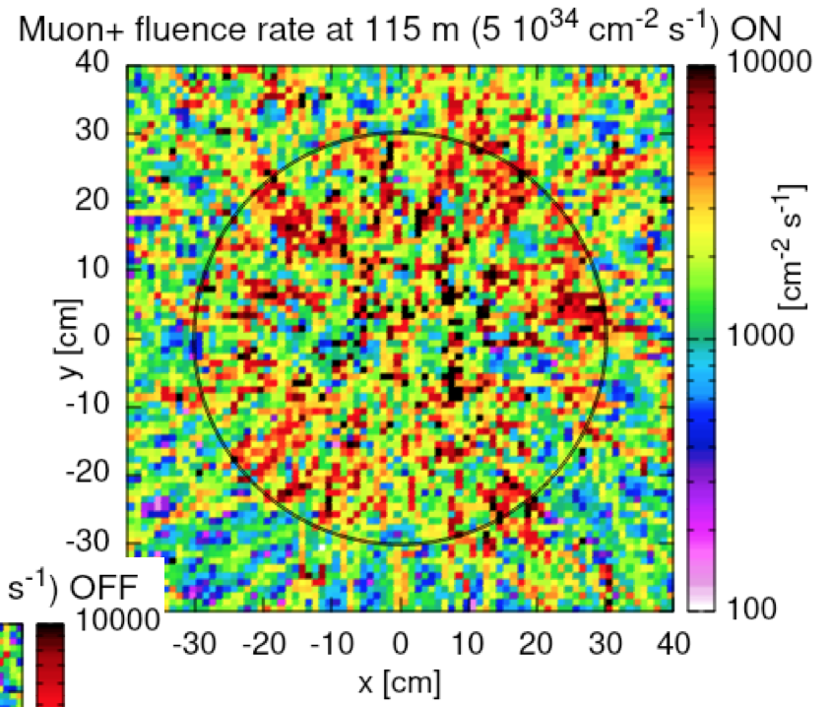
From F. Cerutti’s talk 2020.04.16
Roughly 2000 μ /cm² /s Area (full) = 0.25m² = 2500 cm²
Bunch X/s = 4 x 10⁷ /s So #μ ~ 0.12 per 140X crossing - remove

