Slide 1
Snowmass 2021 – AF4 Kickoff Meeting
Conveners: Nadia Pastrone (INFN), Alexander Valishev (FNAL), Mark Palmer (BNL)
July 8, 2020
Notes:
Please use the Notes field for each slide to prepare the course instructor guide as you go

Slide 2
Agenda
Accelerator Frontier Topical Group 4 Plans
Description of LOI process and needs
Comments from each technical approach
Q&A and Discussion

Slide 3
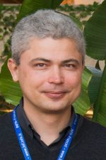
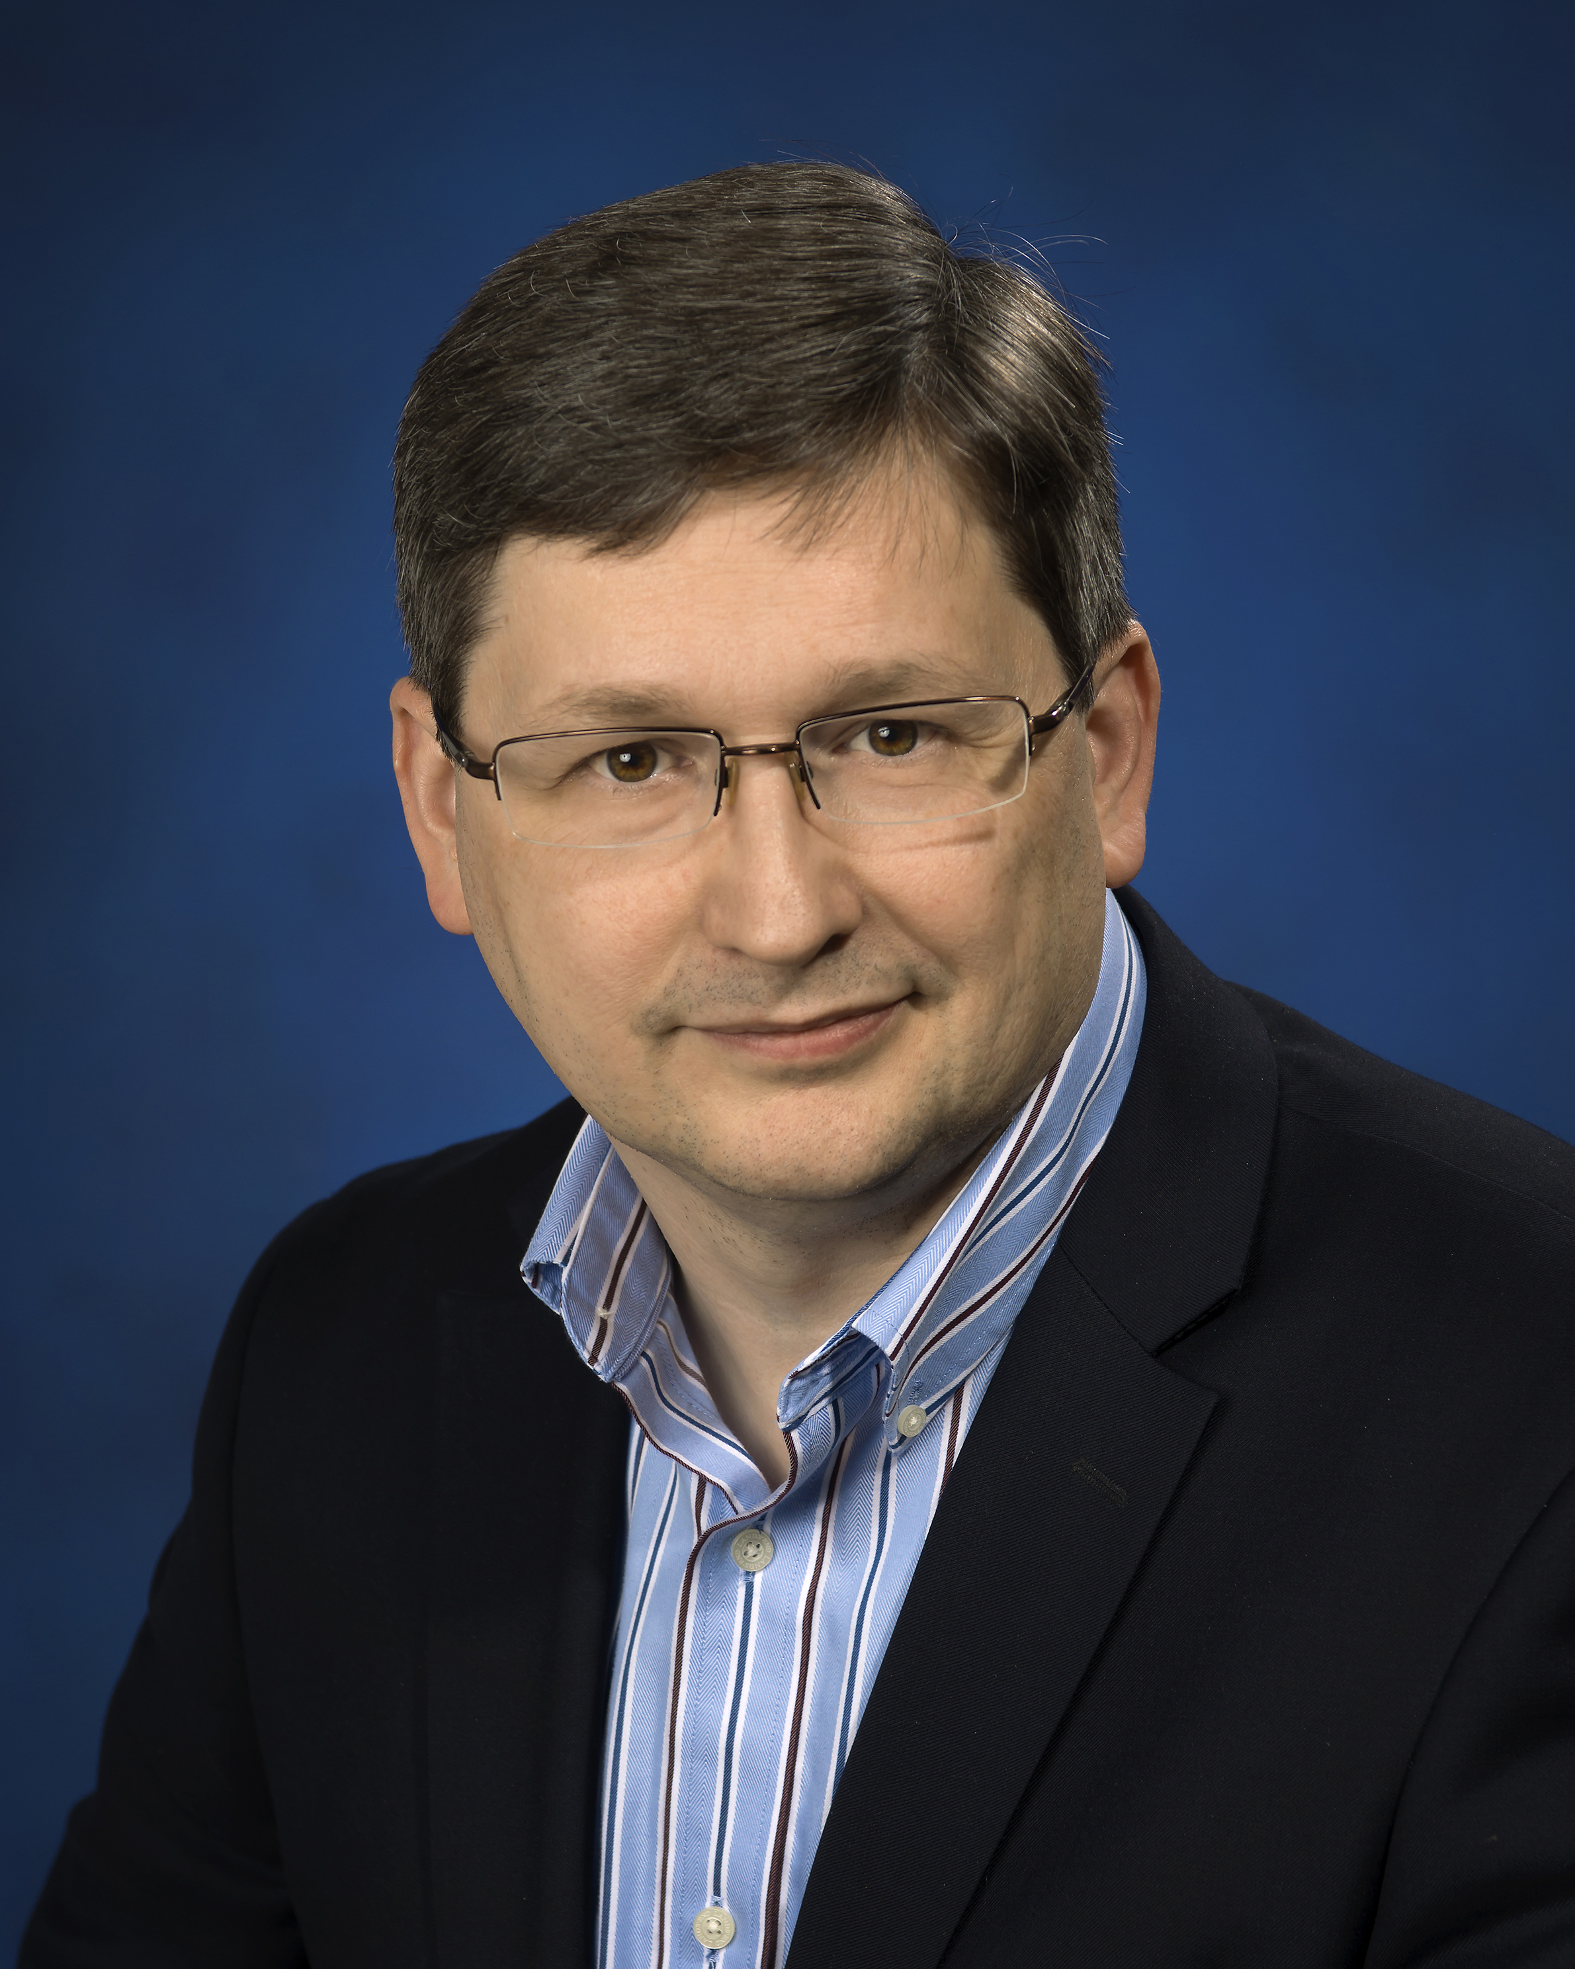
The Conveners
Nadia Pastrone Sasha Valishev Mark Palmer
nadia.pastrone@to.infn.it valishev@fnal.gov mpalmer@bnl.gov

Slide 4
AF4 Focus: Machines with 1-100 TeV Energy Reach, and Beyond...
This Working Group will explore
Potential Machine Routes
R&D Requirements
Potential Readiness Timelines
Common Issues at the very high energy scale such as energy efficiency and cost
It will coordinate with the Energy Frontier Physics Group to identify
Connections between the physics needs and accelerator types
Detailed machine requirements to achieve the community's physics goals

Slide 5
Each AF Working Group
Charged with addressing the following questions:
What is needed to advance the physics?
What is currently available (state of the art) around the world?
What new accelerator facilities could be available on the next decade (or next next decade)?
What R&D would enable these future opportunities?
What are the time and cost scales of the R&D and associated test facilities as well as the time and cost scale of the facility?
Liaisons with other parts of the Snowmass 2021 effort:
Theory Frontier - LianTao Wang
Rare Processes - Robert Bernstein
Energy Frontier - Meenakshi Narain and Dmitri Denisov
Instrumentation Frontier - Andy White

Slide 6
Machines with E_{cm} ≥ 1 TeV and Collaborations
Electron-Positron: ILC, CLIC
Gamma-Gamma:
Muon: MAP, LEMMA, NEW International MC Collab
Hadron: FCC-hh, SPPC
High Energy Electron-Ion: LHeC, FCC-eh
Other possibilities?

Slide 7
Snowmass 2021 Letters of Interest
Submission Period: April 1, 2020 – August 31, 2020
Letters of interest allow Snowmass conveners to see what proposals to expect and to encourage the community to begin studying them. They will help conveners to prepare the Snowmass Planning Meeting that will take place on November 4 - 6, 2020 at Fermilab. Letters should give brief descriptions of the proposal and cite the relevant papers to study. Instructions for submitting letters are available at https://snowmass21.org/loi. Authors of the letters are encouraged to submit a full writeup for their work as a contributed paper.

Slide 8
AF4 Request for Letters of Intent
Request for LOIs To Focus On:
Machine concept
R&D needs to deliver a potential future capability
Connections of the technology to existing facilities (e.g. to provide potential facility construction and/or R&D pathways)
LoIs are short – so multiple LoIs from each team are acceptable
The conveners will work with the contributors to organize a coherent and integrated final set of submissions and presentations
We want to make sure the US community has everything it needs to develop its future Energy Frontier plans
An email list has been created: MULTITEV-SNOWMASS21@fnal.gov
We are planning a series of Joint Working Group meetings as we move through the Snowmass process

Slide 9
Questions?

