Slide 1
Electron-Positron Wakefield Concepts – LoI Plans
Carl Schroeder, Lawrence Berkeley National Laboratory
Spencer Gessner, SLAC National Accelerator Laboratory
John Power, Argonne National Laboratory
and colleagues in the AAC Community
July 8, 2020, AF4: Multi-TeV Collider Kickoff Meeting
Work supported by the U.S. DOE, Office of Science, Office of High Energy Physics, under Contract No. DE-AC02-05CH11231

Slide 2
Advanced Accelerator Concepts: Path to a multi-TeV Collider
Novel accelerator technologies / advanced accelerator concepts (AACs) based on wakefields producing gradients ~1-10 GV/m
Accelerator technology development for an e-/e+/gamma linear collider at multi-TeV, with much reduced footprint (and cost)
medium
Dielectric (~1 GV/m)
Plasma (~10 GV/m)
Laser
Dielectric Laser Accelerator (DLA)
Laser wakefield accelerator (LWFA)
driver
Beam
Structure-based wakefield accelerator (SWFA)
Plasma wakefield accelerator (PWFA)
Common features: ultra-high gradient; small structures; short bunches
Technical maturity and time frame: Longer-term collider options (>30 years to operation)
2

Slide 3
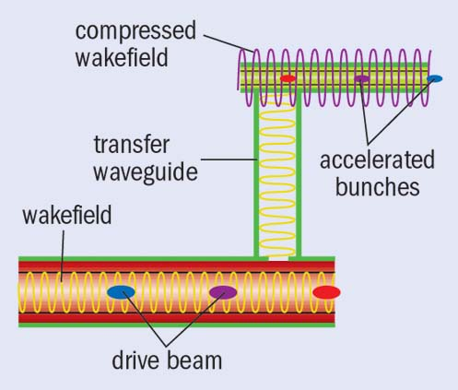
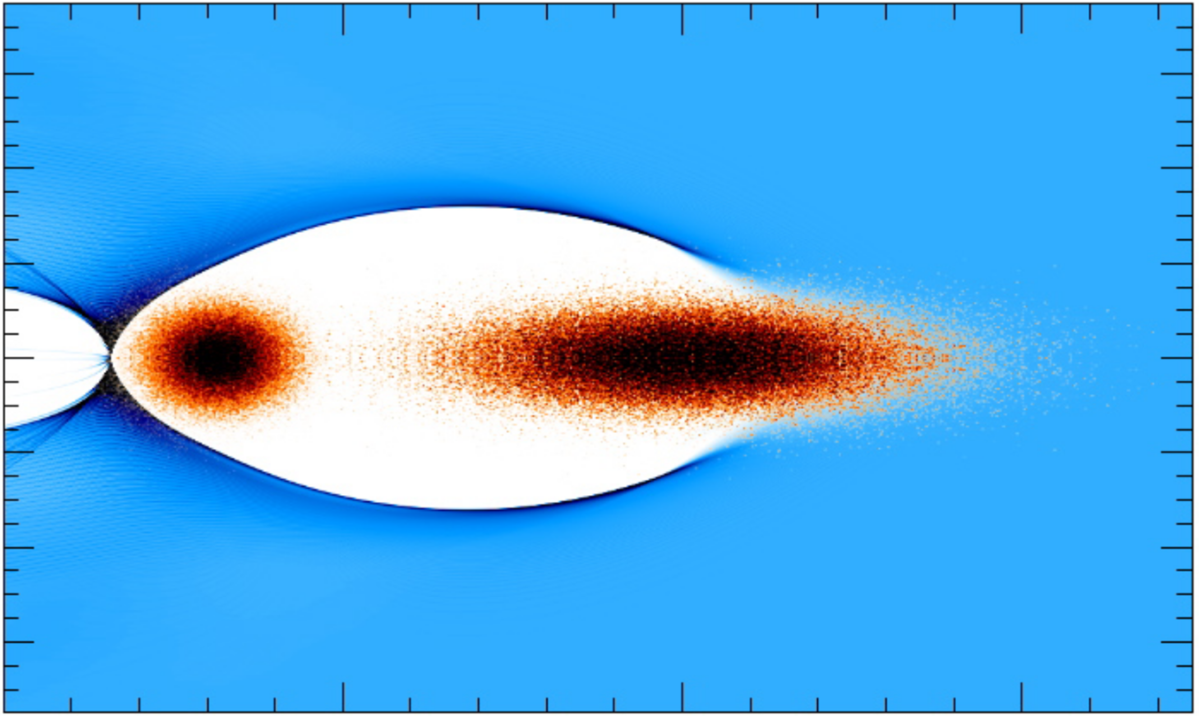
Plasma- and structure-based wakefield accelerators
LASER-DRIVEN PLASMA ACCELERATORS
STRUCTURE WAKEFIELD ACCELERATORS
electron plasma density
particle beam
laser driver
Two Beam Acceleration
plasma wavelength
BEAM-DRIVEN PLASMA ACCELERATORS
Witness Beam
Accelerated by the wake
Drive Beam
Creates plasma wakefield
Transfers energy to plasma
Collinear Wakefield Acceleration
drive beam
Plasma wakefield (blowout regime)
main beam
3

Slide 4
Status and technical readiness
High gradient accelerator technology has been demonstrated
key R&D challenges remain to be addressed for collider application
See Joint AF-EF July 1 Meeting: https://indico.fnal.gov/event/43872/
Concepts require integrated collider design
No conceptual design reports exist
Preliminary designs developed to guide accelerator R&D
Integrated design studies required
Integration of all collider sub-systems
Greenfield or upgrade existing facility (e.g., ILC)
Advancing accelerator R&D in next decade toward collider requires sustained support and new/upgraded facilities.
Letters of Interest (AF6, AF4) to be submitted on wakefield collider concepts:
Beam-driven plasma linear collider
Structure wakefield accelerator linear collider
Laser-plasma accelerator based collider
4

Slide 5
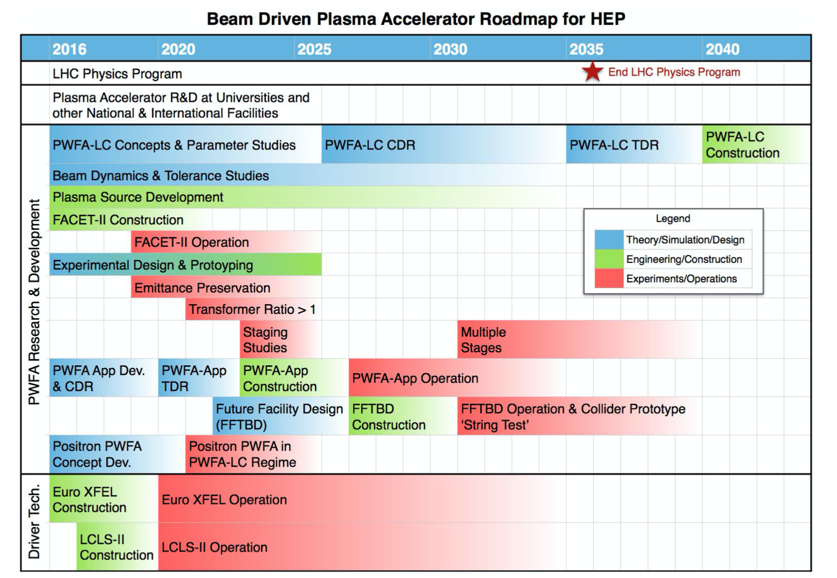
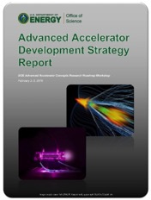
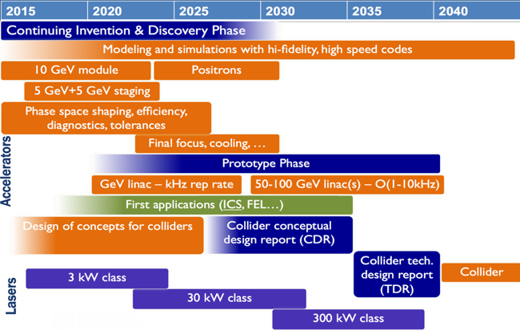
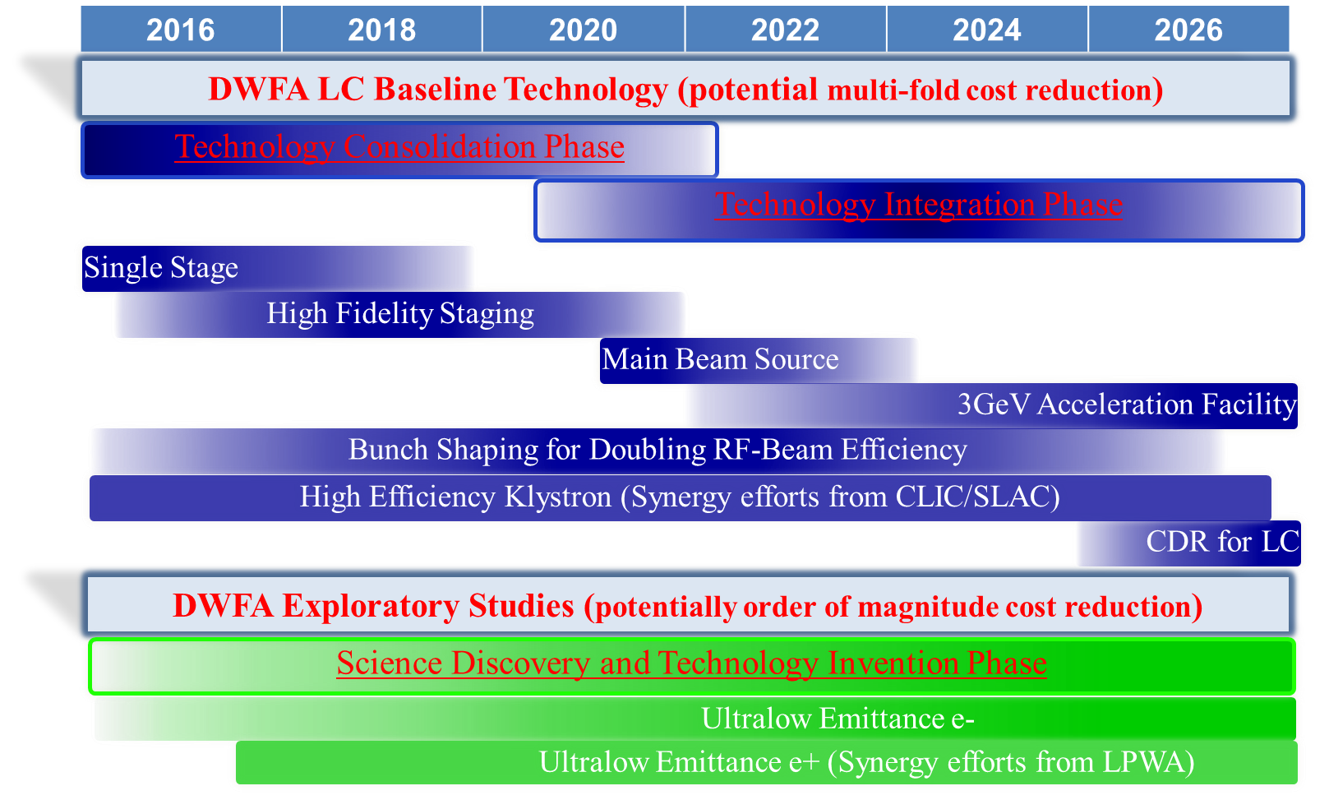
DOE AAC Roadmap: R&D timeline towards a collider
US AAC community outlined AAC R&D goals in 2016
Significant and steady progress on all R&D goals since 2016
DOE HEP AAC Roadmap (2016)
US AAC community to submit an LoI (AF6) describing an update of the Advanced Accelerator Roadmap for accelerator R&D (proposed US R&D path toward collider)
5

Slide 6
International community working toward addressing collider R&D challenges
Advanced LinEar collider study GROup
ICFA
ICFA ANA Panel
http://www.lpgp.u-psud.fr/icfaana/alegro
B Cros
C Schroeder
P Muggli
ALEGRO Steering Group
Euronnac
Foster Advanced Linear Collider activities based on Advanced and Novel Acceleration (ANA) concepts
Framework to amplify international coordination, broaden the community, involving accelerator labs/institutes
Identify topics of ANAs requiring R&D and facilities needed
ALEGRO Working Groups
Physics
Case
LWFA
SWFA
Positron Acceleration
Worldwide
R&D for all aspects of collider design
Collider Machine Design
PWFA
DLA
Theory
Modeling Simulations
arXiv:1901.08436
Input document for the European Strategy
Global Scientific Roadmap
Development of an Advanced Linear Collider (ALIC) at the energy frontier
Contribution to the US strategy
Based on the work already done for ESPP (HEP benefits, R&D requirements), ALEGRO is interested in preparing an LoI for Snowmass21
arXiv:1901.10370
6

Slide 7
Summary – Wakefield accelerators based on AACs
Advanced Accelerator Concepts:
High gradient accelerators: ~1-10 GV/m
e-/e+/gamma linear collider at multi-TeV, with much reduced footprint (and cost)
Longer-term collider options: >30 years
US facilities to advance R&D in next decade:
ATF (BNL), AWA (ANL), BELLA (LBNL), FACET-II (SLAC), FAST (FNAL)
Facility upgrades are required to address challenges (e.g., e+ capabilities, high-rep-rate laser tech. demonstration, etc.)
Nearer-term applications (compact x-FEL, 𝛾-ray sources, medical applications, etc.) are being pursued
Nearer-term applications are important demonstrations that will advance collider R&D
B. Innovative accelerator technology underpins the physics reach of high-energy and high-intensity colliders. It is also a powerful driver for many accelerator-based fields of science and industry. The technologies under consideration include…
…plasma wakefield acceleration and other high-gradient accelerating structures, …
The European particle physics community must intensify accelerator R&D and sustain it with adequate resources...
7

Slide 8
Thank you.
8

Slide 9
Backup material
9

Slide 10
Potential Facility Table
Laser-plasma collider - e-/e+ |  | 1 TeV cme | 3 TeV cme | 30 TeV cme
Beam Energy | TeV | 0.5 | 1.5 | 15
Luminosity (10^34) | cm-2 s-1 | 1 | 10 | 1000
Int. Luminosity | ab-1/yr | 0.18 (5000hrs) | 1.8 (5000hrs) | 18 (5000hrs)
Beam dE/E at IP |  |  |  | (Y>>1 regime)
Transv. Beam sizes at IP x/y | nm | 50 / 1 | 10 / 0.5 | 0.2 / 0.2
Rms bunch length / beta* | mm | 0.0085 / 0.1 | 0.0085 / 0.1 | 0.0085 / 0.2
Crossing angle | urad
Rep. frequency | kHz | 47 | 47 | 47
Bunch spacing | us | 21 | 21 | 21
# of IPs |  | 1 | 1 | 1
# of bunches |  | 1 | 1 | 1
Length (2x main linac tunnel) | km | 0.44 | 1.3 | 13
Facility site power (2 linacs) | MW | 105 | 315 | 3151
Cost range | $B US
Timescale till operations |  | >30 years | >30+ years | >30++ years
1 um laser wavelength
10¹⁷ cm⁻³ plasma density
Schroeder et al. NIMA (2016)
ALL PARAMETERS NEED SYSTEM-INTEGRATED DESIGN STUDY
TBD: similar to conventional collider designs
Laser rep. rate not available with present laser technology
Upgrade potential: Same laser system for 1, 3, 30 TeV
requires laser tech maturity before estimate
10

