Slide 1
High-Energy LHC (HE-LHC)
Snowmass AF4 Meeting
Frank Zimmermann, 8 July 2020
HE-LHC design was accomplished thanks to
D. Amorim, S.A. Antipov, S. Arsenyev, M. Benedikt, M.I. Besana, R. Bruce, F. Cerutti, M. Crouch, S. Fartoukh, M. Giovannozzi, B. Goddard, M. Hofer, S. Izquierdo Bermudez, J. Keintzel, R. Kersevan, V. Mertens, Y. Muttoni, J. Osborne, V. Parma, V. Raginel, S. Redaelli, T. Risselada, I. Ruehl, B. Salvant, D. Schoerling, E. Shaposhnikova, L. Tavian, E. Todesco, R. Tomas, D. Tommasini, F. Valchkova-Georgieva, V. Venturi, D. Wollmann, F. Zimmermann, CERN, Geneva, Switzerland; A. Apyan, ANSL, Yerevan, Armenia; G. Guillermo Cantón, CINVESTAV Mérida, Mexico; F. Burkart, DESY, Hamburg, Germany; J. Barranco, L. Mether, T. Pieloni, L. Rivkin, C. Tambasco, EPFL, Lausanne, Switzerland; J.L. Abelleira, E. Cruz-Alaniz, P. Martinez Mirave, H. Pikhartova, A. Seryi, L. van Riesen-Haupt, JAI, U.K.; K. Ohmi, K. Oide, D. Zhou, KEK, Ibaraki, Japan; Y. Cai, Y. Nosochkov, SLAC, Menlo Park, U.S.A.

Slide 2
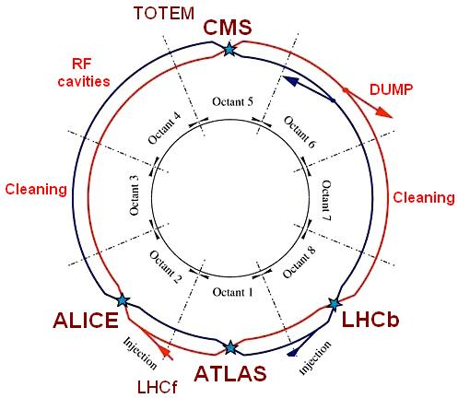
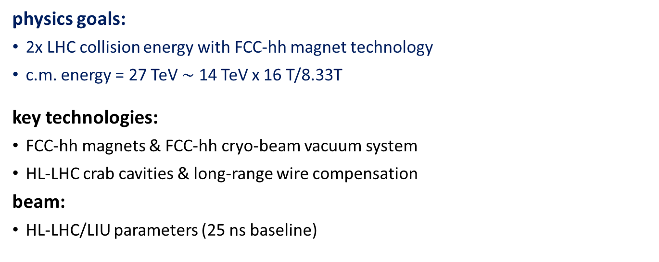
HE-LHC design goals & basic choices
physics goals:
2x LHC collision energy with FCC-hh magnet technology
c.m. energy = 27 TeV $\sim$ 14 TeV x 16 T/8.33T
key technologies:
FCC-hh magnets & FCC-hh cryo-beam vacuum system
HL-LHC crab cavities & long-range wire compensation
beam:
HL-LHC/LIU parameters (25 ns baseline)
target luminosity ≥ 10 ab⁻¹ over 20 years
8 interaction regions (IRs)
2 high-luminosity experiments in IR1 & 5
2 secondary experiments (perhaps including one e-p collision point) in IRs 2 & 8, shared with injection
IR3: momentum collimation
IR4: radiofrequency (RF) and diagnostics
IR6: beam extraction
IR7: betatron collimation
HE-LHC layout like LHC

Slide 3
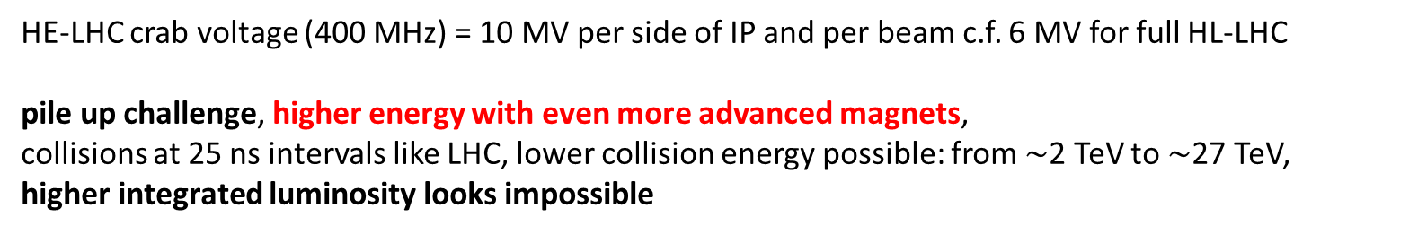
hadron collider parameters
parameter | FCC-hh |  |  | HE-LHC | HL-LHC | LHC
collision energy cms [TeV] | 100 |  |  | 27 | 14 | 14
dipole field [T] | 16 |  |  | 16 | 8.33 | 8.33
circumference [km] | 97.75 |  |  | 26.7 | 26.7 | 26.7
beam current [A] | 0.5 |  |  | 1.1 | 1.1 | 0.58
bunch intensity [10¹¹] | 1 |  | 1 | 2.2 | 2.2 | 1.15
bunch spacing [ns] | 25 |  | 25 | 25 | 25 | 25
synchr. rad. power / ring [kW] | 2400 |  |  | 101 | 7.3 | 3.6
SR power / length [W/m/ap.] | 28.4 |  |  | 4.6 | 0.33 | 0.17
long. emit. damping time [h] | 0.54 |  |  | 1.8 | 12.9 | 12.9
beta* [m] | 1.1 | 0.3 |  | 0.45 | 0.15 (min.) | 0.55 (0.25)
normalized emittance [μm] | 2.2 |  |  | 2.5 | 2.5 | 3.75
peak luminosity [10³⁴ cm⁻²s⁻¹] | 5 |  | 30 | 16 | 5 (lev.) | 1
events/bunch crossing | 170 |  | 1000 | 460 | 132 | 27
stored energy/beam [GJ] | 8.4 |  |  | 1.3 | 0.7 | 0.36
HE-LHC crab voltage (400 MHz) = 10 MV per side of IP and per beam c.f. 6 MV for full HL-LHC
pile up challenge, higher energy with even more advanced magnets,
collisions at 25 ns intervals like LHC, lower collision energy possible: from $\sim$2 TeV to $\sim$27 TeV,
higher integrated luminosity looks impossible

Slide 4
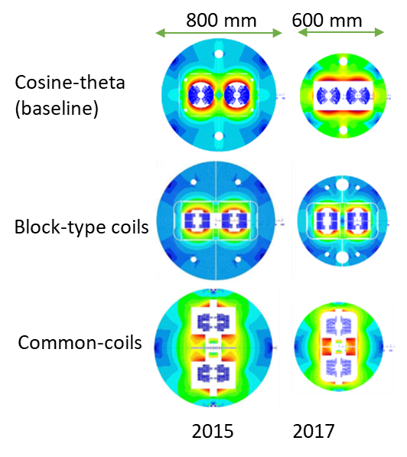
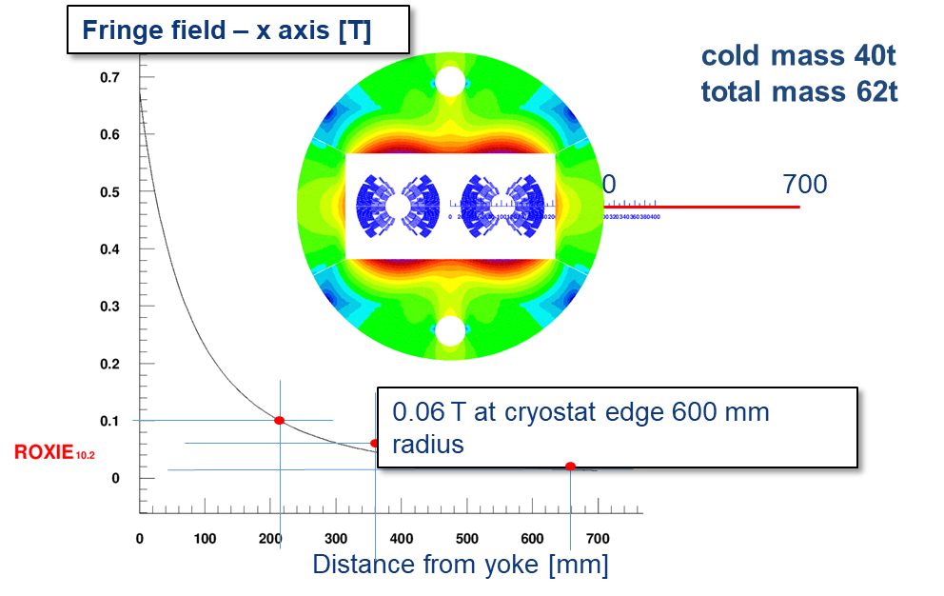
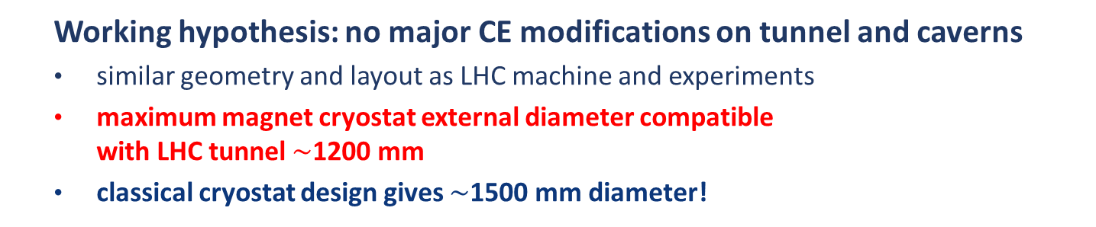
HE-LHC integration aspects
  Working hypothesis: no major CE modifications on tunnel and caverns
  similar geometry and layout as LHC machine and experiments
  maximum magnet cryostat external diameter compatible with LHC tunnel $\sim$1200 mm
  classical cryostat design gives $\sim$1500 mm diameter!
  LHC tunnel diameter 3.8 m
Strategy:
allow stray-field and/or cryostat as return-yoke
optimization of inter-beam distance (compact)
  → smaller diameter also relevant for FCC-hh cost
16 T cryo-dipole integration approach
QRL Φ830 mm (LHC 650)
MB Φ1200 mm (LHC 1106)
Description | ID in mm | OD in mm
Iron yoke | - | 600
Aluminium shrinking cylinder | 600 | 740
Stainless steel He tight shell | 740 | 760
Al radiation shield | 934 | 940
Vacuum vessel (magnetic steel) | 1120 | 1220
2018: intrabeam distance → 250 mm (194 mm for LHC)

Slide 5
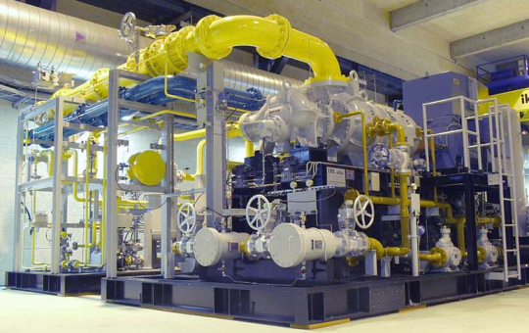
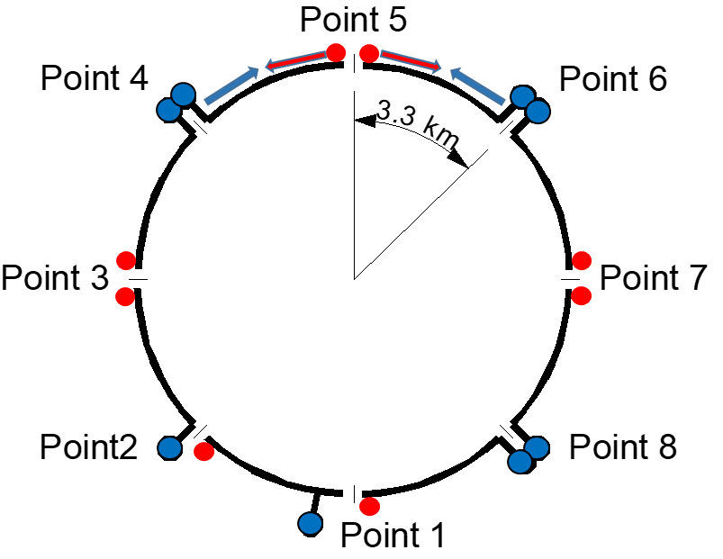
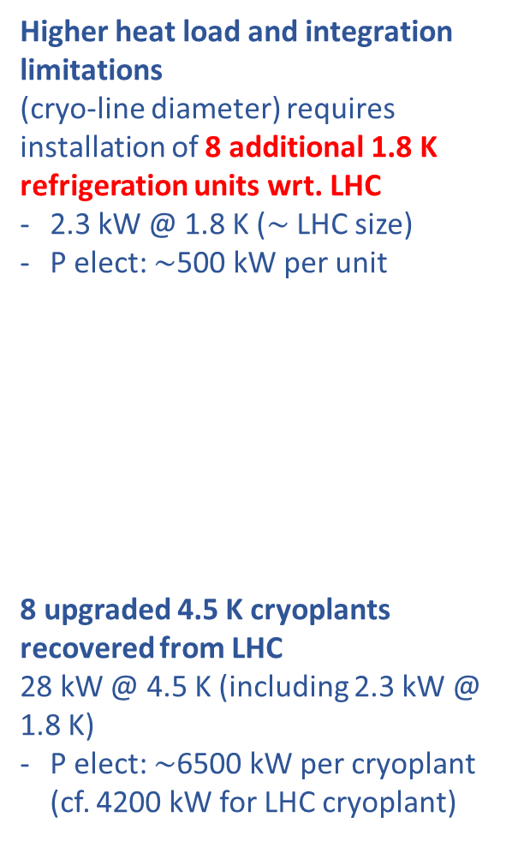
HE-LHC cryogenic layout
Higher heat load and integration limitations
(cryo-line diameter) requires installation of 8 additional 1.8 K refrigeration units wrt. LHC
2.3 kW @ 1.8 K ($\sim$ LHC size)
P elect: $\sim$500 kW per unit
8 upgraded 4.5 K cryoplants recovered from LHC
28 kW @ 4.5 K (including 2.3 kW @ 1.8 K)
P elect: $\sim$6500 kW per cryoplant
(cf. 4200 kW for LHC cryoplant)
Half-sector cooling instead of full sector (as for LHC) to limit cross section of cryogenic distribution line
new caverns required
at points 3 & 7, plus new
shafts

Slide 6
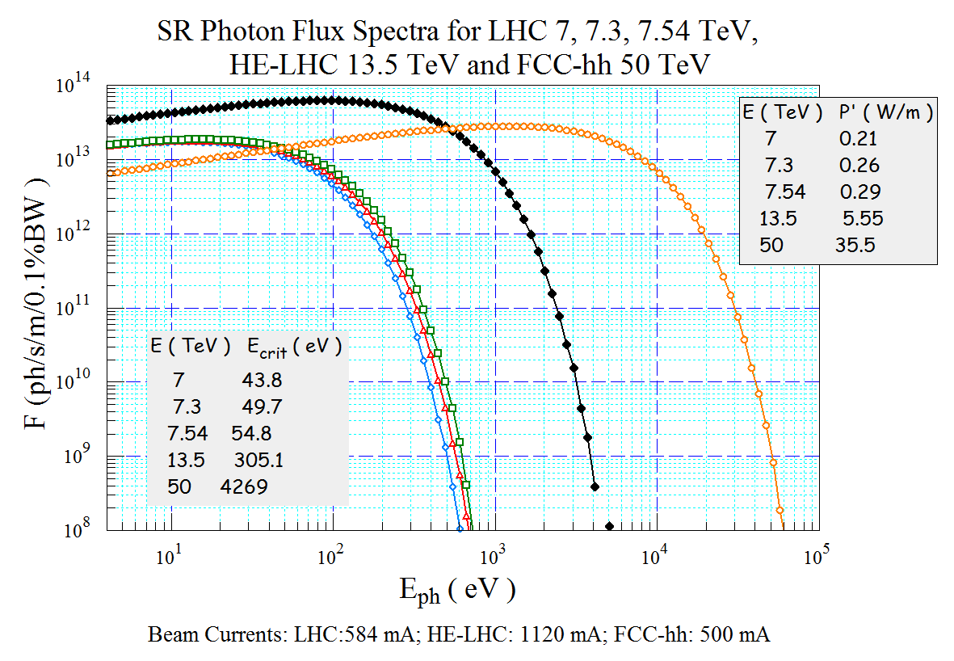
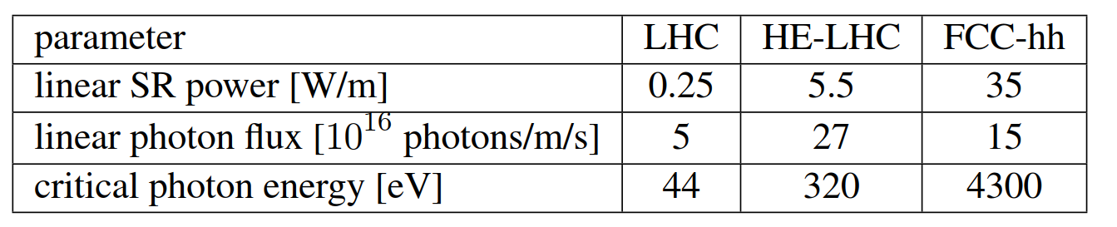
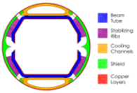
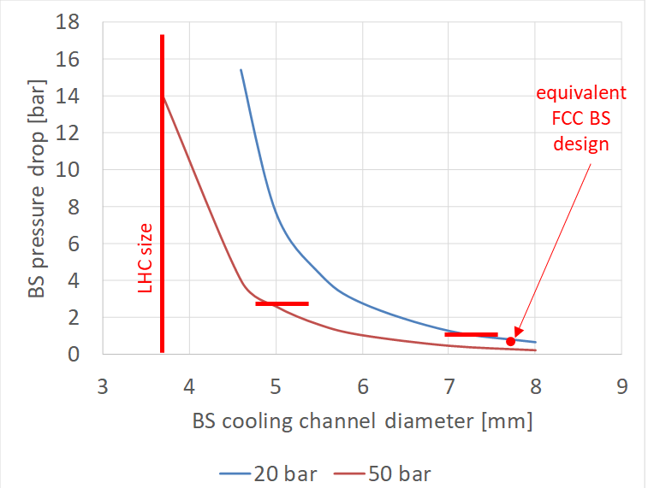
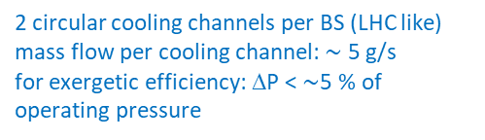
HE-LHC synchrotron radiation (SR)
HE-LHC photon flux per meter = 5.4x LHC (7 TeV) and 1.8x FCC-hh (50 TeV)
→ FCC-hh beam-screen for intercepting SR at higher T, efficient cooling, low impedance, e-cloud suppression and adequate cryo-pumping
HE-LHC electrical power to refrigerator vs pressure drop
HE-LHC beam-screen pressure drop
2 circular cooling channels per BS (LHC like)
mass flow per cooling channel: $\sim$ 5 g/s
for exergetic efficiency: ΔP < $\sim$5 % of operating pressure
FCC-hh BS compatible w 20 bar
operating pressure
BS type | Operating Pressure [bar] | DP [bar] BS (+ CV) | Power to ref. [W/m/beam] | Operation cost (10 y) [MCHF] | Distribution cost
LHC-type beam screen | 20 | N/A | N/A | N/A | N/A
 | 50 | 14 (+3) | 300 | 52 | +
FCC-type beam screen | 20 | 0.8 (+1) | 200 | 35 | -
 | 50 | 0.3 (+1) | 184 | 32 | +

Slide 7
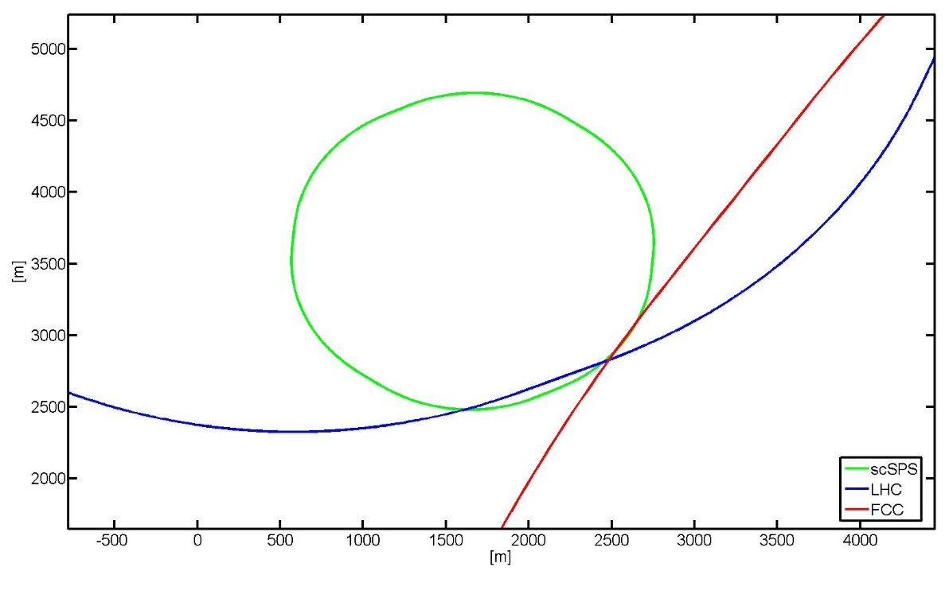
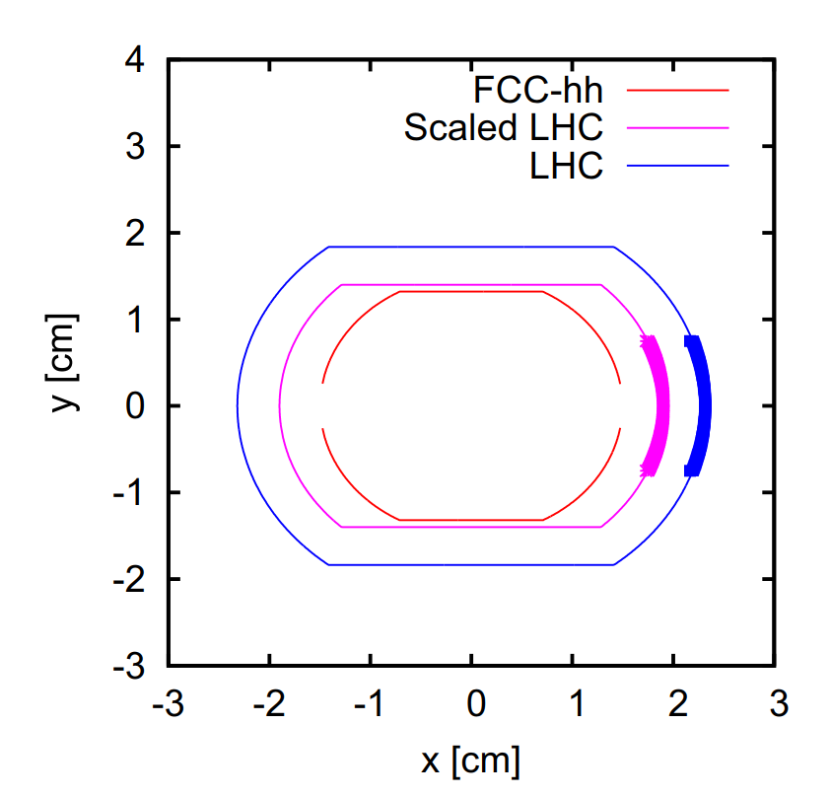
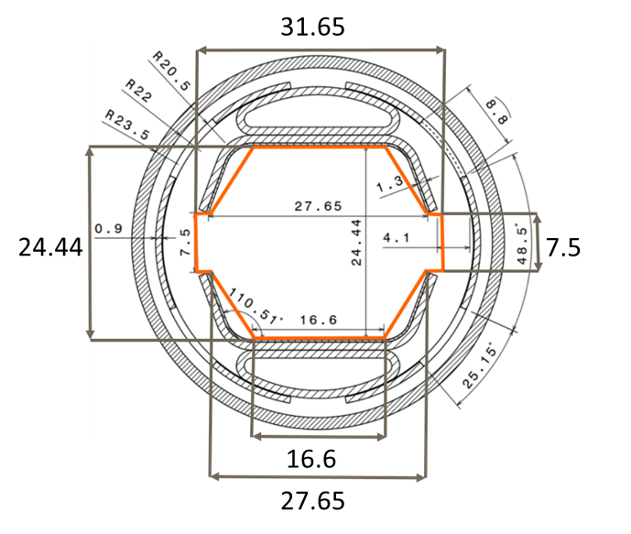
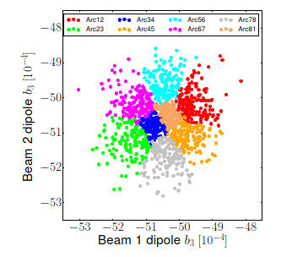
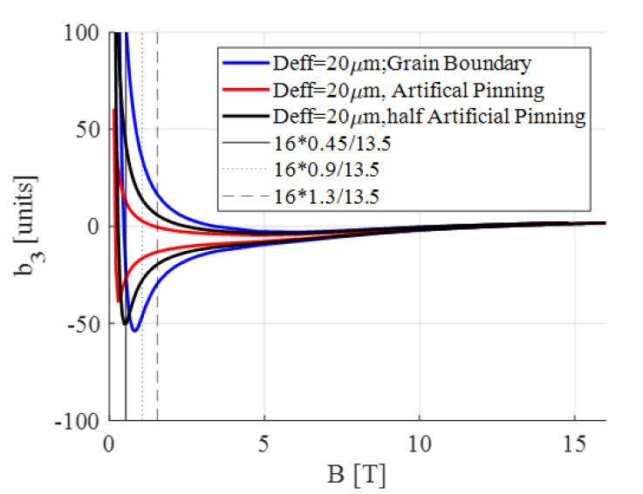
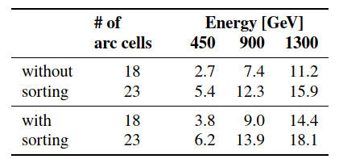
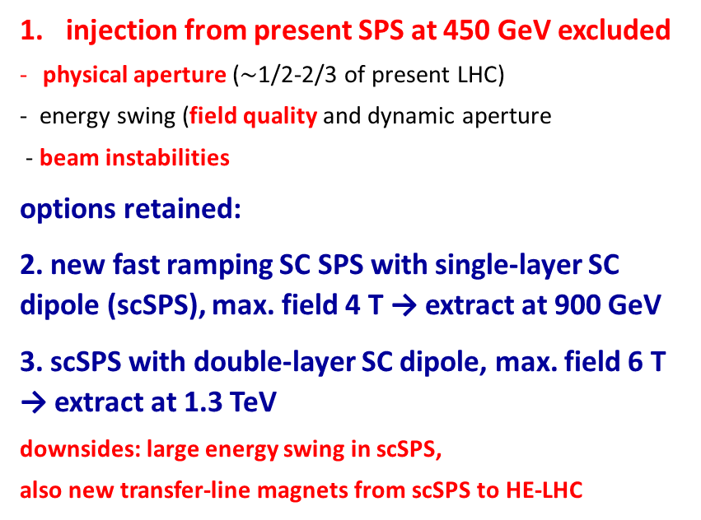
HE-LHC injector options
injection from present SPS at 450 GeV excluded
physical aperture ($\sim$1/2-2/3 of present LHC)
- energy swing (field quality and dynamic aperture
- beam instabilities
options retained:
2. new fast ramping SC SPS with single-layer SC dipole (scSPS), max. field 4 T → extract at 900 GeV
3. scSPS with double-layer SC dipole, max. field 6 T → extract at 1.3 TeV
downsides: large energy swing in scSPS,
also new transfer-line magnets from scSPS to HE-LHC
North Area
LSS3
RF
LSS4
Fast extraction
LSS2
Slow extraction
LSS5
Collimation
LSS1
Injection
LSS6
Fast extraction
& Beam dump
physical aperture in arcs
HE-LHC
vs LHC
beam screen
dynamic aperture [σ] in arcs
sorting
magnet field quality:
eﬀective ﬁlament size 20 µm, APCs,
with 50% pinning eﬃciency, interbeam distance →250 mm,
and magnet sorting
(+ dipole bending)

Slide 8
LoI
HE-LHC did not appear prominently in the conclusions of the EPPSU 2020. Physics justification not obvious.
HE-LHC is a difficult machine facing various obstacles.
Magnet technology is more challenging than for the FCC-hh.
We do not plan submitting any LoI related to HE-LHC at present.

Slide 9
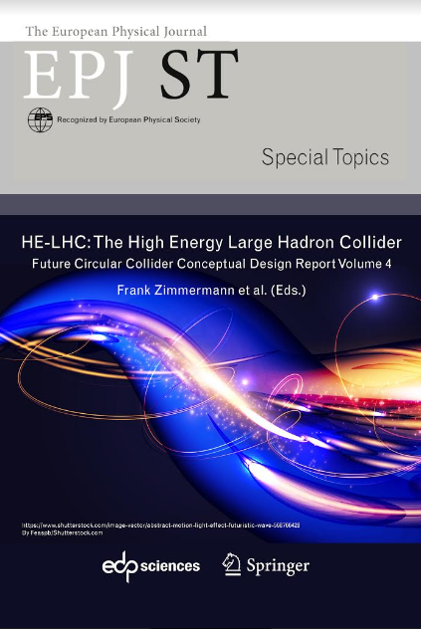
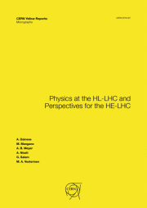
selected HE-LHC references
  HE-LHC: The High Energy Large Hadron Collider, FCC CDR vol. 4 (F. Zimmermann et al.), EPJ ST 228, 5 (2019) 1109-1382
  ESPPU 2020 Physics Briefing Book, CERN-ESU-4
  Report on the Physics at the HL-LHC, and Perspectives for the HE-LHC (A. Dainese et al.), CERN-2019-007
  HE-LHC input document to ESU 2019/20, https://cds.cern.ch/record/2653676
  Dynamic aperture at injection energy for the HE-LHC, M. Hofer et al., IPAC’2019 Melbourne, doi:10.18429/JACoW-IPAC2019-MOPMP023
  Machine Parameters and Projected Luminosity Performance of Proposed Future Colliders at CERN, F. Bordry et al., https://arxiv.org/abs/1810.13022 (2018)

Slide 10
appendix

Slide 11
Facility “Standard Table”
HE-LHC | p-p (p-A, A-A) | * frank.zimmermann@cern.ch
Beam Energy | GeV | 13500 (p-p)
Peak Luminosity (10³⁴) | cm⁻²s⁻¹ | 16 (p-p)
Int. Luminosity | ab⁻¹/yr | ≥0.5
Beam dE/E at IP (rms) |  | 8x10⁻⁵
Transv. Beam sizes at IP x/y | μm | 9/9 (initial)
Rms bunch length / beta* | cm | 9, 45
Crossing angle | μrad | 330 (full)
Rep./Rev. frequency | Hz | Rep rate = 2.7x10⁻⁵ Hz (5 h t.-a. + 5.3 h run length); rev freq.=11,245 Hz
Bunch spacing | ns | 25
# of IPs |  | 2
# of bunches |  | 2808 / beam
Length/Circumference | km | 26.7
Facility site power | MW | 162
Cost range | $B US | 7-8
Timescale till operation |  | > 2050

Slide 12
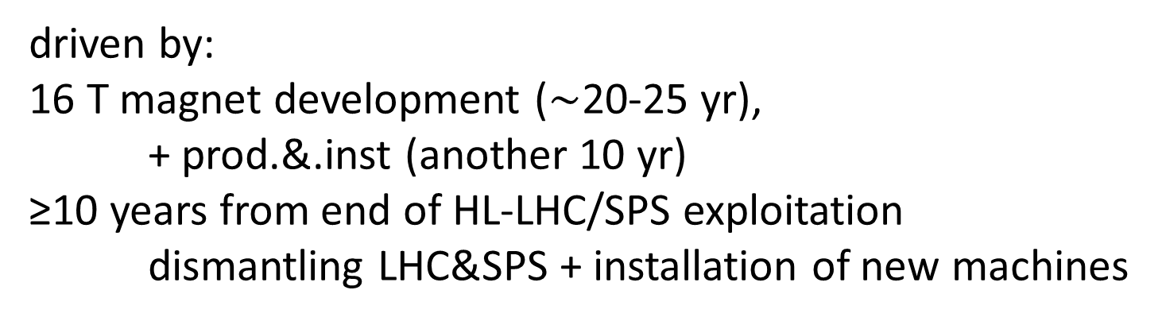
HE-LHC time line
driven by:
16 T magnet development ($\sim$20-25 yr),
+ prod.&.inst (another 10 yr)
≥10 years from end of HL-LHC/SPS exploitation
dismantling LHC&SPS + installation of new machines
HE-LHC cost
Domain | Cost in MCHF
Collider | 5,000
Injector complex | 1,100
Technical infrastructure | 800
Civil Engineering | 300
TOTAL cost | 7,200
Dominant cost item: 1,250 Nb₃Sn 16 T main dipole magnets, with a cost target of 2.3 MCHF/magnet, totalling 2,900 MCHF; also include dare 260 MCHF for LHC disposal.
Estimated cost for construction of a new 1TeV superconducting SPS ~1,100 MCHF)

Slide 13
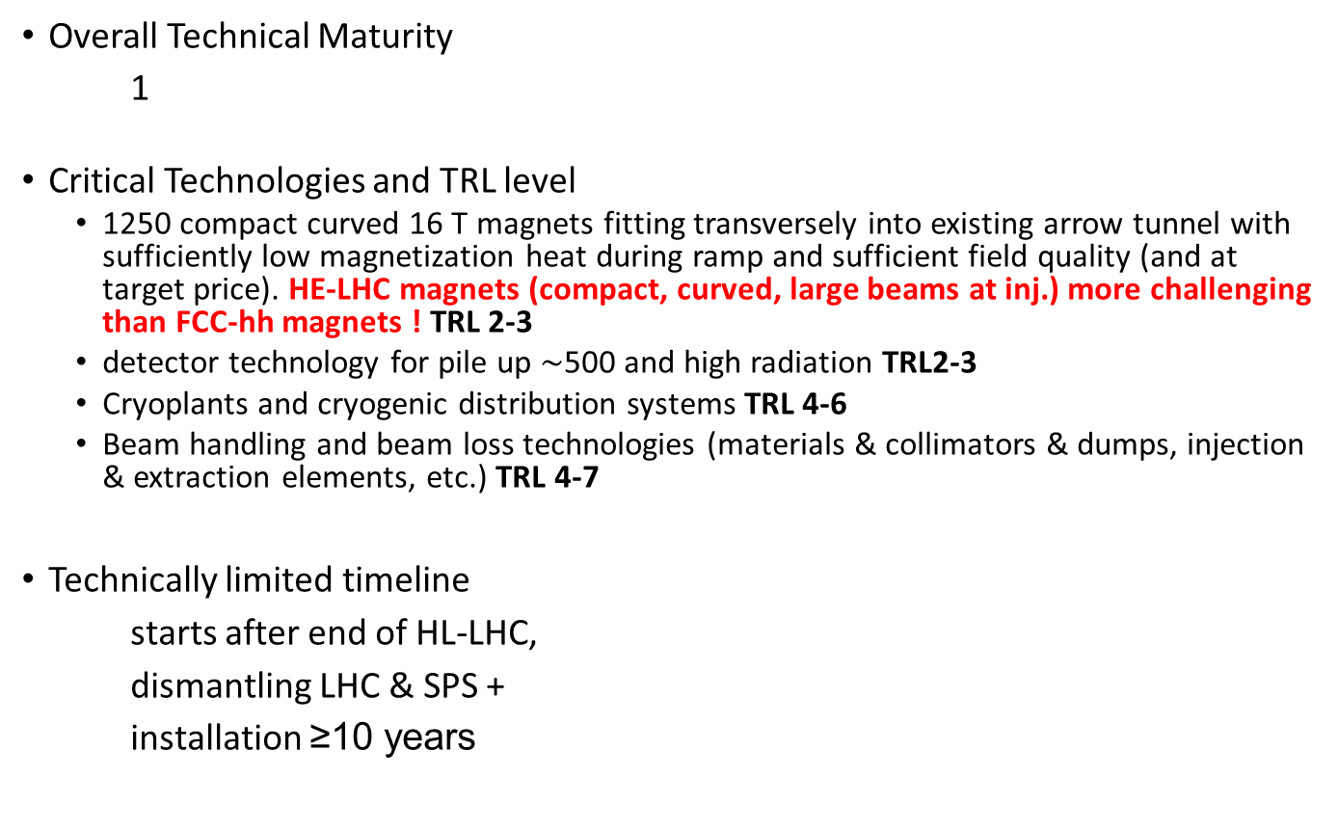
Technical Maturity
1- Significant R&D required
2– Some R&D in a few key areas required
3 – Shovel ready
Overall Technical Maturity
1
Critical Technologies and TRL level
  1250 compact curved 16 T magnets fitting transversely into existing arrow tunnel with sufficiently low magnetization heat during ramp and sufficient field quality (and at target price). HE-LHC magnets (compact, curved, large beams at inj.) more challenging than FCC-hh magnets ! TRL 2-3
  detector technology for pile up $\sim$500 and high radiation TRL2-3
  Cryoplants and cryogenic distribution systems TRL 4-6
  Beam handling and beam loss technologies (materials & collimators & dumps, injection & extraction elements, etc.) TRL 4-7
Technically limited timeline
starts after end of HL-LHC,
dismantling LHC & SPS +
installation ≥10 years
R&D
Construction
5 10 15 20 25 30
(Modify as appropriate)

Slide 14
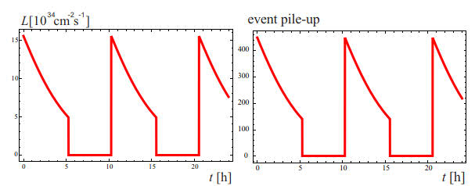
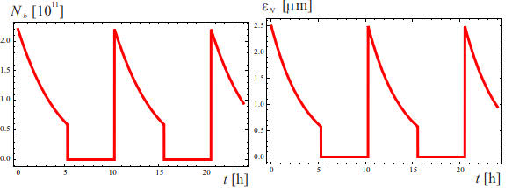
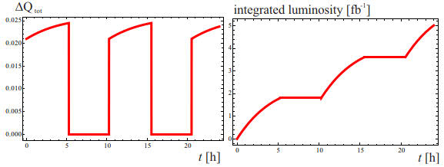
a “typical day” at the HE-LHC
Estimate of integrated luminosity performance:
160 days scheduled for physics per year for HL-LHC, HE-LHC, FCC-hh. Assumed machine availability: (LHC 2017: 81%); HL-LHC: 80%; HE-LHC 75 %, FCC-hh: 70%, corresponding to 39% (HE-LHC) and 54% (HL-LHC) of time “in physics” (stable beams) → annual luminosity ~0.5/ab

Slide 15
HE-LHC topics requiring special attention
many aspects extrapolated/copied from HL-LHC or FCC-hh. most important exceptions:
tunnel integration and magnet technology
compact 16 T magnets (magnetic cryostat, shielding) (LHC tunnel 3.8 m vs. FCC-hh 5.5 m)
HE-LHC Nb₃Sn magnets must be bent: 9 mm horizontal orbit shift over 14 m (vs. 2 mm for FCC-hh)
arc optics optimization
dipole filling factor: energy reach versus strong focusing for lower energy injection
strength of quadrupoles and sextupoles
dynamic aperture, beam size, physical apertures at injection
limited length of straight sections
low-beta insertions, longer triplet than HL-LHC, β* reach
collimation insertions, LHC or FCC-hh optics scaling not applicable, warm dipole length !
extraction straights – length of kicker & septum sections
optics for dispersion suppressor (DS) and collimation
need DS collimators, HL-LHC approach probably not viable (22 T inserts?)
injector and injection energy
physical & dynamic aperture, impedance and beam stability, swing of 16 T magnets…

Slide 16
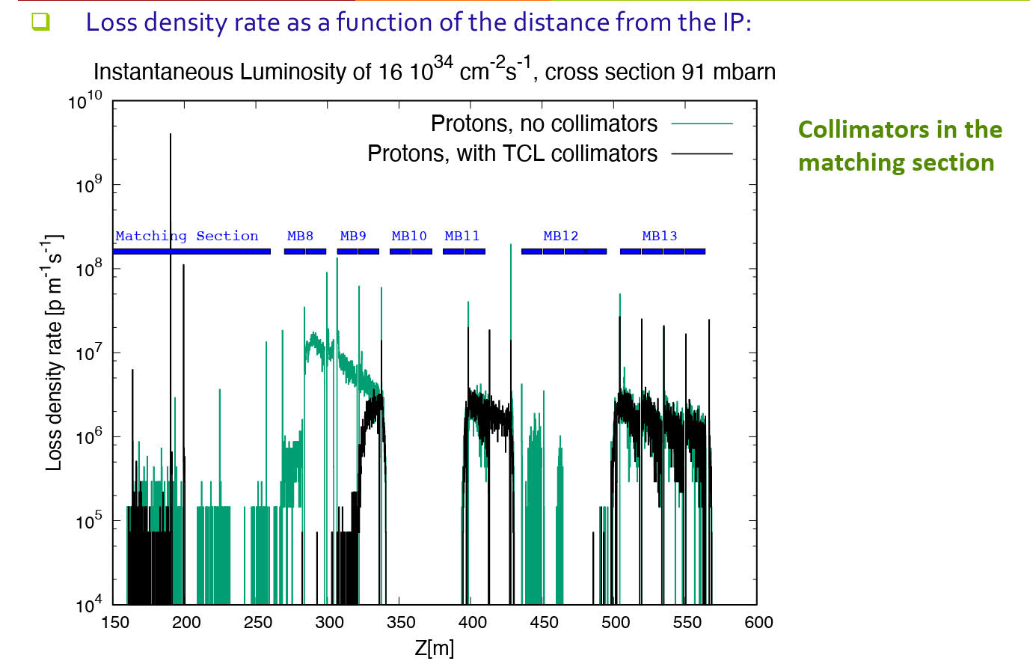
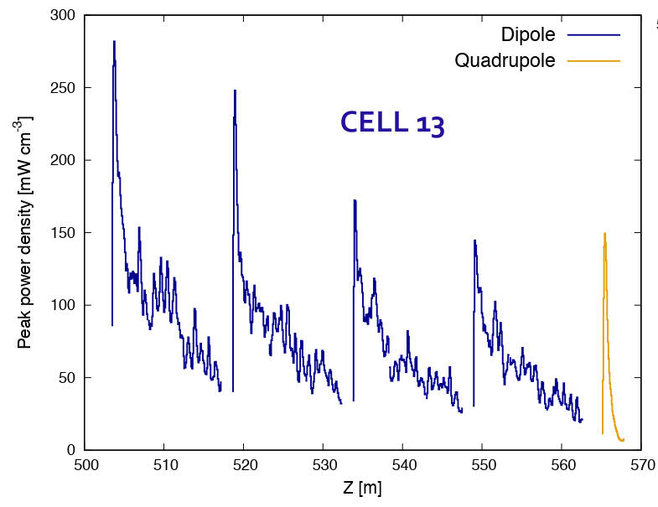
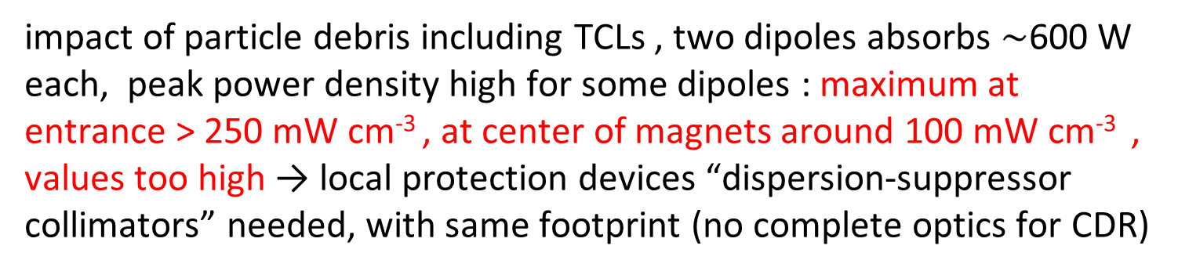
HE-LHC collision debris challenge
TCL collimators
peak power density
impact of particle debris including TCLs , two dipoles absorbs $\sim$600 W each, peak power density high for some dipoles : maximum at entrance > 250 mW cm⁻³ , at center of magnets around 100 mW cm⁻³ , values too high → local protection devices “dispersion-suppressor collimators” needed, with same footprint (no complete optics for CDR)

Slide 17
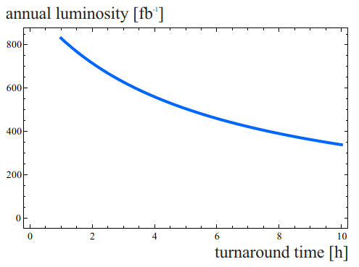
HE-LHC turn-around time
HE-LHC
design value
LHC2017 value (w/o faults)

Slide 18
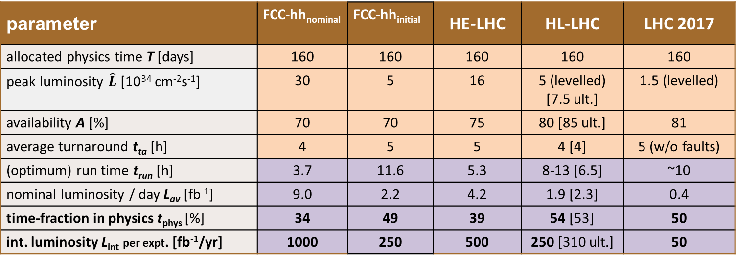


FCC-hh, HE-LHC, HL-LHC performance numbers
parameter | FCC-hh_{nominal} | FCC-hh_{initial} | HE-LHC | HL-LHC | LHC 2017
allocated physics time T [days] | 160 | 160 | 160 | 160 | 160
peak luminosity $\hat{L}$ [10³⁴ cm⁻²s⁻¹] | 30 | 5 | 16 | 5 (levelled) [7.5 ult.] | 1.5 (levelled)
availability A [%] | 70 | 70 | 75 | 80 [85 ult.] | 81
average turnaround t_{ta} [h] | 4 | 5 | 5 | 4 [4] | 5 (w/o faults)
(optimum) run time t_{run} [h] | 3.7 | 11.6 | 5.3 | 8-13 [6.5] | ~10
nominal luminosity / day L_{av} [fb⁻¹] | 9.0 | 2.2 | 4.2 | 1.9 [2.3] | 0.4
time-fraction in physics t_{phys} [%] | 34 | 49 | 39 | 54 [53] | 50
int. luminosity L_{int} per expt. [fb⁻¹/yr] | 1000 | 250 | 500 | 250 [310 ult.] | 50
$$t_{phys}≈A\frac{t_{run}}{t_{run}{+t}_{ta}}$$
$$L_{int}≈A T L_{nominal per day}$$
all these hadron machines feature two high-luminosity experiments and up to two lower-luminosity (or special) interaction points

