Slide 1
Projection of future measurements of m_{H} and Γ_{H}
R. Chatterjee¹, Z. Liu², R. Rusack¹
1: University of Minnesota
2: Maryland Center for Fundamental Physics, The University of Maryland.
5th August, 2020
Thanks to M. Cepeda and E. Scott for suggestions and discussion

Slide 2
Outline
The mass of the Higgs boson (m_{H})
Motivation for precise measurement of m_{H}
Summary of the current measurements of m_{H}
Key challenges for sub 0.1% precision in m_{H} measurements (in a single channel).
The width of the Higgs boson (Γ_{H})
Summary of the current attempts to constrain Γ_{H}
Future attempts to constrain Γ_{H} from the diphoton decay channel.

Slide 3
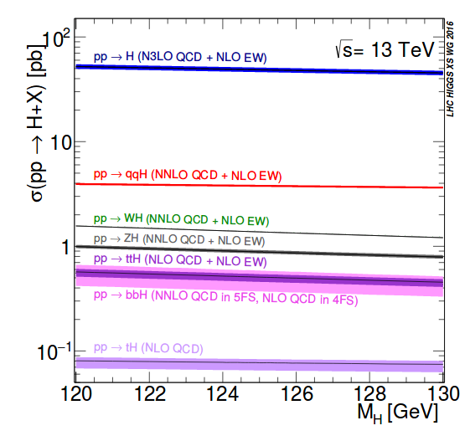
The Higgs boson mass
The mass of the Higgs boson is not predicted from theory.
All properties of the Higgs boson(couplings and cross-sections) are a function of m_{H}
This motivates precision measurements of m_{H}
Currently the m_{H} measurements are carried out in the two high resolution decay channels H→γγ and H→ZZ→4l

Slide 4
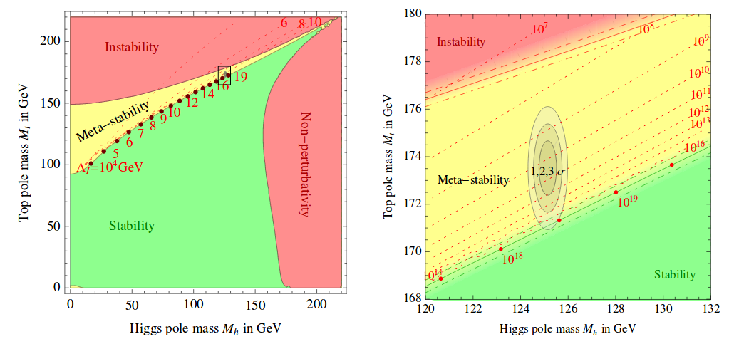
The Higgs boson mass (contd …)
Butazzo et. al. JHEP 12(2013)089
m_{top} & m_{H} are the most important params. that determine the various electroweak phases of the SM
Its important to keep measuring these params. as precisely as possible to determine in which of these regions we live.

Slide 5
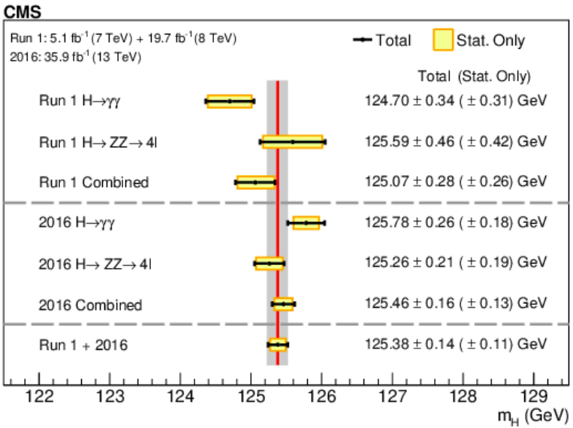
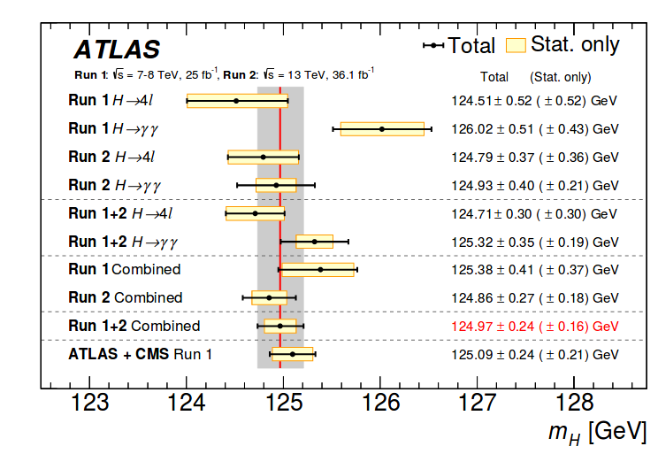
Summary of current m_{H} measurements in ATLAS and CMS
Phys. Lett. B 805 (2020)
JHEP 12(2013)089
The most recent measurement is from ATLAS with the full Run 2 dataset in the H→ZZ→4l channel: m_{H} = 124.92 ± 0.21 (± 0.19) GeV [ATLAS-CONF-2020-005]
The most precise single channel measurements are from ATLAS(full Run 2) and CMS(2016 only) in the H→ZZ→4l channel with a precision of ~0.17%
The most precise measurement of m_{H} to date is from the CMS Run 1 + 2016 combination in the H→γγ and H→ZZ→4l channels with a precision of ~0.11%
The measurement in the diphoton channel is tending to be systematically limited

Slide 6
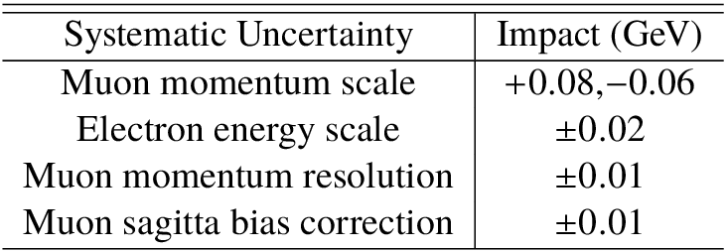
Key challenges in measurements of m_{H}
The precision with which we can measure m_{H} is directly linked to precision with which we can reconstruct (energy scale and resolution) photons and leptons.
ATLAS H→ZZ [ATLAS-CONF-2020-005]
CMS H→γγ [Phys. Lett. B 805 (2020)]
Precision in energy scale | ATLAS | CMS
Muon | 0.05% [|η| < 2.2] | 0.04%
Electron | < ~0.1 % | ~0.05% - 0.15%
Photon | ~ 0.1% | ~0.075% - ~0.15%

Slide 7
m_{H} projections for the future
In the following “simple” projections are made for the statistical precision on m_{H} for full Run 2, Run 3(300 fb⁻¹) and HL-LHC (3000 fb⁻¹), by extrapolating the statistical precision of the CMS Run 1 + 2016 combination
 | Statistical precision [MeV]**
Run 2 | ~100
Run 3 | ~ 60
HL-LHC | ~ 10
Clearly in future the measurement of m_{H} will be increasingly systematics limited.
It will be a significant challenge to obtain similar levels of precision on the physics object energy scales.
As we accumulate more statistics the H→ZZ→4µ channel will yield the most precise results.
It is also important to strive to enhance the precision in m_{H} in the diphoton channel.
The analysis will have to be limited to the categories where the detector is least affected by radiation damage and the photon energy scale is measured most precisely.
**These are the best we can achieve assuming we can maintain the physics object scale and resolution at current levels

Slide 8
Direct measurement of the Higgs boson width

Slide 9
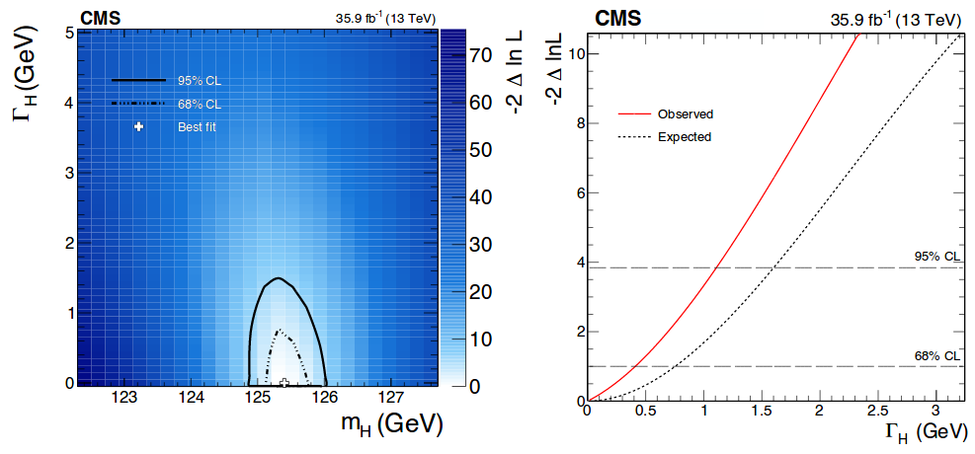
Direct measurement of the width
H→ZZ [JHEP 11 (2017) 047]
The expected limit at 95% CL on Γ_{H} is ~ 1.1 GeV, limited by the detector resolution.
Γ_{H} of the SM is 4.1 MeV

Slide 10
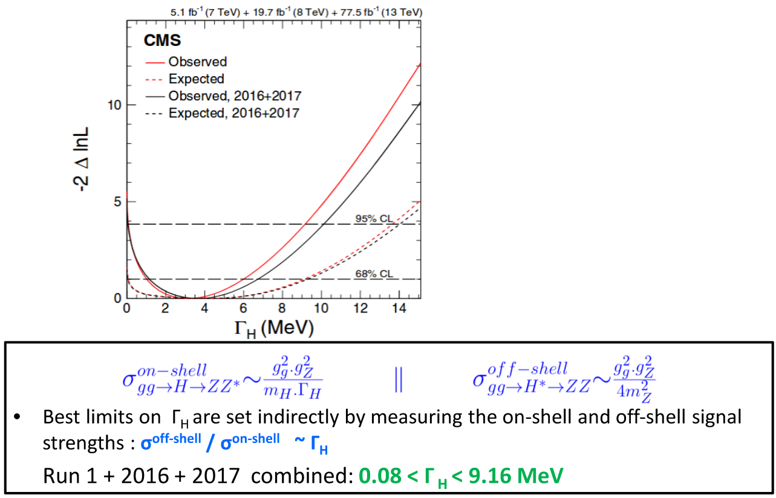
Indirect measurements of the Higgs width
ASSUMPTIONS:
-- Nature of the interference in the off-shell
region
-- Coupling modifiers are the same in the two regions
H→ZZ [PRD 99, 112003]

Slide 11
Indirect measurements of the Higgs width in the diphoton channel

Slide 12
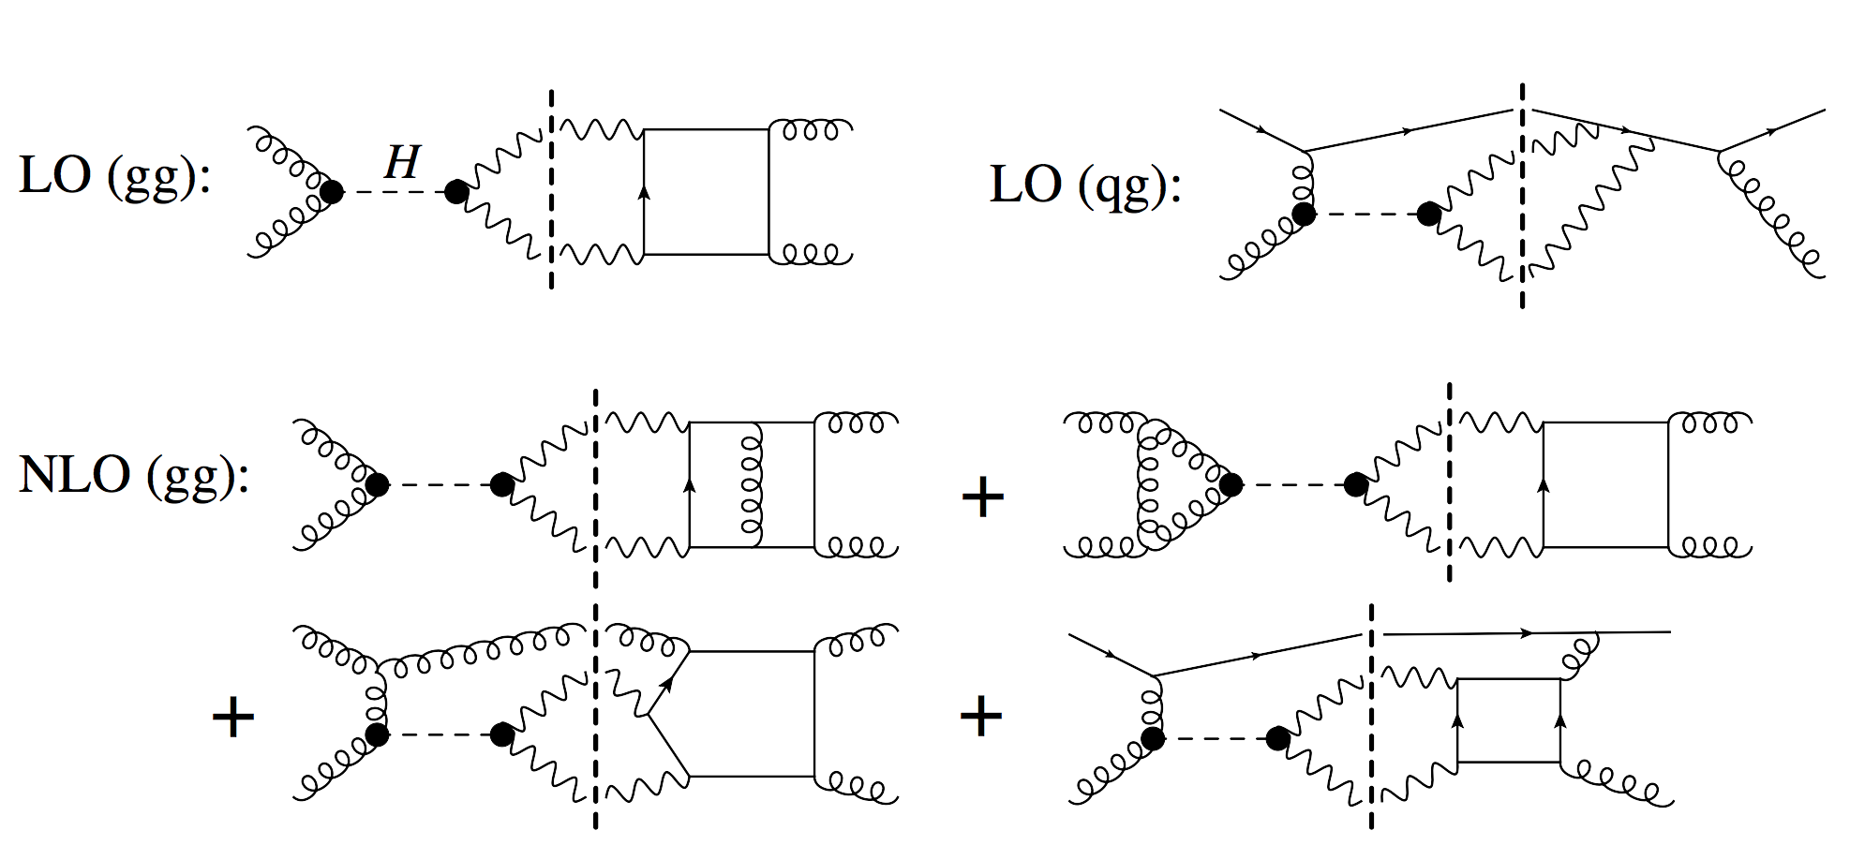
Interference between GGH and the QCD continuum
Reference : CERN YR4 PG-257
The interference has two parts:
Real → results in a shift in m_{H}
Imaginary → modifies production cross-section and hence the measured signal strength.
This effect is significant the diphoton decay channel.

Slide 13
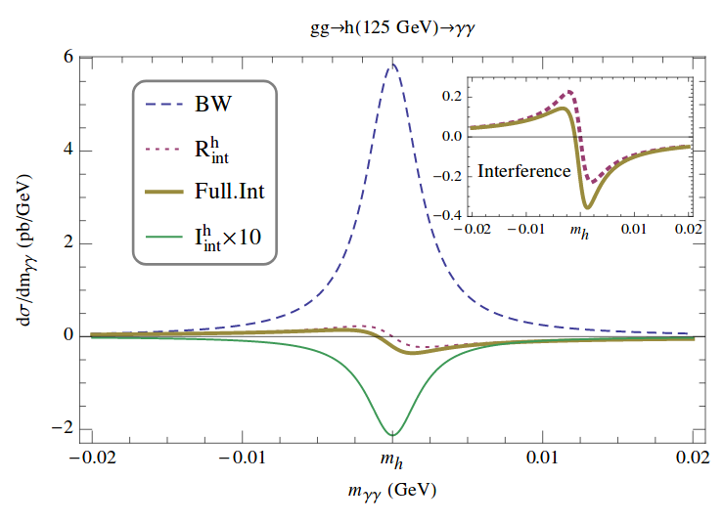
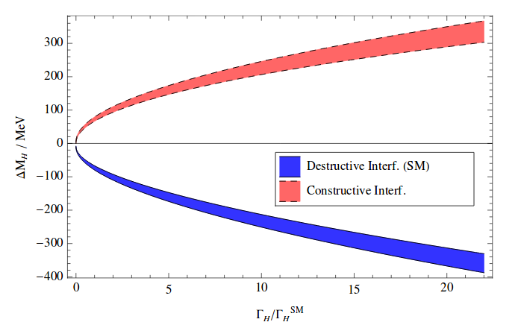
A shift in m_{H} and σ_{H} as a result of interference
Campbell et. al. Phys. Rev. Lett. 119, 181801
Dixon et. al. Phys. Rev. Lett. 111, 111802
m_{H} shifts as a result of interference. The direction of the shift and the magnitude depends on if the interference is constructive/destructive and the order in of the calculation (in QCD)
The Higgs boson production C.S is also suppressed as a result of this interference.
For the SM this amounts to ~2-3%
Both the mass shift and the C.S suppression are a function of Γ_{H .} Hence these measurements can be used to indirectly constrain Γ_{H}

Slide 14
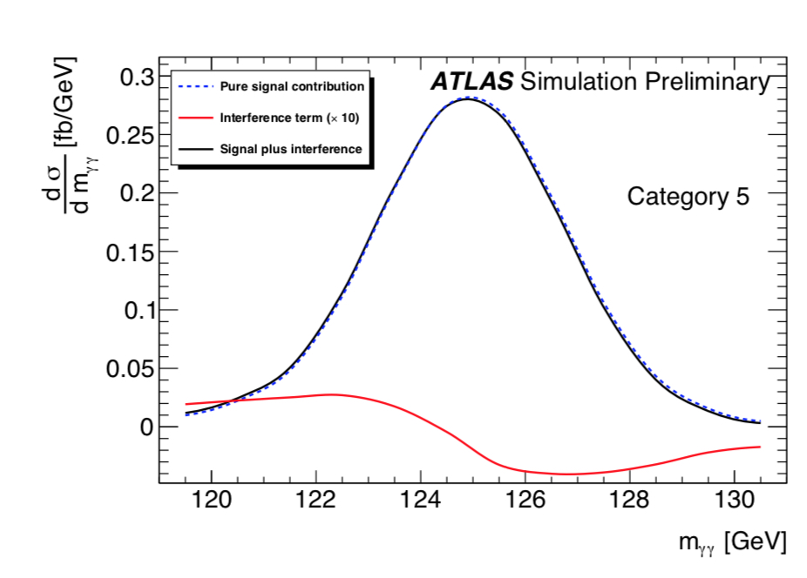
Strategy to measure the mass shift
ATLAS-PHYS-PUB-2016-009
The current precision with which we can measure m_{H} [~0.2%] makes a mass measurement the best tool to access this effect in Run 2.
A public note from ATLAS lays out a strategy to estimate the mass shift by carrying out a “normal” mass measurement where the signal model includes the interference effect.
Δm_{H} = 35 ± 0.3 (stat) ± 8 (theory) ± 4 (syst.) MeV

Slide 15
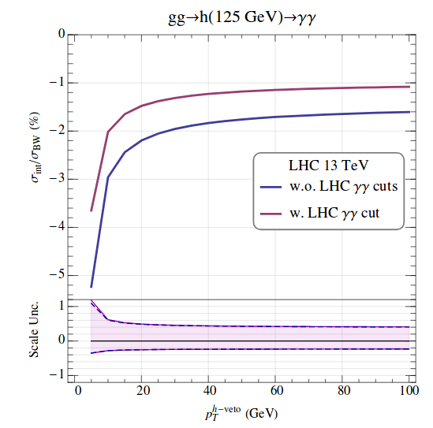
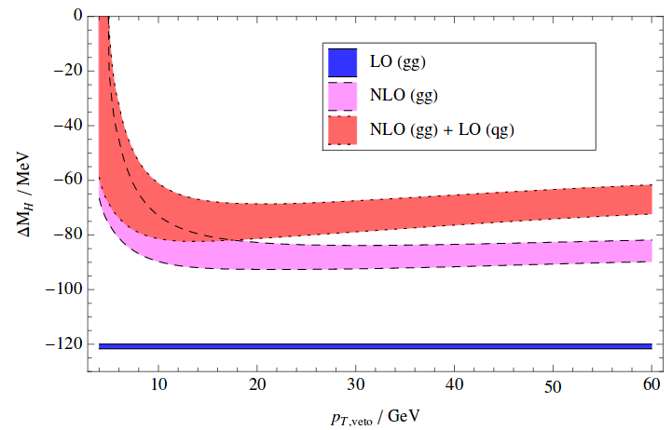
A shift in m_{H} and σ_{H} as a result of interference (contd…)
Dixon et. al. Phys. Rev. Lett. 111, 111802
Campbell et. al. Phys. Rev. Lett. 119, 181801
The magnitude of the interference and hence its manifestation in the form of m_{H} and σ_{H} shifts are a function of the scale of the event.
It is important to carry out these measurements as a function of p_{T}(H)

Slide 16
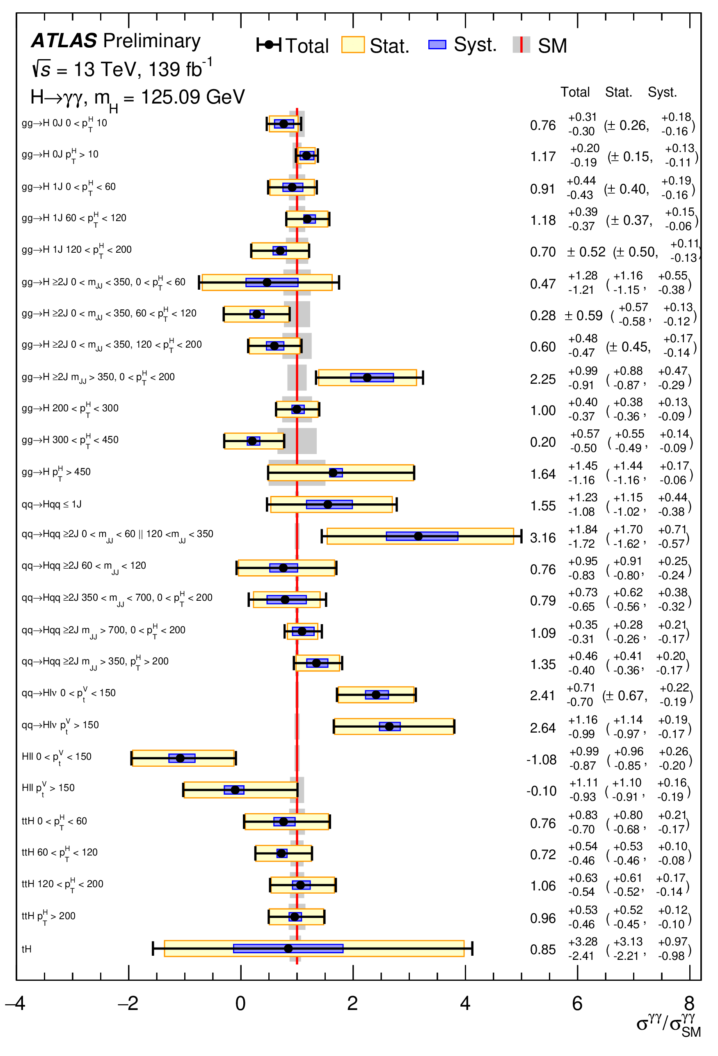
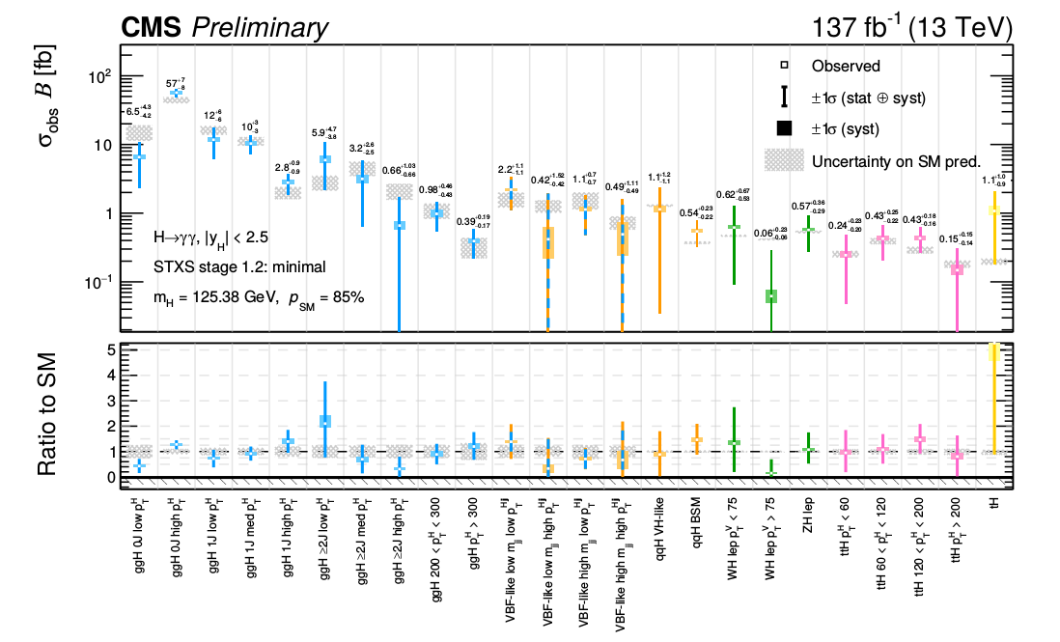
A digression: The STXS stage 1.2 measurements
ATLAS-CONF-2020-026
CMS-PAS-HIG-19-015
The exp. precision of the cross-sections of GGH production in several STXS 1.2 bins is approaching the theoretical precision.
Important to estimate the impact of interference on the GGH production C.S in these bins.

Slide 17
Proposal to estimate projections for m_{H} and Γ_{H}
Based on the currently available measurements m_{H} , would like to estimate updated projections for the precision of m_{H} in Run 3 and HL-LHC
While the H→ZZ→4µ drive the precision it is important to develop strategies to obtain sub-100 MeV precision in the diphoton channel
The best limits on Γ_{H} are obtained indirectly from the H→ZZ→4l channel
However this requires several assumptions.
The interference between Higgs production, in the diphoton decay channel, via gluon fusion and the QCD continuum can also be used to constrain Γ_{H}
We would like to use our best knowledge of the precision in m_{H} possible to update the corresponding projections .

Slide 18
BACKUP

Slide 19
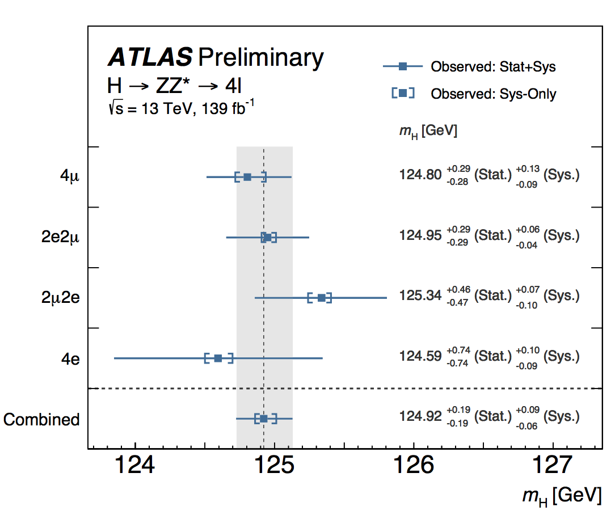
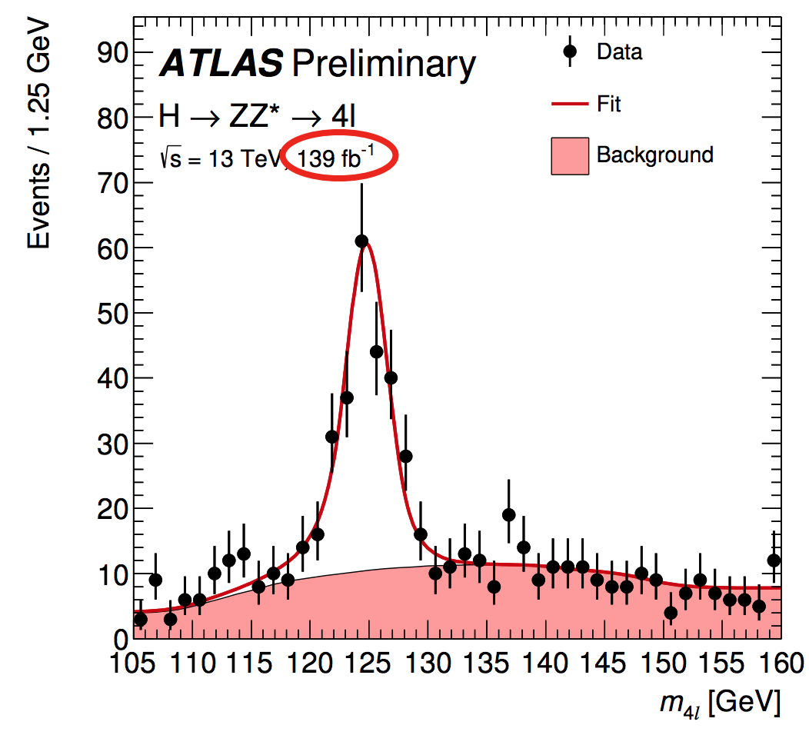
Mass measurements with full Run 2
ATLAS CONF-2020-005
First m_{H} measurement with full Run 2. Precision(0.21 GeV) comparable to CMS HZZ with 2016 only.
2D event categorization based on per event resolution and S/B BDT.
A NN was trained to predict the per event resolution.

Slide 20
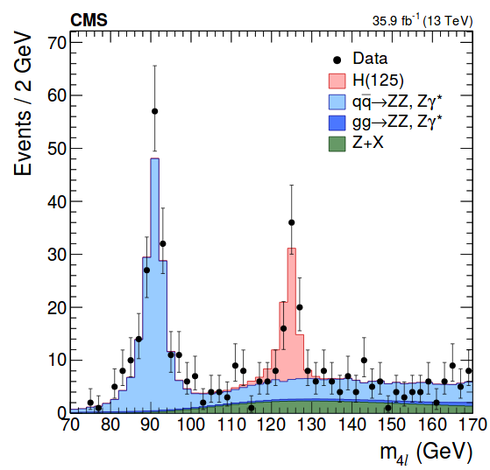
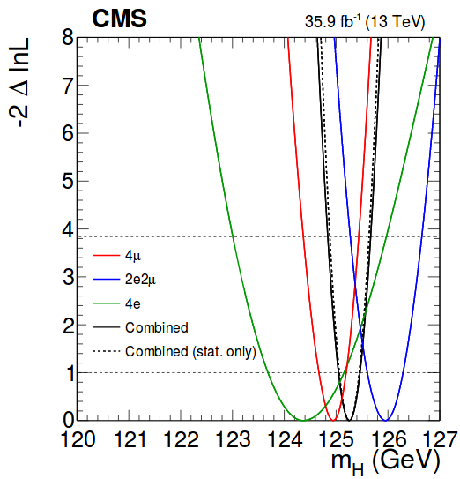
m_{H} measurement in H→ZZ* with the 2016 dataset
Three event categories based on 4 isolated leptons: 4μ, 2e2μ, 4e
The m_{H} measurement based on a 3D fit on the m_{4l}, per event uncertainty on m_{4l} and the kinematic discriminant(separates signal from background) : Improves the precision by 11% w.r.t a 1D fit.
m_{H} = 125.26 +/- 0.21 [0.20 (stat.) +/- 0.08 (syst.) ] GeV
The measurement in statistically limited.
Main systematics: electron and muon energy scale unc.
The most precise measurement in a single channel

Slide 21
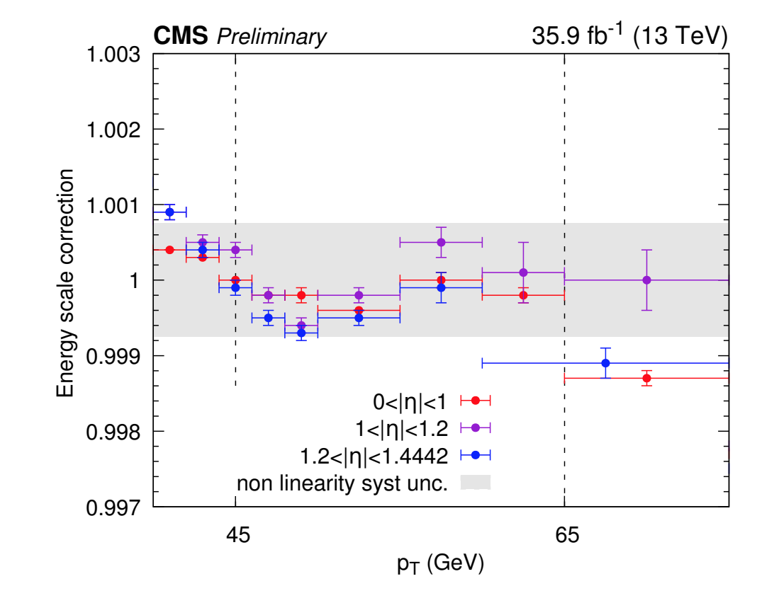
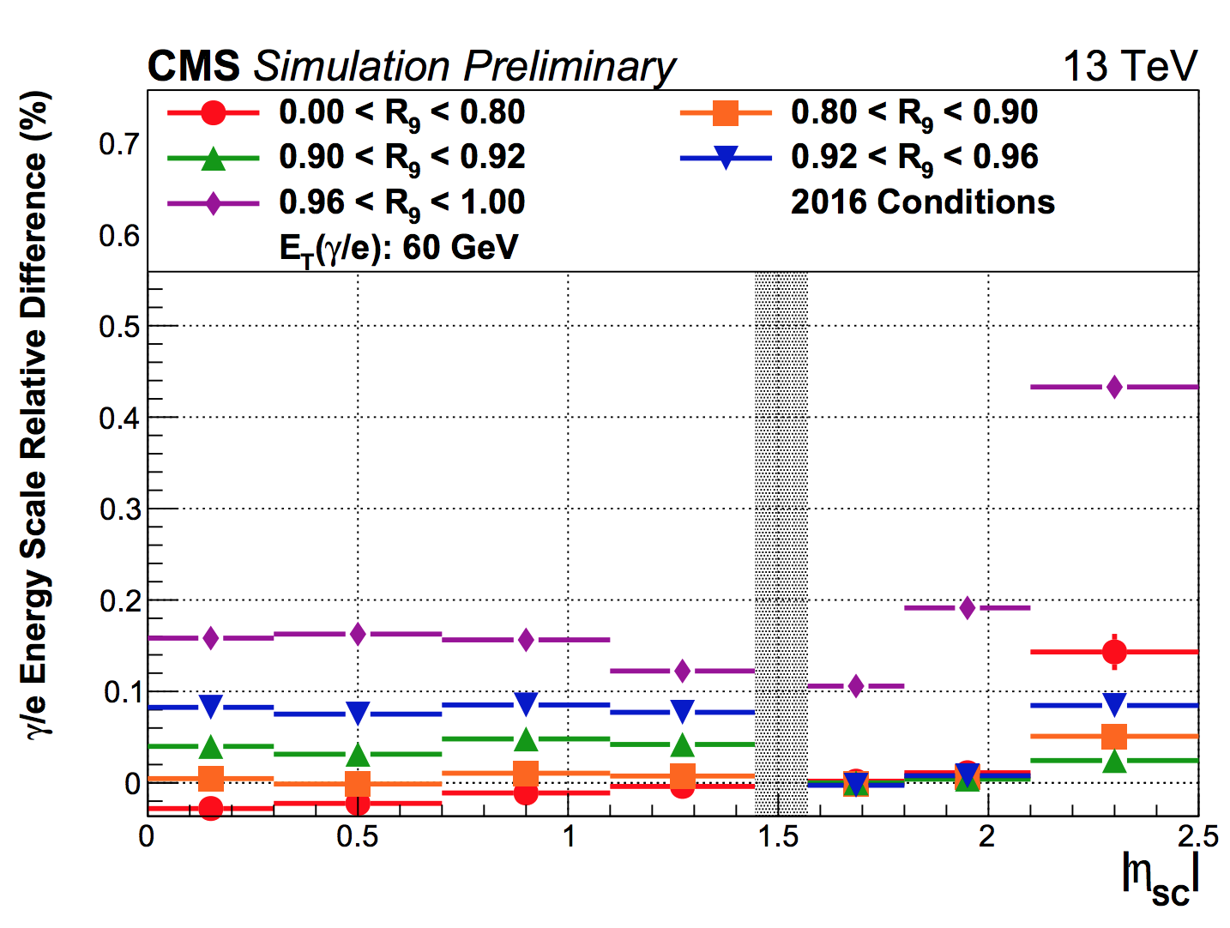
Key elements of HIG-19-004
General strategy the same as in HIG-16-040 with the following improvements :
Updated legacy re-reconstruction of the 2016 dataset.
Dedicated p_{T} dependent residual energy scale corrections.
A method to estimate the systematic uncertainty on the photon energy scale due to radiation damage of ECAL crystals.
A simplified event categorization : dropped the 7 categories dedicated for the VH and ttH tags.
The measurement of m_{H} from the H→γγ decay channel with the 2016 dataset was combined with the same measurement in the H→ZZ decay channel with the 2016 dataset[HIG-16-041] and the Run 1 combination.

Slide 22
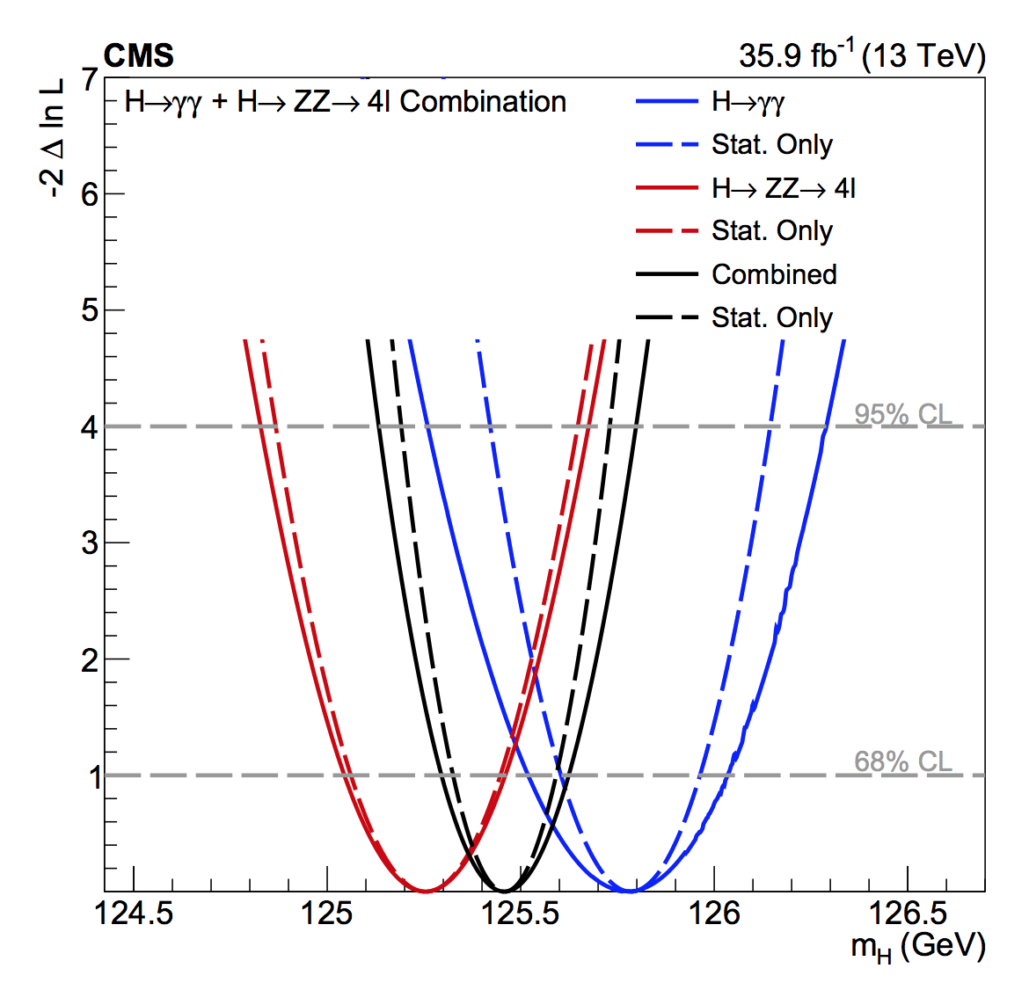
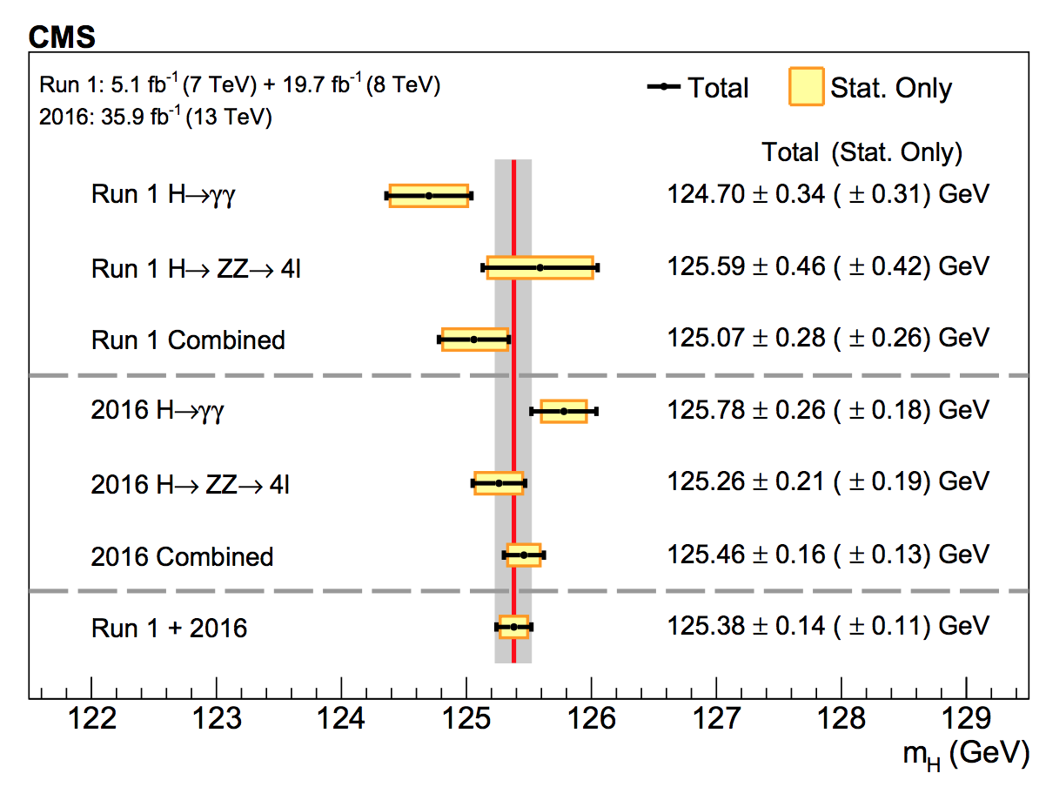
Summary of the combined m_{H} measurement

Slide 23
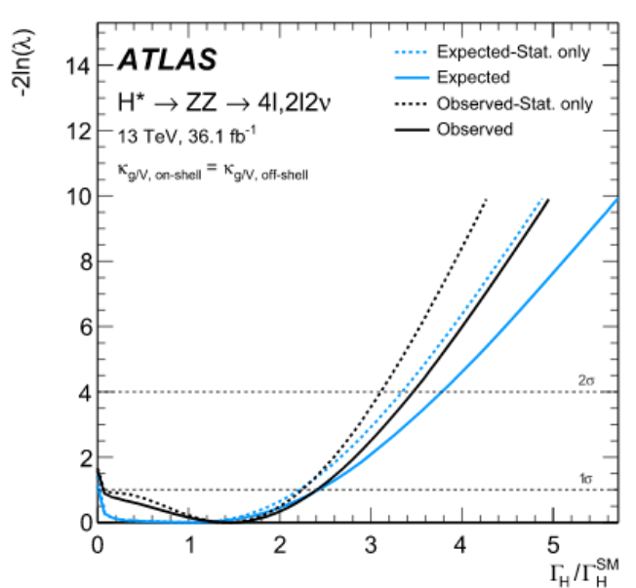
Indirect measurements of the Higgs width
H→ZZ [PLB 786 (2018) 223]
Γ_{H} < 14.4 MeV at 95% CL

Slide 24
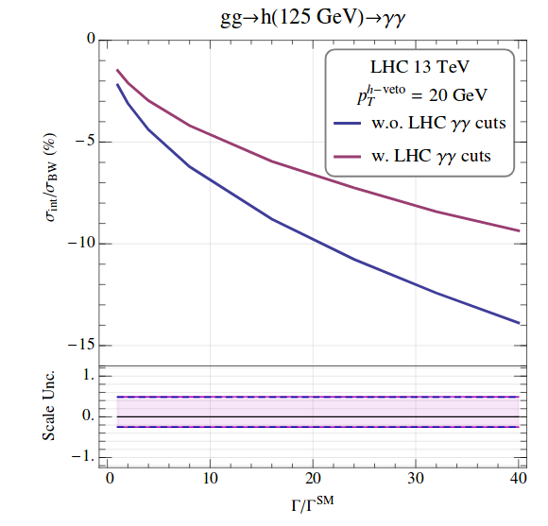
A shift in σ_{H} as a result of interference
Campbell et. al. Phys. Rev. Lett. 119, 181801

