Slide 1
Department self assessment draft action items
Compiled by Brendan Casey from notes taken by Brendan Kiburg, Bob Bernstein and Adam Lyon with input so far from Saskia Charity, Jessica Esquivel, Manolis Kargiantoulakis, Brendan Kiburg, Tammy Walton, Julie Whitmore, and Sam Zeller

Slide 2
Process
I believe this is the process we are in:
Took assessment and did some brainstorming on June 10
By design, the session was exclusive and not inclusive
Drafted some action items, and now we need to discuss them and get inclusive feedback from everyone before we start implementing them
Feedback can be in any form: too week, too strong, not enough, too much, or it can be completely different ideas.

Slide 3
Self Assessment
Following the call for a strike for Black lives, several of us got together on June 10 to perform a self assessment of the muon department and to try and brainstorm some action items
We followed the department self assessment in appendix 8 of the Team Up report.
Designed for undergraduate departments but many aspects are applicable to our department
Based on key factors identified in the report
Belonging, physics identity, academic support, personal support, leadership and structures.
If you haven’t read the entire report yet, you should.
https://www.aip.org/diversity-initiatives/team-up-task-force

Slide 4
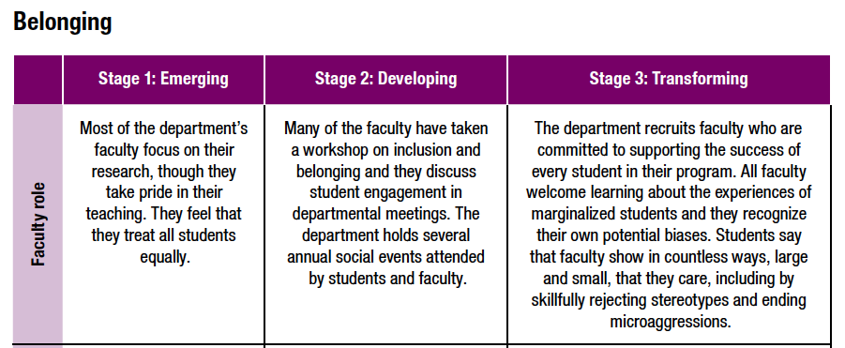
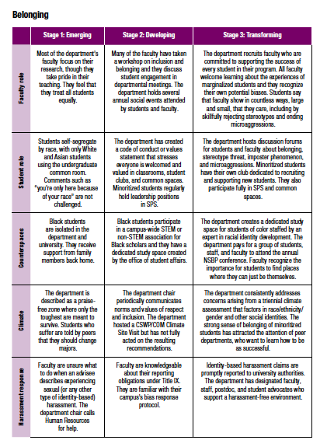
Self assessment
For each key factor, the self assessment examines different roles
role of the faculty (senior staff), role of the student (junior staff), and other environmental/organizational aspects of the department
Examples are given to see what stage the department is in, emerging, developing, or transforming

Slide 5
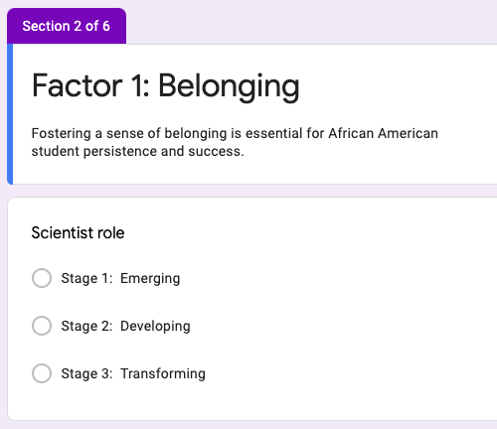
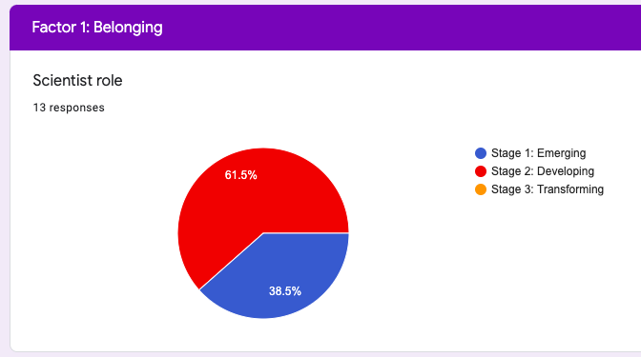
Self assessment
We made a google survey and asked everyone participating to perform the assessment before we got together. We did not gather any information on who responded.
https://forms.gle/NZNWTiRNy8gxXcDx6
I believe you can access the results here (let me know if there is a problem):
https://docs.google.com/forms/d/1edbfUeXv6gV0RMdlF5Nm49p-fGPUtkyZp1JzRDSczJU/edit#responses

Slide 6
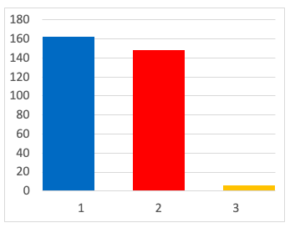
Assessment results
We gave ourselves a ~1.5
Majority of responses still have the department in the “Emerging” category
Although we didn’t gather demographic info, we know the department is skewed to senior white males so those biases should be considered.
Going through the questions together, we asked if there are ways to try and get up to 2 for starters.
Emerging
Developing
Transforming

Slide 7
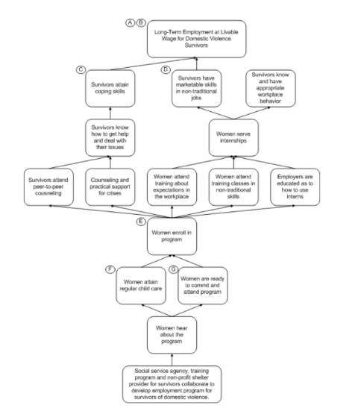
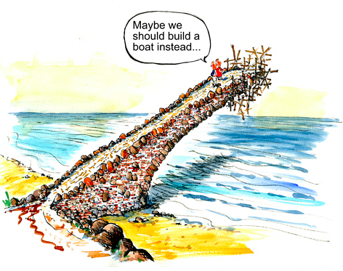
Change management
Other thing that came up several times was the final section of the Team Up report on “Change Management”
We need to be strategic. Burnout is real.
We need to bring people along (sensemaking)
We need a combination of top-down and bottoms-up approaches (shared leadership)
Points to lots of external references about successful change
https://www.theoryofchange.org/what-is-theory-of-change/

Slide 8
Action items
Came up with several action items from the notes of the discussion
For the one’s we choose to implement, I’d like to ask for volunteers to form a small team to take on each one.
Would be great if everyone was on a team
No one should be on more than one team
But teams should solicit input from everyone

Slide 9
1) Have a retreat to write a Statement of Values for the Department
Goal: spell out our shared values
First step in developing a theory of change
We would want to bring in outside facilitators to help with this
Personally, I think this should be more than a D&I statement and should address things like service and outreach/engagment and how we value those things
Can also include how we reward these (give the statement teeth)

Slide 10
2) Restart Journal club/seminar series
Would be good to have a mix of scientific topics and social topics
Need the implementing team to recommend an organization structure that doesn’t rely on one or two people to take on the entire burden
Maybe something like the colloquium committee?

Slide 11
3) Revamp the vestibule area in front of the elevators as a ‘Welcome to the Muon Department’ area
Goal: make visitors feel welcome and make employees, users, and interns, feel proud when they get off the elevators
Include bios of everyone like what we have in MC-1
Gives everyone a chance to say who they are and what is important to them
4) Revamp common space on the southwest side of 9E
Goal: encourage more discussion/group bonding

Slide 12
5) Update the department’s web page
Goal: highlight who we are with our bios, are statement of values, and help create an alumni network.
Can also promote contacts to different professional organizations and external mentoring programs.
Need the implementing team to recommend an organization structure that doesn’t rely on one or two people to take on the entire burden
Hire someone to do this?
Rotating web master every quarter?

Slide 13
6) Increase participation in existing public engagement and intern programs
Goal: get more people involved in engagement and help make the lab’s engagement efforts successful
Step 1: Invite Sandra Charles to a future department meeting to discuss current engagement programs and let us know where she needs volunteers the most
Step 2: make sure everyone participating has quality training. This is a place where we could easily do more harm then good.

Slide 14
7) Increase participation in identity-based conferences
Need a few people to recommend the frequency of attendance and then we can set aside the appropriate travel budget for this.
postdocs go to 1 a year or more? Senior people go how frequently? Or something completely different?
We should remember that these are science focused meetings, and these are opportunities to present our results just like at any other conference.

Slide 15
8) Rewrite job advertisement for the next department hire
Should be based on our values
Should request a D&I statement
Should include suggestions from the lecture by Jesus Pando (DePaul)
https://vms.fnal.gov/asset/detail?recid=1956022&recid=1956022
This will have to be the hiring manager working with the recruiter
The add is important because it is the beginning and the basis for the official process. The unofficial process of making contacts is a continuous effort.

Slide 16
9) Evaluate current mentor program
Current program hosted by WDRS started in March. We will meet with Holly Lett after getting feedback from the 1st cohort to understand how to improve the program.
In the meantime, don’t forget to sign up
https://hr.fnal.gov/training/mentor-profile/
https://hr.fnal.gov/training/mentee-profile/

Slide 17
Next steps
Discuss now
Think about it
Make suggested changes / additions / deletions offline
Consider volunteering for one of the teams.
I think if we start planning soon we can have a retreat in the mid fall (hopefully in person, outdoors)
I think it would be nice to get the others started soon as well

