Slide 1
NuComp News
Lee Lueking
October 19, 2011

Slide 2
Outline
Maintenance day stuff
IF Computing Resource Summary
A closer look at GP Grid usage

Slide 3
Maintenance Day: Tomorrow 10/20
Memory upgrades for GPWN003-7
These nodes will be out of the GPSN01 pool during the work.
Should be transparent to users.
FermiGrid expects to do a VDT upgrade on Grid gatekeepers.
Running jobs won't be disturbed due to this work.
New job submissions may be delayed a few minutes.

Slide 4
Maintenance Day Next Month Thursday 11/17
5-8AM: /afs software will be upgraded
Needed to accommodate compound principals (kcron)
Not well tested due to lack of good test platform. Roll back if it does not work.
8AM-NOON: IF/GPCF/MINOS/MB reboots (pending confirmation of new kernel).

Slide 5
SLF4 EoL
SLF4 will no longer be supported after Feb. 12, 2012
Running SLF 4 Node Report URL: http://fefweb.fnal.gov/slf4eol/
IF/GPCF/MINOS/MB NODES:
BooNE – 11 nodes
BooNE-LANL – 9 nodes
IF01-05; MNVNEARLINE1,2,D;MINERVA-OM;MINERVA05,20,21;MNVNEARLINEBCK2
MINOS-DB;MINOS25,26,27; MINOS-OFFLINE2,3;EVENT2;MINOSGPVM02
NOVADBDEV;NOVADBPROD

Slide 6
IFront Computing Resource Summary
Central Storage
GP Grid Cluster

Slide 7
Disk Usage Trends (1/3)
/app
/data
All
/argoneut
/gm2

Slide 8
Disk Usage Trends (2/3)
/app
/data
/lbne
/minerva
/minos

Slide 9
Disk Usage Trends (3/3)
/app
/data
/mu2e
/nova
/microboone
/miniboone

Slide 10
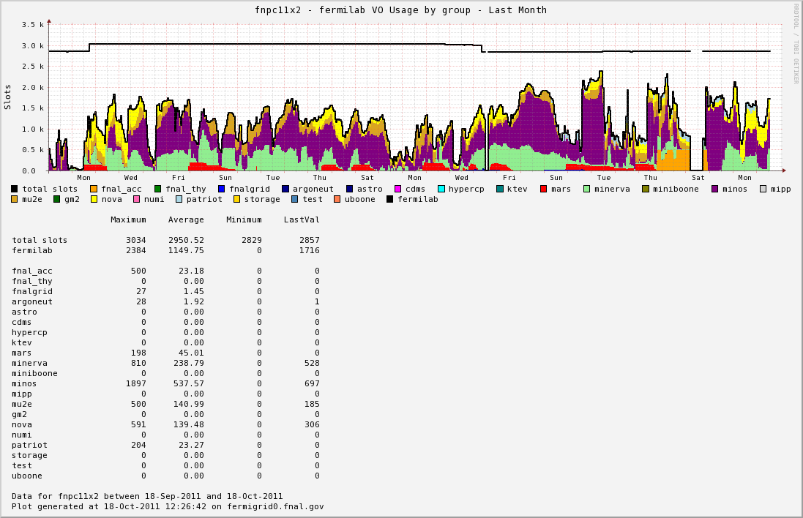
GP Grid Cluster Use, Last Month

Slide 11
GP GRID Usage Monthly wall clock time (hrs)
Month 1=Apr. 2011
Month 7=Oct. 2011
Month 1=Sep. 2010
Month 14=Oct. 2011

Slide 12
November & December NuComp
No Plans!
Let me know if there are topics that need to be discussed.

Slide 13
finish

