Slide 1
Activities and Plans for Snowmass 2021
HEPAP Meeting
July 10, 2020
Young-Kee Kim
University of Chicago
DPF Chair
On behalf of the Snowmass Coordination Team

Slide 2
Snowmass
Long-term planning exercise for the particle physics community
Its goal is to develop the community’s long-term physics aspirations.
Its narrative will communicate
the opportunities for discovery in particle physics
to the broader scientific community and to the government.

Slide 3
U.S. Strategic Planning Process for Particle Physics
~year-long process
Snowmass Community-Wide “Science” Study
Organized by Division of Particles and Fields (DPF) of APS
Input to P5
~year-long process
P5 (Particle Physics Project Prioritization Panel)
formulate a 10-year execution plan (20 year vision) within funding constraints
Subpanel of HEPAP, High Energy Physics Advisory Panel for DOE/NSF funding agencies
Particle Physics is not isolated:
Long-Range Plan for Nuclear Science (neutrinos, fundamental symmetry, QCD, …)
Decadal Survey on Astronomy and Astrophysics (dark energy, CMB, dark matter, …)
HEPAP Accelerator R&D Subpanel Report
….

Slide 4
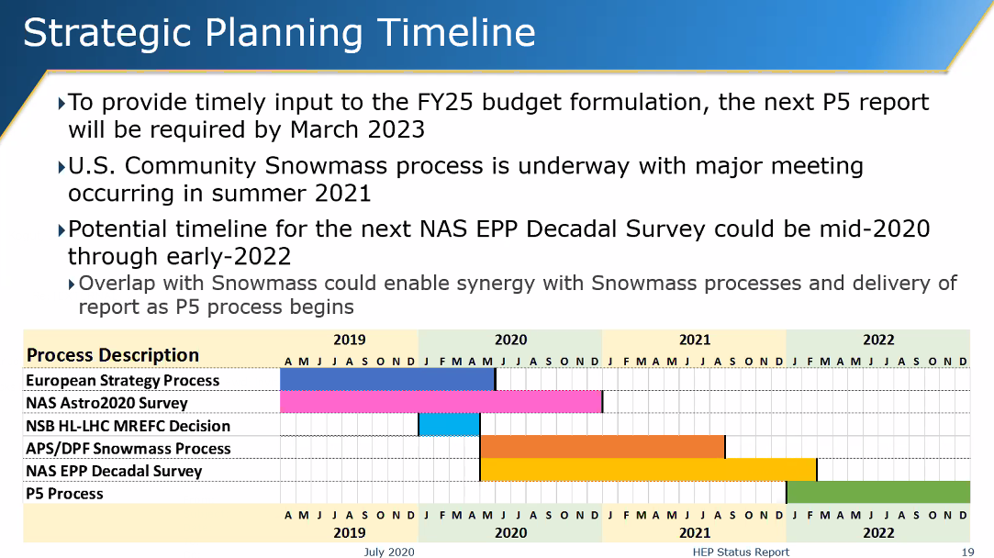
Timeline
Jim Siegrist’s presentation (2020-07-09)
Snowmass 2021
NAS EPP 2022
P5 2023

Slide 5
Particle Physics is Global
Europe and U.S.
Frequency: 7 years (Europe), ~8 years (U.S.)
Process: ~2 years in total (~1 year on science by the community + ~1 year priorities)
Asia, Canada, Latin America, …
Snowmass (U.S.)
P5 (U.S.)
Year
11 | 12 | 13 | 14 | 15 | 16 | 17 | 18 | 19 | 20 | 21 | 22 | 23 | 24 | 25 | 26 | 27
2006 plan
Europe
Executing the 2013 plan
Planning
2008 plan
U.S.
10 year plan: Executing the 2014 plan
Planning
(Snowmass + P5)
Europe
European Strategy Update: 2020 plan
Planning
U.S.
TBD: P5 2023 plan
Planning
(Snowmass + P5)
Now

Slide 6
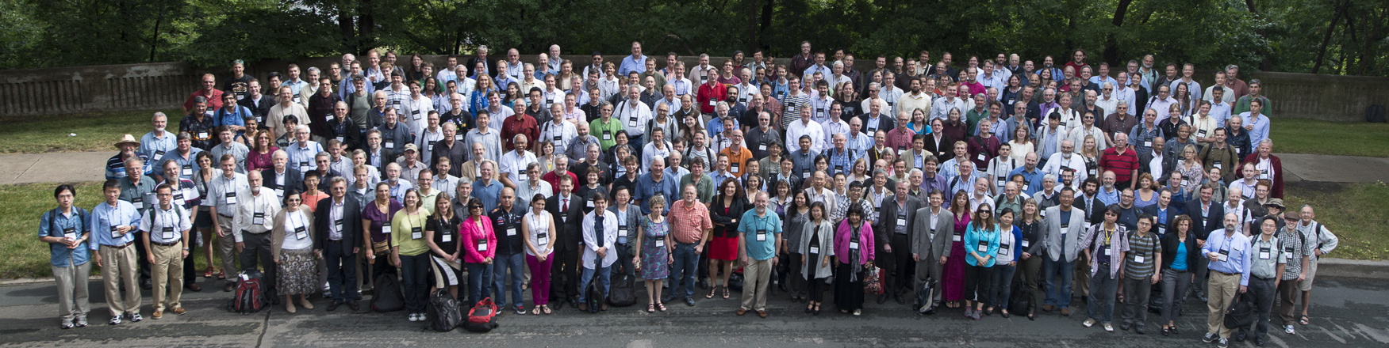
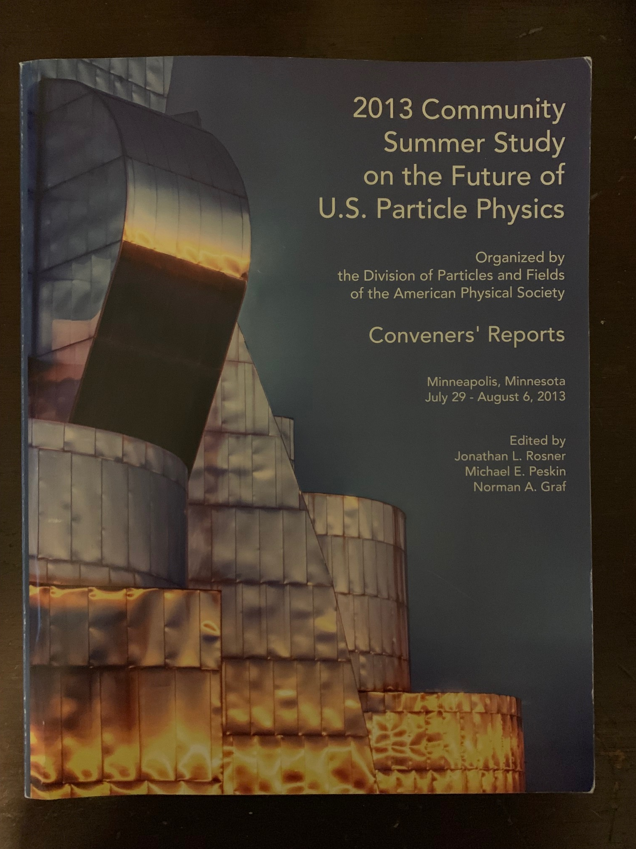
Snowmass 2013
Snowmass Planning Meeting at Fermilab, October 2012
Various frontier workshops in multiple locations
Snowmass Summer Study at Minnesota (July 29 – August 6, 2013)
Snowmass Report (December 2013)
A successful Snowmass process results in community buy-in, even when hard budgetary decisions need to be made

Slide 7

Snowmass Topics led to P5 Science Drivers
Snowmass 2013 Report
Frontiers
  Energy Frontier
  Intensity Frontier
  Cosmic Frontier
Cross-Cutting
  Facilities (Underground and Accelerator)
  Instrumentation
  Computing
  Theory
  Communication
P5 2014 Report
29 recommendations !!

Slide 8
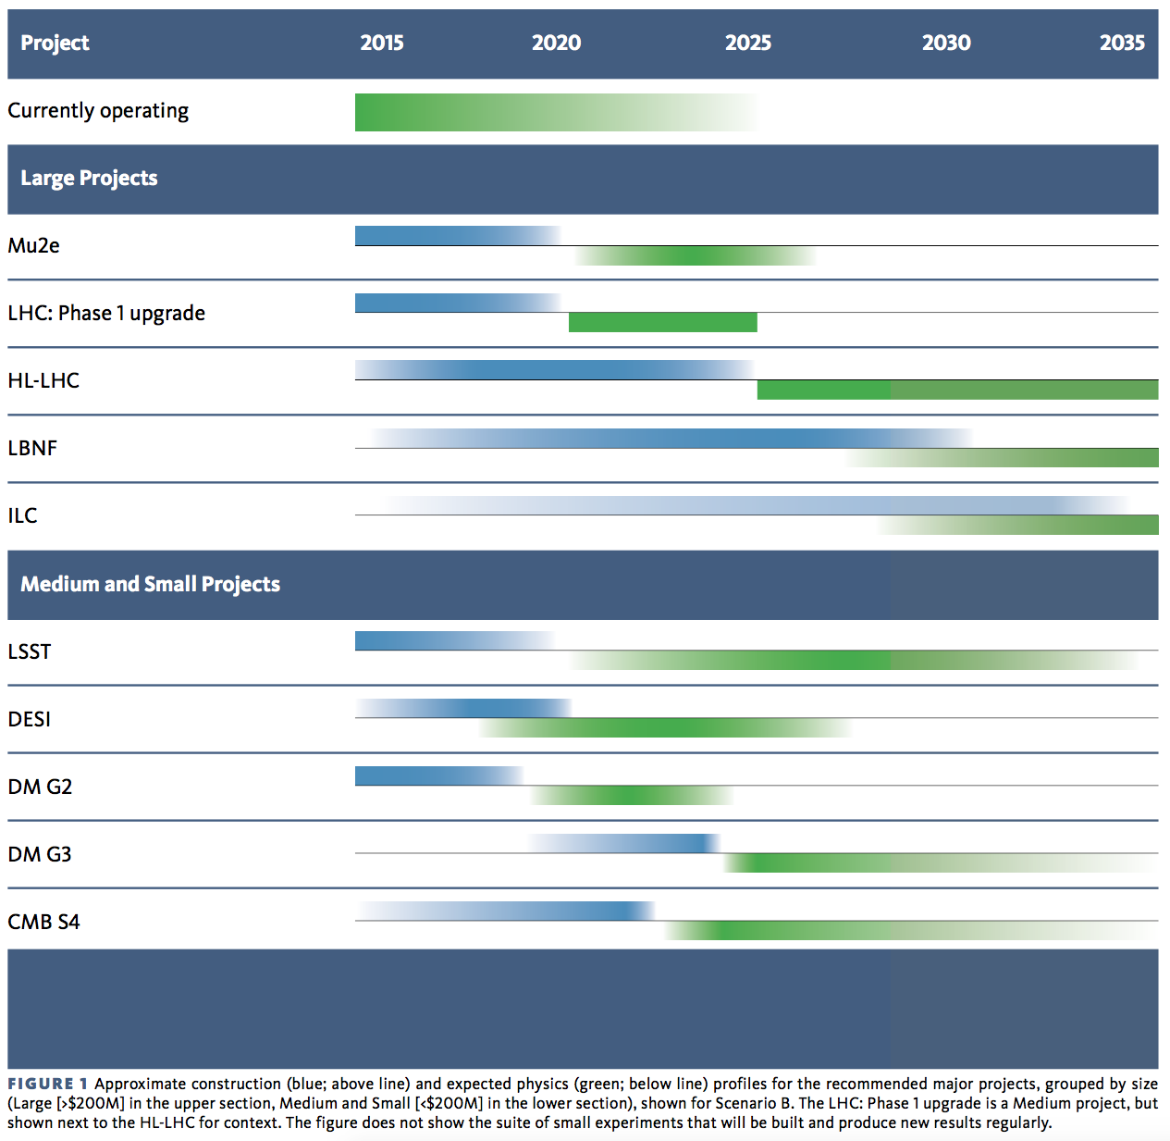
Snowmass 2013 + P5 2014 has been very successful !!
P5 2014 Report
Support a program of projects of all scales (large, medium, small), new ideas & developments
Accelerator science / R&D, instrumentation R&D, computing / software; next gen. education and training
Blue: construction
Green: physics
P5 2014: 10 year plan (Scenario B)
(large projects)
Scientific Drivers
The Unknown (U.S.)
Higgs, the Unknown (Europe)
Neutrino (U.S.)
Cosmic Acceleration (U.S.)
Dark Matter (U.S.)
Cosmic Acceleration (U.S.)

Slide 9
Snowmass 2021
Successful Snowmass 2013 is our guide!
  Implement lessons learned from Snowmass 2013
Snowmass 2021: Ten Frontiers
  Energy Frontier
  Frontiers in Neutrino Physics
  Frontiers in Rare Processes & Precision Measurements
  Cosmic Frontier
  Theory Frontier
  Underground Facilities and Infrastructure Frontier
  Accelerator Frontier
  Instrumentation Frontier
  Computational Frontier
  Community Engagement Frontier

Slide 10
Create a transparent and inclusive process
DPF Executive Committee + DPF Program Committee + DAP, DNP, DPB, DGRAV representatives
  Initial organization work
  Scope of each Frontier + first draft of subgroups of each Frontier
  Facilitate convener nominations
General call for frontier & topical convener nominations
  Closed November 15, 2019
  Self-nominated, by peer, or by a small group
Frontier co-conveners
  Chosen by elected representatives (DPF EC + Chair-line of DAP, DNP, DPB, DGRAV)
  Based on balance: senior/junior; theory/experiment; gender; region; labs/univ.s
  ~3 co-conveners for each of the 10 Frontiers
Topical groups and topical group conveners
  6-10 topical groups for each frontier: 78 topical groups in total
  ~3 co-conveners for each topical group: topical group conveners from all the compiled nominations + others (e.g. international members), endorsed by the Steering Group
Engaged DAP, DNP, DPB, DGRAV in the process from the beginning

Slide 11
Community Contribution
Letters of Interest (submission : April 1, 2020 – August 31, 2020)
  Informal documents intended to be useful in the first stages of the Snowmass study
  Help conveners to prepare the Snowmass Community Planning Meeting (Nov. 2020)
  Include opinions, interests and proposals that could further be studied
  Maximum of 2 pages of text, plus relevant bibliography
  Submission instructions: https://snowmass21.org/loi
  LoI authors are welcome to make a full writeup as a contributed paper (not required)
Contributed (“white”) Papers (submission : April 1, 2020 – July 31, 2021)
  Scientific or technical articles on relevant physics / technical topics, and reasoned expressions of physics priorities, including those related to community engagement.
  Part of Snowmass proceedings (permanent record of Snowmass 2021)
  Help shape the long-term scientific strategy of particle physics in the U.S.
  Submission instructions: https://snowmass21.org/submissions/
  LoIs are not required in order to submit contributed papers

Slide 12
Snowmass Timeline
Virtual Kick-off
Town Hall
APS April Meeting
European Strategy Update
11/19 | 12/19 | 1/20 | 2/20 | 3/20 | 4/20 | 5/20 | 6/20 | 7/20 | 8/20 | 9/20 | 10/20
Preparation
Letters of Interest
Contributed (“white”) Papers
10 Frontier & 78 Topical Groups: Meetings & Workshops
Virtual: COVID-19
Openness: no restriction
(Early November)
Community Summer Study (CSS)
July 11-20, 2021
(UW Seattle)
DPF 2021 (TBD) + CSS 2021
2021
APS April
Meeting
Community Planning Meeting (CPM)
Nov 4-6, 2020 (Fermilab)
Snowmass
Report
11/20 | 12/20 | 1/21 | 2/21 | 3/21 | 4/21 | 5/21 | 6/21 | 7/21 | 8/21 | 9/21 | 10/21
Contributed (“white”) Papers
10 Frontier & 78 Topical Groups: Meetings & Workshops

Slide 13
Community-Wide Meetings & Workshops
CPM Local Organizing Committee
Jonathan Asaadi | U. Texas, Arlington
Sapta Bhattacharya | Northwestern U.
Zoltan Gecse | Fermilab
Shih-Chieh Hsu | U. Washington, Seattle
Bo Jayatilaka, co-chair | Fermilab
Brendan Kiburg, co-chair | Fermilab
Erica Snider | Fermilab
Tiziana Spina | Fermilab
Gordon Watts | U. Washington
Yuanyuan Zhang | Fermilab
2020 APS April Meeting
  Snowmass Kick-off meeting: Town Hall
Community Planning Meeting (CPM 2020)
  Early November, 2020, virtual
  Local Organizing Committee
  Program Committee in progress
    10 members: 1 from each Frontier
    2 early careers
    ~4 with overall and global views
2021 APS April Meeting
  Mid-term evaluation (to be determined)
Community Summer Study (CSS 2021)
  July 11-20, 2021 at UW Seattle
  Local Organizing Committee
  Exploring DPF 2021 + CSS 2021 option (to be determined)
    DPF 2021: ~3 days primarily talks by early careers on current results
    ~1 day break
    Snowmass CSS: 9-10 days
CSS Local Organizing Committee
Alvaro Chavarria | U. Washington, Seattle
Jason Detwiler | U. Washington, Seattle
Anna Goussiou | U. Washington, Seattle
Alejandro Garcia | U. Washington, Seattle
Shih-Chieh Hsu, co-chair | U. Washington, Seattle
Seyda Ipek | UC Irvine
Laura Jeanty | U.. Oregon
Joey Key | U. Washington, Seattle
Tongyan Lin | UC San Diego
Henry Lubatti | U. Washington, Seattle
Elise Novitski | U. Washington, Seattle
Gray Rybka | U. Washington, Seattle
Jan Strube | PNNL
Lauren Tompkins | Stanford U.
Gordon Watts , co-chair | U. Washington, Seattle
Tien-tien Yu | U.. Oregon

Slide 14
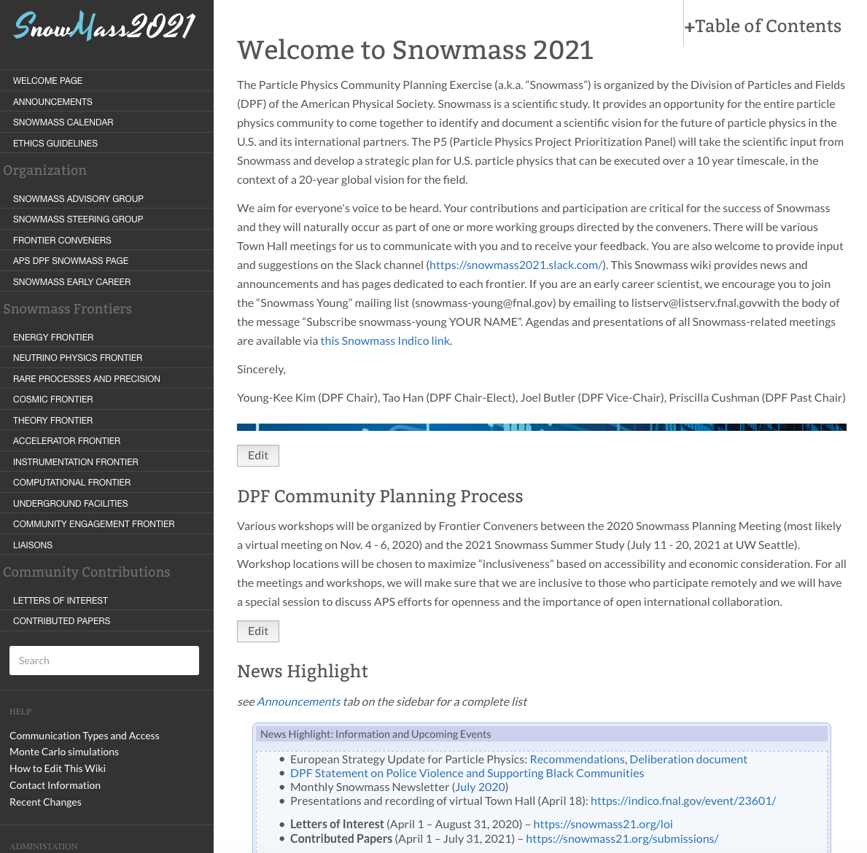
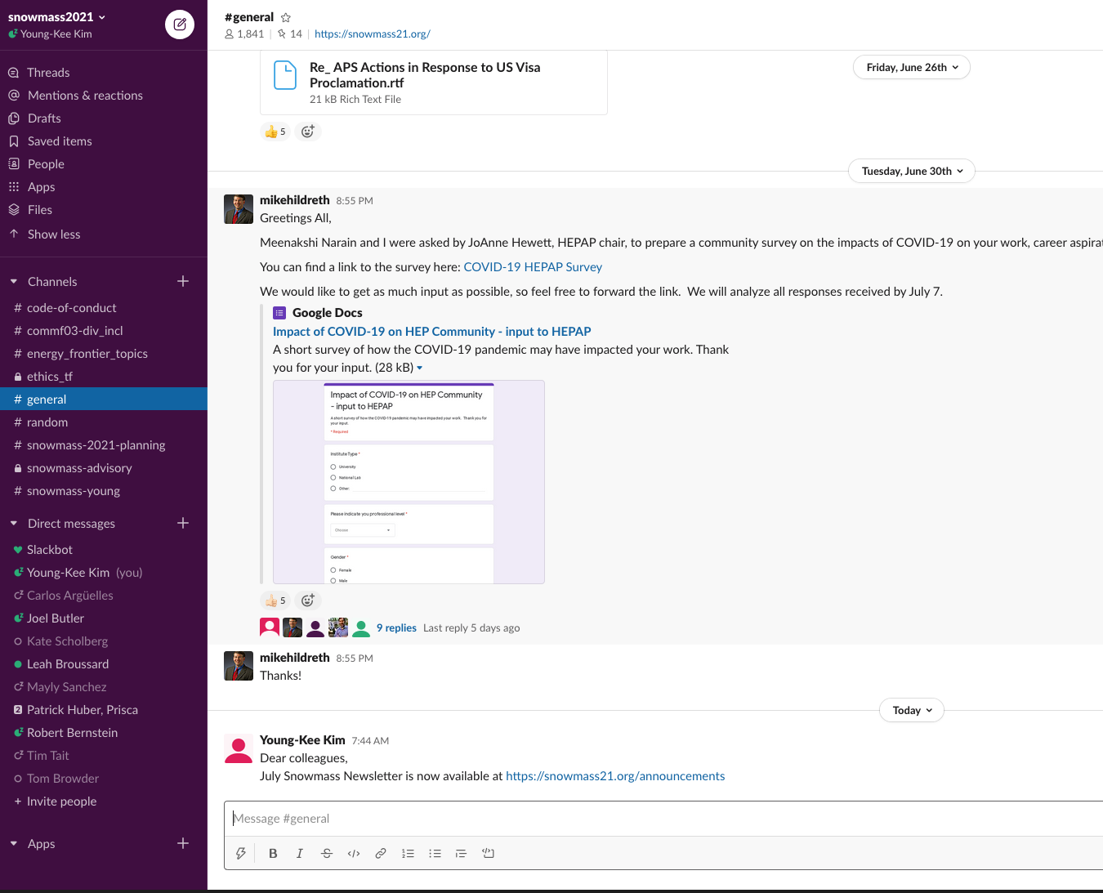
Communication to the community
Snowmass Wiki (https://snowmass21.org/)
  One-stop shop
  Technical liaison: Sergei Chekanov, ANL
  Snowmass email
    snowmass@fnal.gov
    snowmass-young@fnal.gov
    Frontier & Topical group mailing lists
  Slack Channels
  Monthly Snowmass Newsletter

Slide 15
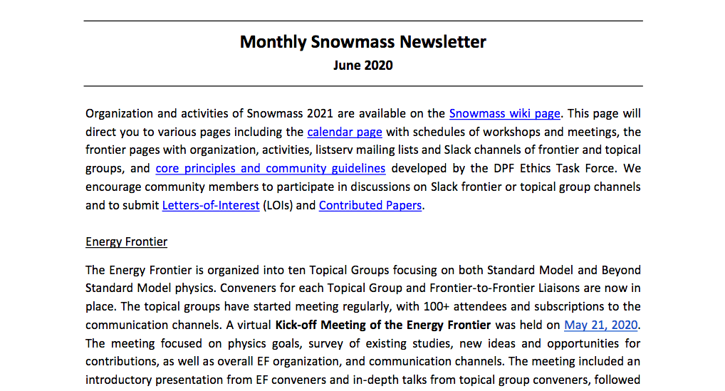
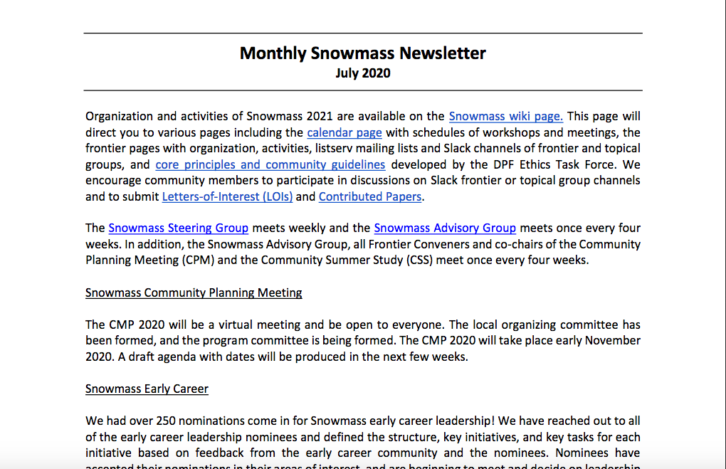
Monthly Snowmass Newsletter

Slide 16
Snowmass Coordination Team
27 Advisory Group members (including 8 Steering Group members)
30 Conveners for 10 Frontier Groups
> 200 Conveners for 78 Topical Groups
“many” (TBD) representatives of Early Careers
26 LOC members for 2020 Planning Meeting and 2021 Summer Study
42 liaisons for cross-cutting areas between Frontier Groups and Topical Groups
New topical groups and liaisons will be added if needed

Slide 17
Snowmass Advisory Group
DPF Executive Committee
  Chair: Young-Kee Kim
  Chair-Elect: Tao Han
  Vice Chair: Joel Butler
  Past Chair: Prisca Cushman
  Secretary/Treasurer: Mirjam Cvetic
  Councilor: Elizabeth Simmons
  Member-at-Large: Rick Van Kooten
  Member-at-Large: Elizabeth Worcester
  Member-at-Large: Natalia Toro
  Member-at-Large: Andre de Gouvea
  Member-at-Large: Mary Bishai
  Member-at-Large: Lauren Tompkins
  Early Career Member-at-Large: Sara Simon
Editor and Communication
  Editor – Michael Peskin
  Communication – Bob Bernstein
Representatives from other Divisions
  DPB: Sergei Nagaitsev
  DNP: Yury Kolomensky
  DAP: Glennys Farrar
  DGRAV: Gabriela Gonzales
Representatives from the Int. Community
  Africa / Middle East
    Azwinndini Muronga, Nelson Mandela Metropolitan Univ, South Africa
  Asia / Pacific
    Atsuko Ichikawa, Kyoto University, Japan
    Xinchou Lou, IHEP, China
  Canada
    Heather Logan, Carleton University, Canada
  Europe / Russia
    Val Gibson, Cavendish Laboratory, UK
    Berrie Giebels, CNRS, France
  Latin America
    Claudio Dib, Universidad Tecnica Federico Santa Maria, Chile
Steering Group
Steering group meets weekly; Advisory group meets once every 4 weeks;
All Frontier conveners + Advisory group + CPM/CSS LOC co-chairs meet once every 4 weeks
Monitoring the progress to make sure that all is moving forward smoothly to achieve the goals of the planning exercise

Slide 18
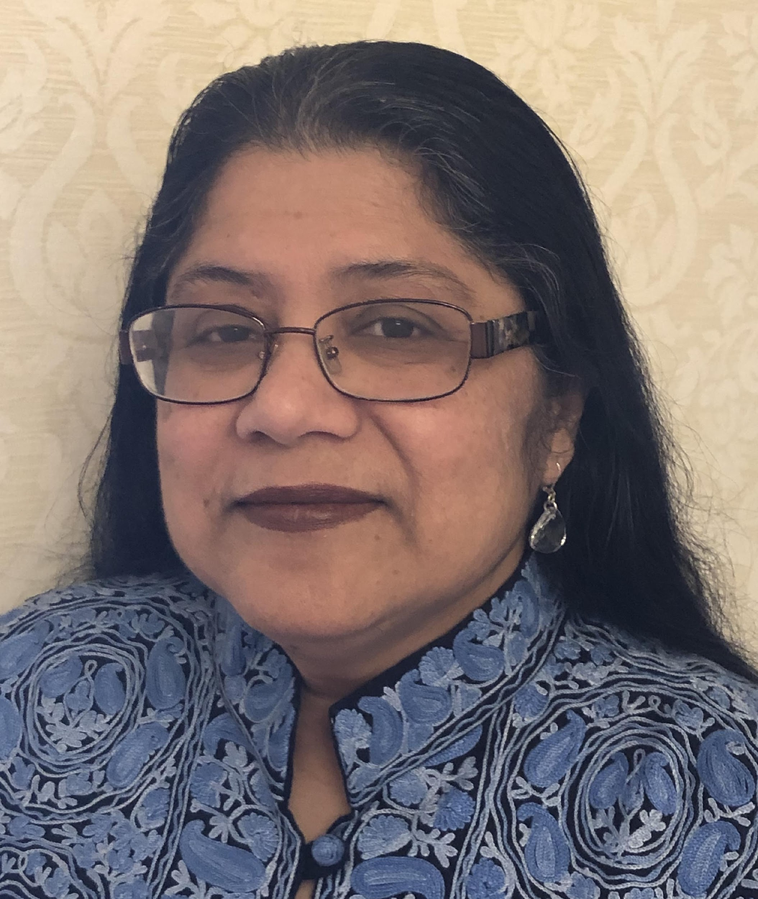
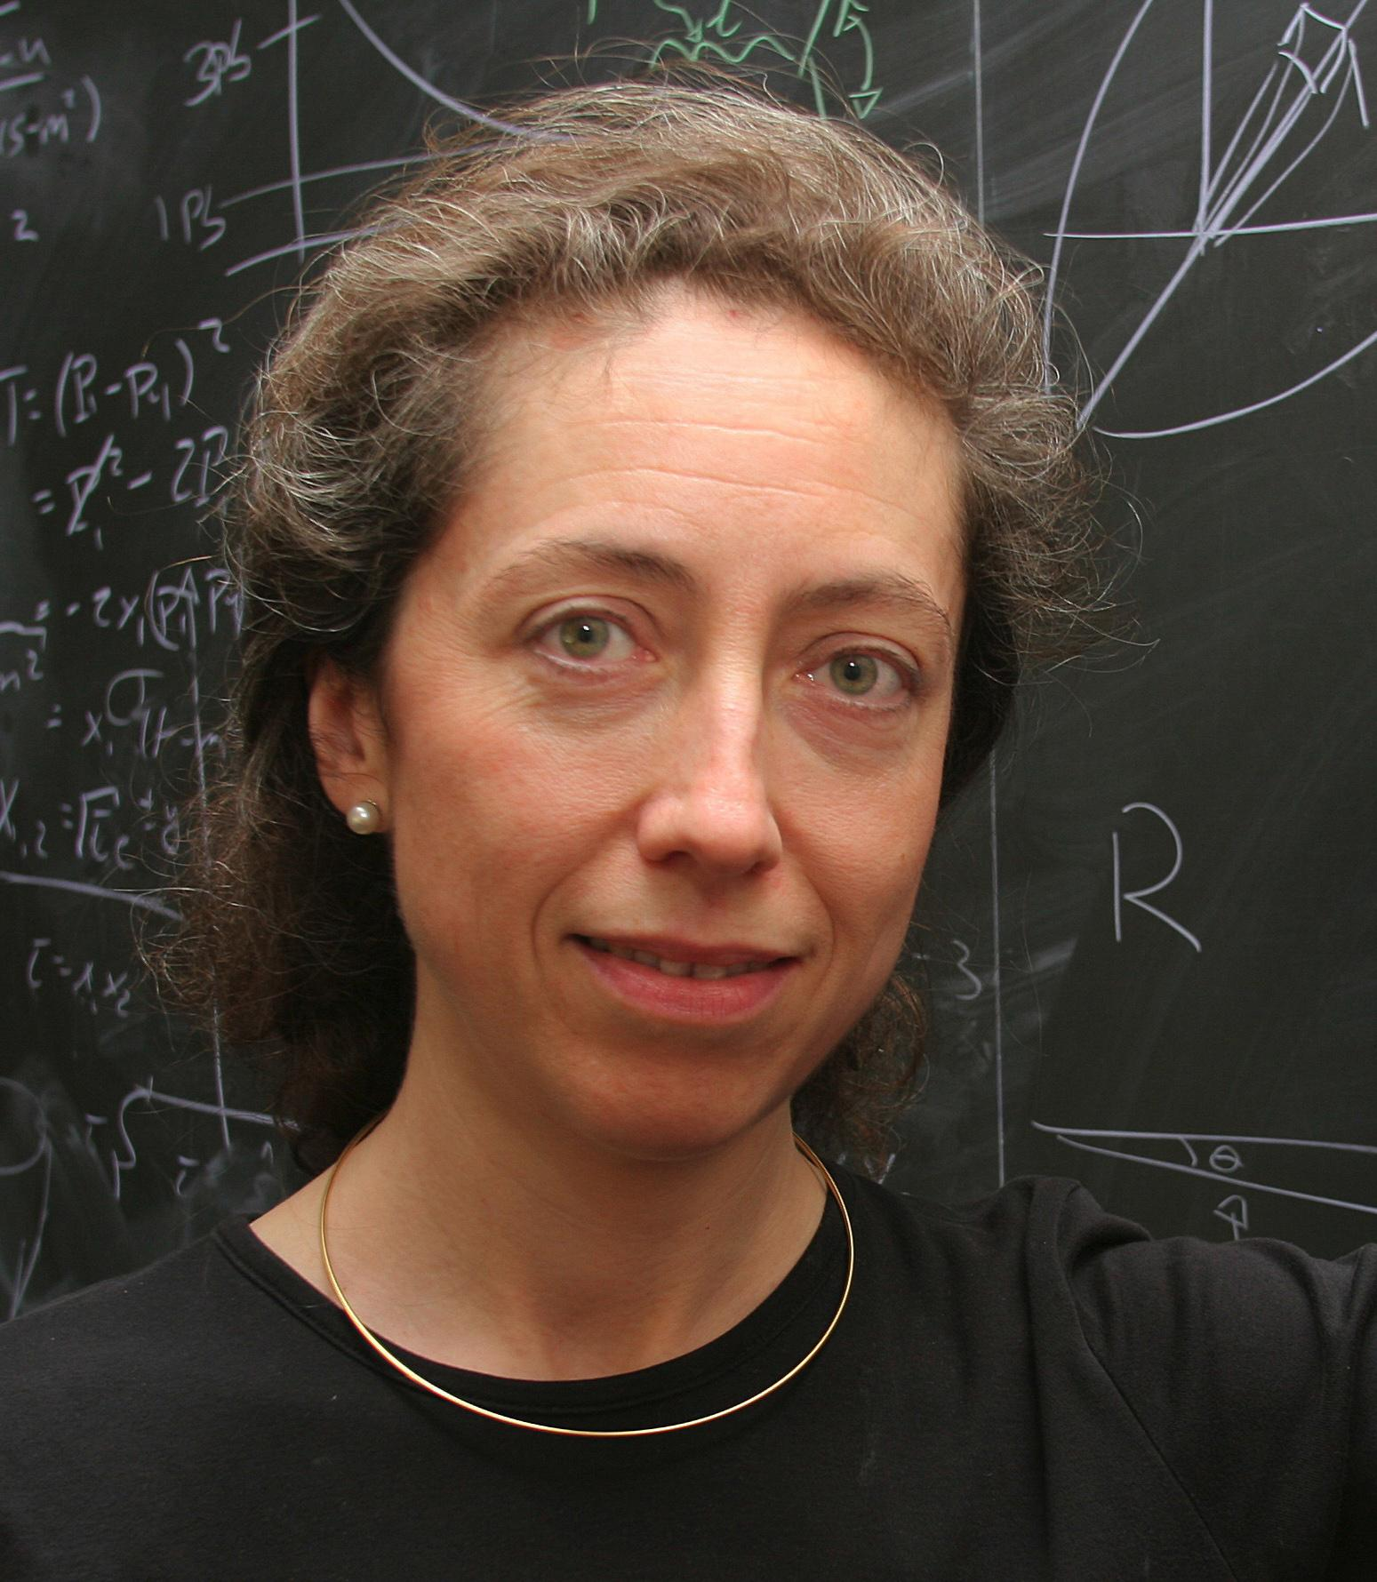
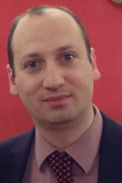
Energy Frontier
Meenakshi Narain (Brown U)
Laura Reina (FSU)
Alessandro Tricoli (BNL)
Topical Group |  |  | Topical Group co-Conveners
EF01 | EW Physics | Higgs Boson properties and couplings | Sally Dawson (BNL) | Andrey Korytov (U Florida) | Caterina Vernieri (SLAC)
EF02 |  | Higgs Boson as a portal to new physics | Patrick Meade (Stony Brook) | Isobel Ojalvo (Princeton)
EF03 |  | Heavy flavor and top quark physics | Reinhard Schwienhorst (MSU) | Doreen Wackeroth (Buffalo)
EF04 |  | EW Precision Phys. & constraining new phys. | Alberto Belloni (Maryland) | Ayres Freitas (Pittsburgh) | Junping Tian (Tokyo)
EF05 | QCD and Strong Interactions | Precision QCD | Michael Begel (BNL) | Stefan Hoeche (FNAL) | Michael Schmitt (NW)
EF06 |  | Hadronic structure and forward QCD | Huey-Wen Lin (MSU) | Pavel Nadolsky (SMU) | Christophe Royon (Kansas)
EF07 |  | Heavy Ions | Yen-Jie Lee (MIT) | Swagato Mukherjee (BNL)
EF08 | BSM | Model specific explorations | Jim Hirschauer (FNAL) | Elliott Lipeles (UPenn) | Nausheen Shah (Wayne State)
EF09 |  | More general explorations | Tulika Bose (UW-Madison) | Zhen Liu (Maryland) | Simone Griso (LBL)
EF10 |  | Dark Matter at colliders | Caterina Doglioni (Lund) | LianTao Wang (Chicago)

Slide 19
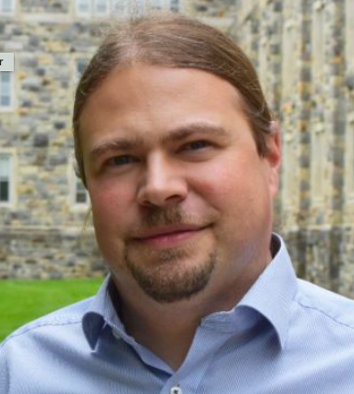
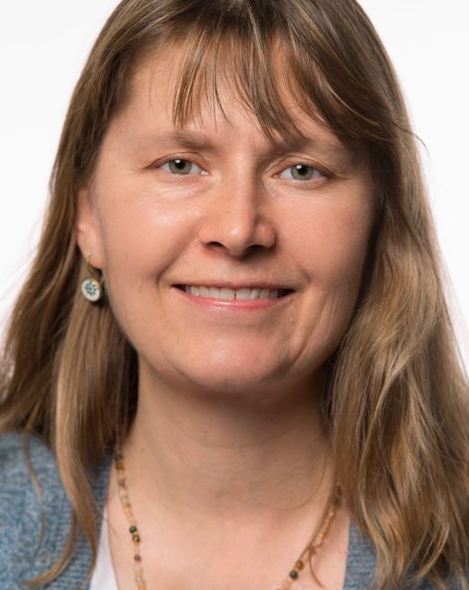
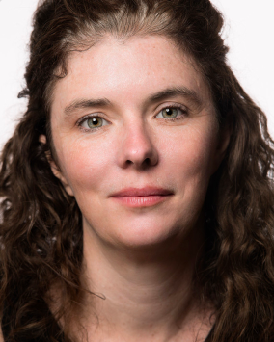
Frontiers in Neutrino Physics
Patrick Huber (Virginia Tech)
Kate Scholberg (Duke University)
Elizabeth Worcester (BNL)
Topical Group |  | Topical Group co-Conveners
NF01 | Neutrino Oscillations | Peter Denton (BNL) | Megan Friend (KEK) | Mark Messier (Indiana) | Hiro Tanaka (SLAC)
NF02 | Sterile Neutrinos | Georgia Karagiorgi (Columbia) | Bryce Littlejohn (IIT) | Pedro Machado (Fermilab) | Alex Sousa (Cincinnati)
NF03 | Beyond the SM | Pilar Coloma (Valencia) | Lisa Koerner (U.Houston) | Ian Shoemaker (Virginia Tech) | Jae Yu (UT Arlington)
NF04 | Neutrinos from Natural Sources | Yusuke Koshio (Okayama) | Gabriel Orebi Gann (UCB/LBNL) | Erin O’Sullivan (Uppsala) | Irene Tamborra (NBIA)
NF05 | Neutrino Properties | Carlo Giunti (Torino) | Ben Jones (UT Arlington) | Lisa Kaufman (SLAC) | Diana Parno (CMU)
NF06 | Neutrino Cross Sections | Jonathan Asaadi (UT Arlington) | Baha Balantekin (U.Wisconsin) | Kendall Mahn (MSU) | Jason Newby (ORNL)
NF07 | Nuclear Safeguards and Other Applications | Nathaniel Bowden (LLNL) | Jon Link (Virginia Tech) | Wei Wang (Sun-Yat Sen U.)
NF08 | Theory of Neutrino Physics | André de Gouvêa (NW) | Irina Mocioiu (Penn State) | Saori Pastore (Washington U.) | Louis Strigari (TAMU)
NF09 | Artificial Neutrino Sources | Laura Fields (FNAL) | Alysia Marino (U.Colorado, Boulder) | Pedro Ochoa (UCI) | Josh Spitz (U.Michigan)
NF10 | Neutrino Detectors | Josh Klein (U.Penn) | Ana Machado (UNICAMP) | Dave Schmitz (U.Chicago) | Raimund Strauss (TUM)

Slide 20
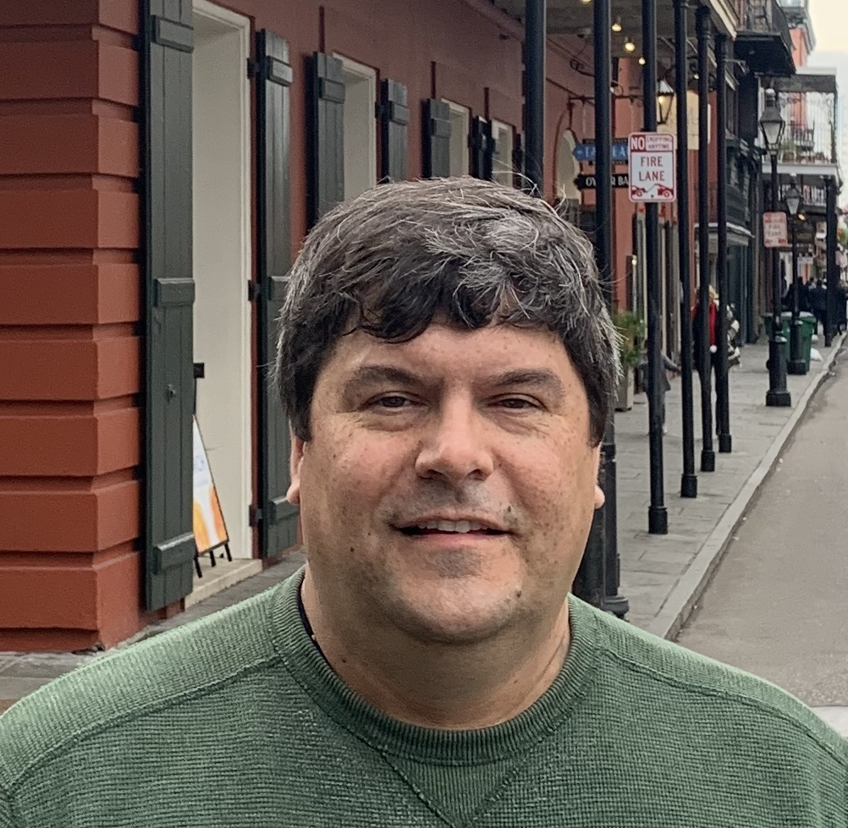
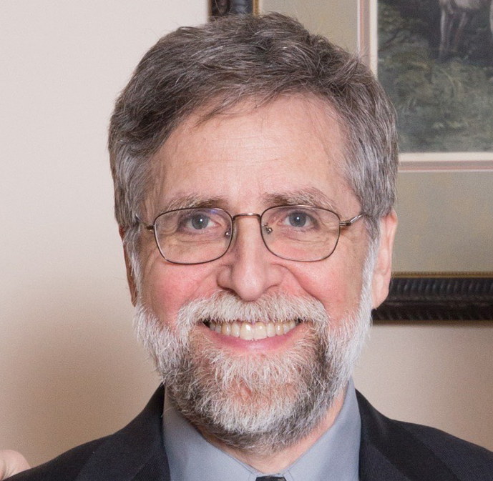
Frontier of Rare Processes & Precision Measurements
Face Photo
Name
Institution
Face Photo
Name
Institution
Marina Artuso (Syracuse U.)
Alexey Petrov (Wayne State U.)
Bob Bernstein (FNAL)
Topical Group |  | Topical Group co-Conveners
RF01 | Weak Decays of b and c | Angelo di Canto (BNL) | Stefan Meinel (U. Arizona)
RF02 | Strange and Light Quarks | Emilie Passemar (Indiana) | Evgueni Goudovski (Birmingham)
RF03 | Fundamental Physics and Small Experiments | Tom Blum (Connecticut) | Peter Winter (ANL)
RF04 | Baryon and Lepton Number Violation | Pavel Fileviez Perez (Case Western Reserve U.) | Andrea Pocar (U. Mass, Amherst)
RF05 | Charged Lepton Flavor Violation | Sacha Davidson (Lyon) | Bertrand Echenard (Caltech)
RF06 | Dark Sector at Low Energies | Stefania Gori (UCSC) | Mike Williams (MIT)

Slide 21
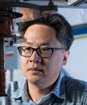
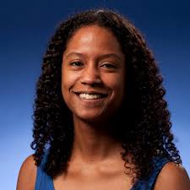
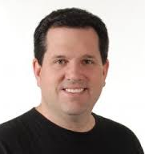
Cosmic Frontier
Aaron Chou (Fermilab)
Marcelle Soares-Santos (Brandeis)
Tim Tait (UC Irvine)
Topical Group |  | Topical Group co-Conveners
CF01 | Particle DM | Jodi Cooley (SMU) | Tongyan Lin (UCSD) | Hugh Lippincott (UCSB) | Tracy Slatyer (MIT)
CF02 | Wavelike DM | Joerg Jaeckel (Heidelberg) | Gray Rybka (UW) | Lindley Winslow (MIT)
CF03 | DM Astro Probes | Alex Drlica-Wagner (FNAL) | Chanda Prescod-Weinstein (NH) | Haibo Yu (Riverside)
CF04 | DE & CA The Modern Universe | Jeff Newman (Pittsburgh) | Masao Sako (Penn) | Anze Slosar (BNL)
CF05 | DE & CA Cosmic Dawn & Before | Clarence Chang (ANL) | Laura Newburgh (Yale) | Deirdre Shoemaker (Georgia Tech.)
CF06 | Dark Energy complementarity | Chihway Chang (Chicago) | Brenna Flaugher (Fermilab) | David Schlegel (LBNL)
CF07 | Cosmic Probes | Rana Adhikari (Caltech) | Luis Anchordoqui (CUNY) | B.S. Sathyaprakash (Penn State) | Kirsten Tollefson (MSU)

Slide 22
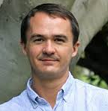
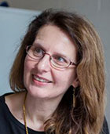
Theory Frontier
Nathaniel Craig (UCSB)
Csaba Csaki (Cornell)
Aida El-Khadra (UIUC)
Topical Group |  | Topical Group co-Conveners
TF01 | String theory, quantum gravity, black holes | Daniel Harlow (MIT) | Shamit Kachru (Stanford) | Juan Maldacena (IAS)
TF02 | Effective field theory techniques | Patrick Draper (UIUC) | Ira Rothstein (CMU)
TF03 | CFT and formal QFT | David Poland (Yale) | Leonardo Rastelli (Stony Brook)
TF04 | Scattering amplitudes | Zvi Bern (UCLA) | Jaroslav Trnka (UCD)
TF05 | Lattice gauge theory | Zohreh Davoudi (UMD) | Taku Izubuchi (BNL) | Ethan Neil (UC Boulder)
TF06 | Theory techniques for precision physics | Radja Boughezal (ANL) | Zoltan Ligeti (LBNL)
TF07 | Collider phenomenology | Fabio Maltoni (Louvain / Bologna) | Shufang Su (U. Arizona) | Jesse Thaler (MIT)
TF08 | BSM model building | Patrick Fox (FNAL) | Hitoshi Murayama (UCB)
TF09 | Astro-particle physics and cosmology | Dan Green (UCSD) | Joshua Ruderman (NYU) | Ben Safdi (UM) | Jessie Shelton (UIUC)
TF10 | Quantum information science | Simon Catterall (Syracuse) | Roni Harnik (FNAL) | Veronika Hubeny (UCD)

Slide 23
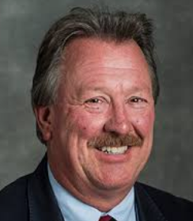
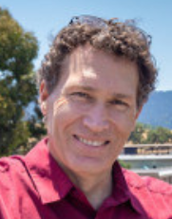
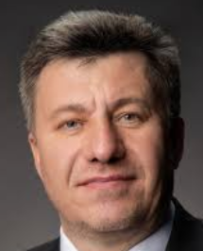
Accelerator Frontier
Steve Gourlay (LBNL)
Tor Raubenheimer (SLAC)
Vladimir Shiltsev (FNAL)
Topical Group |  | Topical Group co-Conveners
AF01 | Beam Phys & Acc. Education | Mei Bei (GSI) | Zhirong Huang (SLAC/Stanford) | Steve Lund (MSU)
AF02 | Accelerators for Neutrinos | John Galambos (ORNL) | Bob Zwaska (FNAL) | Gianluigi Arduini (CERN)
AF03 | Accelerators for EW/Higgs | Georg Hoffstaetter (Cornell) | Qing Qin (IHEP, Beijing) | Marc Ross (SLAC)
AF04 | Multi-TeV Colliders | Mark Palmer (BNL) | Nadia Pastrone (INFN, Torino) | Alexander Valishev (FNAL)
AF05 | Accelerators for PBC & Rare Processes | Mike Lamont (CERN) | Richard Milner (MIT) | Eric Prebys (UC Davis)
AF06 | Advanced Accel. Concepts | Ralph Assmann (DESY) | Cameron Geddes (LBNL) | Mark Hogan (SLAC) | Pietro Musumeci (UCLA)
AF07 | Accelerator Technology R&D
 | RF | Emilio Nanny (SLAC) | Sam Posen (FNAL) | Hans Weise (DESY)
 | Magnets | Susana I. Bermudez (CERN) | Gianluca Sabbi (LBNL) | Sasha Zlobin (FNAL)
 | Targets/Sources | Charlotte Barbier (ORNL) | Frederique Pellemoine (MSU/FNAL) | Yin-E Sun (ANL)

Slide 24
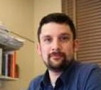
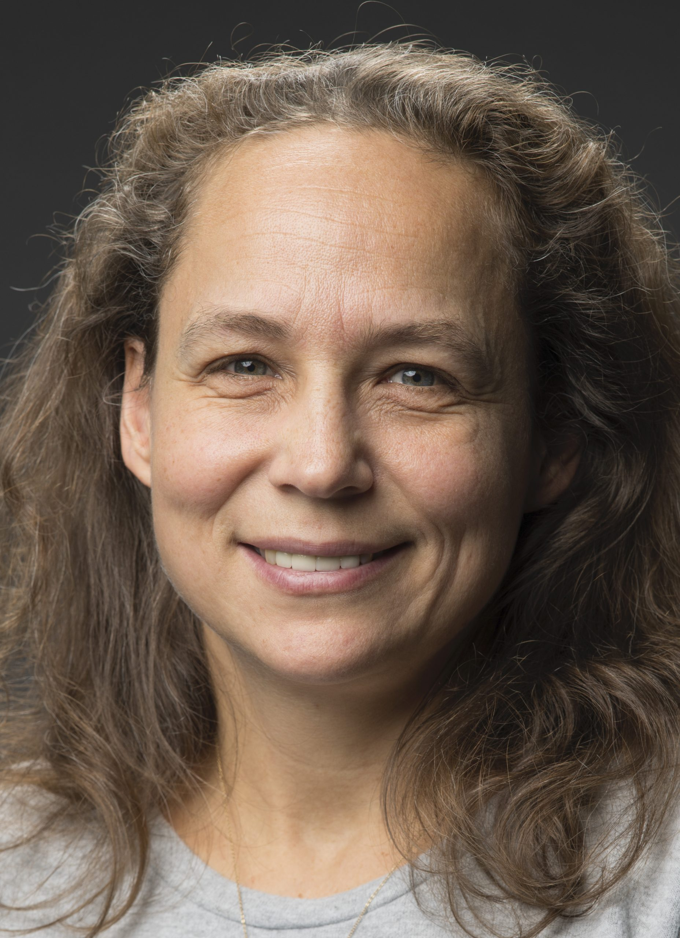
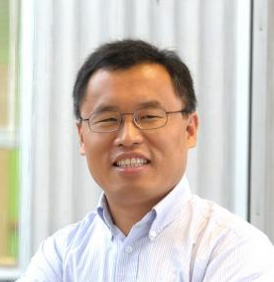
Instrumentation Frontier
Phil Barbeau (Duke)
Petra Merkel (FNAL)
Jinlong Zhang (ANL)
Topical Group |  | Topical Group co-Conveners
IF01 | Quantum Sensors | Thomas Cecil (ANL), | Kent Irwin (SLAC) | Reina Maruyama (Yale) | Matt Pyle (Berkeley)
IF02 | Photon Detectors | Juan Estrada (FNAL) | Mayly Sanchez (ISU) | Abigail Vieregg (U.Chicago)
IF03 | Solid State Detectors & Tracking | Tony Affolder (UCSC) | Artur Apresyan (FNAL) | Lucie Linssen (CERN)
IF04 | Trigger and DAQ | Darin Acosta (Florida) | Wes Ketchum (FNAL) | Stephanie Majewski (Oregon)
IF05 | Micro Pattern Gas Detectors | Bernd Surrow (Temple) | Maxim Titov (SACLAY) | Sven Vahsen (Hawaii)
IF06 | Calorimetry | Andy White (UTA) | Minfang Yeh (BNL) | Rachel Yohay (FSU)
IF07 | Electronics/ASICS | Gabriella Carini (BNL) | Mitch Newcomer (UPenn) | John Parsons (Columbia)
IF08 | Noble Elements | Eric Dahl (Northwestern) | Roxanne Guenette (Harvard) | Jen Raaf (FNAL)
IF09 | Cross Cutting and System Integration | Jim Fast (PNNL) | Maurice Garcia-Sciveres (LBL) | Ian Shipsey (Oxford)

Slide 25
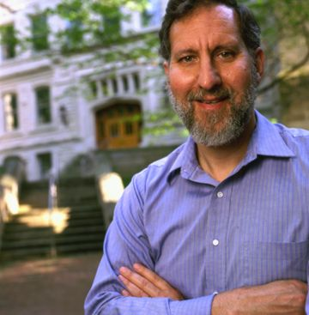
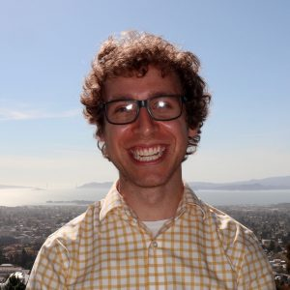
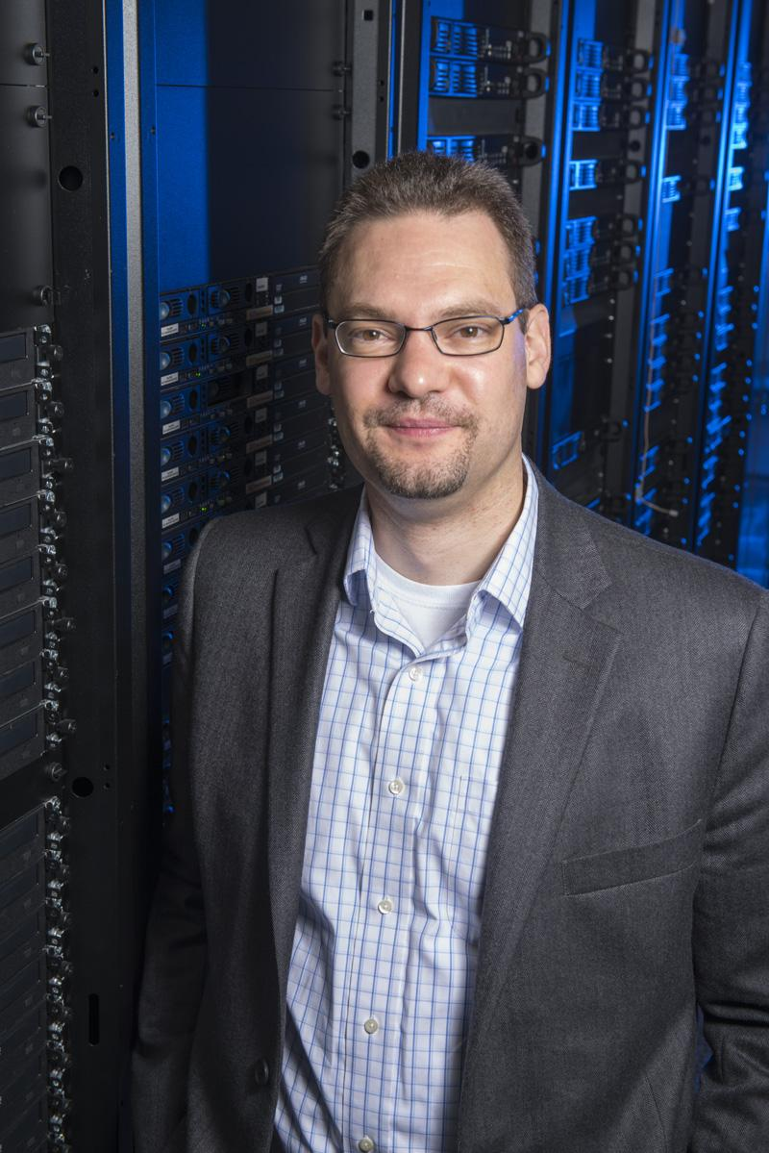
Computational Frontier
Steven Gottlieb (Indiana U)
Ben Nachman (LBNL)
Oliver Gutsche (FNAL)
Topical Group |  | Topical Group co-Conveners
CompF01 | Experimental Algorithm Parallelization | Guiseppi Cerati (FNAL) | Katrin Heitmann (ANL) | Walter Hopkins (ANL)
CompF02 | Theoretical Calculations and Simulation | Peter Boyle (BNL) | Daniel Elvira (FNAL) | Ji Qiang (LBNL)
CompF03 | Machine Learning | Phiala Shanahan (MIT) | Kazu Terao (SLAC) | Daniel Whiteson (Irvine)
CompF04 | Storage and processing resource access (Facility and Infrastructure R&D) | Wahid Bhimji (NERSC) | Rob Gardner (U Chicago) | Frank Würthwein (UCSD)
CompF05 | End user analysis | Gavin Davies (U.Mississippi) | Peter Onyisi (UT Austin) | Amy Roberts (UC Denver)
CompF06 | Quantum computing | Travis Humble (ORNL) | Gabriel Perdue (FNAL) | Martin Savage (U Washington)
CompF07 | Reinterpretation and long-term preservation of data and code | Kyle Cramner (NYU) | Mike Hildreth (U Notre Dame) | Matias Carrasco Kind (Illinois/ NCSA)

Slide 26
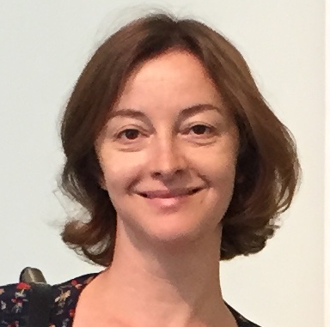
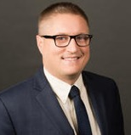
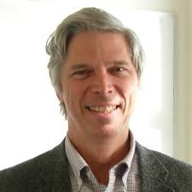
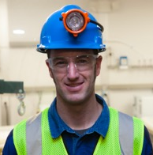
Underground Facilities and Infrastructure Frontier
Laura Baudis (U. Zurich)
Jeter Hall (SNOLAB)
Kevin Lesko (LBNL)
John Orrell (PNNL)
Topical Group |  | Topical Group co-Conveners
UF01 | Underground Facilities for Neutrinos | Tim Bolton | Patrick Decowski | TBD
UF02 | Underground Facilities for Cosmic Frontier | Kaixuan Ni | Emilija Pantic
UF03 | Underground Detectors | TBD | TBD
UF04 | Supporting Capabilities | Richard Schnee | Alvine Kamaha | Brianna Mount
UF05 | Synergistic Research | Daniel Robertson | TBD | TBD
UF06 | An Integrated Strategy for Underground Facilities and Infrastructure | Laura Baudis | Jeter Hall | Kevin Lesko | John Orrell

Slide 27
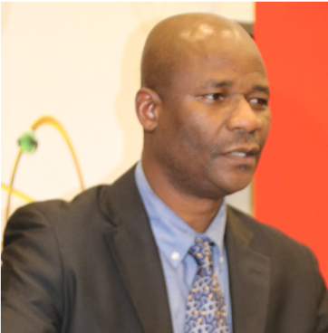
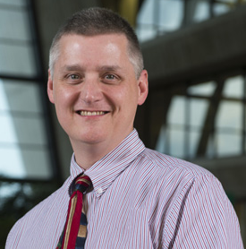
Community Engagement Frontier
Kétévi A. Assamagan (BNL)
Breese Quinn (Mississippi)
Topical Group |  | Topical Group co-Conveners
Comm01 | Applications & Industry | Farah Fahim (FNAL) | Alex Murokh (RadiaBeam Technologies) | Koji Yoshimura (Okayama)
Comm02 | Career Pipeline & Development | Sudhir Malik (UPRM) | Yangyang Chen (Cornell) | Amr El Zant (BUE)
Comm03 | Diversity & Inclusion | Mu-Chun Chen (UCI) | Sam Meehan (CERN) | Carla Bonifazi (UFRJ)
Comm04 | Physics Education | Randy Ruchti (Notre Dame) | Frossie Economou (LSST) | Sijbrand de Jong (Radboud)
Comm05 | Public Education & Outreach | Sarah Demers (Yale) | Kathryn Jepsen (SLAC) | Don Lincoln (FNAL/Notre Dame) | A. Muronga (Nelson Mandela)
Comm06 | Public Policy & Government Engagement | Rob Fine (Rochester) | Louise Suter (FNAL) | Brajesh Choudhary (Delhi)

Slide 28
Snowmass Early Careers
The Snowmass 2021 process is towards a long-term strategic plan
  Voices of early career members are critically important
  Enrich and strengthen Snowmass-Young (SNOWMASS-YOUNG@LISTSERV.FNAL.GOV)
  Grad students, postdocs, ….
Organization and Leadership
  Forming representatives for Snowmass Early Careers
    Solicited nominations: > 250 nominated!!
      Coordinated by DPF Executive Committee Early Career Members: Sara Simon (2020) and Fernanda Psihas (2019)
  Defined key initiatives and key tasks for each initiative based on feedback from the early career community and the nominees.
    surveying the early career membership, in-reach, long-term organization, DEI (diversity, equity, and inclusion), Snowmass coordination (a few liaisons per frontier)
  Nominees are beginning to meet and decide on leadership for each of the key initiative groups as well as work on immediate tasks.
  Once the full organizational and leadership structure is defined in the next few weeks, meetings will be advertised to the whole Snowmass early career community.

Slide 29
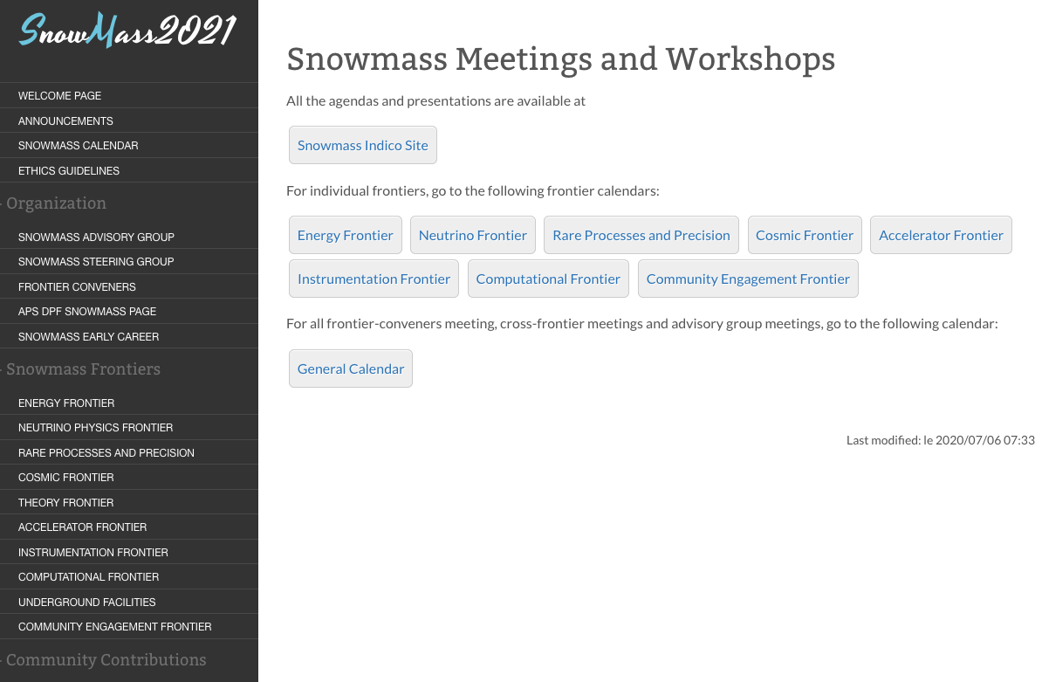
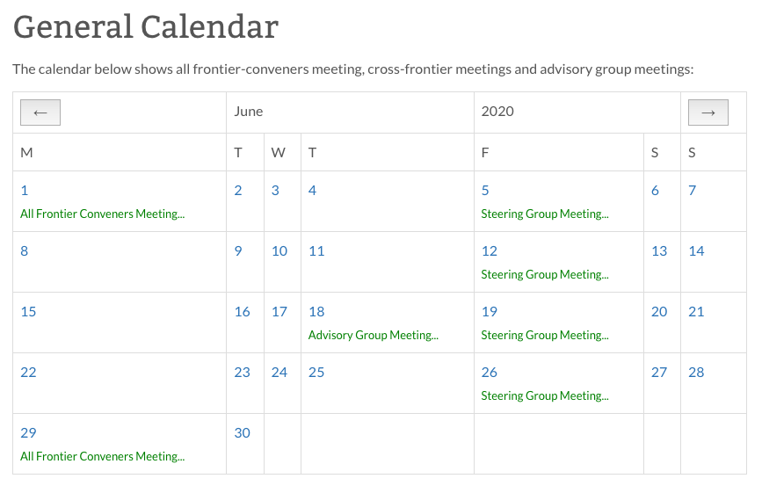
Current Activities
Frontier / topical groups: regular meetings, kick-off workshops / town hall meetings, ….
More workshops planned in the next couple of months.
Large-scale workshops in Spring 2021
Regular meetings: Steering Group, Advisory Group,
All Frontier Conveners + Advisory Group + LOC co-chairs of CPM and CSS
Snowmass calendar (Snowmass wiki)

Slide 30
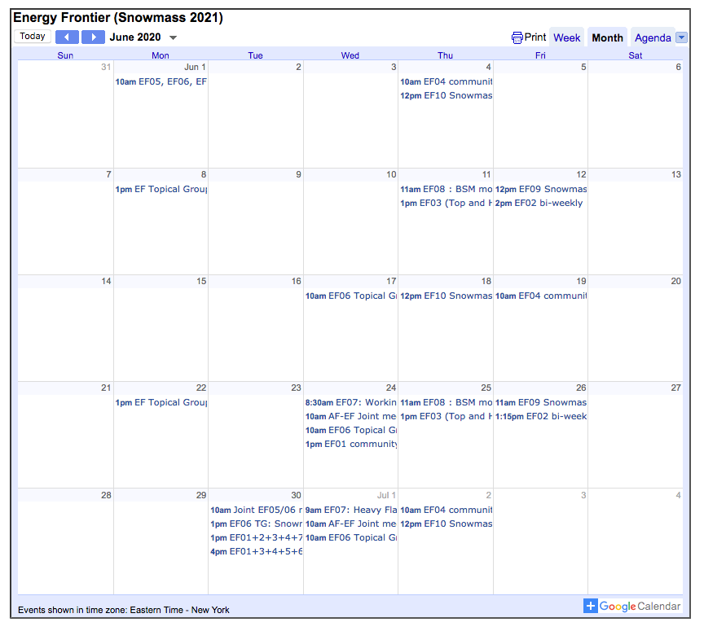
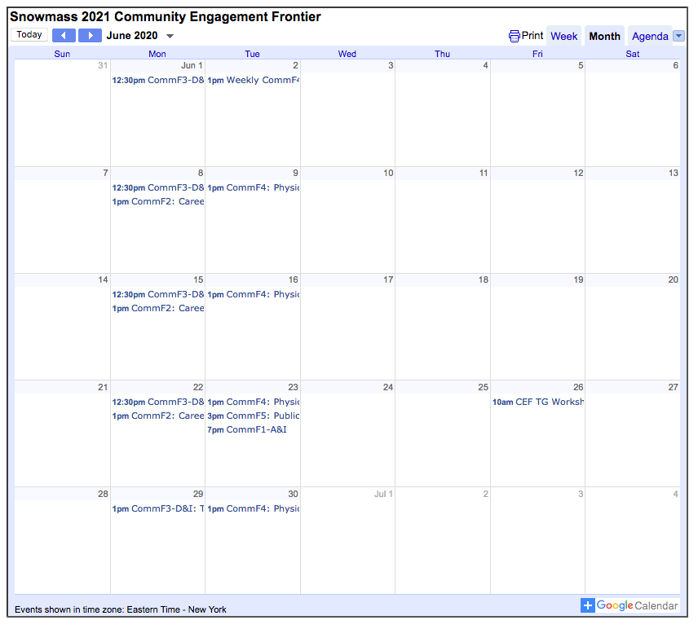
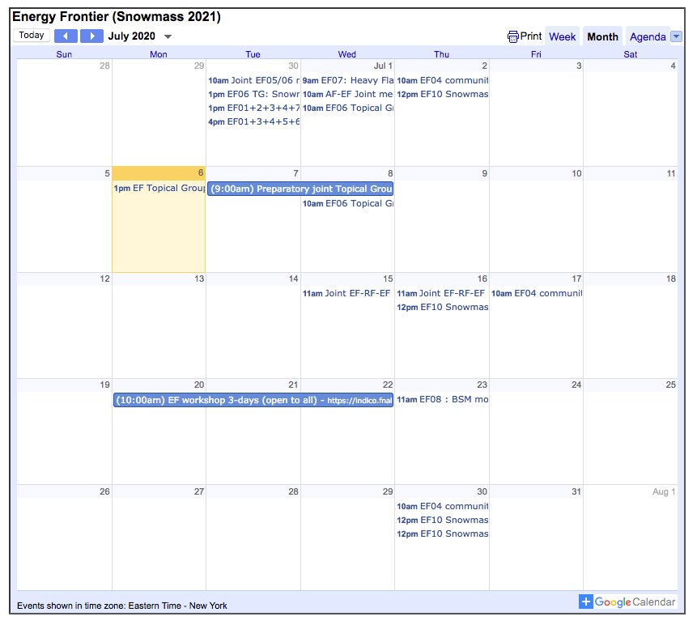
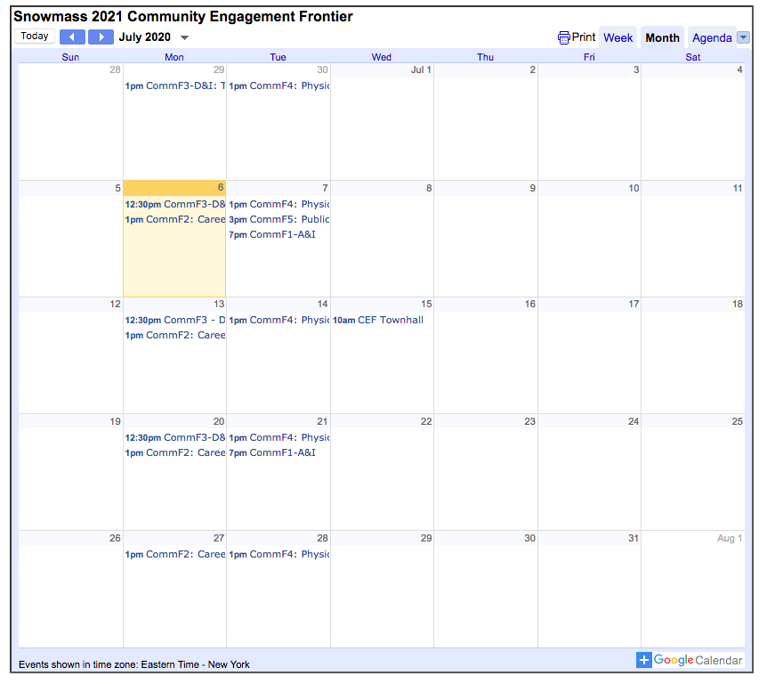
Current Activities
……..
……..

Slide 31
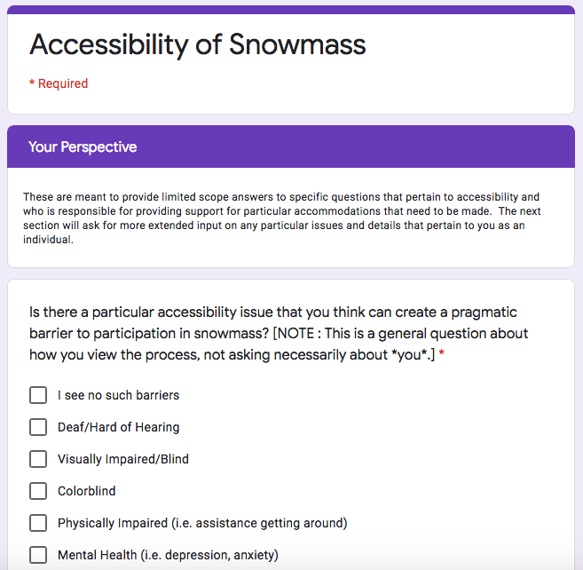
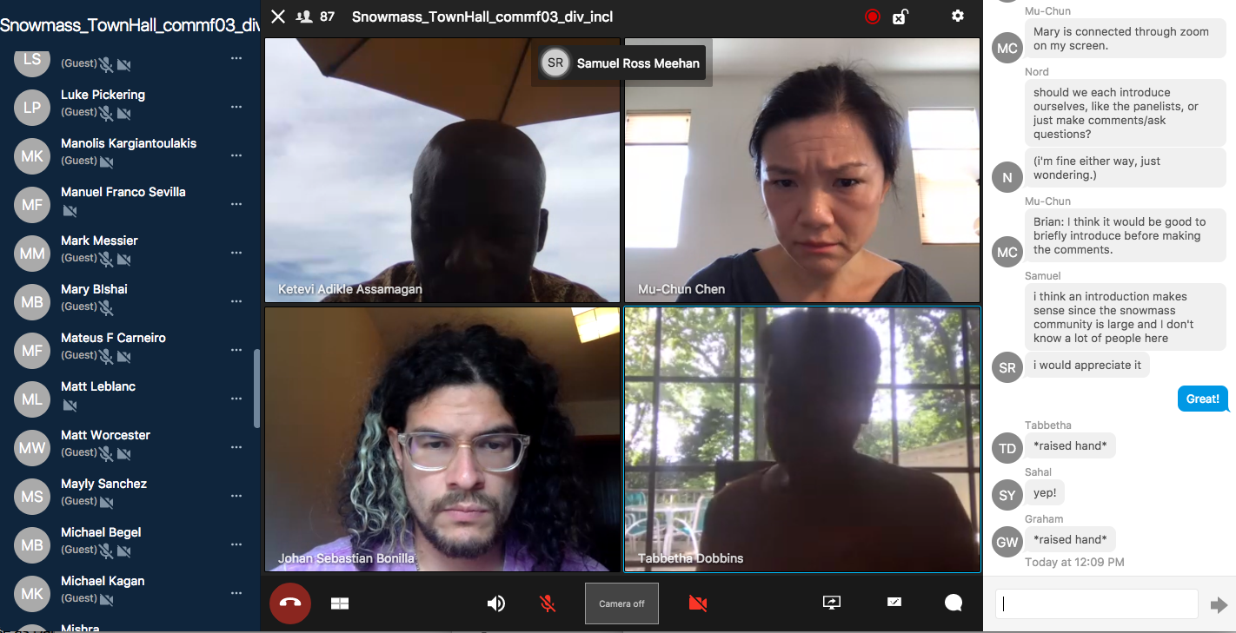
Current Activities
Community Engagement Frontier’s Diversity & Inclusion Topical Group
bi-weekly Town Hall meetings
  Accessibility (June 1)
  Racial Justice and Supporting Our Black Community Members (June 15, June 29)
Survey on accessibility
  Perspective of how accessibility applies to the Snowmass process (including impacts due to COVID-19)
  Valuable insights that can likely be extrapolated more broadly to our field
June 15th Town Hall meeting
  Code of Conduct and Accountability (July 13)

Slide 32
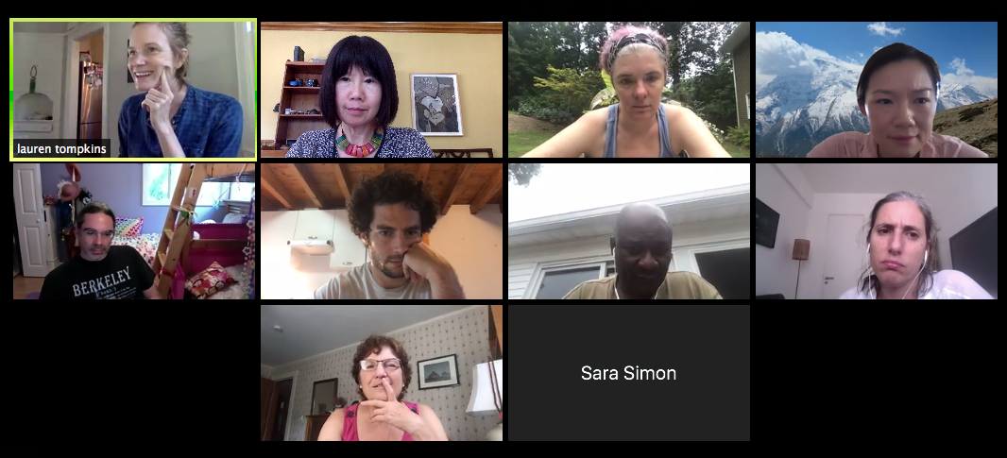
DPF Ethics Task Force
The Snowmass process is a dynamic exchange of ideas across a large swath of the community, taking place in a variety of virtual (e.g., slack, meetings, workshops) and in person (e.g., workshops) formats.
It is imperative that all DPF community members feel safe and supported in engaging in all exchanges.
DPF Ethics Task Force (formed in April 2020)
  Membership
    DPF EC members
      Lauren Tompkins (chair), Prisca Cushman,
      Andre de Gouvea, Young-Kee Kim (ex-officio),
      Sara Simon, Elizabeth Worcester
    Snowmass Comm. Eng. Frontier’s D&I topical group
      Ketevi Assamagan, Carla Bonifazi, Mu-hun Chen, Sam Meehan
  Has produced a set of core principles and community guidelines aimed at governing DPF sponsored activities, including all facets of Snowmass process
  Will educate our community about microaggressions and proactively work to provide a supportive environment.
  Is instituting a moderator process to address concerns as they arise on slack
DPF Ethics Committee
  Will be formed Fall 2020 as a Standing Committee
  Will call for nominations from the community in ~1 month.

Slide 33
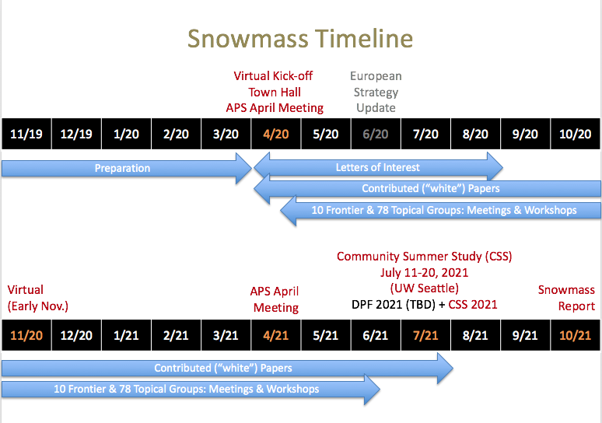
Conclusion
We very much look forward to a productive Snowmass study
Please visit the Snowmass wiki page “often”
  One-stop shop (https://snowmass21.org/)
Snowmass is a community-driven process
  We welcome any comments, suggestions, and concerns from the community
  We appreciate the community’s strong participation in the process

