Slide 1
NuComp News (and FY11 Spending Plan)
Lee Lueking
May 18, 2011

Slide 2
Outline
Maintenance day stuff
Computing Resource Summary
Plan for FY11 spending

Slide 3
Maintenance Day:
Tomorrow 5/19: MINOS specific work
Main MySQL DB will be moved back to minos-mysql2
Farm replica DB will be moved to minos54.
Upgrade minos51 and minos52 to SLF 5 (?)
GP GRID work
Accessibility will be limited because half of the gatekeepers will be down.
These dates are currently scheduled for
May 24 2011 when the first rack moves to FCC2 ( which will take out gatekeepers fnpcosg1 and fnpcfg2) and
June 7, 2011 when the second rack moves to GCC. (which will take out gatekeeper fnpcfg1).
Regular grid should be subscribed to the fermigrid-announce E-mail list.
Next Month 6/16: IF/GPCF/MINOS/MB reboots for new kernel

Slide 4
IFront Computing Resource Summary

Slide 5
Central Disk (BlueArc) Allocations
 | 2009 | 2010 | 2011 (replace) | 2012 request
MiniBooNE | P80 | 30 | P25 (+13) | 0
MINOS | P90 | P30 | P30 (P30+30) | 30
MINERvA | P10 | P20 | P40 | 40
Argoneut | P20 | 0 | 0 | 0
NOvA | P4 | P26 | P10+P20 | 100
MicroBooNE | P2 | 0 | P5 | 30
LBNE (all) | 0 | P2 | P10+P10 | 0
Mu2e | 0 | P2 | P2 | 0
g minus 2 | 0 | 0 | P10 | 0
Psatisfied
Pin-hand

Slide 6
BlueArc Data Areas

Slide 7
BlueArc App Areas

Slide 8
GPCF Status
 | Int. Login status | Comments | Local Batch
ArgoNeuT | 1 VMP |  | Jobs submitted through gpsn01 Currently 84 job slots: 7 worker nodes with 12 slots on each (limited by memory, plan to purchase). In limbo: gpcf026,30,31,32.
LBNE | 2 VMsP
MicroBooNE | 1 VMP
MINERvA | If01-if05 2 VM’sP
MiniBooNE | (not assigned)
MINOS | Minos50-54P 1VM (for testing)
Mu2e | 1 VMP+ 1 VM (for testing)
NOvA | 5 VM’sP+ 2 x gpcf nodes temporarily | Gpcf028+29 until VM I/O issues resolved

Slide 9
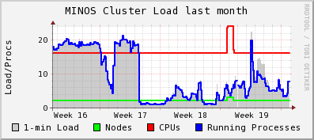
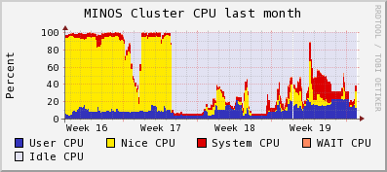
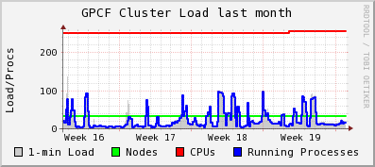
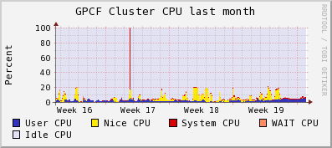
Ganglia Stats
Linked from https://cdcvs.fnal.gov/redmine/projects/ifront/wiki/Monitoring_Stats

Slide 10
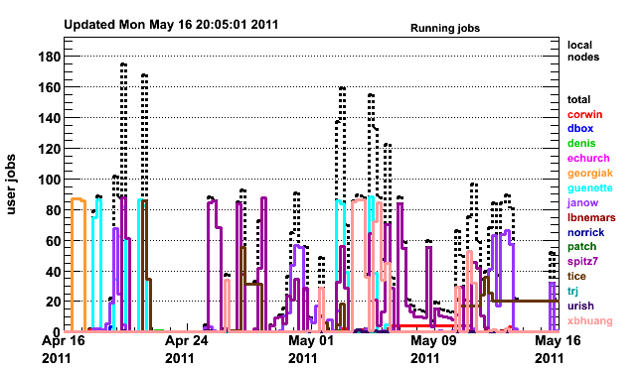
Batch Jobs gpsn01 Cluster
http://gpsn01.fnal.gov/condor_monitor/index_month_grid.html

Slide 11
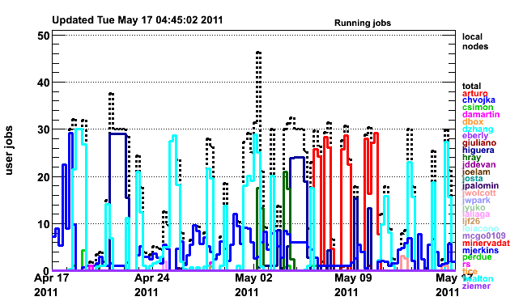
Batch Jobs on if01 Cluster
http://if01.fnal.gov:8080/condor_monitoring/index_month_local.html
24 total slots

Slide 12
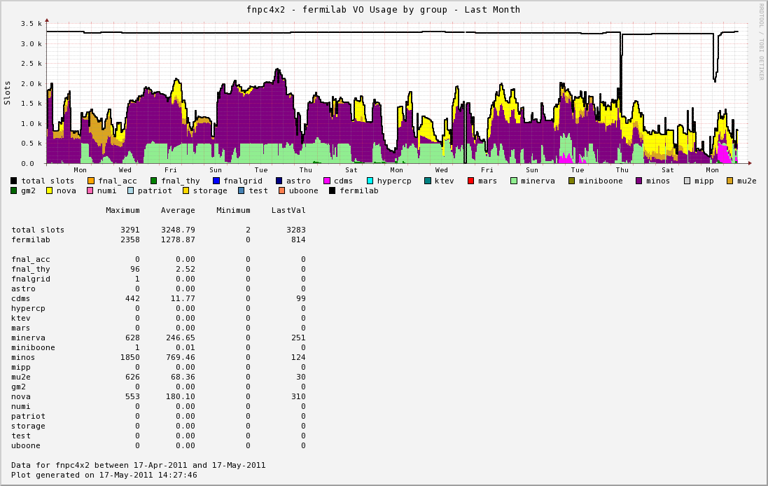
FermiGrid GP Cluster Last Month

Slide 13
Plans for FY11 Purchases
Executive Summary
258TB BlueArc
340 TB tape archive
740 GP Farm worker slots
3 DB Servers, 2 other server machines

Slide 14
Disk Purchases
108 TB total “per experiment” purchases (chart)
150 TB additional pre-purchase for FY12

Slide 15
Tape Purchases

Slide 16
GP Grid worker cores

Slide 17
GPCF
Replace existing worker nodes (7 nodes) with “farm” type nodes. Increase number of WN’s as needed.
Increase number of VM host nodes with existing (7 worker + 4 unused) gpcf nodes.

Slide 18
Miscellaneous Servers
General-IF-DB server plan
General purpose for conditions data, ECL, etc.
Three large, 16 core, 64GB Memory, 2TB data disk
Dev: Develop and test applications
Prod: Production service
Farm Replica: Replica for scaling to farm clients.
Both MySQL and PostgresSQL instances
Independent “clusters” for each experiment
MINERvA: One event display machine, one VM server.

Slide 19
finish

