Slide 1
PIP-II Coupler activity update at FNAL
Nikolay Solyak
08 July 2020

Slide 2
SSR2 coupler procurements status
Documentation for procurement are complete, waiting procurement to proceed with RFP
Basic docs:
SSR2 EPDM ED001257 – reference for all documentation of SSR2, incl. couplers
SSR2 coupler assembly, drawings: F10110745 rev B
SSR2 coupler Procurement Plan: ED0011771 rev A
SSR2 coupler Fabrication Specification: ED0011772 rev A
Ceramic disks are received. Acceptance Criteria for Coupler Ceramic Window F10133029 rev. None, Inspection Traveler under revision
Goal to have PO in August. (Sept?)

Slide 3
650 MHz coupler procurement status
Same design for both LB650 and HB650 couplers.
Final List of TC documentation, sent to FNAL procurement to start RFP,
Working with procurement to finalize documentation, reqs.
ED0001240 – EPDM for 650MHz coupler with references (will be updated)
ED0005788-C---650MHZ COUPLER ASSEMBLY Procurement Plan
ED0005689-C--650 COUPLER Technical Specification
F10056895 Rev C - 650MHz Main Coupler Drawing Package, minor changes (heater) later
F10130914 Rev A - Antenna Assembly Drawing Package
DRAFT_Proposed Evaluation Criteria_650 couplers
DRAFT_Acquisition Plan-0026 (exported to word from RAPTR)
FPC Bidders List
This order will be a best value procurement with a technical evaluation of bids constituting a 70% weight.
RFP shall only go to companies that have produced RF couplers for accelerators (CPI, RITH, and Cannon/Toshiba).

Slide 4
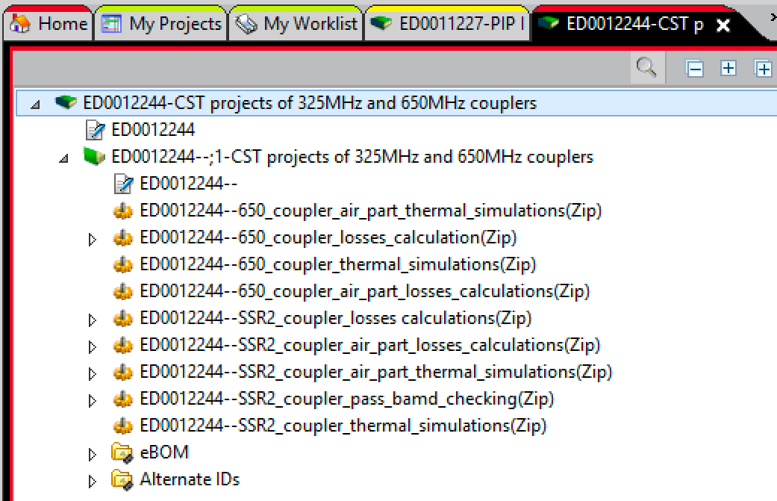
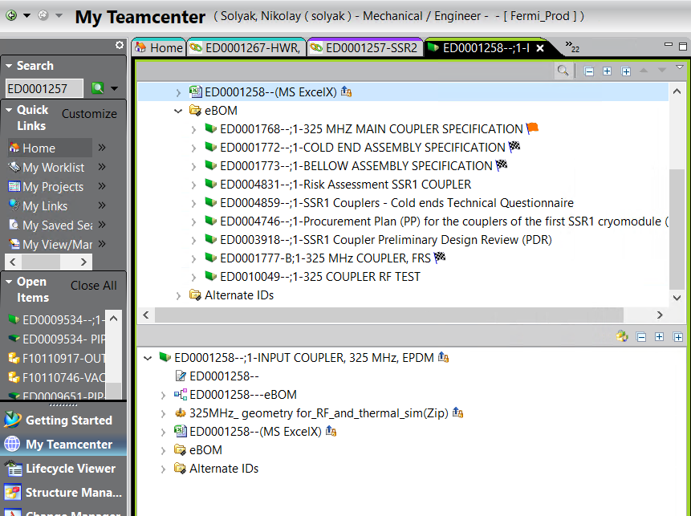
SSR2 and 650 MHz CTS projects in TC (zip files)
ppSSR2 EPDM-ED0001257

Slide 5
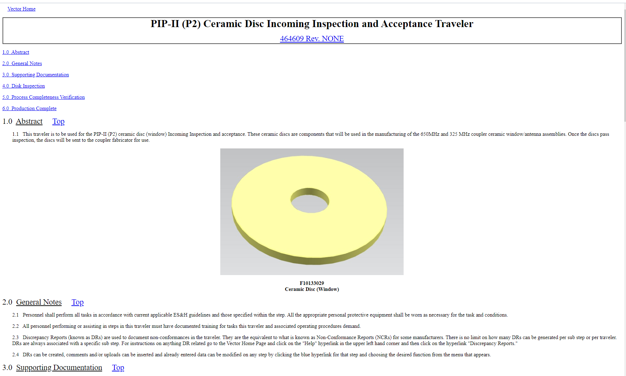
Ceramics disks for SSR2 and 650 coupler (20+20)
All ceramic disks are delivered to Fermilab (end of June)
Incoming Inspection and acceptance documentation
Traveler is ready for review
Each disk will have serial number on package
QC inspection will start soon

Slide 6
TiN coating studies
5 disks (from SSR1 batch) will be coated in CPI with different thicknesses to measure loss factors. Expecting quote from CPI soon.
Studies of charge leakage rate vs. TiN thickness using electron microscope under discussion. Technique developed and tested at Euclid Techlab. They also able to coat TiN on samples and measure thickness and composition. We are working with company to finalize statement of work and get quotation.

Slide 7
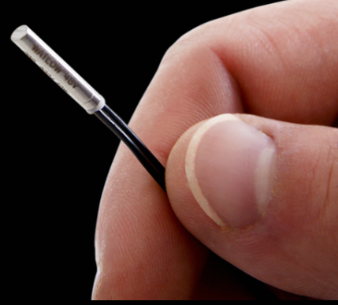
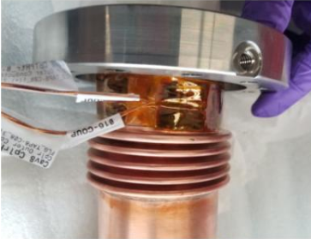
Cartridge Heater (4 x 10 W, OD=¼”, length=1”)
Can provide temperatures - up to 1000 degC.
Ordered from Watt-Flex
Foil type heater (SSR1 coupler)

Slide 8
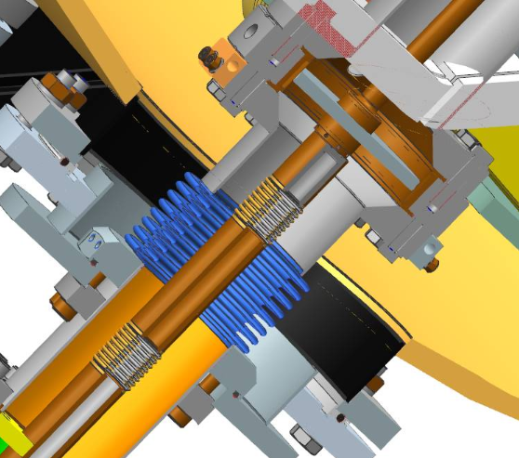
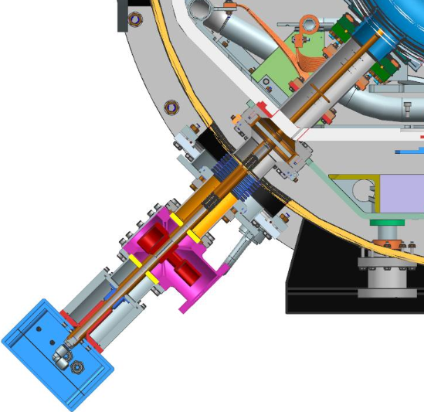
Heater on SSR2 coupler
Four copper blocks (20mm thick) with hole for heater cartridge. Installed and wired on the flange of warm section. Clearance in CM flange is enough (30mm) to install warm coupler inside CM. Thermal braids are installed on the window flange and attached to strong-back (not shown here). Design is fixed for prototype coupler.

Slide 9
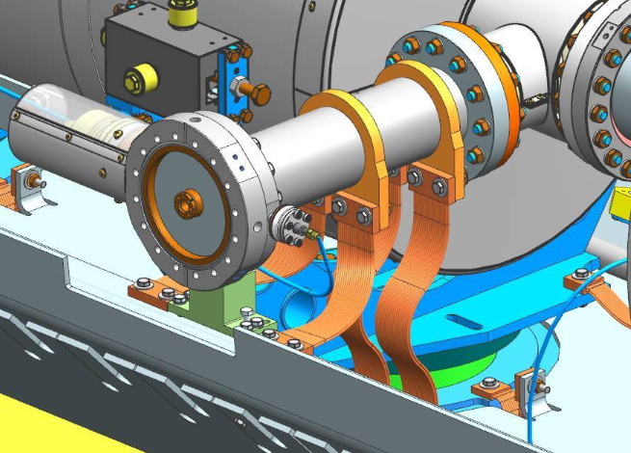
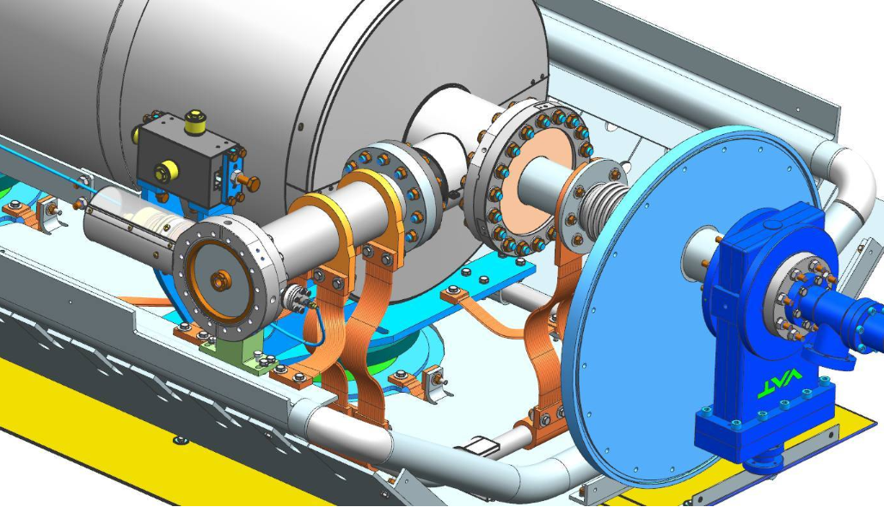
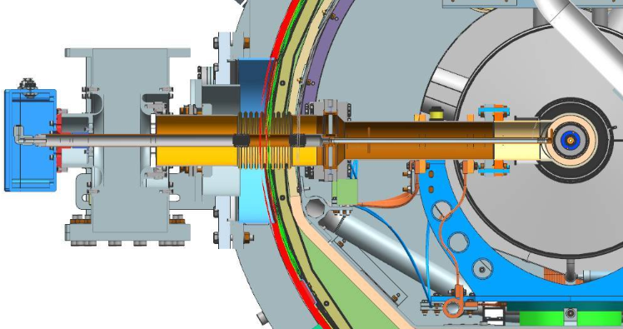
650MHz coupler
Design is not fixed yet.
Possible solution same as for SSR2
Or heater and braids are installed on window flange.
4 holes in flange for heaters.
T-sensors are bolted to braids or installed in holes in flange (LCLS-II)

Slide 10
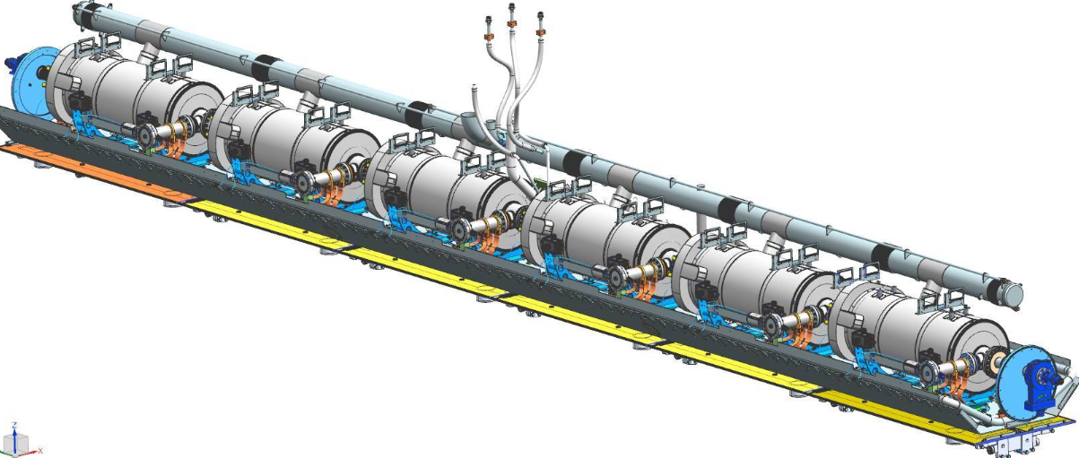
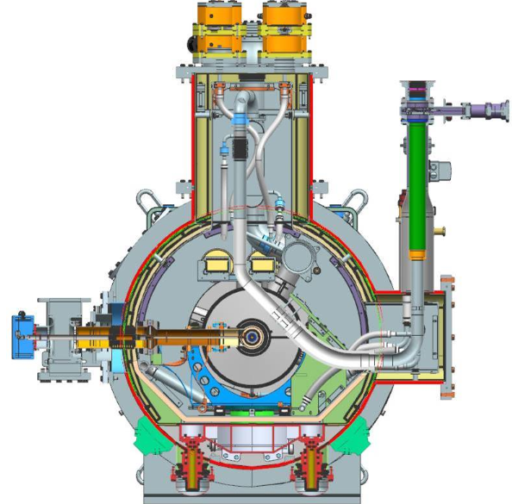
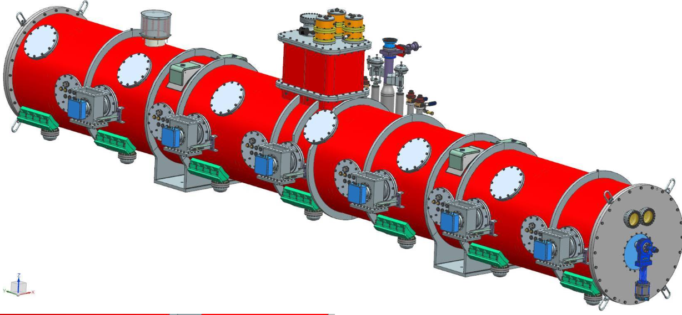
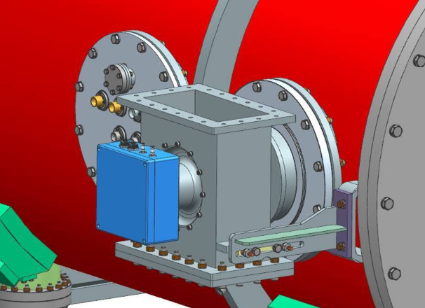
HB650 Cryomodule

