Slide 1
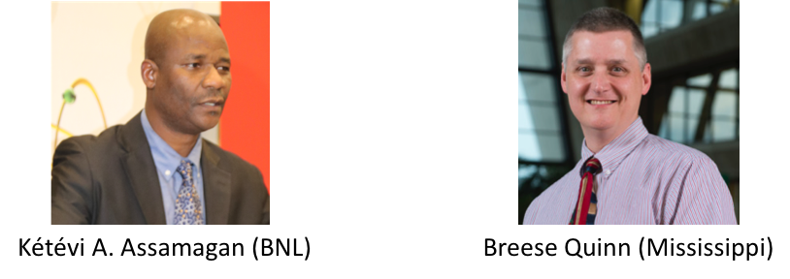
Community Engagement Frontier
Main Wiki : https://snowmass21.org/community/start

Slide 2
Who/what/where/when/why?
Snowmass is a process that can be most successful when everyone’s voice is heard! We are shaping the field of high energy physics for everyone involved, so everyone’s ideas should have equal weight in the process. We implore everyone who considers themselves a part of our high energy physics community to contribute to the Snowmass proceedings during course of the coming year through virtual or in person meetings like this, on the slack workspace, or the email lists. Whether you are a graduate student, technician, post-doc, academic faculty, engineer, research scientist ... we welcome everyone to contribute in this discussion.
If you feel this is not the case for whatever reason, don’t hesitate contact the conveners of the Diversity & Inclusion topical group of the Community Engagement Frontier: Mu-Chun Chen, Sam Meehan, Carla Bonifazi, and Ketevi Assamagan.
… and SLAC, BNL, LBNL, CERN, ... all the labs and universities
fnal.gov/we-are-one-fermilab.jpg

Slide 3
Guidelines for the discussion
[1] Be Seen : Please raise your hand on Zoom if you would like to make a comment or ask a question. Please wait to be called on by the session moderator before speaking.
[2] Be Mindful : Please be mindful of others if you are dominating the discussion. Share the air. We want to hear as many voices as possible.
[3] Be Relevant : Please keep questions and comments relevant to the discussion.
[4] Be Respectful : As always, be respectful of your colleagues. Everyone has a right to be heard, so speak up but give space for others to contribute as well. Let’s have a good meeting!
[5] Stay connected…
Listserv: SNOWMASS-COMM-ENG-FRONTIER-GRP@fnal.gov
Slack: Go here https://snowmass2021.slack.com/ → community_engagement_frontier_topics

Slide 4
Community Engagement Frontier
Improve and sustain strategic engagements with our communities in order to draw support for and strengthen the field of particle physics, while playing key roles in serving those communities. These engagements take well-coordinated efforts in many areas where the communities of experts and non-experts can understand and communicate our field’s value, maximize its impact on global socioeconomic development, and open its doors to broader participation.•
Note concerning the nature of the Community Involvement Frontier
This one is somewhat different. Composed of Topical Groups dealing with different issues of community-wide engagement that cut across all Frontiers, rather than all focusing on specific aspects of one area of our field.
Each CEF Topical Group will need to work with other Frontiers at least as much as with other CEF Topical Groups.

Slide 5
Community Engagement Topical Groups
Applications & Industry
Develop and strengthen HEP/Industry relationships in both directions: form more partnerships to draw on industry expertise to further HEP goals, and build on programs to facilitate transfer of HEP technologies/techniques for use in the broader society.
Career Pipeline & Development
Not simply making young scientists aware of different opportunities, but also changing culture of HEP career paths (e.g. issues with Computational staffing)
Diversity & Inclusion
Improve diversity, inclusion and equity in our field
Physics Education
Broader than simply how we teach physics courses. It is about what education and training our field needs to produce the physicists required for the HEP program to be successful (e.g. computational, beams, instrumentation; workshops, univ/lab/collaboration-level courses, etc.)
Public Education & Outreach
This is where most of Snowmass 2013 CEO Frontier focus lives, and what some think of as the whole of Snowmass 2021 CEF.
Public Policy & Government Engagement
Been quite successful on US Federal level. Need to look at both smaller picture (local/state), and larger picture (international).

Slide 6
Community Engagement Frontier Topical Groups and Conveners
Topical Group |  | Topical Group co-Conveners |  |  |  | Ex officio
Comm01 | Applications & Industry (A&I) | Farah Fahim (FNAL) | Alex Murokh (RadiaBeam) | Koji Yoshimura (Okayama) |  | B. Quinn
Comm02 | Career Pipeline & Development (CP&D) | Sudhir Malik (UPRM) | Yangyang Chen (Cornell) | Amr El Zant (BUE) | Julie Hogan (Bethel) | K. Assamagan
Comm03 | Diversity & Inclusion (D&I) | Mu-Chun Chen (UCI) | Sam Meehan (CERN) | Carla Bonifazi (UFRJ) |  | K. Assamagan
Comm04 | Physics Education (PE) | Randy Ruchti (Notre Dame) | Sudhir Malik Prabhakar (UPRM) | Sijbrand de Jong (Radboud) |  | B. Quinn
Comm05 | Public Education & Outreach (PE&O) | Sarah Demers (Yale) | Kathryn Jepsen (SLAC) | Don Lincoln (FNAL/Notre Dame) | A. Muronga (Nelson Mandela) | K. Assamagan
Comm06 | Public Policy and Government Engagement (PP&GE) | Rob Fine (Rochester) | Louise Suter (FNAL) | Brajesh Choudhary (Delhi) |  | B. Quinn

Slide 7
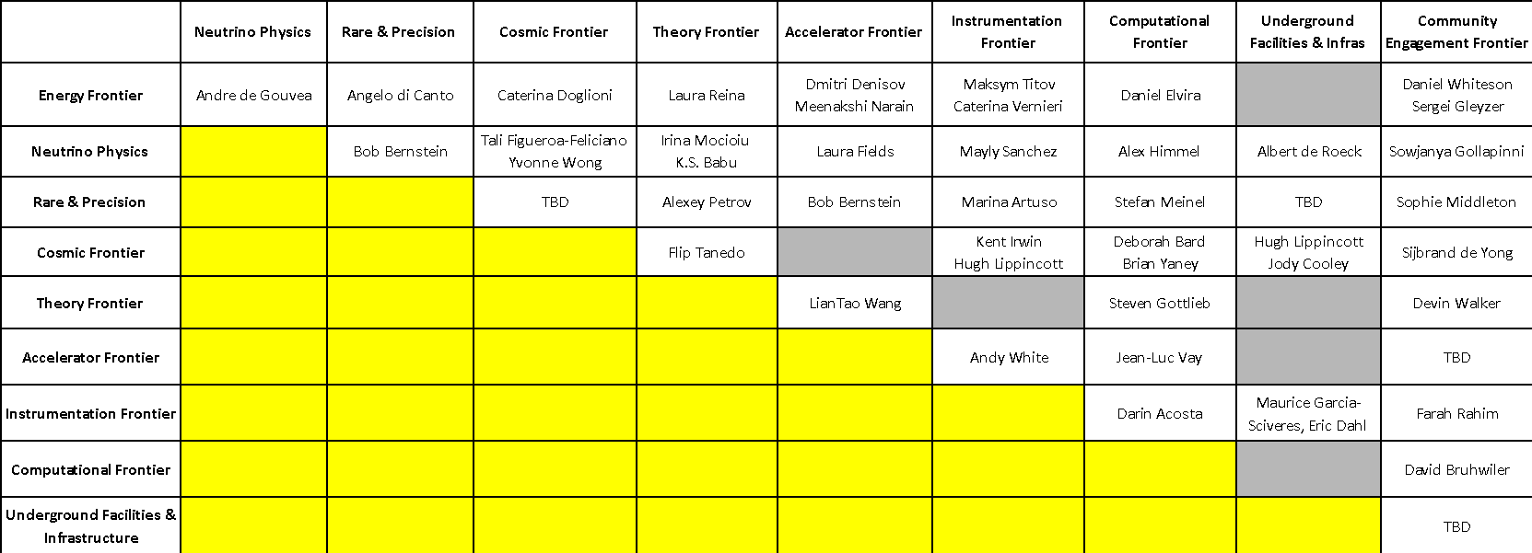
CEF Liaisons with other Frontiers

Slide 8
Today’s Town Hall
The mission and scope of the CEF
How you can participate in the work to be done in its 6 Topical Groups:
CommF1: Applications & Industry
CommF2: Career Pipeline & Development
CommF3: Diversity & Inclusion
CommF4: Physics Education
CommF5: Public Education & Outreach
CommF6: Public Policy and Government Engagement
Preliminary list of Working Topics in all the Topical Groups
From today’s discussion, see where you might want to contribute, or to suggest additional areas of investigation that CEF should pursue.
We look forward to working with you on these important issues during the Snowmass process.

Slide 9
The agenda for Today
Introduction
CEF
Topical Groups
Break
Topical group discussions
CP&D + AI
PE + PE&O
Break
D&I + PP&GE
Cross cutting & Conclusions
Recruitment, Evaluation and Recognition (D&I)
Master in Applied Physics (PE)
Next Steps

Slide 10
CommF1: Applications & Industry
https://snowmass21.org/community/applications
Farah Fahim, Alex Murokh, Koji Yoshimura

Slide 11
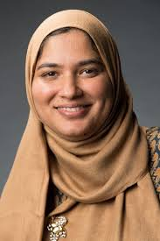
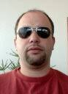
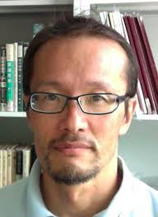
Who are we?
Farah Fahim
Fermilab
farah@fnal.gov
Alex Murokh
Radiabeam
murokh@radiabeam.com
Koji Yoshimura
Okayama
Working Group - 50% (Lab + Academia) + 50% industry
Need to create strong ties to Career Pipeline and Development
Public Policy and Government Engagement
Bi-monthly meetings: Tuesdays 6-7pm CT

Slide 12
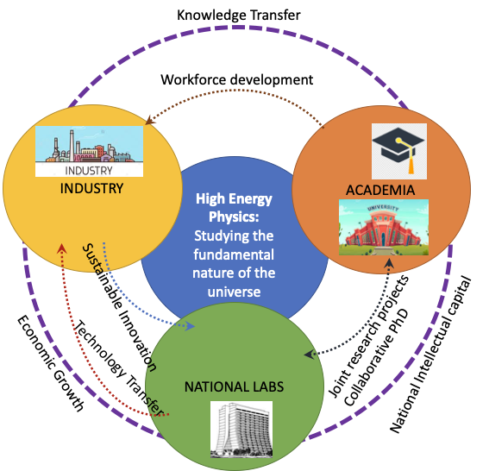
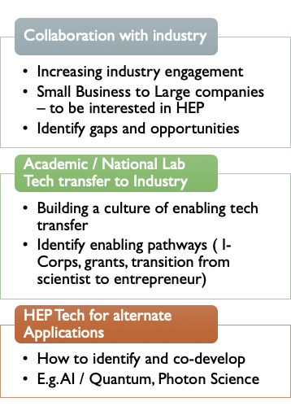

Slide 13
CommF2: Career Pipeline & Development
https://snowmass21.org/community/career
Sudhir Malik, Yangyang Chen, Julie Hogan, Amr El Zant

Slide 14
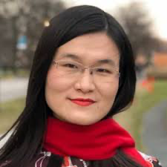
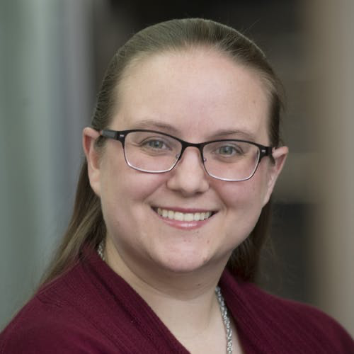
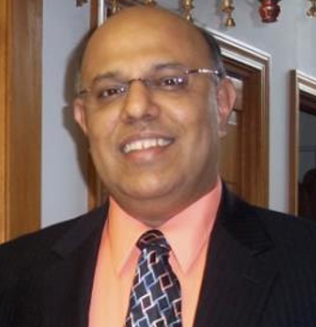
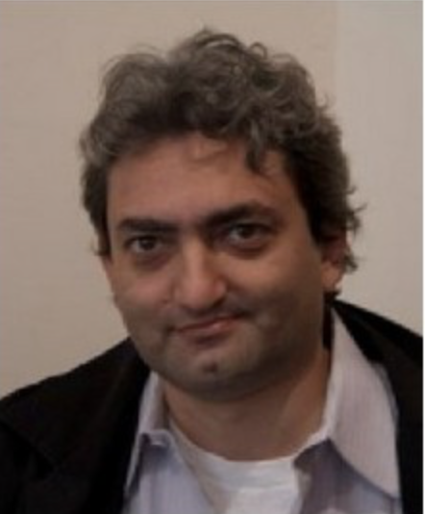
Who are we?
Yangyang Cheng
Cornell University
yangyang.cheng@cornell.edu
Julie Hogan
Bethel University
j-hogan@bethel.edu
Sudhir Malik
UPRM
sudhir.malik@upr.edu
Amr El-Zant
British University in Egypt
Amr.Elzant@bue.edu.eg
Most enter HEP for the love of basic science, but skills learnt can get more ‘generic’ job
Topics here connect to other groups and Snowmass frontiers (e.g. Computational and Snowmass Young)
Topics and Goals
Identify and promote career opportunities --- HEP and non-HEP
Identify and promote skill development --- varied: technical and presentational
Training/partnerships relevant to non-academic careers + funding strategies + 4 yr institution
Encourage placement based on background (which abilities → which career)
Synergy with other Topical Groups in CEF → vision for development of career opportunities and paths
More Info
Topics to contribute to: LOIs (group working topics: look for Career Pipeline & Development)
Meetings - https://indico.fnal.gov/category/1156/
Subscribe to email - https://listserv.fnal.gov/scripts/wa.exe?A0=SNOWMASS-COMMF-04-PHYS_EDU
Slack Channel - https://app.slack.com/client/TNNU4A570/C013K1YFP4Y/details/top?cdn_fallback=2

Slide 15
CommF3: Diversity & Inclusion
https://snowmass21.org/community/diversity
Mu-Chun Chen, Samuel Meehan, Carla Bonifazi
Fill this out and get your colleagues to fill this out :
Accessibility Survey
(Only 10% of snowmass has responded thus far)

Slide 16
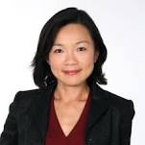
Who are we?
Carla Bonifazi
(Univ. Fed. do Rio de Janeiro)
Mu Chun Chen
(UC Irvine)
Samuel Meehan
(CERN)
The promotion and support of Diversity, Equity, and Inclusion is mission critical
Form a more just society (professionally, academically, relationally, ...)
“The more the merrier” : Diversity of perspectives furthers creativity and success
Creating a professional climate that is conducive to allowing all to succeed
Concentrate on (1) surveying issues, (2) contextualizing in DPF fields in terms of DEI, (3) laying guidelines for the immediate and future (resource for the field and next snowmass)
Gatherings : Bi-Weekly Townhall (e.g. Monday), no current group planning meeting

Slide 17
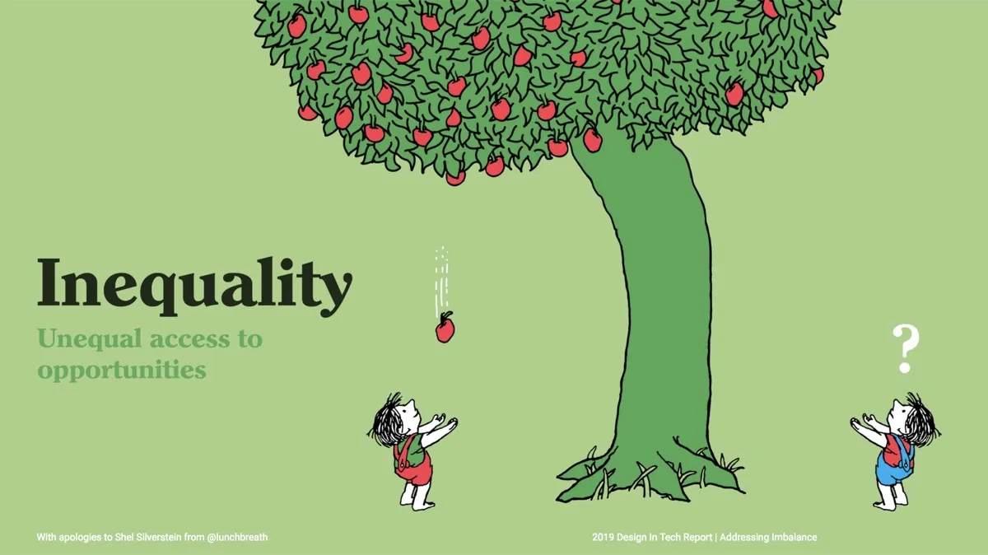
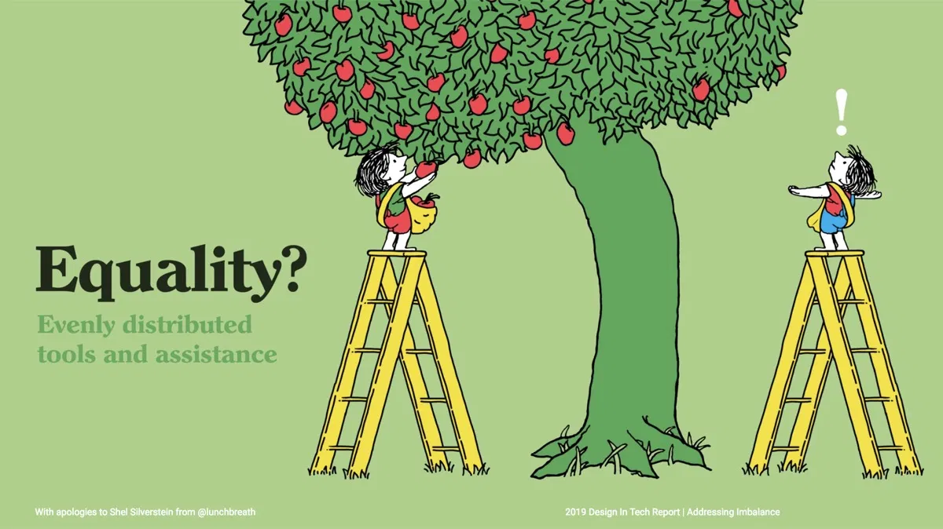
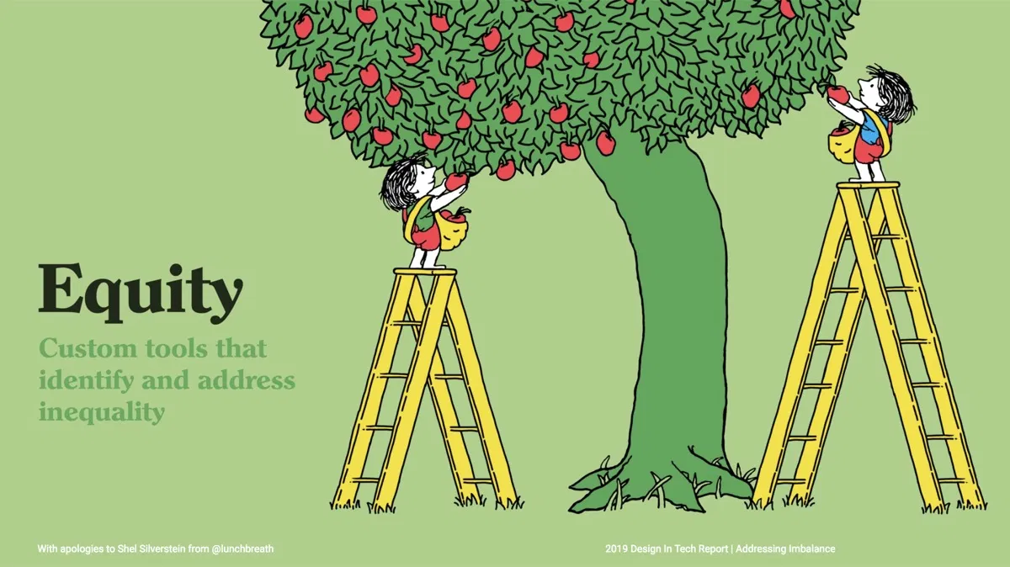
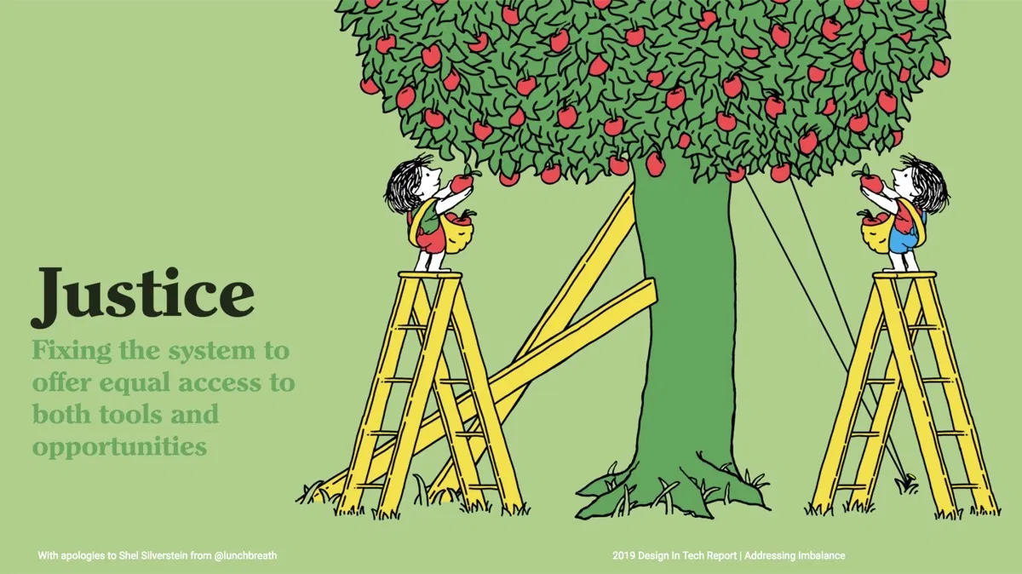
Who/what/how … by analogy
2019 Design in Tech Report
“Science”
Culture
Funding
Career
Publications
Enjoyment
...
Unis
Labs
“Us”
“Us”

Slide 18
CommF4: Physics Education
https://snowmass21.org/community/education
Randal Ruchti, Sijbrand de Jong, Sudhir Malik

Slide 19
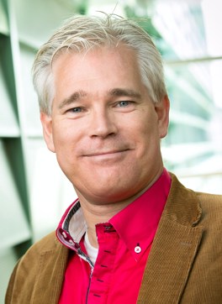
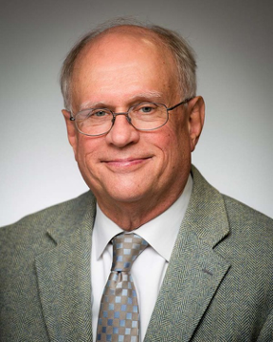
Who are we?
Convenors:
Education required to sustain and improve (the people working in) our field (in the widest sense):
(Particle) Physics
Mathematics
Computer Science
Managerial and technical skills
Randy Ruchti
Notre Dame
rruchti@nd.edu
Sudhir Malik
UPRM
sudhir.malik@upr.edu
Sijbrand de Jong
Radboud University
sijbrand@hef.ru.nl
Concentrate on mechanisms and organisation, less on teaching material
Strong overlap with other frontiers and within CEF (Career, diversity, outreach)
Weekly Zoom meeting: Join us, see agendas at: https://indico.fnal.gov/category/1158/

Slide 20
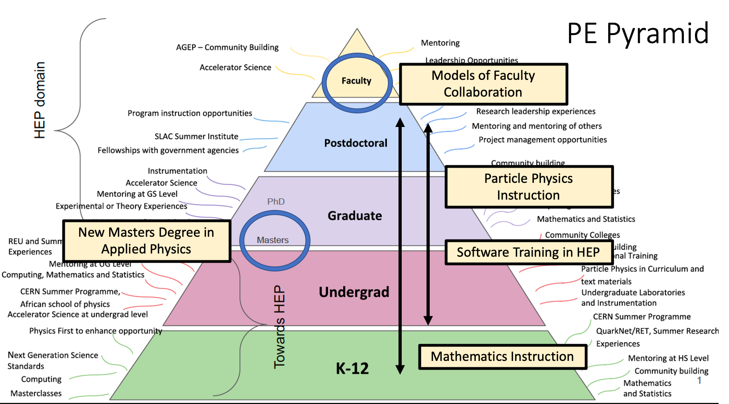
PE Pyramid

Slide 21
CEF5: Public Education & Outreach
https://snowmass21.org/community/outreach
Sarah Demers, Kathryn Jepsen, Don Lincoln, Azwinndini Muronga

Slide 22
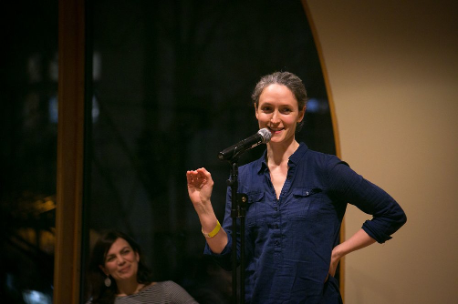
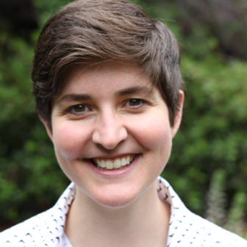
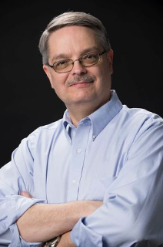
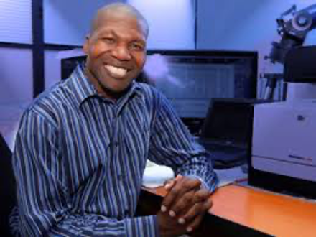
Who are we?
Convenors:
Sarah Demers
Yale University
sarah.demers@yale.edu
Kathryn Jepsen
Symmetry Magazine
kjepsen@slac.stanford.edu
Don Lincoln
FNAL
lincoln@fnal.gov
Azwinndini Muronga
Nelson Mandela University
Azwinndini.Muronga@mandela.ac.za
Discuss the why, what, who and how of public engagement, education and outreach
Overlap with other TGs within CEF and have impact in all other Snowmass frontiers
Regular Zoom meetings: Join us, see calendar at: https://snowmass21.org/community/start

Slide 23
CEF5: Who are we and what we do?
•Overall Goal(S):
•To have public engagement and education in particle physics recognized as important scientific activities and supported at all levels.
•To have public education and outreach part of every practicing particle physicist’s job description and to be recognized at all levels.
•Overall Objective(s):
•To facilitate discussions amongst HEPP community and its stakeholders on the transformative public engagement through public education & outreach

Slide 24
CommF6: Public Policy and Government Engagement
https://snowmass21.org/community/policy
Rob Fine, Louise Suter, Brajesh C. Choudhary

Slide 25
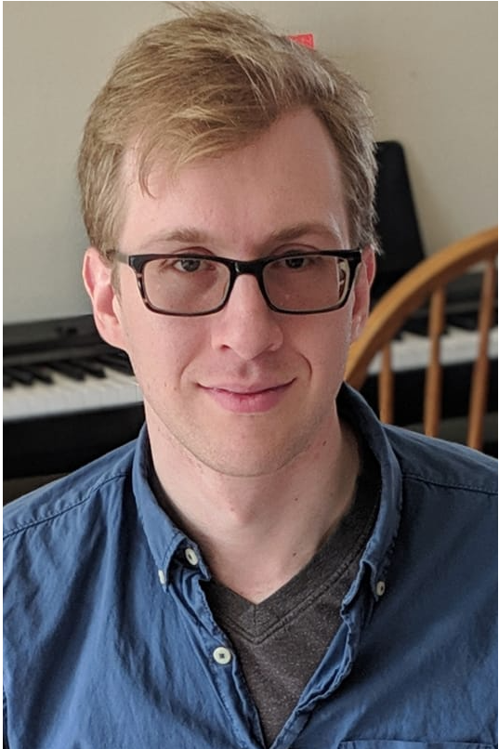
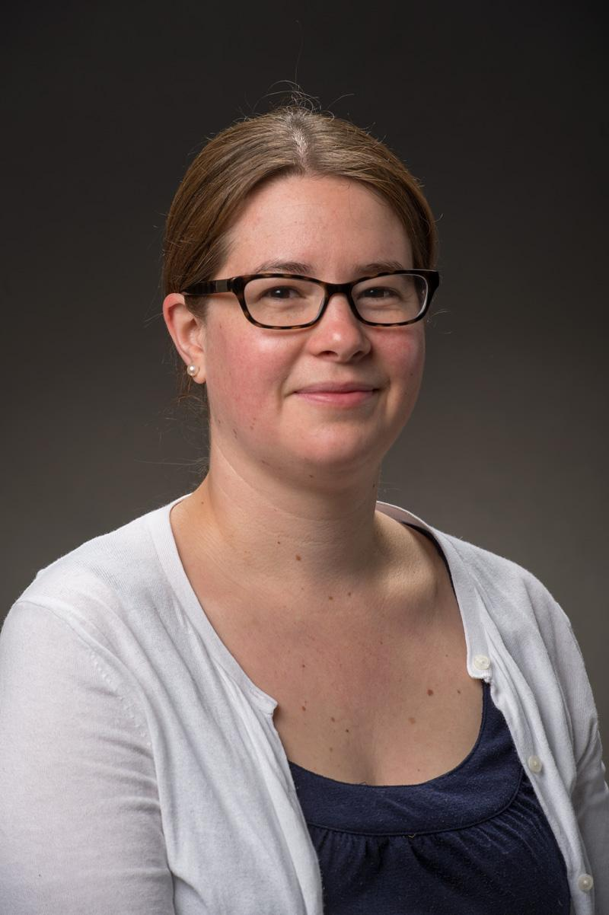
Who are we?
Rob Fine
University of Rochester
finer@pas.rochester.edu
Louise Suter
Fermilab
lsuter@fnal.gov
Brajesh Choudhary
University of Delhi
brajesh@fnal.gov
Topics under discussion:
How does the HEP community engage with legislators in the US congressional government re: funding? What has worked well and where can we improve? (e.g. annual “DC Trip”)
Should the scope of our advocacy be expanded to include e.g. State-level government officials?
Should we expand the subject of our advocacy beyond funding? To advocate e.g. immigration issues impacting HEP?
How do we increase awareness within our community of these efforts and their importance?
How do we provide training, tools and a gateway so everyone feels able to engage with these efforts?
How to join the conversation:
Subscribe to our email listserv: SNOWMASS-COMMF-06-PPGE
Join our Slack channel: https://app.slack.com/client/TNNU4A570/C012V6WUNRY/details/top?cdn_fallback=2
Attend meetings: https://indico.fnal.gov/category/1156/
Contribute an LOI (see Public Policy & Government Engagement for topics we have considered here)

