Slide 1
Compensation of linear space charge forces in the IOTA ring
Aleksandr Romanov
IOTA Physics Meeting
13 July 2020

Slide 2
Linear part of space charge forces
On each step a thin-lens matrix is added to account for linear space charge effect
Calibration convention (KV beam), thin matrix element (2,1):
n_{q} is linear charge density normalized to charge of electron
r_{q} is classical radius of interacting particles
If coupling is present, transformation in and out of a coordinate frame where new second moment <x*y*> becomes zero is necessary before and after application of SC kick matrix.
IOTA is relatively short ring therefore a constant step was used
Optimally, integration step should be defined basing on minimum of betaX and betaY
Convergence was verified by reducing step size by x10 with no significant changes to lattice properties

Slide 3
Fit algorithm
Strong space charge effects can make intrabeam dynamics unstable in a ring tuned for a beam with negligible space charge forces. Therefore, many traditional fitting software fail at the first step of calculation of initial closed solution. There are several workarounds, for example one can gradually increase beam current while fitting necessary parameters at each step, but such approaches require a lot of manual manipulations. To overcome initial stability issues, the algorithm was developed to treat the ring lattice as a channel with some initial guess on the beam's second moments at the beginning M_{start}. In order to have a closed solution, the set of goal parameters necessary for proper ring operation is expanded with requirement to have the same second moments at the beginning of the lattice and at the end:

Slide 4
Fit parameters
Initial SM matrix may need to be defined through set of free to vary parameters
Emittances has to be fixed, otherwise fit process tend to converge to a solution with very big emittances.
If there are enough fit knobs (e.g. quads), SM may be fixed but in general it is not necessary.
In case of IOTA, SM matrix for a given NL strength is known in the middle of the NL insertion, which make it optimal starting point
Envelopes outside of NL depend on its set point, therefore SC compensation scheme depends on NL strength.

Slide 5
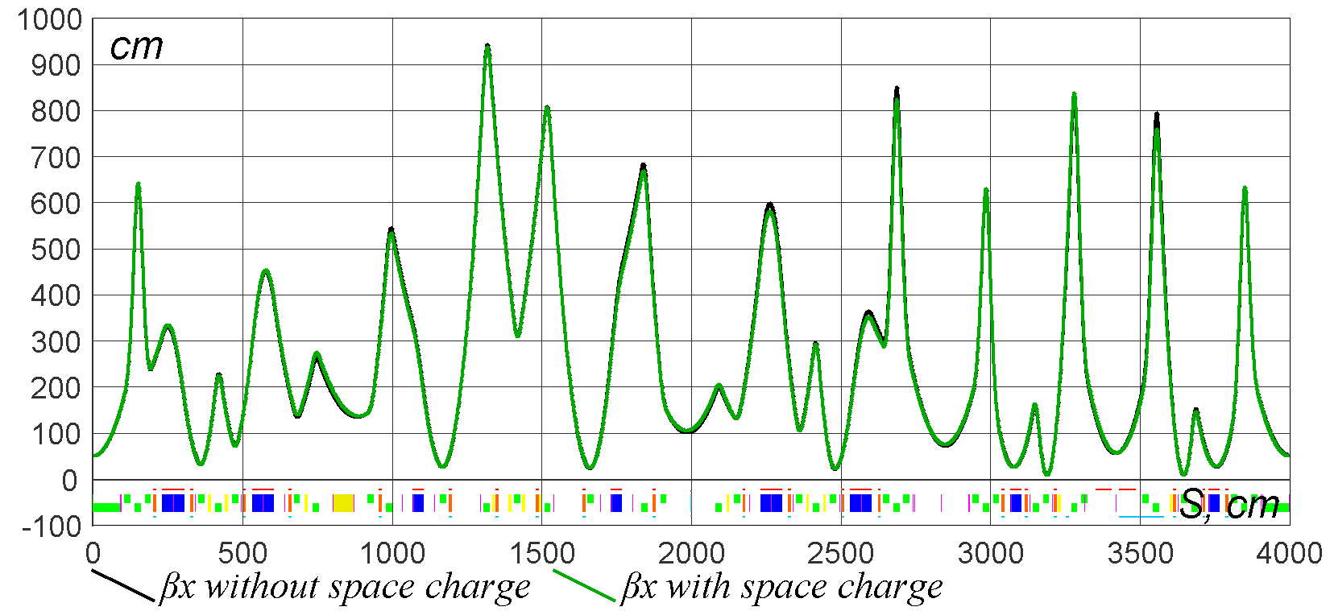
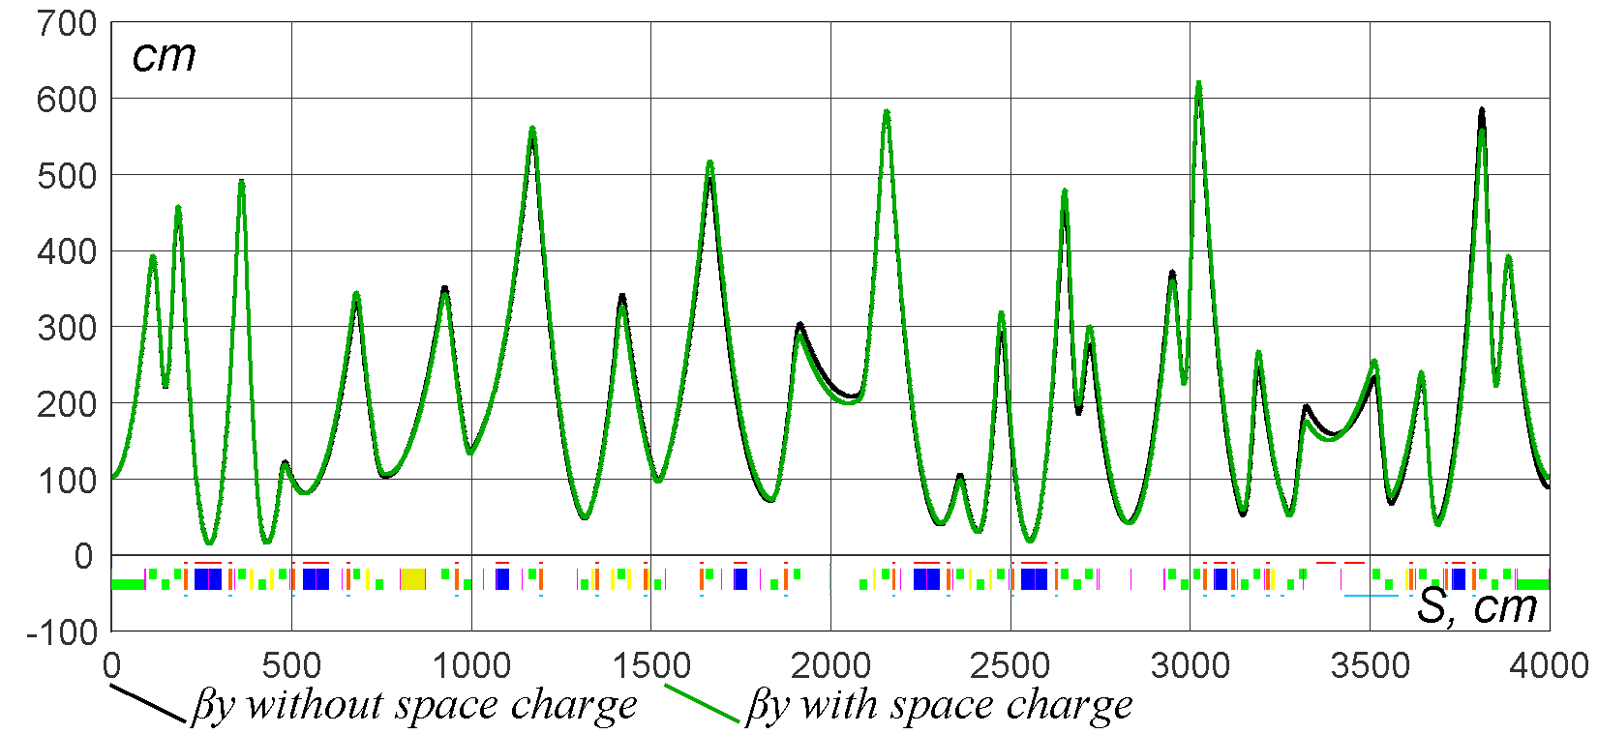
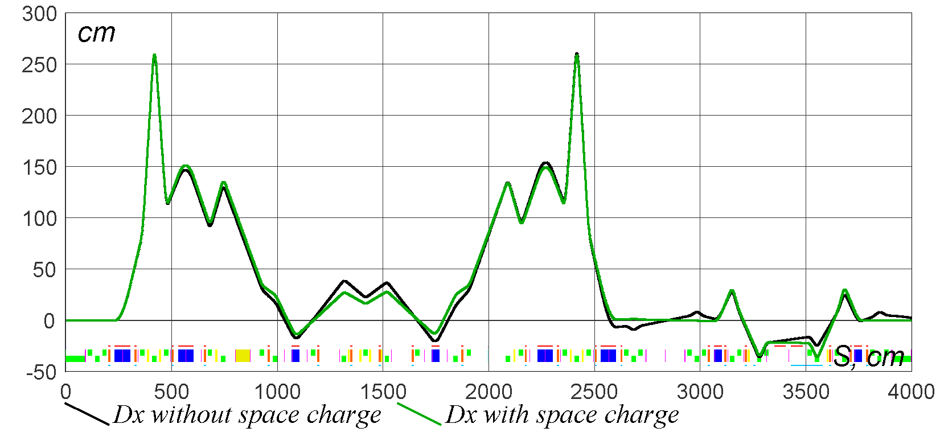
Space charger tune depression -0.03, NL at t=0.3
Periodic solution with linear space charge forces and all NL-specific lattice requirements satisfied
Horizontal beta functions
IOTA NL v8.3
Vertical beta functions
Black – without SC
Green – with SC
Dispersions

Slide 6
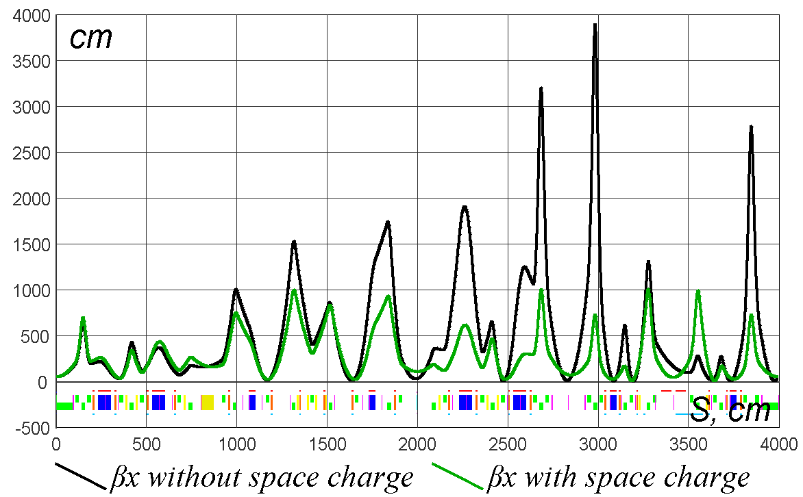
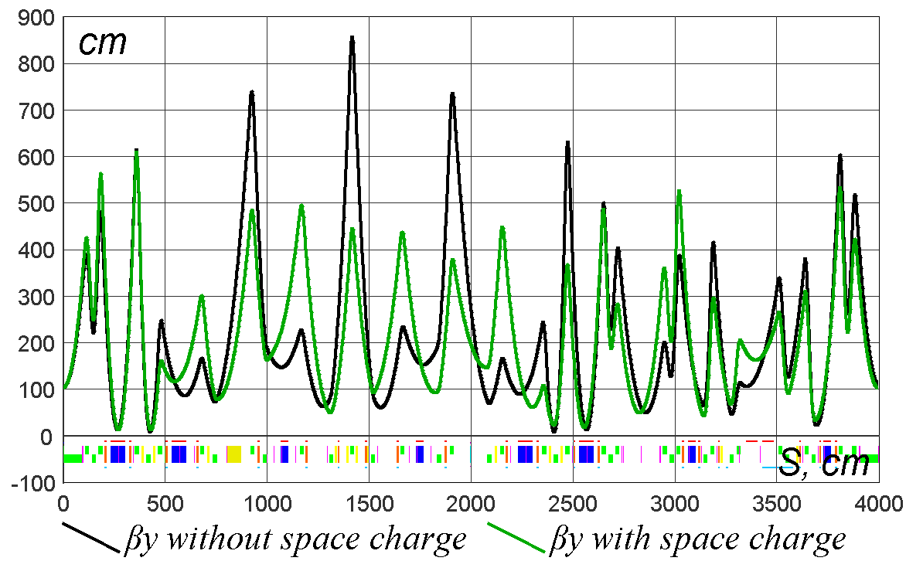
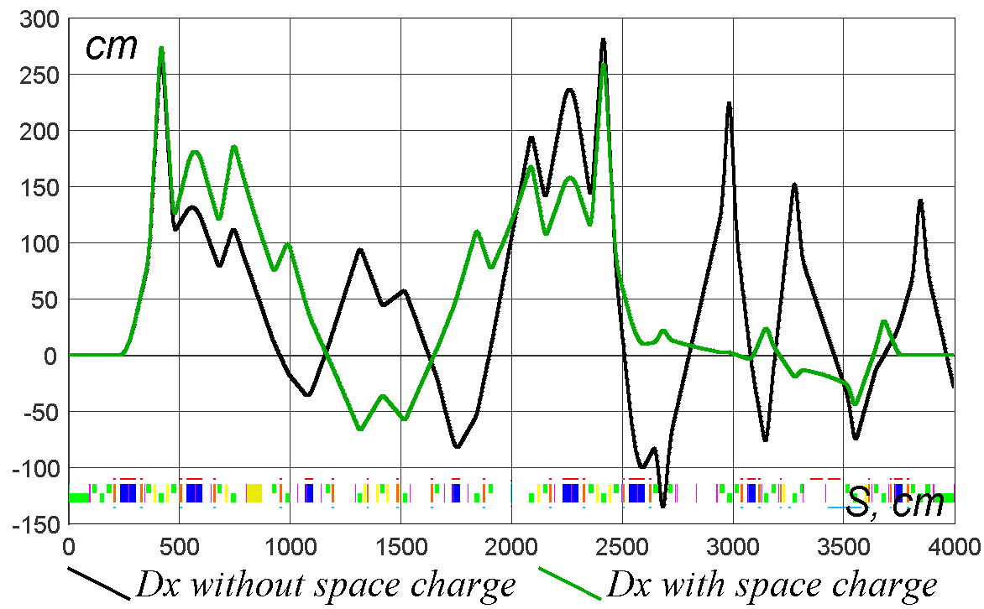
Space charger tune depression -0.45, NL at t=0.3
Periodic solution with linear space charge forces and all NL-specific lattice requirements satisfied
Horizontal beta functions
IOTA NL v8.3
Vertical beta functions
Black – without SC
Green – with SC
Dispersions

Slide 7
SC effects with e-?
Bunches out of FAST are short enough to have strong SC forces
For IOTA at 100MeV, at 1mA emittances are determined by intrabeam scattering and for fully coupled case are about 5um for both planes, momentum spread is 3E-3. That corresponds to tune shift of -0.002 for central particles of 10cm bunch.
It is about the same scale for higher currents, because emittances and momentum spread get bigger.

Slide 8
Summary
It would be interesting to do realistic tracking with and without linear SC compensation to see if it benefits stability if nonlinear forces are taken into account.

