Slide 1


302.4.04 – Cryo-assemblies Horizontal Test
Weekly status report
Guram Chlachidze
July 13, 2020

Slide 2
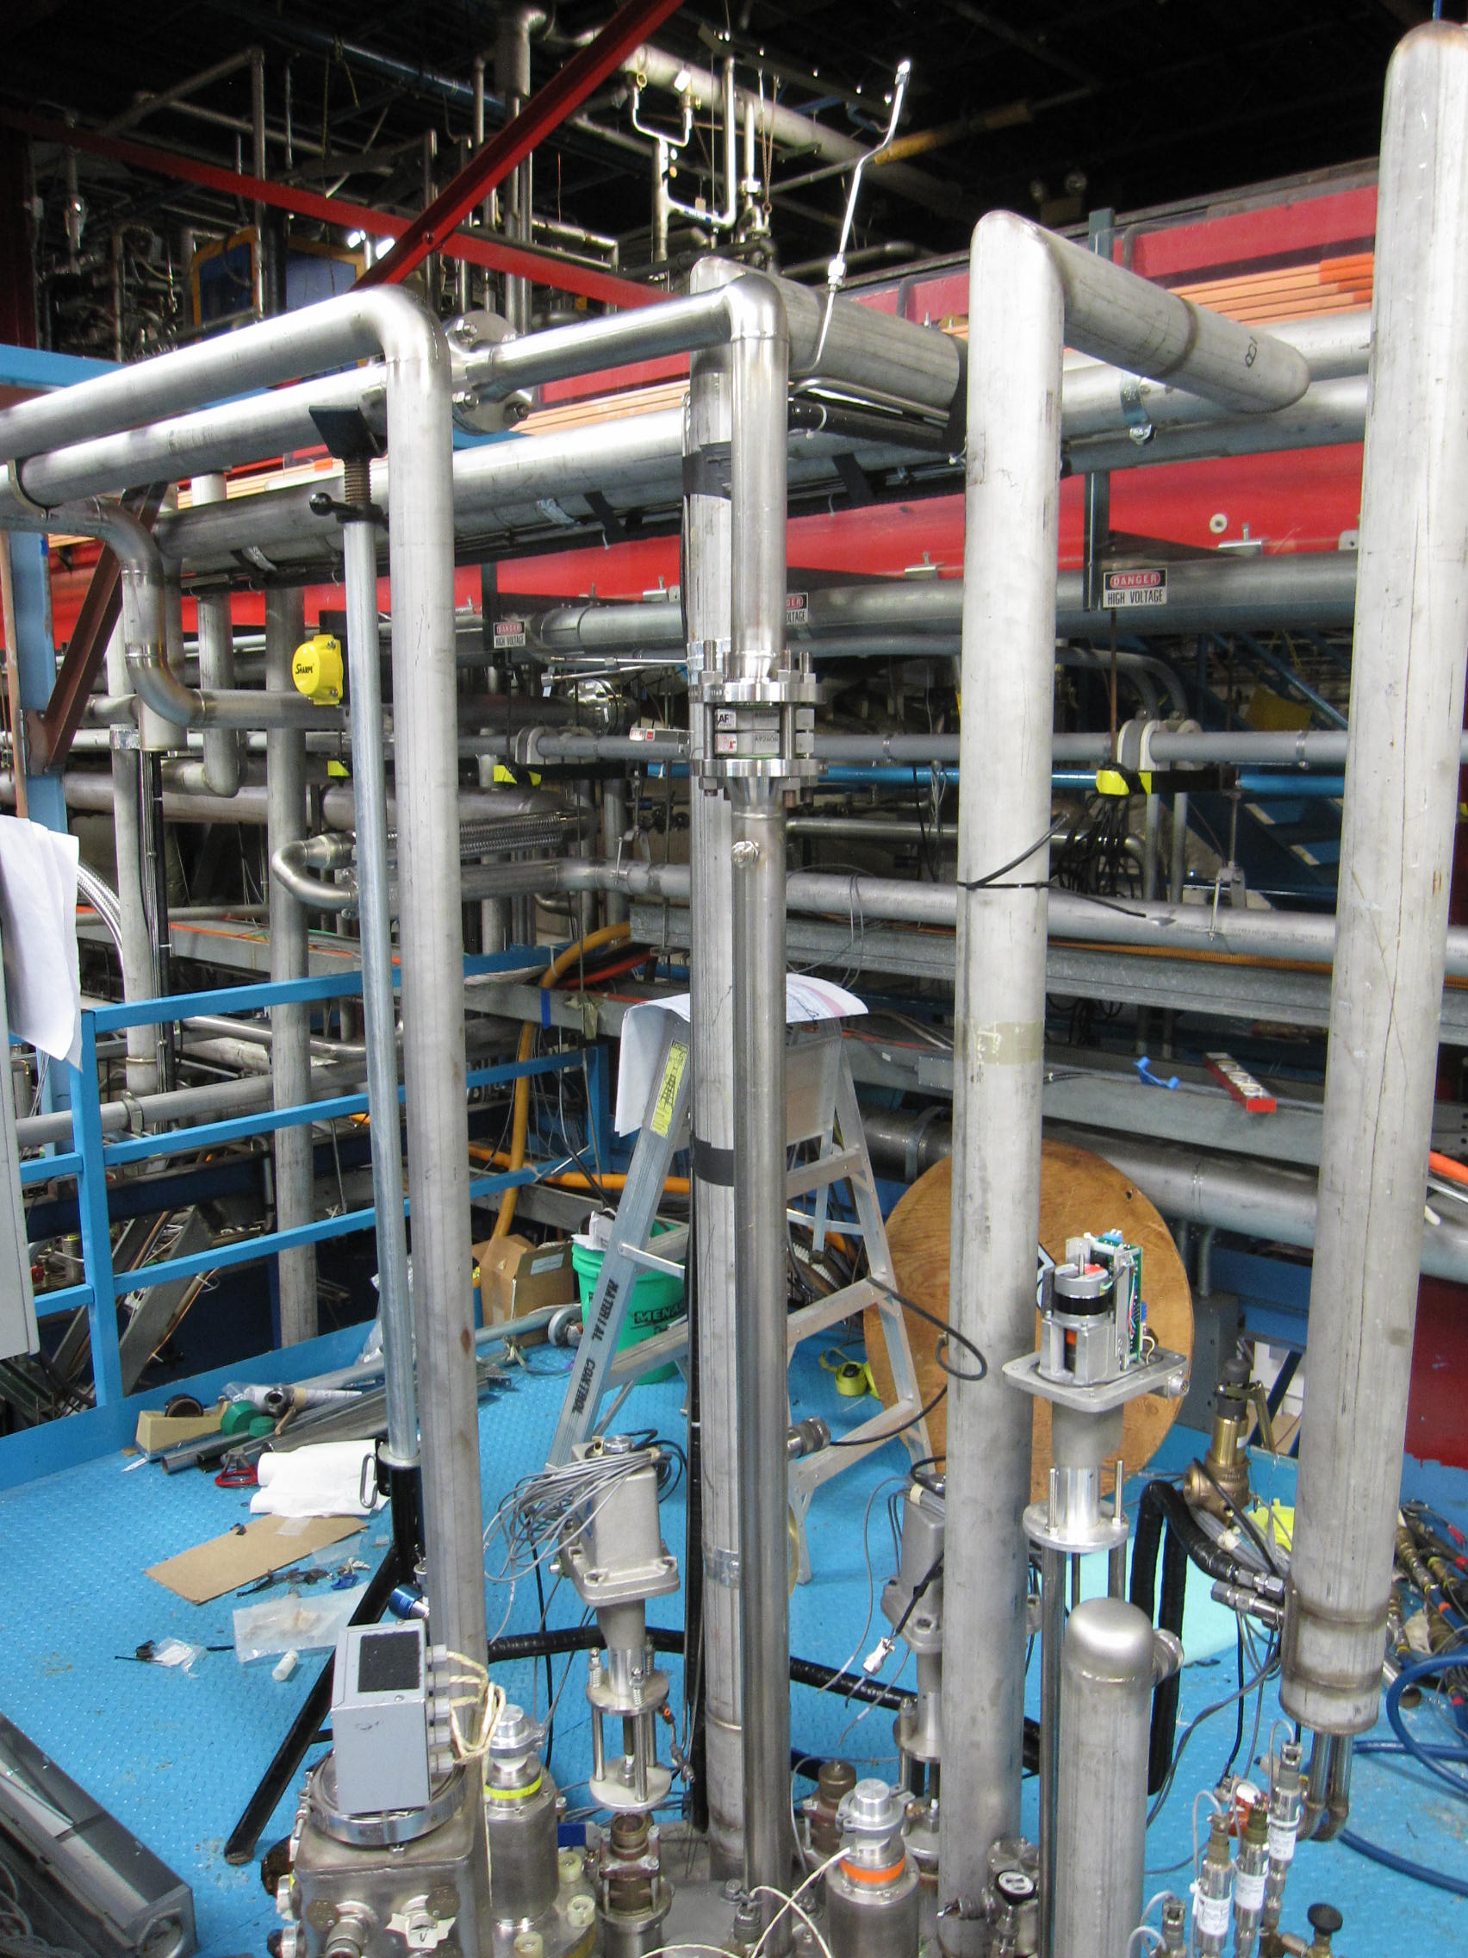
Test Stand 4 Upgrades
External piping installations resumed at Test Stand 4
  Total of 14 installation steps
  Step 12 - Rupture disk line is complete
  Step 13 - Fit-up of U-tubes in progress
  Step 14 - Cool-down return/leads bypass
  piping in progress
Stand 4 Pressure tests
  Relief valve spool test in MW9 - Done
  CA relief vent line – Done, Jul. 9
  LN2 bath vent line – Done, Jul. 9
  FB/AB thermal shield piping – this week
  Return end thermal shield piping – this week
None of the Fermi trailers are good for Q1/Q3 CA transportation between the ICBA and IB1 buildings
  Rental trailer is the only option (1000-1500$ per use)

Slide 3
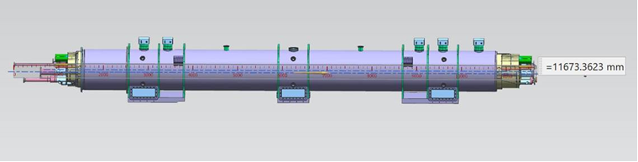
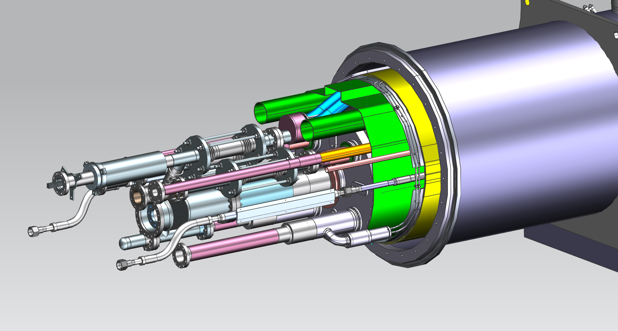
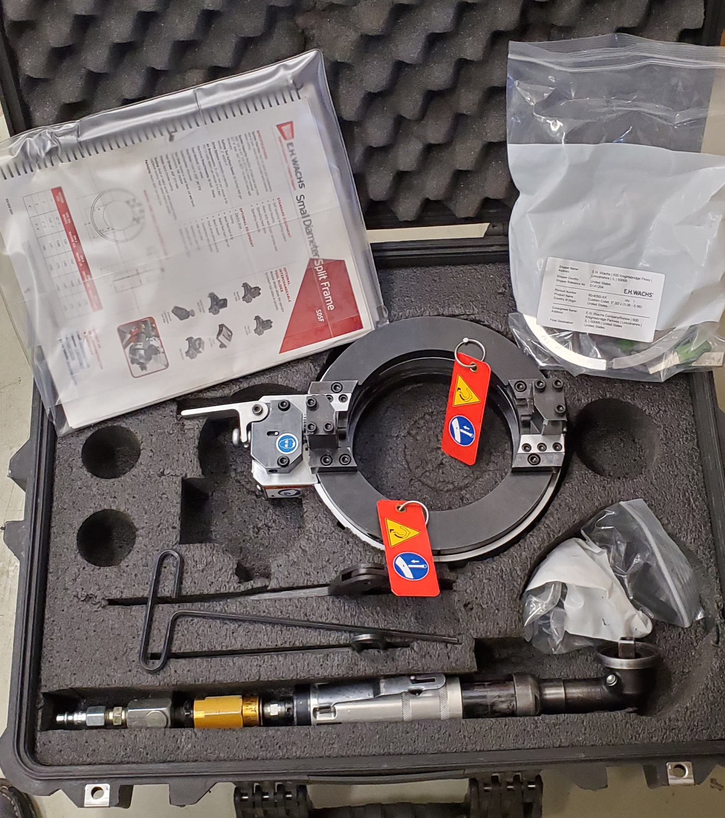
Cutting extended pipes in Q1/Q3 CA
Q1/Q3 cryo-assemblies with extended piping does not fit the shipping crate
  Current plan is to cut pipes with split-frame cutters
Before purchasing cutters, we would like to make sure that the portable cutters are working. 3D printed template was prepared for cutting demonstration
WACHS 5” SDSF cutter is in our possession
for two weeks
  First will be tested with the 3D printed
  template
  Next will be real size pipe cutting in ICBA

Slide 4
Test Stand 4 PLC progress (Off-project)
Work on PLC cables in progress
UPS will be installed during the July shutdown (July 18)
Analog Inputs
  40/40 cables pulled
  31/40 terminated on both ends
  7/40 terminated, cabinet end only
  8/40 tested
Digital Inputs
  19/19 cables pulled
  10/19 terminated on both ends
  1/19 terminated, cabinet end only
  0/19 tested
Analog Outputs
  10/12 cables pulled
  4/12 terminated on both ends
  8/14 terminated, cabinet end only
  0/14 tested
Digital Outputs
  14/18 cables pulled
  0/18 terminated on both ends
  11/18 terminated, cabinet end only
  0/18 tested
Lakeshore modules
  31/31 cables pulled
  9/31 terminated, one end only
  0/31 tested

Slide 5
Test Stand 4 Preparations
UPS installed in two QPM racks
CERN HFU upgrade for ZMT
  All 4 HFUs are modified
  1 unit is fully tested, 3 units will be tested Mon-Tue
  Two power transformers (one unit per two HFU racks) are mounted at Stand 4
  FESS will do all wiring work this week
AQD, DQD, QLM and Tier-III integration tests (off-project)
  In preparation to move QPM components to the test stand
Zero-magnet test ORC review in progress

Slide 6
Test Stand 4 ORC
ORC for Zero-magnet test only
ORC 1731 created
Electrical ORC: First comments and suggestions are received
Darryl’s group is in touch with D. Mertz to address some of his questions
Document with answers to the review findings and recommendations has been updated last Week
Next step is walkthrough at Test Stand 4

Slide 7
Test Stand 4 ORC (2)
Cryogenic ORC status
 | Engineering Notes | TC number | Review Status
1 | P&ID | F10121488 | In progress - 95%
2 | Valve, Instrument, and Equipment (VIE) list | ED0009958 | In progress - 95%
3 | Failure Mode Effects Analysis (FMEA) | ED0010083 | In progress - 95%
4 | Process controls description | ED0011588 | Complete
5 | System description | ED0010620 | Complete
6 | What If Analysis | ED0011786 | Complete
7 | Operating procedures/checklists
 | Leak check procedure |  | In progress
 | Cryogenic operating procedure |  | In progress
 | Pre-cooldown checklist |  | Complete
 | Overnight shutdown checklist |  | Complete
 | Pre-warmup checklist |  | Complete
 | Warm & secure checklist |  | Complete
8 | LOTO/configuration control description | ED0012043 | Complete
9 | LN2 supply to thermal shield | EN03232 | Preliminary review completed, walkthrough completd. Ready for pressure test permit submittal for signature.
10 | LN2 supply to baffle shield | EN03216 | Pressure test completed. Awaiting final review/approval of note.
11 | LHe supply | EN03233 | Pressure test completed. Awaiting final review/approval of note.
12 | Feed Box/Interconnect/Adapter Box thermal shields | EN03449 | Pressure test permit approved
13 | TeV subcooler pressure vessel | EN01498 | Complete
14 | Feed Box LHe vessel | EN02043 | Complete
15 | LN2 jumper | EN03323 | Pressure test completed. Awaiting final review/approval of note.
16 | LN2 supply to bath | EN03324 | Need preliminary review prior to pressure test permit approval
17 | Cold GHe jumper | EN03323 | Pressure test completed. Awaiting final review/approval of note.
18 | Cold GHe to Feed Box | EN03391 | Need preliminary review prior to pressure test permit approval
19 | Feed Box relief piping | EN03531 | Preliminary review completed, walkthrough completd. Ready for pressure test permit submittal for signature.
20 | LN2 bath vent | EN03530 | Preliminary review completed, walkthrough completd. Pressure Test Complete
21 | Vacuum vessel | EN02044 | In progress - 90%
22 | Zero magnet turnaround piping | EN03897 | Preliminary review completed, walkthrough completd. Ready for pressure test permit submittal for signature.
23 | Adapter Box and Feed Box-Adapter Box interconnect He piping | EN03454 | Preliminary review completed. Ready for pressure test permit submittal for signature.
24 | Pumping line | EN03851 | Preliminary review completed, walkthrough completd. Ready for pressure test permit submittal for signature.
25 | Cryo-Assembly relief spool | EN03755 | Complete
26 | Cryo-Assembly relief vent line | EN03757 | Pressure test permit approved, Pressure Test Complete
27 | High-pressure GHe supply | EN03800 | Pressure test permit approved
28 | Return end thermal shield piping | EN03801 | Pressure test permit approved
29 | Cool-down return | EN03838 | Pressure test permit approved
30 | Leads bypass/suction return | EN03835 | Pressure test permit approved
31 | Quench line | EN03898 | Pressure test permit approved

