Slide 1
NF conveners meeting
10/29/2020
Patrick Huber, Kate Scholberg,
Elizabeth Worcester

Slide 2
NF/IF joint meeting
Coordinating Panel for Advanced Detectors (CPAD) Instrumentation Workshop, March 18, 19 and 22, 2021
NF workshop is March 15–17, 2021
Need to find date around that time which is not (March 18 is likely ok) colliding with those dates.

Slide 3
LOI matrix
Really like to finish this, so we can make the list public.

Slide 4
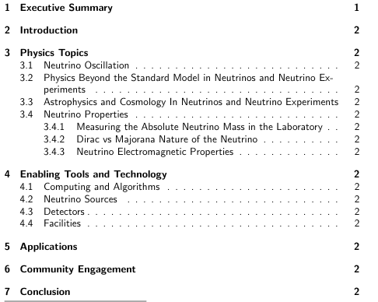
Report outline
Is this the right high-level structure?
Are the sub-heading in 3 and 4 right?
Can we already try to fill in the 3rd level headings?
Are their major issues we need to address?
We do not plan public TG reports,
we are waiting for steering group
feedback
https://www.overleaf.com/2935946612pkctqccnqthg

Slide 5
Contribution workshops
Focus has to be on report
White papers are invaluable but not the deliverable itself
Report drafting and white paper writing need to be coordinated – individually but also in their interactions
We agreed to draft the report early to provide time for feedback and ensure that all ideas can find appropriate representation
We propose a series of bi-weekly workshops starting in November starting with a NF wide kickoff meeting

Slide 6
Contribution workshops
Kickoff workshop will set stage and formulate goals & expectations
Each following workshop could be centered around one of the level-3 report headings (if needed a single heading can have more than one workshop)
In the context of these headings, white paper plans can be developed, either initiated by us or brought to us by the community
The idea is that the focus of these workshops evolves as we progress towards a final report.
Scheduling would be similar to TG meeting, i.e. different times of the day and week days in rotation.

