Slide 1




Monte Carlo Integration on GPUs – The gVEGAS Algorithm
Smita Darmora, Walter Hopkins
New Perspectives 2020 (2.0)
24-25 August 2020

Slide 2

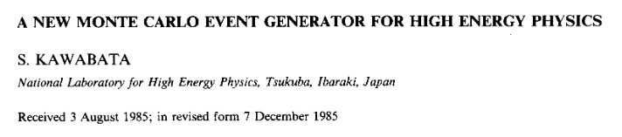
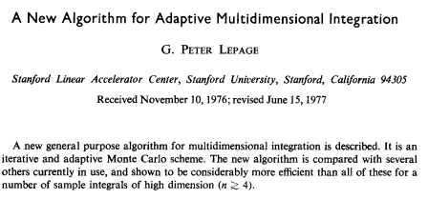
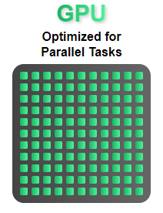
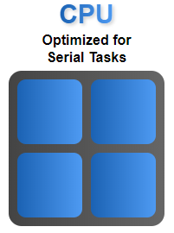

Introduction
An effort to explore and revive a CUDA based GPU version of MadGraph.
A Monte Carlo (MC) integration and event generation package.
Widely used MC integration program, VEGAS/BASES is parallelized for running on a GPU.
CUDA version is compared to the standard serial implementation which runs on a CPU.

Slide 3
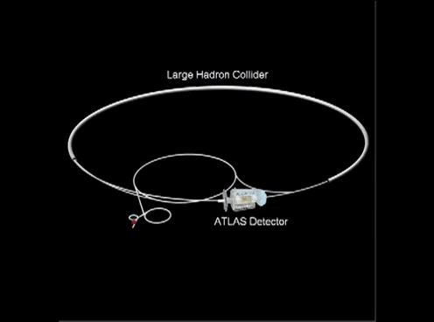
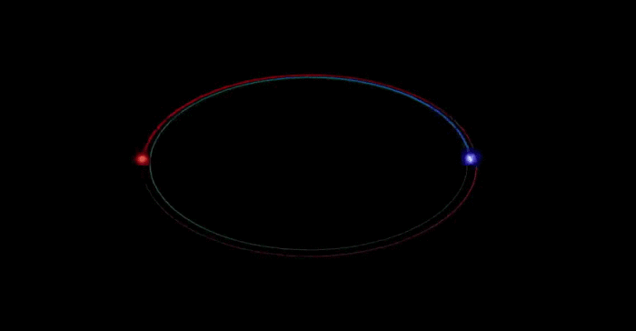
Experiment
ATLAS experiment at the Large Hadron Collider (LHC), a particle accelerator at CERN (the European Organization for Nuclear Research)

Slide 4

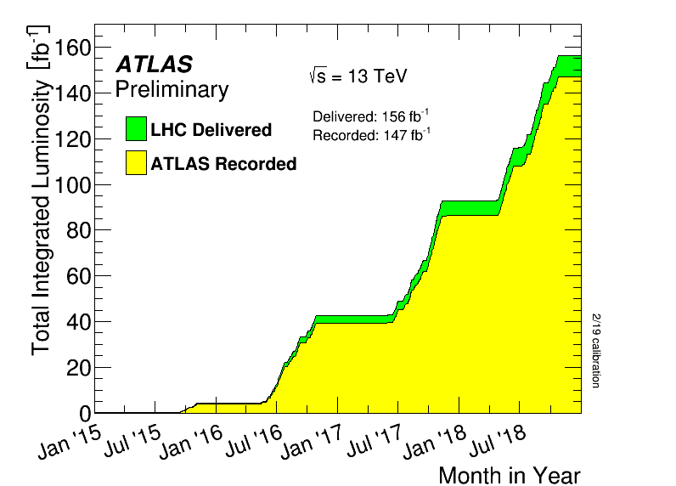
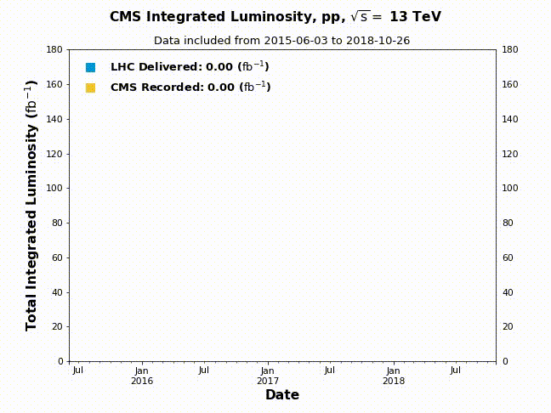
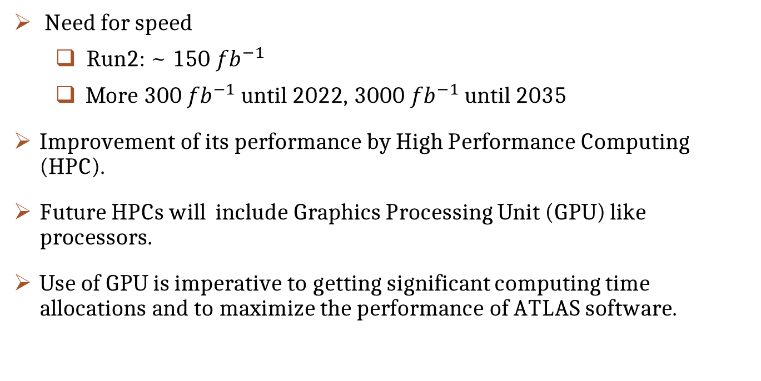
Motivation
Need for speed
  Run2: ~ 150 ${fb}^{−1}$
  More 300 ${fb}^{−1}$ until 2022, 3000 ${fb}^{−1}$ until 2035
Improvement of its performance by High Performance Computing (HPC).
Future HPCs will include Graphics Processing Unit (GPU) like processors.
Use of GPU is imperative to getting significant computing time allocations and to maximize the performance of ATLAS software.

Slide 5

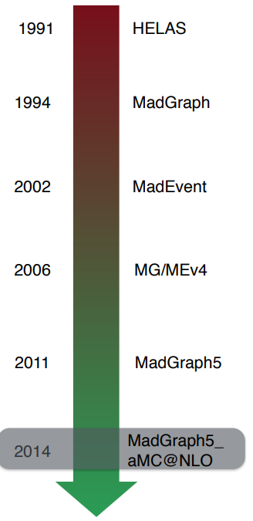

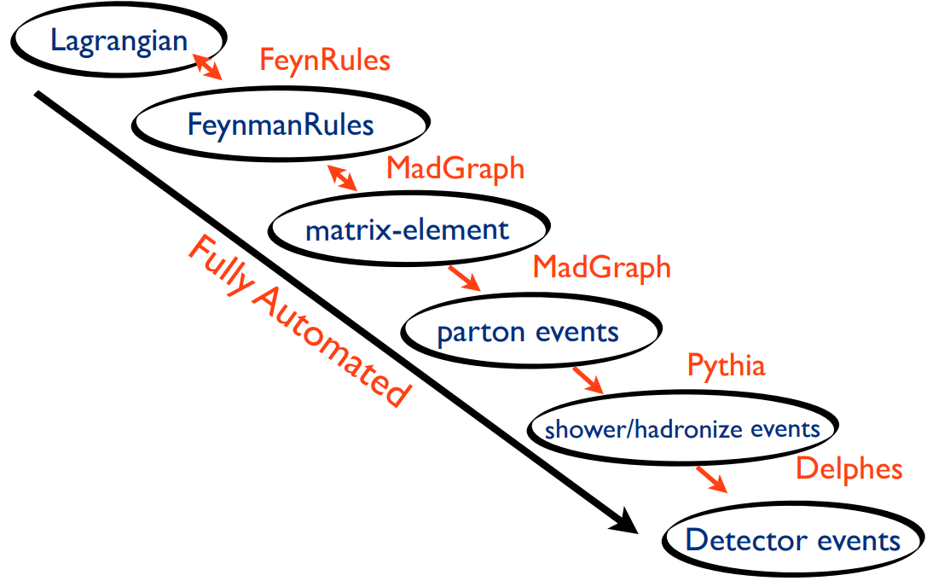
MadGraph
HEP Phenomenology framework
  Feynman Diagrams
  Cross Sections
  Event Generation
MadGraph on GPU
Next

Slide 6
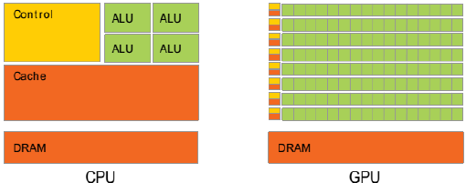



Improving Performance
Graphics Processing Units (GPUs)
  Made for accelerated image production
  Highly parallelized
  Established development platform with CUDA

Slide 7
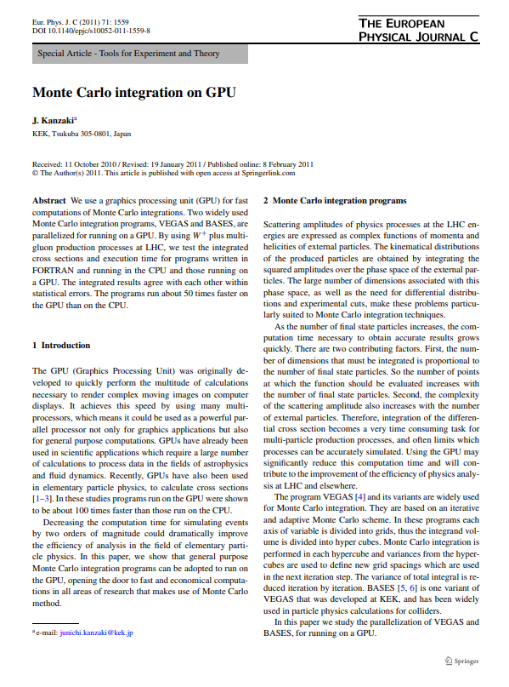

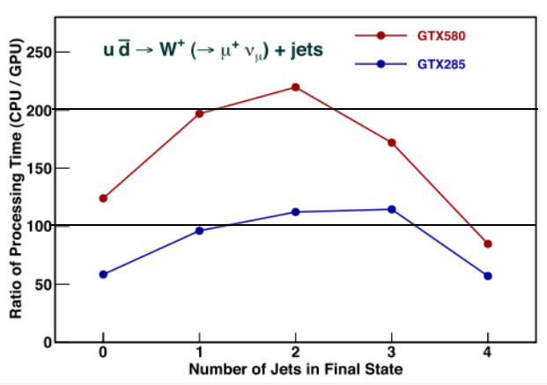
GPU based MadGraph
History
Development began in 2008
  Work on parallelizing (HEGET, gVEGAS, gBASES, gSPRING)
“GPU” version of Madgraph created
  CUDA-based version of Madgraph that was last updated in 2013
Benchmarking was done for integration.
  J. Kanzaki, Eur. Phys.J.C71 (2011), e-print arXiv: 1010.2107
The GPU programs were not fully integrated
• GTX580 has 512 cores. •GTX285 has 240 cores.

Slide 8



MadGraph Profiling
We want to be fast,
Where do we spend our time?
  In which function?
  Called by whom?
  Which instruction take time?
  Where to parallelize?
find the hotspot in the code and figure out what is using most of the CPU time.
Goal is to optimize them by parallelism.
Intel VTune Amplifier, a profiling tool.
Steps:
Event: g g > t t~ g g for leading order (LO) and next leading order (NLO).
Run Madgraph (MadGraph5_aMC@NLO) for different number of events with the Vtune.
Analyze the function call flow and threads.
Analyze total CPU time of any function vs the number of events.

Slide 9
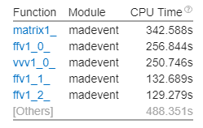
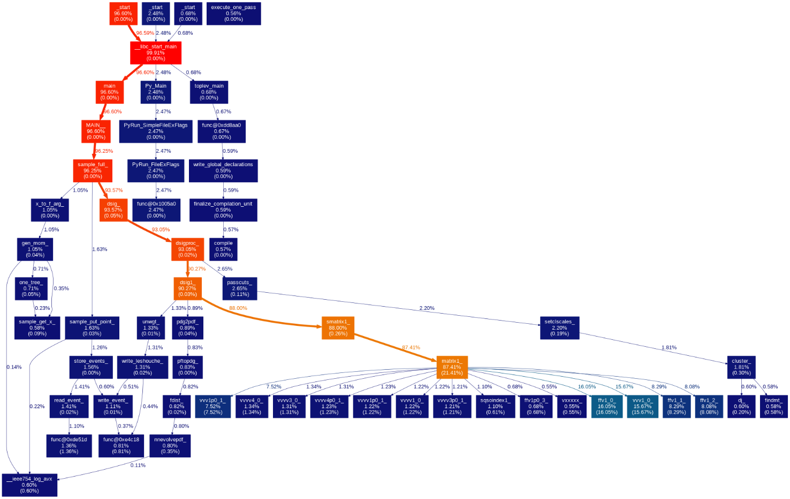
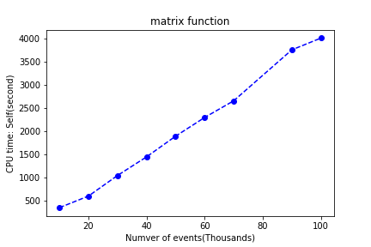
Profiling Continue….
Most active functions in the MadGraph. Optimizing these hotspot functions can improve overall application performance.
Top hotspots function
Total time vs hot function
Visual Call Graphs from Intel® VTune™ Amplifier Output

Slide 10
MadGraph on GPU
Simplified view of event generation with MadGraph:
Generation of amplitude program of various physics processes:
Multi-channel integration of multi-physics processes
Event generation based on the integrated results with multi physics processes.
For improvement of performance:
Do in parallel as much as possible: the gain of performance depends on the fraction of parallelizable part.
3 parts of MC generation separately CUDAfied:
Helicity amplitude (matrix element) evaluation (HELAS) into HEGET.
Phase-space Integration: (g)VEGAS/(g)BASES.
Event generation: (g)SPRING

Slide 11
Amplitude Program
Amplitude of physics processes at each phase space point is computed with library, HEGET (HELAS Evaluation with GPU Enhanced Technology).
Converted from a FORTRAN library, HELAS to C functions for the use of GPU.
Monte Carlo integration on GPU (gVEGAS/gBASES)
Two widely used MC Integration programs, parallelized for running on a GPU.
Most time-consuming part of integration is already available on GPU: gVEGAS/gBASES
Event Generation on GPU (gSPRING)
Event generation of multi-physics processes.
SPRING generates unweighted events based on BASES integration results.

Slide 12
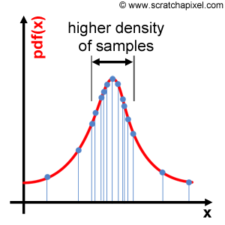
VEGAS/BASES – Adaptive sampling
A variance reduction technique that hastens convergence of a Monte-Carlo integration .
VEGAS: uses approximate importance sampling .
Function evaluations are concentrated where the integrand is largest in magnitude.
Iterative and adaptive Monte Carlo algorithm
It does several passes over the integral and uses the results of the previous passes to improve its estimate of the importance sampling function.

Slide 13
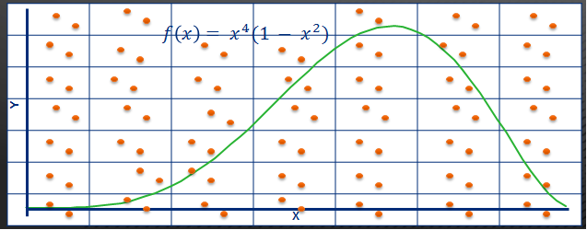
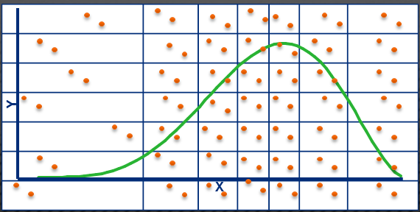
VEGAS Algorithm
The algorithm :
1) The area in the limits of the integration is subdivided into equal sized blocks called bins.
2) A large number of random samples are generated such that there are equal number of samples in each bin.
3) The integral is now evaluated for each bin of samples. Bins are now weighted by the contribution they make to the integral's value.
4) Using the weights obtained in the previous step the grid is now resized to reflect those weights. The grid resize ensures that there are more number of bins in the area that forms the meat of the function.
5) We go back to step 3.
6) Steps 3,4 and 5 are repeated until the necessary confidence interval is achieved.

Slide 14
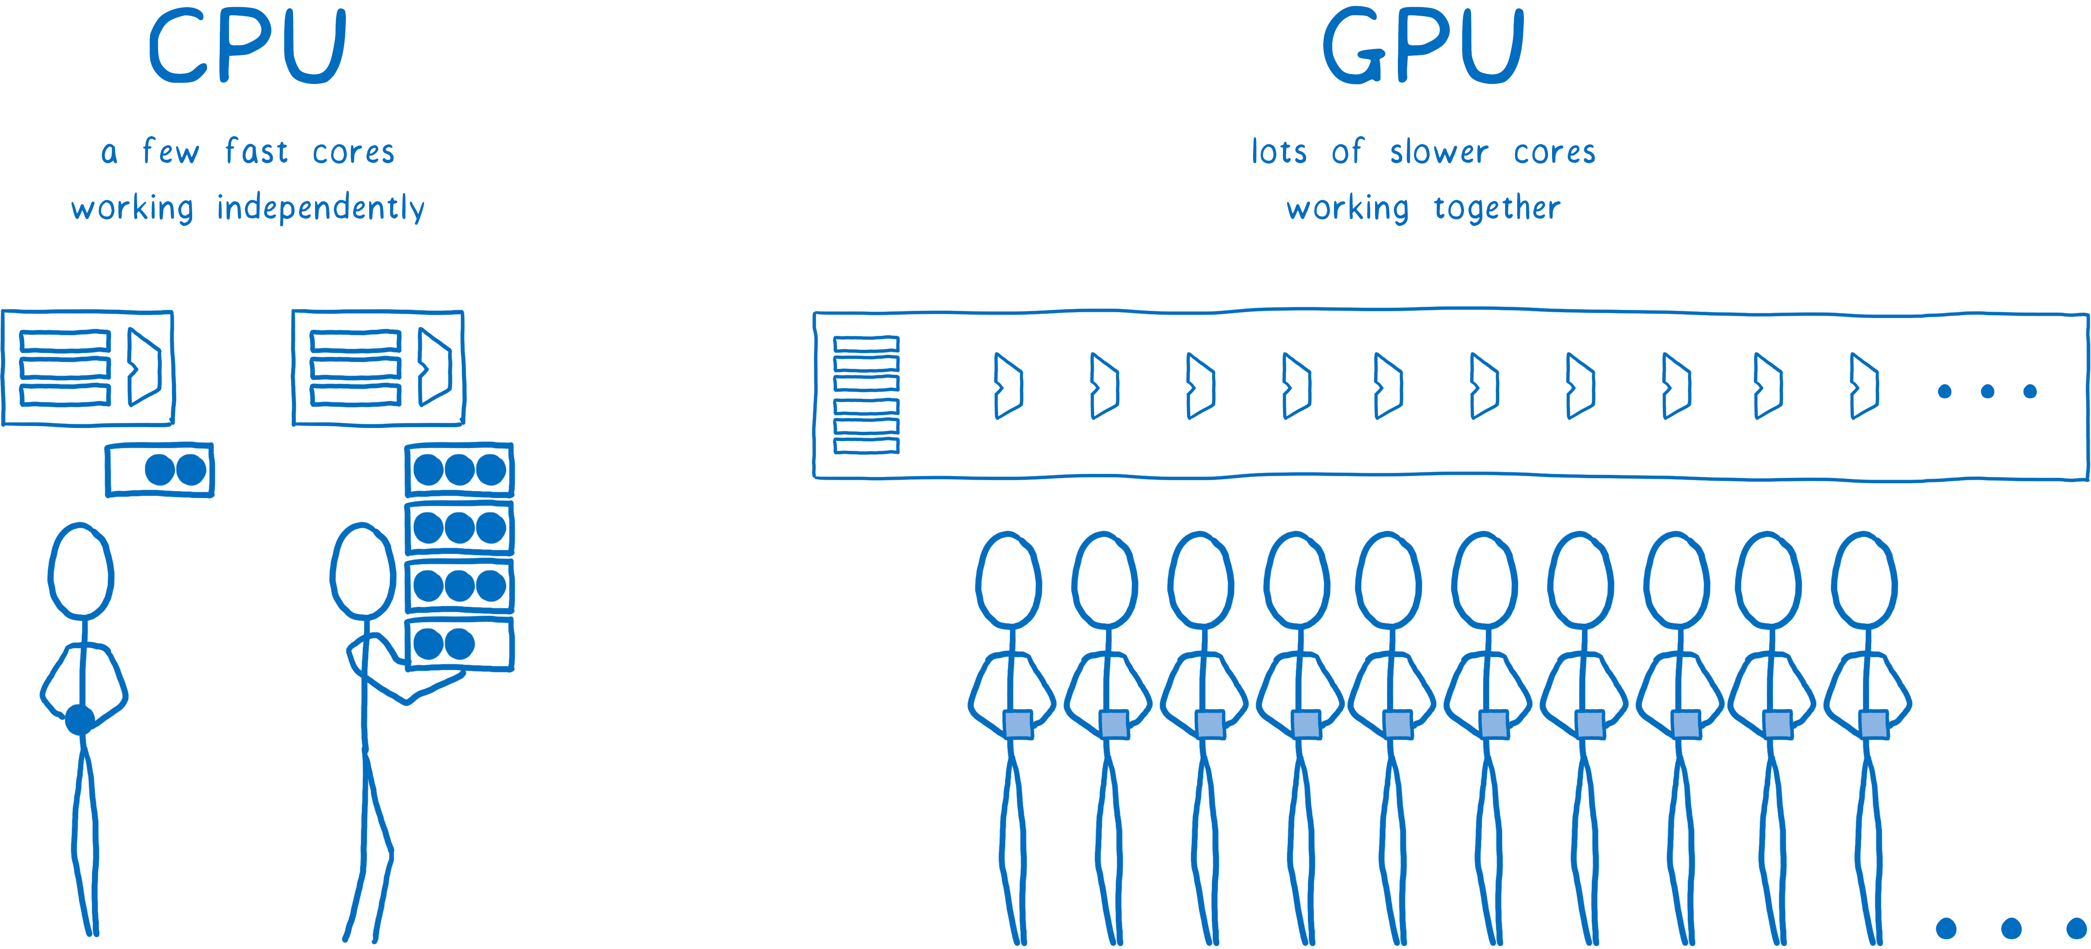

Opportunity to use GPU
If its Monte Carlo, think GPU!
VEGAS uses Monte Carlo method with sampling based on adaptive Importance Sampling technique
Parallelization
  Generating random samples in volume of integration
  Independent evaluation of integrals in each bin
  More the samples, better the accuracy
  GPUs make it faster

Slide 15
gVEGAS
VEGAS and BASES, have the following common structure:
    initialize parameters,
    generate N points consisting of a set of k random numbers
    evaluate an integrand function at the generated space point,
    sum up values of the integrand function and their squares for all phase space points, and compute their averages and variances,
    Repeat steps 2–5 up to M iterations or until the desired accuracy is reached.
In BASES, after M iterations (grid optimization phase) are done, further iteration steps are executed in order to improve accuracy of the integration (Integration phase).
The results of this integration phase are used for event generation by the program gSPRING.

Slide 16

HEGET
(Compute helicity amplitude at a many phase space points simultaneously.)
Random number generation on GPU
Generate amplitude on GPU for the phase space points
Sum up all the values to obtain cross section on the CPU
gSPRING
(integration phase are used for event generation and each GPU thread generate one event.)
gVEGAS (gBASES)
(Monte Carlo integrator, based on an iterative and adaptive MC Scheme )
Random number generation on GPU
Generation of phase space points and evaluate integrand function at the generated phase space , parallelized on GPU
Values transferred to CPU and compute their average and variances
For leading order process, event generation and cross-section computation is simultaneous.

Slide 17
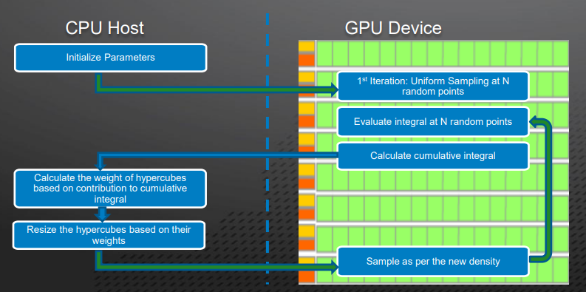
VEGAS using CUDA

Slide 18

Status:
  Staring with the example: g g > t t~ g g
  Profiling using VTune
    Profiling Measures the execution time of the program and everything that compose
    Vtune detects performance bottlenecks (hotspots) in an application and performs optimization for systems running on Intel processors
  Comparing CPU time for LO and NLO integration function for different number of events
  gVEGAS works on test function in stand-alone mode
  Understand what parts are actually done on the GPU and document findings.

Slide 19
Summary & Prospect
  Program components of cross section computation and event generation based on MadGraph system can be executed on GPU with high performance:
  - GPU version of VEGAS and BAES/SPRING
  Improvement factor of performance can become between 10~100 for total execution time of BASES integration.
  Sample source codes of the gVEGAS program are available from the web page: http://madgraph.kek.jp/KEK/GPU/ gVEGAS/example/

Slide 20
Thank you

