Slide 1
PIP-II Report
PIP-II Team
Project Management Group
15-July-2020

Slide 2
WBS 121.01 Project Management
Early Conventional Facilities (ECF) subproject ESAAB scheduled 16-Jul-2020.
Procurement package on track for end of July award.
“What if” Scenario planning:
Scenarios for reduced FY21/22/23 funding levels
Jan.2020 IPR scenario - $120M/$120M/$120M
$60/$90M/$120M - $51M increase, 12 month delay
$80M/$100M/$120M - $26M increase, 6 month delay
COVID impacts. Results presented at 6/4, 6/25 IPTs. Next major iteration to include partner inputs.
Procurement activities and challenges:
Staffing challenges
Critical SRF procurements
Internal Audit ongoing
Inquiries on OHEP monthly reports, procurements, in-kind contributions, cyber security, lessons learned

Slide 3
EVMS, RLS
EVMS
Small decrease in SPI 0.905->0.901, CPI unchanged.
Current period variances in HB650, Linac Complex Design, LLRF
Transitioning from bundled BCRs to individual
RLS Development
Updated WBS for ECF
Updated COVID analysis coding
Collecting partner input on milestones

Slide 4
ESH
Several false ODH Monitor Alarms occurred last week
Traced to RF leakage from the HWR input couplers
Engineers investigating source of the leakage
COVID-19
PIP-II COVID-19 Recovery Plan continued throughout June
To date, completed 5 rounds of returning employees to work
Overall activities continue to go well
PIP2IT Accelerator Readiness Review
Scheduled for August 5-6
Working on support documents and presentations
Developing COVID-19 protocols for the review
Plan to have the reviewers in a conference room together (Sky Box capacity 10)
Presenters and observers connect remotely
Developed a model to apportion Program Support Indirect costs to PIP-II
Model being reviewed by CFO for CAS compliance
Supporting procurement and design reviews
Reviews of D/S/P Min-Safe plans continued
Started developing the ES&H section of the draft FDR

Slide 5
Quality Assurance
Advanced Partners Quality Plans have been submitted by STFC and CEA Partners. Great work has been done so far!
All other Partners are working on developing their Preliminary Quality Plans.
All Partners are engaged in quality-related discussions necessary for the development of supporting processes, such as Nonconformance Management and the use of in-process travelers.
The PIP-II Nonconformance Handling Procedure is currently begin updated to clarify expectations. All Partners will align with defined severity levels to ensure consistency and effective communication.

Slide 6
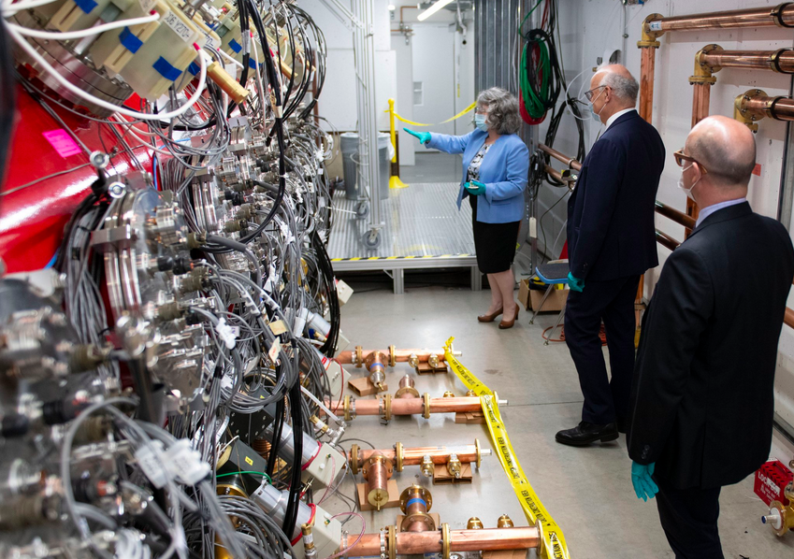
International General
French Ambassador
visited PIP2IT Friday,
July 10
Post-COVID T6 MS/input to IKC Partners schedule:
sent to EU Partners,
working in-progress for DAE (R&D and Construction). Plan is to send them by next week.
Received back INFN and WUST schedule.
i-CRADA drafted for LLRF partnership with WUT (Warsaw University of Technology) and LUT (Lublin University of Technology) in Poland.

Slide 7
International Documents Update
Meeting with DOE-GC on PPD Part 1 and status of PPDs.
DOE-GC reviewing UK and DAE PPD Part 1
Meeting with STFC this week on PPD Part 1
Goal: Apply UK PPD Part 1 language to other PPD Part 1
PPD Part 2 including post-COVID dates in progress:
UKRI, INFN, WUST – Phase 1
Goal: Sign UK PPDs in ~1.5 month [early September]
CEA/IN2P3 – Phase 2
DAE – Phase 3
Acceptance Plans:
UKRI and CEA in the finalization stage
For the other EU PIP-II Partners work in progress

Slide 8
Procurements
Item |  | Req # | Est SubK Value | Status | Expected Award Date
650 MHz Cavity, B=0.92 |  | 302069 | $455K | Bids closed 1/29/2020. 3 proposals rcvd. 6 week delay waiting for tech evals. Rec’d tech eval 3/10/20. Procurement eval completed on 3/16. BAA determination received from OGC on 7/7. Proceeding with negotiations with RI. Quote validity period extension requested from RI on 7/8. OGC provided comments to RI's exceptions to Ts and Cs on 7/14. Meeting being scheduled with Project, OGC, and Procurement to discuss. RI extended proposal validity 120 days from 7/13. | 8/10/20
PIP-II Construction of Cryo Plant |  | 305761 | $16.5M | Submitted award package for expedited review and internal approvals on 6/22/20. Issued award package to FSO for review/approval on 6/23/20. Received 26 FSO comments on 7/7/20. Addressed comments and resubmitted to FSO on 7/10/20. | 7/31/2020
IDIQ Controls Eng for Dev and Implementation, Training, & Consulting |  | 31729 (Paper Req) | (Est $1.2M) | FPRs received 4/21. Finalizing best value determination for award. Preparing two IDIQ subcontract awards. OCI reviews for both suppliers completed by OCG 6/1. Routed two IDIQ subcontract awards for internal approval 6/11. Internal approvals completed on 7/10. Award of both IDIQ subcontracts expected 7/14. | 7/14/2020
Construction phase support services for PIP-II Cryogenics Building |  | 307598 | $800K | Requested updated quote from Gensler for task order on IDIQ Subcontract No. 651024. | 7/31/2020
A/E services for 100% design of the PIP-II Linac Complex (Est. $1.7M) |  | 308956 | $1.7M | Assigned 6/23. Working on mod to add requirements under Task Order 665242. | Aug 2020
*Top 5 = High Lab Visibility; Critical Path Procurements; Critical Procurement Issues

Slide 9
Procurements
Item |  | Req # | Est SubK Value | Status | Expected Award Date
RRR300 Niobium Sheet Nb |  | 305748 | $392K | 4/24 Requestor final decision to split requirements. Both RFPs to be issued 4/29. Solicitations Closed 5/19. Technical Evaluations started 5/22. Technical consensus report submitted 6/1. Negotiations underway. Req returned on 7/7 for additional funds. Awaiting re-approval. | Aug 2020
RRR300 Niobium Sheet NbTi |  | 305748 | $40K | 4/24 Requestor final decision to split requirements. Both RFPs to be issued 4/29. Solicitations Closed 5/19. Technical Evaluations started 5/22. Technical consensus report submitted 6/1. Negotiations underway. Req returned on 7/7 for additional funds. Awaiting re-approval. | Aug 2020
SSR2 Resonator Cavities |  | 305165 | $960K | Pre-Solicitation Issued 2/19. RFP issued 4/13. Solicitation Close 5/1 Technical Evaluations Consensus Report submitted to Procurement on 5/22. Negotiations/Award phase started 5/26. Negotiation points rcvd from Donato. Preparing for negotiations for possible awards to two suppliers (both foreign). Working with OGC on RI's exceptions to FRA Ts and Cs. OGC provided comments to RI's exceptions to Ts and Cs on 7/14. Meeting being scheduled with Project, OGC, and Procurement to discuss. | Aug 2020
SSR2 Coupler Assembly and Ceramic Window / Antenna Assembly |  | 308167 | $190K | Presolicitation Notice posted in Beta.Sam on 3/31 prior to receiving approved req. Formal solicitation targeted for week of 7/27 | Sep 2020
*Top 5 = High Lab Visibility; Critical Path Procurements; Critical Procurement Issues

Slide 10
WBS 121.2 SRF Updates – HWR Status
Cryomodule test is in progress
CAV4 achieved > 10 MV/m
CAV3 partially tested (~6.5 MV/m), due to RFPI issue (now resolved)
Issues
RF leakage from coupler DC block trips ODH alarm
Solution was found. Work in progress
LLRF phase lock issue
Investigation is in progress
Cryoplant trip
HWR on standby
Investigation in progress
Cavity Position | Cavity Serial # | Nominal gradient required (MV/m) | Maxium gradient (MV/m) | Cavity Q₀ | Note
CAV1 | #2 | 1.6 |  | #2
CAV2 | #0 | 2.5 |  | #0
CAV3 | #1 | 3.5 |  | #1
CAV4 | #3 | 4.8 | > 10 | #3 | No FE, no MP
CAV5 | #8 | 6.5 |  | #8
CAV6 | #4 | 8.7 |  | #4
CAV7 | #5 | 9.4 |  | #5
CAV8 | #7 | 9.7 |  | #7

Slide 11
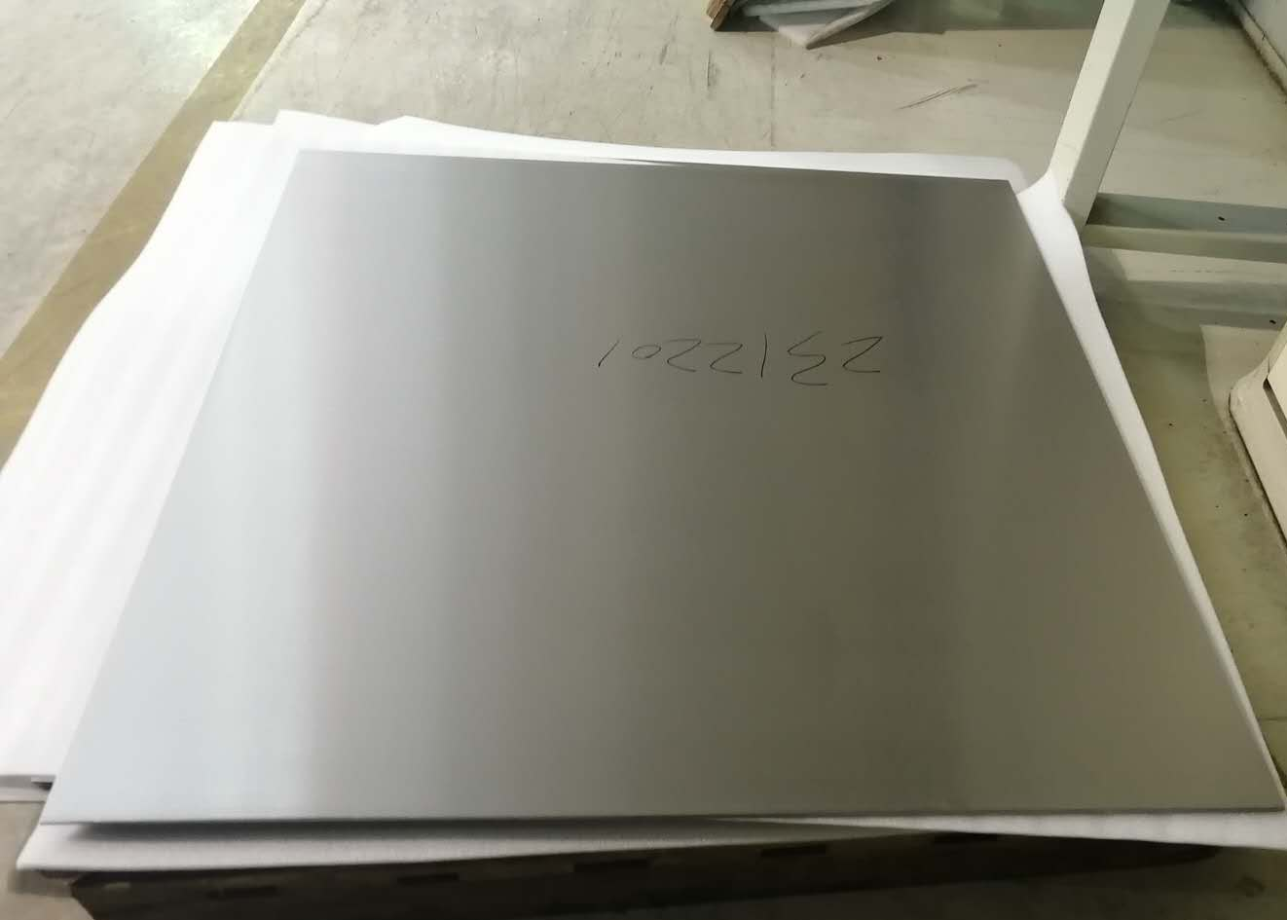
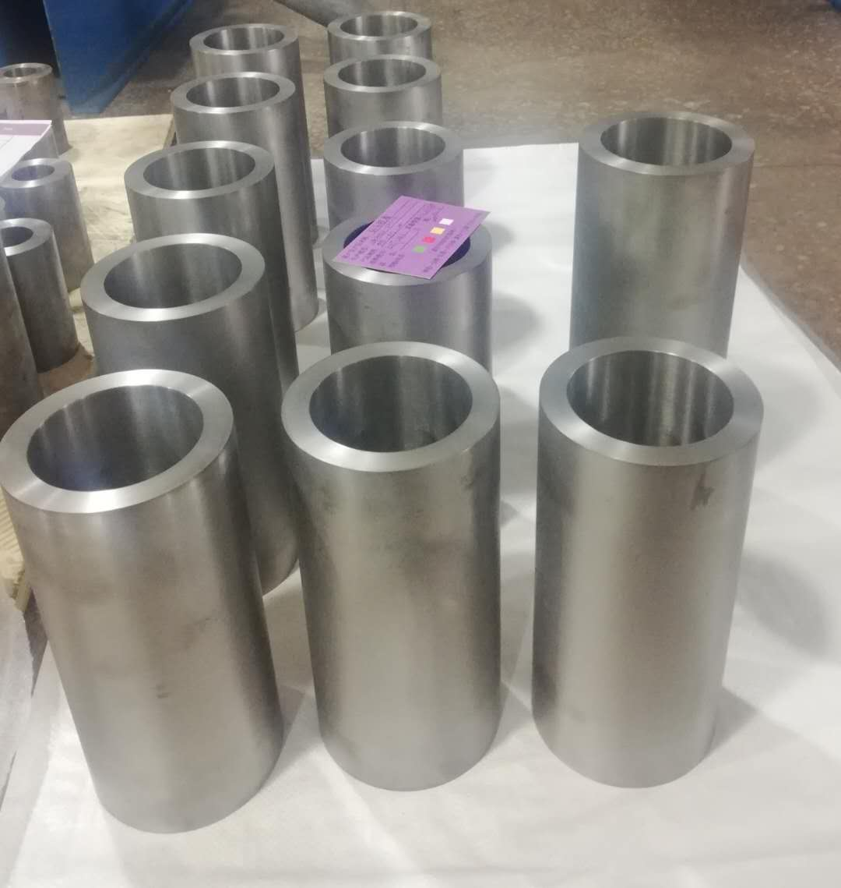
WBS 121.2 SSR Cryomodules
SSR1: installation is mostly completed at PIP2IT test cave
ORC is pending.
Cooldown is pending cryoplant trip investigation.
SSR2: Niobium sheets production at vendor
All 40 pcs Nb sheets completed.
QC hold point: Samples were cut and sent to Fermilab for sample test before shipping.
Tube samples were tested. Evaluation is in progress at vendor site
Composition met spec.
RRR: met spec (362 – 480)
SSR2: Cavity procurement is in progress
Bids evaluation completed, pending procurement action (See previous procurement slide)
SSR2: Conduction cooled solenoid FDR scheduled around 8/3/20
SSR2: Power coupler procurement is in progress, pending procurement action (See previous procurement slide)
SSR2: cryomodule design in progress.
SSR2 Nb: All sheets completed
SSR2 Nb: Nb tubes
finished the machining process

Slide 12
WBS 121.2 SRF Updates – 650 Cryomodules
Status and plans of four HB650 5-cell cavities
B9A-AES-007; Cavity jacketing pending hardware from AES-008
B9A-AES-008; The second phase of jacketing is in progress.
B9A-AES-009: Met vertical testing acceptance. Pending cavity jacketing.
B9A-AES-010: Transportation to RRCAT is paused, pending RRCAT request.
B92A-RRCAT-502: First set of cage received. Cleaning and fit test are in progress. HPR is expected this week.
LB650 Cavities:
INFN ESS MB704 received. Processing on hold.
MSU cavity S65-01: Vertical re-test completed. 24 MV/m. (1.6e10)
Previous test at MSU achieved 21 MV/m (2.1e10 @ 16 MV/m).
MSU cavity S65-02 re-processing completed. Vertical test is not schedule yet.
INFN prototype 5-cell: Half of EP (60 um) completed. EP uniformity was much better than expected.
INFN 1-cell LB650: Niobium material characterization. Processing is pending ANL EP tooling and BCR.

Slide 13
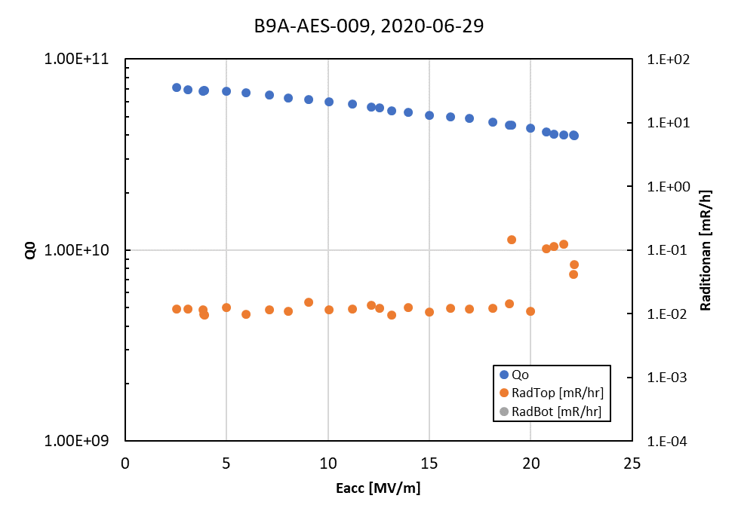
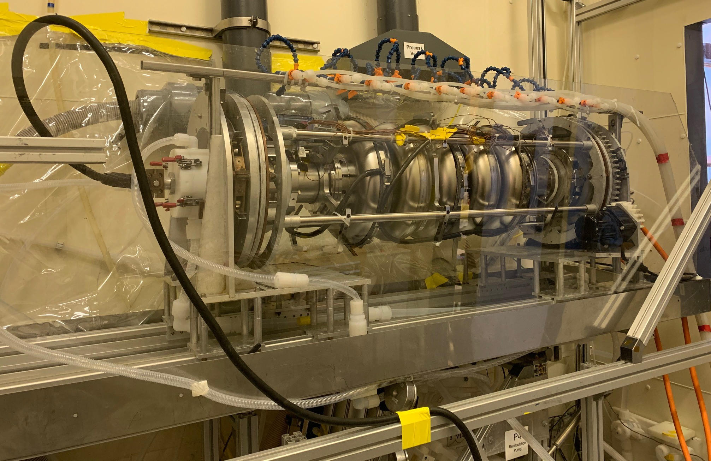
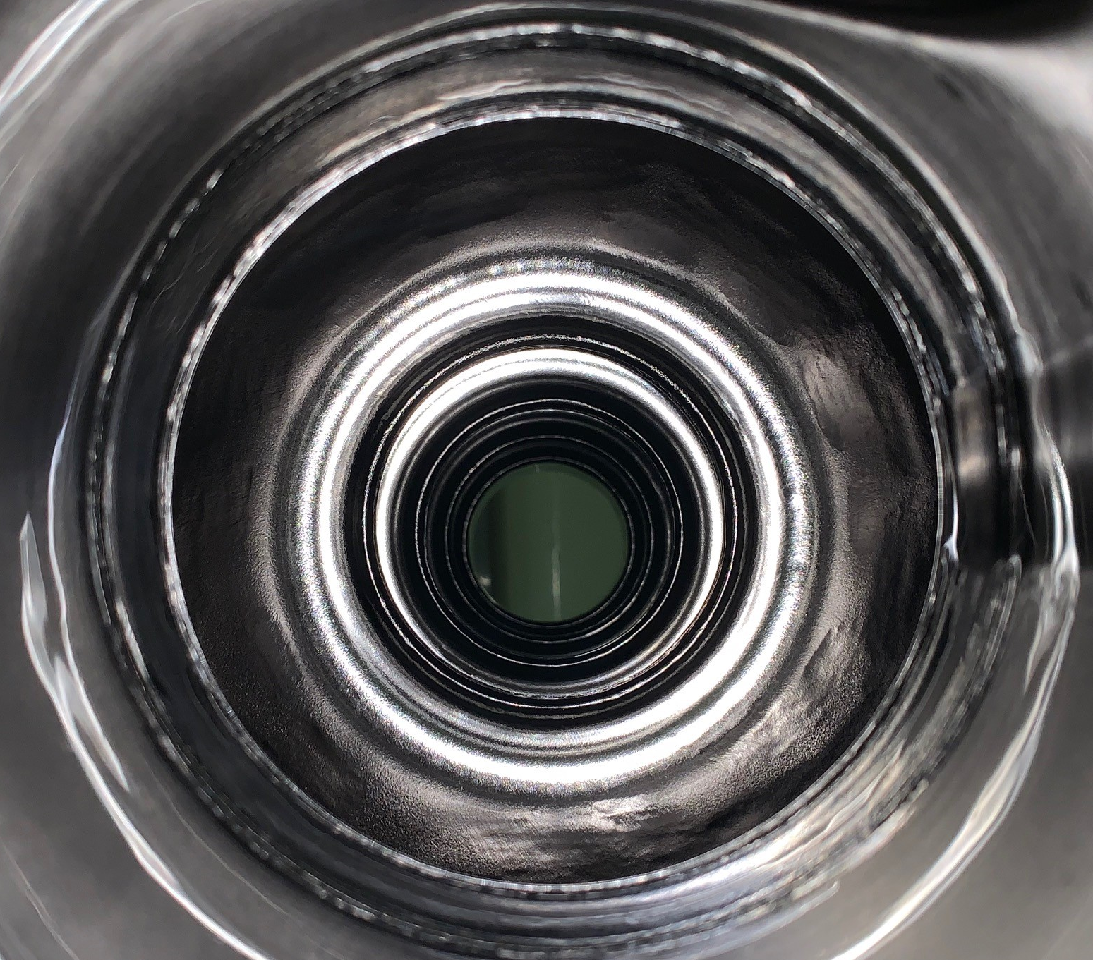
WBS 121.2 SRF Updates – 650 Cryomodules
B9A-AES-009 met specification with good gradient margin
B9A-AES-008 Final weld showed good frequency spectrum response
- G. Eremeev
- C. Grimm
B61-EZ-001 on ANL EP stand for first 60 um step
EP showed acceptable material removal uniformity
- G. Eremeev

Slide 14
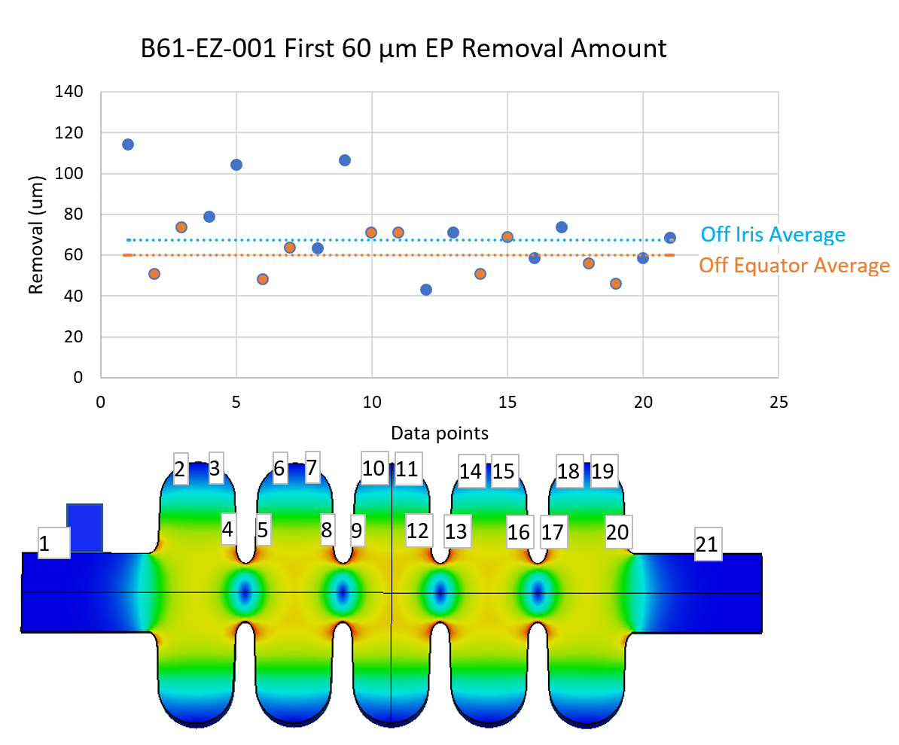
WBS 121.2 SRF Updates – 650 Cryomodules
Preliminary
- G. Eremeev

Slide 15
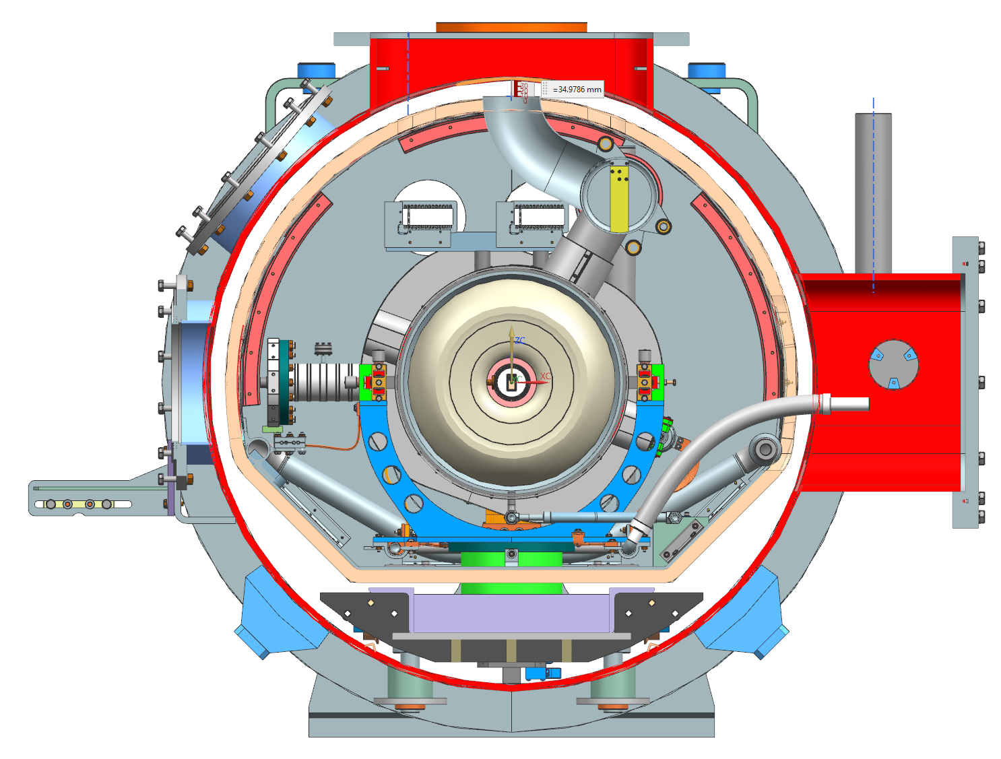
WBS 121.2 SRF Updates – 650 Cryomodules
Niobium specification:
Received NX niobium samples from INFN
Conducting sample studies as soon as allowed
Focusing on cavity processing and testing (LB650 5-cell and 1-cell)
Procurements (previously reported):
B92 cavity procurement is in progress. Buy American Act review took longer time than expected and quote was extended
650 MHz coupler procurement is pending procurement action.
LB650 MHz niobium procurement is pending procurement action
Cryomodule Design:
HB650 FDR dry run was completed 7/6-8
Attended by all 650 MHz partner labs
Many issues resolved
FDR was scheduled 7/29-31
Reviewing presentation
Post presentations next week (7/20)
Improve design for transportation
PIP-II LB650 and HB650 Cryomodule Requirements Workshop is scheduled 7/21-22

Slide 16
WBS 121.2 SRF Updates – Cryogenics
Cryoplant award is in progress.
DAE approved requisition.
Cryoplant integration preliminary design is in progress
CDS final design is in progress. FDR is scheduled on 8/12/2020.

Slide 17
Accelerator Systems
Acc Sys overall
PIP2IT on-site activity – virtually all L3 subsystems
HWR RF leakage affecting several subsystems
Active investigation on all fronts esp. HPRF, LLRF/RFPI, Interlocks
Electronics procurements – how to streamline process
MPS
Upgrades and expansion continue
Hardware beam switch
Increased # of inputs
Firmware updates
Differential beam current measurements (via Ring pick-ups) demonstrated

Slide 18
Accelerator Systems
HPRF/RF distribution
New Deputy L3 manager in place (Victor Grzelak)
PIP2IT
Complete SSR1 distribution installation
40 kW 650 MHz SSA path forward
LLRF
PIP2IT on-site work
RFPI Technical Requirements with IIFC partners
Updated SOW with LBNL
Polish collaboration: I-CRADA being drafted for LLRF partnership with WUT and LUT
IPT briefing on Thursday

Slide 19
Accelerator Systems
Magnets/Power supplies
PIP2IT on-site work
Focus on SSR1 completion
BTL magnet acquisition plan completion expected in August
Vacuum
PIP2IT on-site work
Completed Analysis of cryomodule gas loads
Dialogue with SRF/Cryo: beamline vacuum burst disks, gate valves, coupler vacuum instrumentation

Slide 20
Accelerator Systems
Controls
PIP2IT
Controls IDIQ awards to go out today
Self-paced EPICS training development
Safety Systems
FESHM draft chapter on Non-ionizing radiation hazards
Beam Instrumentation
PIP2IT on-site support
BPM system functioning
Laser-based profile monitor development

Slide 21
Installation and Commissioning
PIP2IT
COVID Recovery
Essentially all critical personnel are back on site for PIP2IT
Detailed work planning, social distancing, and PPE usage continues
Employees are adapting well, no major issues
Tracking weekly progress to try to quantify efficiency during COVID recovery phase
June – actual progress matched very well with our assumption (50% efficiency - primarily due to phased return to work and initial preparation of facility)
July – tracking at ~ 75-80% efficiency (assumption is 100%)
It is too early to tell if it is COVID related, or just operational start-up issues (see next slide)

Slide 22
Installation and Commissioning
PIP2IT Progress
HWR cold RF testing of individual cavities began
MEBT beam commissioning
Re-established beam through LEBT, RFQ and into MEBT
Operation/commissioning of BPM’s, MPS and instrumentation
SSR1 cooldown
Final preparation for cooldown
ORC walkthrough, tuner checks, interlock testing
Cooldown planned to begin this week
PIP2IT Delays/Issues
RF leakage tripping ODH system – under investigation/mitigation (operations/technical delay)
Facility chiller problems - (COVID-delay due to lack of maintenance and inability of contractors to access site)
VIP tours – (management delay)

Slide 23
Installation and Commissioning
Activities that continue to be worked on remotely
Management of detailed PIP2IT COVID19 Recovery Plan & schedule
650 Test Stand Cryo Transfer Line (CTL) Final Design phase
Support of CF design work
Updating electrical/mechanical requirements, specifications and 3D CAD drawings in support of CF 60% design review
PIP-II CAD model
CAD Model updates (LCW piping, electrical layout, 60% CF model import for A&E firm)

Slide 24
Accelerator Complex Upgrades
BTLBA (Beam Transfer Line Beam Absorber)
Finalizing the design of Beam Absorbers (Permanent, Movable)
Engineering help from AD/TSD
Booster
Finalizing the Design of the Injection Beam Absorber
Addressing recommendations from the Booster Collimators PDR Review.
Started work on Booster Longitudinal Dampers PDR
MI/RR/Booster RF
Finalizing the MI RF Upgrade Design
AD/RF department personnel working on Modulator Upgrade
Resumed High Power Testing of the new Booster RF station

Slide 25
Conventional Facilities
Early Conventional Facilities (ECF) Subproject
BCR in progress
WBS 121.06.03 - Cryogenics Plant Building
Responding to comments from Procurement documents
Required update to Project Manual (1,584 pages in 182 documents)
A/E Support (construction administration and construction coordination) proposals received
Construction Coordinator purchase order issued
Construction Administration requisition in Procurement
WBS 121.06.05 - Linac Complex
Detailed design continues
60% design review scheduled for August 2020
Final Design Proposal
Within the budget estimate
Accelerates the completion date to December 2020
Requisition in Procurement

Slide 26
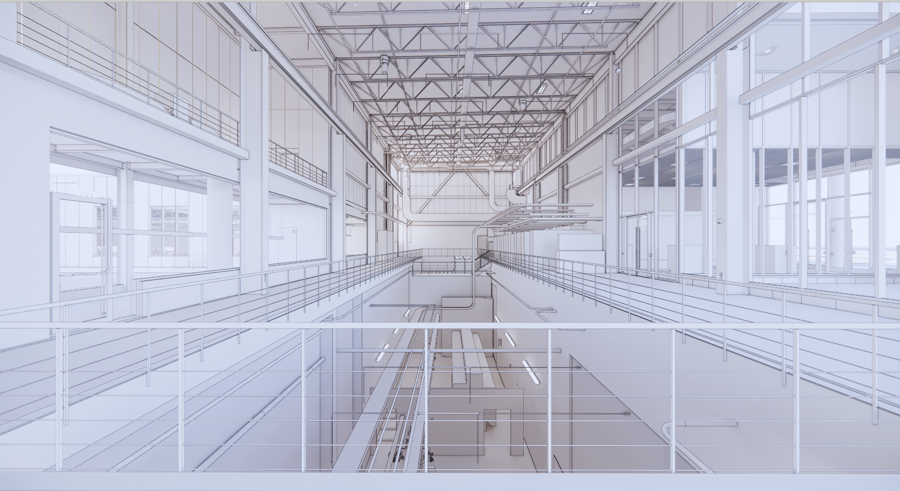
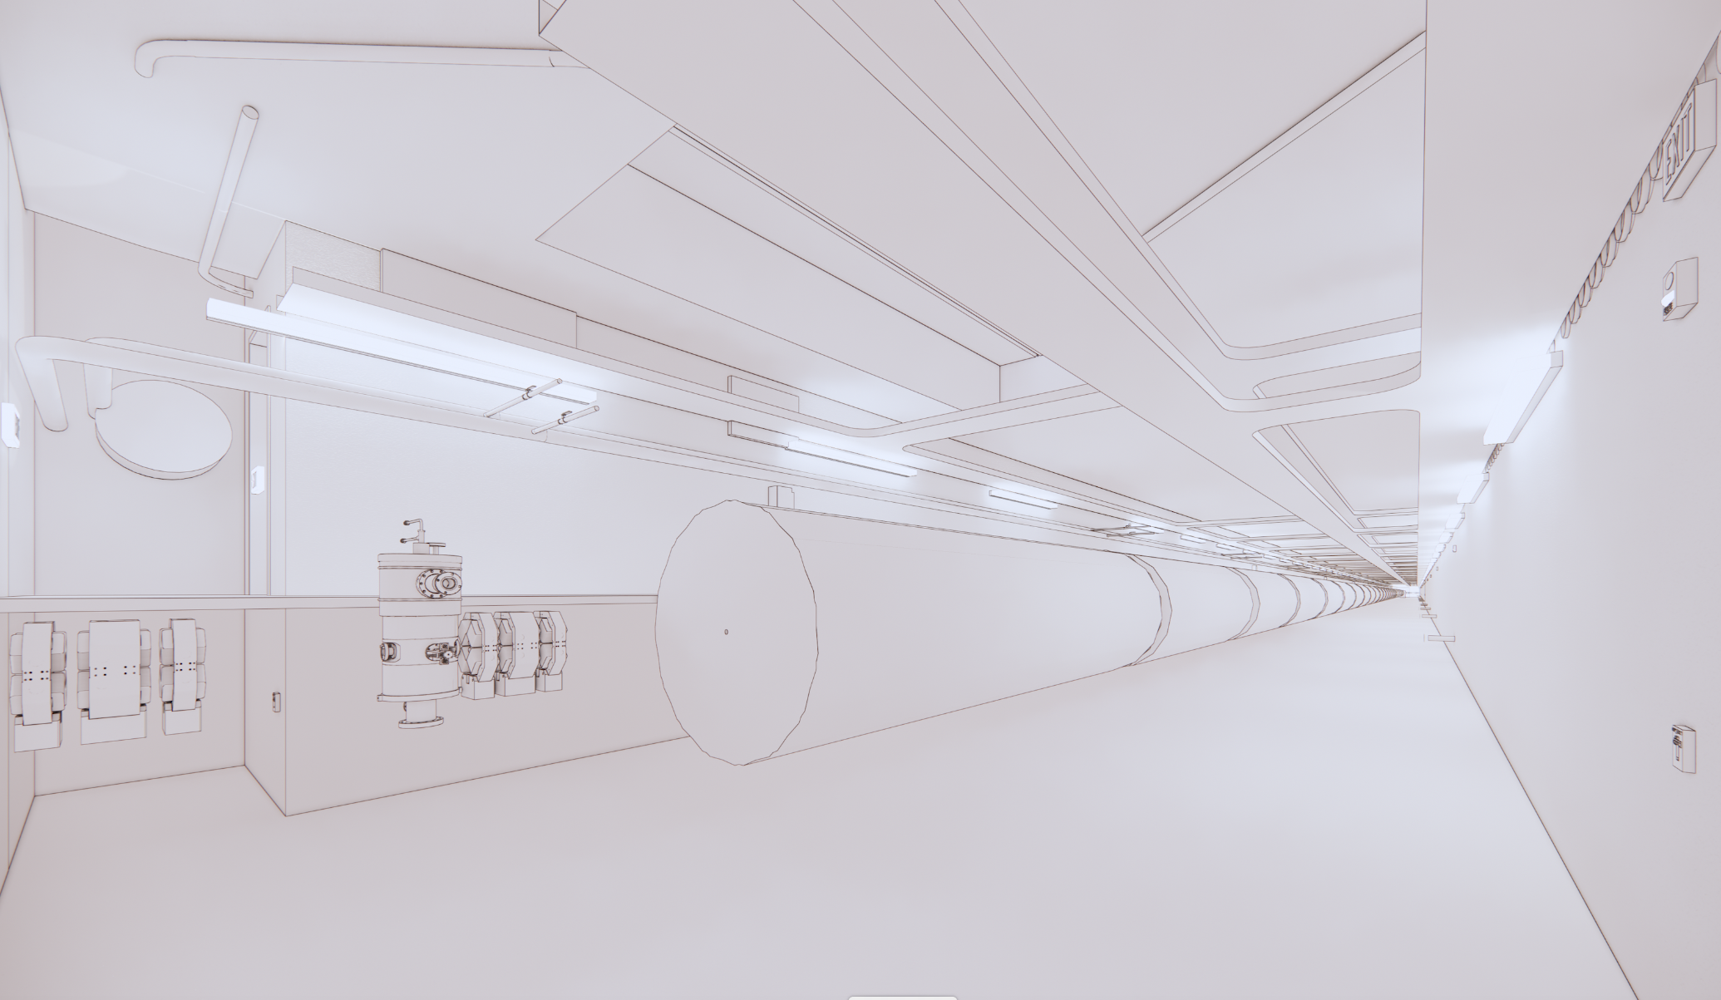
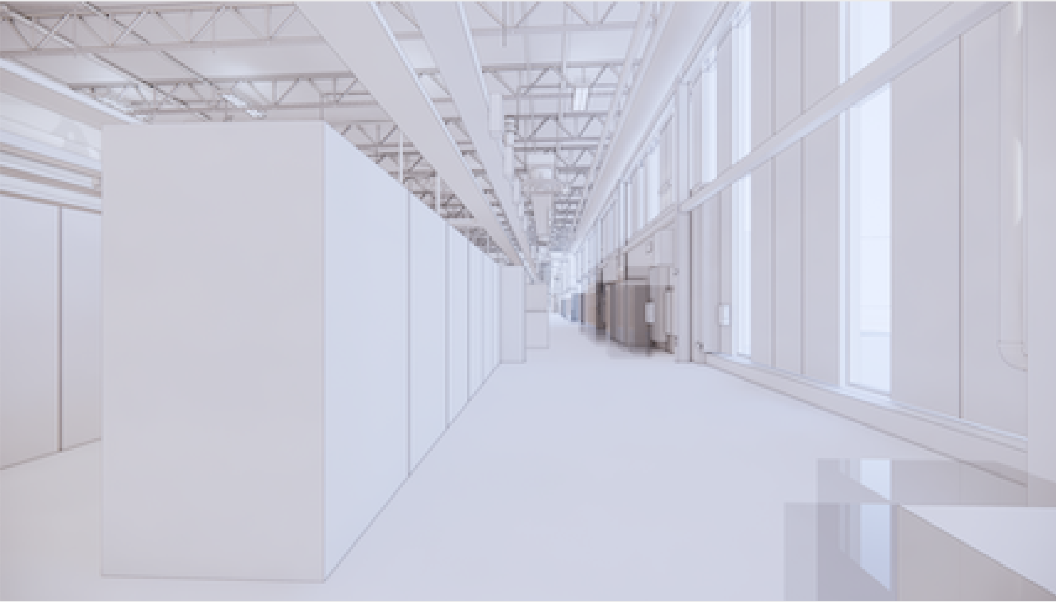
Conventional Facilities
View Looking South in High Bay
View Looking Downstream in Tunnel
View Looking South in Gallery

