Slide 1
CRYOMODULE 650 (TESLA Style) Stand Alone update
Tom Peterson and Yuriy Orlov
Collaboration Meeting
10 May 2011

Slide 2
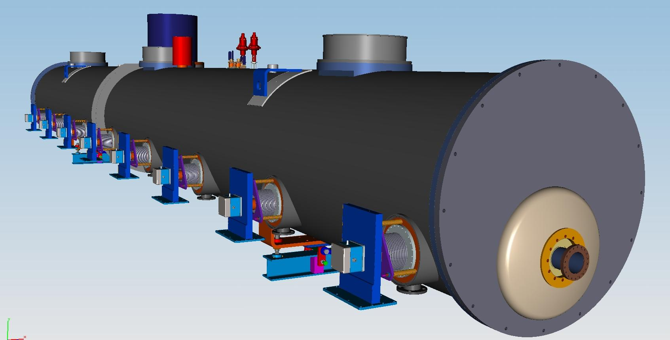
650 MHz Cryomodule (Tesla Style-Stand Alone)
Cold mass supports (2+1)
Vacuum Vessel
Power MC (8)
End Plate
Beam

Slide 3
Updated requirements doc
FRS 650 MHz HE_CM_draft-v4.pdf
Will upload this to the Project X document database
Includes requirement for access to tuner motors

Slide 4
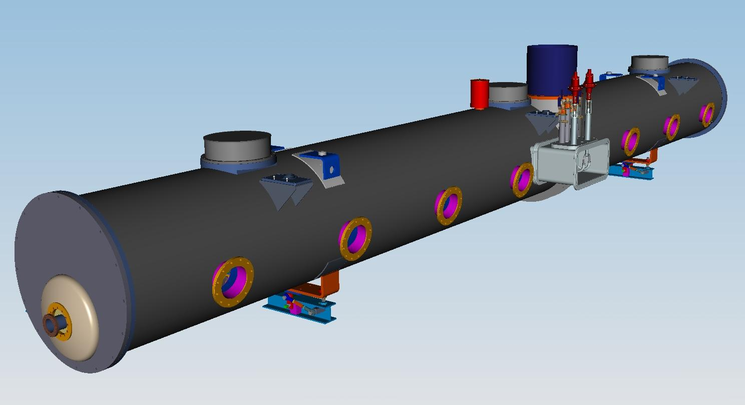
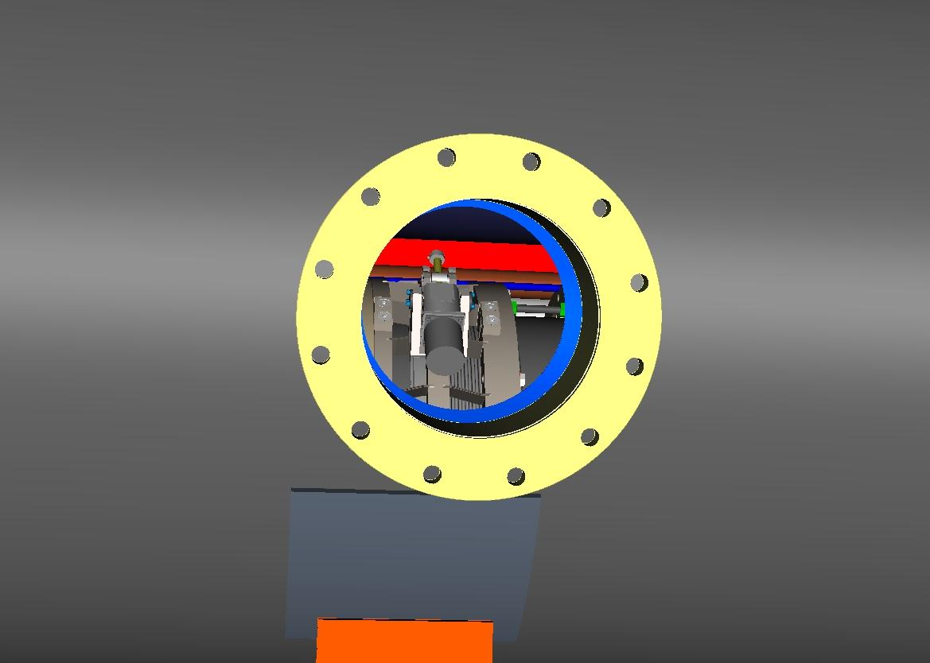
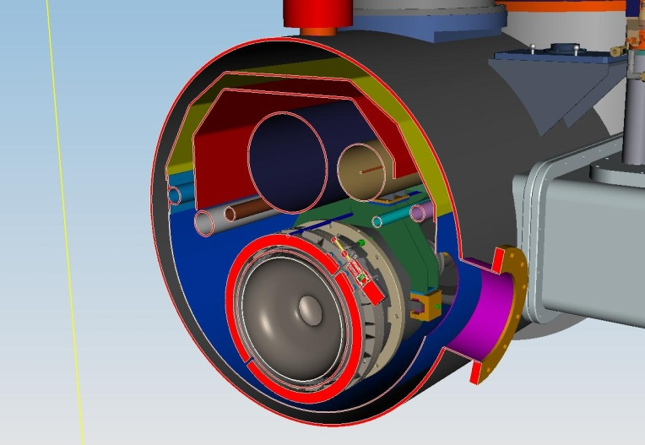
650 MHz Cryomodule. Tuner motor ports
Flange opening Dia:~250mm
Tuner motor access
Ports (opposite MC Ports)
Tuner motor, install
on the cavity

Slide 5
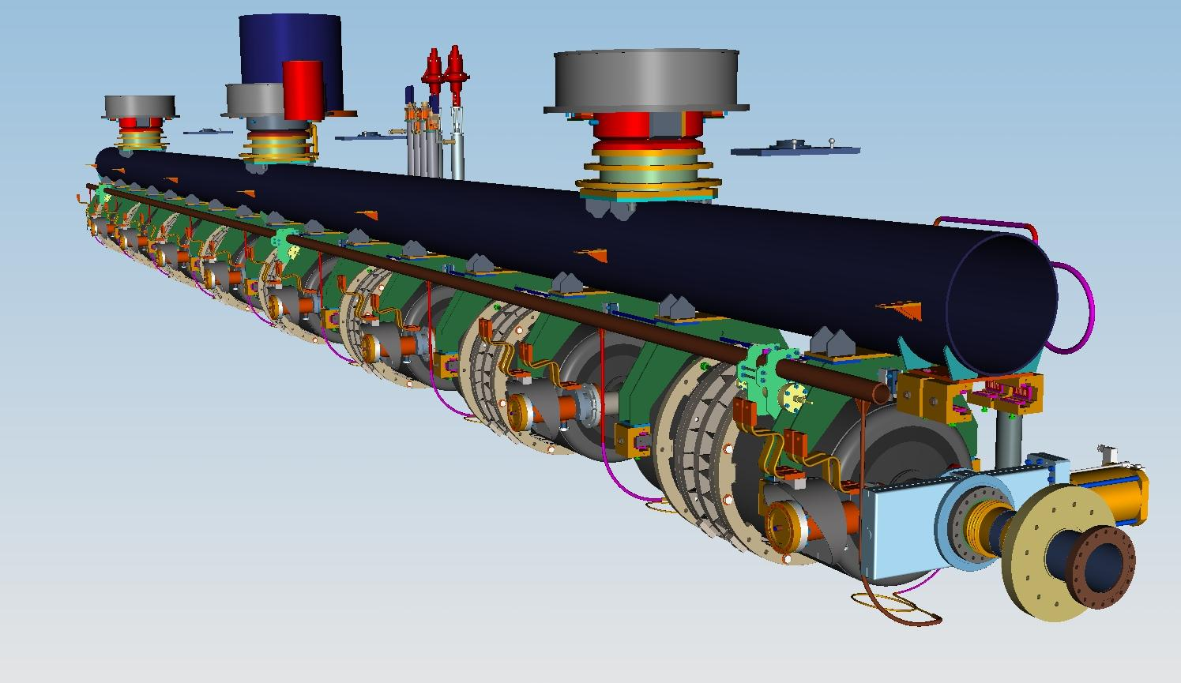
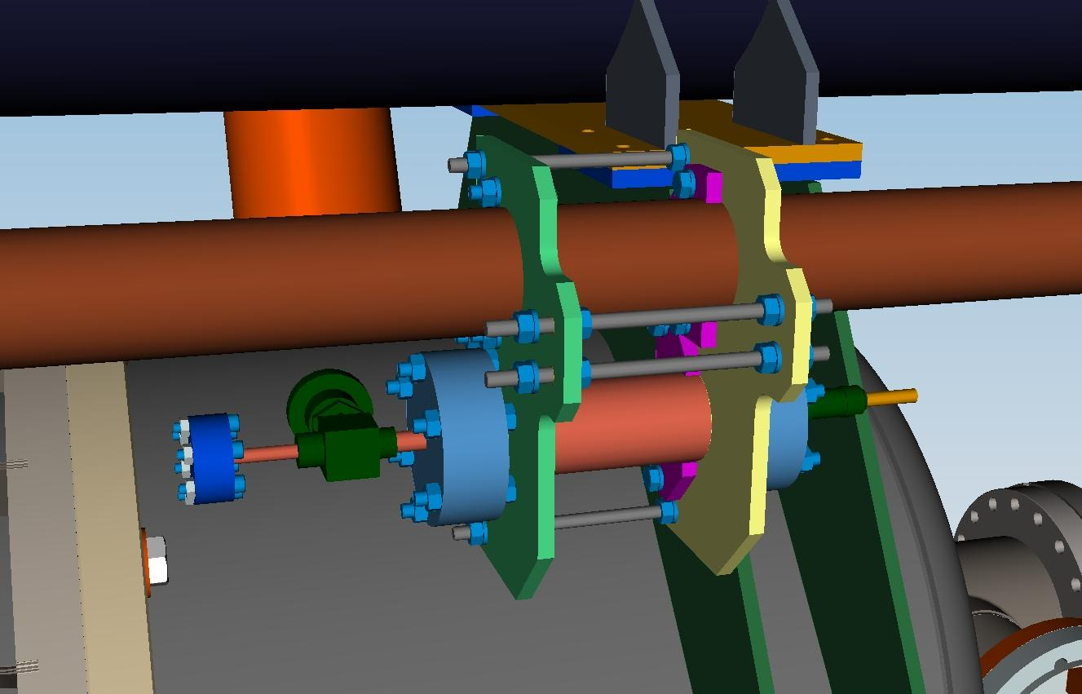
650 MHz Cryomodule. Vacuum loss monitors.
Cryogenic Ionization
Chambers (3 per CM)
Type : Cryogenic beam loss monitors
can be operate from inside the
cryomodules from 5k to 350k.
(by Arden Warner, FNAL)

Slide 6
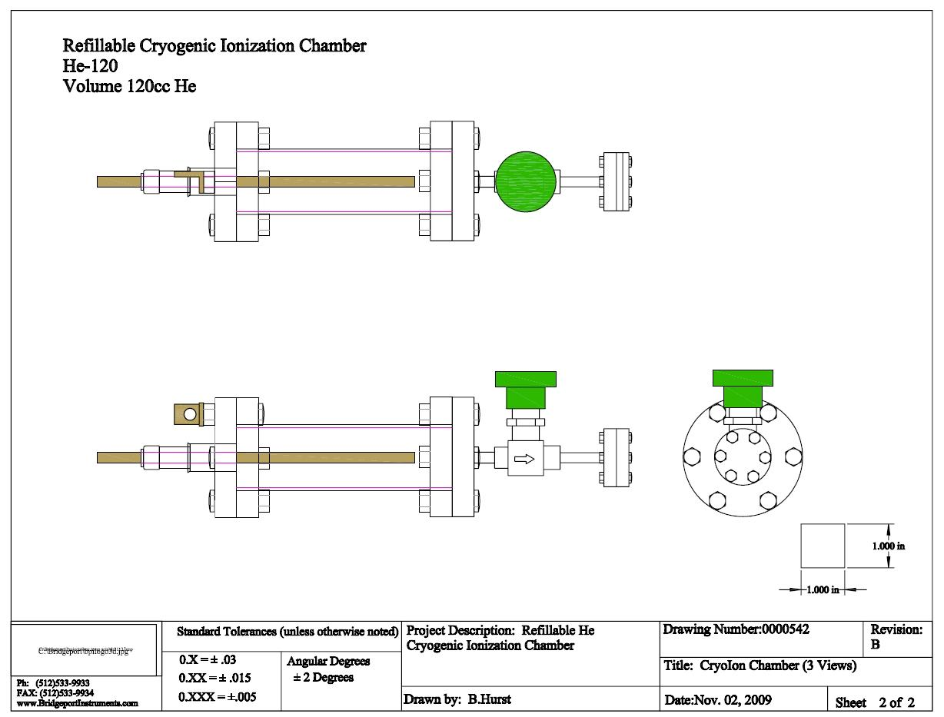
Refillable Cryogenic Ionization Chamber

