Slide 1
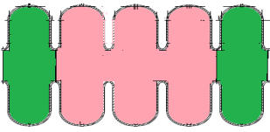
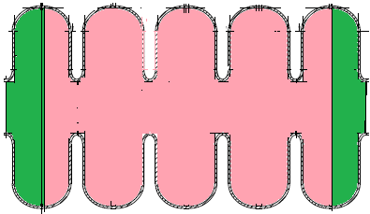
Simulation differences between FNAL and VECC
 | RF parameters By Fermilab | Sfish simulation of Flab design By VECC
Frequency | 650 MHz | 650.72MHz
Ep/Ea | 2.26 | 2.84
Bp/Ea | 4.21 | 5.37
G | 191 | 239.9
R/Q | 378 | 335.25
Previous differences between the results
Main reasons of the discrepancies
In previous presentation from Fermilab, inner cell and end cell angle(α and α_end) were rounded to 2º and 2.7º respectively. Actual values are 1.8567º and 2.657569º.
According to the Fermilab presentation ,Half cell length for inner cells and outer end cells are 70.34 mm and 71.385mm respectively and it was assumed that both the half cells of an end cell having length of 71.385mm. But from the autofish input file from Mr.Saini,it was found that only outer half cell of an end cell is having length 71.385mm,other half cell length is 70.335mm.
half cell length 71.385mm
Wrong end cell
half cell length 70.34mm
Right end cell

Slide 2
Simulation differences between FNAL and VECC
 | SLans simulation By Fermilab | Sfish simulation By Fermilab | Sfish simulation By VECC
Frequency | 650MHz | 650.055MHz | 650.012MHz
Emax/E0 |  | 1.6977 | 1.6837
Bmax/Emax |  | 1.842 | 1.9136
Transit time factor |  | .7123 | .713
Ep/Ea | 2.26 | 2.383 | 2.361
Bp/Ea | 4.21 | 4.39 | 4.52
G | 191 | 196.1 | 197.88
R/Q | 378 | 350.3 | 350.7
Comparison of results after considering exact values of wall angle and end cell length

Slide 3
THANK YOU

