Slide 1

Theory Errors in the SMEFT
William Shepherd
Snowmass ’21 Theory Frontier Meeting
July 29, 2020

Slide 2
Based on…
1711.07484 with Stefan Alte and Matthias König
1812.07575 with Stefan Alte and Matthias König
2007.12698 with Alyssa Horne, Jordan Pittman, Marcus Snedeker, and Joel Walker

Slide 3
EFT error treatment
The consistent EFT treatment is to expand the observable in a power series
  Cross section, not amplitude
Must include the full set of contributing operators at dim-6
  Surprisingly, only two independent angular distributions contribute strongly
  Remaining small differences arise from PDF evolution
As we only have the full dim-6 contribution, everything else ought to be discarded from signal
The dim-6 squared piece is a proxy for the size of the unknown total dim-8 contribution
  Note that additional operators needn’t give correlated angular distribution

Slide 4
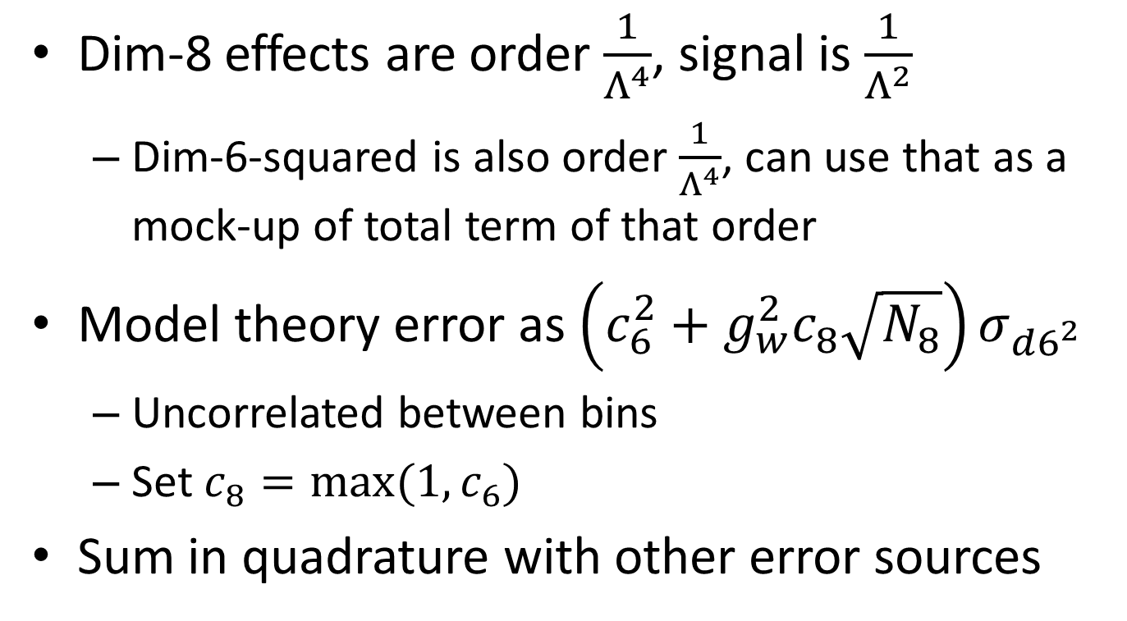
Theory Error Treatment
Dim-8 effects are order $\frac{1}{Λ^{4}}$, signal is $\frac{1}{Λ^{2}}$
  Dim-6-squared is also order $\frac{1}{Λ^{4}}$, can use that as a mock-up of total term of that order
Model theory error as $\left(c_{6}^{2}+g_{w}^{2}c_{8}\sqrt{N_{8}}\right)σ_{d6^{2}}$
  Uncorrelated between bins
  Set $c_{8}=max⁡(1,c_{6})$
Sum in quadrature with other error sources

Slide 5
LHC Sensitivity

Slide 6
The Take-Away
Neglecting theory errors gets our analyses ignored by model-builders, who should be our biggest customers, so definitely stop doing that!
  Produce results that they can’t evade by utilizing an honest error estimate
  ‘New and improved’ sales pitch needed to bring them back
  Push back against any claim that a model can always be built to evade our EFT results

Slide 7

We need to make Bhaskar wrong about this!
“Whatever bound you get from your EFT, I can always write down a model that passes the test against data and violates the bound you claim to have.” – Bhaskar Dutta

Slide 8
Thank You!

