Slide 1
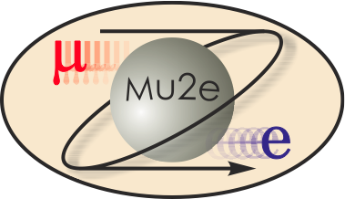
Mu2e-II workshop
Preparation for Snowmass21
Frank Porter
July 29, 2020
DocDB 34605
This meeting will be recorded

Slide 2
What is Mu2e-II?
It is at least:
An upgraded version of Mu2e, improving sensitivity to µ → e conversion according to the ratio:
for an Al target by at least an order of magnitude over Mu2e
It is also capable of measuring µ → e conversion on a titanium target, and the ΔL=2 process µ⁻ → e⁺
Uses 800 MeV PIP-II linac H⁻ beam
Is it anything else? Note common interest with other muon CLFV physics measurements

Slide 3
Snowmass21 context
Frontier: RARE PROCESSES AND PRECISION MEASUREMENTS
Convenors: Marina Artuso, Bob Bernstein, Alexey A Petrov
“Topical groups”
https://snowmass21.org/rare/start
RF1: Weak decays of b and c quarks
RF2: Weak decays of strange and light quarks
RF3: Fundamental Physics in Small Experiments
RF4: Baryon and Lepton Number Violating Processes
RF5: Charged Lepton Flavor Violation (electrons, muons and taus)
RF6: Dark Sector Studies at High Intensities
RF7: Hadron Spectroscopy (new)
Rare Frontier RF5 topical group charged to address:
CLFV decays (μ → eγ, μ → 3e, tau decays, etc.) and conversion (eN → μN)
Muonium-anti-muonium oscillations, LFV leptonium decays
Radiative and non-radiative LFV decays of mesons and baryons (J/ψ → eμ(γ), χ_{c} → eμ(γ), etc.)
Direct (non-decay) LFV processes at accelerators (μ and τ production)
Studies of CLFV at EIC (Electron Ion Collider)
Related theory
Mu2e-II resides here
RF5-1: Charged Lepton Flavor Violation (electrons, muons and taus)
Conveners: Sacha Davidson (Lyon), Bertrand Echenard (Caltech)
https://snowmass21.org/rare/clfv

Slide 4
Snowmass21 Schedule
CLFV workshops:
muons – July 2, 2020
taus – July 23, 2020
flavor/direct decays – Aug 13, 2020
August 31, 2020
Letter of Interest final deadline
October 5-9, 2020
Snowmass Planning Meeting
April 1 to July 31, 2021
Contributed papers submission period
July 11-20,
2021
Snowmass meeting
UW, Seattle
Note change from original Nov 4-6 dates
Precision frontier meeting in planning for around March 2021
Mu2e-II meetings and/or workshops
June 18, 2020
July 29, 2020
August 26, 2020
September 23, 2020
so far scheduled:

Slide 5
Formation of Mu2e-II Working Groups
In order to provide some organization for addressing the several aspects of Mu2e-II, we have formed several working groups
Groups and Convenors (thanks!!) on next slide
If you are interested in contributing to one or more of these areas, please contact the relevant convenors
Expect that members of the working groups will be authors of the final Snowmass contributed paper
There may be additional contributed papers from the working groups individually

Slide 6
Mu2e-II Working Groups and Convenors
Mu2e-II working groups | Convenors
Theory | Julian Heeck Lorenzo Calibbi
Accelerator (including PS, production target, extinction) | David Neuffer Eric Prebys
Radiation mitigation (includes radiation simulation) | Vitaly Pronskikh Michael MacKenzie Stefan Mueller
Tracker | Daniel Ambrose Giovanni Tassielli
Calorimeter (and STM?) | Ivano Sarra Luca Morescalchi David Hitlin
CRV | Yuri Oksuzian Uva person (TBD)
Sensitivity estimate (includes simulation, stopping target) | Lisa Goodenough Sophie Middleton Yuri Oksuzian
Trigger and DAQ | Giani Pezzullo Antonio Gioiosa

Slide 7
Snowmass21 Letter of Interest
Letters of Interest (LOI) (submission period: April 1, 2020 – August 31, 2020)
Allow Snowmass conveners to see what proposals to expect and to encourage the community to begin studying them
Help conveners to prepare the Snowmass Planning Meeting that will take place on November 4 - 6, 2020 at Fermilab
Letters should give brief descriptions of the proposal and cite the relevant papers to study
Instructions for submitting letters at https://snowmass21.org/loi
Authors of letters encouraged to submit a full write-up for their work as a contributed paper
Index:
https://www.snowmass21.org/docs/files/?dir=summaries/
Rare frontier:
https://www.snowmass21.org/docs/files/?dir=summaries/RF
Limited to 2 pages,
plus references
Currently uploaded:
LHCb (cross-listed)
FNAL low-E muon facility
J/ψ factory
srEDM
Committee plans to prepare a LOI for Mu2e-II and circulate for signatures of interested people

Slide 8
Snowmass21 Letter of Interest
A draft LOI for Mu2e-II has been written and may be viewed at the link:
https://www.overleaf.com/read/rmscdsghznbs
Please take a look, and send us comments (e.g., to fcp@caltech.edu)
Note that author list is so far just a few people to check formatting is OK
Deadline for comments is Wednesday, August 5, 2020
After August 5, we will make a general request for interested people to join the author list
Deadline for additions to author list is Wednesday, August 19, 2020
Reserve right to make small tweaks/corrections to LOI up to submission
LOI will be submitted before August 31, 2020

Slide 9
Signing the Mu2-II Snowmass21 Letter of Interest
Signing LOI is open to anyone who is interested in the project
Not a commitment to work on Mu2e-II for Snowmass21
Signing process starts immediately and ends August 19
(we’ll try to accommodate late arrivals if LOI not yet submitted)
Send email to fcp@caltech.edu
Include:
Your name as you would like it (initials plus surname)
Your institution in format (as applicable):
Institution name, Institution address (city, state, mail code, country)
I’ll try to make additions quickly; please check that I got it right

Slide 10
Snowmass21 Contributed Paper(s)
Submission period: April 1, 2020 – July 31, 2021)
Will be part of the Snowmass proceedings
May include white papers on
specific scientific areas
technical articles presenting new results on relevant physics topics
reasoned expressions of physics priorities, including those related to community involvement
Will help shape the long-term strategy of particle physics in the U.S.
Part of the permanent record of Snowmass 2021
Instructions for submitting at https://snowmass21.org/submissions/
Will put up a framework in Overleaf
after LOI is submitted
Committee plans to coordinate writing a contributed paper for Mu2e-II with broad participation
Note that additional contributed papers on specialized topics by smaller groups are encouraged (but if related to Mu2e-II, we would like to reference it)

Slide 11
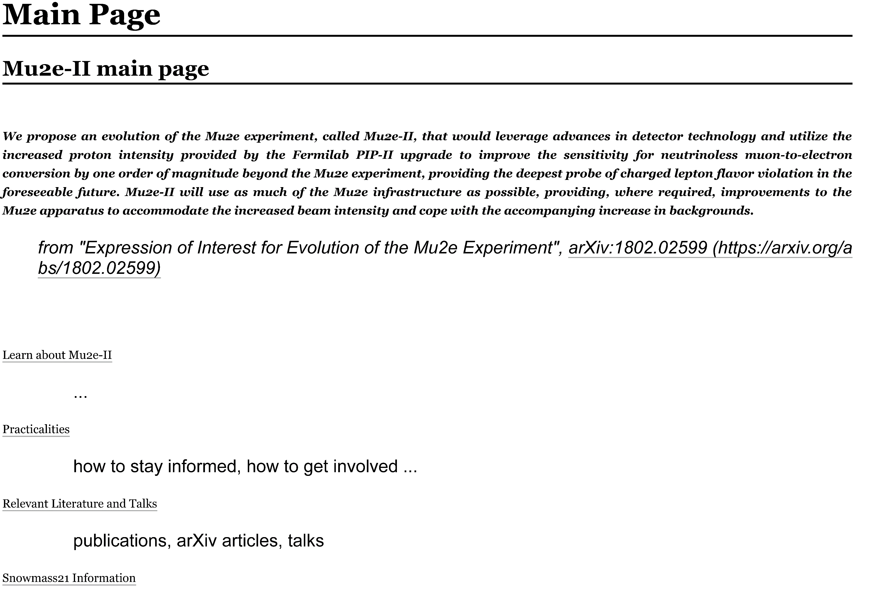
Mu2e-II Wiki
Mu2e-II has a public wiki page:
https://mu2eiiwiki.fnal.gov/wiki/Mu2e-II
Will continue to work on content
Will consider whether we also need a private wiki

Slide 12
Mu2e-II Workshops
Nearby workshop dates | Links to recordings
Thursday, June 18 | AM: https://caltech.box.com/s/b67edbgtxofaujuooorafm4kfq9owhjd PM: https://caltech.box.com/s/vnsm9nh7qroznt3n6q5n3sn4ut1bswo5
Wednesday, July 29 (today)
Wednesday, August 26
Wednesday, September 23

Slide 13
Email, Communication
Email lists:
mu2eii@listserv.fnal.gov Primary channel for communications in Mu2e-II community
To subscribe send email to listserv@fnal.gov with body
subscribe mu2eii <your full name>
Calorimeter working group also on listserv@fnal.gov
subscribe MU2EII-CALORIMETER <your full name>
All working groups should announce meetings on mu2eii, or on a subscribable mailing list
Note that we can’t count on everyone having a FNAL account, at least for now. Thus we communicate with
Meeting agendas and slides on public indico pages
Documents in cloud with links people can use
Email lists
Public wiki (do we need a private wiki as well?)

Slide 14
Mu2e-II Workshop agenda (https://indico.fnal.gov/event/44541/)
When | Who | What
10:00-10:20 | Frank Porter | Introduction
10:25-10:45 | Julian Heeck | Working group reports - Theory
10:50-11:10 | Eric Prebys | Working group reports – Accelerator/Extinction
11:15-11:35 | Lisa Goodenough, Sophie Middleton, Yuri Oksuzian | Working group reports - Sensitivity
11:40-12:10 | All | Break
12:10-12:30 | Brendan Casey | Low mass tracker
12:35-12:55 | Yuri Oksuzian | Working group reports – Cosmic ray veto
13:00-13:20 | Antonio Gioiosa, Gianantonio Pezzullo | Working group reports – Trigger/DAQ
13:25-13:45 | Francesco Renga | μ→eγ, μ→eee at FNAL
14:00 | All | End

Slide 15
Additional Material

Slide 16
Some links to literature
Search Mu2e DocDB for “Mu2e-II”
Northeastern slides
LDRD documents
Snowmass 2013 Report: https://www.slac.stanford.edu/econf/C1307292/
Expression of Interest for Evolution of the Mu2e Experiment: https://arxiv.org/abs/1802.02599
Expression of Interest for the Evolution of Mu2e – Mu2e-II (PAC slides): https://indico.fnal.gov/event/17480/contributions/43397/attachments/26855/33285/PAC-Mu2eII-180716.pdf
Summary Report of the Mu2e-II Workshop at Northwestern University: DocDB-23236
2020 European Strategy Physics input on CLFV: https://arxiv.org/pdf/1812.06540.pdf
Lepton Flavor and Number Conservation, and Physics Beyond the Standard Model: https://arxiv.org/abs/1303.4097
The quest for μ → eγ and its experimental limiting factors at future high intensity muon beams: https://arxiv.org/abs/1811.12324
The hunt for lepton flavor violation with the Mu3e experiment: https://www.psi.ch/sites/default/files/2019-10/nufact_dittmeier_mu3e_201908_v1.pdf
Mu2e-II : next generation muon conversion experiment: https://indico.cern.ch/event/773605/contributions/3493637/attachments/1899088/3134136/Mu2eII_NuFact2019.pdf

Slide 17
Snowmass21 process
Organized by APS DPF
“Snowmass is an opportunity for the entire HEP community to come together to identify and document a vision for the future of particle physics in the U.S. and its international partners.”
https://snowmass21.org/start
[This process may be invaluable towards obtaining R&D funding for Mu2e-II technology,
e.g., consider Snowmass submissions proposing such work]

Slide 18
Mu2e-II Snowmass21 Committee
Name | Institution | Email
Dan Ambrose | U Minn | ambrose0028@gmail.com
Rebecca Chislett | UC London | rebecca.chislett@ucl.ac.uk
Lisa Goodenough | FNAL | goodenou@fnal.gov
Julian Heeck | U Virginia | julian.heeck@gmail.com
David Neuffer | FNAL | neuffer@fnal.gov
Yuri Oksuzian | ANL | yoksuzian@anl.gov
Frank Porter (chair) | Caltech | fcp@caltech.edu
Giovanni Tassielli | INFN-Lecce | giovani.tassielli@le.infn.it
Robert Bernstein (ex officio) | FNAL | rhbob@fnal.gov
Jim Miller (ex officio) | Boston U | miller@bu.edu

Slide 19
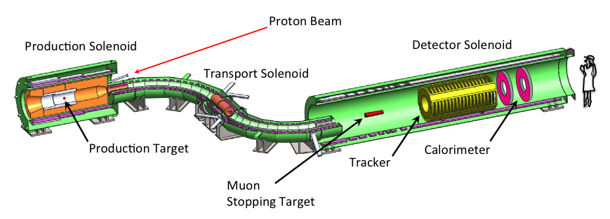
Our focus (partial committee “charge”)
Goal: Make case for Mu2e-II at Snowmass 21
The committee will form immediately and continue until the Snowmass process is complete
The committee should move expeditiously to identify the best path forward
The goal is to
develop the preliminary experimental concept
Accelerator and detector
What can we keep on Mu2e?
What needs to be revised/replaced?
What performance can we expect?
A rough idea of total cost
2) promote interest among theorists
3) prepare for presenting the theoretical and experimental cases in
anticipation of and during the Snowmass process
Accelerator complex
Delivery ring PIP-II
Extinction
monitor
Stopping target
monitor

Slide 20
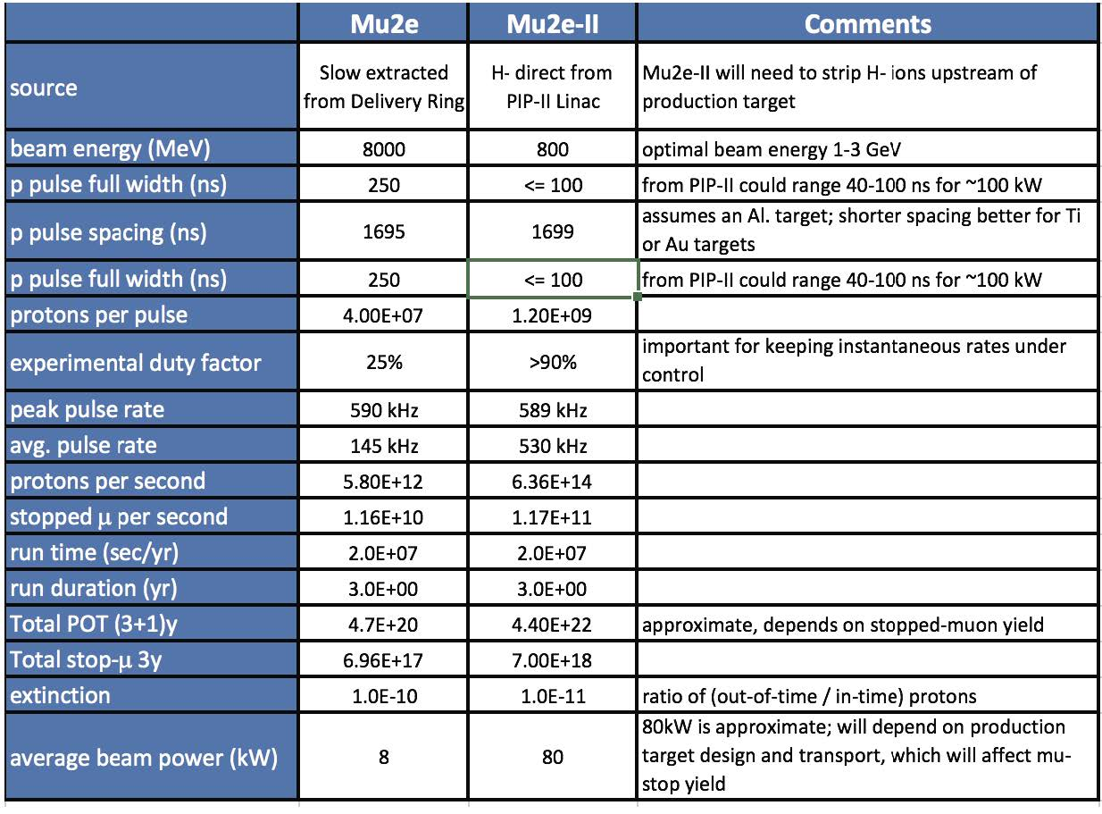
Some tentative parameters, Mu2e-II vs Mu2e
Ref: DocDB-180827

Slide 21
CLFV muon decay schedule context
From 2020 European Strategy Physics input on CLFV
https://arxiv.org/pdf/1812.06540.pdf

