Slide 1
PIP II accelerator beam for mu2e-II
Eric Prebys*
July 2020
*largely taken from Dave Neuffer’s talk, last month

Slide 2
Outline
Introduction
PIP-II and mu2e-II
  Up to 1.6 MW of 800 MeV beam
  Tuneable beam delivery
mu2e-II challenges
  lower energy p-beam injection
  Extinction
  Target
  Production Solenoid
Need to get into Snowmass agenda

Slide 3
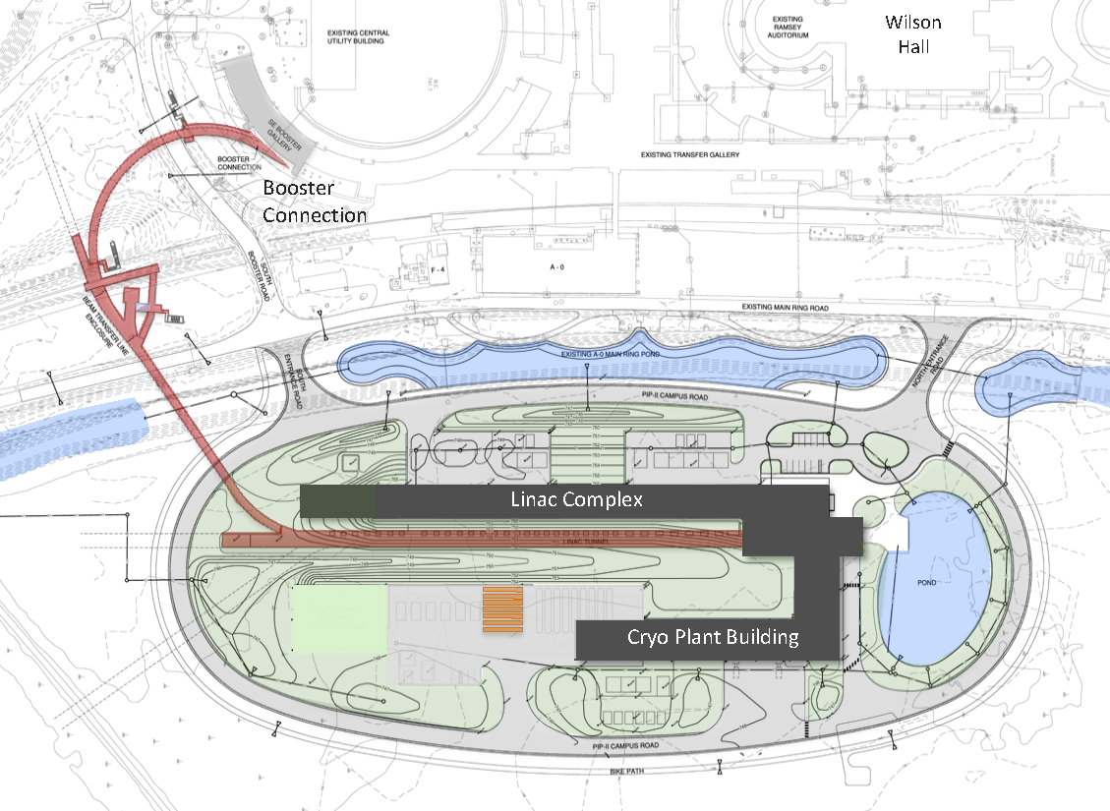
PIP-II Scope Overview
800 MeV H− linac
  Pulsed: 20Hz, 0.55ms, 2ma to Booster
  Can be cw at 2 ma
Additional beam
  3-way beam split
Upgraded Booster
  20 Hz, 800 MeV injection
  New injection area
Upgraded Recycler & Main Injector
  RF in both rings
Conventional facilities
  Site preparation
  Cryoplant Building
  Linac Complex
  Booster Connection
To mu2e
The PIP-II scope enables the accelerator complex to reach 1.2 MW proton beam on LBNF target.

Slide 4
PIP-II Performance Goals
Performance Parameter | PIP | PIP-II
Linac Beam Energy | 400 | 800 | MeV
Linac Beam Current | 25 | 2 | mA
Linac Beam Pulse Length | 0.03 | 0.55 | msec
Linac Pulse Repetition Rate | 15 | 20 | Hz
Linac Beam Power to Booster | 4 | 17 | kW
Linac Upgrade potential | N/A | 1.6 MW CW
Mu2e Upgrade Potential (800 MeV) | N/A | >100 | kW
Booster Protons per Pulse | 4.4×10¹² | 6.8×10¹²
Booster Pulse Repetition Rate | 15 | 20 | Hz
Booster Beam Power @ 8 GeV | 80 | 170 | kW
Beam Power to 8 GeV Program | 32 | 85 | kW
Main Injector Protons per Pulse | 4.9×10¹³ | 7.5×10¹³
Main Injector Cycle Time @ 60-120 GeV | 1.33* | 0.7-1.2 | sec
LBNF Beam Power @ 60-120 GeV | 0.7* | 1.0-1.2 | MW
LBNF Upgrade Potential @ 60-120 GeV | NA | >2.0-2.4 | MW
*NOvA operations at 120 GeV

Slide 5
PIP-II status
800 MeV-2ma cw-capable H⁻ linac
  Initially 17 ma (15 kW)
On trajectory toward construction –completion in 2027
  CD-0 → CD-1 (6/2018) → CD2-3a (2020?)
  the major accelerator project for Fermilab
Purpose of PIP-II
  upgraded intensity of injector for LBNF/DUNE
    uses ~8--17 kW to produce > 1MW at 60—120 GeV
    with “PIP-III” (8 GeV RCS?) can provide >2MW at 60—120 GeV
  Platform for future high-intensity program
    upgradeable to ~1.6MW
  Could provide up to 100 kW beam for mu2e-II
    first identified user of high-intensity program

Slide 6
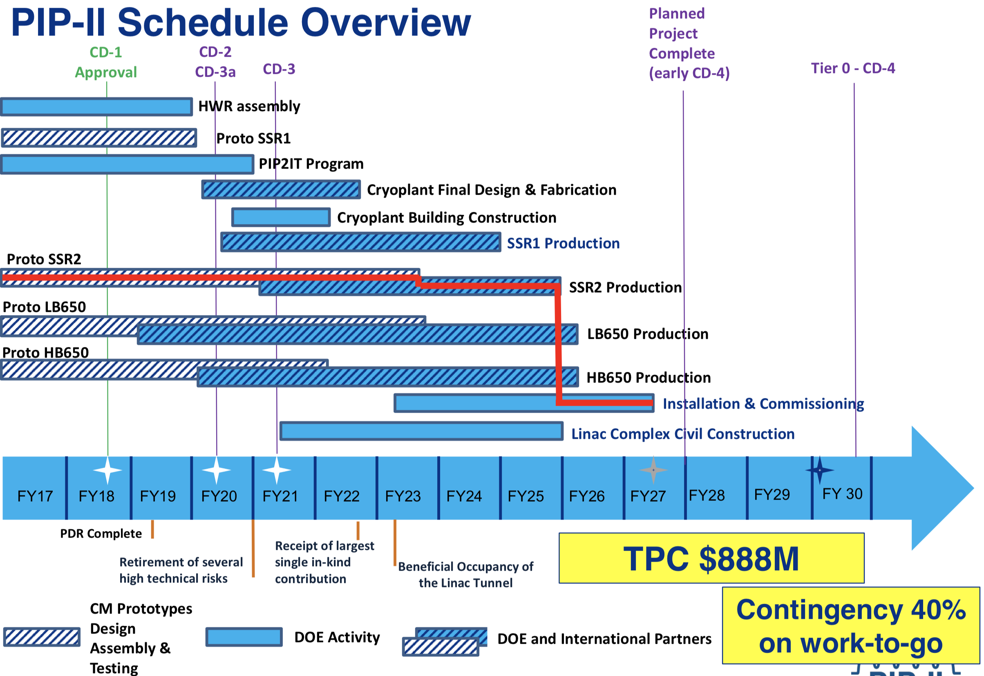
PIP-II Schedule*
*talk by Lia Merminga, 22 November, 2019

Slide 7
PIP-II and Next Generation Mu2e
Cryoplant with capacity for CW operations
PIP-II Source can produce arbitrary bunch structures with:
  Peak current ≤ 5 mA
  cw Average current ≤2 mA
  Can deliver 800-MeV protons directly to a second generation Mu2e
Mu2e-II
  Use PIP-II (800 MeV) as beam source
  Reuse as much as possible of the baseline Mu2e experiment
    Follow similar experimental scenario
    Improve if possible
Need strong Snowmass Letter of Intent & white paper(s)
    will need R&D on changes and improvements

Slide 8
Comment Re: Snowmass
Current plans for PIP-II and the Booster Replacement* are driven entirely by the neutrino program.
Plans regarding other uses for 800 MeV protons, or future intermediate (1.5-3 GeV) energy protons are completely fluid at this point.
  Some of these have important implications for future incarnations of Mu2e
Snowmass is a real opportunity to influence these decisions.
*artist formerly known at PIP-III

Slide 9
Important Question: Bunch Switching
The full bunch rate out of the PIP-II linac is 162.5 MHz
The high energy (≧8GeV) program will use about 1% of the potentially available beam
  Limited by the 20 Hz rep. rate of the upgraded Booster
I’m assuming beam headed for the Booster will be switched by a 20 Hz switching magnet (not challenging)
If we’re the only other user, then we would access to the full 162.5 MHz; however
If we’re not the only user, our ~600 kHz bunch rate is certainly too fast for a pulsed kicker.
If there are multiple 800 MeV users, then the most likely solution is an RF beam separator.

Slide 10
RF Beam Splitting
The Beam will go through an RF deflector running at 162.5/4=40.625 MHz
Individual beam lines are selected by choosing which bunches to populate.

Slide 11
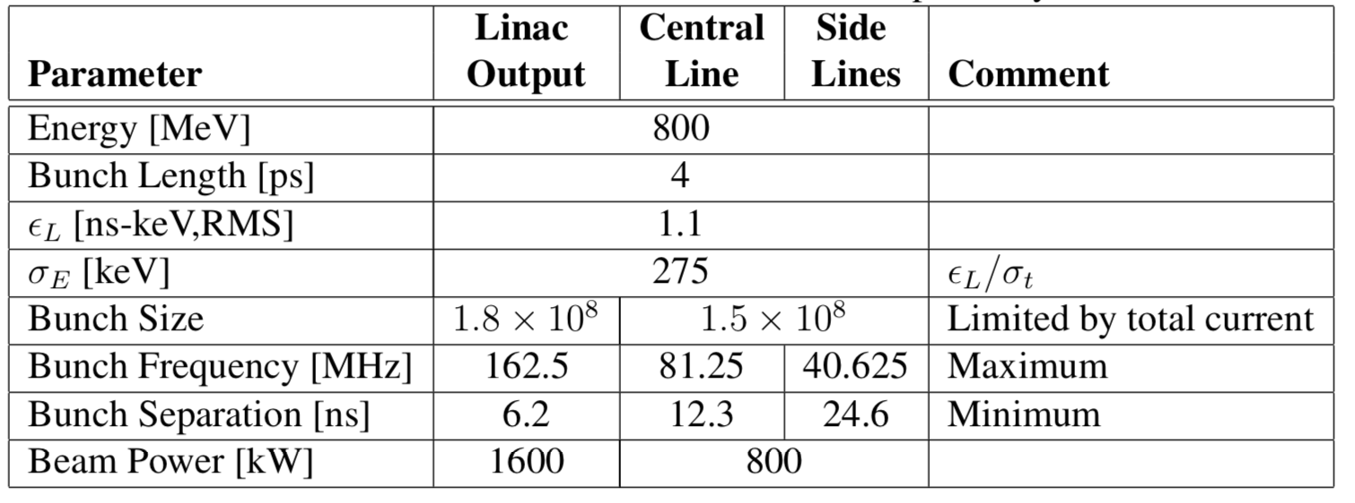
PIP-II Linac Beam Parameters
Assume this limit for short bursts.

Slide 12
Mu2e-II Beam formation
Possible beam structure (100 kW):
  8 bunch bursts
  1.8x10⁸ protons
  600 kHz repetition rate
  = 110 kW
The pulse width depends on the bunch rate
  162.5 MHz = 50 ns
  81.25 MHz = 100 ns

Slide 13
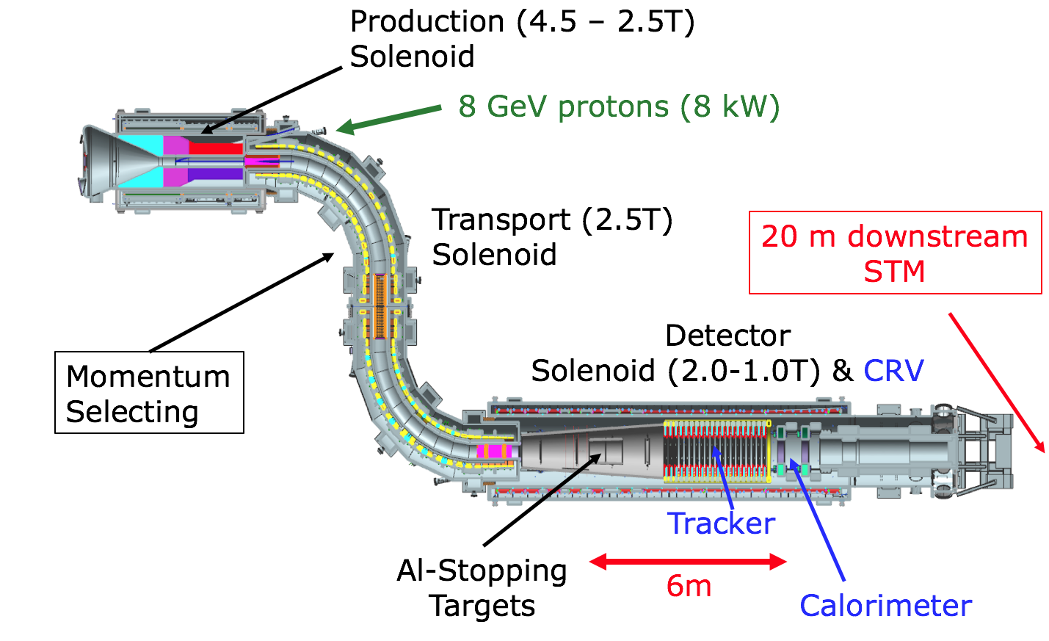
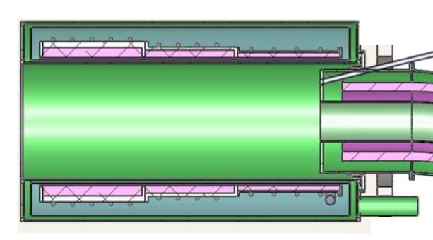
mu2e → mu2e-II
8 GeV→ 0.8 GeV
PIP-II 800 MeV Beam

Slide 14
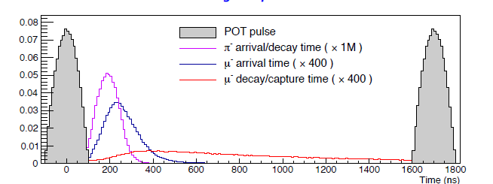
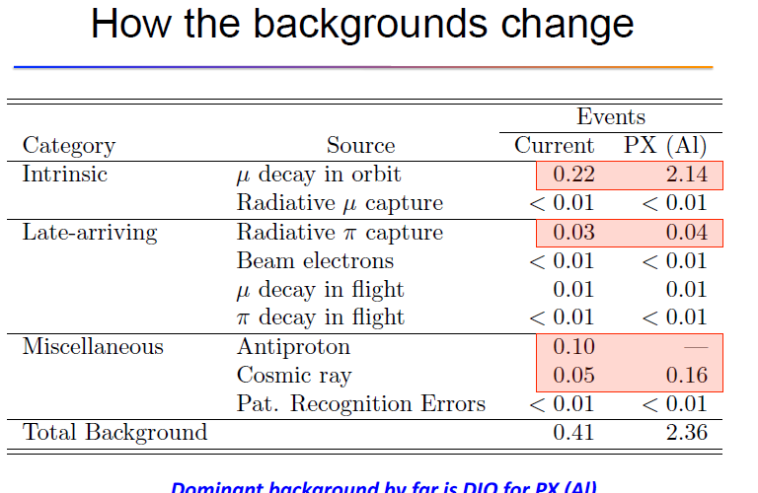
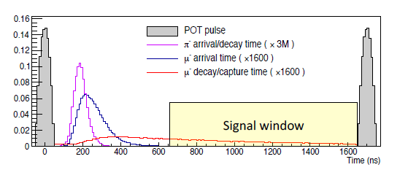
mu2e→mu2e-II
mu2e →mu2e-II
  shorter pulses
timing comparison
  K. Knoepfel et al.

Slide 15
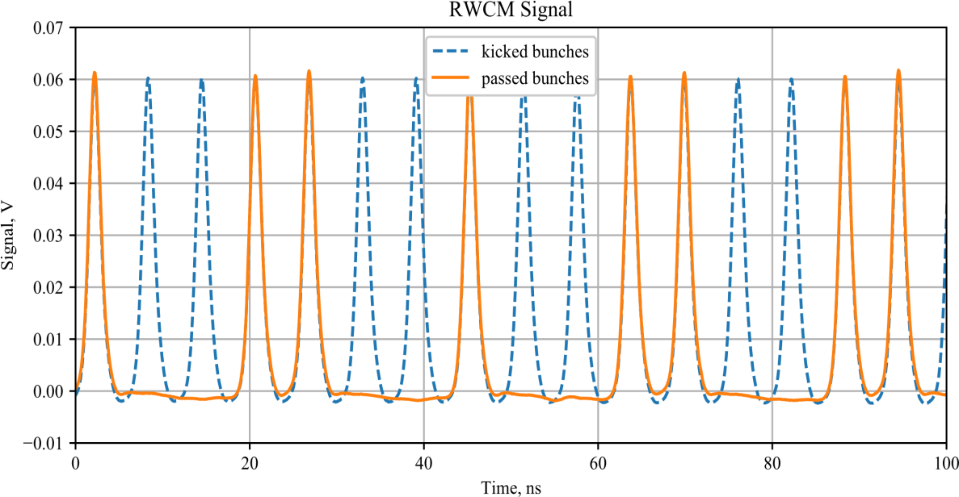

Bunch to Bunch extinction
Chopping efficiency
  kickers designed to deliver beam or no beam
    > 10⁻⁴ extinction factor ..
  need >10⁻¹¹ for mu2e-II
    need secondary extinction
spill uniformity
  linac pulse-to pulse variation fairly small
  variation in mu2e slow extraction is intrinsically large
    “One should not be expecting beam intensity variations below ±50% in Mu2e” –Nagaslaev .
I_{AV}*(1+ Δ_{FSM})
I_{AV}
I_{AV}*(1- Δ_{FSM})

Slide 16
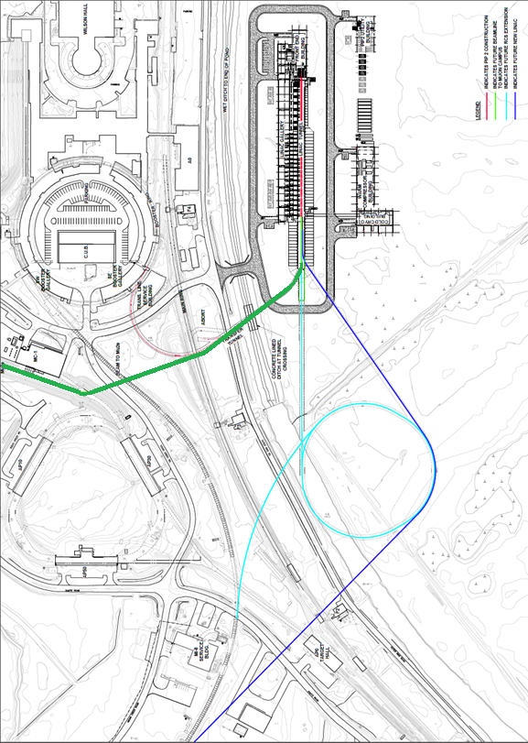
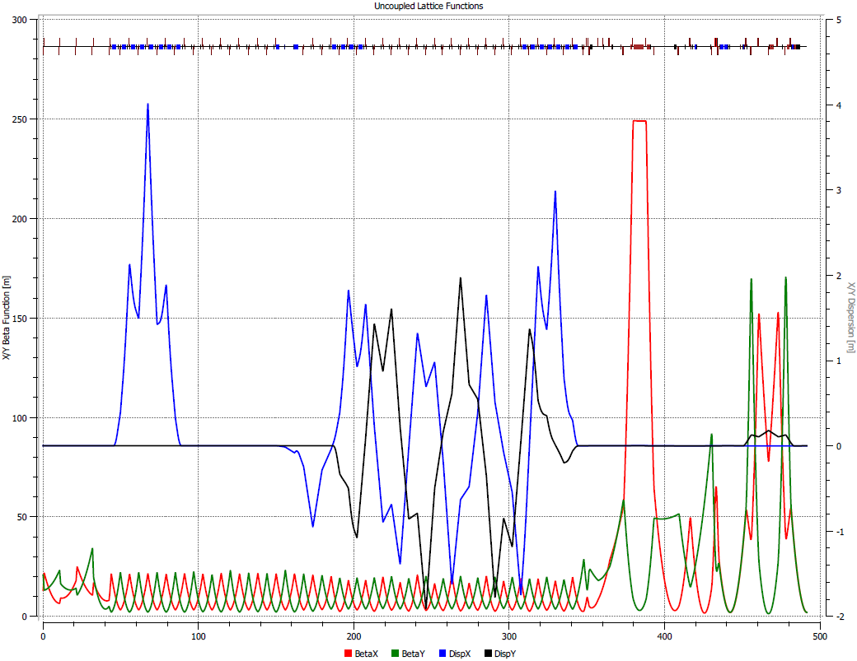
New beamline to mu2e experiment
800 MeV beam line from PIP-II
  directly to production target
    no Recycler, DR, slow extraction
    0.3 mm-mrad emittance H⁻
  starts with transport to Booster
    low-field (B<0.25 T) for H⁻
    switchyard kicker splits (Booster /mu2e)
  mu2e line continues into M5 line
    uses same magnets at lower strength (1/6)
      could use mu2e extinction …
PIP-II
Booster
mu2e-II transport
PIP-III
RCS or linac
A. Vivoli, M. Xiao

Slide 17
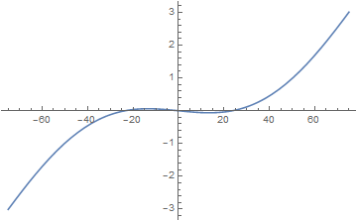
Extinction comments
could use Mu2e AC dipole extinction
  Beam size of PIP-II 0.8 GeV and current 8 GeV beam are similar
    Bρ: 29.84 → 4.91 T-m
  Use magnets and fields at ~1/6 strength
PIP-II beam length is ~2× smaller
  reduce window a factor of 2 by changing h, f, and Kick strength
  Kick ~ sin(πx/t_{o})-f sin(πhx/t_{o})
    K=2.5/6, h=21, f=0.055 (from h=15, f=0.084)
But - Extinction monitor must change
  No 4.2 GeV/c beam …
Kicker
Collimator
120 ns

Slide 18
Shortening the Transmission Window
With the same transmission window, the extinction dipoles will need ~1/6 the field for an 800 MeV beam, HOWEVER
If we shorten the transmission widow, both the frequency of the higher harmonic and the amplitude of both fields will scale as the inverse
Limit?
Assumes the same emittance, which won’t be the case -> Not this bad

Slide 19
Extinction Questions
Our current system assumes
  Need 10⁻¹⁰
    10⁻⁵ from bunch formation in Recycler/Delivery Ring
    10⁻⁷ from AC Dipole
    Factor of 100 safety margin
Mu2e-II
  Need 10⁻¹¹
    Assume 10⁻⁴ from chopper
      Upper limit, probably better
    Would need 10⁻⁹ to get the same safety margin
      AC dipole system should work much better with a lower energy, smaller emittance beam, but…

Slide 20
PIP –II delivery on target
PIP-II Linac is H⁻
  beam enters ~4T field
    14º → ~0.9 T transverse
    H⁻ stripping time (W. Chou)
    P=1.463 GeV/c
    βγcτ = ~12cm
  Beam should be stripped upstream
    orbit bump onto stripper foil could add to extinction (Roberts ….)

Slide 21
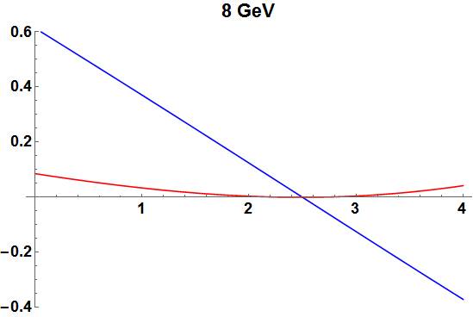
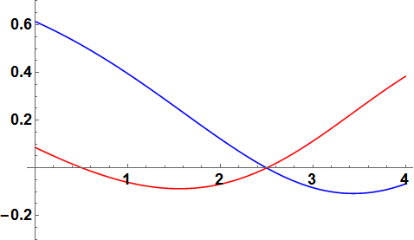
Beam Deflection 8 GeV vs 800 MeV
 | x,y (8 GeV) | x’,y’ (8GeV) | x,y (800 MeV) | x’ , y ’ (800 MeV)
0 | 0.614, 0.086 | -13.5º, -3.4º | 0.614, 0.086 | -9.9º, -10.5º
2.5 | 0, 0 | -14.0º, 0º | 0, 0 | -12.0º, 10.5º
4 | -0.37, 0.042 | -13.6º, 3.2º | -0.067, 0.384 | 7.95º, 13.75º
x
8 GeV
x
y
y
x
800 MeV
y

Slide 22
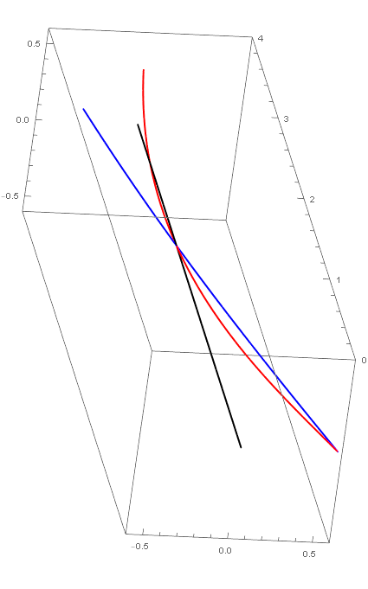
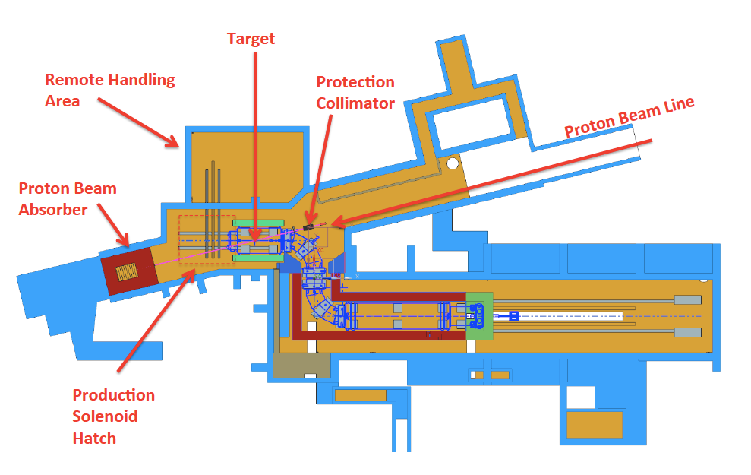
3-D projection of trajectories..
0.8 GeV beam would not meet proton absorber
  unless steered toward it …
    ~0.3 T-m bend ..
  Or inject ~vertically
    exiting beam would be horizontal
proton absorber changes?
  multiple scattering in target is six times larger
  rms angle (θ_{o} → 3.6º at 16cm W)
  Lower energy
0.8 GeV
8 GeV
proton
absorber
center line

Slide 23
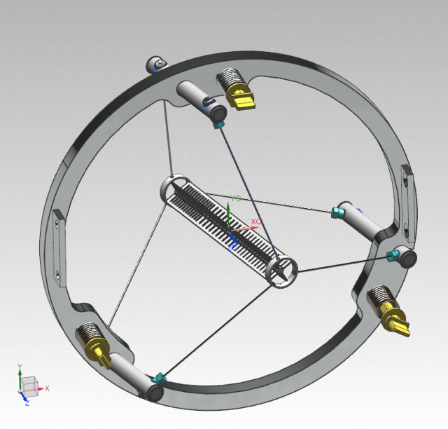
Target considerations
Mu2e
  8 GeV, 8 kW (0.7 kW in target)
  passively cooled, freestanding W target
    3.15mm radius, 22cm long (segmented)
Mu2e-II
  800 MeV, 100kW (22.5 kW in target)
  Target DPA >> 1 → (rad damage)
Update requires new target
  Need active cooling
  800 MeV beam has much larger multiple scattering -
LDRD to study target options
  I.Fang, K.Lynch, D.Neuffer, J.Popp, V.Pronskikh, D.Pushka
  See next talk

Slide 24
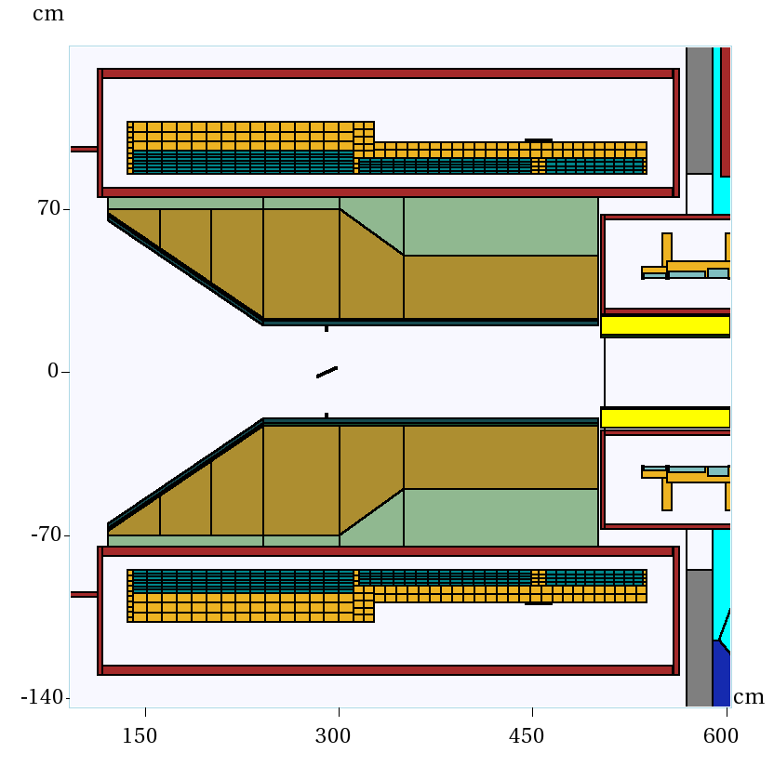
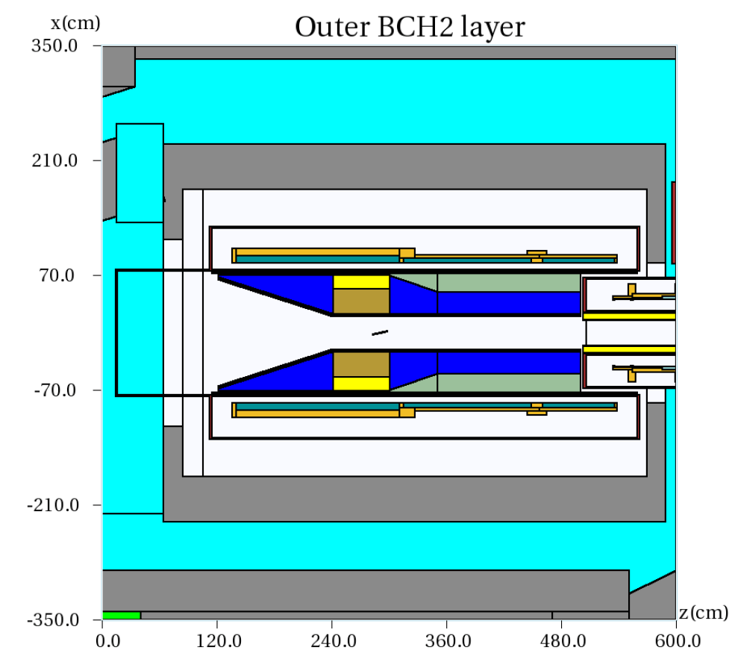
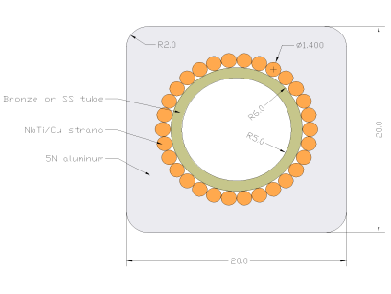
Production Solenoid
Requires changes for mu2e-II
  Beam entrance hole must change
  Radiation damage from mu2e run?
  10× more energy deposited
    V. Kashikin
Update Design for HRS
    V. Pronskikh
  Modify material
    W→ Bronze + B-CH₂
  Need improved cooling for coils
  Modify coils to improve cooling
Change Design if rebuilt ??

Slide 25
Accelerator Issues Approximately Ordered by Difficulty
Beam transport into and through the PS – How do we hit the target, dump, and extinction monitor?
  Changing input angle to hit target changes exit angle toward dump; extinction monitor must change
Target upgrades required for 100 kW 800 MeV beam.
  Active cooling + material/geometry change
Replace Production Solenoid ? Change if replaced?
  HRS shielding upgrade
Extinction – Can chopper + beamline extinction system achieve the required 10⁻¹¹ extinction?
Where to strip H⁻ to p⁺?
Radiological issues – shielding for 100 kW mu2e ?

Slide 26
Backup

Slide 27
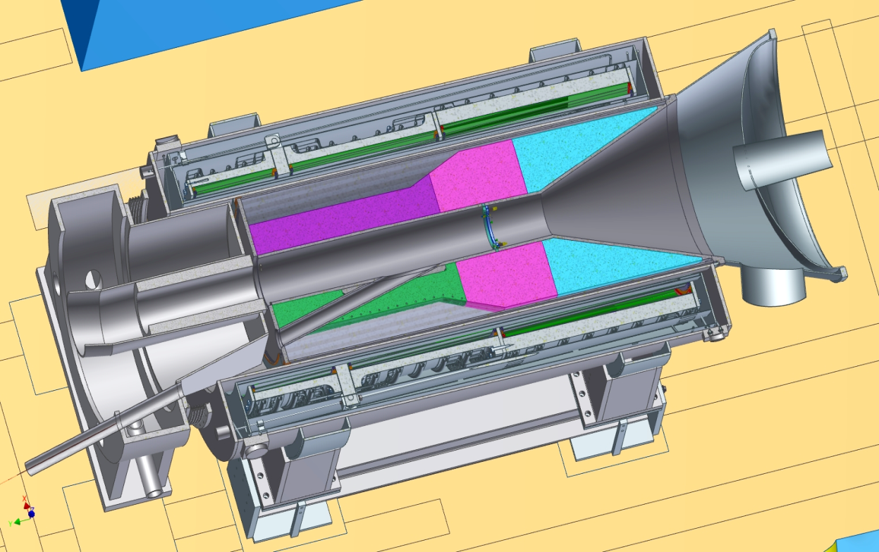
Primary Beam Transport through the Solenoid:
8 GeV proton beam enters PS:
~0.6 m off-axis
vertical pitch =~ -3°
horizontal bearing = ~13.6 °
8 GeV proton beam follows a straight line to the target.
800 MeV beam is greatly deflected
Target
~14°
Requires change in direction of injection
  need initial vertical angle (~10° ), and reduced horizontal angle (~10.5 °)
Notes:
Notes:
The horizontal bearing changes from 13.6$°$ (at PS entrance) to 14$°$ (at target) due to the small vertical pitch of the beam velocity vector.
The vertical pitch of the beam increases from -3.1$°$ to 0$°$ due to the horizontal bearing of beam velocity vector

Slide 28
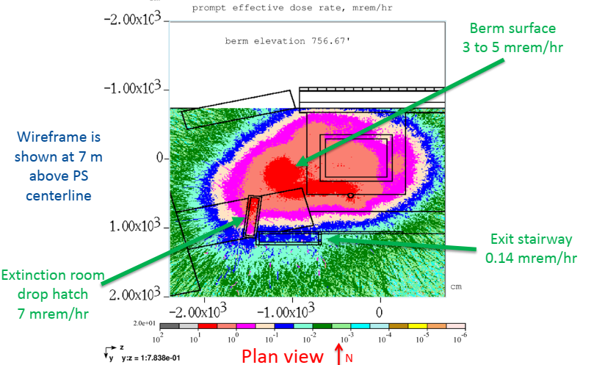
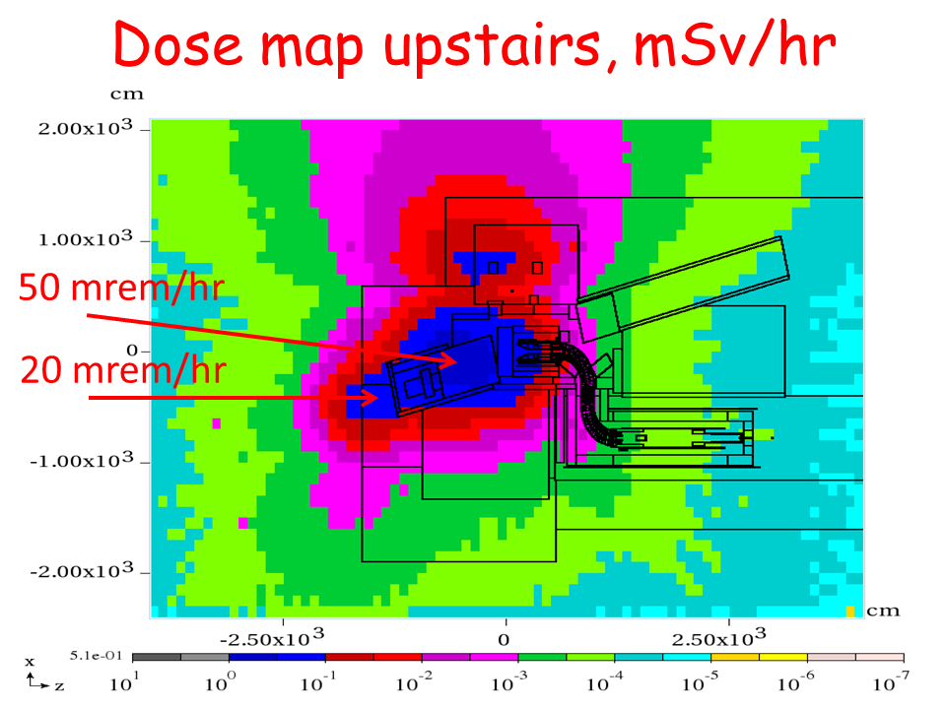
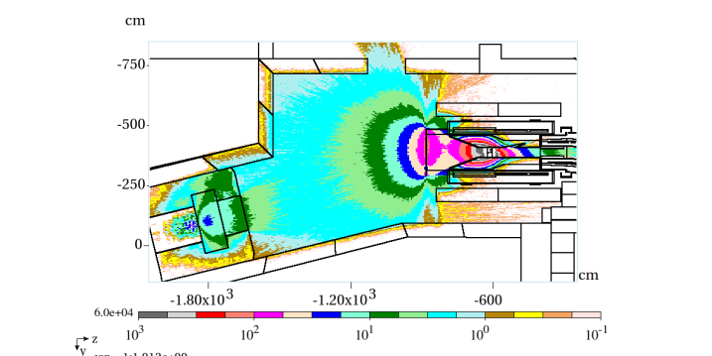
Radiation for mu2e-II?
10 × radiation load of mu2e …
  Lower energy beam -
Will not use delivery ring
  (which is weakly shielded)
  new transport line to mu2e may need more shielding.
No antiprotons or other GeV-scale secondaries
  modify collimation; p absorber
Mu2e radiation calculation
A. Leveling
Inside PS hall

