Slide 1
Thin straw update
Brendan Casey, July 27, 2020

Slide 2
‘Baseline’ straws
We have purchased and shipped material to PPG to try and manufacture ~8 micron thick spiral wound straws
They have received the material and are working on it
3 micron mylar x 2 + adhesive
Mylar is not metalized straws
Goal:
They say they think they can do it
They send us some to test (creep, etc…)
Straws pass those tests
We purchase material to make a batch of metalized straws
We want to get the POs in before the end of the fiscal year
We have them make a batch and then we can do further tests plus start making single straw and few straw prototypes

Slide 3
Thinner spiral wound straws
Started testing thinner materials.
Have also sent samples of these materials to PPG
Told them to work on baseline first and then start playing with these
Have done some instron tests

Slide 4
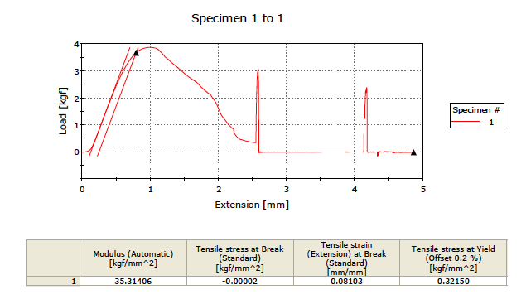
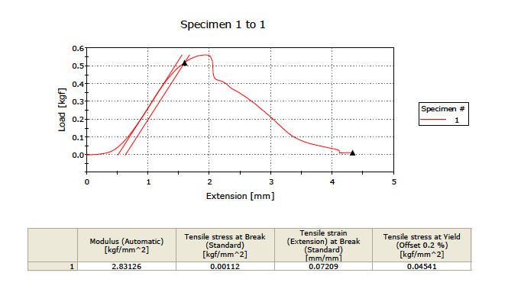
Pull tests
12 micron mylar
1.5 micron mylar

Slide 5
Pull tests
Thickness (microns) | Yield strength (sample 1) (kgf/mm²) | Yield strength (sample 2)
1.5 | 0.034 | 0.045
3.5 | 0.078 | 0.079
6 | 0.146 | 0.157
12 | 0.310 | 0.322

Slide 6
Metal straws
Have one quote from one group to do some R&D on extruding aluminum
Extrude in multiple stages and then etch outer diameter
I’m evaluating their quote
I need to give them a spec for outer wall surface finish
My gut feeling is this in not that important if it is below fractions of a micron but I need to think about it a little more.

Slide 7
Conclusions
Making progress at greater than a snail’s pace.
I’ll try and have at least a little progress at every meeting

