Slide 1
SAND: Construction and Installation Schedule and Magnet + ECAL Status
C. Montanari
FNAL – INFN
DUNE ND General Meeting – October 28, 2020

Slide 2
Schedule: Goals, assumptions and strategy
  The main goal of the schedule is to have the detector fully operational by the time the neutrino beam is turned on.
  The following assumptions come from the official construction schedule of the ND site and the beam facilities.
    Start of ND site beneficial occupancy: Beginning of Jan 2027
      The availability of the experimental hall is presently conditioned by the availability of funds for the construction. Funding is supposed to become available in Q4 2023.
    Beam available (checkout): May 2029
  The following assumptions come from the present status of SAND
    Magnet, with Yoke, and ECAL are both available in Frascati
      Magnet requires some re-certification
      ECAL requires some substitution of PMTs; the decision to replace all PMTs with SiPMs is pending.
    The choice of the technical solution for the inner tracker is still to be made
      Decision will be taken by end of April 2021
      Independently from the chosen solution some prototyping and optimization is required
      Funding for the inner tracker have to be found.

Slide 3
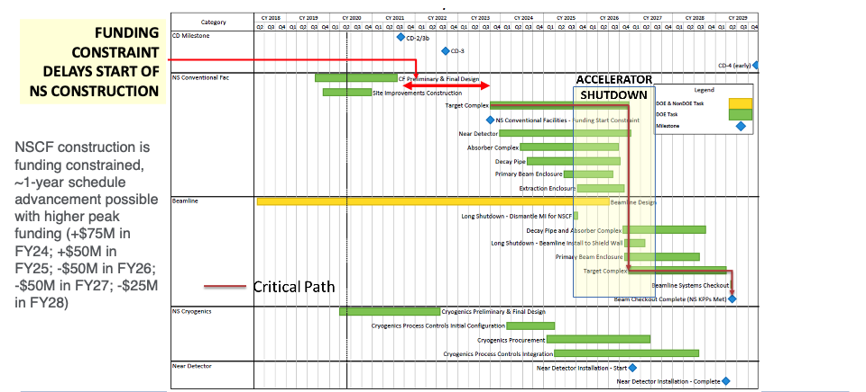
LBNF Near Site Summary Schedule

Slide 4
Schedule: Goals, assumptions and strategy (cont.)
    The LAr part of the inner tracker is accepted
      Requires R&D and prototyping
    A decision about the necessity of an external muon detector is yet to be made
      Technical solution is still undefined, depending on the results of the Montecarlo simulations.
      Funding has to be found.
  The following strategic choices are proposed
    Minimize the work to be done in the experimental hall, by taking advantage of an assembly area in a surface building at Fermilab (to be requested to the Fermilab Director)
      Assemble all detectors inside the magnet cryostat in this area and then move the assembled detector (cryostat + ECAL + inner tracker + LAr detector) in the experimental hall as soon as the hall will become available.
    Perform an extensive set of tests during the construction and assembly of the detectors (prioritize reliability over schedule).

Slide 5
Proposed timeline for SAND

Slide 6
Proposed timeline for SAND

Slide 7
Status: Yoke and Magnet
  Yoke:
      3D model (as built) completed and provided to ND engineering group
      Preliminary estimates of the cost/times/logistic of the transfer to FNAL with a specialized company: done.
      Preliminary cost/times estimates with the company which assembled the yoke for disassembly/remounting: underway.
  Magnet:
    Replacement of power supply, power breakers, quench protection system:
      Funds are available;
      Contacts with Oxford Instruments are underway: tender will be launched at the beginning of 2021.
    Survey of Oxford Instruments planned in 2021 for the survey of all other ancillary systems

Slide 8
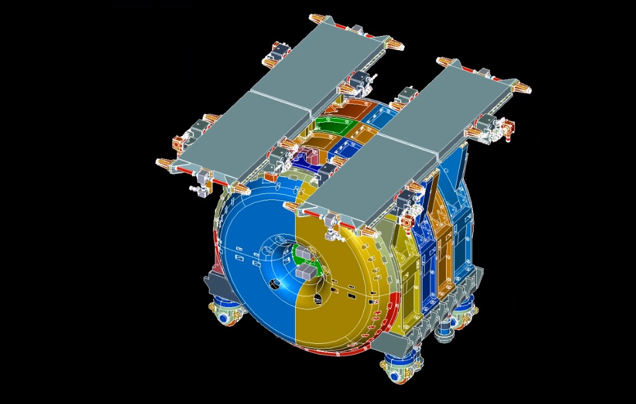
3D model: Yoke, as built

Slide 9
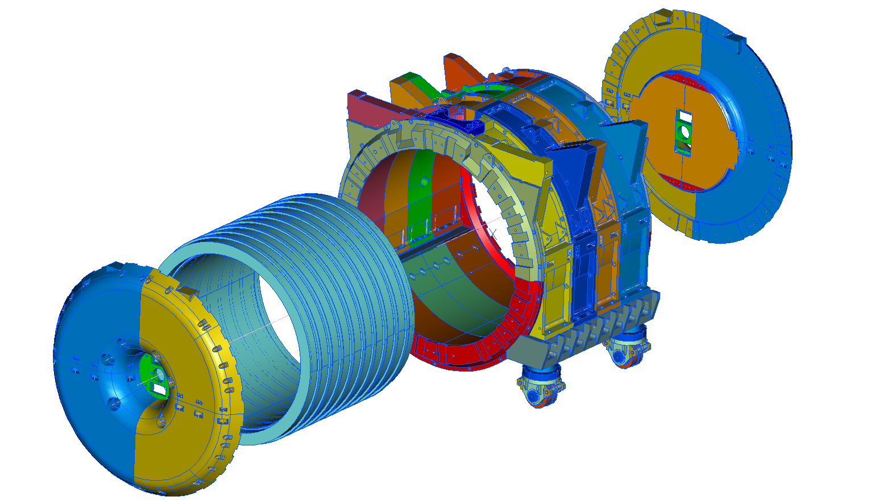
3D model: Yoke, as built

Slide 10
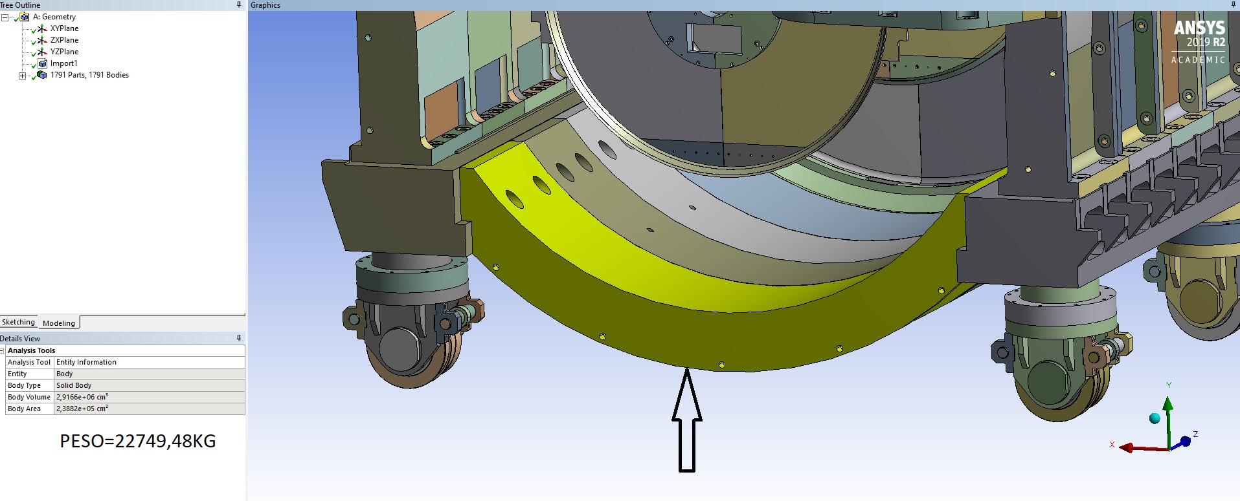
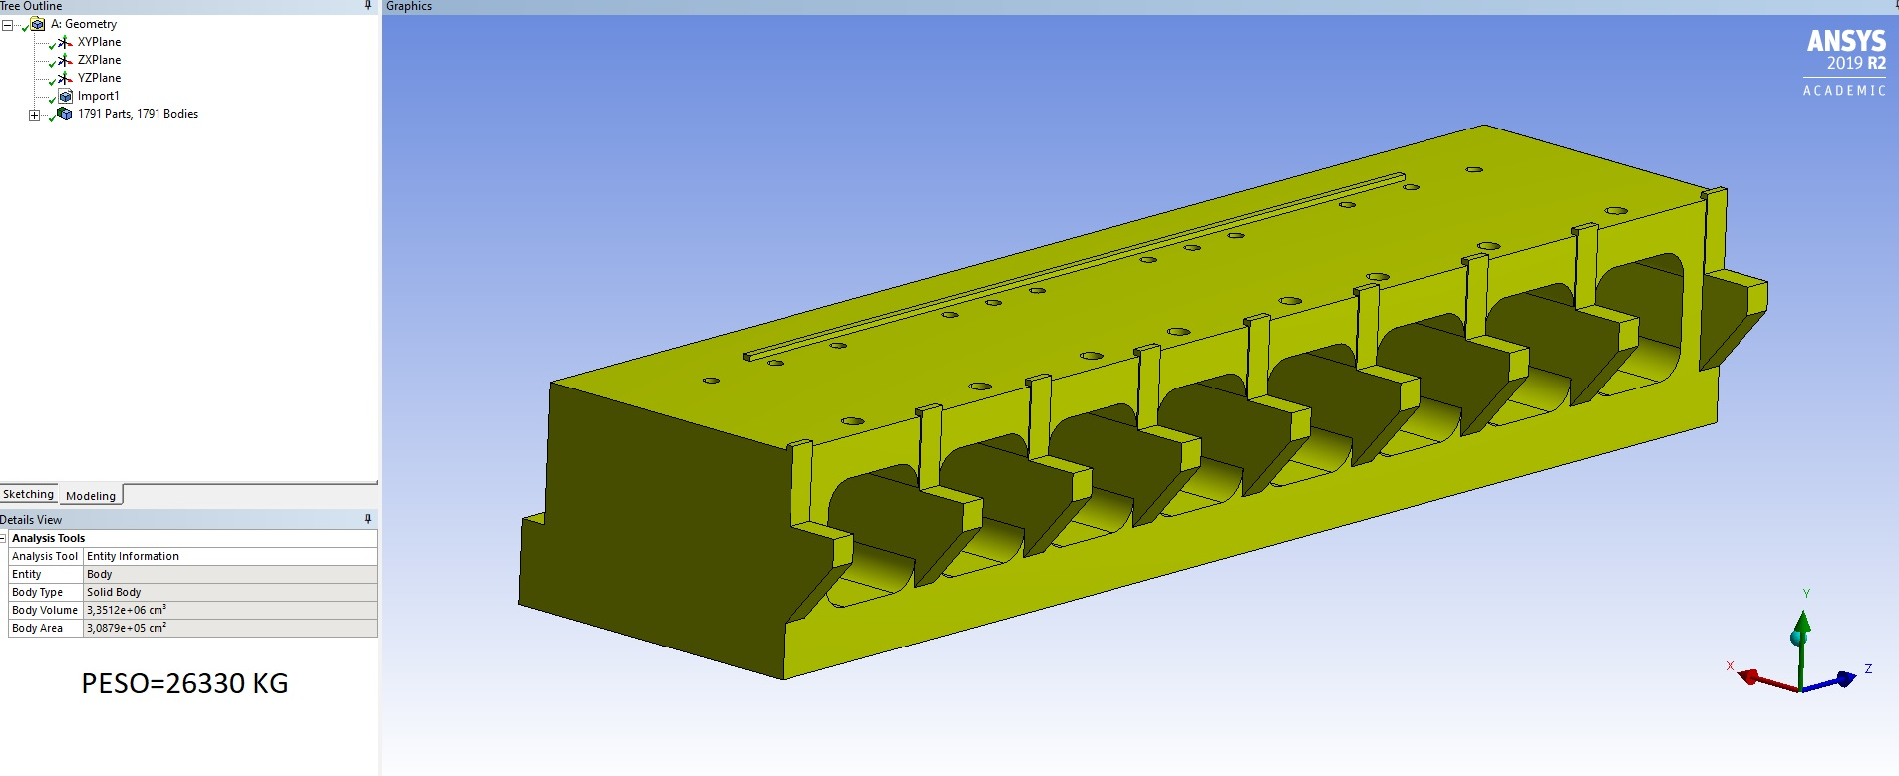
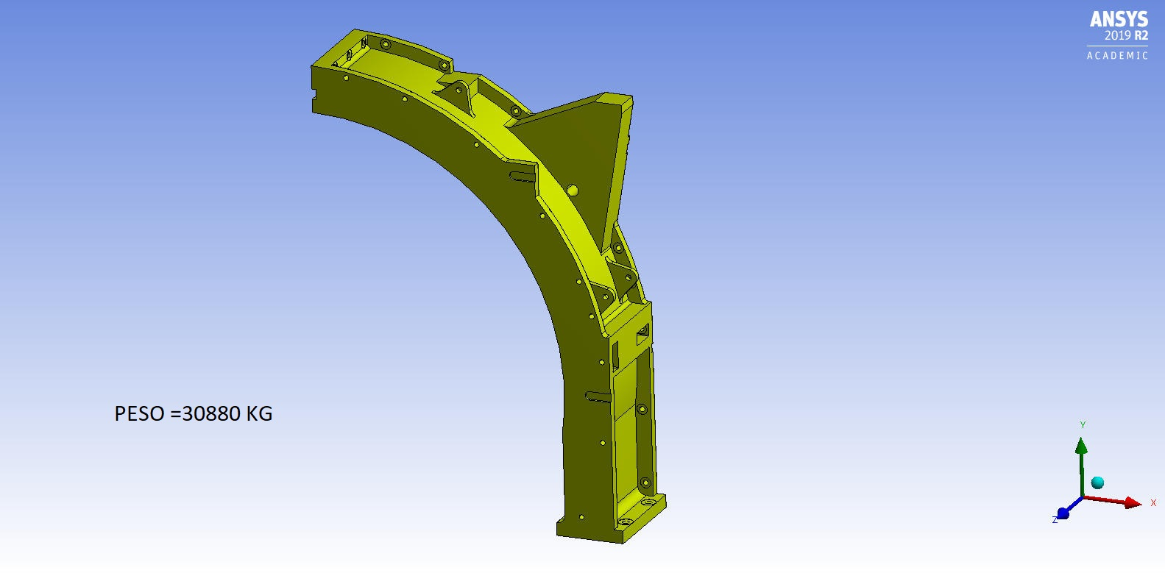
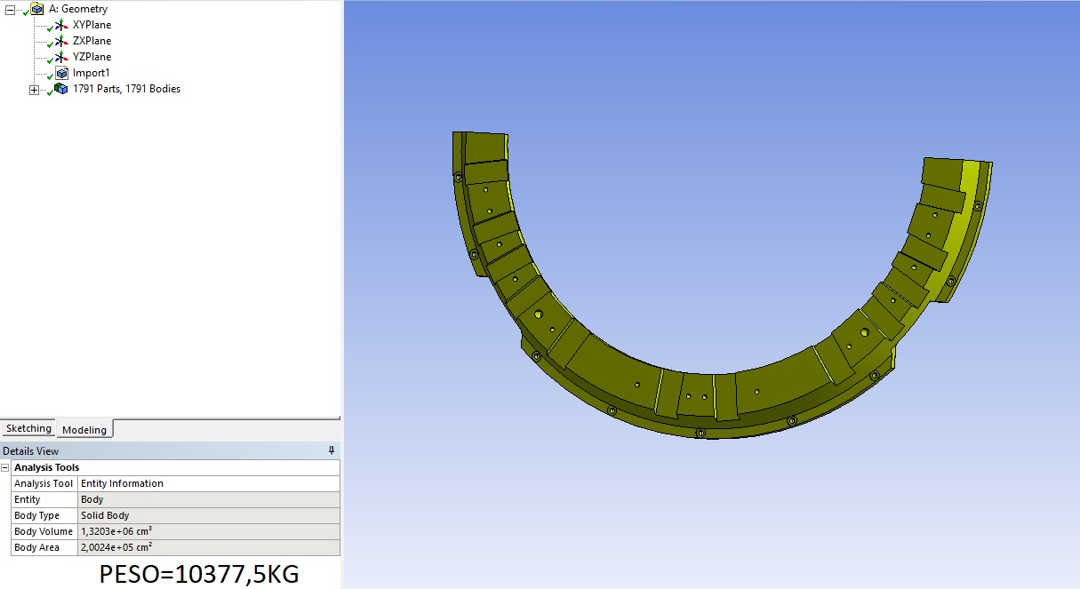
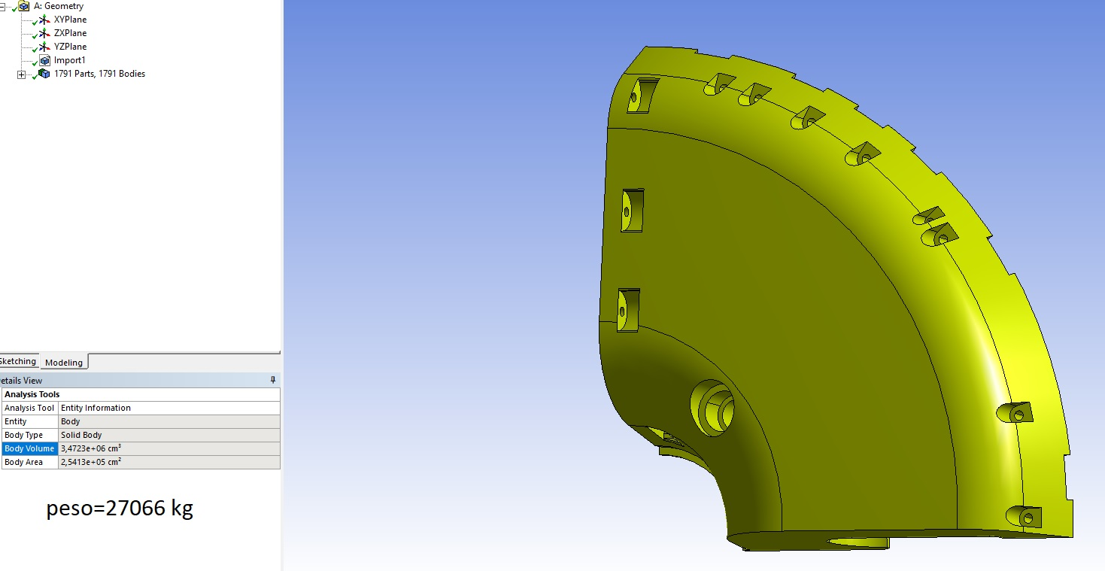
3D model: Yoke - components

Slide 11
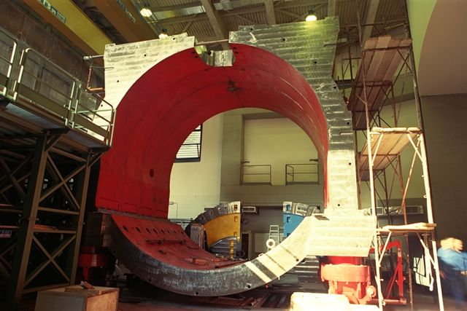
The DAΦNE Yoke at INFN in Frascati - Italy

Slide 12
Status: ECAL
  Recovery / reconstruction and preparation of the tools to dismount the calorimeter: in progress.
  Dismounting, servicing and testing the calorimeter modules: scheduled for 2021.
  Also in 2021: complete the comparison PM to SiPM on a calorimeter slice:
    … depending on the results, either purchase spare PMs or a number of SiPMs
    Substitute the HV system
  Started a program with CAEN industry to update the ADC/TDC system

Slide 13
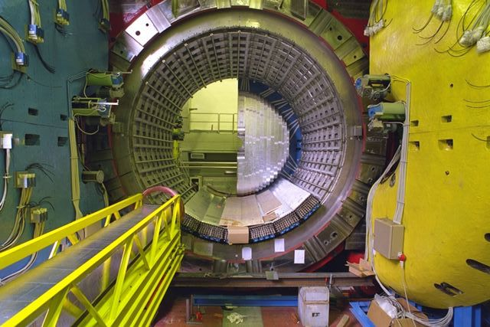
Installation of the ECAL modules
Guiding/positioning rails
ECAL modules
Installation tool

Slide 14
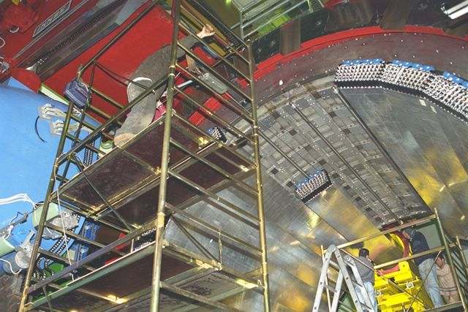
Installation of the ECAL modules

Slide 15
Summary
  A schedule for the construction, installation and commissioning of SAND has been developed with the goal to have the detector in steady state operation by the end of 2028.
    The schedule assumes the start of the detector assembly around end of 2024 in a surface building at Fermilab.
    All detector elements will be installed inside the magnet in the surface building, before being lowered down in the experimental hall.
  Activities on the magnet, yoke and ECAL are progressing and they will continue during 2021. Delivery at Fermilab of the Magnet and of the ECAL modules is planned for the second half of 2024./

