Slide 1
121.04.04 Building Infrastructure (BldgI)
Introduction & Overview of Electrical Systems L4
Jonathan Hunt, L3 Manager
Electrical Systems (Cables & Racks) PDR
August 31, 2020

Slide 2
Introduction
Welcome to the Preliminary Design Review for the Building Infrastructure – Electrical Systems (Cables and Racks)!
Review Committee:
Chris Jensen – Committee Chair – AD/EE Support
Matt Boyes – SLAC
Steve Hays – AD/EE Support

Slide 3
Project Team
Jonathan Hunt – Level 3/Control Account Manager for Building Infrastructure. Maurice Ball will be taking over this role starting 9/1/20.
Ryan Crawford – Level 4/Subject Matter Expert for AC power distribution, cable specifications, layouts, racks
Michele McCusker-Whiting – Application developer for the PIP-II cable database

Slide 4
Review Charge Questions
Is the Linac Complex electrical system design and its associated documentation at the preliminary design level (~30-50%)?
Are the engineering approaches and methodologies presented herein suitable to meet project requirements?
Have lessons learned from other projects been incorporated into the design?

Slide 5
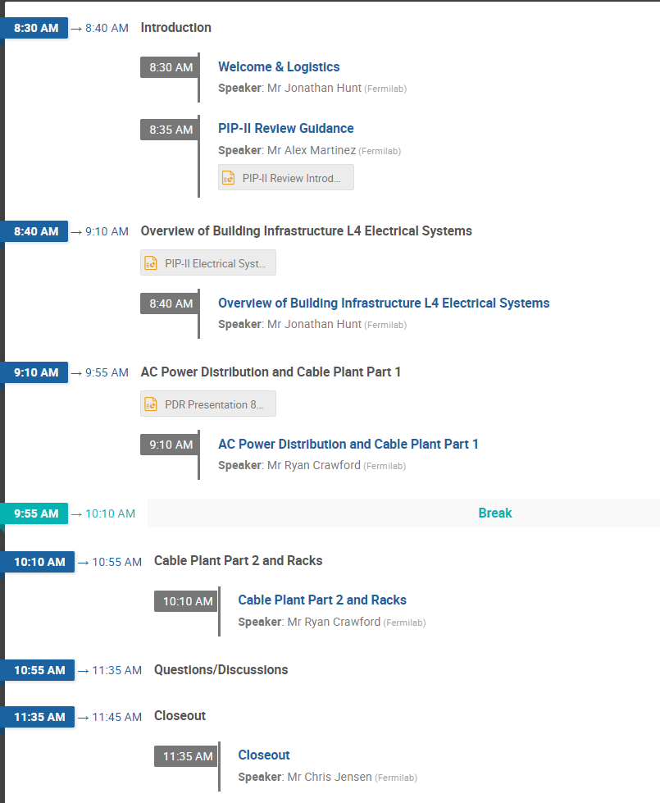
Agenda

Slide 6
End Intro – Start Overview

Slide 7
Overview Outline
Overview of the scope of work for Electrical Systems WBS
Where BldgI Electrical starts, ends, and everything in-between
Cost and Schedule highlights

Slide 8
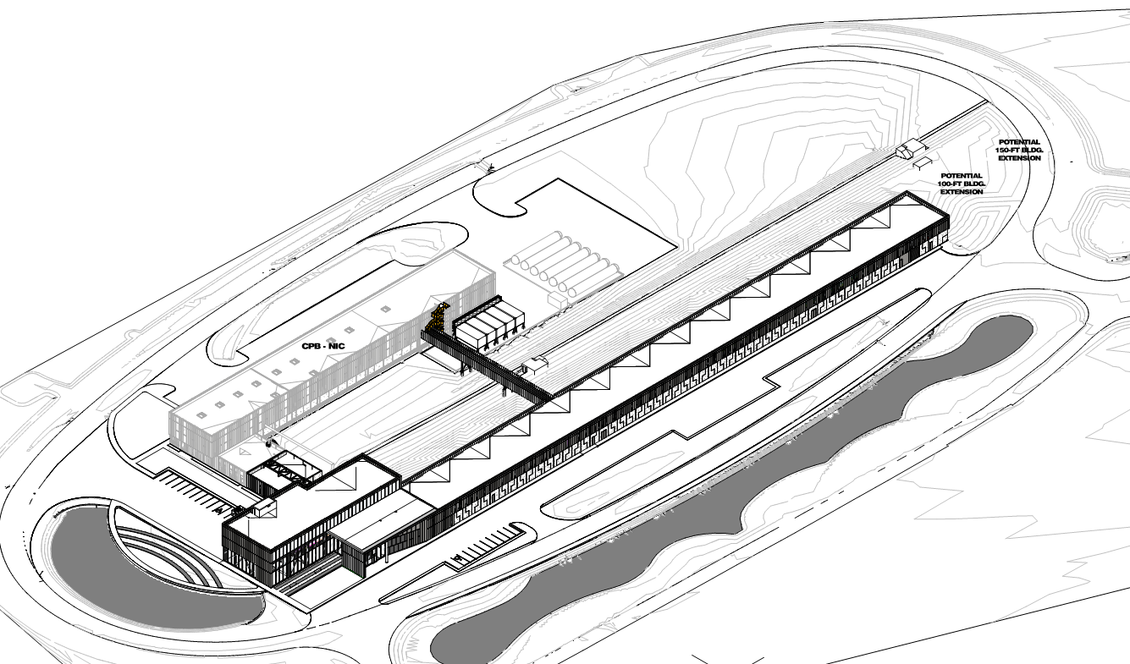
WBS Definition
WBS 121.04.04 – Building Infrastructure
WBS 121.04.04.01 – Project Management
WBS 121.04.04.02 – Cable Database and Layout
WBS 121.04.04.03 – Mechanical Systems
WBS 121.04.04.04 – Electrical Systems

Slide 9
WBS Definition
WBS 121.04.04.02 – Cable Database and Layout
“Layout design for racks, cables, and cable trays in the High Bay Building, Linac gallery, Linac tunnel, and Beam Transfer Line. Also includes effort towards tailoring the cable database to meet PIP-II needs.”
WBS 121.04.04.04 – Electrical Systems
“Design of the AC power distribution (480V, 208V, 120VAC, cable tray & grounding) for the Linac High Bay Building, Linac tunnel, Linac gallery, Beam Transfer Line tunnel and the Utility Plant at the Cryoplant Building. Also includes, the layout planning, procurement and QA, but not installation, of accelerator sub system electrical connections (standard system cables, connectors, racks & grounding) for the Linac High bay, Linac tunnel, Linac gallery and Beam Transfer Line tunnel.”
WBS dictionary PIP-II-doc-599

Slide 10
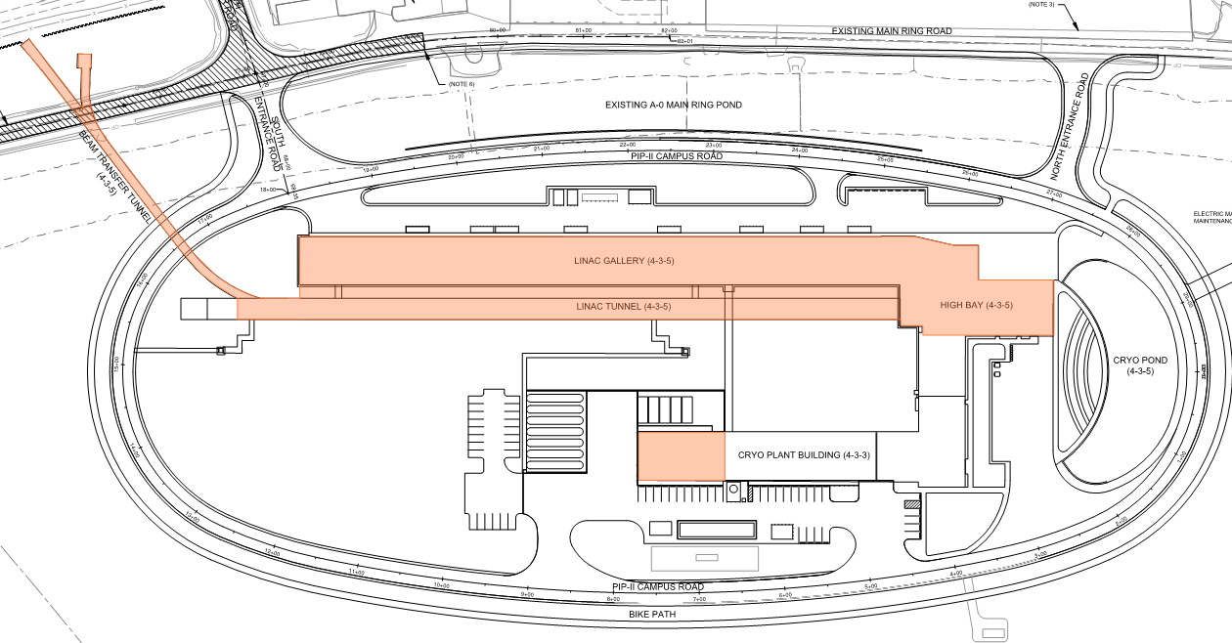
PIP-II Linac Complex
Building Infrastructure – Electrical Infrastructure Locations
Beam Transfer Line
Linac Gallery
Linac Tunnel
High Bay Building
Utility Plant in the Cryoplant Building

Slide 11
Cross Section of Linac Gallery and Tunnel
Penetrations
Linac Gallery
Linac Tunnel
Utility Trench

Slide 12
Scope and Deliverables
Design:
PIP-II cable database
Implementation strategy for power distribution and grounding
Rack layout specifications and grounding
Cable routing and cable plant management
Procurement:
Standard cables and connectors for Linac Complex
Standard relay racks
Grounding from cable trays to racks
Installation:
Cables, racks, and grounding for Process Cooling Water system controls in Utility Plant of Cryoplant Building

Slide 13
Organization
WBS 121.04.04
Building Infrastructure
J. Hunt (M. Ball starting 9/1/20)
WBS 121.04.04.02
Cable Database
M. McCusker-Whiting
R. Crawford
WBS 121.04.04.03
Mechanical Systems
Yurick Czajkowski
M. Ball
WBS 121.04.04.04
Electrical Systems
R. Crawford
R. Wielgos
Team in place with many years of subject matter experience designing, maintaining and operating accelerators
M. McCusker-Whiting – AD/Controls – programmer
R. Crawford – AD/EE Support
R. Wielgos – FESS/Engineering (Electrical Engineer)
M. Ball – AD/MSD
Yurick Czajkowski – Contractor (Mechanical Engineer)

Slide 14
Interfaces
WBS 121.04.04
BldgI
WBS 121.2.03 SSR
WBS 121.2.02 HWR
WBS 121.3.09 BI
WBS 121.3.08 SS
WBS 121.3.05 MagPS
WBS 121.3.04 LLRF
WBS 121.2.06 CDS
WBS 121.2.04 650 MHz
WBS 121.3.07 Cntrl
WBS 121.3.03 HPRF
WBS 121.3.02 AP
WBS 121.4.02 WFE
WBS 121.5.02 BSTR
WBS 121.5.04 TLBA
WBS 121.6.04 UtilB
WBS 121.6.05 Cmplx
Interfaces identified and managed through Master Interface (TC#ED00010433) Document
Top 3 interfaces:
High-power RF system
LLRF system
Magnets

Slide 15
Scope Boundaries for BldgI – Electrical Systems
Conventional Facilities
AC Power Distribution up to disconnect switches
Cable Tray and Penetrations
Building Infrastructure
Works with CF during A/E design phase
Procures standard cables, connectors, racks
QC checks, hands off to installation L3s
Linac Installation and Beam Transfer Line Installation
Pulls and terminates cables, installs racks, and commissions

Slide 16
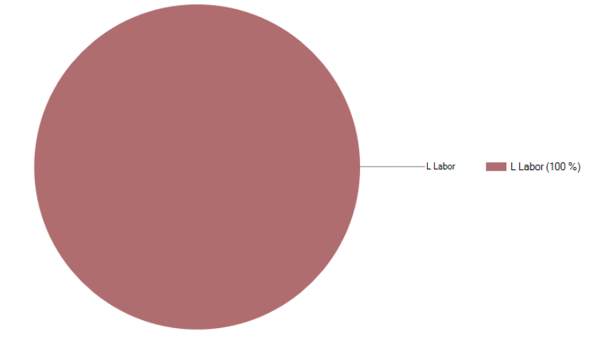
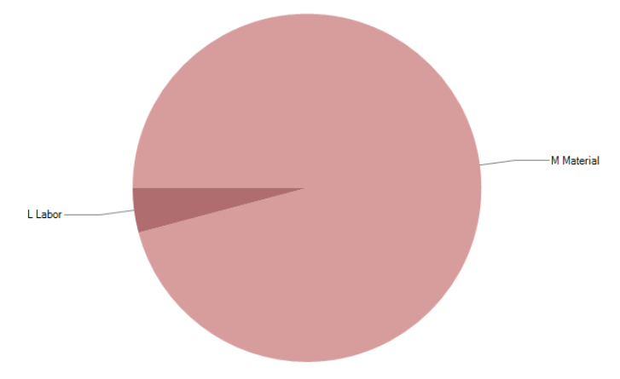
Baseline Costs
121.04.04.02 Inst – Building Infrastructure – Cable Database and Layout 121.04.04.04 Inst – Building Infrastructure – Electrical Systems

Slide 17
FTE Breakdown
0.80
0.60
FTE
0.40
0.20
0

Slide 18
FTE Breakdown
0.80
0.60
FTE
Electrical Eng. to support procurements of
Cables/connectors/racks/grounding
0.40
Installation at Utility Plant
0.20
0
Labor to support
design for Linac Complex and
Utility Plant
Time-phase materials delivery/QC

Slide 19
Schedule Summary – Design Phase

Slide 20
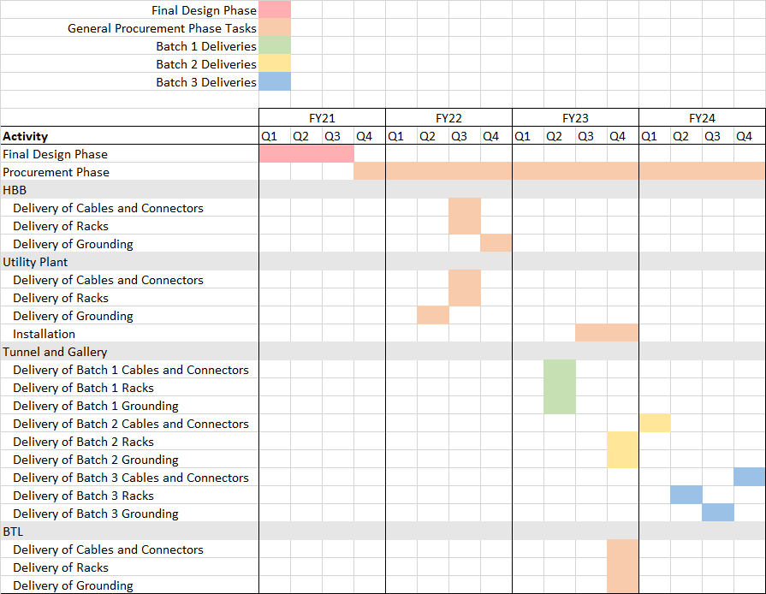
Schedule Summary – Procurement/Installation

Slide 21
Questions?

