Slide 1
Building Infrastructure Electrical PDR
Ryan Crawford
Preliminary Design Review
August 31, 2020

Slide 2
Outline – Part 1
AC Distribution
System Requirements
CF Infrastructure Scope
Linac Installation and Building Infrastructure Scope
Safety
Cable Plant
Documentation
Cable Counts
Pull Plans
Cable DB
QC
Risks

Slide 3
Outline – Part 2
Racks
Requirements
CF Space Planning
Current Design
Path Forward
Lessons Learned
LCLS-II (SLAC)
FRIB
PIP2IT

Slide 4
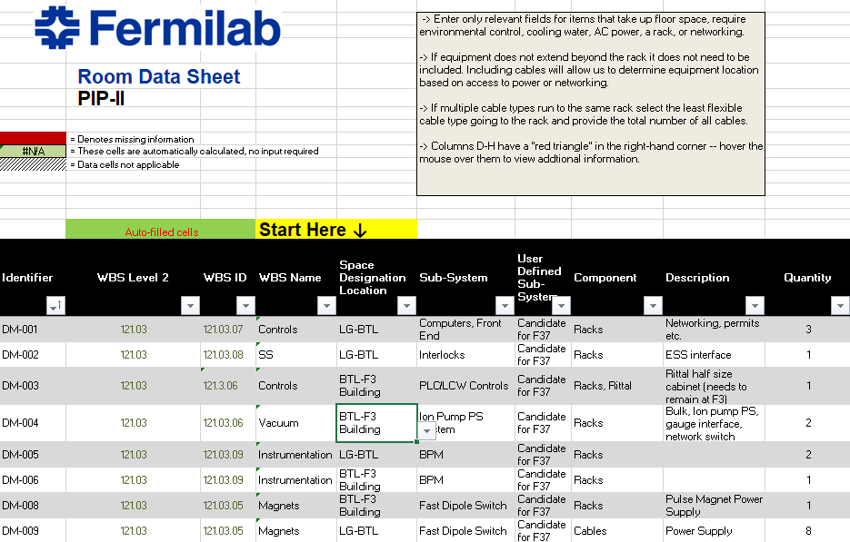
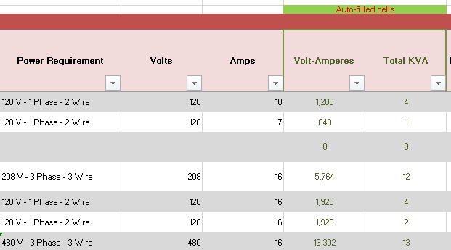
AC Distribution - Requirements
F-121.04.04-A012
F-121.04.04-A013
System Requirements captured in RDS
Controlled document in TeamCenter

Slide 5
AC Distribution - Requirements
F-121.04.04-A012
RDS Captures
Voltage, Current, PF, Single or Three Phase
Filtering Requirements
Backup Power requirements
Follow NEC code
NRTL ratings
Sizing
Keep clear areas
FESHM

Slide 6
AC Distribution – CF Infrastructure Scope
F-121.04.04-A012
Unit Sub Stations
3 MVA transformers with dual 1500 kVA secondaries in most cases
Design allows for phase shifting if necessary
Dry-Type
2x 2000A secondary breakers (LSIG protection) in most cases
Transformers that feed Amplifiers are connected via two motorized disconnect switches
Kirk Key
Allows for easy tunnel access
Amplifier controls powered via second feed
No interruption to controls work during access
Underground cable entry, Overhead cable way exit

Slide 7
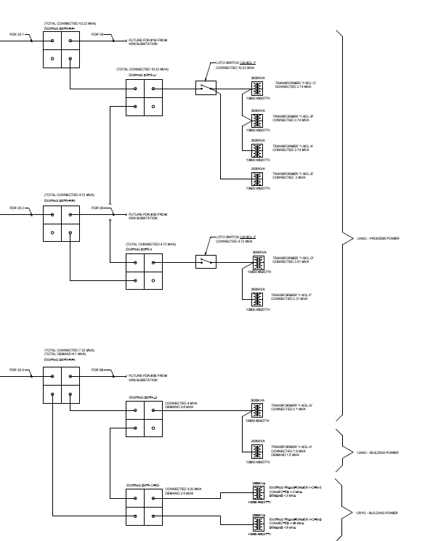
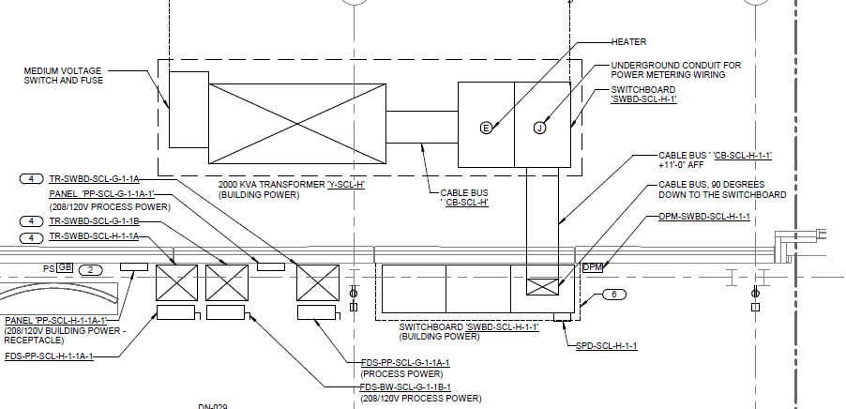
AC Distribution – CF Infrastructure Scope
F-121.04.04-A012

Slide 8
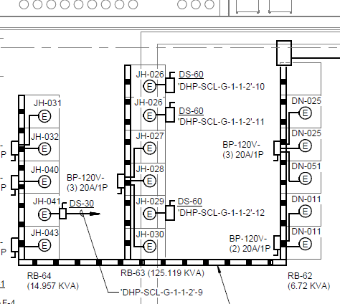
AC Distribution – CF Infrastructure Scope
F-121.04.04-A012
F-121.04.04-A013
208Y/120V Feeds
Most systems fed via Busway or Wireway with an occasional conduit fed system
Feeds sized from RDS and Rack Bank Sheet
Easily Expandable
Minimal Spares
Consistent approach
All feeds 3 Phase?

Slide 9
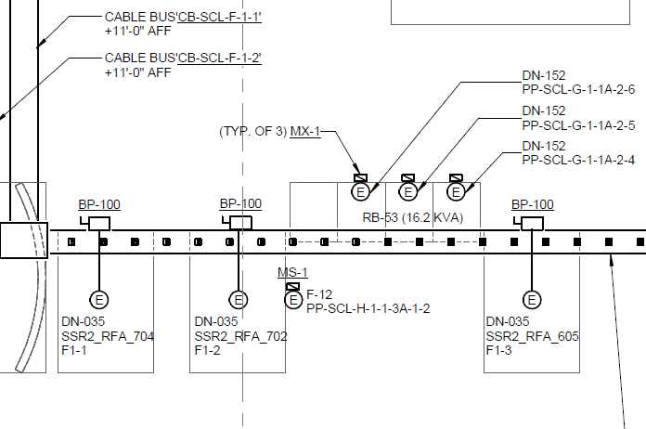
AC Distribution – CF Infrastructure Scope
F-121.04.04-A012
480Y/277V Feeds
Most systems fed via Busway or Wireway with an occasional conduit fed system
Power Supplies fed via Conduit
Feeds sized from RDS and Rack Bank Sheet
RDS Indicators added to CF drawings
Easily Expandable

Slide 10
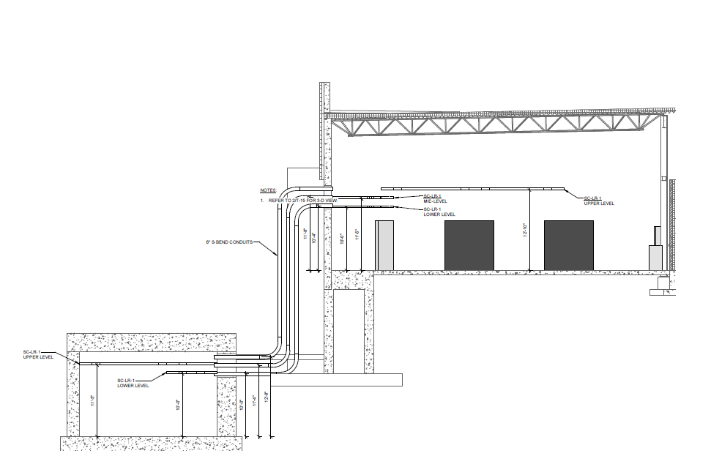
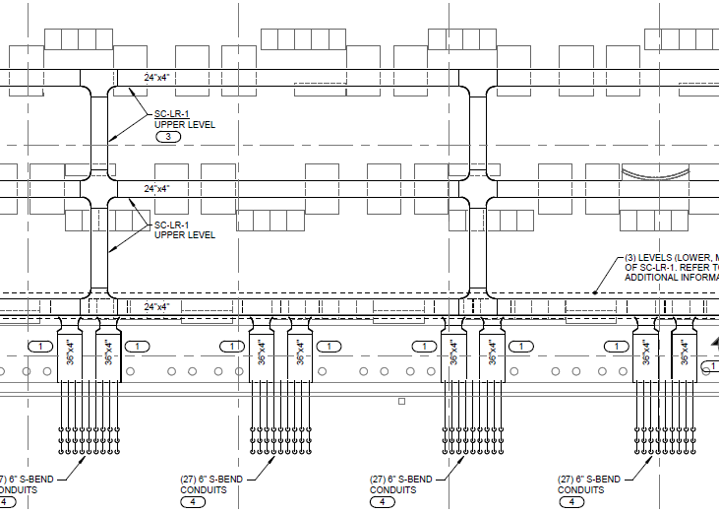
AC Distribution – CF Infrastructure Scope
F-121.04.04-A018
Cable Tray
All Cable Tray is provided by CF prior to Beneficial Occupancy
Multiple Levels along East Wall

Slide 11
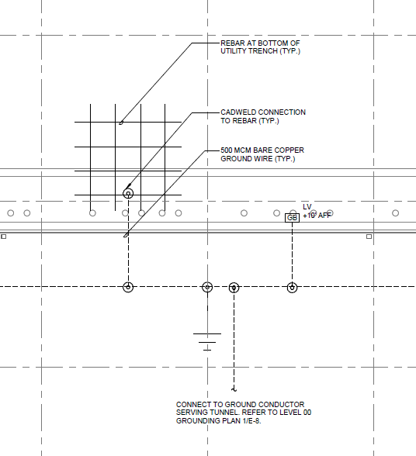
AC Distribution – CF Infrastructure Scope
F-121.04.04-A014
Ground
CF will provide a building ground
500 MCM ground will be available the entire length of the tunnel

Slide 12
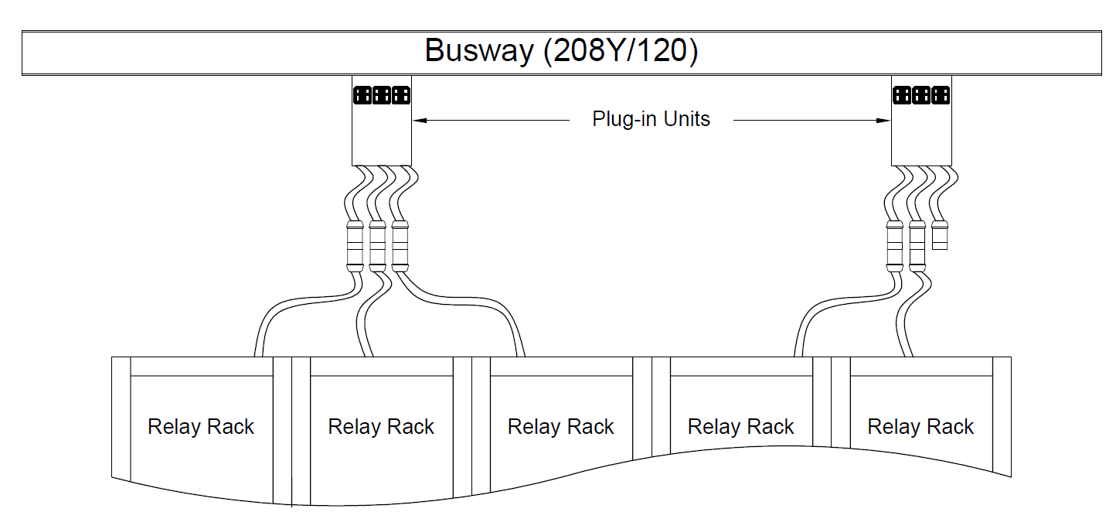
AC Distribution – LI/BldgI Infrastructure Scope
F-121.04.04-A012
Relay Racks
LI will manage plug and cord connections of relay racks, and 480V conduit and THHN feeds as necessary from the load side of the disconnect switch
Wireway will be used when necessary to minimize costs, but will be managed in the same way as busway

Slide 13
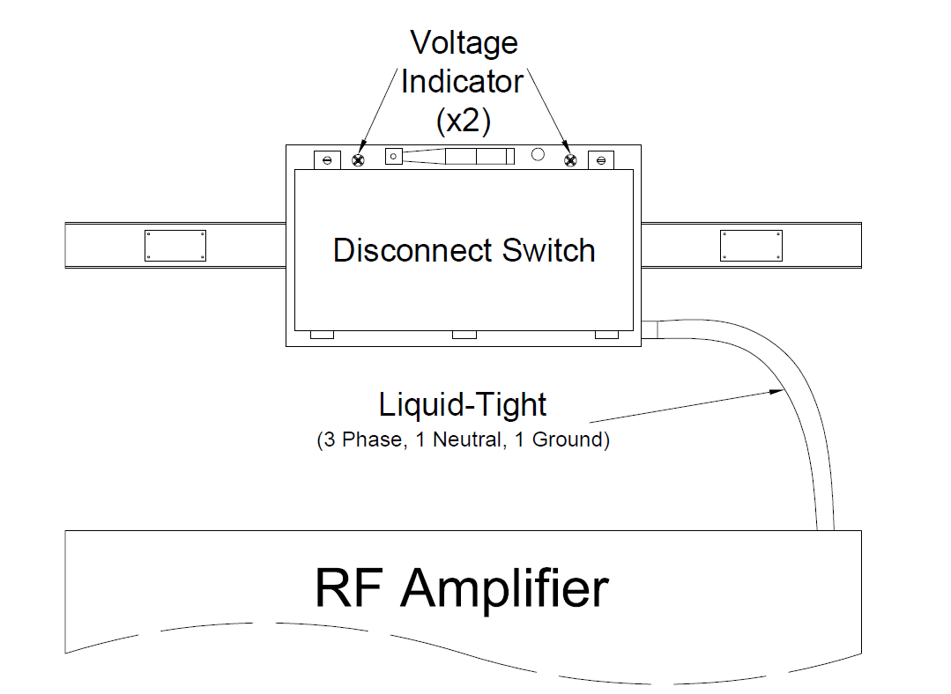
AC Distribution – LI/BldgI Infrastructure Scope
F-121.04.04-A012
Amplifiers
LI will install conduit/liquid-tight and THHN for amplifier loads from the load side of the disconnect switch

Slide 14
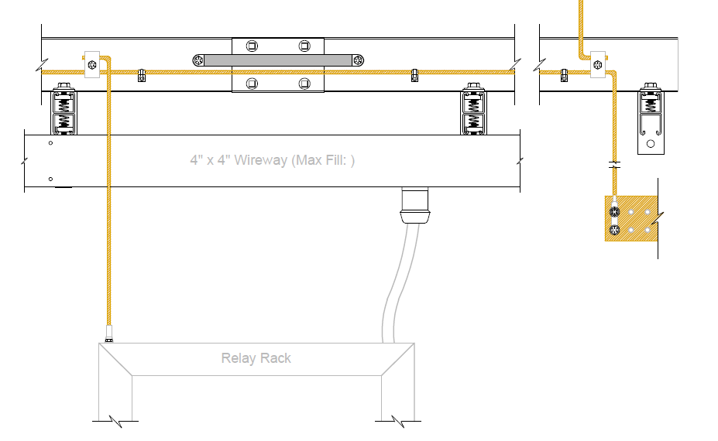
AC Distribution – LI/BldgI Infrastructure Scope
F-121.04.04-A014
F-121.04.04-A020
Ground
LI will attach grounding material provided by BldgI to the main CF trunk line
Any equipment likely to become energized must be grounded
Verify that grounds maintain metal to metal contact
CF Scope
BldgI and LI
Scope

Slide 15
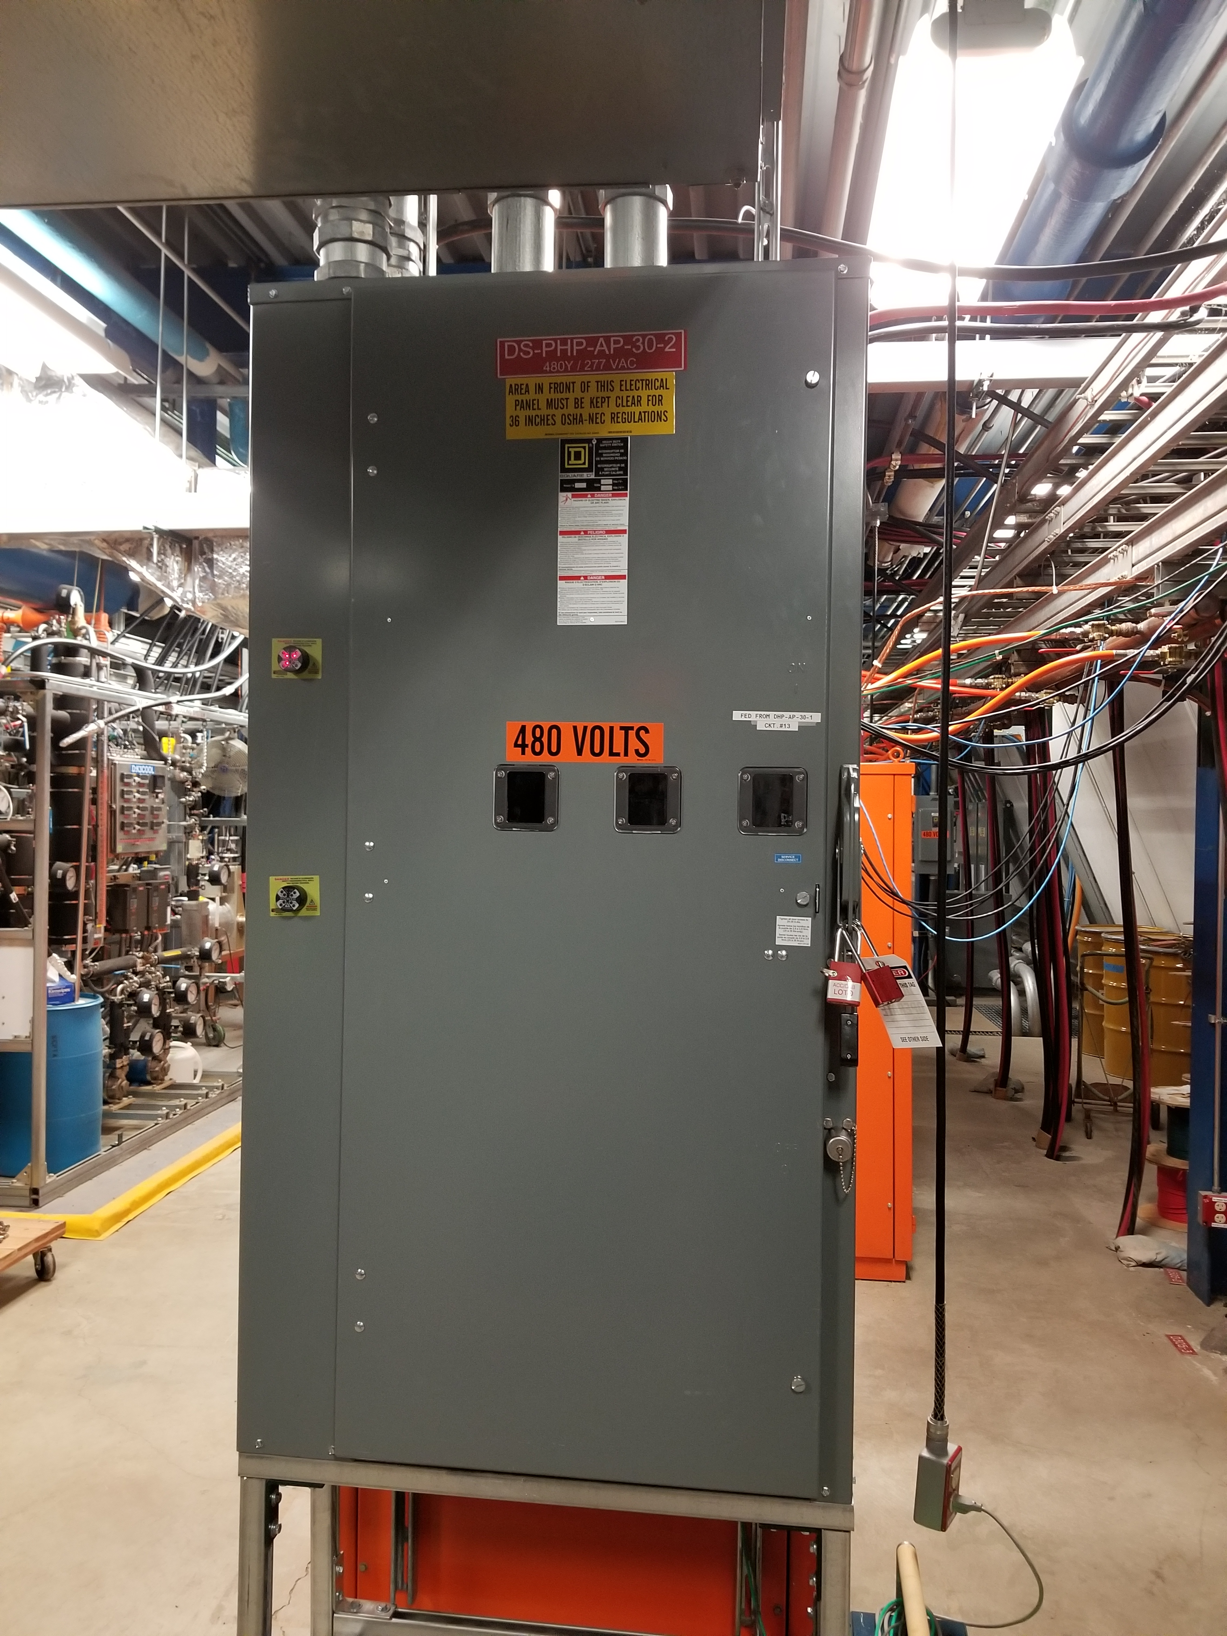
AC Distribution – Safety
F-121.04.04-A012
F-121.04.04-A014
LOTO
208Y/120V systems are almost exclusively plug and cord
Voltage indicators still in use at the termination box of the busway
480Y/277V systems will have voltage indicator and test points
Grounds
All cable tray grounds must be visible and easily traced back to building ground

Slide 16
Cable Plant – Documentation
F-121.04.04-A016
PIP-II-DocDB-2892: Cable Pull and Documentation Plan
Overall cable plant management document
Roles and responsibilities
Schedules
PIP-II-DocDB-2824: Standard Cable and Connectors
Formally lists material Building Infrastructure will purchase for L3 systems
Based on input from L3 systems
PIP-II-DocDB-3054: Cable Criteria
Formalizes cable requirements
PIP-II-DocDB-4900: Cable Scaling
Explains methodology behind current cable counts

Slide 17
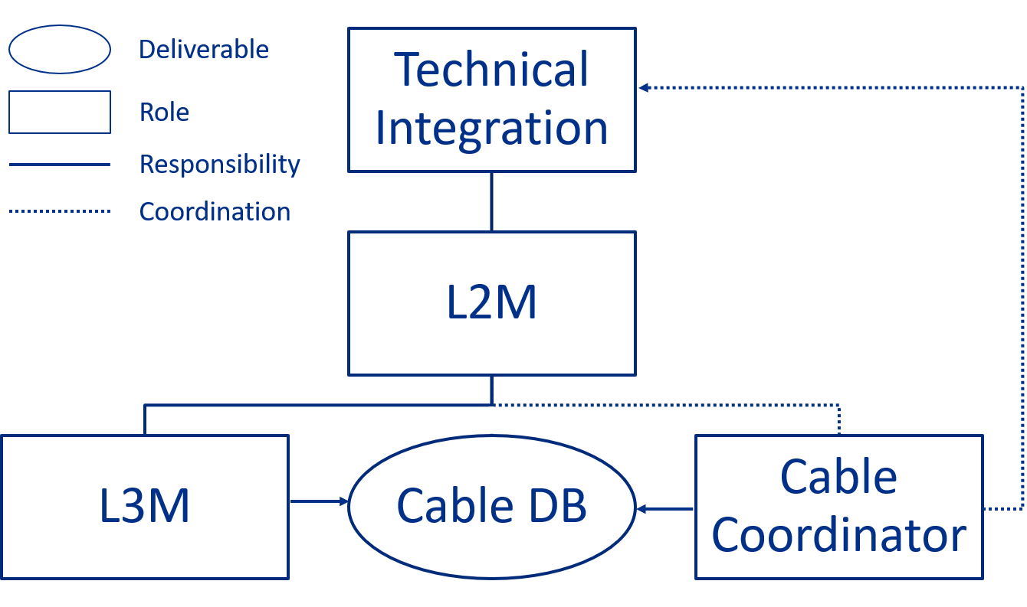
Cable Plant – Cable/Pull and Documentation Plan
F-121.04.04-A016
Cable DB Design and Entry Phase Responsibilities
L2Ms
Oversee DB design and L3 entries
L3Ms
Beta testers
Responsible party for cable entries
Cable Coordinator
Involved at every stage
Manages Cable DB
Technical Integration Team
Manages cable/cable DB issues that span multiple systems

Slide 18
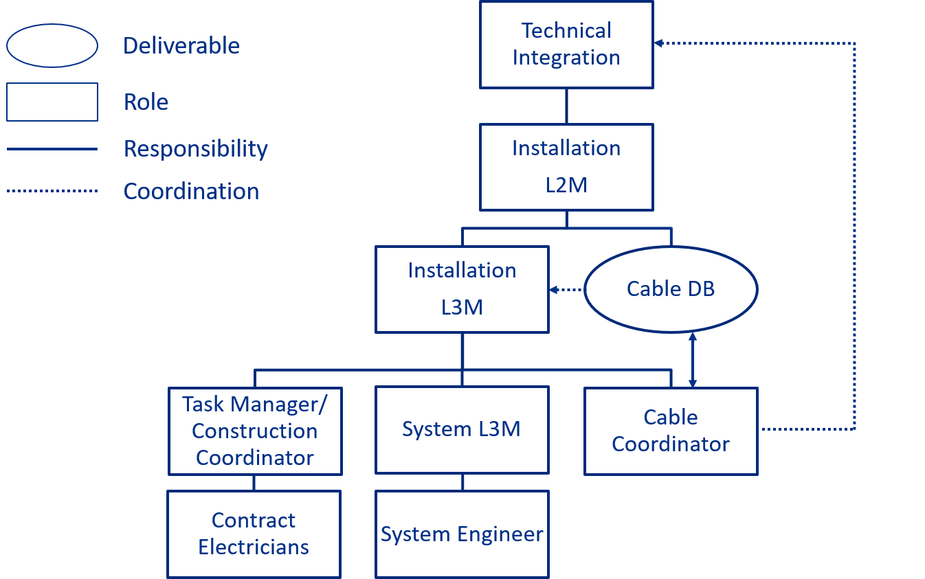
Cable Plant – Cable Pull/Documentation Plan
F-121.04.04-A016
Installation and Validation Phase
Technical Integration Team
Manages Installation or QC issues that span multiple systems
Track progress
Installation L2M
Review weekly roll up reports
Oversee Installation L3M
Assume duties if L3M unavailable
Installation L3M
Manages Installation
Review weekly roll up report
Alert TM/CC and Cable Coordinator if any issues arise
Assume Cable Coordinator role if they are unavailable

Slide 19
Cable Plant – Cable Pull/Documentation Plan
F-121.04.04-A016
Installation and Validation Phase
TM/CC
Manage contract electricians
Present issues to Cable Coordinator and Installation L3M
Contract Electricians
Responsible for cable pulls
Temporary labeling
Terminate load and network cables
Produce field markup drawings
L3Ms
Validate cable pulls
Present issues to Installation L3M, Cable Coordinator, and TM/CC

Slide 20
Cable Plant – Cable Pull/Documentation Plan
F-121.04.04-A016
Installation and Validation Phase
Sub System Engineer
Validate Cable Pulls
Alert L3M, TM/CC, Cable Coordinator of any issues
Manage technicians
Terminate cables
Label cables
Cable Coordinator
Hold weekly meetings with TI group
Single Point Contact for Cable DB
Provide weekly roll up reports
Print and deliver permanent cable labels
Perform QC checks at delivery
Document QC checks
Release material to Installation L3M
Provide training

Slide 21
Cable Plant – Cable Pull/Documentation Plan
F-121.04.04-A016
Schedule
Request more cable and connector information at 60% CF drawing milestone
Reevaluate tray fill
Reevaluate penetration fill
Finalize cable and connector types by CF 90% drawings

Slide 22
Cable Plant – Standard Cable/Connectors
F-121.04.04-A016
Cable
Tracks common cable types
L3M input
PIP2IT
Provides link to datasheets
Cable not shown in this document is considered “special”
Connectors
Track common connectors
Only show one “gender” and/or type
Need to expand
Provides link to datasheets

Slide 23
Cable Plant – Cable Criteria
F-121.04.04-A016
Ratings
Presents NEC guidelines and references
Ampacity
Voltage
Tray Rating
UV Rating
Vertical Flame Tests
Connector Ratings
Fermilab Requirements
Color Code
Low Smoke Zero Halogen

Slide 24
Cable Plant – Cable Scaling
F-121.04.04-A016
F-121.04.04-A018
Methodology
Based on CMTF Cable DB
Need to validate against PIP2IT now that all cables are pulled for HWR and SSR1 prototype
Location | Count | Comments
PIP2IT WFE | 752 | CMTF Cable DB
CMTS1 | 884 | CMTF Cable DB
Location | Count | Comments
Scaled PIP2 | 17,825 | Total Count: 19,411
Super conducting LINAC Power Cables | 309
BTL Signal Cables | 1,145
BTL Power Cables | 132
Location | Count | Comments
BOE Signal Cables | 19,221 | Per CD-2 Total Count: 19,662
BOE Power Cable Count | 441 | Per CD-2

Slide 25
Break

Slide 26
Cable Plant – Pull Plans
F-121.04.04-A018
Tray
Sensitive equipment is located nearest to the tunnel entrance
3 levels
Power, Clean Signal, General Signal
Minimize long runs by locating equipment in gallery near the equipment it feeds in the tunnel
Tray will be installed with a cantilever support
Trapezes will be used only where necessary
Label all sections of tray for easy tracking
Develop and track weekly pull plans in Cable DB
Everyone involved has real time updates
Write privileges limited to Installation L3M, Cable Coordinator and TM/CC

Slide 27
Cable Plant – Pull Plans
F-121.04.04-A018
Tray Sizing
Spreadsheet developed
Checks NEC requirements based on tray usage
For instance : power cable may only allow for width of the tray and % fill plays no role
Based on BOE counts
Alerts if 20% overhead is not maintained
Can account for different tray sizes and automatically adjusts
Can account for control fiber Panduit
Uses 4” of available tray width
Checks and tracks weight per linear foot

Slide 28
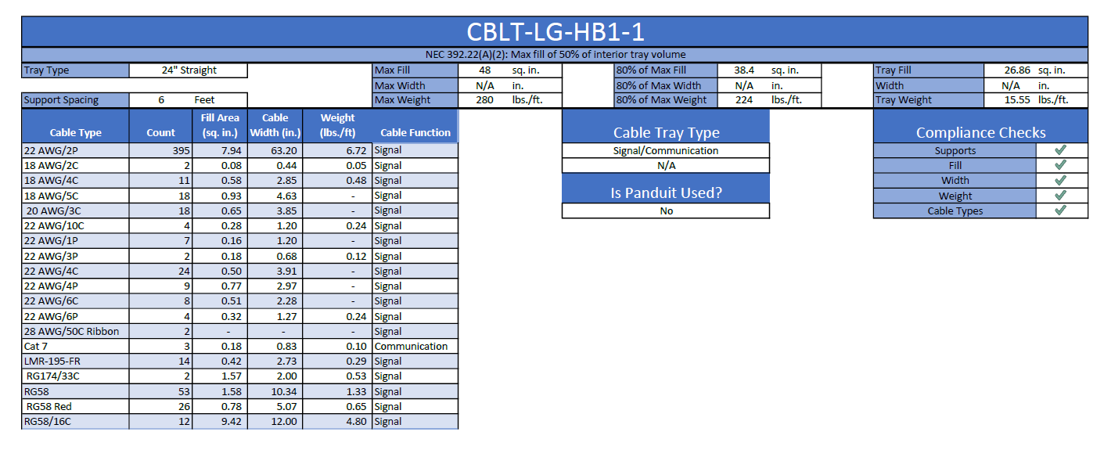
Cable Plant – Pull Plans
F-121.04.04-A018
Tray Sizing
Different sheet for each cryomodule section and the BTL
BTL currently presents problems, but building F37 will elevate many if not all tray concerns

Slide 29
Cable Plant – Pull Plans
F-121.04.04-A018
Penetration Sizing
Handled in much the same way as tray
Power cables must be de-rated manually
Hoping to account for this soon

Slide 30
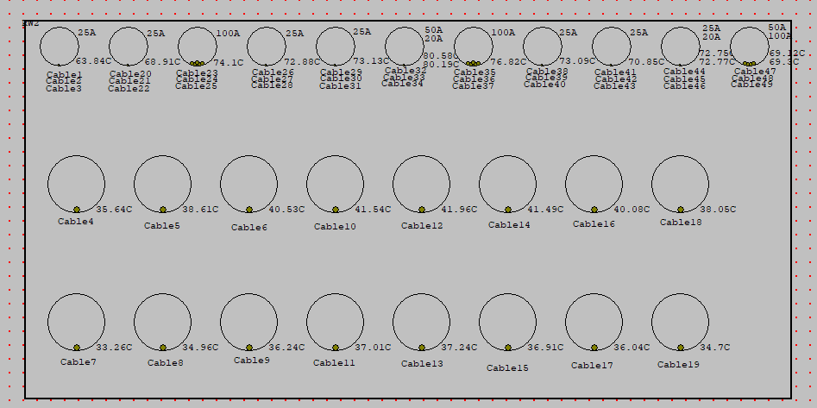
Cable Plant – Pull Plans
F-121.04.04-A018
Penetration Heating
Using ETAP to minimize inadvertent heating issues
Heating from power supply cables may be problematic for LLRF

Slide 31
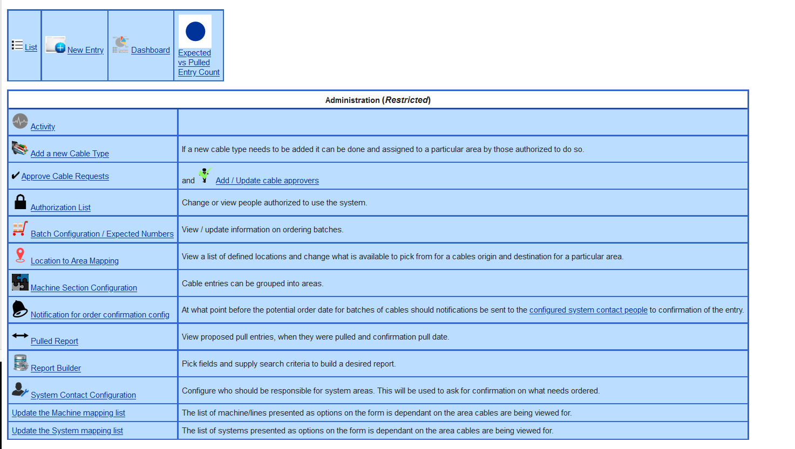
Cable Plant – Cable DB
F-121.04.04-A015

Slide 32
Cable Plant – Cable DB
F-121.04.04-A015
List
Track approvals, status, type, origin, destination, route
Search entire database

Slide 33
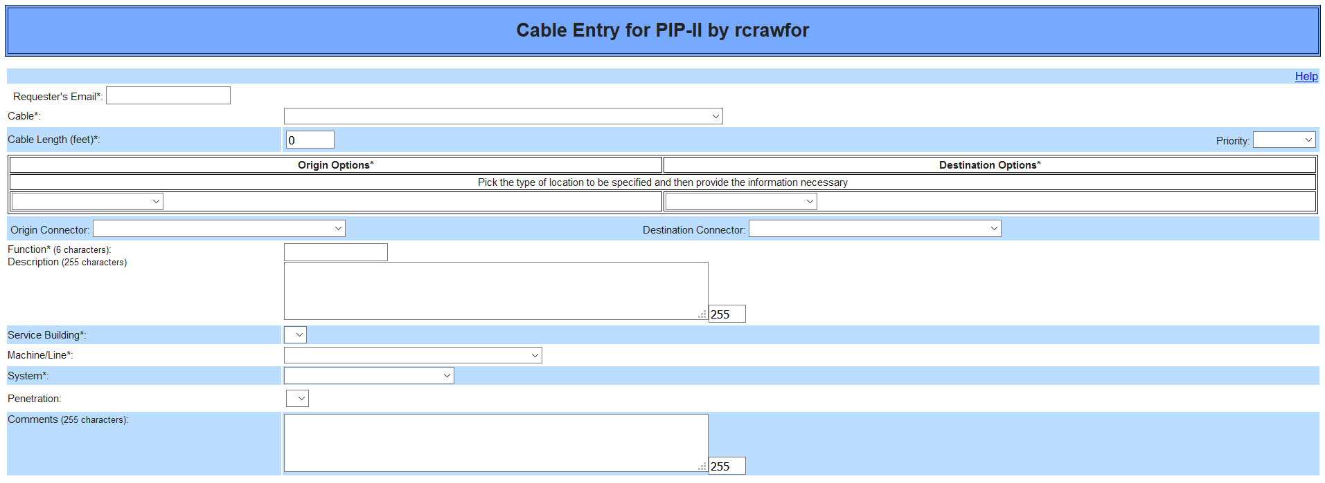
Cable Plant – Cable DB
F-121.04.04-A015
New Entry
Allows users to add information to the DB

Slide 34
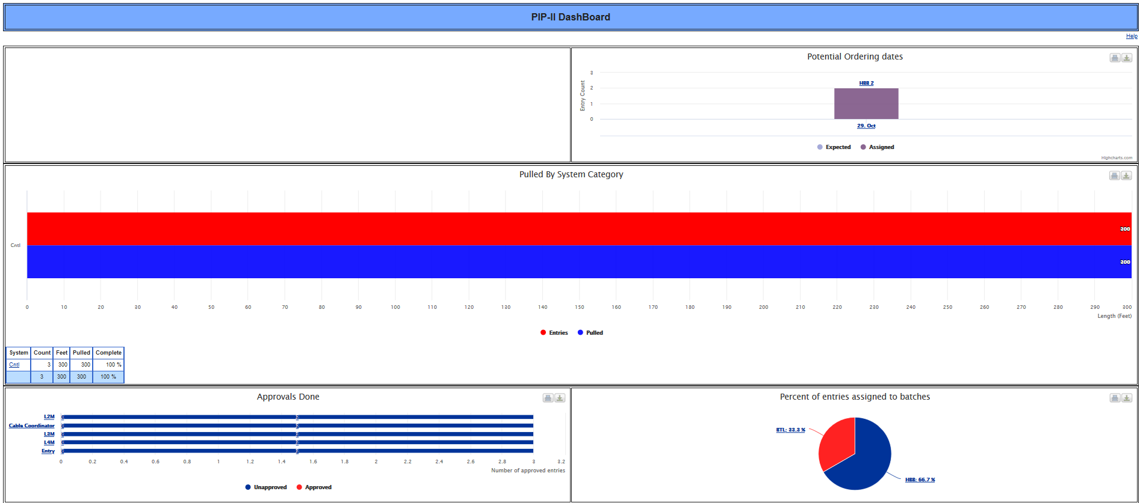
Cable Plant – Cable DB
F-121.04.04-A015
Dashboard
Real time graphs for important information

Slide 35
Cable Plant – Cable DB
F-121.04.04-A015
Batch Tracking
Lock out dates
Procurement tracking

Slide 36
Cable Plant – Cable DB
F-121.04.04-A015
Pull Planner
Allows for pull plans that are accessible by everyone
Real time updates
Everyone works from the same information

Slide 37
Cable Plant – Cable DB
F-121.04.04-A015
Report Builder
Allows for quick weekly roll up reports
Allows for custom reports

Slide 38
Cable Plant – QC
F-121.04.04-A016
Delivery
Cables
Visual inspection with two individuals
Continuity check with length meter or multimeter
Validate part numbers against PO
Validate lengths against PO
Connectors
Visual inspection with two individuals
Validate part numbers against PO
Validate count against PO
Only check a certain % in each package, but inspect every package
Installation
Multiple checks of pulled cable
Both Fermilab and Contractor Checks
Single Point contacts provided for quick issue resolution

Slide 39
Cable Plant – QC
F-121.04.04-A016
F-121.04.04-A017
Travelers
Being developed for Cable, Connectors, Racks
Master Tracking Spreadsheet
Tracks PO’s, Inspections, Travelers, Status, etc.
Building Infrastructure Materials QC Plan
QC Plan drafted and submitted for peer review
Adheres to Linac Installation & Commissioning QA Plan (PIP-II-doc-2611)

Slide 40
Cable Plant – Risks
F-121.04.04-A016
Long Lead Times
Lots of time built into schedule
Cable DB tracks cables that may be problematic
Installation issues
Allow for flexible pull plans
Everyone works from a database that is updated constantly
Single point contacts for quick resolutions
Material Damage
Schedule allows for time to replace damaged cable
Strong QC plan will be crucial to minimize disruptions due to material damage
Cable will be stored near installation site to minimize transportation risks on site

Slide 41
Racks – Requirements
F-121.04.04-A012
F-121.04.04-A013
RDS Captures Requirements
Quantity
Power requirements
Filtering requirements
Water requirements
System owners
Space requirements
Independent Rack Layout Worksheet (Next Slide)
Used to validate RDS entries
Individual systems are responsible for populating
Managed by Cable Coordinator

Slide 42
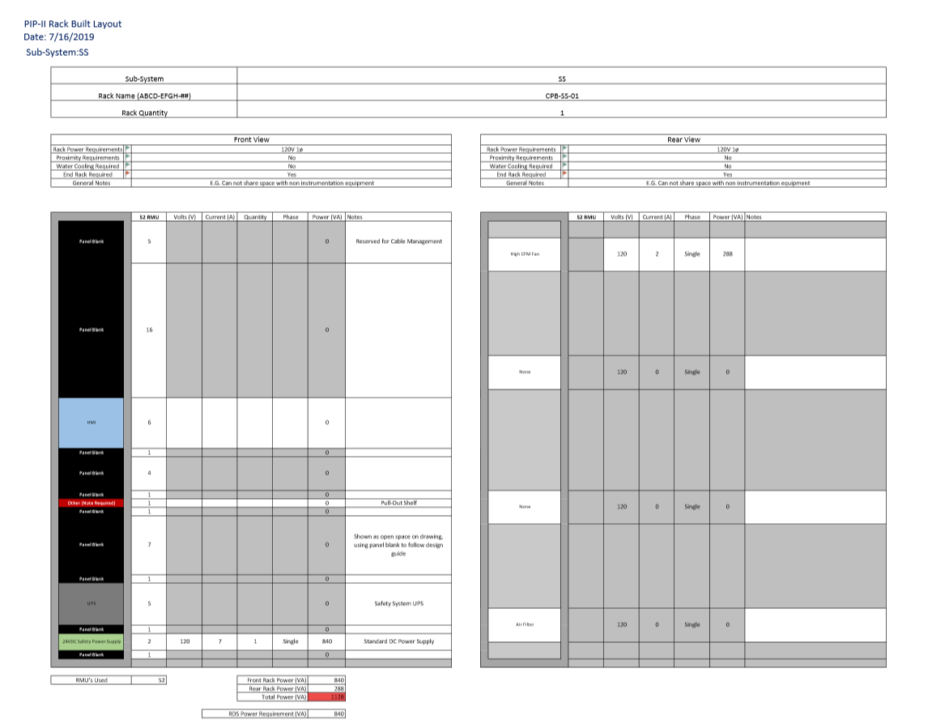
Racks – Requirements
F-121.04.04-A012
F-121.04.04-A013
Rack layout worksheet
Used to validate rack counts, location, and power draws
Coded alerts to flag possible problems or issues that need review
End-rack required?
Multiple power sources
Liquid cooling
Proximity requirements
Any other special concerns
Title block
Front rack view
Rear rack view
Total rack power requirement

Slide 43
Racks – CF Space Requirements
F-121.04.04-A012
F-121.04.04-A013
Space Allocation Meeting
Weekly meeting between multiple L3 systems to discuss space requirements
LI group builds a 3D model based on these meetings and passes this information to the CF A/E firms
Group Meetings
Will be used to allocate rack space
Location requirements
Space sharing concerns
Each L3 system will be able to review and comment on applicability for their system
Current Allocation
First pass complete based on information from L3 systems
Information was used to form Rack Bank tracking spreadsheet
Relates every rack requirement back to the RDS

Slide 44
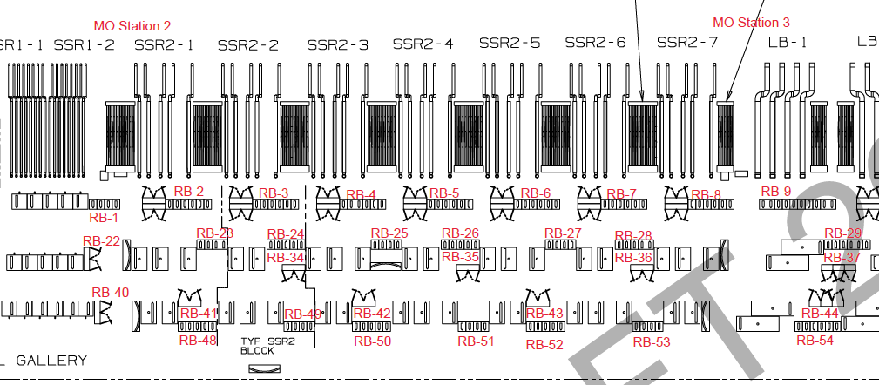
Racks – CF Space Requirements
F-121.04.04-A012
F-121.04.04-A013
LI Model
Used to layout space based on RDS
Information passed to A/E Firms

Slide 45
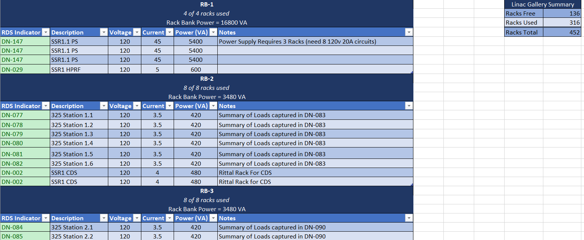
Racks – CF Space Requirements
F-121.04.04-A012
F-121.04.04-A013
Rack Bank Spreadsheet
Linked back to LI Model
Will be used to allocate space moving forward

Slide 46
Racks – Current Design
F-121.04.04-A017
Rack Specification
In process
52 RMU
Tool-less, plated, and marked support rails
Support Shelves
Top, Bottom, Rear, and Side Panels
Heavy-Duty construction with transportation pallet
Grounding and Bonding Requirements
LED Lighting
Ganging Kits
PDU Mounting Rail
Cable management

Slide 47
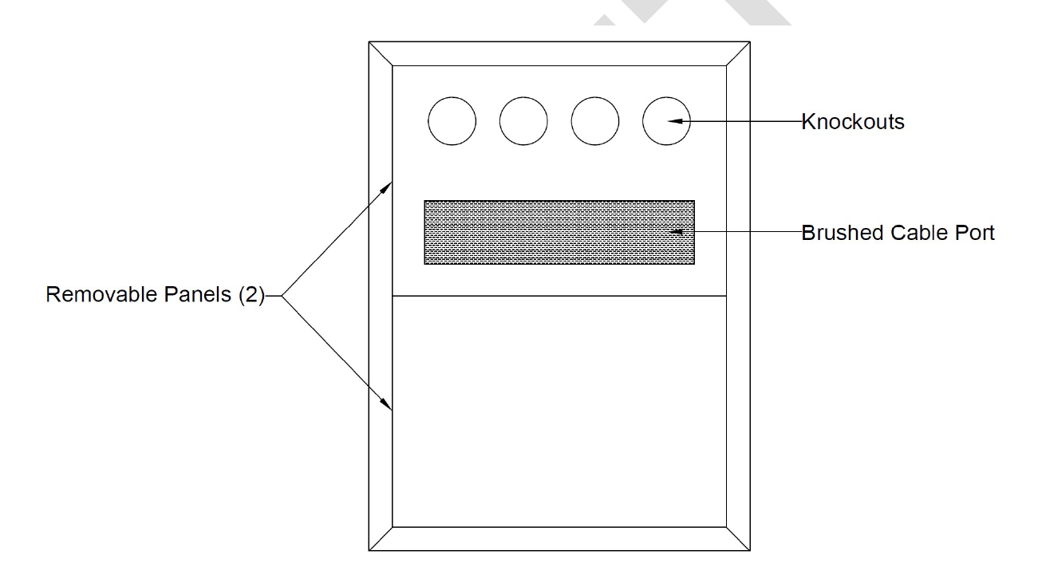
Racks – Current Design
F-121.04.04-A017

Slide 48
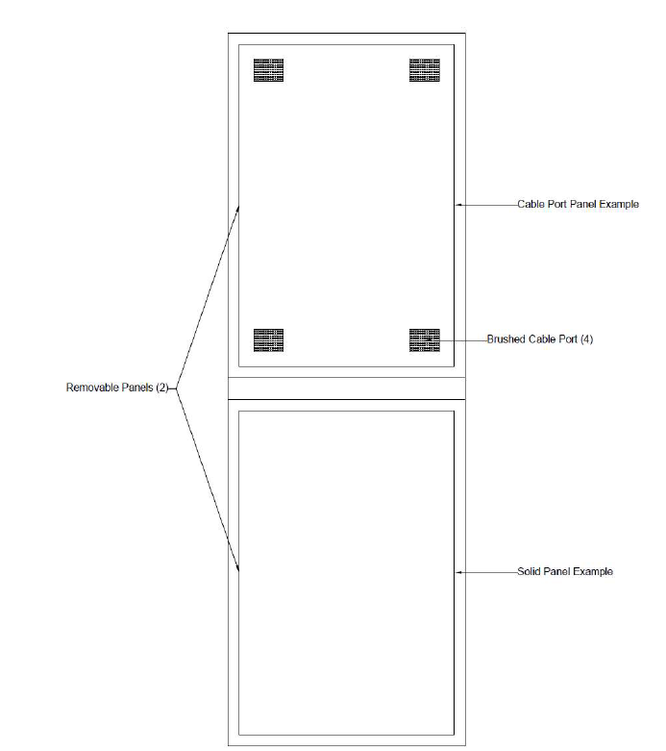
Racks – Current Design
F-121.04.04-A017

Slide 49
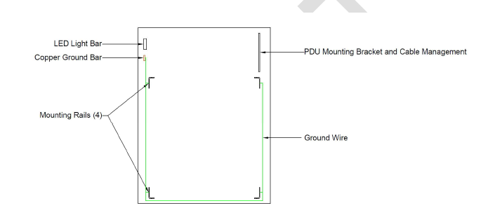
Racks – Current Design
F-121.04.04-A017

Slide 50
Racks – Path Forward
F-121.04.04-A017
Rack Working Group
Receiving input and specification assistance from multiple systems
LLRF
Instrumentation
Power Supplies
Controls
Purchase a prototype rack
Allow system users to provide feedback
Modify specification

Slide 51
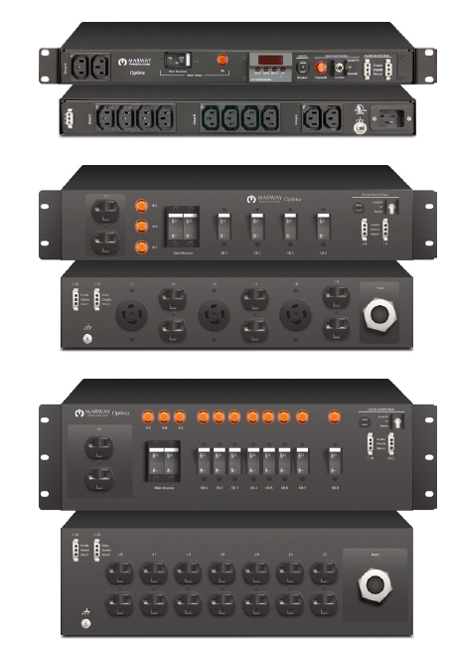
Racks – Path Forward
F-121.04.04-A017
Consider new Filtered PDU
Allows for 3 phase power in, custom outputs
Filtered
Individually protected outlets on the front
Minimize accidental trips from test equipment, cleaning crews, etc.
Allows for recessed installation for added protection
*Image from Marway Power Solutions
PDU datasheet

Slide 52
Lessons Learned - SLAC
Cables must have an owner that is outside of the A/E Company
Cable Coordinator is responsible for the cable plant
Fermilab has oversight capabilities and responsibilities for QC
Fully Integrate with CF
Cable Coordinator is involved with CF via weekly meetings
Cable Coordinator holds smaller meetings with system owners
Manage Cable DB continuously
Cable DB is real time
Allow for plan routing of cables
3D models early on
A/E is developing a 3D model with input from LI L3M
Managed via weekly space allocation meetings

Slide 53
Lessons Learned - FRIB
Contractor only received copy of DB once a month
Real time Cable DB
Contractors will have Read and “Mark as Pulled” capabilities
Let Contractor purchase and manage cables
Exploring this option
Fermilab oversight is a must
Schedules must be developed with input from multiple individuals
LI L3M
LI L2M
Contractor
Give contractor cable information up front
Crafted a standard cable and connector document
Will provide special cable information when needed

Slide 54
Lessons Learned – PIP2IT
Maintain consistent labeling
Added scope to account for cable labeling
Names must be agreed upon early
Minimize/Eliminate name changes when installation is occurring
Consider having individual pulls cut to length
This has worked well across the laboratory
Currently evaluating vs. bulk spooling

