Slide 1
monochromatized collisions for s-channel e⁺e⁻ → Higgs production at FCC-ee
Marco Alan Valdivia, U. Guanajuato
Angeles Faus-Golfe, IJClab
Frank Zimmermann, CERN
thanks to Alain Blondel, Anton Bogomyagkov, David d’Enterria, Dima El Khechen, Patrick Janot, Eugene Levichev, Katsunobu Oide, Dmitry Shatilov, Valery Telnov, Alexander Zholents
Snowmass21 EF01 Meeting
2 September 2020

Slide 2
monochromatization - history
A. Renieri, “Possibility of Achieving Very High Energy Resolution in e+e− Storage Rings”, Frascati, Preprint INF/75/6(R) (1975).
A.A. Avdienko et al., “The Project of Modernization of the VEPP-4 Storage Ring for Monochromatic Experiments in the Energy Range of Ψ and Υ Mesons”, HEACC’83 (1983) 186.
K. Wille, A.W. Chao, “Investigation of a Monochromator Scheme for SPEAR”, SLAC/AP-32 (1984).
M. Jowett, “Feasibility of a Monochromator Scheme in LEP”, CERN LEP Note 544 (1985).
A. A. Zholents, “Sophisticated Accelerator Techniques for Colliding Beam Experiments”, Nuclear Instruments and Methods in Physics Research A265 (1988) 179-185
Yu.I. Alexahin, A. Dubrovin, A.A. Zholents, “Proposal on a Tau-Charm Factory with Monochromatization”, EPAC90, Nice, France, 1 2–16 June 1990, pp. 398
A. Zholents, “Polarized J/Ψ Mesons at a Tau-Charm Factory with a Monochromator Scheme”, CERN SL/97-27, June (1992).
A. Faus-Golfe and J. Le Duff, “Versatile DBA and TBA Lattices for a Tau-Charm Factory with and without Beam Monochromatization”, Nucl. Instr. Methods A 372 (1996) 6–18.
A. Faus-Golfe, M. A. Valdivia Garcia, and F. Zimmermann, “Towards a Monochromatization Scheme for Direct Higgs Production at FCC-ee”, IPAC2016 Conference, Busan, Korea (2016)
A. Bogomyagkov and E. Levichev, “Collision Monochromatization in e+e− Colliders”, Phys. Rev. Accel. Beams 20, 051001 (2017).
M. A. Valdivia Garcia, F. Zimmermann, “Effect of emittance constraints on monochromatization at the Future Circular e+e− Collider”, IPAC2019 Melbourne (2019)
V. Telnov, “Monochromatization of e+e− colliders with a large crossing angle” 31.08. 2020
several studies, but
never used in any real machine;
new feature for FCC: beamstrahlung

Slide 3
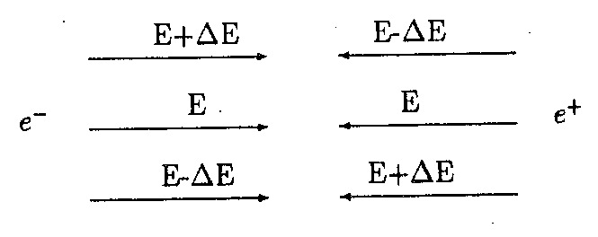
mono-chromatization for direct Higgs production
e⁺e⁻→H at FCC-ee
one concept: introduce antisymmetric dispersion at the collision point
rel. collision energy spread
for standard conditions
$${\left(\frac{σ_{W}}{W}\right)}_{\text{standard}}=\frac{σ_{δ}}{\sqrt{2}}$$
rel. collision energy spread
w. monochromatization
$${\left(\frac{σ_{W}}{W}\right)}_{\text{m}\text{.}\text{c}\text{.}}=\frac{σ_{δ}}{\sqrt{2}}\frac{1}{λ}$$
monochromatization
factor
$$λ=\sqrt{\frac{D_{x}^{∗2}σ_{δ}^{2}}{ε_{x}β_{x}^{∗}}+1}$$
in LEP(-1) bunch train operation created unwanted antisymmetric vertical dispersion (G. Wilkinson, Rome), ε_{y}$\sim$400 pm, β_{y}*=50 mm, σ_{δ}=0.07%, D_{y}*$\sim$2 mm:→ λ$\sim$1.05

Slide 4
effect of beamstrahlung (BS) on transverse emittance
BS : synchrotron radiation emitted during collision
blow up of energy spread and bunch length
- in particular:
$$D_{x}^{∗}≠0→Δε>0$$
two coupled nonlinear equations determine equilibrium emittance and energy spread:
nonlinear
function of σ_{δ,tot} and ε_{x,tot}
λ
$$σ_{z,tot}=\frac{α_{C}C}{2πQ_{s}}σ_{δ,tot}$$
$$n_{γ}〈u^{2}〉∝\frac{N_{b}^{3}γ^{2}}{σ_{z}^{2}σ_{x}^{3}}$$
M.A. Valdivia Garcia
F. Zimmermann
https://arxiv.org/abs/1911.03420

Slide 5
baseline monochromatization scheme for FCC-ee
like the classical Renieri scheme, but with dispersion in x, not y;
larger x-size helps reduce beamstrahlung, & preserves y emittance;
we try to maintain (or modify as little as possible)
the IR geometry; physics operation also requires many bunches;
→ keep 30 mrad crossing angle
implementing this scheme requires crab cavities
RF crab cavities (KEKB, HL-LHC, EIC…) rotate bunches so that they collide effectively head on
dispersion at IP, D_{x}*, increases the horizontal IP beam size and ensures monochromatization;
we need to determine optimum way to generate D_{x}* (incl. impact geometry)

Slide 6
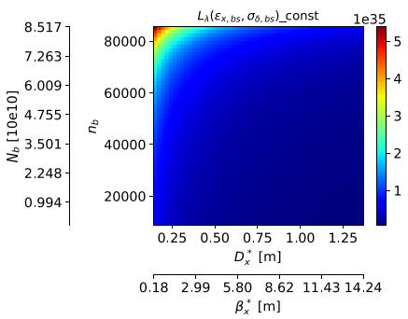
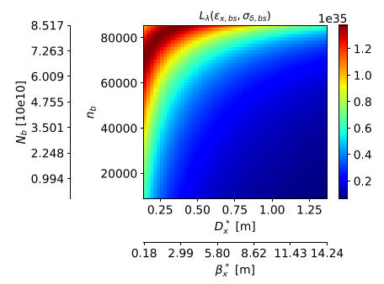
optimization, different assumptions on vert. emittance
scan two parameters S & T: $D_{x}^{∗}=S×D_{x,0}^{∗}$, $β_{x}^{∗}={S^{2}×β}_{x,0}^{∗}$, $n_{b}=n_{b,0}×T$, $N_{b}=N_{b,0}/T$
luminosity including beamstrahlung eﬀects
$$ε_{y, }=\text{const}.$$
$$ε_{y}=κ_{ε}ε_{x}$$
vert. emittance due to residual dispersion or limited by the resolution limit of the available diagnostics, e.g. X-ray interferometer and BPM responses
vertical emittance dominated by residual betatron coupling
M.A. Valdivia, F.Z., IPAC’19

Slide 7
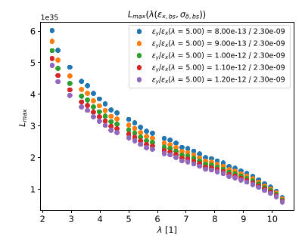
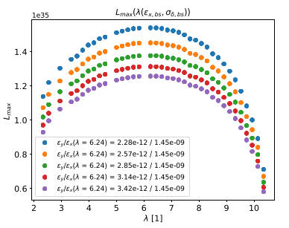
luminosity with beamstrahlung vs λ for the two cases
$$ε_{y, }=\text{const}.$$
$$ε_{y}=κ_{ε}ε_{x}$$
example: pick λ$\sim$5, $σ_{W}≈6 \text{MeV}$
M.A. Valdivia, F.Z., IPAC’19

Slide 8
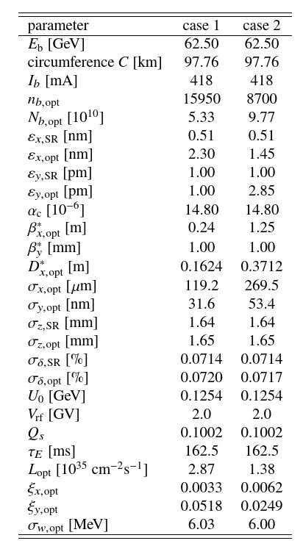
optimized monochromatized parameters for $σ_{W}≈6 \text{MeV}$
M.A. Valdivia, F.Z., IPAC’19

Slide 9
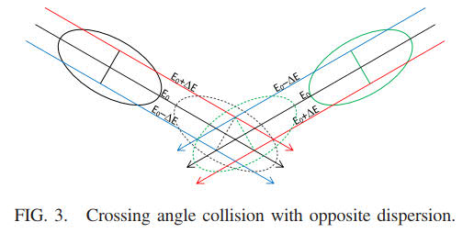
other monochromatization schemes 1:
A. Bogomyagkov, V. Levichev, 2017
PRAB 20, 051001 (2017)

Slide 10
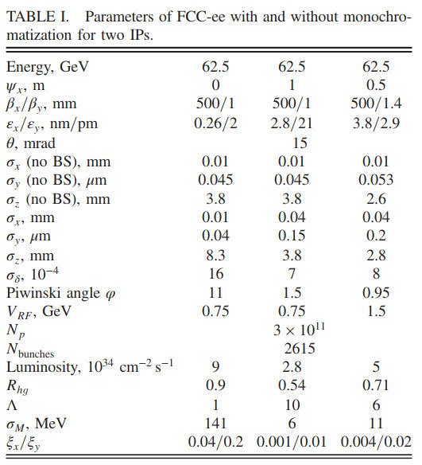
other monochromatization schemes 1 – applied to FCC-ee
A. Bogomyagkov, V. Levichev, 2017
total luminosity
(sum of 2 IPs)
$\sim$6x10³⁴ cm⁻²s⁻¹
with σ_{W}$\sim$6 MeV
PRAB 20, 051001 (2017)

Slide 11
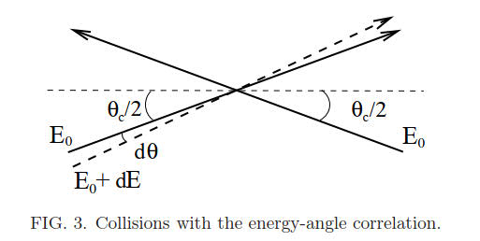
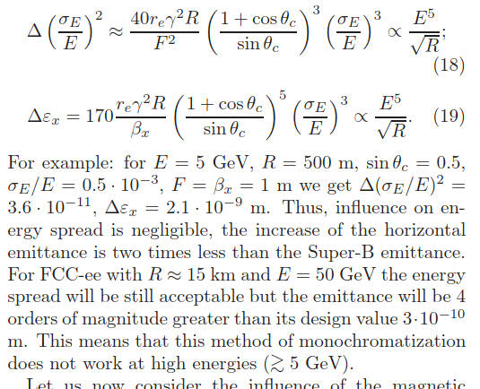
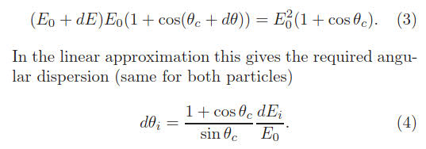
other monochromatization schemes 2: angular IP dispersion
V. Telnov, 31 August 2020,
arXiv 2008.13668
requires large crossing angle,
may not work >5 GeV (?)

Slide 12
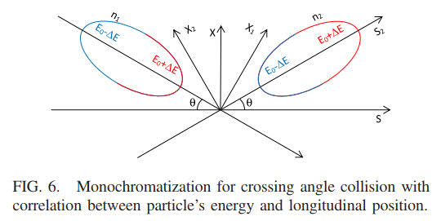
other monochromatization schemes 3: strong RF focusing
A. Bogomyagkov, V. Levichev, 2017
requires large RF voltage and/or high synchrotron tune, challenging >5 GeV (?)
PRAB 20, 051001 (2017)

Slide 13
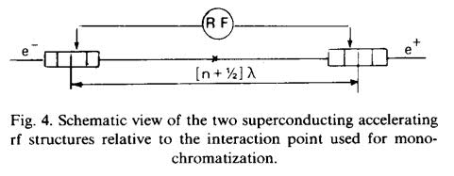
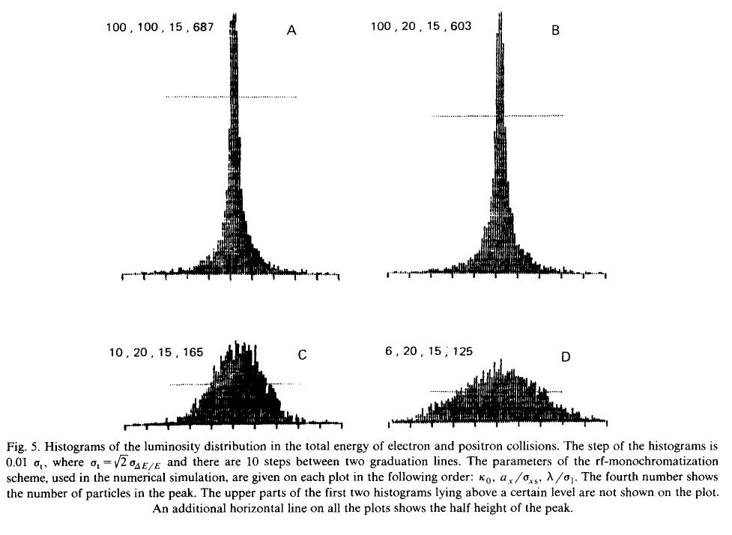
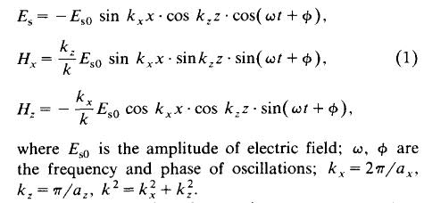
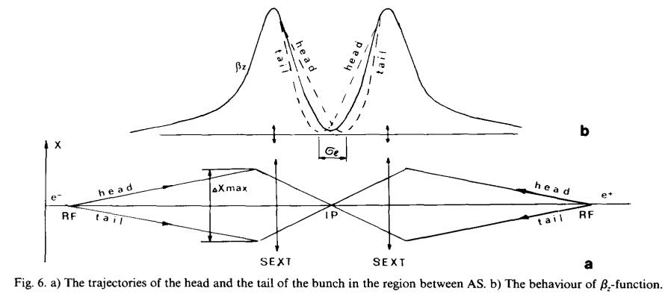
other monochromatization schemes 4: SC cavity upstream of IP
TM₂₁₀ cavity
A. Zholents, NIM A 265 (1988) 179
dispersion at RF cavity;
true reduction of beam
energy spread at IP
can crab cavities be used?
RF voltage? side effects?

Slide 14
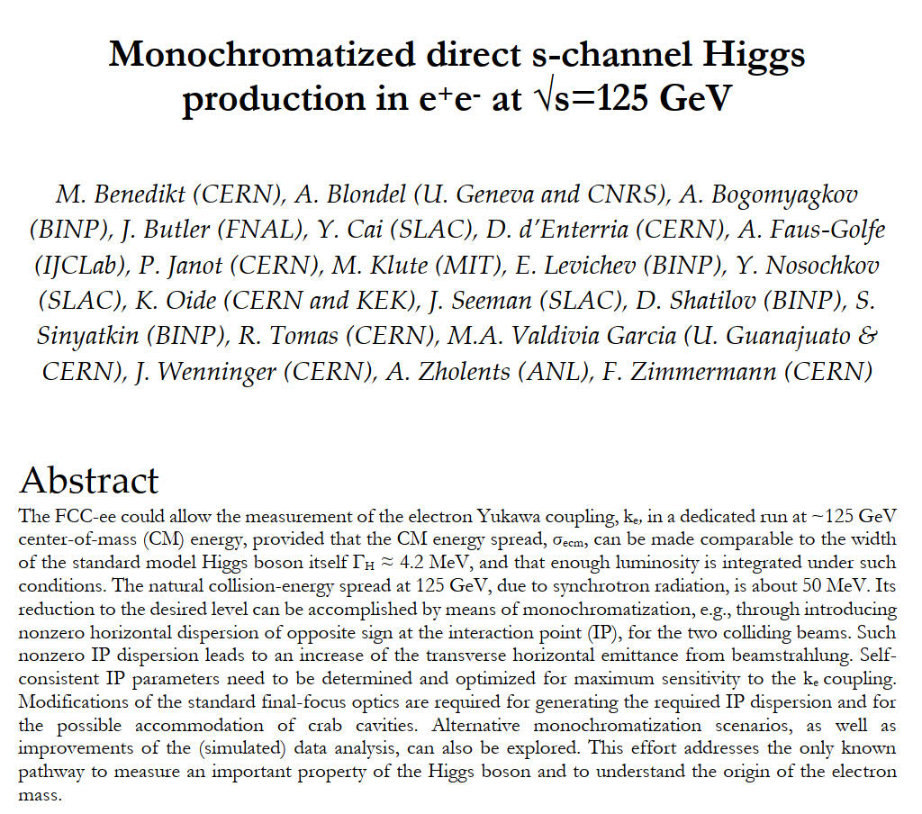
Snowmass2021 Letter of Interest

Slide 15
a few conclusions
several approaches exist to achieve monochromatized s-channel
Higgs production at FCC-ee, with e.g. L$\sim$10³⁵ cm⁻²s⁻¹ , or higher,
at σ_{W}$\sim$6 MeV - is this of interest for physics? how should we optimally trade off luminosity and energy spread?
there are quite a number of monochromatization approaches –
the latest proposal (Telnov) appeared on arXiv this Monday
crab cavities needed in the monochromatization baseline could
also be used for the Zholents scheme; perhaps a combination of
these schemes would be optimum
we are assembling a stronger team (CERN, Guanajuato, IJCLab, ANL, SLAC,…) to address open questions – notice great interest in our LOI
we are looking forward to advance in the frame of Snowmass’21

