Slide 1
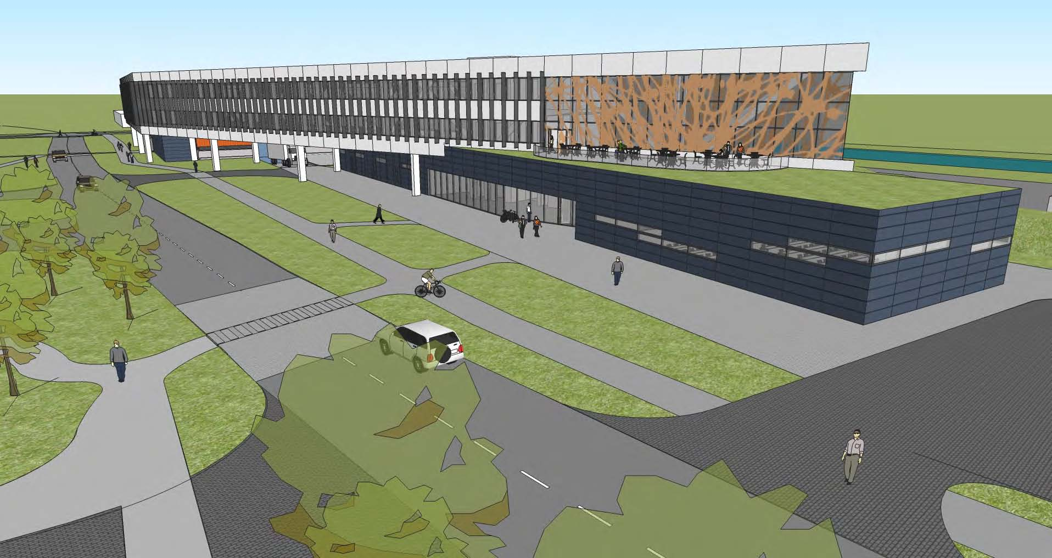
OTE Building PMG Report 05/16/2011
Rhonda Merchut

Slide 2
Overall Project Summary Status:
OTE bi-weekly design meetings on-going. Includes HOK, RBA, FESS-Eng, Ops, Services, CDF, AD, CD
OTE Building Preliminary Design review completed 4/22/11.
Particular areas of concern due to incomplete HOK submittal:
Cost/schedule
LEED/Guiding Principles

Slide 3
Overall Project Summary Status:
Project presented to Master Planning Task Force 4/4/11.
In agreement with Conference area direction : 175-person Lecture Center + 30/30 executive
Changes to exterior, zinc (grey) 1st floor cladding, irregular column spacing were not favorably received
Liked durability of zinc, but too industrial for OTE
will return to “jewel like” color scheme from CDR.
It was determined that public entrance for Tev display should not be through OTE Building
Lunch Room service will be limited to cold food.

Slide 4
Overall Project Summary Status:
Coordination of related projects on-going.
IASU & FCC San Sewer NTP 5/4/11, construction subcontractor Barton Malow Co (BMC).
Schedule development under way by BMC – postponement of some work to coordinate with 9/30/11 Tev shutdown required.
Coordination with Tev D&D task force underway.
Coordination with impacted Div/Sections continues.

Slide 5
Table of Recommendations – Corrective Action Plan (no changes this month)
Open Items:
Identification of add’l scope items (if bids are favorable/not favorable) underway.

Slide 6
$100,020 |  |  | less 60 person conf room build out
$137,750 |  |  | less fire rated glass 3rd
$137,750 |  |  | less fire rated glass 2nd
$275,500 |  |  | less fire rated glass 1st
$0 |  |  | less tiered lecture hall build out
$37,500 |  |  | less roof patio
$75,000 |  |  | less perm paver entry
$50,000 |  |  | less employee entry revolving door
$0 |  |  | less carpet at tenant office space
$25,000 |  |  | less Upgraded Moveable Wall in conference room
$135,000 |  |  | less Green Roof (9000 sq ft @ $15/sf)
$168,000 |  |  | less interior window graphic film
$1,141,520 |  |  | Alternate scope
$187,497 |  |  | Less 11% for items reduced |  |  | $1,704,519
$208,000 |  | Add alternate for enhanced exterior cladding (zinc)
$175,000 |  | Add alternate for enhanced exterior cladding (conc)
$150,000 |  | Add alternate for enhanced exterior cladding (resin)

Slide 7
Table of Recommendations – Corrective Action Plan (no changes this month)
Integrated design schedule and time frames: on-going
Design remains on track to meet Final Design Director’s review 7/21/11

Slide 8
C A P
# | Recommendations | Assigned to | Status/Corrective Action | Due Date | Closed
2.0 | Project Preparedness
2.1 | Cost and Scope
1. | The use of the DOE escalation rate for FY12 is not a recognized best practice. Facility and construction escalation costs have historically been significantly higher than DOE rates. It is recommended more appropriate escalation rates be used for the cost estimate. | Merchut | Comment withdrawn by J. Budd per email 10/14/10. 5.4% Escalation indicated in PP adequate. |  | 10/14/10
2. | Additional scope items need to be identified, estimated, and prioritized so in the event favorable bids are received during the construction RFP a clear plan is in place for allocating the additional funds. | Merchut | Additional Scope items identification & design included as part of HOK scope of work. Postponed until prelim design complete | Prelim: 5/1/11 Final: 7/14/11
3. | Project currently plans include continuation of RBA as LEED project manager to insure the project obtains Gold certification. Project should consider assigning responsibility for LEEDs Gold certification as part of the HOK design contract. In the same manner that “design to cost” is a contract requirement, “design to LEEDs Gold” could also be a delivery requirement. | R. Merchut | LEED Manager responsibility to provide final design documents to achieve LEED Gold, with all supporting documentation, tracking, shop drawing verification, & final systems verification included in HOK scope of services. RBA project coordination RFP is to provide review & oversight of HOK LEED work. |  | 11/18/10

Slide 9
# | Recommendations | Assigned to | Status/Corrective Action | Due Date | Closed
2.0 | Project Preparedness
2.2 | Schedule
4. | Create an integrated overall IARC schedule which includes accelerator operation decision points, scheduled shutdowns, the utility upgrade project, and the OTE design and construction schedules. | R. Merchut B. Aprile AD CDF | Baseline integrated schedule for utility upgrade project and OTE created and will be updated and expanded on-going during final design & construction. Start of construction scheduled after Tev close 9/30/11 | 6/2/11 | 11/10/10
5. | Review the OTE project schedule to assure that adequate time is included for performing reviews, addressing recommendations and obtaining signoff/approval of final procurement documents. | R. Kephart R. Merchut | The additional Director’s Review at the end of final design is incorporated into the schedule. Add’l time DOE approvals to be determined and added. | 5/6/11 | 11/10/10
6. | The impact of vibration due to construction on accelerator operations has not been clearly understood. The committee recommends pre-drilling a prototype casing foundation to measure the impact on operations. | R. Merchut CDF AD | Prototype caisson will NOT be pursued. Caissons work to be after 9/30/11. | Spring 2011 | 1/19/11

Slide 10
# | Recommendations | Assigned to | Status/Corrective Action | Due Date | Closed
2.0 | Project Preparedness
2.3 | Management & Oversight
7. | There should be CDF and AD people on the IPT. | R. Merchut P. Czarapata | Dervin Allen has been added for CDF. AD representative to be identified. Duane Newhart added as AD representative. | 12/15/10 | 12/15/10
8. | Retain the Project Managers control over change to a reasonable level, and make the PMG function as the change control board for larger changes. This eliminates the separate change control board and removes the need to check with the PMG for changes that require broader consideration. | R. Kephart R. Merchut | The Project Plan has been revised to eliminate the separate Change Control Board. The PMG is now identified as the Change Control Board. |  | 10/29/10
9. | Project management should convene a working group or mini-review where operations experts can work with the FESS to ensure the proposed building construction steps fit the schedule and minimally impact operations, e.g. CDF, TD, Road D, fire response, etc. | R. Merchut | To be conducted during Concept validation. Additional reviews will take place as the design develops | 12/30/10 7/14/11 | 12/30/10
10. | There should be a review prior to submitting an RFP for the construction contract to ensure that the cost, schedule and interface conditions are well understood. | R. Merchut | A Director’s Review at the conclusion of Final Design has been added to the schedule. | 7/21/11

Slide 11
Fiscal – EDI Professional Services
Conference room A/E services at $53K
Geothermal test bore: $20K
Perc tests if permeable pavers will be used: $4-$5K
Site Survey: 8K
A/E design changes based on test bore: 22K

Slide 12
Schedule Resource loaded schedule in progress
Tracking Milestone | Definition | Target Date | Date Accomplished
OTE Building
CDR Complete | RBA delivers CDR document | 6-Oct-10 | 6-Oct-10
Director’s Review | Review by FNAL mgmt of Proj Plan | 13-Oct-10 | 13-Oct-10
Engineering Start | Proj Plan approved, directorate sign-off | 18-Nov-10 | 16-NOV-10
A/E start | Proposal negotiations complete, PO issued | 18-Nov-10 | 3-DEC-10
Concept Validation |  | 30-Dec-10 | 7-Feb-11
Prelim Final Design OTE building |  | 30-March-11 | 22-April-11
Pre-Final Design OTE Building |  | 8-June-11
CC Review Building Final Design |  | 29-June-11
Eng Drawings complete | CCR comments incorporated | 15-Jul-11
Director’s Review | Review by FNAL management for cost, schedule, & interface conditions per 10/13/10 Director's Review | 21-Jul-11

Slide 13
External Milestones
IASU & FCC San Sewer projects NTP 5/4/11
A1-CDF Road paving postponed until Fall ‘11
Accelerator Shutdown:
Final Close 9/30/11: Start Building construction after all systems shut down Nov 2011.

Slide 14
Risk Management External Risk Status
NEPA categorical exclusion (CX) amended Environmental Review form 5/13/11 to include geothermal bores.
Jurisdictional Determination: COE to make site visit 5/31/11.

Slide 15
Risk Management External Risk Status
IASU/FCC San Sewer construction projects– may extend construction completion to allow electrical shutdown after 9/30/11

Slide 16
Risk Management Internal Risk Status
DCEO Bond funding court ruling: Stay issued by Illinois Supreme Court. J. Eisenmenger will continue to monitor
Safeguards and Securities lab costs impact: C. Conger will continue working on.

Slide 17
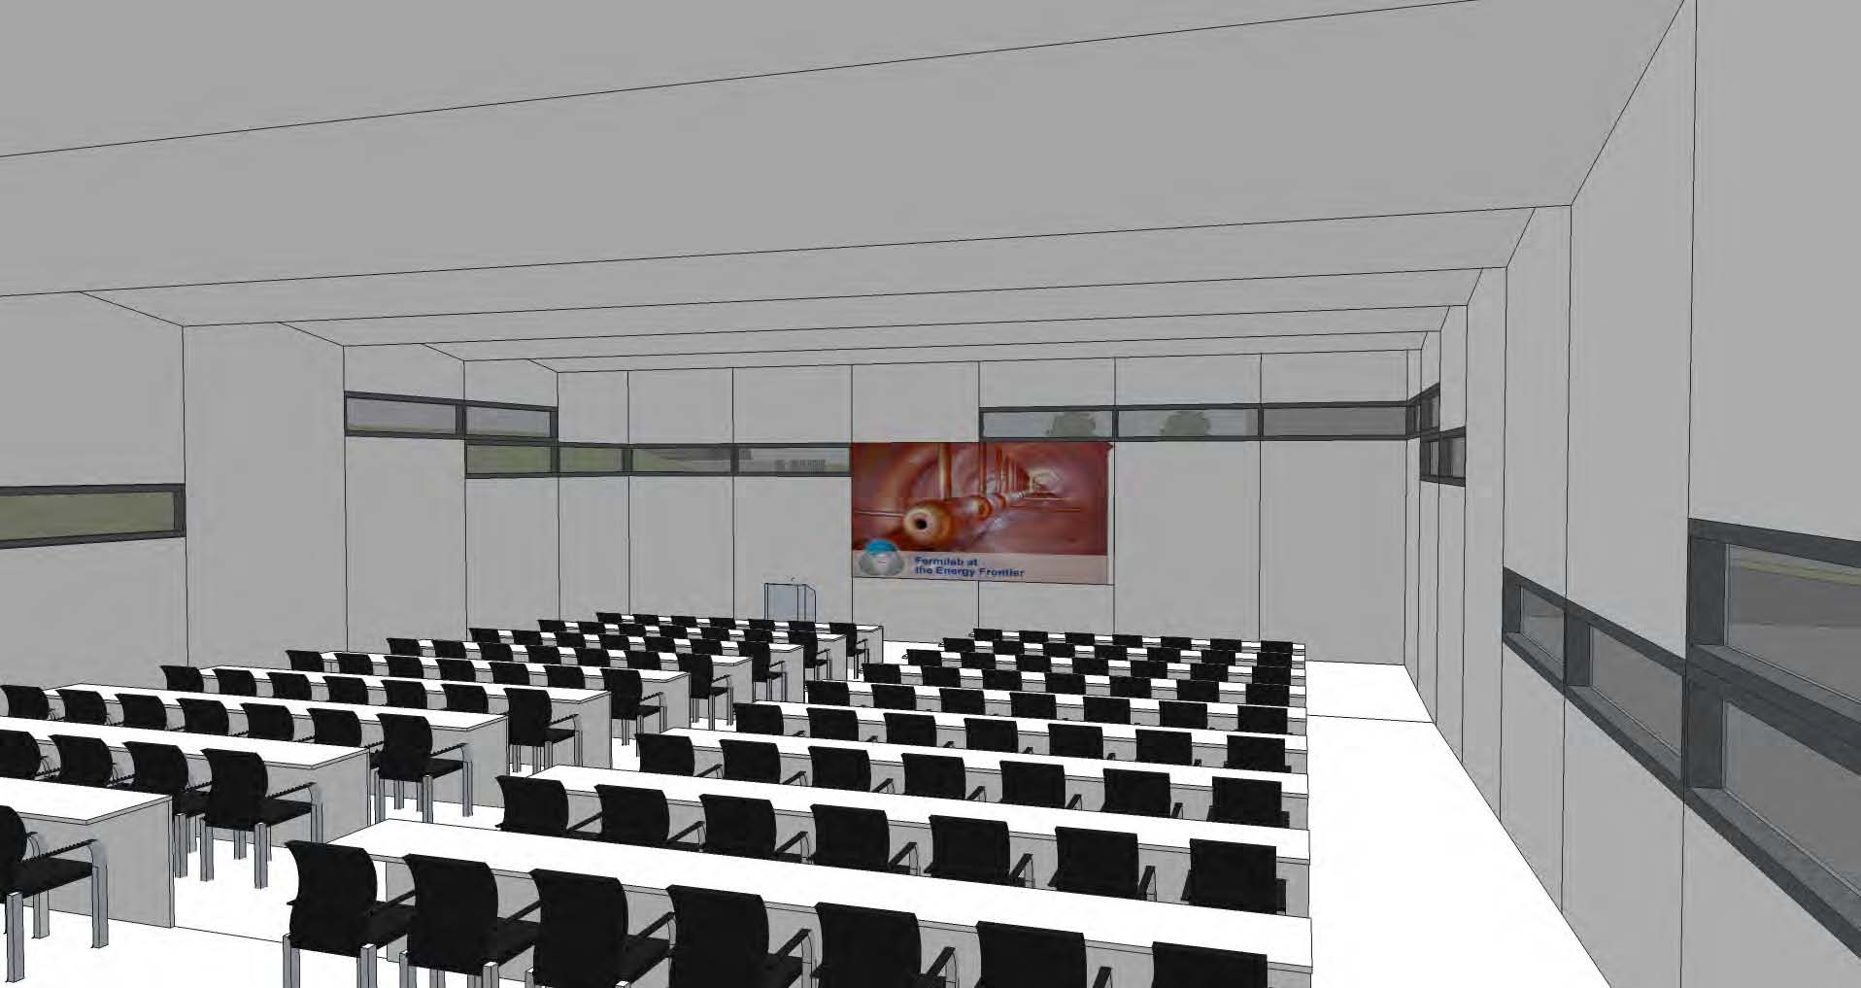
Risk Management Internal Risk Status
Conference Area Change: Updated cost estimate based on Prelim Design (4/07) to be basis for understanding additional cost impact.

Slide 18
Risk Management Internal Risk Status
Impact of existing CDF equipment on north elevation: Owner equipment to be removed prior to construction start. Dervin Allen, Jonathan Lewis are identifying, advising.
Coordination of work area within CDF Assembly Hall underway. Cost impact vs. schedule to be evaluated.
Timing of roof reinforcement along north bay
Bridge
Conduit runs

Slide 19
Procurements
RFP for Thermal Conductivity Testing for Ground-Loop Heat Exchanger in progress (geothermal test well).
Procurement through change order to BMC.
Final Design proceeding as assumption based design: Bore depth, spacing & quantity may be effected.

Slide 20
Procurements
External
IASU/FCC San Sewer construction contracts underway
“Deduct Alternate” not effective procurement.
Add’l IASU IGPP work to be procured at same time as OTE Building procurement (separate price).
CDF Improvement to be GPP project procured at same time as OTE Building procurement (separate price).
Need to understand “Equipment” funding to determine if applicable to OTE Building equipment.
Air switches received
Start REQ for transformer & switchboard

Slide 21
Labor Resources

Slide 22
Change Control per PP

Slide 23
Scope
Project Plan:
Proposed Conference Center:
Tiered Conference/Lecture Center for 175 people to replace current 4-25 person class rooms.
30/30 Executive Conference Room in lieu of 1 Tech Space

Slide 24
Project Plan Budget
 |  |  | Base Cost | Management Reserve | Indirect Costs | Subtotal
1.0 | EDI |  | $ 2,561,550 | $ 128,742 | $ 263,550 | $ 2,953,842
 |  | Total State EDI | $ 2,561,550 | $ 128,742 | $ 263,550 | $ 2,953,842
 |  | anticipated EDI | $ 1,505,000
 |  | anticipated surplus | $ 1,056,550
2.0 | State Grant #1: 10-203829 Construction |  | $ 1,191,150 | $ 147,100 | $ 106,552 | $ 1,444,802
3.0 | State Grant #2: 10-203828 Construction |  | $ 13,704,694 | $ 1,700,000 | $ 193,256 | $ 15,597,950
 |  | Total State Construction | $ 14,895,844 | $ 1,847,100 | $ 299,809 | $ 17,042,752
 |  | State Totals | $ 17,457,394 | $ 1,975,842 | $ 563,359 | $ 19,996,594
 |  | Anticipated Construction Budget | $ 15,952,394 | $ 1,975,842

Slide 25
Conference Center Estimated Construction Cost
Preliminary Cost Estimate based on CDR | $14,517,428
Preliminary Cost Estimate w/ lecture hall | $15,188,978
Preliminary Cost Estimate w/ Lecture Hall & Executive Conference Room | $15,300,000
Conference Center within project budget of $15,952,394.

Slide 26
EDIA: $52K previously approved change
Contingency: no change, fixed by State Grant
Indirects: no change, within costs identified in project plan.
Schedule: no change, within schedule identified in project plan.

Slide 27
Issues
Increase responsiveness of A/E
Rec’md start procurement process (req approval) prior to 7/21/11 Director’s Review to allow add’l CCR time.
Wetlands COE inspection of wetlands 5/31/11
JD determination of waters of the US considered very low risk per previous 2/8/11 email from Kathy Chernich, Regulatory Branch, COE Chicago District
Radiation – need to understand requirements for maintaining berm/fence post Tev
Coordination with Tev D&D work.
PP required for CDF Improvement GPP project

Slide 28
Issues
Structural understanding of CDF snow loading, fire separation protection of roof – additional steel for snow loading required. Investigating constructability in CDF. Resolved & incorporated into design.
DOE Directive for $2M – will this be a “new start”? GPP is not new start
Zinc cladding: understand Buy American implications Sole Source procurement will probably make zinc cost prohibitive.

Slide 29
Issues
Toilet Fixture count: evaluate “surge factor” for conference areas. Resolved and incorporated into final design.
CDF bridge: evaluate internal vs external solution. Bridge will be internal. Can bridge be supported from crane girders?
Permeable Pavers: requires special snow removal (no sand). If limited to pedestrian areas, can building owner do snow removal? Permeable pavers to be limited to pedestrian areas, with snow removal by building owner consistent with pedestrian snow removal at Industrial Complex.

Slide 30
Issues
New Gas Meter location: consider west wall of CDF, north of loading dock. Resolved. To be located on west wall of CDF with appropriate screening.
Access to CDF west loading dock during construction? Continue to coordinate with Tev D&D
Fire Department Hook-up location: re-route through OTE Ground floor east. Approval by Fire Department required. Resolved per 4/28/11 mtg w/ FD & AHJ
NOVA FHEP Table: need schedule of transporting out & in of CDF. Must be coordinated with construction schedule. Need final schedule for Table movement.

Slide 31
Look Ahead
Complete Final Design.
Cost estimate
LEED Gold
Select Interiors
Finalize Exterior
Finalize Construction Acquisition Strategies
Continue working on Integrated Project Schedule.
State Report quarterly report due 6/30/11.

