Slide 1
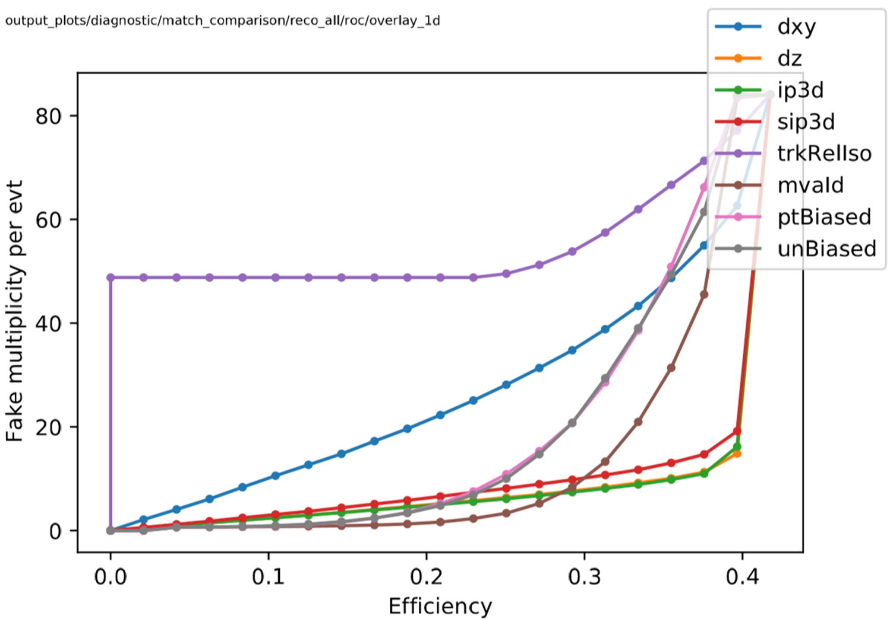
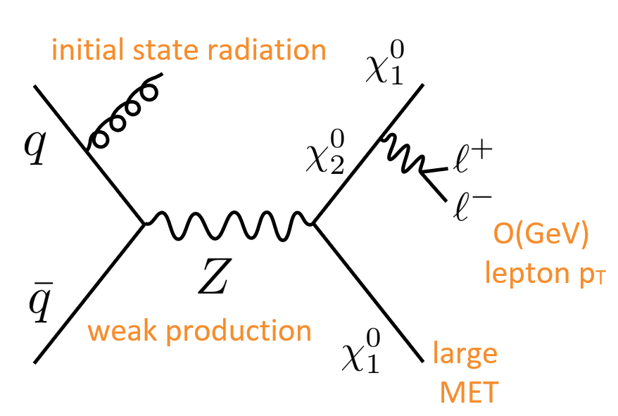
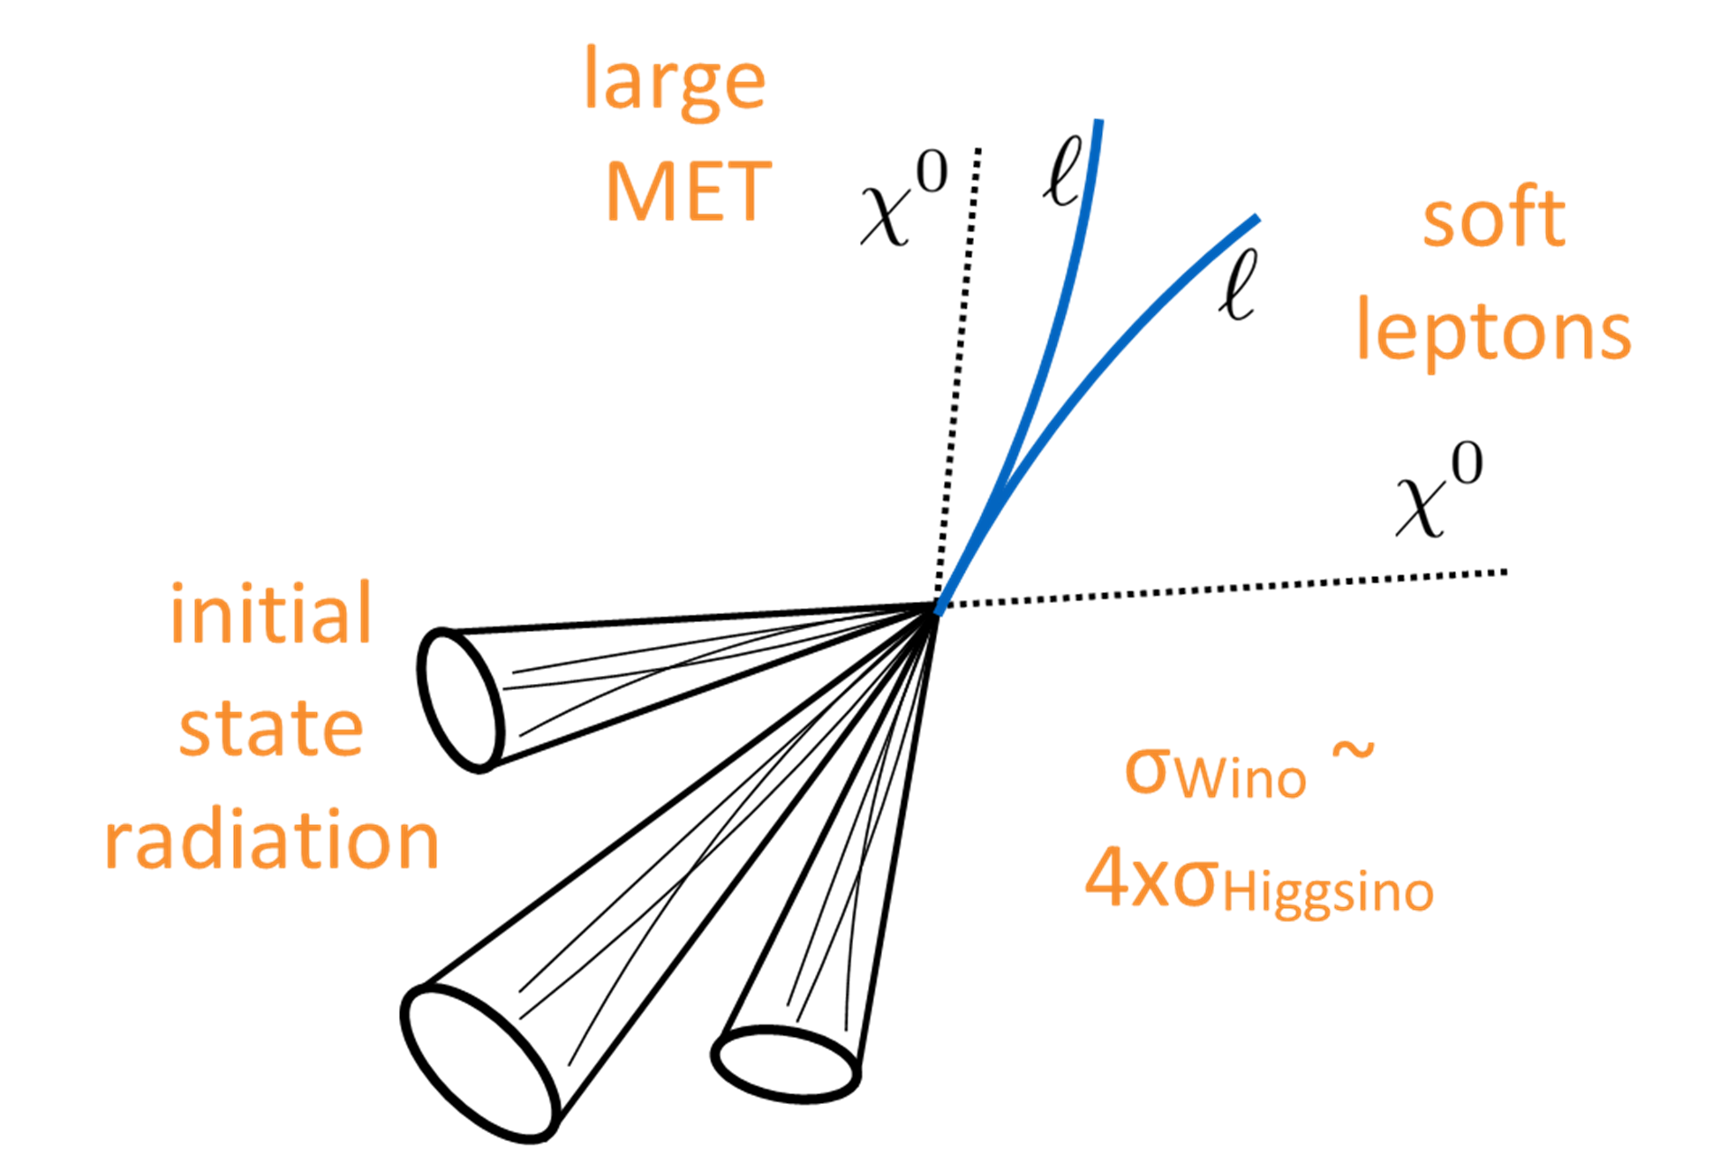
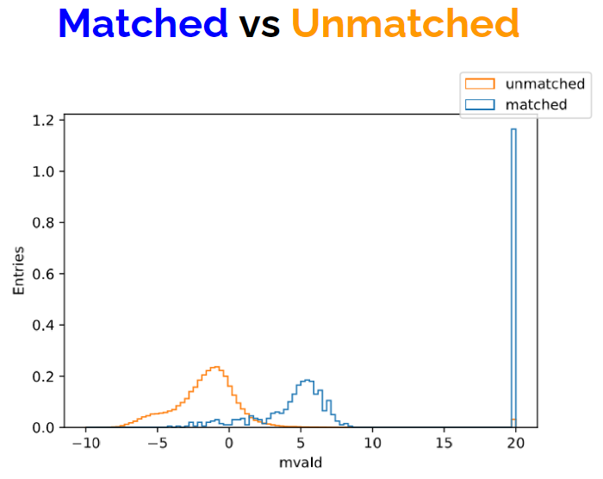
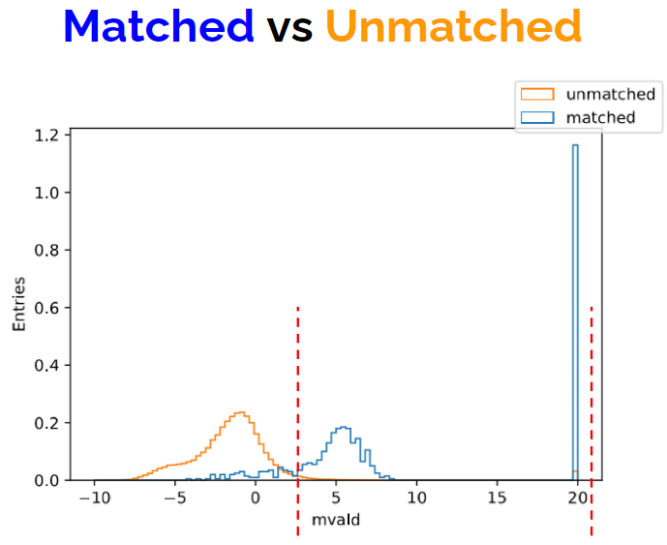
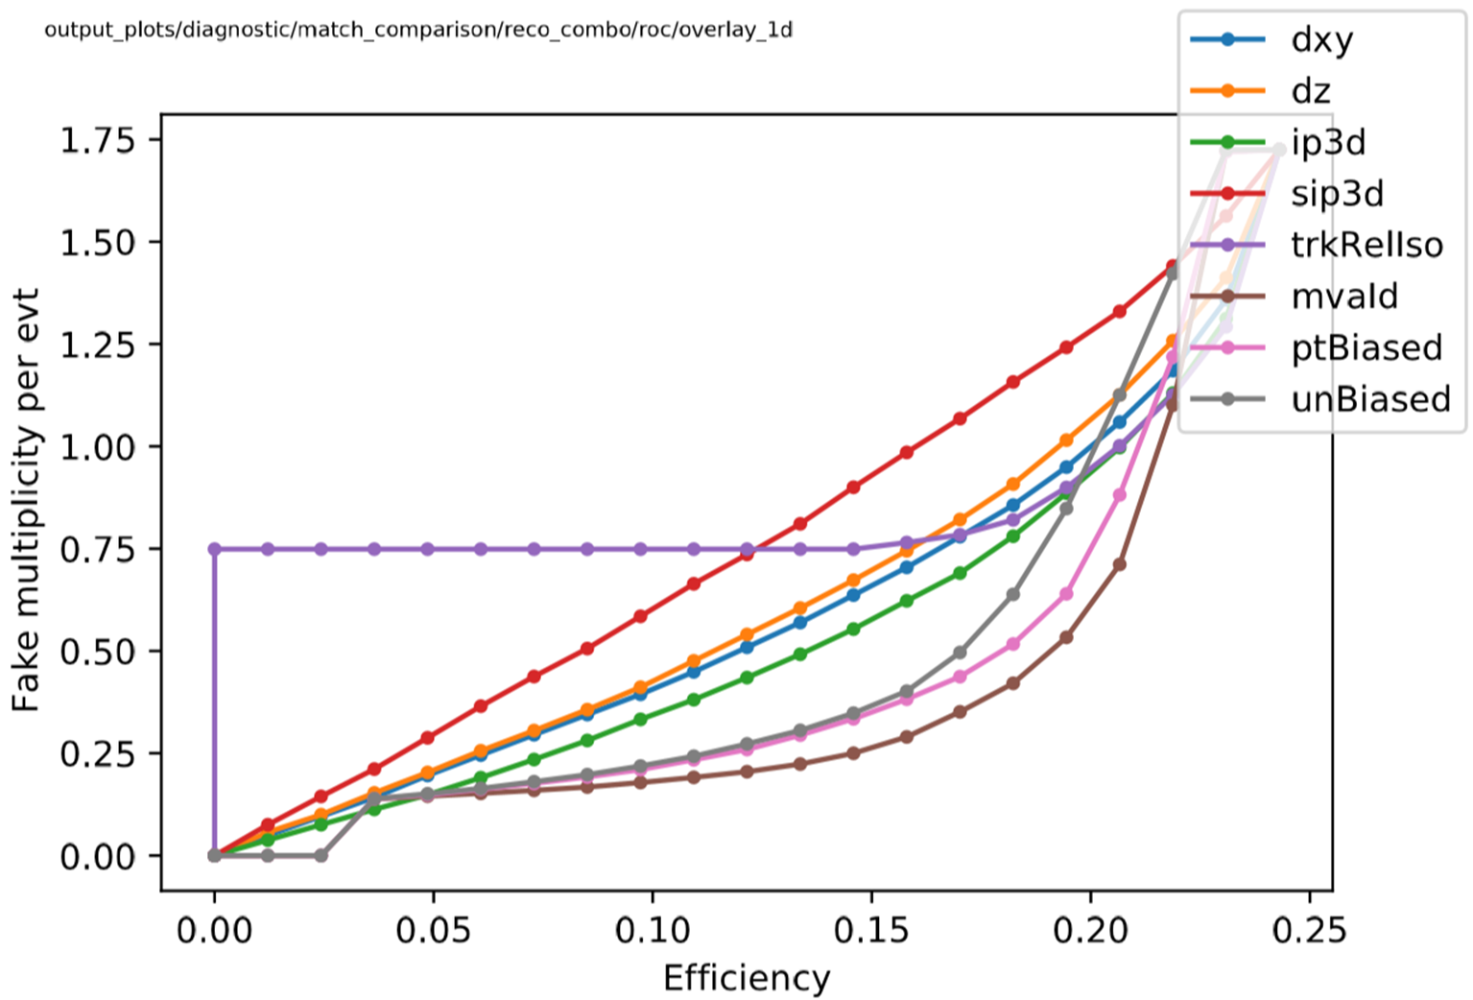
Identifying low energy electrons in WIMP Cascade Decays
Dominic Lehner, University of Wisconsin, Eau Claire
Introduction
Method
ROC plot of electron data given by the eight selected variables prior to any cuts or changes.
The Large Hadron Collider (LHC) is the world’s highest-energy particle collider, located at CERN, where proton-proton (pp) collisions may be able to produce hypothetical dark matter candidates, weakly interacting massive particles (WIMP). This search targets models where the dark matter candidate $X_{1}^{0}$ is accompanied by a heavier neutral particle $X_{2}^{0}$ that interacts via this weak force. Although the dark matter particle $X_{1}^{0}$ is itself undetectable, its presence may be revealed by requiring a large "missing" momentum in the detector, along with exploiting cascade decays of the $X_{2}^{0}$ to $X_{1}^{0}$ and the measurable leptons that are released.
Monte Carlo methods* are used to simulate the production and interaction of $X_{1}^{0} X_{2}^{0}$ events in the detector, allowing the comparison of the electrons produced in the pp collision ("truth" electrons) with those reconstructed by CMS ("reconstructed" electrons). By matching truth and reconstructed electrons, the efficiency to identify electrons from $X_{2}^{0}$ decays can be measured. Furthermore, this allows measurement of the "fake rate": the number of electrons that are reconstructed but are not associated with a truth electron from an $X_{2}^{0}$ decay. The purity of the reconstructed electron sample is enhanced by selecting only those electrons with signal-like characteristics, reducing the fake rate at the expense of small reductions in efficiency. This is desirable, because situations of low electron energy will already have low efficiency, as well as having high fake rates.
Note the unfavorably high fake rate at these low efficiencies (ex: 0.1 ≡ 10%)
Results
Feynman Diagram of quarks annihilating to form a Z boson resulting in the decay and production of the $X$ particle with its released electrons.
After creating and applying the most useful cuts at differing GeV ranges, a notable pattern arose. For extremely low energies (0-2 GeV), position-based variables (such as dxy and sip3d) gave the best results when cut. Slightly larger energies (2-5 GeV) favored cuts on energy cluster and isolation variables (such as mvaId and trkRelIso). Ultimately, the final combination of cuts created slightly lowered the reconstruction efficiency while greatly lowering the fake rates (see table below). This new information contributes to the overall analysis of WIMP cascade decay data and is a promising investigation in this region of incredibly soft electron release.
*Monte Carlo methods refers to a class of computational algorithms that utilize random sampling to create numerical results, often used for comparison.
The properties of the studied reconstructed electrons fall into three categories:
Impact parameters, measuring the compatibility of the electron with the primary pp collision vertex.
(dxy, dx, ip3d, sip3d)
Isolation variables, indicating the presence of nearby particles, potentially from hadronic showers.
(trkRelIso)
Energy cluster and track quality, quantified with various multivariate discriminants.
(mvaId, ptBiased, unBiased)
Initial state radiation jets reveal the energy of the collision products: the $X_{1}^{0}$ and lepton particles.
These eight variables were selected primarily because of their high potentials to affect fake rate and efficiency when given limits/cuts.
Cuts | Δm [1 GeV] | Δm [3 GeV] | Number of Fakes
None | 9.44% | 34.2% | ~80
“Combination” | 3.69% | 11.9% | ~1.75
Goal
Sample visual for applying cuts to a variable. Variable shown is mvaId.
The energy from these $X$ particle decays, which depend on the mass difference of the $X_{1}^{0}$ and $X_{2}^{0}$ particle, have been well analyzed in studies of large mass splittings. This study focuses on the experimentally-challenging low energy instances of decay ($≤$ 3 GeV). This requires excellent identification of very low-energy electrons given off by the WIMPs using the CMS detector.
ROC plot of the differing ranges of cuts combined
Note the, much more favorable, low fake rate at these low efficiencies.
Note the dashed red lines created to show a favorable cut.

