Slide 1
Instrumentation for 21cm cosmology
Paul O’Connor
20200730

Slide 2
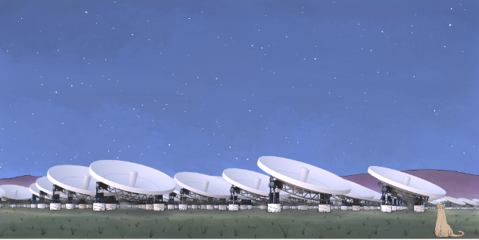
What?
PUMA
Packed Ultrawideband Mapping Array
A cosmological survey using the 21cm intensity mapping technique:
An array of 32,000 6-m parabolic reflectors (900,000m^2 collecting area)
Low noise 200-1100MHz front end electronics and on-antenna digitizers
Real-time ~100 PFLOPS processor for interferometric correlation
DAQ output 7PB/day, sky maps in 4,000 frequency bands
Calibration hardware for gain, phase, angular acceptance per dish
arXiv:1907.12559v1, arXiv:2002.05072
https://puma.bnl.gov

Slide 3
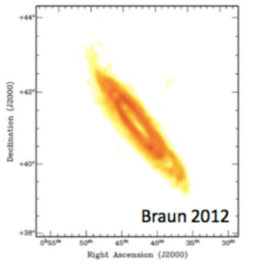
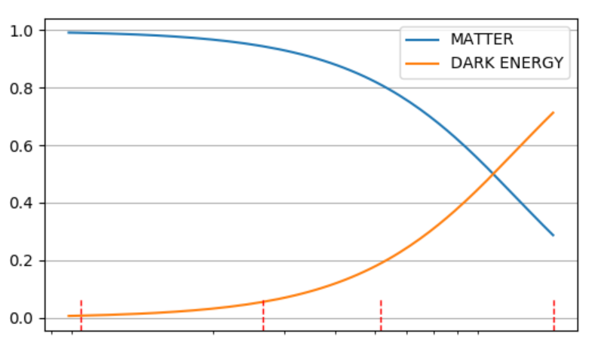
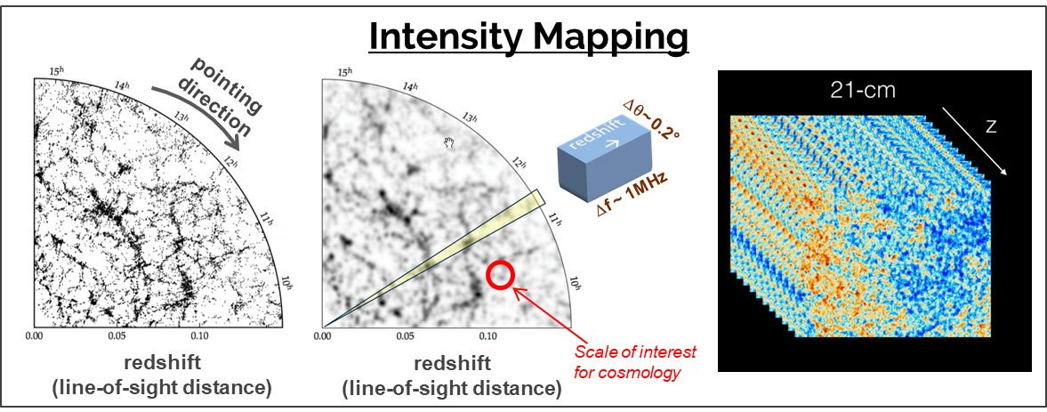
Why?
Cost-effective approach for investigating cosmic acceleration after current generation of survey experiments (Rubin Obs / DESI / CMB-S4).
Look where we haven't looked before : redshift range 6 < z < 1.2
Make a tomographic map of the dark matter distribution in the universe
Monitor the transient radio sky: fast radio bursts, pulsars, LIGO followup
Take advantage of emerging digital RF technologies
Nearby galaxy M31 imaged in 21cm
⬅ CMB-S4 (z = 1100)
PUMA
Rubin, DESI
6
2.5
1.2
NOW
redshift z

Slide 4
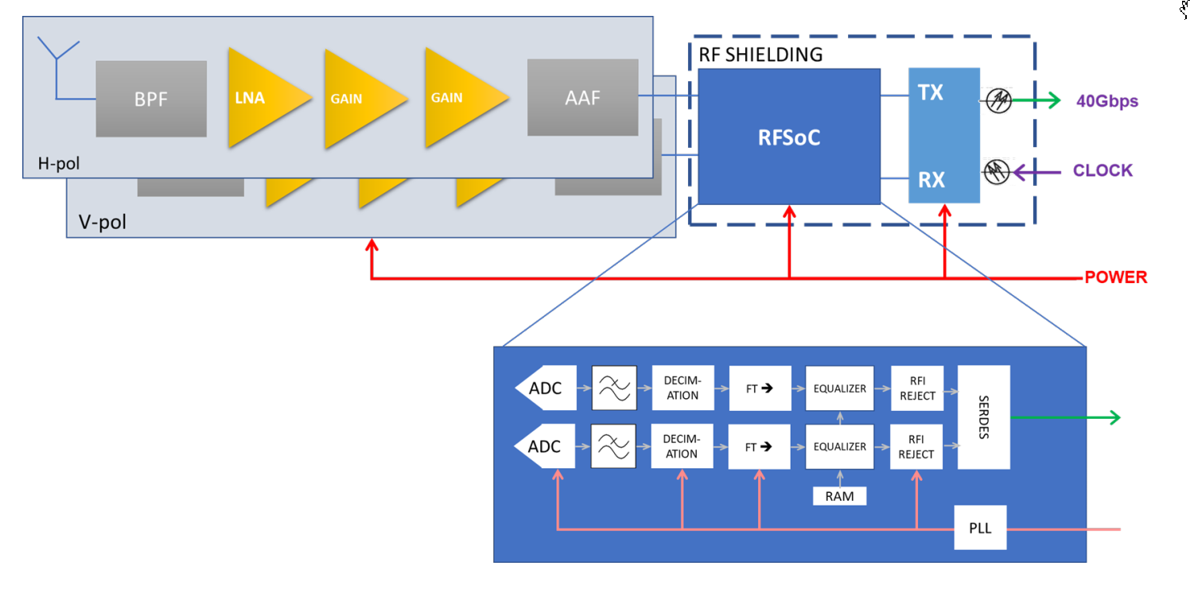
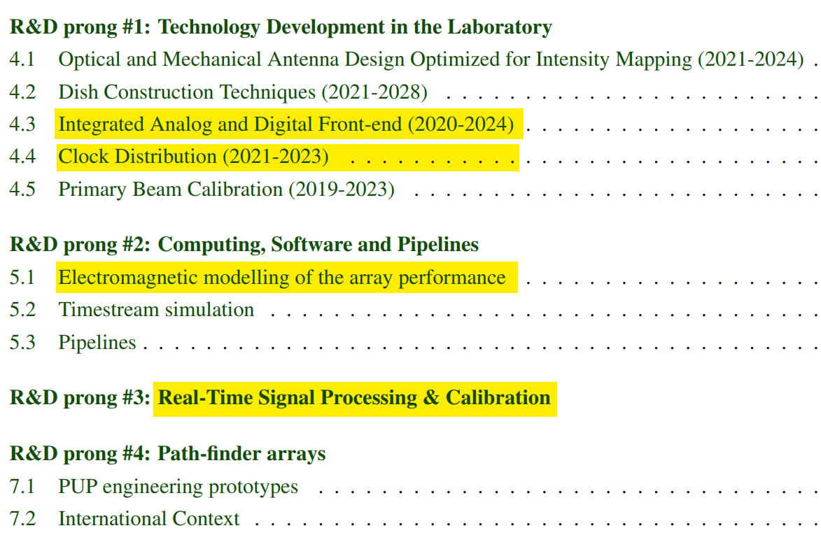
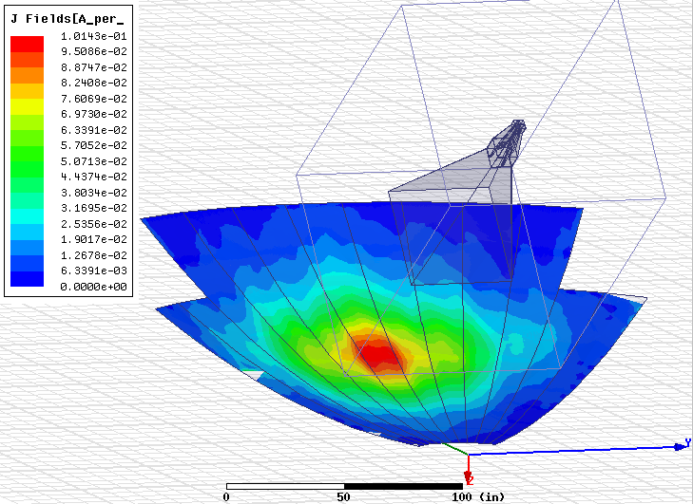
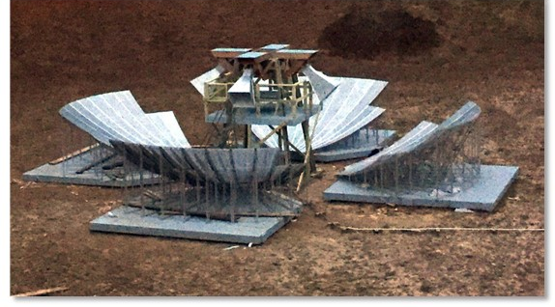
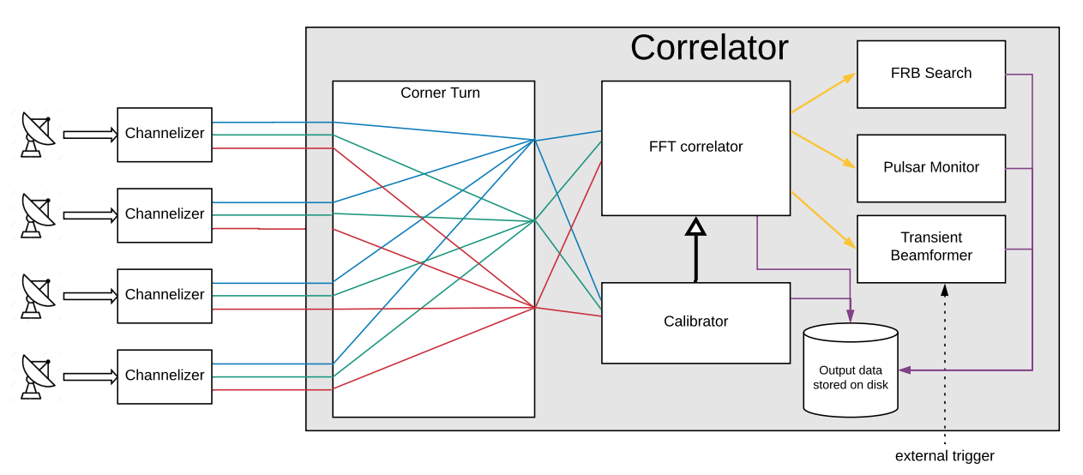
How?
Technological path
Team
Jamali 2016 IEEE MTT-S
See arXiv:2002.05072 for details of R&D plan

Slide 5
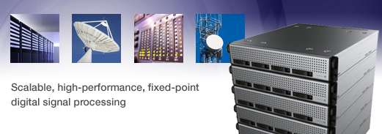
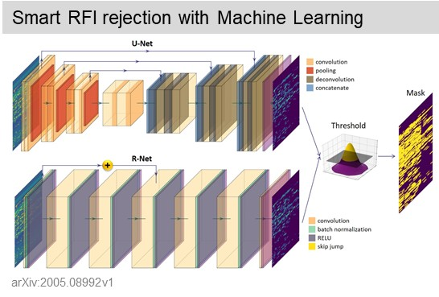
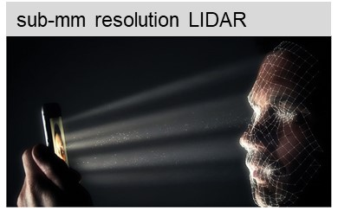
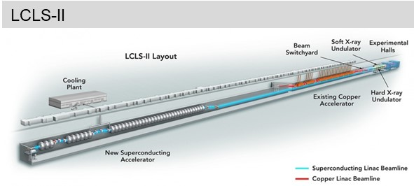
Synergies?
picosecond timing and synchronization (FELS, TOF/LIDAR, under-ice neutrino detectors
digital RF beamforming (radar, 5G), digital RF FDM
machine learning for RFI rejection
high-throughput DSP architectures
exascale computing

Slide 6
Conclusion
21cm intensity mapping is a new, cost-efficient observational technique that is complementary to optical and CMB surveys.
It opens the largely unexplored redshift range 2.5 < z < 6 where beyond-ΛCDM physics can be studied - dynamic DE, modified GR, inflationary relic signatures.
Leverages industry advances (wireless, AI) and requires no specialized detector environments (cryo, radiation).
Research needs center on DAQ architectures (with 2030-era electronics), and on calibration methods, including sub-picosecond phase synchronization.
The PUMA project is well-matched to HEP expertise and is synergistic with many emerging trends in EF and IF electronics.

Slide 7
Backup slides

Slide 8
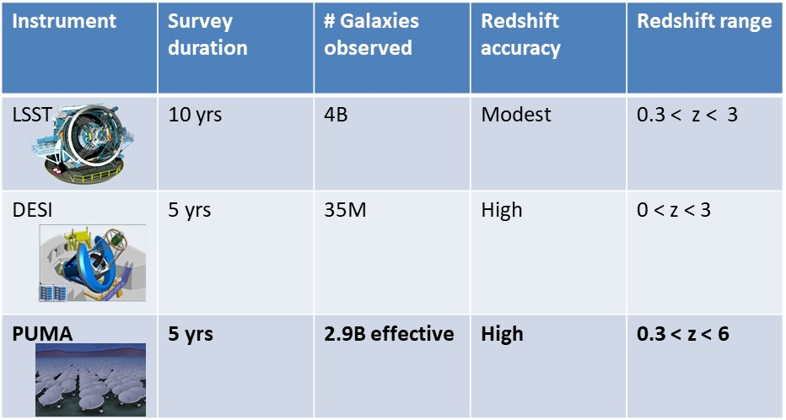
PUMA: speed of LSST/Rubin, accuracy of DESI

Slide 9
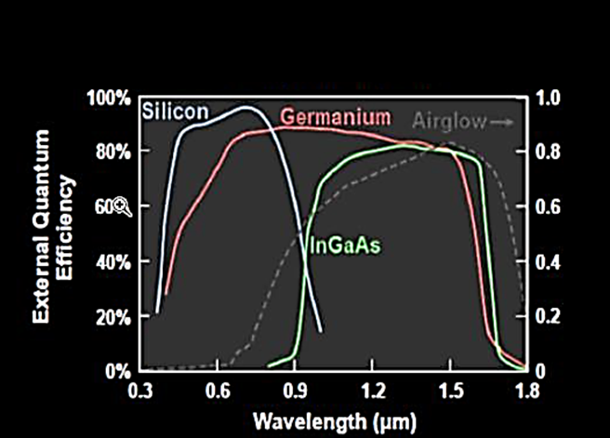
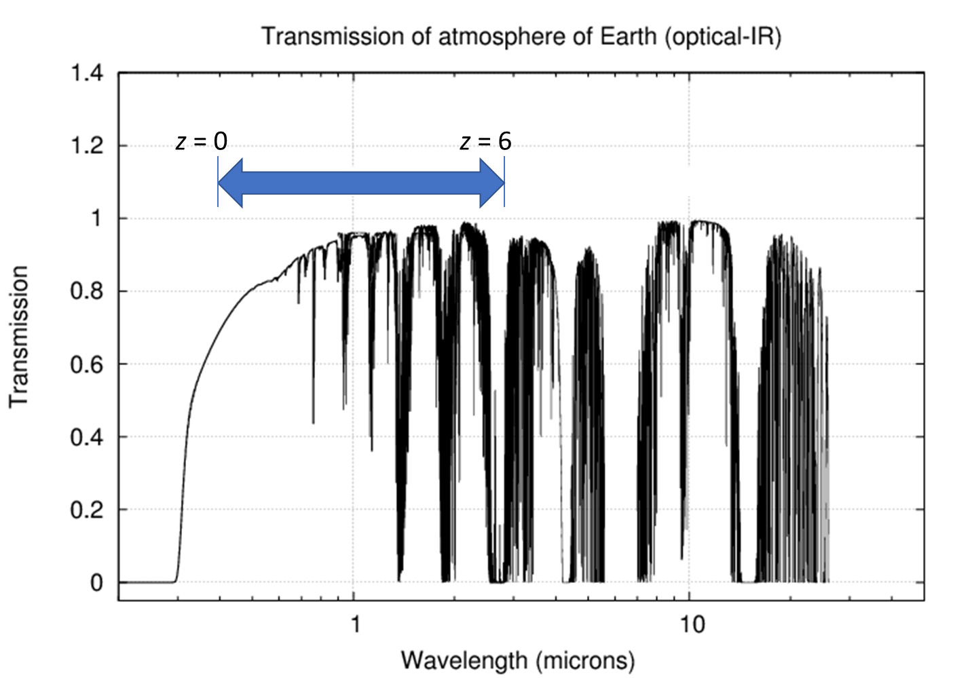
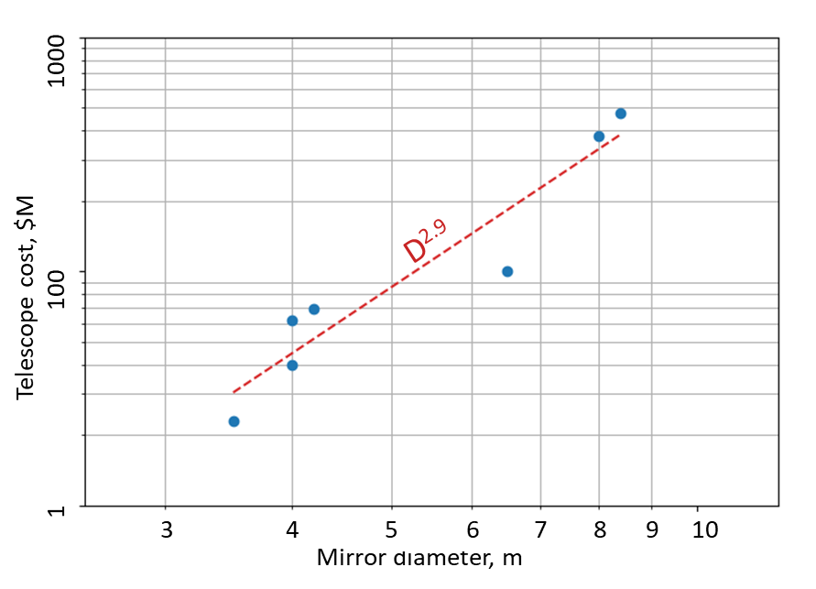
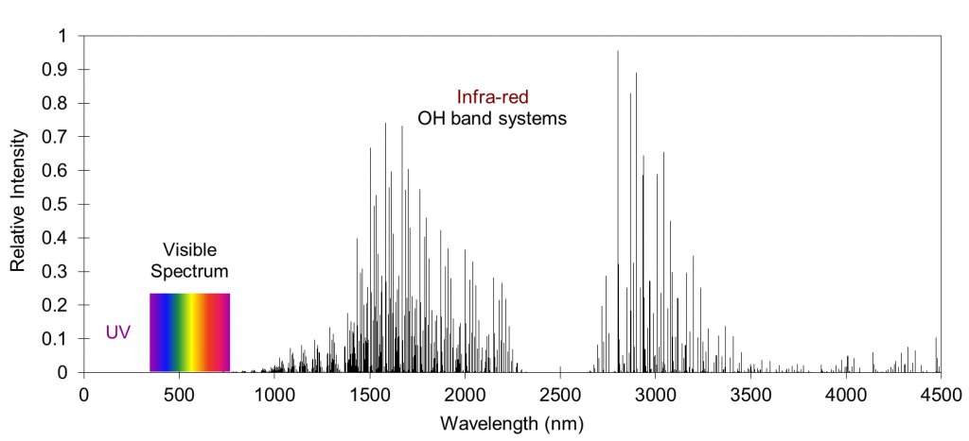
Obstacles to scaling optical surveys
Detector technology for IR
Atmospheric transparency in IR
Telescope cost scaling
z = 0
z = 3.5
Airglow
Let’s consider another wavelength range…

Slide 10
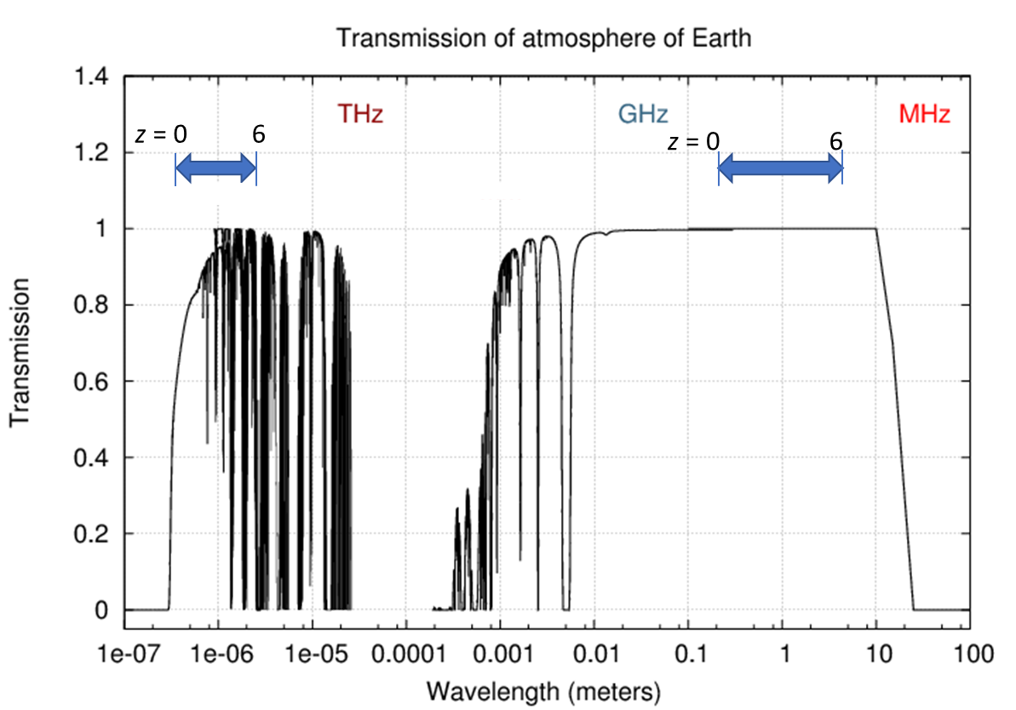
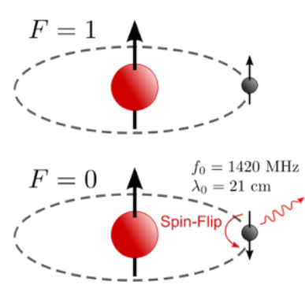
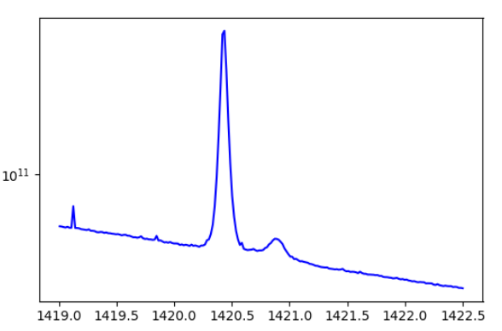
The 21cm transition of neutral hydrogen provides precise redshift marker
Spin-flip transition of neutral atomic hydrogen
Atmospheric transmission is favorable in radio window
21cm line in Milky Way galaxy, observed by BMX pathfinder
f, MHz
Spectral line at 21cm rest-frame wavelength is sharp and isolated
→ Once detected, provides precise redshift

Slide 11
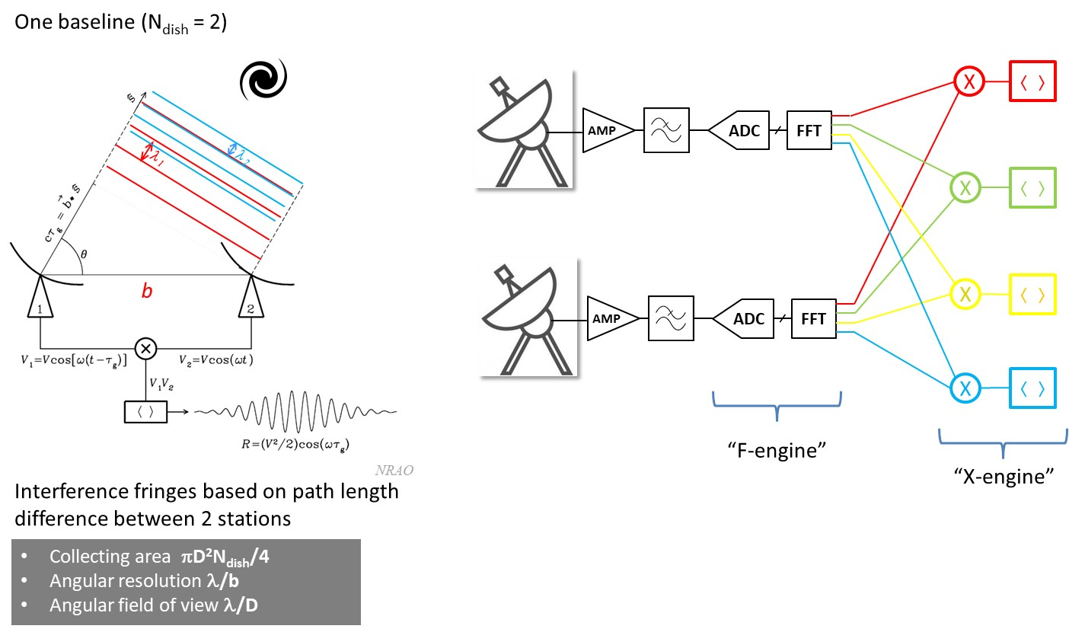
Polychromatic Interferometer

Slide 12
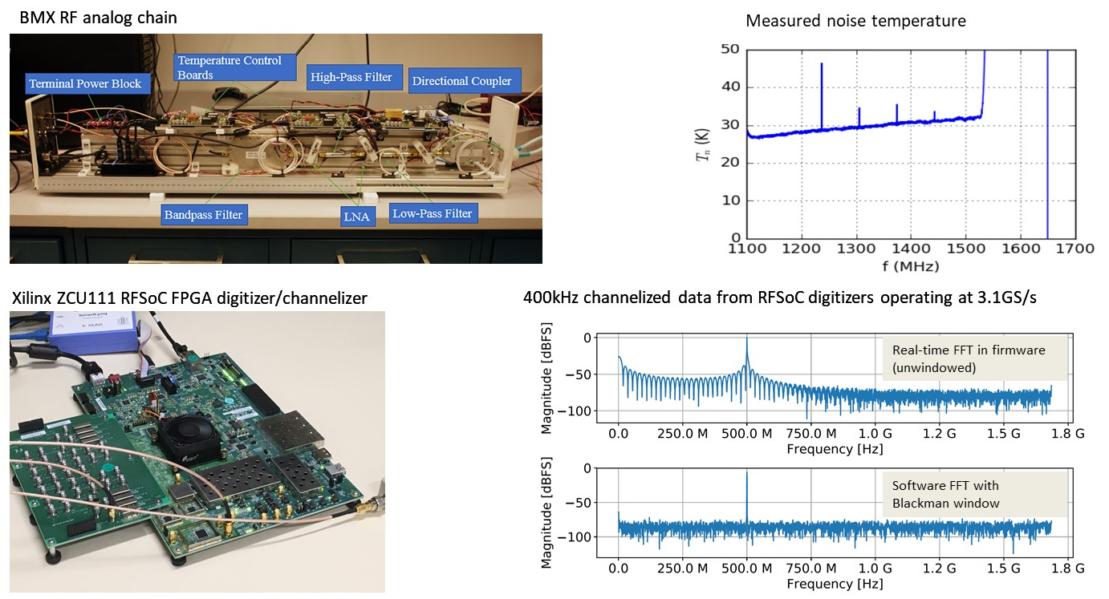
Front end electronics for BMX pathfinder

Slide 13
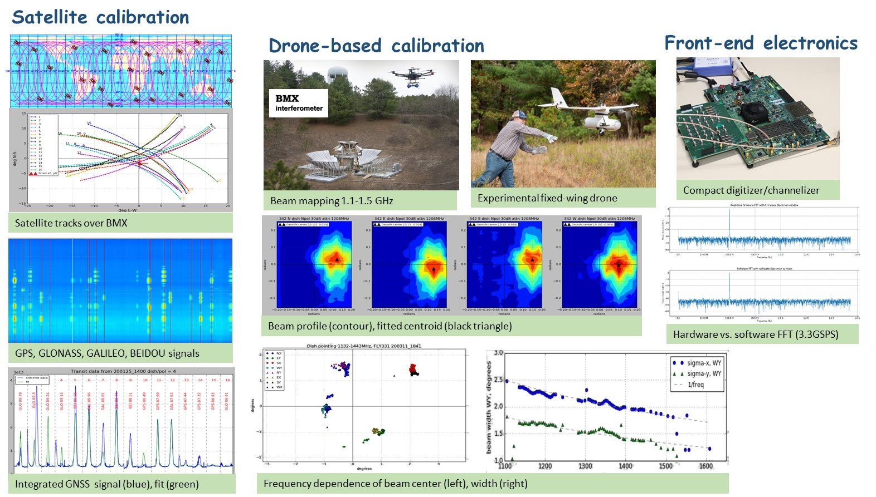
BMX pathfinder activities

Slide 14
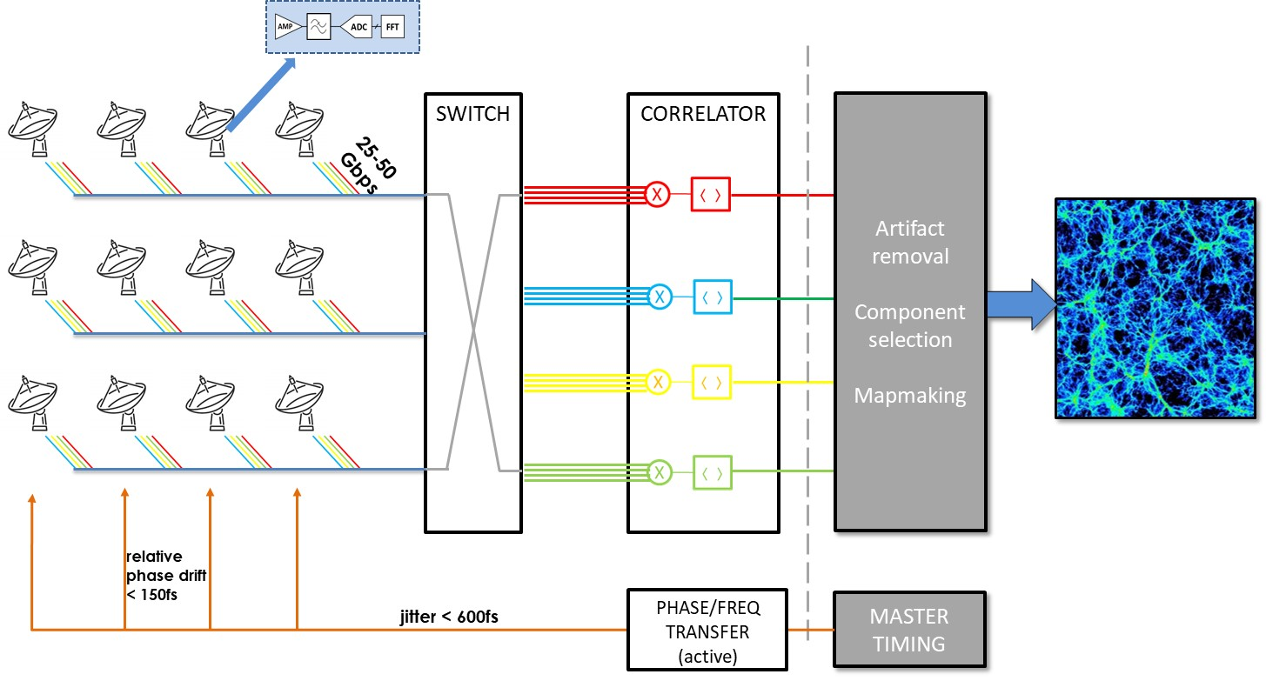
Full array network

Slide 15
Data and computation rates: current estimates
 | PUMA-5K | PUMA-32K
Raw data rate | 240 | 1500 | Tbit/s
Real-time computation | 15 | 100 | PFLOP
Output data rate | 13 | 82 | GB/s
Data volume | 0.9 | 5.7 | PB/day
Power * | .23 | 1.5 | MW

Slide 16
Notional schedule (from whitepaper)
Note: a smaller (5,000-dish) instrument configuration, with scaled-back science reach, is also described in the whitepaper and can be considered as a first stage to construction of the full array.

Slide 17
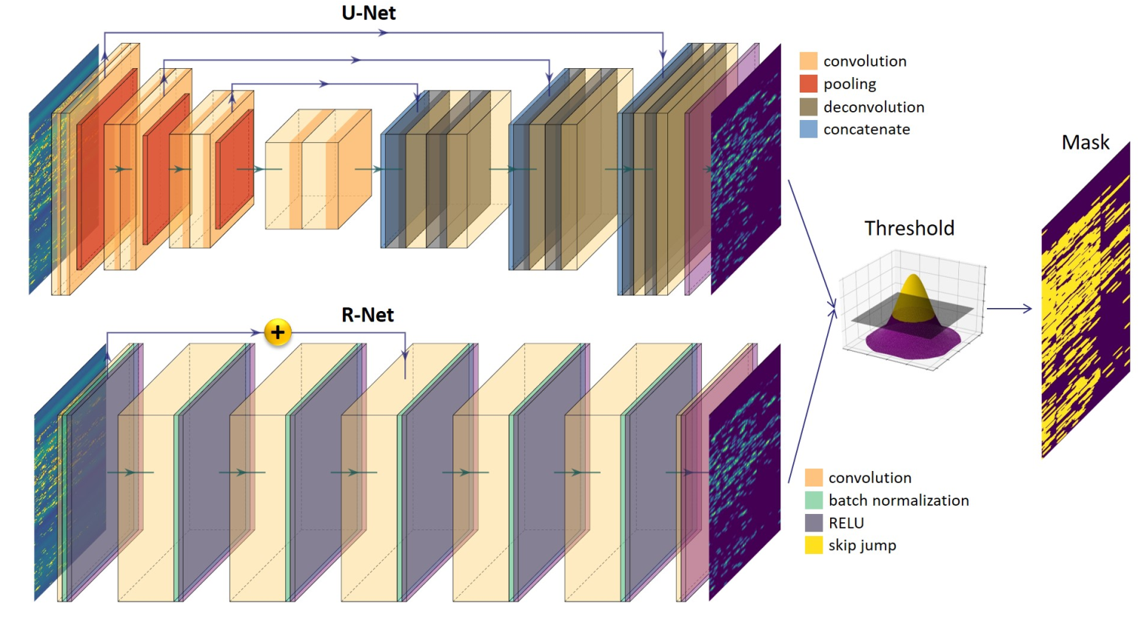
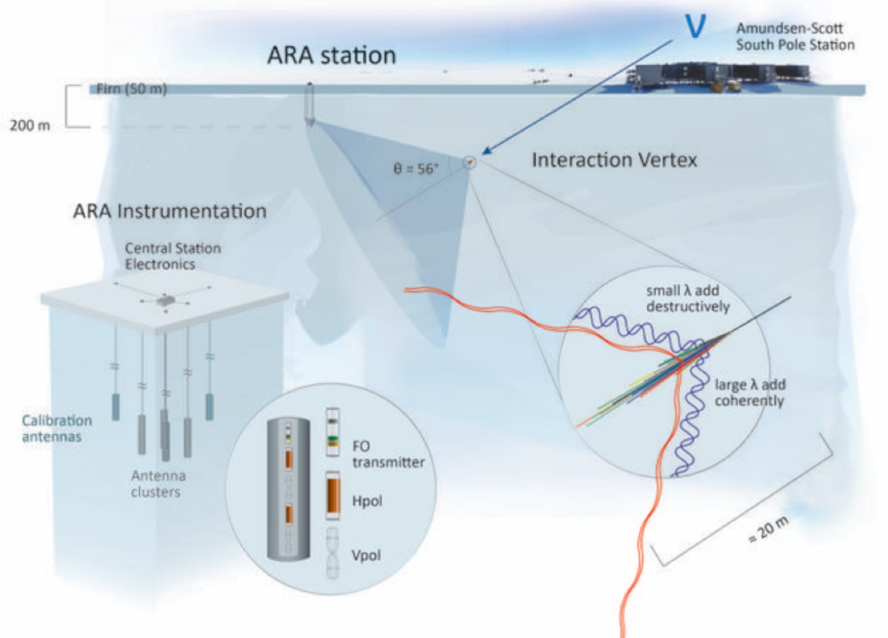
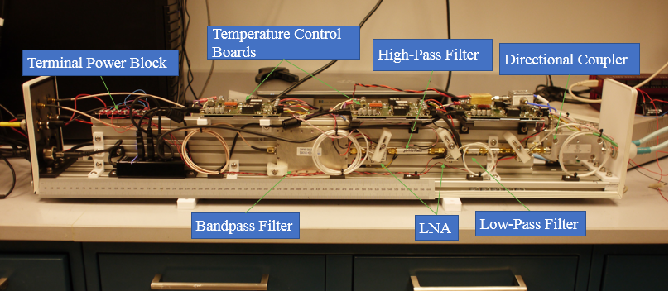
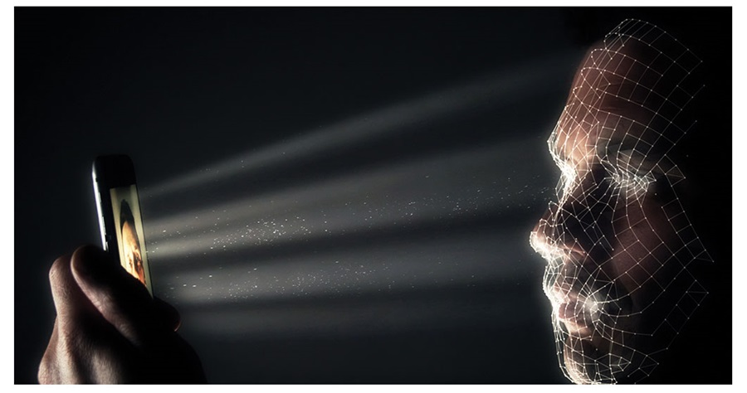
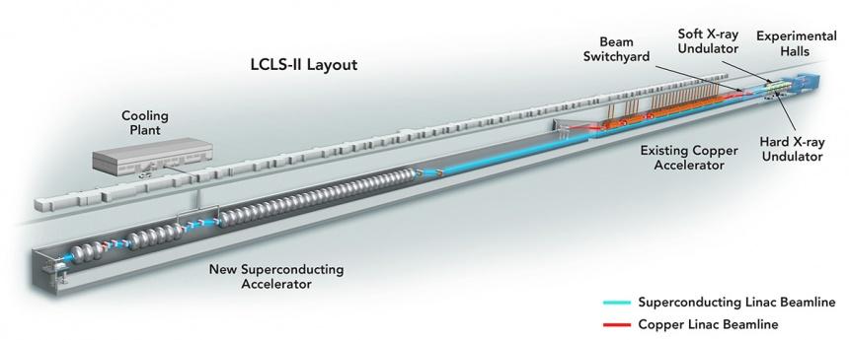
Smart RFI rejection with Machine Learning
CMS (HL-LHC upgrade) 4D tracking
Askaryan Radio Array
arXiv:2005.08992v1
sub-mm resolution LIDAR
LCLS-II
2005 cellphone

