Slide 1
CryoCMOS for Sensor Readout Carl Grace, Aritoki Suzuki - LBNL
20200730

Slide 2
TES, MKID, Resonators
TES, MKID, Resonators will (continue to) play essential role in future experiments
Dark matter/photon
Galaxy survey
Neutrino experiment
… and more

Slide 3
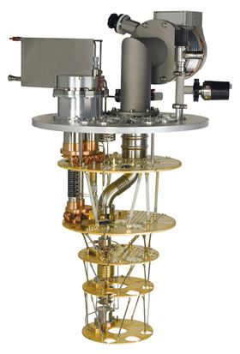
Limited cooling power → multiplexed readout
Allowed Power Dissipation
Oxford Instruments dilution refrigerator
300 K
100 W
70 K
10 W
4 K
500 µW
100 mK
10 µW
20 mK
Limited cooling power at coldest temperature
Scaled readout of superconducting sensors needs low power-per-channel electronics to operate at coldest temperature
Multiplexed readout

Slide 4
Multiplexed readout
Sensors
Multiplexer chip
FPGA Signal analyzer
TES
Multiplexer
TES
Multiplexer
TES
Multiplexer
Cold
Amplifier
Warm
Amplifier
TES
Multiplexer
TES
Multiplexer
TES
Multiplexer
10~100mK
4K ~ 50 K
300 K

Slide 5
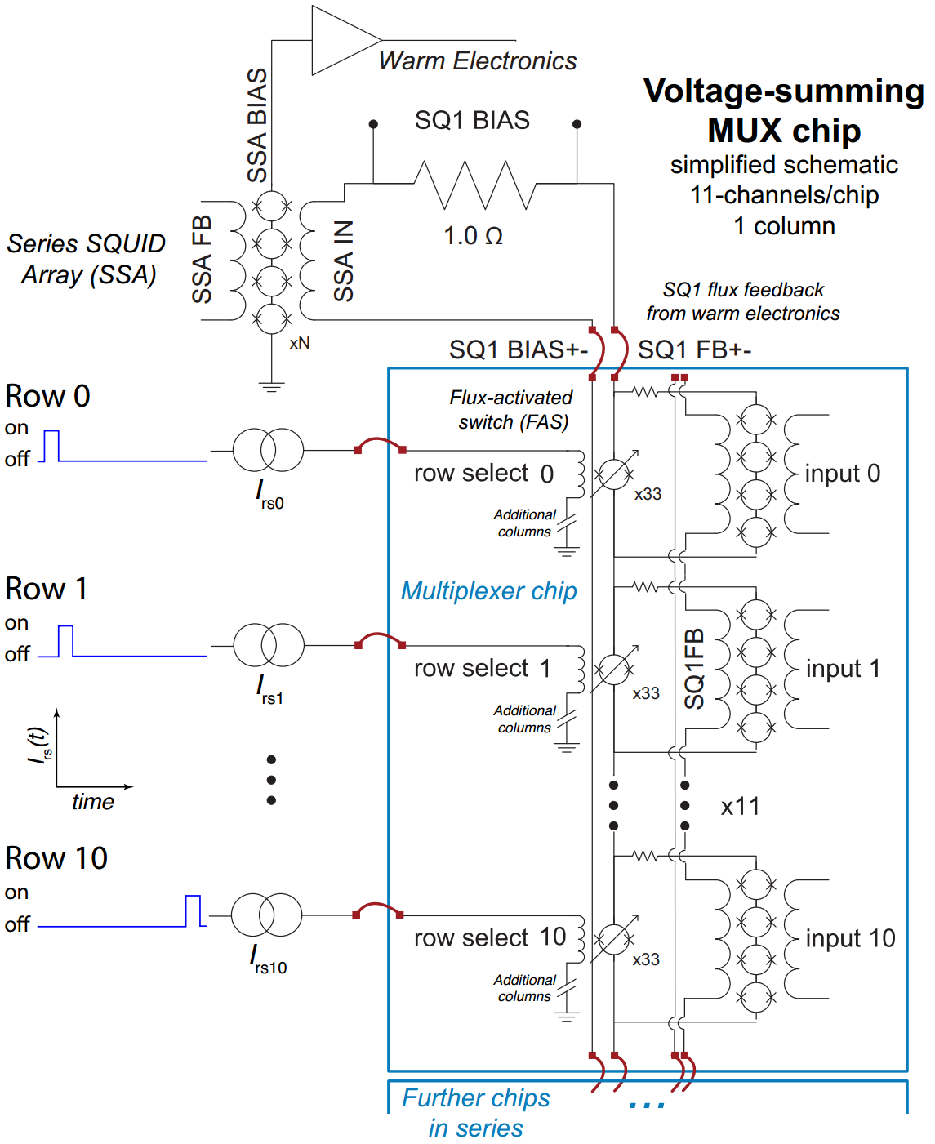
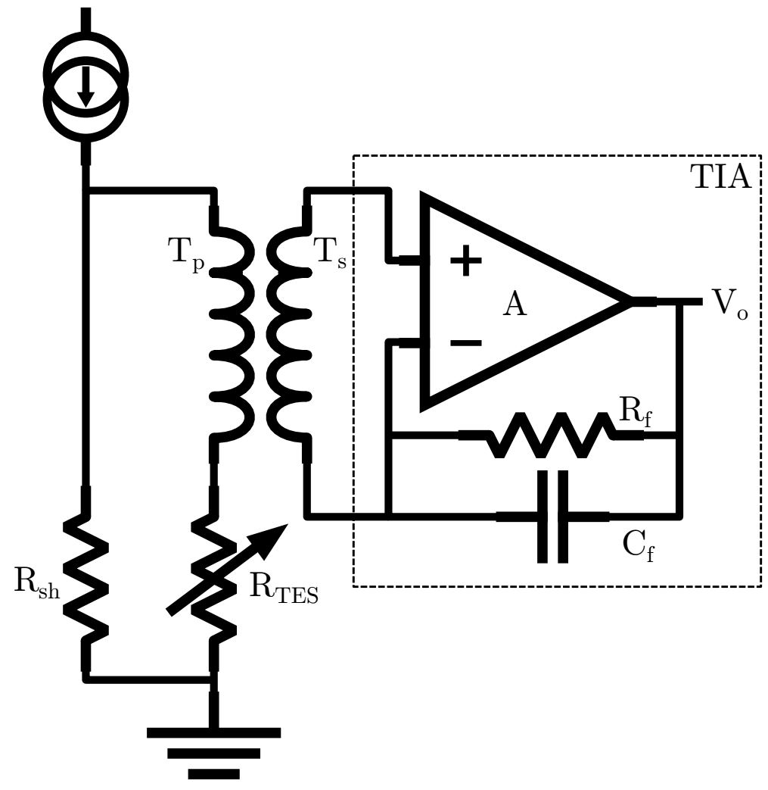
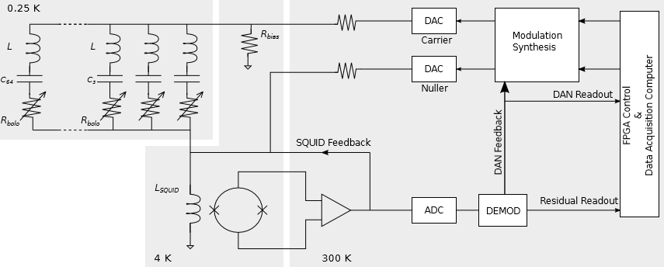
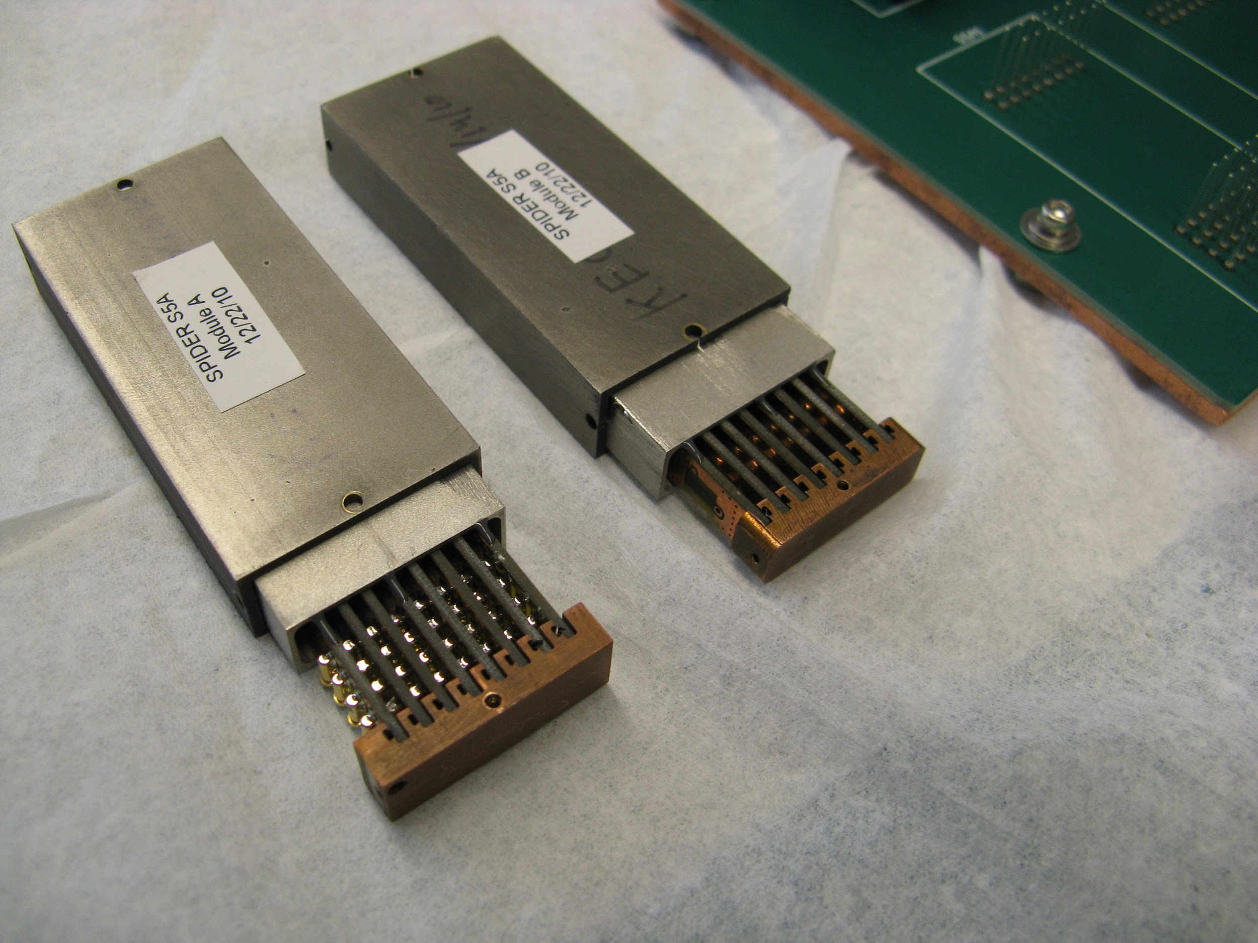
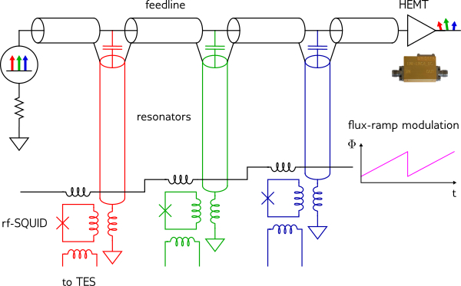
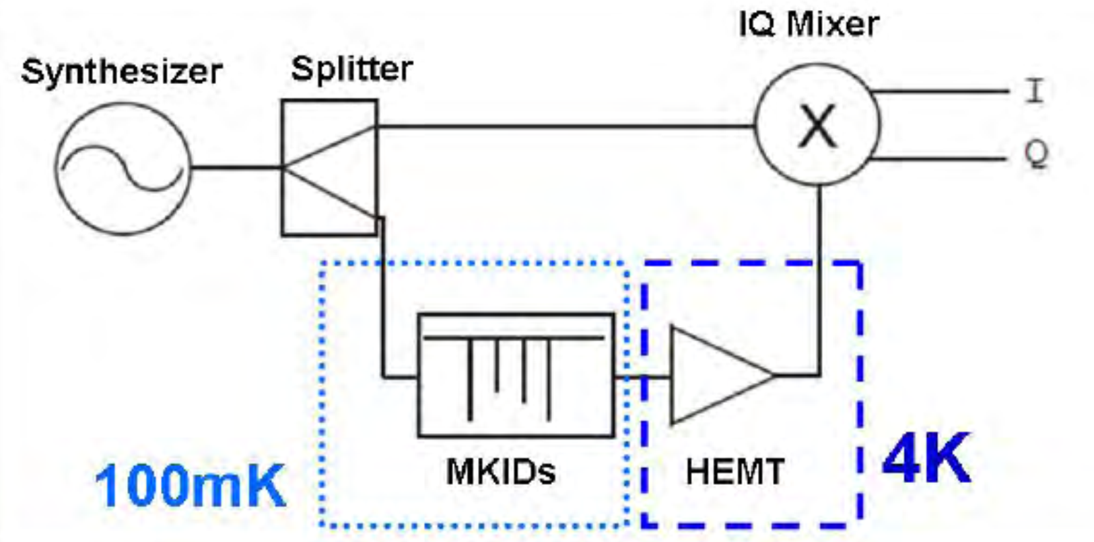
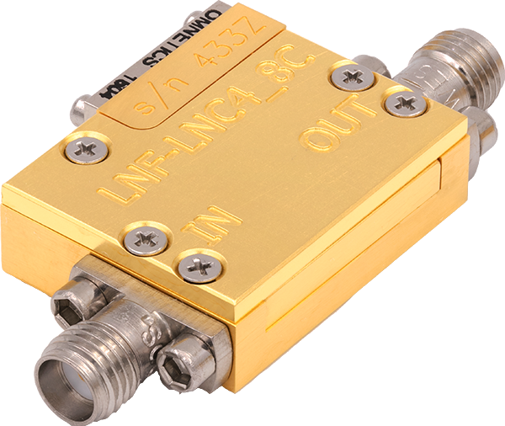
Custom Cryo Sensor Readout ASICs
Can we replace SQUID/ HEMT:
With CMOS amplifier?
SQUID amp readout (time domain mux , frequency domain mu (right))
Y. Mei, NSD
To improve
Scalability
Ease of use
Cost
HEMT amp readout (microwave mux (left), MKID (right))

Slide 6
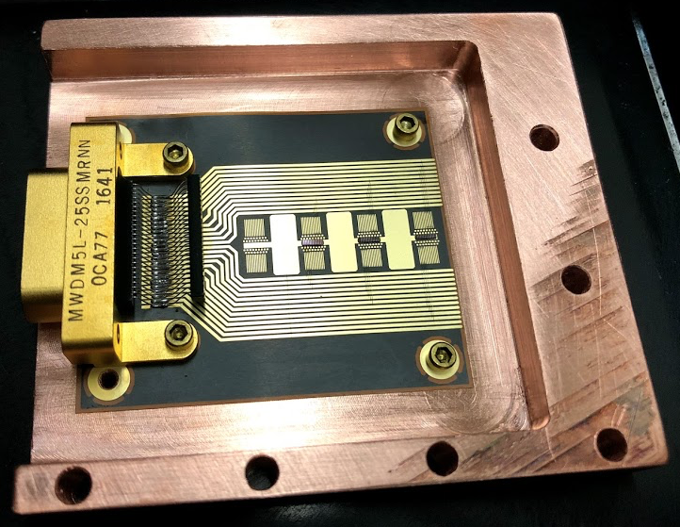
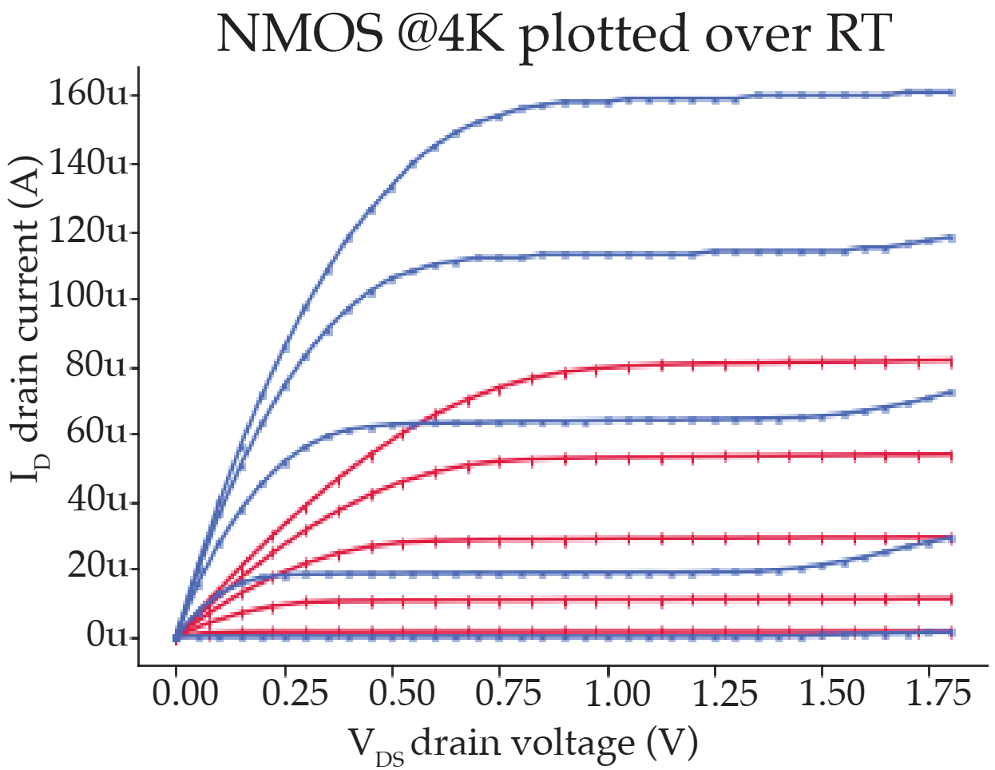
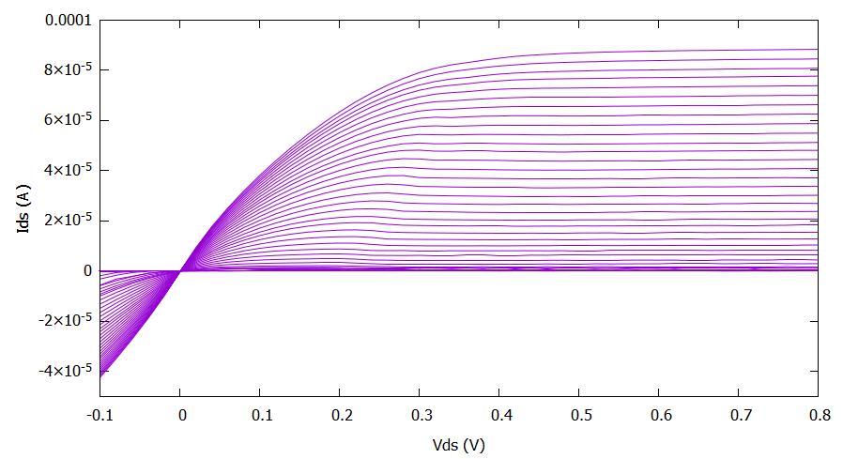
Does 180 nm work at 4K and below?
Test setup compatible with temperatures down to approximately 10 mK
NMOS Devices displaying transistor behavior at 100 mK
W = 0.5 µm / L = 1.2 µm
Why 180 nm? Cost.

Slide 7
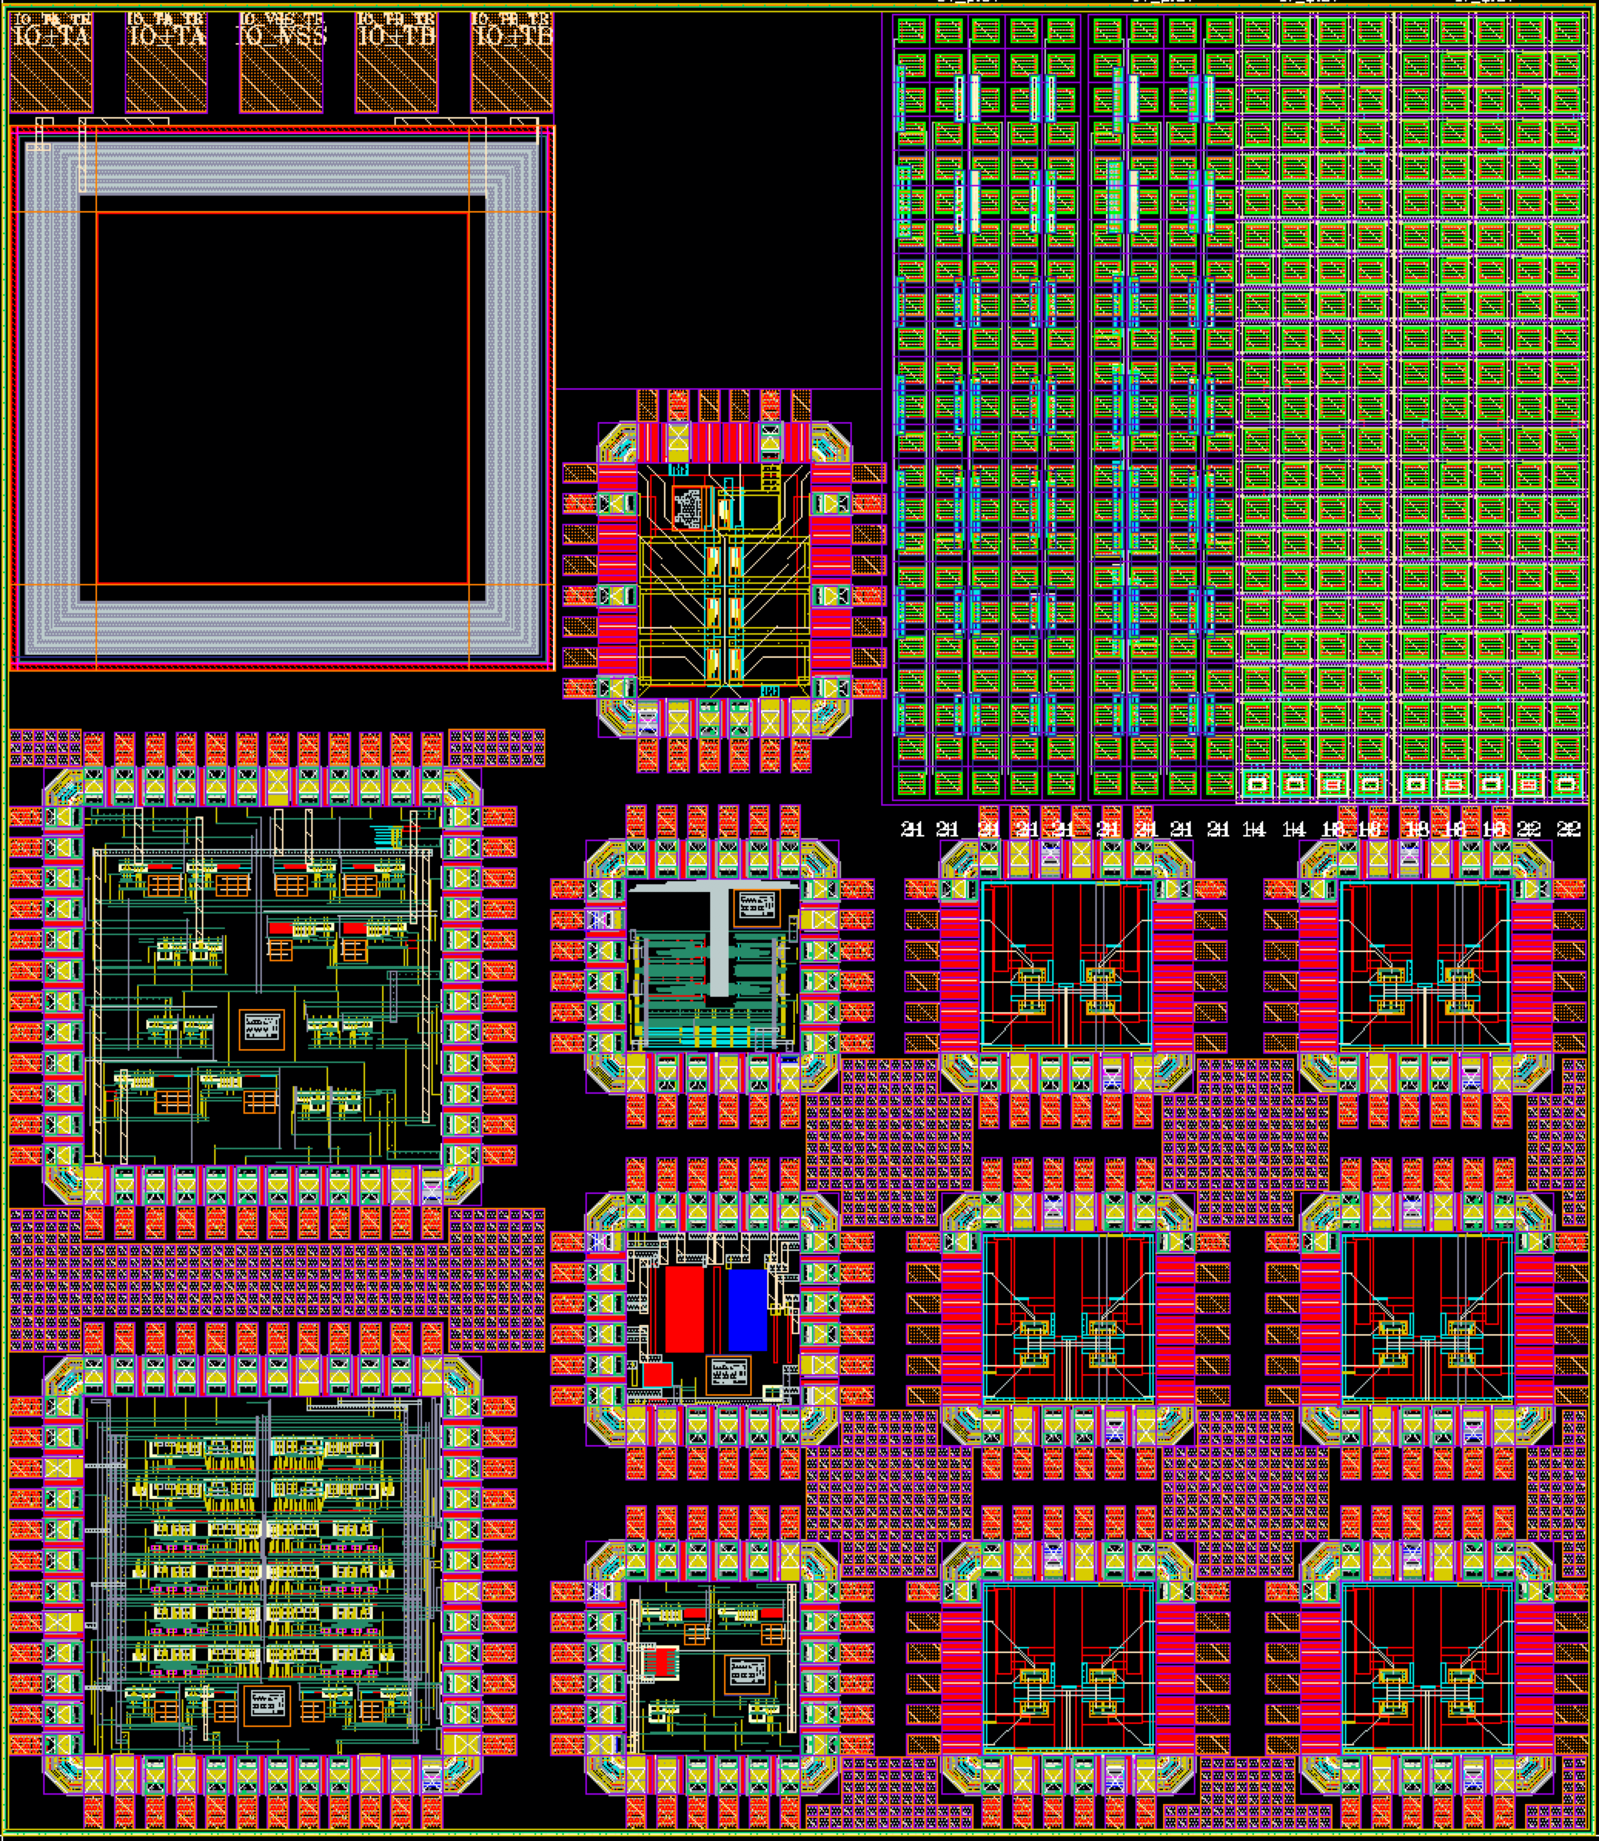
Conclusion
Comprehensive simulation models and design experience needed
Can harness deep HEP experience in extreme-environment electronics (e.g. radiation) and large channel-count systems to develop high-performance, scaled readout solutions for superconducting sensors
180nm testchip including transformer, amplifiers, switches, and sea-of-transistors

